Slide 1

环保.绿色.健康
Notes:
更多模板请关注：https://haosc.taobao.com

Slide 2



CONTENTS
目录
01
your title here
02
your title here
03
your title here
04
your title here

Slide 3

01
put your title here

Slide 4
YOU TITLE HERE
2015-2020
please put your title here
2011
please put your title here
四
二
三
一
2010-2015
2010
please put your title here
please put your title here

Slide 5
YOU TITLE HERE
2016
2014
put your title here
David Beckham's emails have
2012
put your title here
David Beckham's emails have
put your title here
David Beckham's emails have
2011
put your title here
David Beckham's emails have
2013
2017
put your title here
David Beckham's emails have
2015
put your title here
David Beckham's emails have
put your title here
David Beckham's emails have

Slide 6


YOU TITLE HERE
put your title here
David Beckham's emails have been hacked. The people who did it wanted him to pay them to keep quiet.
put your title here
David Beckham's emails have been hacked. The people who did it wanted him to pay them to keep quiet.

Slide 7





YOU TITLE HERE
02/
专项旅游者
04/
领导视察
以专项旅游爱好者和特种游客为主
莅临参观指导
01/
03/
修学科考人员
自然旅游爱好者
以珠三角洲等地的旅客为主
来自国内及港澳的高等学校的教学实习、科学考察、科学研究专家、学者、等科普教育旅游团体

Slide 8
YOU TITLE HERE
David Beckham's emails have been hacked. The people who did it wanted him to pay them to keep quiet. Neil and Catherine look at the language the world's media is using to discuss this story - and show you how you can use it in your everyday English.
David Beckham's emails have been hacked. The people who did it wanted him to pay them to keep quiet. Neil and Catherine look at the language the world's media is using to discuss this story - and show you how you can use it in your everyday English.
David Beckham's emails have been hacked. The people who did it wanted him to pay them to keep quiet. Neil and Catherine look at the language the world's media is using to discuss this story - and show you how you can use it in your everyday English.

Slide 9
YOU TITLE HERE
put your title here
David Beckham's emails have been hacked. The people who did it wanted him to pay them to keep quiet.
put your title here
David Beckham's emails have been hacked. The people who did it wanted him to pay them to keep quiet.
S
W
put your title here
David Beckham's emails have been hacked. The people who did it wanted him to pay them to keep quiet.
O
T
put your title here
David Beckham's emails have been hacked. The people who did it wanted him to pay them to keep quiet.

Slide 10
YOU TITLE HERE
David Beckham's emails have been hacked. The people who did it wanted him to pay them to keep quiet. Neil and Catherine look at the language the world's media is using to discuss this story - and show you how you can use it in your everyday English.
David Beckham's emails have been hacked. The people who did it wanted him to pay them to keep quiet. Neil and Catherine look at the language the world's media is using to discuss this story - and show you how you can use it in your everyday English.
David Beckham's emails have been hacked. The people who did it wanted him to pay them to keep quiet. Neil and Catherine look at the language the world's media is using to discuss this story - and show you how you can use it in your everyday English.

Slide 11
02
put your title here

Slide 12
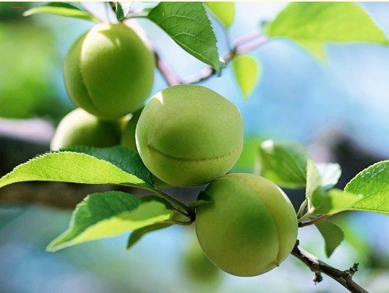
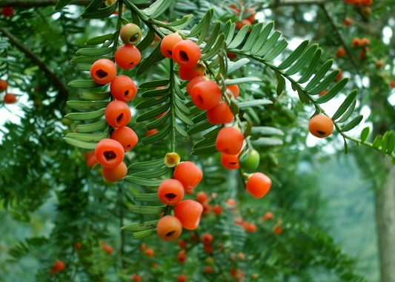

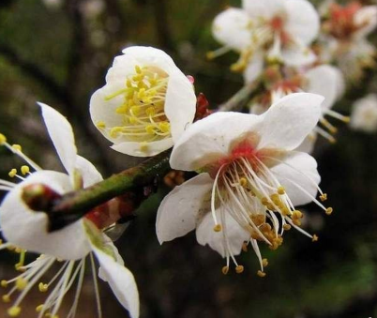
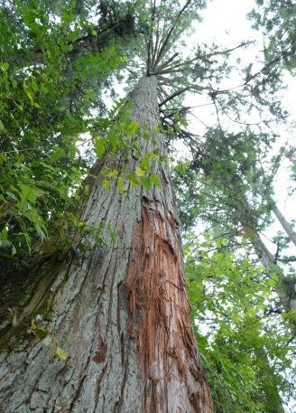


YOU TITLE HERE
put your title here
David Beckham's emails have been hacked. The people who did it wanted him to pay them to keep quiet.
David Beckham's emails have been hacked. The people who did it wanted him to pay them to keep quiet.
David Beckham's emails have been hacked. The people who did it wanted him to pay them to keep quiet.

Slide 13
YOU TITLE HERE
your title
your title
your title
your title
David Beckham's emails have been hacked. The people who did it wanted him to pay them to keep quiet.
David Beckham's emails have been hacked. The people who did it wanted him to pay them to keep quiet.
David Beckham's emails have been hacked. The people who did it wanted him to pay them to keep quiet.
David Beckham's emails have been hacked. The people who did it wanted him to pay them to keep quiet.

Slide 14
your title
your title
David Beckham's emails have been hacked. The people who did it wanted him to pay them to keep quiet.
David Beckham's emails have been hacked. The people who did it wanted him to pay them to keep quiet.
your title
your title
David Beckham's emails have been hacked. The people who did it wanted him to pay them to keep quiet.
David Beckham's emails have been hacked. The people who did it wanted him to pay them to keep quiet.

Slide 15
9860万
David Beckham's emails have been hacked. The people who did it wanted him to pay them to keep quiet.
your title
David Beckham's emails have been hacked. The people who did it wanted him to pay them to keep quiet.

Slide 16
YOU TITLE HERE
20%
40%
70%
percent
percent
percent

Slide 17
YOU TITLE HERE
your title Here
your title Here
David Beckham's emails have been hacked. The people who did it wanted him to pay them to keep quiet.
David Beckham's emails have been hacked. The people who did it wanted him to pay them to keep quiet.
your title Here
your title Here
David Beckham's emails have been hacked. The people who did it wanted him to pay them to keep quiet.
David Beckham's emails have been hacked. The people who did it wanted him to pay them to keep quiet.
your title Here
your title Here
David Beckham's emails have been hacked. The people who did it wanted him to pay them to keep quiet.
David Beckham's emails have been hacked. The people who did it wanted him to pay them to keep quiet.

Slide 18
YOU TITLE HERE
your title Here
David Beckham's emails have been hacked. The people who did it wanted him to pay them to keep quiet.
your title Here
David Beckham's emails have been hacked. The people who did it wanted him to pay them to keep quiet.
your title Here
David Beckham's emails have been hacked. The people who did it wanted him to pay them to keep quiet.
your title Here
David Beckham's emails have been hacked. The people who did it wanted him to pay them to keep quiet.

Slide 19
YOU TITLE HERE
title one
title two
David Beckham's emails have been hacked. The people who did it wanted him to pay them to keep quiet.
Neil and Catherine look at the language the world's media is using to discuss this story - and show you how you can use it in your everyday English.

Slide 20
YOU TITLE HERE
your title
David Beckham's emails have been hacked. The people who did it wanted him to pay them to keep quiet.
your title
David Beckham's emails have been hacked. The people who did it wanted him to pay them to keep quiet.
your title
David Beckham's emails have been hacked. The people who did it wanted him to pay them to keep quiet.
your title
David Beckham's emails have been hacked. The people who did it wanted him to pay them to keep quiet.
your title
David Beckham's emails have been hacked. The people who did it wanted him to pay them to keep quiet.

Slide 21
YOU TITLE HERE
your title Here
your title Here
David Beckham's emails have been hacked. The people who did it wanted him to pay them to keep quiet.
David Beckham's emails have been hacked. The people who did it wanted him to pay them to keep quiet.
？
your title Here
your title Here
David Beckham's emails have been hacked. The people who did it wanted him to pay them to keep quiet.
David Beckham's emails have been hacked. The people who did it wanted him to pay them to keep quiet.
your title Here

Slide 22
YOU TITLE HERE
1
2
B
3
avid Beckham's emails have been hacked.
David Beckham's emails have been hacked.
David Beckham's emails have been hacked.

Slide 23
YOU TITLE HERE
your title Here
一
David Beckham's emails have been hacked. The people who did it wanted him to pay them to keep quiet.
your title Here
五
二
your title Here
David Beckham's emails have been hacked. The people who did it wanted him to pay them to keep quiet.
David Beckham's emails have been hacked. The people who did it wanted him to pay them to keep quiet.
TILTE
your title Here
四
三
your title Here
David Beckham's emails have been hacked. The people who did it wanted him to pay them to keep quiet.
David Beckham's emails have been hacked. The people who did it wanted him to pay them to keep quiet.

Slide 24
YOU TITLE HERE
TITLE
HERE
01
02
your title Here
your title Here
2015/11/12
2017/12/03

Slide 25
YOU TITLE HERE
title one
title two
title three
David Beckham's emails have been hacked. The people who did it wanted him to pay them to keep quiet.
David Beckham's emails have been hacked. The people who did it wanted him to pay them to keep quiet.
David Beckham's emails have been hacked. The people who did it wanted him to pay them to keep quiet.
title four
title five
title six
David Beckham's emails have been hacked. The people who did it wanted him to pay them to keep quiet.
David Beckham's emails have been hacked. The people who did it wanted him to pay them to keep quiet.
David Beckham's emails have been hacked. The people who did it wanted him to pay them to keep quiet.

Slide 26
03
put your title here

Slide 27
STEPS
PROCESS
INFO
STEP 02
STEP 04
David Beckham's emails have
David Beckham's emails have been hacked. The people
STEP 01
STEP 03
David Beckham's emails have been hacked. The people
been hacked. The people
David Beckham's emails have
emails have been

Slide 28
YOU TITLE HERE
02
put your title here
David Beckham's emails have been hacked. The people who did it wanted him to pay them to keep quiet.
put your title here
David Beckham's emails have been
01
03
put your title here
David Beckham's emails have been hacked. The people who did it wanted him to pay them to keep quiet.

Slide 29
YOU TITLE HERE
put your title here
David Beckham's emails have been et.
put your title here
David Beckham's emails have been et.
put your title here
David Beckham's emails have been et.
put your title here
David Beckham's emails have been et.
put your title here
David Beckham's emails have been et.

Slide 30
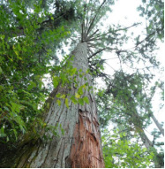
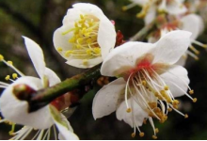

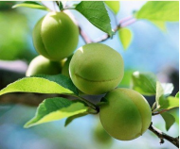
YOU TITLE HERE
your title
your title
your title
your title
David Beckham's emails have been hacked. The people
David Beckham's emails have been hacked. The people
David Beckham's emails have been hacked. The people
David Beckham's emails have been hacked. The people

Slide 31
YOU TITLE HERE
your title
David Beckham's emails have been hacked. The people
your title
David Beckham's emails have been hacked. The people ,David Beckham's emails have been hacked. The people
your title
David Beckham's emails have been hacked. The people,Beckham's emails have been hacked. The people
your title
David Beckham's emails have been hacked. The people
your title
David Beckham's emails have been hacked. The people

Slide 32
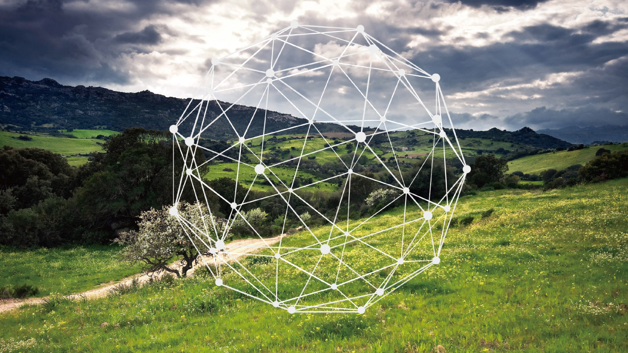
THANK YOU

