Slide 1





圣诞节晚会主题ppt模板

Slide 2




CONTENT
part 1
TITLE HERE
part 2
TITLE HERE
part 3
TITLE HERE

Slide 3
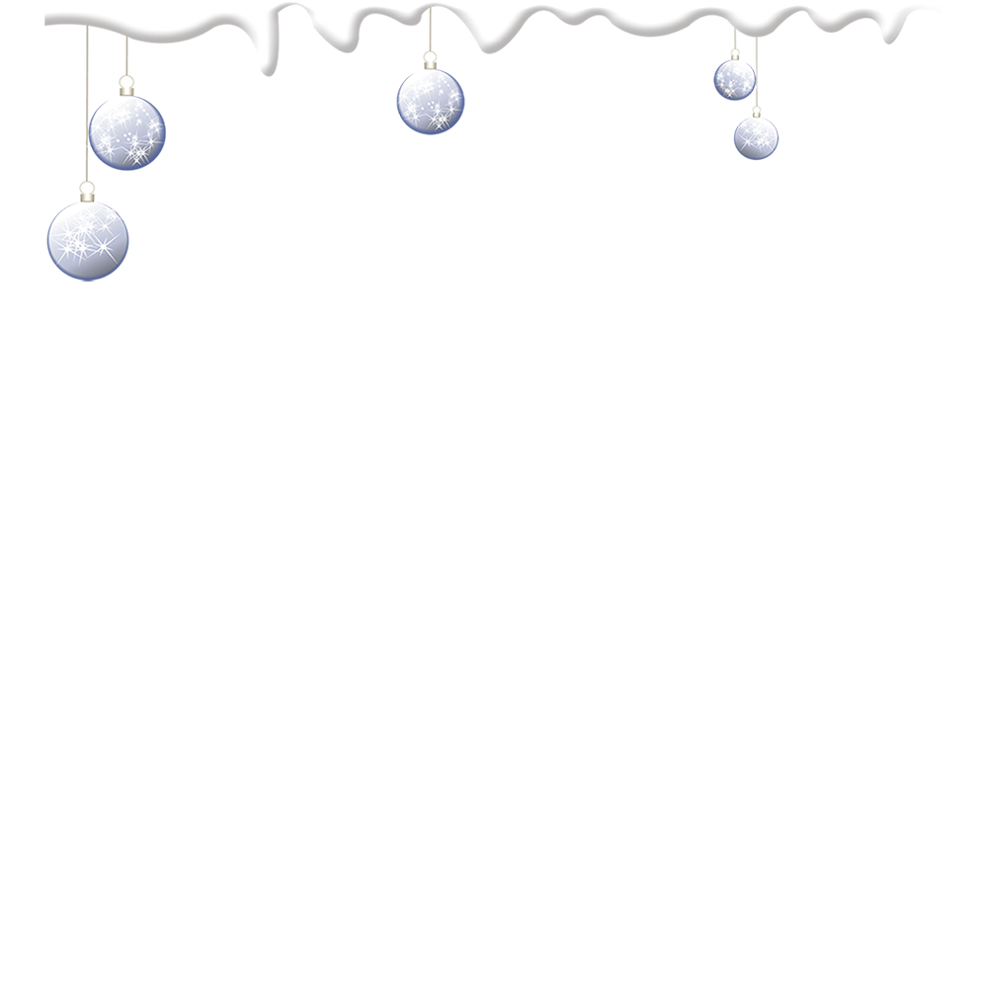
part 1

Slide 4

在此添加本页的标题
CLICK TO ADD UP YOUR TITLE HERE
1
2
3
The quick brown fox jumps over the lazy dog. The quick brown fox jumps over the lazy dog.
The quick brown fox jumps over the lazy dog. The quick brown fox jumps over the lazy dog.
The quick brown fox jumps over the lazy dog. The quick brown fox jumps over the lazy dog.

Slide 5

The quick brown fox jumps over the lazy dog. The quick brown fox jumps over the lazy dog.
2000
2006
2010
The quick brown fox jumps over the lazy dog. The quick brown fox jumps over the lazy dog. The quick brown fox jumps over the lazy dog.
The quick brown fox jumps over the lazy dog. The quick brown fox jumps over the lazy dog. The quick brown fox jumps over the lazy dog.

Slide 6

The quick brown fox jumps over the lazy dog. The quick brown fox jumps over the lazy dog.
2012
2015
2017
The quick brown fox jumps over the lazy dog. The quick brown fox jumps over the lazy dog. The quick brown fox jumps over the lazy dog.
The quick brown fox jumps over the lazy dog. The quick brown fox jumps over the lazy dog. The quick brown fox jumps over the lazy dog.

Slide 7
part 2

Slide 8

在此添加本页的标题
CLICK TO ADD UP YOUR TITLE HERE
The quick brown fox jumps over the lazy dog. The quick brown fox jumps over the lazy dog. The quick brown fox jumps over the lazy dog.
The quick brown fox jumps over the lazy dog. The quick brown fox jumps over the lazy dog. The quick brown fox jumps over the lazy dog.
在此添加本页的内容
CLICK TO ADD UP YOUR TITLE HERE

Slide 9

在此添加本页的内容
CLICK TO ADD UP YOUR TITLE HERE
The quick brown fox jumps over the lazy dog. The quick brown fox jumps over the lazy dog. The quick brown fox jumps over the lazy dog.

Slide 10

在此添加本页的内容
在此添加本页的内容
在此添加本页的内容
The quick brown fox jumps over the lazy dog. The quick brown fox jumps over the lazy dog.
The quick brown fox jumps over the lazy dog. The quick brown fox jumps over the lazy dog.
The quick brown fox jumps over the lazy dog. The quick brown fox jumps over the lazy dog.

Slide 11
part 3

Slide 12


在此添加本页的标题
CLICK TO ADD UP YOUR TITLE HERE
The quick brown fox jumps over the lazy dog. The quick brown fox jumps over the lazy dog. The quick brown fox jumps over the lazy dog.
The quick brown fox jumps over the lazy dog. The quick brown fox jumps over the lazy dog. The quick brown fox jumps over the lazy dog.

Slide 13
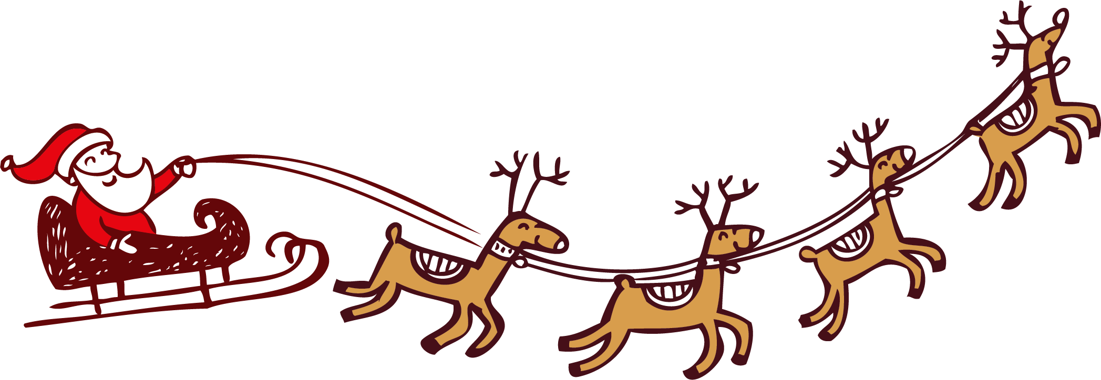
在此添加本页的内容
CLICK TO ADD UP YOUR TITLE HERE
The quick brown fox jumps over the lazy dog. The quick brown fox jumps over the lazy dog. The quick brown fox jumps over the lazy dog.

Slide 14

The quick brown fox jumps over the lazy dog. The quick brown fox jumps over the lazy dog. The quick brown fox jumps over the lazy dog.
在此添加本页的内容
CLICK TO ADD UP YOUR TITLE HERE

Slide 15

The quick brown fox jumps over the lazy dog. The quick brown fox jumps over the lazy dog. The quick brown fox jumps over the lazy dog.
在此添加本页的内容
CLICK TO ADD UP YOUR TITLE HERE

Slide 16
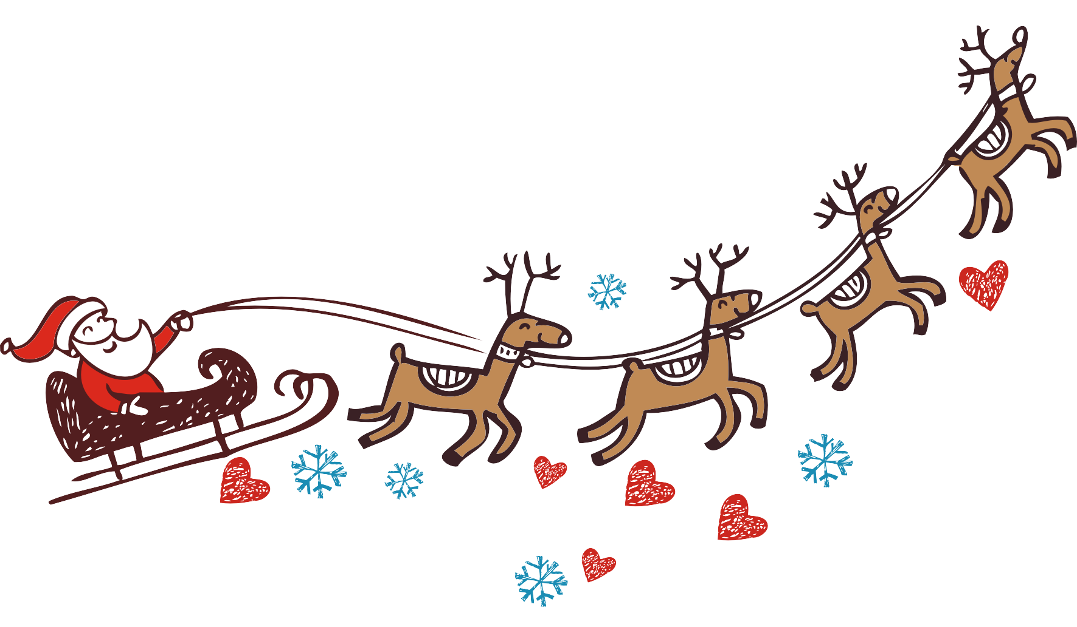
The quick brown fox jumps over the lazy dog. The quick brown fox jumps over the lazy dog. The quick brown fox jumps over the lazy dog.
在此添加本页的内容
CLICK TO ADD UP YOUR TITLE HERE

Slide 17

The quick brown fox jumps over the lazy dog. The quick brown fox jumps over the lazy dog. The quick brown fox jumps over the lazy dog.
The quick brown fox jumps over the lazy dog. The quick brown fox jumps over the lazy dog. The quick brown fox jumps over the lazy dog.

