Slide 1


20XX
人事月度工作总结
The user can demonstrate on a projector or computer, or presentation and make it film to be used in a wider fieldThe user can demonstrate on a projector or computer, or presentation
and make it film to be used in a wider field
汇报人：XXX
部 门：XXX
时 间：XXXX

Slide 2

CONTENT
工作总结概述
print the presentation and make it into a film a wider field
工作完成情况
print the presentation and make it into a film a wider field
工作不足之处
print the presentation and make it into a film a wider field
下步工作规划
print the presentation and make it into a film a wider field

Slide 3

1
工作总结概述
The user can demonstrate on a projector or computer, or presentation and make it film to be used in a wider field

Slide 4

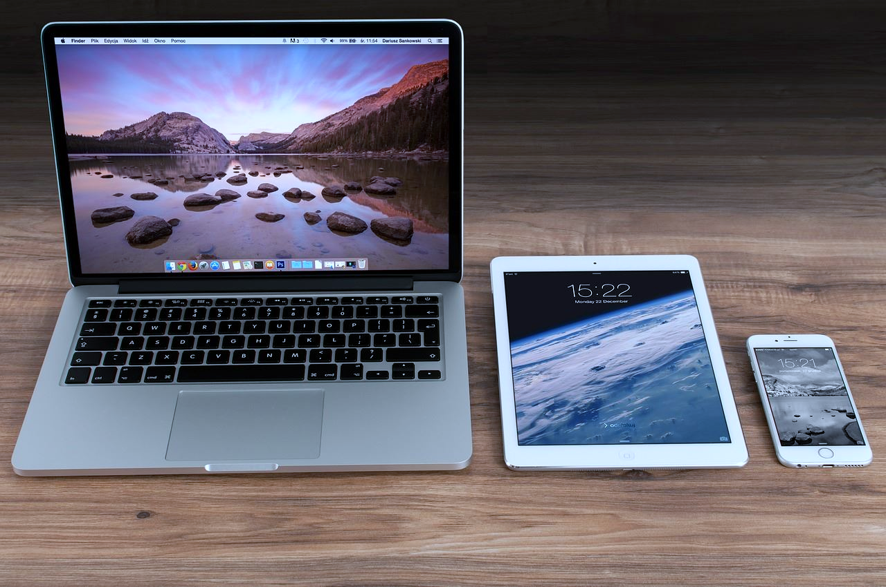
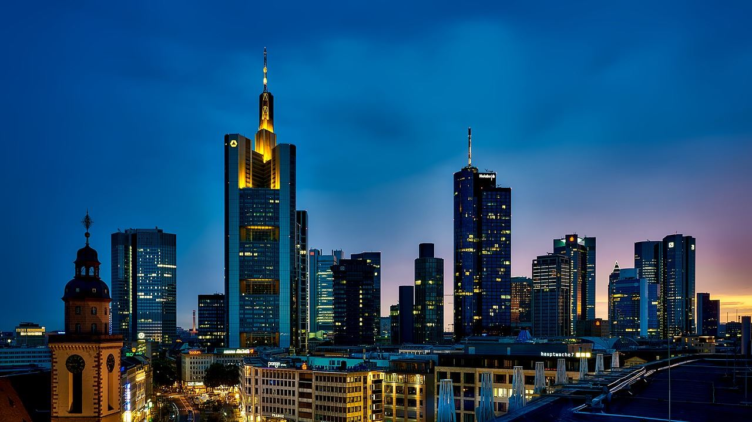


工作总结概述
print the presentation and make it into a film to be used in a wider field
The user can demonstrate on a projector or computer, or print the presentation and make it into a film to be used in a wider field. Using PowerPoint, not only can you create presentations
The user can demonstrate on a projector or computer, or print the presentation and make it into a film to be used in a wider field. Using PowerPoint, not only can you create presentations
The user can demonstrate on a projector or computer, or print the presentation and make it into a film to be used in a wider field. Using PowerPoint, not only can you create presentations
The user can demonstrate on a projector or computer, or print the presentation and make it into a film to be used in a wider field. Using PowerPoint, not only can you create presentations

Slide 5
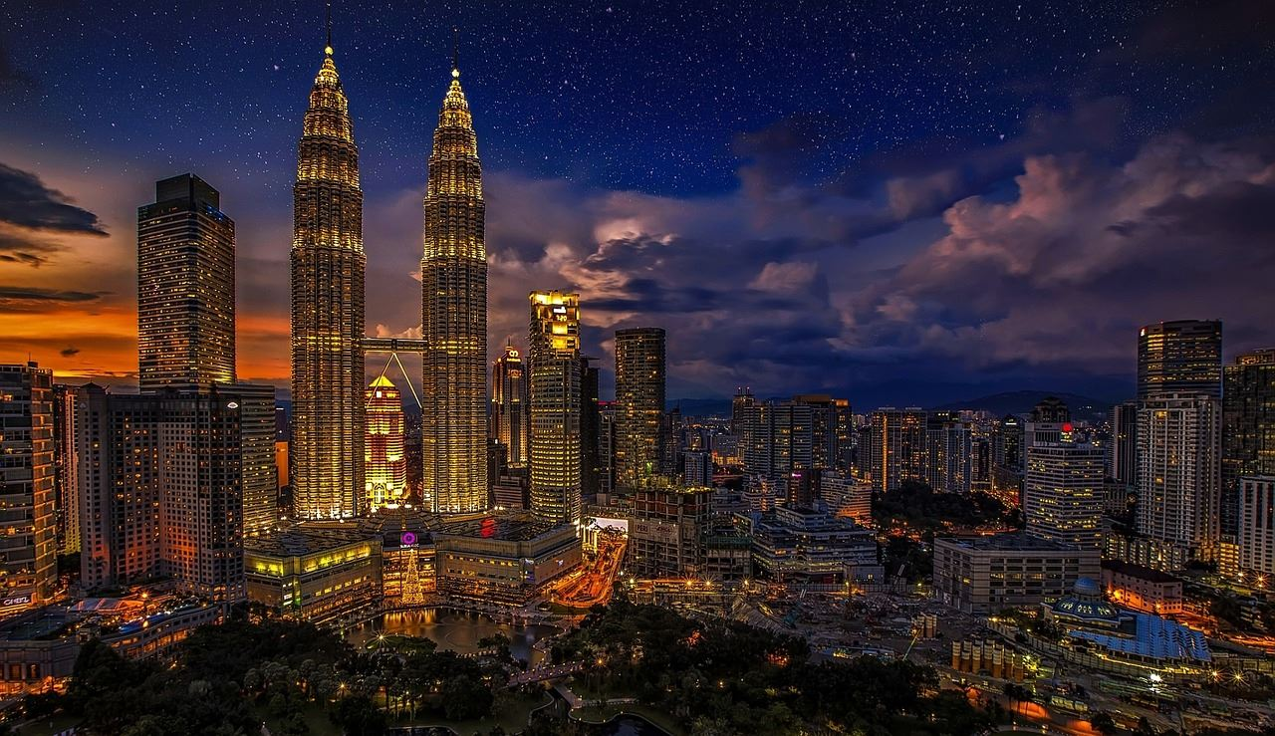
工作总结概述
print the presentation and make it into a film to be used in a wider field
标题文字添加
标题文字添加
标题文字添加
The user can demonstrate on a projector or computer, or print the presentation and make it into a film to be used in a wider field.
The user can demonstrate on a projector or computer, or print the presentation and make it into a film to be used in a wider field.
The user can demonstrate on a projector or computer, or print the presentation and make it into a film to be used in a wider field.

Slide 6
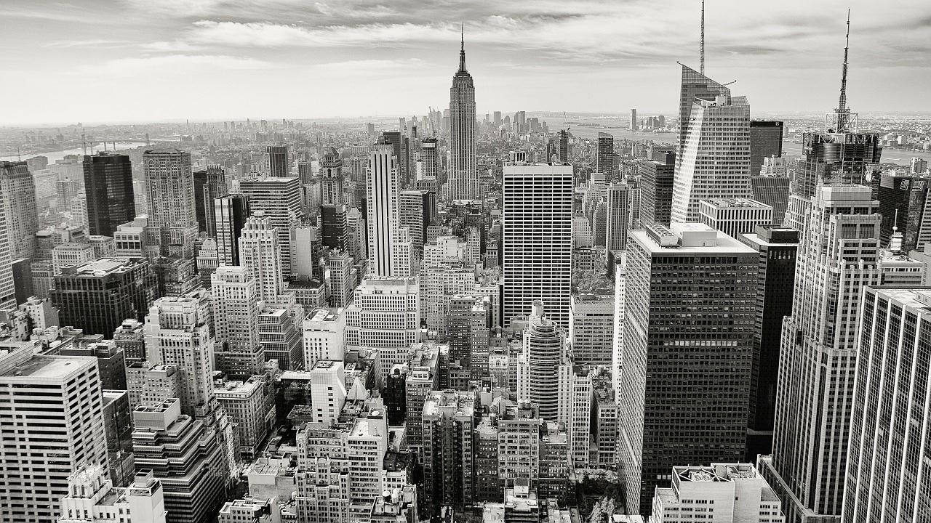
工作总结概述
print the presentation and make it into a film to be used in a wider field
标题文字添加
The user can demonstrate on a projector or computer, or presentation and make it film to be used in a wider fieldThe user can demonstrate on a projector or computer, or presentation
10
60
%
%
标题文字添加
标题文字添加
The user can demonstrate on a projector or computer, or presentation and make it film to be used in a wider field
The user can demonstrate on a projector or computer, or presentation and make it film to be used in a wider field
The user can demonstrate on a projector or computer, or presentation and make it film to be used in a wider field

Slide 7
工作总结概述
print the presentation and make it into a film to be used in a wider field
标题文字添加
标题文字添加
The user can demonstrate on a projector or computer, or presentation and make it film to be used in a wider field
The user can demonstrate on a projector or computer, or presentation and make it film to be used in a wider field
标题文字添加
标题文字添加
The user can demonstrate on a projector or computer, or presentation and make it film to be used in a wider field
The user can demonstrate on a projector or computer, or presentation and make it film to be used in a wider field

Slide 8
工作总结概述
print the presentation and make it into a film to be used in a wider field
职务名称
职务名称
职务名称
职务名称
职务名称
职务名称
职务名称
职务名称
职务名称
职务名称
职务名称
职务名称
职务名称
职务名称
职务名称
职务名称
职务名称
职务名称
职务名称

Slide 9

2
工作完成情况
The user can demonstrate on a projector or computer, or presentation and make it film to be used in a wider field

Slide 10



工作完成情况
print the presentation and make it into a film to be used in a wider field
标题文字添加
The user can demonstrate on a projector or computer, or presentation and make it film to be used in a wider field
标题文字添加
标题文字添加
The user can demonstrate on a projector or computer, or presentation and make it film to be used in a wider field
The user can demonstrate on a projector or computer, or presentation and make it film to be used in a wider field

Slide 11
工作完成情况
print the presentation and make it into a film to be used in a wider field
标题文字添加
The user can demonstrate on a projector or computer, or presentation and make it film to be used in a wider field
标题文字添加
The user can demonstrate on a projector or computer, or presentation and make it film to be used in a wider field
标题文字添加
The user can demonstrate on a projector or computer, or presentation and make it film to be used in a wider field

Slide 12


工作完成情况
print the presentation and make it into a film to be used in a wider field
标题文字添加
The user can demonstrate on a projector or computer, or presentation and make it film to be used in a wider fieldThe user can demonstrate on a projector or computer, or presentationThe user can demonstrate on a projector or computer, or presentation and make it film to be used in a wider fieldThe user can demonstrate on a projector or computer, or presentation
标题文字添加
The user can demonstrate on a projector or computer, or presentation and make it film to be used in a wider field
标题文字添加
The user can demonstrate on a projector or computer, or presentation and make it film to be used in a wider field
标题文字添加
The user can demonstrate on a projector or computer, or presentation and make it film to be used in a wider field

Slide 13
工作完成情况
print the presentation and make it into a film to be used in a wider field
标题文字添加
标题文字添加
The user can demonstrate on a projector or computer, or presentation and make it film to be used in a wider field
The user can demonstrate on a projector or computer, or presentation and make it film to be used in a wider field

Slide 14
工作完成情况
print the presentation and make it into a film to be used in a wider field
25%
40%
35%
标题文字添加
The user can demonstrate on a projector or computer, or presentation and make it film to be used in a wider field
标题文字添加
The user can demonstrate on a projector or computer, or presentation and make it film to be used in a wider field
标题文字添加
The user can demonstrate on a projector or computer, or presentation and make it film to be used in a wider field

Slide 15

3
工作不足之处
The user can demonstrate on a projector or computer, or presentation and make it film to be used in a wider field

Slide 16
工作不足之处
print the presentation and make it into a film to be used in a wider field
02
01
03
标题文字添加
标题文字添加
标题文字添加
The user can demonstrate on a projector or computer, or presentation and make it film to be used in
a wider field
The user can demonstrate on a projector or computer, or presentation and make it film to be used in
a wider field
The user can demonstrate on a projector or computer, or presentation and make it film to be used in
a wider field

Slide 17
工作不足之处
print the presentation and make it into a film to be used in a wider field
标题文字添加
The user can demonstrate on a projector or computer, or presentation and make it film to be used in a wider fieldThe user can demonstrate on a projector or computer, or presentation and make The user can demonstrate on a projector or computer,
标题文字添加
标题文字添加
The user can demonstrate on a projector or computer, or presentation and make it film to be used in a wider field
The user can demonstrate on a projector or computer, or presentation and make it film to be used in a wider field
The user can demonstrate on a projector or computer, or presentation and make it film to be used in a wider field
The user can demonstrate on a projector or computer, or presentation and make it film to be used in a wider field

Slide 18
工作不足之处
print the presentation and make it into a film to be used in a wider field
标题文字添加
标题文字添加
The user can demonstrate on a projector or computer, or presentation and make it film to be used in a wider field
The user can demonstrate on a projector or computer, or presentation and make it film to be used in a wider field
标题文字添加
标题文字添加
标题文字添加
The user can demonstrate on a projector or computer, or presentation and make it film to be used in a wider field
The user can demonstrate on a projector or computer, or presentation and make it film to be used in a wider field
The user can demonstrate on a projector or computer, or presentation and make it film to be used in a wider field

Slide 19
工作不足之处
print the presentation and make it into a film to be used in a wider field
25%
标题文字添加
25%
25%
25%
01
The user can demonstrate on a projector or computer, or presentation and make it film to be used
标题文字添加
02
The user can demonstrate on a projector or computer, or presentation and make it film to be used
标题文字添加
03
The user can demonstrate on a projector or computer, or presentation and make it film to be used
标题文字添加
04
The user can demonstrate on a projector or computer, or presentation and make it film to be used

Slide 20

4
下步工作规划
The user can demonstrate on a projector or computer, or presentation and make it film to be used in a wider field

Slide 21
下步工作规划
print the presentation and make it into a film to be used in a wider field
标题文字添加
标题文字添加
113
The user can demonstrate on a projector or computer, or presentation and make it film to be used in a wider field
The user can demonstrate on a projector or computer, or presentation and make it film to be used in a wider field
95
88
78
78
标题文字添加
标题文字添加
The user can demonstrate on a projector or computer, or presentation and make it film to be used in a wider field
45
The user can demonstrate on a projector or computer, or presentation and make it film to be used in a wider field
35
25
01
02
03
04

Slide 22
下步工作规划
print the presentation and make it into a film to be used in a wider field
标题文字添加
标题文字添加
The user can demonstrate on a projector or computer, or presentation and make it film to be used in a wider field
The user can demonstrate on a projector or computer, or presentation and make it film to be used in a wider field
标题文字添加
标题文字添加
The user can demonstrate on a projector or computer, or presentation and make it film to be used in a wider field
The user can demonstrate on a projector or computer, or presentation and make it film to be used in a wider field

Slide 23
下步工作规划
print the presentation and make it into a film to be used in a wider field
49%
64%
71%
79%
标题文字添加
标题文字添加
标题文字添加
标题文字添加
The user can demonstrate on a projector or computer, or presentation and make it film to be used in a wider field
The user can demonstrate on a projector or computer, or presentation and make it film to be used in a wider field
The user can demonstrate on a projector or computer, or presentation and make it film to be used in a wider field
The user can demonstrate on a projector or computer, or presentation and make it film to be used in a wider field

Slide 24
下步工作规划
print the presentation and make it into a film to be used in a wider field
标题文字添加
The user can demonstrate on a projector or computer, or presentation and make it film to be used in a wider field
标题文字添加
The user can demonstrate on a projector or computer, or presentation and make it film to be used in a wider field
标题文字添加
The user can demonstrate on a projector or computer, or presentation and make it film to be used in a wider field
标题文字添加
The user can demonstrate on a projector or computer, or presentation and make it film to be used in a wider field
64%
46%
81%
45%

Slide 25
20XX
演示完毕 感谢观看
The user can demonstrate on a projector or computer, or presentation and make it film to be used in a wider fieldThe user can demonstrate on a projector or computer, or presentation
and make it film to be used in a wider field
汇报人：XXX
部 门：XXX
时 间：XXXX

