Slide 1
minus
_{minimal presentation template}

Slide 2
About Us
You Can Write Here
About Us

Slide 3
WRITE SOMETHING
About Us
WRITE HERE SOMETHING ABOUT
WRITE HERE SOMETHING ABOUT
Entrepreneurial activities differ substantially depending on the type of organization and creativity. Entrepreneurial activities differ substantially depending on the type of organization and creativity. Entrepreneurial activities differ substantially depending on the type of organization and creativity. Entrepreneurial activities differ substantially.
Entrepreneurial activities differ substantially depending on the type of organization and creativity. Entrepreneurial activities differ substantially depending on the type of organization and creativity. Entrepreneurial activities differ substantially depending on

Slide 4

You Can Write Here
WRITE SOMETHING
About Us
WRITE HERE SOMETHING ABOUT
Entrepreneurial activities differ substantially depending on the type of organization and creativity. Entrepreneurial activities differ substantially depending on the type of organization and creativity. Entrepreneurial activities differ substantially depending on the type of organization and creativity. Entrepreneurial activities differ substantially.

Slide 5


You Can Write Here
WRITE SOMETHING
A bit of history
WRITE HERE SOMETHING ABOUT
Entrepreneurial activities differ substantially depending on the type of organization and creativity. Entrepreneurial activities differ substantially depending on the type of organization and creativity. Entrepreneurial activities differ substantially depending on the type of organization and creativity. Entrepreneurial activities differ substantially.

Slide 6

You Can Write Here
Write here
Something
about
Entrepreneurial activities differ substantially depending on the type of organization and creativity. Entrepreneurial activities differ substantially depending on the type of organization

Slide 7

You Can Write Here
Your Title
Entrepreneurial activities differ substantially depending on the type of organization and creativity. Entrepreneurial activities differ substantially depending on the type of organization and creativity. Entrepreneurial activities differ substantially depending on the type of organization and creativity. Entrepreneurial activities differ substantially.
WRITE SOMETHING
01
02
04
06
LEARN MORE
Notes:
To change the image behind the Mock up.
Select the layer - > Right Click -> Send to Back -> Delete the image -> Drag & Drop your Own Picture -> Send to Back (again)

Slide 8

02
You Can Write Here
WRITE SOMETHING
Your Title
Entrepreneurial activities differ substantially depending on the type of organization and creativity. Entrepreneurial activities differ substantially depending on the type of organization and creativity..
02
04
06
LEARN MORE
Notes:
To change the image behind the Mock up.
Select the layer - > Right Click -> Send to Back -> Delete the image -> Drag & Drop your Own Picture -> Send to Back (again)

Slide 9
WRITE SOMETHING
You Can Write Here
Entrepreneurial activities differ substantially depending on the type of organization and creativity. Entrepreneurial activities differ substantially depending on the type of organization and creativity. Entrepreneurial activities differ substantially depending on the type of organization and creativity. Entrepreneurial activities differ substantially.
timeline
1990 START
2000: TITLE HERE
2010: TITLE HERE
Entrepreneurial activities differ substantially depending on the type of organization and creativity. Entrepreneurial activities differ
Entrepreneurial activities differ substantially depending on the type of organization and creativity. Entrepreneurial activities differ

Slide 10
2000: TITLE HERE
Entrepreneurial activities differ substantially depending on the type of organization and creativity. Entrepreneurial activities differ
2010: TITLE HERE
Entrepreneurial activities differ substantially depending on the type of organization and creativity. Entrepreneurial activities differ
2000: TITLE HERE
Entrepreneurial activities differ substantially depending on the type of organization and creativity. Entrepreneurial activities differ

Slide 11
2000: TITLE HERE
2010: TITLE HERE
Entrepreneurial activities differ substantially depending on the type of organization and creativity. Entrepreneurial activities differ
Entrepreneurial activities differ substantially depending on the type of organization and creativity. Entrepreneurial activities differ
2000: TITLE HERE
Entrepreneurial activities differ substantially depending on the type of organization and creativity. Entrepreneurial activities differ

Slide 12
You Can Write Here
full width text
A company is an association or collection of individuals, whether natural persons, legal persons, or a mixture of both. Company members share a common purpose and unite in order to focus their various talents and organize their collectively available skills or resources to achieve specific, declared goals. A company or association of persons can be created at law as legal person so that the company in itself can accept Limited liability for civil responsibility and taxation incurred as members perform (or fail) to discharge their duty within the publicly declared "birth certificate" or published policy.
Because companies are legal persons, they also may associate and register themselves as companies – often known as a corporate group. When the company closes it may need a "death certificate" to avoid further legal obligations. A company or association of persons can be created at law as legal person so that the company in itself can accept Limited liability for civil responsibility and taxation incurred as members perform (or fail) to discharge their duty within the publicly declared "birth certificate" or published policy. A company or association of persons can be created at law as legal person so that the company in itself can accept Limited liability for civil responsibility and taxation incurred as members perform (or fail) to discharge their duty within the publicly declared "birth certificate”

Slide 13
You Can Write Here
two columns
A company is an association or collection of individuals, whether natural persons, legal persons, or a mixture of both. Company members share a common purpose and unite in order to focus their various talents and organize their collectively available skills or resources to achieve specific, declared goals. A company or association of persons can be created at law as legal person so that the company in itself can accept Limited liability for civil responsibility and taxation incurred as members perform (or fail) to discharge their duty within the publicly declared "birth certificate" or published policy.
A company is an association or collection of individuals, whether natural persons, legal persons, or a mixture of both. Company members share a common purpose and unite in order to focus their various talents and organize their collectively available skills or resources to achieve specific, declared goals. A company or association of persons can be created at law as legal person so that the company in itself can accept Limited liability for civil responsibility and taxation incurred as members perform (or fail) to discharge their duty within the publicly declared "birth certificate" or published policy.

Slide 14
You Can Write Here
three columns
A company is an association or collection of individuals, whether natural persons, legal persons, or a mixture of both. Company members share a common purpose and unite in order to focus their various talents and organize their collectively available skills or resources to achieve specific, declared goals. A company or association of persons can be created at law as legal person so that the
A company is an association or collection of individuals, whether natural persons, legal persons, or a mixture of both. Company members share a common purpose and unite in order to focus their various talents and organize their collectively available skills or resources to achieve specific, declared goals. A company or association of persons can be created at law as legal person so that the
A company is an association or collection of individuals, whether natural persons, legal persons, or a mixture of both. Company members share a common purpose and unite in order to focus their various talents and organize their collectively

Slide 15
meet our
You Can Write Here
meet our team

Slide 16

01
Sales
Department
Thomas
Edison
WRITE SOMETHING

Slide 17



You Can Write Here
our awesome
team
WRITE SOMETHING
A company is an association or collection of individuals, whether natural persons, legal persons, or a mixture of both.

Slide 18

You Can Write Here
meet
jane doe
A company is an association or collection of individuals, whether natural persons, legal persons, or a mixture of both.
SKILL
NAME
Entrepreneurial activities differ
Entrepreneurial activities differ
AWESOME
TITLE
Entrepreneurial activities differ
Entrepreneurial activities differ

Slide 19

You Can Write Here
meet
jane doe
A company is an association or collection of individuals, whether natural persons, legal persons, or a mixture of both.
SKILL
NAME
Entrepreneurial activities differ
Entrepreneurial activities differ
AWESOME
TITLE
Entrepreneurial activities differ
Entrepreneurial activities differ

Slide 20
our servi
You Can Write Here
our services

Slide 21
our common
services
WRITE SOMETHING
SERVICE NAME
SERVICE NAME
SERVICE NAME
SERVICE NAME
SERVICE NAME
SERVICE NAME

Slide 22
our common
services
WRITE SOMETHING
SERVICE NAME HERE
SERVICE NAME HERE
Entrepreneurial activities differ substantially depending on the type of organization and creativity involved. Entrepreneurship ranges in scale from solo. Entrepreneurial activities differ
Entrepreneurial activities differ substantially depending on the type of organization and creativity involved. Entrepreneurship ranges in scale from solo. Entrepreneurial activities differ
SERVICE NAME HERE
SERVICE NAME HERE
Entrepreneurial activities differ substantially depending on the type of organization and creativity involved. Entrepreneurship ranges in scale from solo. Entrepreneurial activities differ
Entrepreneurial activities differ substantially depending on the type of organization and creativity involved. Entrepreneurship ranges in scale from solo. Entrepreneurial activities differ

Slide 23






our clients
around the world
WRITE SOMETHING

Slide 24









You Can Write Here
our clients
around
the world
Entrepreneurial activities differ substantially depending on the type of organization and creativity. Entrepreneurial activities differ substantially depending on the type of organization and creativity. Entrepreneurial activities differ substantially depending on the type of organization and creativity. Entrepreneurial activities differ substantially.
LEARN MORE

Slide 25
latest wor
You Can Write Here
latest
works

Slide 26


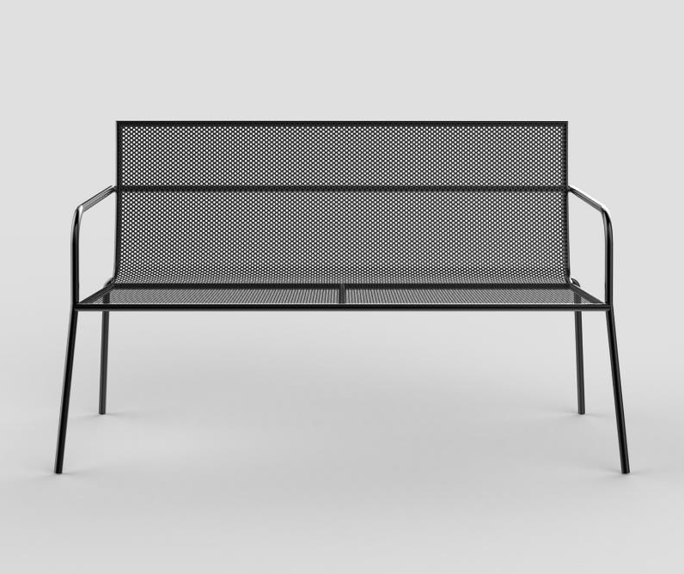
02
Project
Title
Project
Title
03
Project
Title
01

Slide 27
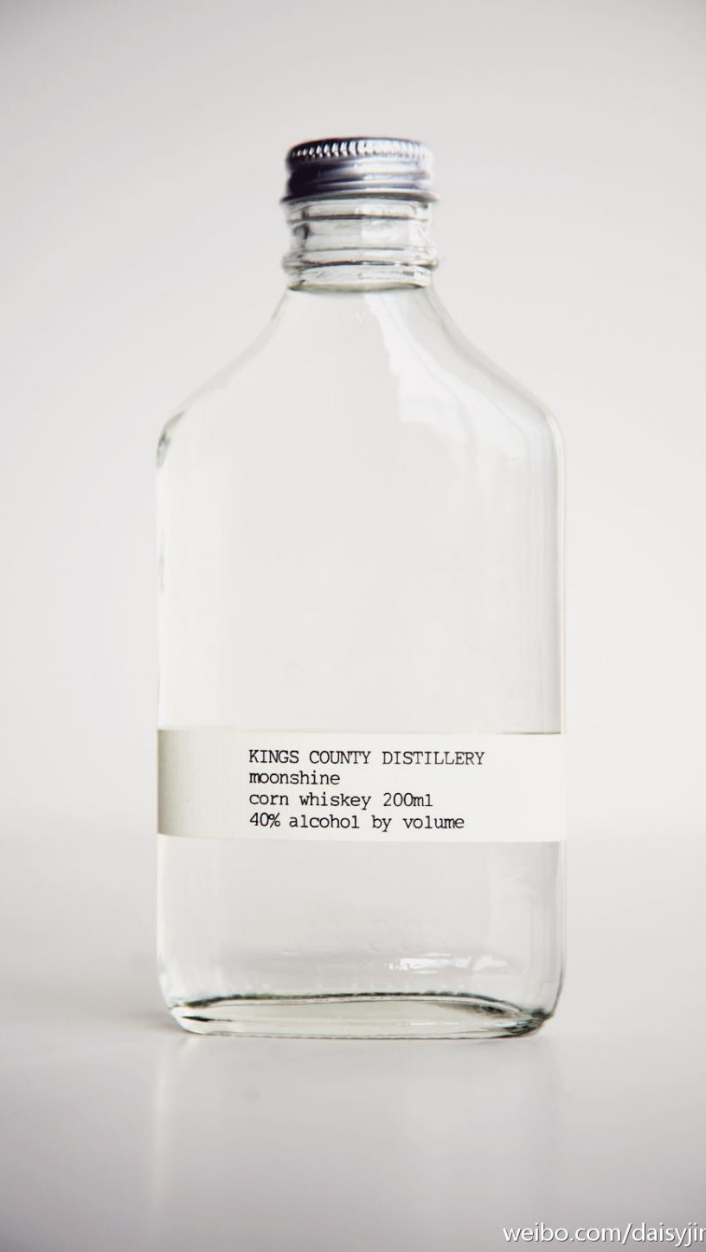
You Can Write Here
project title
& details
WRITE SOMETHING
Entrepreneurial activities differ substantially depending on the type of organization and creativity. Entrepreneurial activities differ substantially depending on the type of organization and creativity. Entrepreneurial activities differ substantially depending on the type
Entrepreneurial activities differ substantially depending on the type of organization and creativity. Entrepreneurial activities differ substantially depending on the type of organization and creativity. Entrepreneurial activities differ substantially depending on the type of organization and creativity. Entrepreneurial activities differ substantially.
LEARN MORE

Slide 28

You Can Write Here
project title
& details
WRITE SOMETHING
Entrepreneurial activities differ substantially depending on the type of organization and creativity. Entrepreneurial activities differ substantially depending on the type of organization and creativity. Entrepreneurial activities differ substantially depending on the type
Entrepreneurial activities differ substantially depending on the type of organization and creativity. Entrepreneurial activities differ substantially depending on the type of organization and creativity. Entrepreneurial activities differ substantially depending on the type of organization and creativity. Entrepreneurial activities differ substantially.
LEARN MORE

Slide 29










You Can Write Here
Entrepreneurial activities differ substantially depending on the type of organization and creativity. Entrepreneurial activities differ substantially depending on the type of organization and creativity. Entrepreneurial activities
our latest
works
Entrepreneurial activities differ substantially depending on the type of organization and
Entrepreneurial activities differ substantially depending on the type of organization and
WRITE HERE
SOMETHING
WRITE HERE
SOMETHING
WRITE HERE
SOMETHING
WRITE HERE
SOMETHING

Slide 30




You Can Write Here
01
project title
& details
Entrepreneurial activities differ substantially depending on the type of organization and creativity. Entrepreneurial activities differ substantially depending on the type of organization and creativity. Entrepreneurial activities differ substantially depending on the type
02
04
06
LEARN MORE

Slide 31




You Can Write Here
project title
& details
Entrepreneurial activities differ substantially depending on the type of organization and creativity. Entrepreneurial activities differ substantially depending on the type of organization and creativity. Entrepreneurial activities differ substantially depending on the type
02
02
04
06
LEARN MORE

Slide 32






You Can Write Here
our latest
work in
the world
Entrepreneurial activities differ substantially depending on the type of organization and creativity. Entrepreneurial activities differ substantially depending on the type of organization and creativity. Entrepreneurial activities differ substantially depending on the type of organization and creativity. Entrepreneurial activities differ substantially.
LEARN MORE

Slide 33





You Can Write Here
our latest
work in
the world
Entrepreneurial activities differ substantially depending on the type of organization and creativity. Entrepreneurial activities differ substantially depending on the type of organization and creativity. Entrepreneurial activities differ substantially depending on the type of organization and creativity. Entrepreneurial activities differ substantially.
LEARN MORE

Slide 34

You Can Write Here
Entrepreneurial activities differ substantially depending on the type of organization and creativity. Entrepreneurial activities differ substantially depending on the type of organization and creativity. Entrepreneurial activities
our latest
works
Entrepreneurial activities differ substantially depending on the type of organization and
Entrepreneurial activities differ substantially depending on the type of organization and

Slide 35

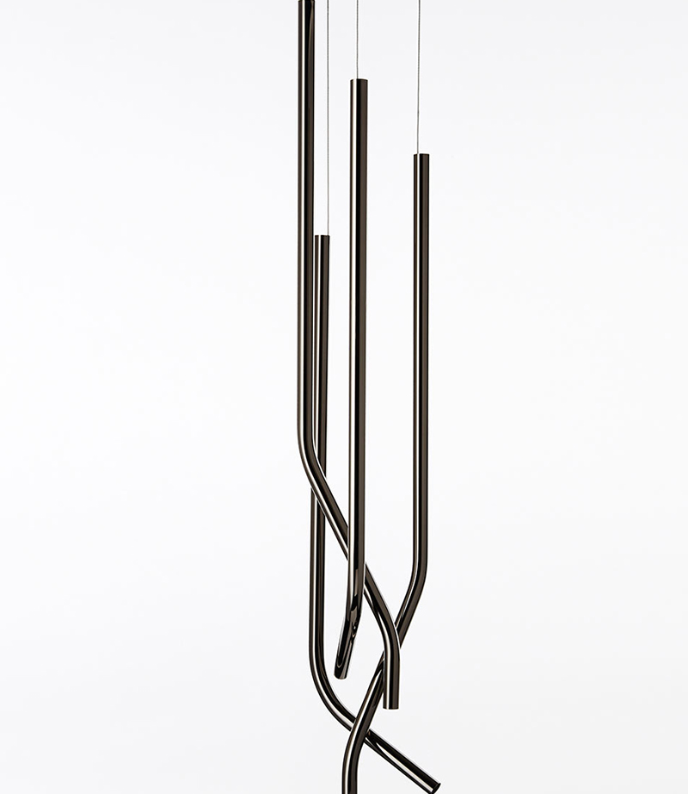

Slide 36




Slide 37
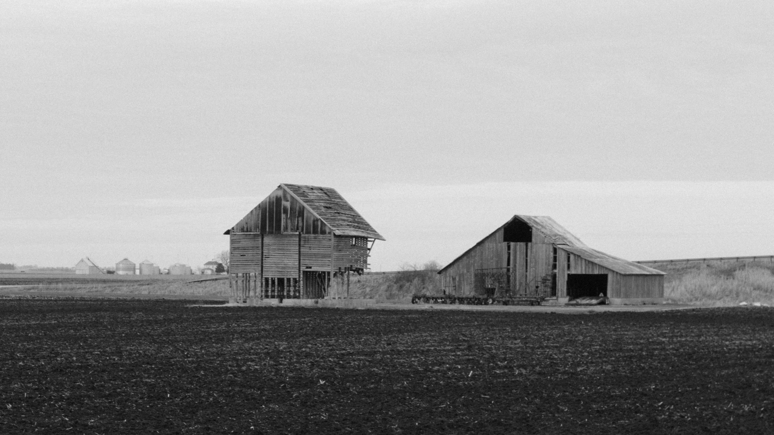
You Can Write Here
Entrepreneurial activities differ substantially depending on the type of organization and creativity. Entrepreneurial activities differ substantially depending on the type of organization and creativity. Entrepreneurial
project
title description

Slide 38



Slide 39




Slide 40







Slide 41

You Can Write Here
Iphone 6
project
PHOTOSHOP SKILLS
Entrepreneurial activities differ substantially depending on the type of organization and creativity involved.
95%
PHOTOSHOP SKILLS
Entrepreneurial activities differ substantially depending on the type of organization and creativity involved.
95%
Notes:
To change the image behind the Mock up.
Select the layer - > Right Click -> Send to Back -> Delete the image -> Drag & Drop your Own Picture -> Send to Back (again)

Slide 42


You Can Write Here
ipad air
project
PHOTOSHOP SKILLS
Entrepreneurial activities differ substantially depending on the type of organization and creativity involved.
95%
PHOTOSHOP SKILLS
Entrepreneurial activities differ substantially depending on the type of organization and creativity involved.
95%
Notes:
To change the image behind the Mock up.
Select the layer - > Right Click -> Send to Back -> Delete the image -> Drag & Drop your Own Picture -> Send to Back (again)

Slide 43


You Can Write Here
Imac
project
PHOTOSHOP SKILLS
Entrepreneurial activities differ substantially depending on the type of organization and creativity involved.
95%
PHOTOSHOP SKILLS
Entrepreneurial activities differ substantially depending on the type of organization and creativity involved.
95%
Notes:
To change the image behind the Mock up.
Select the layer - > Right Click -> Send to Back -> Delete the image -> Drag & Drop your Own Picture -> Send to Back (again)

Slide 44



You Can Write Here
Entrepreneurial activities differ substantially depending on the type of organization and creativity. Entrepreneurial activities differ substantially depending on the type of organization and creativity. Entrepreneurial activities
macbook
mockup
Entrepreneurial activities differ substantially depending on the type of organization and
Entrepreneurial activities differ substantially depending on the type of organization and
Notes:
To change the image behind the Mock up.
Select the layer - > Right Click -> Send to Back -> Delete the image -> Drag & Drop your Own Picture -> Send to Back (again)

Slide 45


You Can Write Here
Iphone 6
project
PHOTOSHOP SKILLS
Entrepreneurial activities differ substantially depending on the type of organization and creativity involved.
95%
PHOTOSHOP SKILLS
Entrepreneurial activities differ substantially depending on the type of organization and creativity involved.
95%
Notes:
To change the image behind the Mock up.
Select the layer - > Right Click -> Send to Back -> Delete the image -> Drag & Drop your Own Picture -> Send to Back (again)

Slide 46
Stats & re
You Can Write Here
stats &
reports

Slide 47

OUR COMPANY IN NUMBERS
/
/
/
754
48
13
127
People working
Design Projects
Awards
Clients

Slide 48
You Can Write Here
Entrepreneurial activities differ substantially depending on the type of organization and creativity. Entrepreneurial activities differ substantially depending on the type of organization and creativity. Entrepreneurial activities
stats &
reports
Entrepreneurial activities differ substantially depending on the type of organization and
Entrepreneurial activities differ substantially depending on the type of organization and
PROJECT NAME
PROJECT NAME
90
30
Entrepreneurial activities differ substantially depending on the type of
Entrepreneurial activities differ substantially depending on the type of

Slide 49
You Can Write Here
Entrepreneurial activities differ substantially depending on the type of organization and creativity. Entrepreneurial activities differ substantially depending on the type of organization and creativity. Entrepreneurial activities
stats &
reports
Entrepreneurial activities differ substantially depending on the type of organization and
Entrepreneurial activities differ substantially depending on the type of organization and
TITLE HERE
Entrepreneurial activities differ substantially depending on the type of Entrepreneurial activities differ
AWESOME THING
Entrepreneurial activities differ substantially depending on the type of Entrepreneurial activities differ
SOMETHING NEW
Entrepreneurial activities differ substantially depending on the type of Entrepreneurial activities differ

Slide 50
You Can Write Here
Entrepreneurial activities differ substantially depending on the type of organization and creativity. Entrepreneurial activities differ substantially depending on the type of organization and creativity. Entrepreneurial activities
stats &
reports
Entrepreneurial activities differ substantially depending on the type of organization and
Entrepreneurial activities differ substantially depending on the type of organization and
TITLE HERE
Entrepreneurial activities differ substantially depending on the type of Entrepreneurial activities differ
AWESOME THING
Entrepreneurial activities differ substantially depending on the type of Entrepreneurial activities differ
SOMETHING NEW
Entrepreneurial activities differ substantially depending on the type of Entrepreneurial activities differ

Slide 51
You Can Write Here
Entrepreneurial activities differ substantially depending on the type of organization and creativity. Entrepreneurial activities differ substantially depending on the type of organization and creativity. Entrepreneurial activities
stats &
reports
Entrepreneurial activities differ substantially depending on the type of organization and
Entrepreneurial activities differ substantially depending on the type of organization and
TITLE HERE
Entrepreneurial activities differ substantially depending on the type of Entrepreneurial activities differ
AWESOME THING
Entrepreneurial activities differ substantially depending on the type of Entrepreneurial activities differ
SOMETHING NEW
Entrepreneurial activities differ substantially depending on the type of Entrepreneurial activities differ

Slide 52
You Can Write Here
Entrepreneurial activities differ substantially depending on the type of organization and creativity. Entrepreneurial activities differ substantially depending on the type of organization and creativity. Entrepreneurial activities
stats &
reports
Entrepreneurial activities differ substantially depending on the type of organization and
Entrepreneurial activities differ substantially depending on the type of organization and
TITLE HERE
Entrepreneurial activities differ substantially depending on the type of Entrepreneurial activities differ
AWESOME THING
Entrepreneurial activities differ substantially depending on the type of Entrepreneurial activities differ
SOMETHING NEW
Entrepreneurial activities differ substantially depending on the type of Entrepreneurial activities differ

Slide 53
You Can Write Here
the USA vector map
TITLE HERE
Entrepreneurial activities differ substantially depending on the type of Entrepreneurial activities differ
AWESOME THING
Entrepreneurial activities differ substantially depending on the type of Entrepreneurial activities differ

Slide 54
You Can Write Here
East Coast USA map
TITLE HERE
Entrepreneurial activities differ substantially depending on the type of Entrepreneurial activities differ
AWESOME THING
Entrepreneurial activities differ substantially depending on the type of Entrepreneurial activities differ
SOMETHING NEW
Entrepreneurial activities differ substantially depending on the type of Entrepreneurial activities differ

Slide 55
You Can Write Here
Entrepreneurial activities differ substantially depending on the type of organization and creativity. Entrepreneurial activities differ substantially depending on the type of organization and creativity. Entrepreneurial activities
stats &
reports
Entrepreneurial activities differ substantially depending on the type of organization and
Entrepreneurial activities differ substantially depending on the type of organization and
TITLE HERE
Entrepreneurial activities differ substantially depending on the type of Entrepreneurial activities differ
AWESOME THING
Entrepreneurial activities differ substantially depending on the type of Entrepreneurial activities differ

Slide 56
You Can Write Here
The Germany vector map
TITLE HERE
Entrepreneurial activities differ substantially depending on the type of Entrepreneurial activities differ
AWESOME THING
Entrepreneurial activities differ substantially depending on the type of Entrepreneurial activities differ

Slide 57
You Can Write Here
Canada Vector Map
TITLE HERE
Entrepreneurial activities differ substantially depending on the type of Entrepreneurial activities differ
AWESOME THING
Entrepreneurial activities differ substantially depending on the type of Entrepreneurial activities differ
SOMETHING NEW
Entrepreneurial activities differ substantially depending on the type of Entrepreneurial activities differ

Slide 58
You Can Write Here
France
vector
map
TITLE HERE
Entrepreneurial activities differ substantially depending on the type of Entrepreneurial activities differ
AWESOME THING
Entrepreneurial activities differ substantially depending on the type of Entrepreneurial activities differ

Slide 59
You Can Write Here
China vector map
TITLE HERE
Entrepreneurial activities differ substantially depending on the type of Entrepreneurial activities differ
AWESOME THING
Entrepreneurial activities differ substantially depending on the type of Entrepreneurial activities differ
SOMETHING NEW
Entrepreneurial activities differ substantially depending on the type of Entrepreneurial activities differ

Slide 60
You Can Write Here
Australia
vector
map
TITLE HERE
Entrepreneurial activities differ substantially depending on the type of Entrepreneurial activities differ
AWESOME THING
Entrepreneurial activities differ substantially depending on the type of Entrepreneurial activities differ

Slide 61
You Can Write Here
Entrepreneurial activities differ substantially depending on the type of organization and creativity. Entrepreneurial activities differ substantially depending on the type of organization and creativity. Entrepreneurial activities
Russia vector map
Entrepreneurial activities differ substantially depending on the type of organization and
TITLE HERE
Entrepreneurial activities differ substantially depending on the type of Entrepreneurial activities differ
AWESOME THING
Entrepreneurial activities differ substantially depending on the type of Entrepreneurial activities differ
SOMETHING NEW
Entrepreneurial activities differ substantially depending on the type of Entrepreneurial activities differ

Slide 62
You Can Write Here
Europe
vector
map
TITLE HERE
Entrepreneurial activities differ substantially depending on the type of Entrepreneurial activities differ
AWESOME THING
AWESOME THING
Entrepreneurial activities differ substantially depending on the type of Entrepreneurial activities differ
Entrepreneurial activities differ substantially depending on the type of Entrepreneurial activities differ

Slide 63
get it tou
You Can Write Here
get in
touch

Slide 64

LOCATION
Entrepreneurial activities differ substantially depending on the
HOUR HOURS
Entrepreneurial activities differ substantially depending on the
CONTACT US
Entrepreneurial activities differ substantially depending on the

Slide 65
General

Slide 66
Electronics
Miscellaneous

Slide 67
E-Commerce
Web

Slide 68
Arrows
Location
Weather

