Slide 1

20XX
公路工程项目施工ppt模板
Also called an investment. If the asset is available at a price worth investing, it is normally expected either

Slide 2
CONTENT 目 录
WRITE SOMETHING HERE
1
2
3
请在此处输入标题
请在此处输入标题
请在此处输入标题
4
5
6
请在此处输入标题
请在此处输入标题
请在此处输入标题

Slide 3

第一部分
Also called an investment. If the asset is available at a price worth investing

Slide 4

请在此处输入标题
WRITE SOMETHING HERE
Investment generally results in acquiring an asset, also called an investment. If the asset is available at a price worth investing, it is normally expected either to generate income, or to appreciate in value, so that it can be sold at a higher price invest Investment generally results results in acquiring an asset lso called an investment. If the asset is available at a price worth investing, it is normally expected either to generate income, or to appreciate in value, so that it can be sold investment generally results in acquiring an asset

Slide 5

请在此处输入标题
WRITE SOMETHING HERE
Investment generally results in acquiring an asset, also called an investment. If the asset is available at a price worth investing, it is normally expected either to generate income, or to appreciate in value, so that it can be sold at a higher price invest Investment generally results results in acquiring an asset also called an investment. If the asset is available at a price worth investing, it is normally expected either to generate income, or to appreciate in value, so that it can be sold investment generally results in acquiring an asset

Slide 6
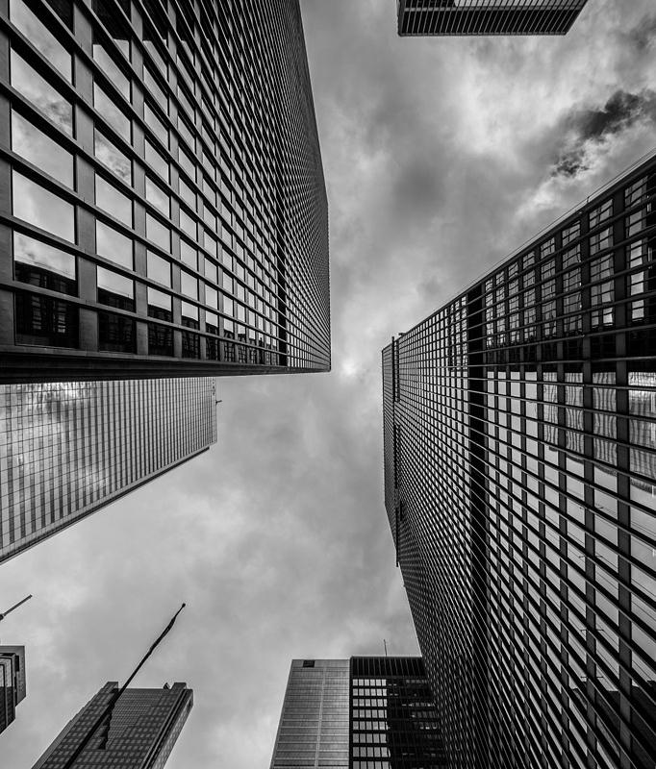
请在此处输入标题
WRITE SOMETHING HERE
Investment generally results in acquiring an asset, also called an investment. If the asset is available at a price worth investing, it is normally expected either to generate income, or to appreciate in value, so that it can be sold at a higher price invest Investment generally results results in acquiring an asset.
WRITE SOMETHING HERE
Also called an investment. If the asset is available at a price worth investing, it is normally expected either to generate income, or to appreciate in value, so that it can be sold
WRITE SOMETHING HERE
Also called an investment. If the asset is available at a price worth investing, it is normally expected either to generate income, or to appreciate in value, so that it can be sold

Slide 7

请在此处输入标题
WRITE SOMETHING HERE
VALUE NAME
VALUE NAME
VALUE NAME
VALUE NAME
Investment generally results in acquiring an asset, also called an investment.
Investment generally results in acquiring an asset, also called an investment.
Investment generally results in acquiring an asset, also called an investment.
Investment generally results in acquiring an asset, also called an investment.

Slide 8

第二部分
Also called an investment. If the asset is available at a price worth investing

Slide 9

输入标题
CREATIVE DESIGNERS
Investment generally results in acquiring an asset, also called an investment. If the asset is available at a price worth investing, it is normally expected either to generate income, or to appreciate in value, so that it can be sold at a higher price invest Investment generally results results in acquiring an asset also called an investment. If the asset is available at a price worth investing, it is normally expected either to generate income, or to appreciate in value, so that it can be sold investment generally results in acquiring an asset
JONH DOE

Slide 10
请在此处输入标题
WRITE SOMETHING HERE
NAME TITLE
YOUR TITLE
YOUR TITLE
NAME TITLE
Investment generally results in acquiring an asset
Investment generally results in acquiring an asset
Investment generally results in acquiring an asset, also called an investment. If the asset is available at a price worth investing, it is normally expected either to generate income, or to appreciate in value, so that it can be sold at a higher price investment also called

Slide 11
请在此处输入标题
WRITE SOMETHING HERE
NAME TITLE
NAME TITLE
NAME TITLE
Investment generally results in acquiring an asset
Investment generally results in acquiring an asset
Investment generally results in acquiring an asset
Investment generally results in acquiring an asset, also called an investment. If the asset is available at a price worth investing, it is normally expected either to generate income, or to appreciate in value, so that it can be sold at a higher price investment also called

Slide 12
请在此处输入标题
WRITE SOMETHING HERE
REACH
WORK
KEEP
FOCUS
Investment generally results in acquiring an asset also the asset is available
Investment generally results in acquiring an asset also the asset is available
Investment generally results in acquiring an asset also the asset is available
Investment generally results in acquiring an asset also the asset is available

Slide 13

请在此处输入标题
Investment generally results in acquiring an asset, also called an investment. If the asset is available at a price worth investing, it is normally expected either to generate

Slide 14

第三部分
Also called an investment. If the asset is available at a price worth investing

Slide 15



请在此处输入标题
WRITE SOMETHING HERE
Meet
The
Experts
Investment generally results in acquiring an asset, also called an investment. If the asset is available at a price worth investing, it is normally expected either to generate
JOHN PEN
PAUL BRUSH
KATY PEN
MANAGER
MANAGER
MANAGER

Slide 16
请在此处输入标题
WRITE SOMETHING HERE
STEP 01
STEP 02
STEP 03
STEP 04
Investment generally results in acquiring an asset, also called an investment.
Investment generally results in acquiring an asset, also called an investment.
Investment generally results in acquiring an asset, also called an investment.
Investment generally results in acquiring an asset, also called an investment.

Slide 17
请在此处输入标题
WRITE SOMETHING HERE
STEP 01
Investment generally results in acquiring an asset also
STEP 02
Investment generally results in acquiring an asset also

Slide 18
STEP 03
Investment generally results in acquiring an asset also
STEP 04
Investment generally results in acquiring an asset also
STEP 05
Investment generally results in acquiring an asset also

Slide 19
STEP 06
Investment generally results in acquiring an asset also
STEP 07
Investment generally results in acquiring an asset also
NOW
WRITE SOMETHING HERE

Slide 20

第四部分
Also called an investment. If the asset is available at a price worth investing

Slide 21

请在此处输入标题
WRITE SOMETHING HERE
FEATURE 01
FEATURE 02
Investment generally results in acquiring an asset, also called an investment asset
Investment generally results in acquiring an asset, also called an investment asset
FEATURE 03
FEATURE 04
Investment generally results in acquiring an asset, also called an investment asset
Investment generally results in acquiring an asset, also called an investment asset

Slide 22



OUR SHOWCASE
WRITE SOMETHING HERE
1
2
3
Investment generally results in acquiring an asset, also called an investment. If the asset is available at a price worth investing, it is normally expected either to generate income, or to appreciate in value, so that it can be sold at a higher price invest Investment generally.

Slide 23
请在此处输入标题
WRITE SOMETHING HERE
YOUR TITLE
WRITE HERE
NAME HERE

Slide 24
请在此处输入标题
WRITE SOMETHING HERE

Slide 25
请在此处输入标题
WRITE SOMETHING HERE
COUNTRY NAME
Also called an investment. If the asset is available at a price worth investing
EUROPE
COUNTRY NAME
AMERICA
Also called an investment. If the asset is available at a price worth investing
BRAZIL
COUNTRY NAME
Also called an investment. If the asset is available at a price worth investing
COUNTRY NAME
Also called an investment. If the asset is available at a price worth investing

Slide 26
联系我们
email@yourdomain.com
123 shandongqingdao St, TX
www.yourdomin.com

