Slide 1
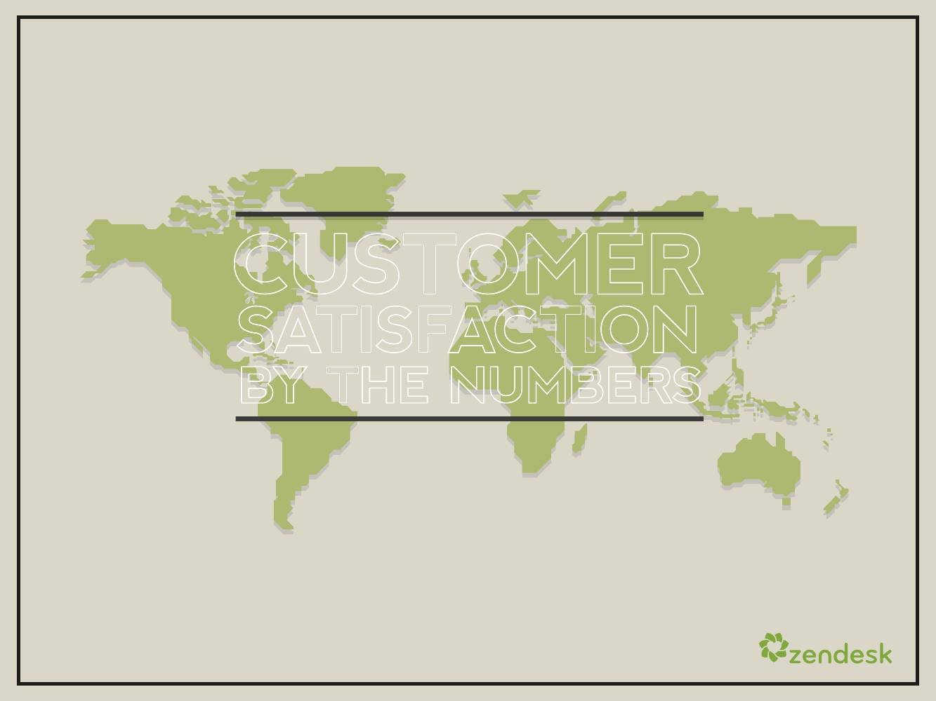
CUSTOMER
SATISFACTION
BY THE NUMBERS
ZENDESK CUSTOMER SATISFACTION INDEX, MARCH 2012

Slide 2
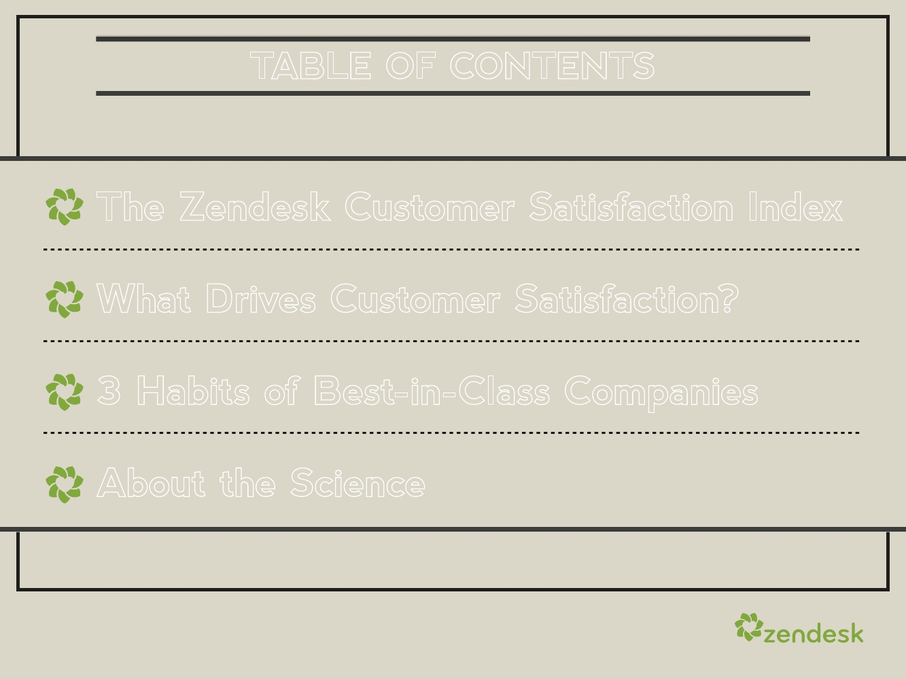
TABLE OF CONTENTS
The Zendesk Customer Satisfaction Index
What Drives Customer Satisfaction?
3 Habits of Best-in-Class Companies
About the Science
1

Slide 3
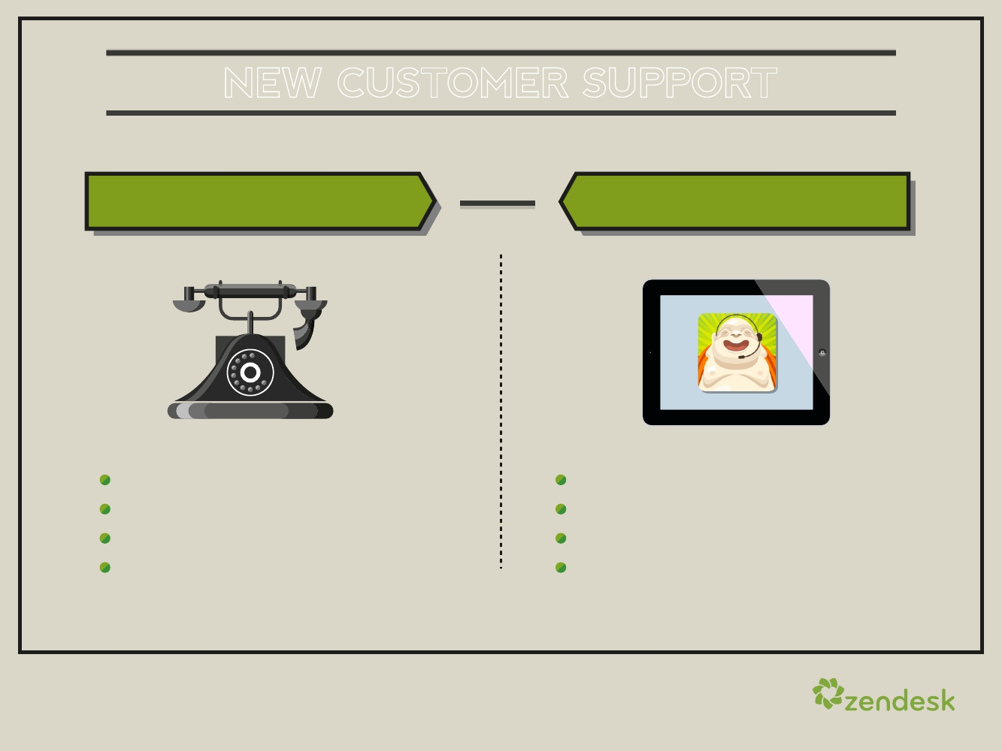
NEW CUSTOMER SUPPORT
YESTERDAY
Segregated by channel
Disconnected from business
Treated as a cost center
Subpar consumer experience
TODAY
Interconnected channel support
Closely tied to marketing/sales
Treated as a revenue engine
Critical to consumer experience
2

Slide 4
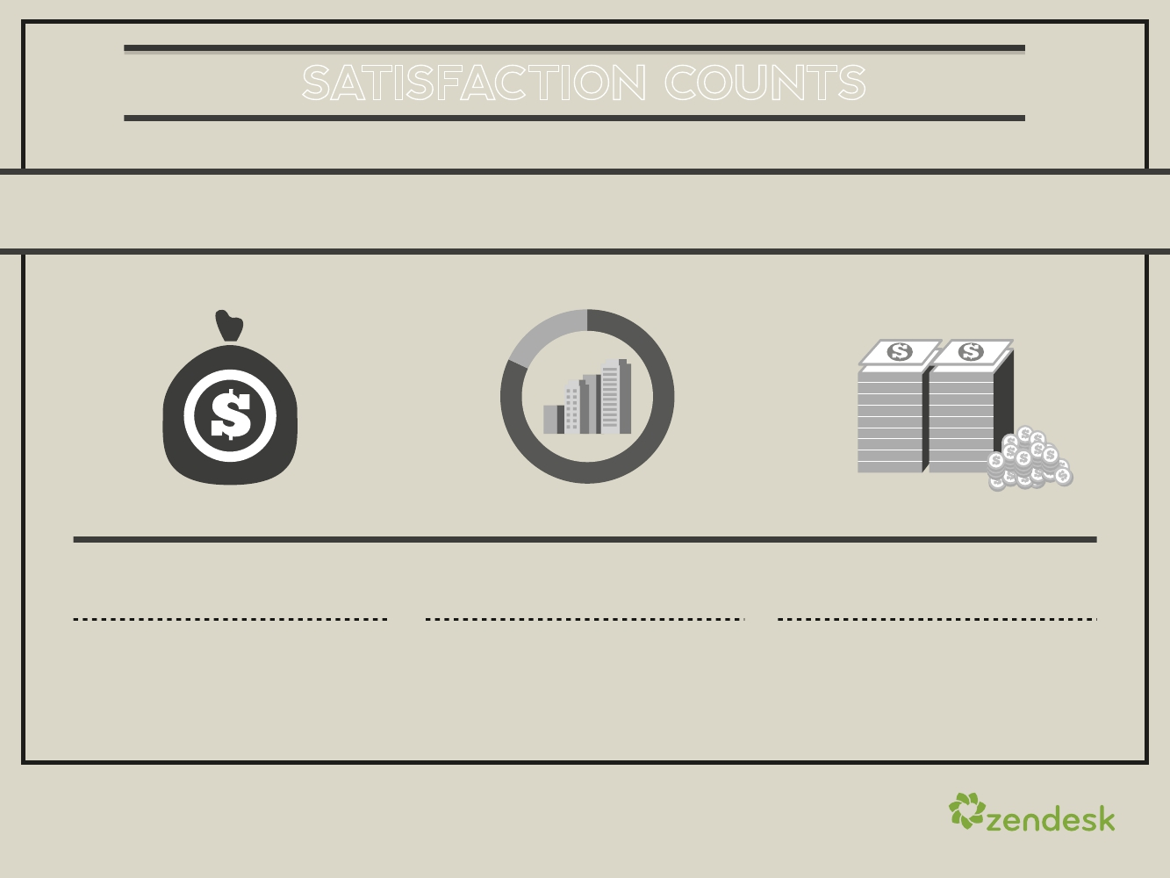
SATISFACTION COUNTS
When it comes to customer service, satisfaction is what matters
most. In fact, bad customer service can cost you billions.
$338.5B
Theamountbad customer service
costsmajor countries aroundthe
world annually
SOURCE: GENESYS GLOBALSURVEY
82%
Percentageof Americanswho saidthey
stoppeddoing businesswith acompany
because ofpoor customer service
$289
Average valueof eachlost
businessrelationshipinthe U.S.
3

Slide 5
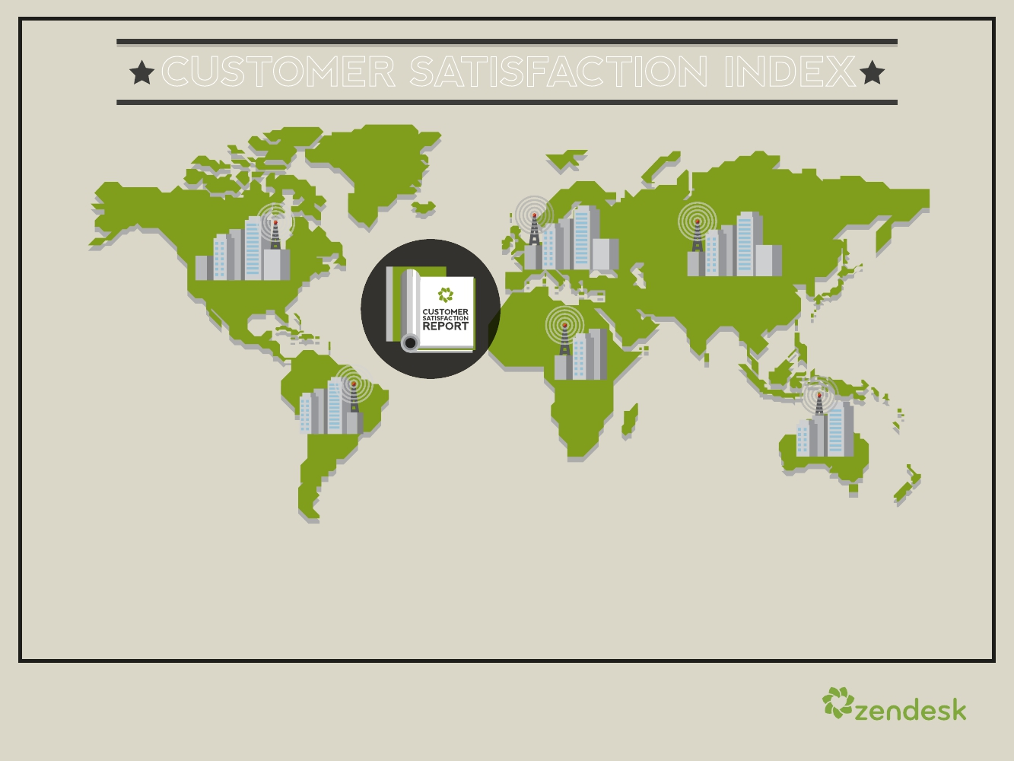
CUSTOMER SATISFACTION INDEX
Zendesk’s Customer Satisfaction Index delivers a periodic measure of
customer satisfaction by collecting data from more than 15,000
companies serving 65 million consumers across 137 countries.
4

Slide 6

GLOBAL BENCHMARK
This global Customer
Satisfaction Index is
the result of a simple
question asked to
millions of customers
at the end of a service
interaction: “How
would you rate the
service you received?”
GLOBAL
86%
CUSTOMER
SATISFACTION
5

Slide 7
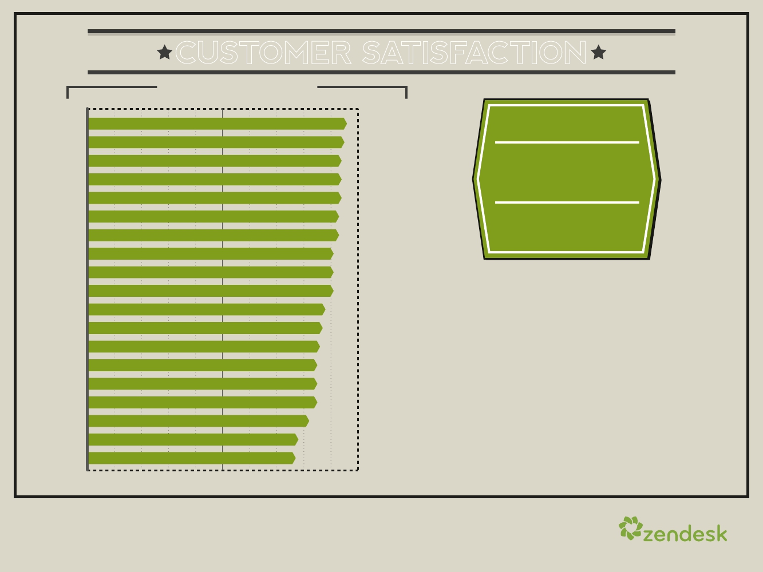
CUSTOMER SATISFACTION
BY INDUSTRY
Real Estate
IT Services & Consultancy
Healthcare
Professional Services
Personal & Business Support Services
Financial & Insurance Services
Nonprofit
Education
Technology - Hosting
Travel, Hospitality & Tourism
Media & Telecommunications
Software
Web Applications
Technology - Hardware
Manufacturing
Marketing
Retail & Wholesale
Social Media
Entertainment & Arts
96%
95%
94%
94%
94%
93%
93%
91%
91%
91%
88%
87%
86%
85%
85%
85%
82%
78%
77%
GLOBAL
86%
CUSTOMER
SATISFACTION
Zendesk customers all interact
directly with their end customers,
and all want to delight those end
customers.
But satisfaction varies vastly
across industries–some expected,
some not.
0
50%
100%
6

Slide 8
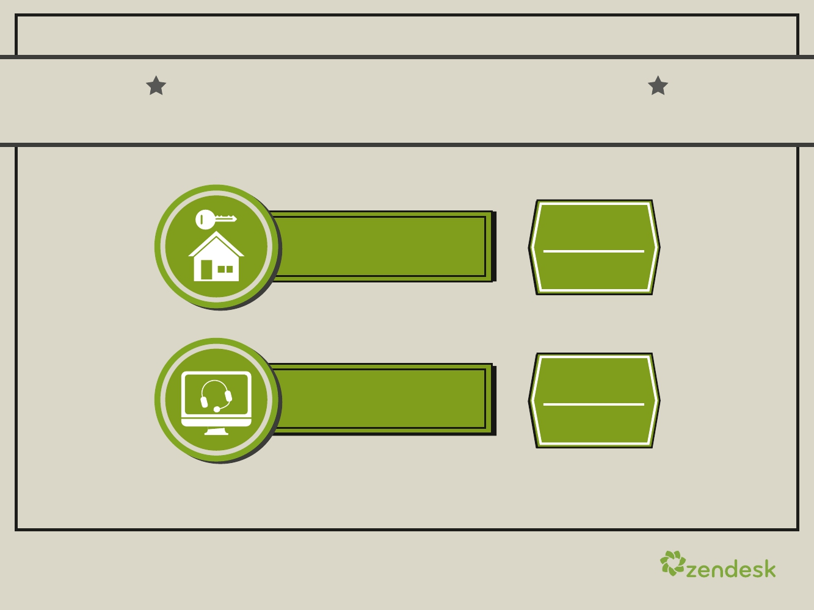
REAL ESTATE AND IT CONSULTING/SERVICES
RATED HIGHEST IN CUSTOMER SATISFACTION OF ANY INDUSTRY
96%
CUSTOMER
SATISFACTION
95%
CUSTOMER
SATISFACTION
Real Estate
IT Services
& Consultancy
7

Slide 9
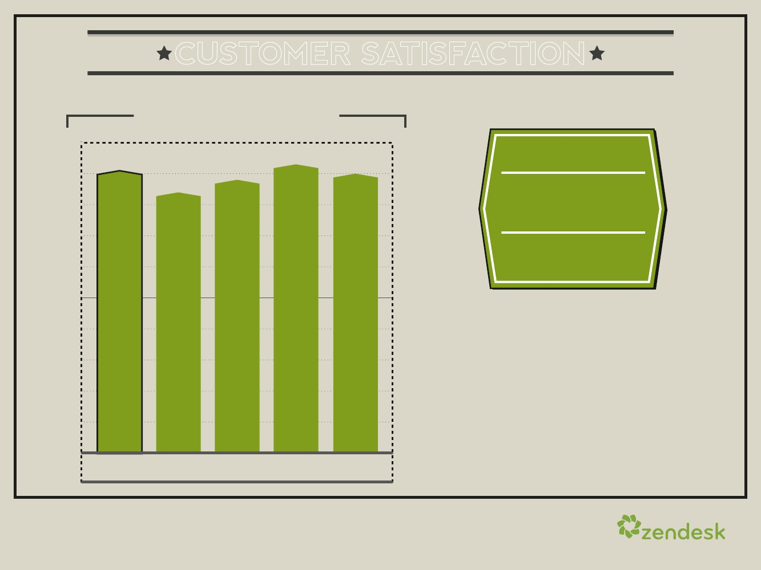
CUSTOMER SATISFACTION
BY COMPANY SIZE
100
GLOBAL
86%
CUSTOMER
91%
93%
88%
90%
84%
SATISFACTION
50
The smallest
companies—whether a
mom-and-pop operation, small
business or a tech
startup—perform well across
almost every industry.
0
1-9
10-99
100-499
500-4,999
5,000+
8

Slide 10
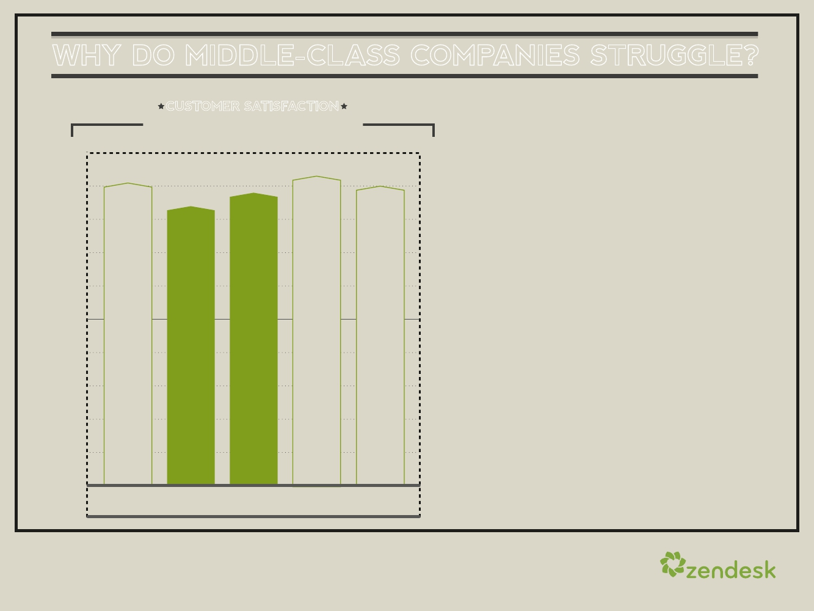
WHY DO MIDDLE-CLASS COMPANIES STRUGGLE?
CUSTOMER SATISFACTION
BY COMPANY SIZE
100
50
93%
91%
90%
84%
88%
Yet once these companies
reach a certain scale—over 10
employees—service suffers.
It’s not until companies reach
scale (500 employees) and
have mature processes and
structures that they recover
their customer service levels.
0
1-9
10-99
100-499 500-4,999 5,000+
9

Slide 11
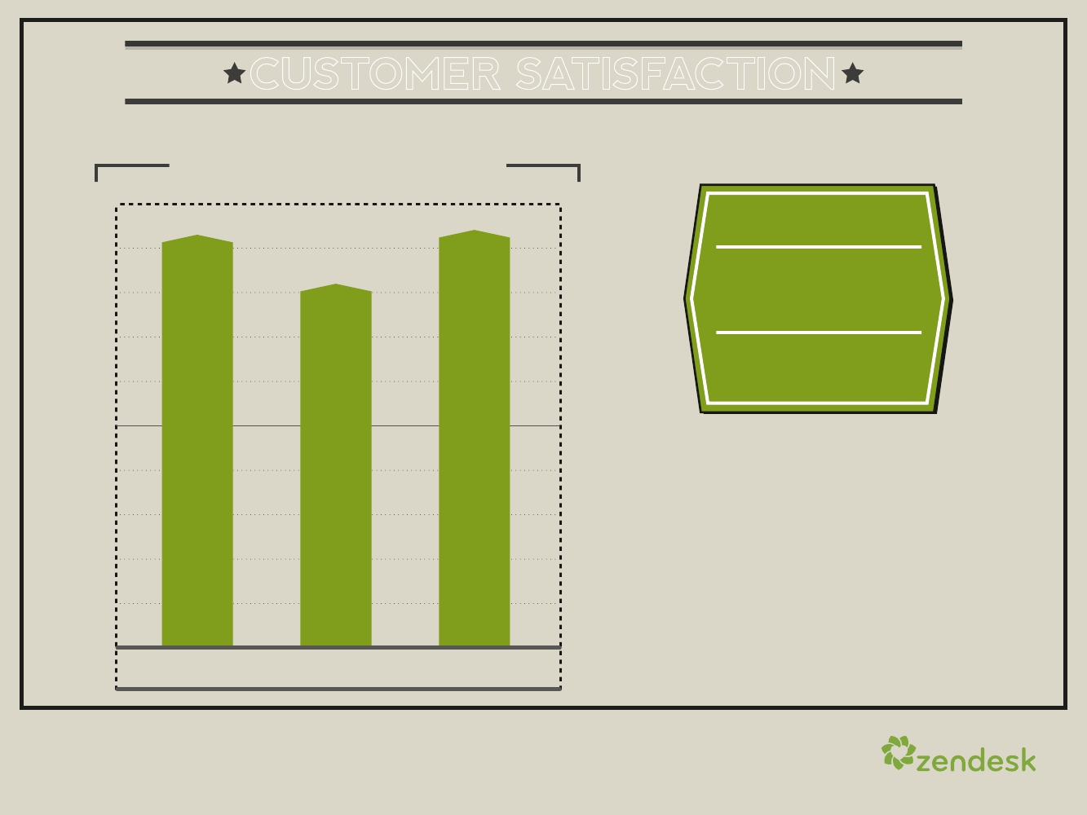
CUSTOMER SATISFACTION
BY TARGET AUDIENCE
100
GLOBAL
86%
CUSTOMER
93%
94%
82%
SATISFACTION
50
Support organizations serve one of
three audiences—consumers, other
businesses or internal employees.
Satisfaction varies widely, depending
on which audience you deliver
support to.
0
Businesses
Consumers
Internal (employees)
10

Slide 12
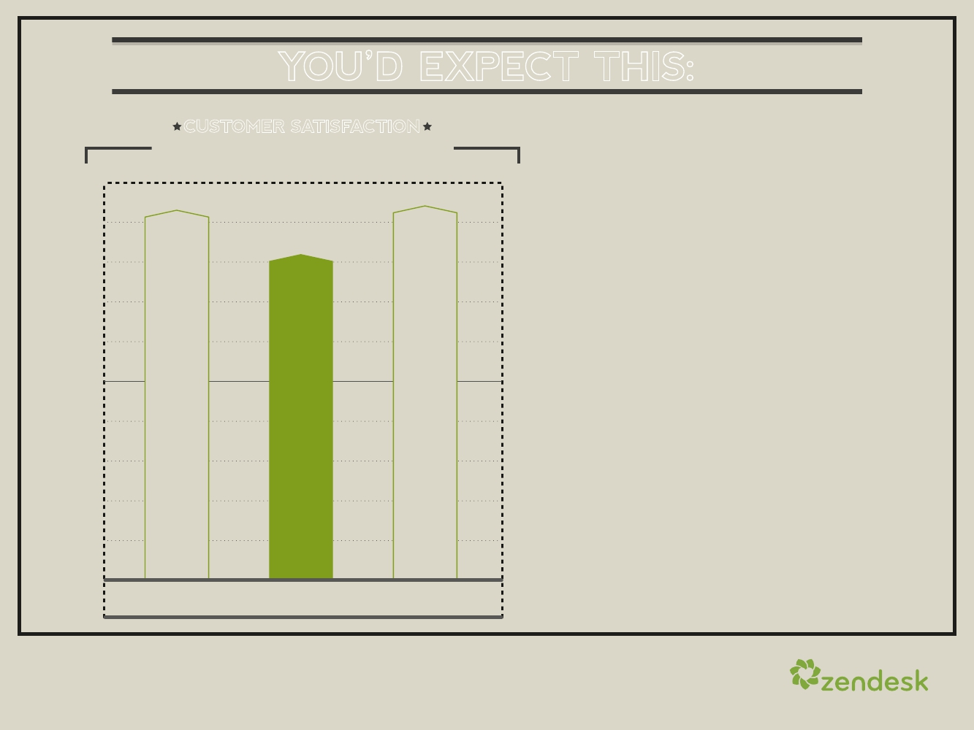
YOU’D EXPECT THIS:
CUSTOMER SATISFACTION
BY TARGET AUDIENCE
100
50
93%
94%
82%
Support sites that service
consumers score the lowest of
any audience. And many
consumer-facing support sites
score well below 75 percent.
Apparently, consumers are
cranky when it comes to
support.
0
Businesses
Consumers
Internal (employees)
11

Slide 13
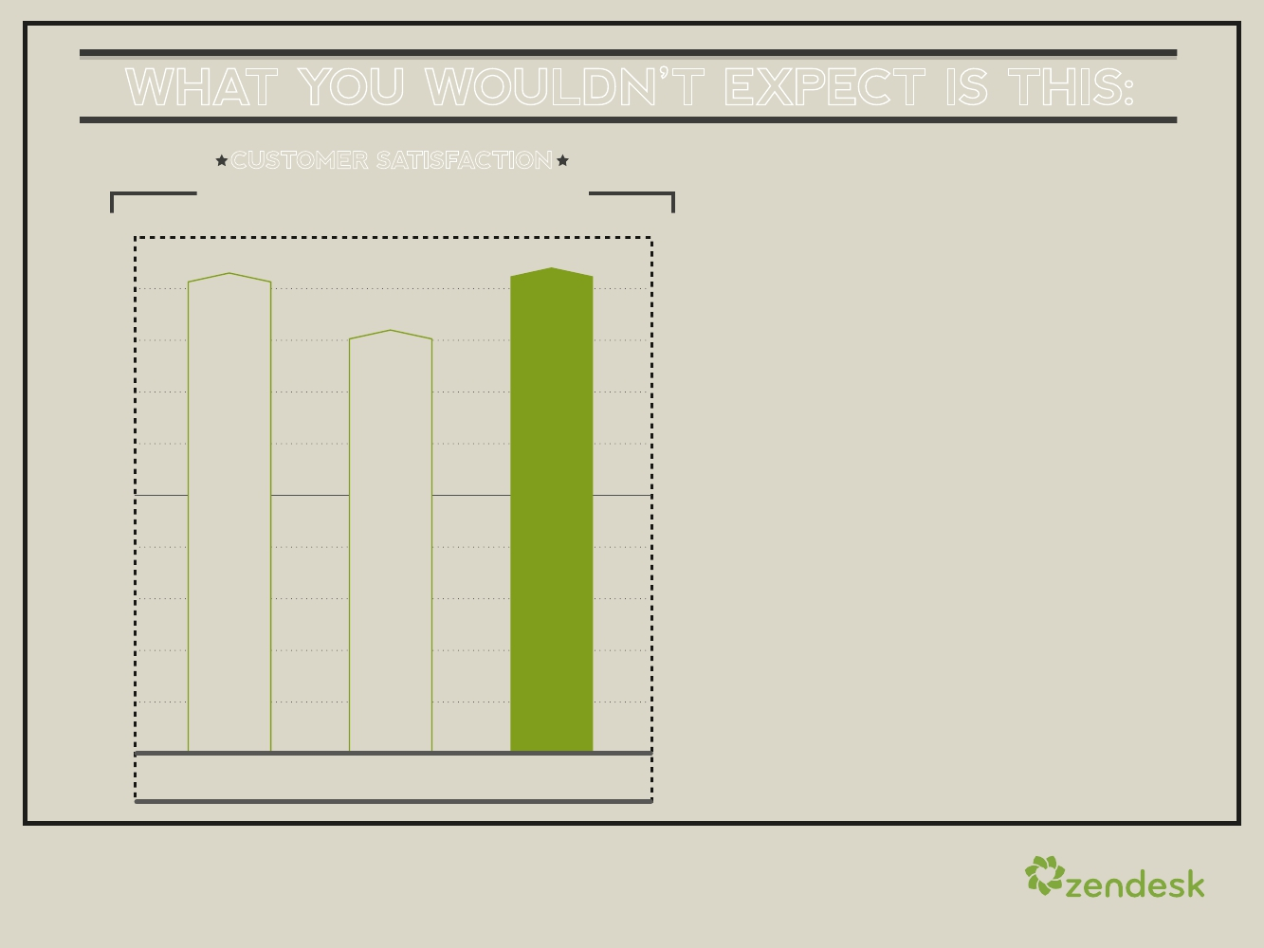
WHAT YOU WOULDN’T EXPECT IS THIS:
CUSTOMER SATISFACTION
BY TARGET AUDIENCE
100
93%
94%
82%
Internal help desks (think of your
IT team that handles employee
requests for software or network
help) have higher customer
satisfaction ratings than help desks
that support either consumers or
other businesses.
50
Perhaps IT doesn’t deserve its
unhelpful stigma?
0
Businesses
Consumers
Internal (employees)
12

Slide 14
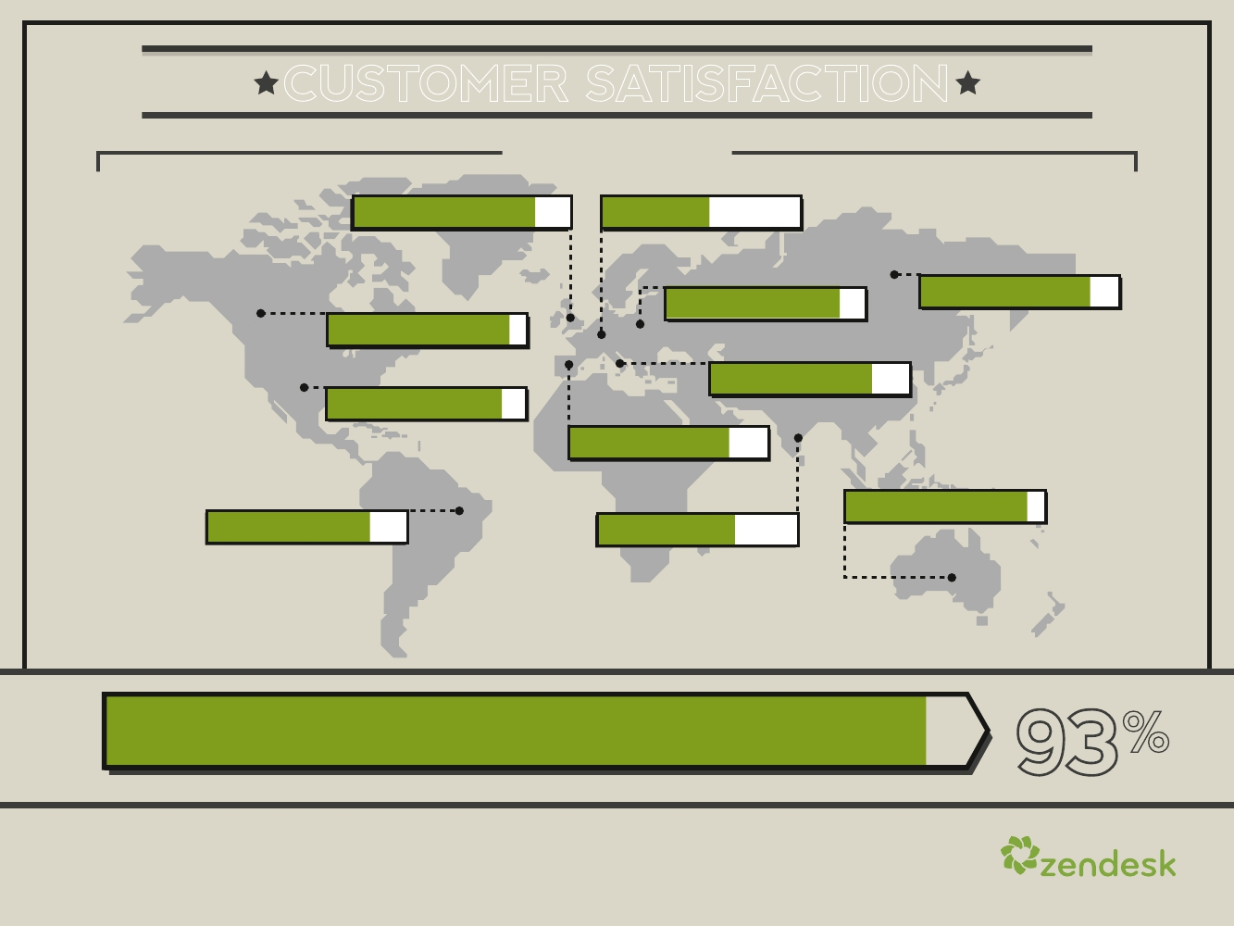
CUSTOMER SATISFACTION
BY COUNTRY*
UNITED KINGDOM: 83%
FRANCE: 57%
0%
100%
0%
100%
GERMANY: 88%
RUSSIA: 80%
CANADA: 93%
0%
0%
100%
0%
100%
100%
ITALY: 81%
UNITED STATES: 87%
0%
100%
0%
100%
SPAIN: 81%
0%
100%
AUSTRALIA: 93%
0% 100%
BRAZIL: 79%
INDIA: 70%
0%
100%
0%
100%
93
%
Australia and Canada lead our Customer Satisfaction Index at
0% 50%
*Countries with the largest economies are shown
100%
13

Slide 15
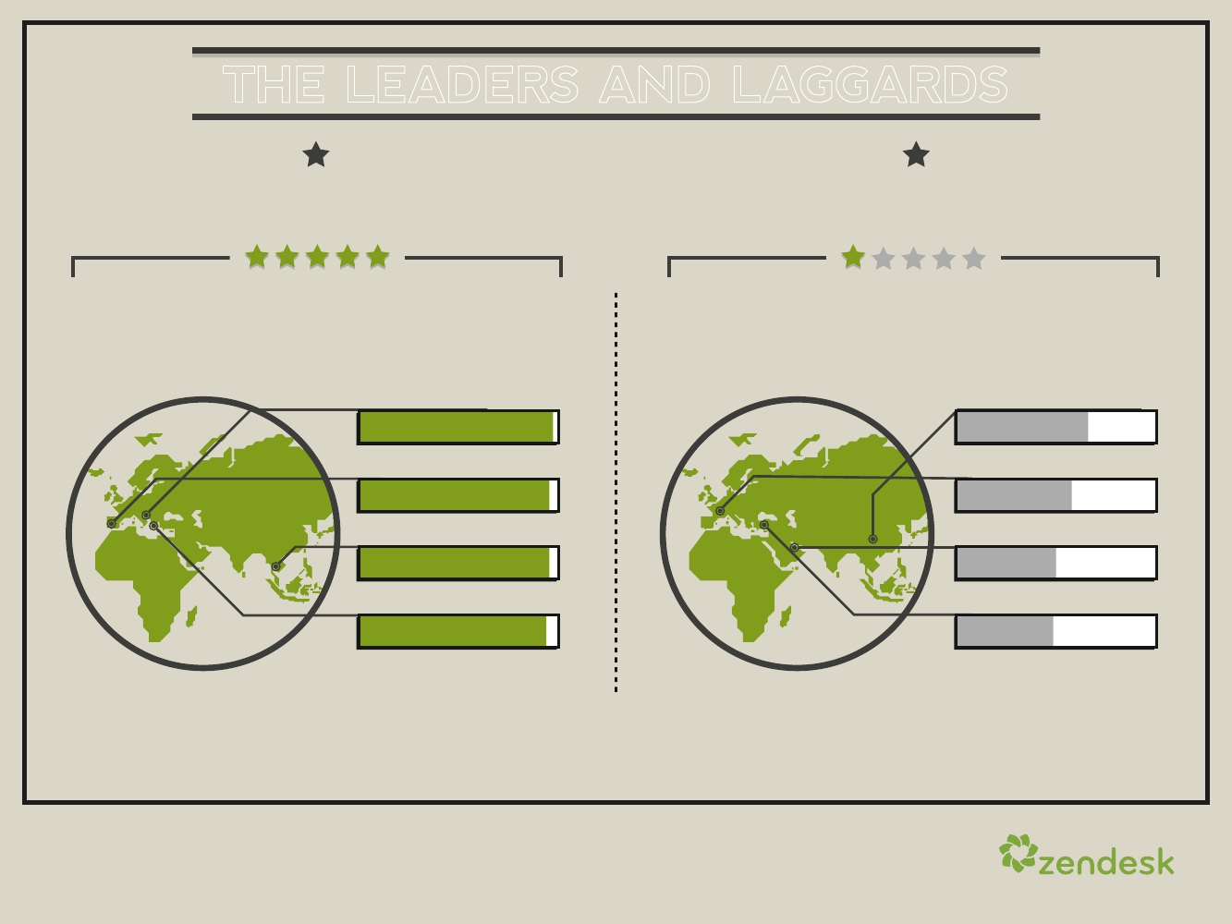
THE LEADERS AND LAGGARDS
CUSTOMERS’ SATISFACTION BY COUNTRY*
THE LEADERS
SATISFACTION SCORE
CROATIA: 98%
THE LAGGARDS
SATISFACTION SCORE
CHINA: 59%
0%
PORTUGAL: 96%
0%
THAILAND: 96%
0%
GREECE: 95%
0%
100%
100%
100%
100%
0%
FRANCE: 52%
0%
QATAR: 45%
0%
TURKEY: 43%
0%
100%
100%
100%
100%
*Minimum 100 satisfaction ratings
14

Slide 16

SO WHAT DRIVES
CUSTOMER
SATISFACTION?
15

Slide 17
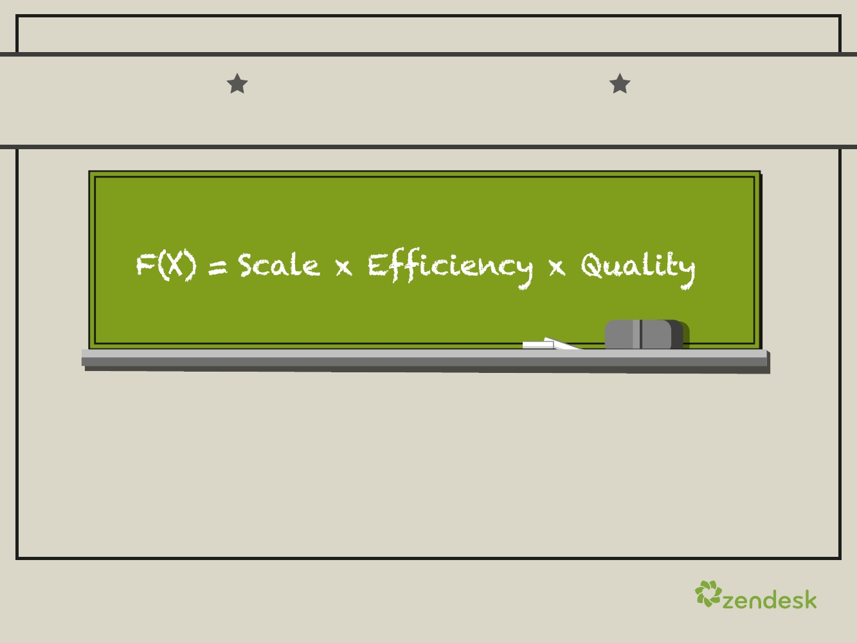
THIS IS THE WINNING FORMULA
FOR CUSTOMER SATISFACTION DEVELOPED BY ZENDESK
Bigger companies that efficiently deliver high-quality support at a large
scale have the most satisfied customers.
16

Slide 18
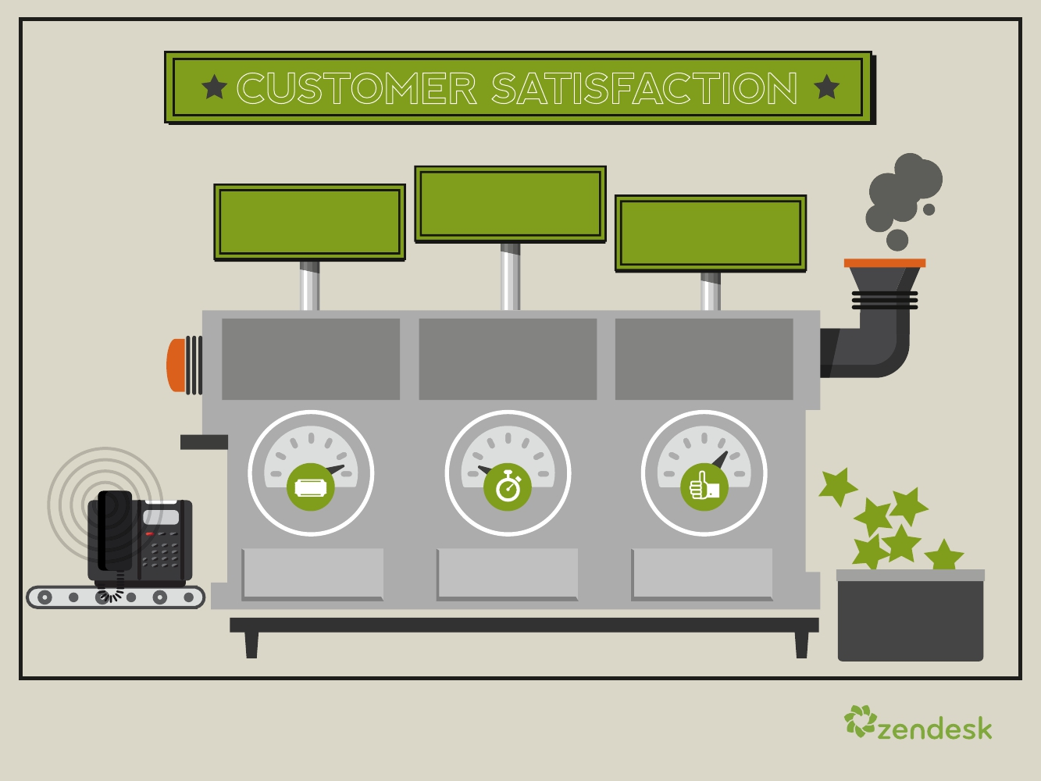
CUSTOMER SATISFACTION
EFFICIENCY
How well
do you handle
customer issues?
First Response
Time
SCALE
How many issues
are you receiving?
###
Number of
Tickets
QUALITY
What is the quality
of the support you
give?
%of Tickets
Resolved
17

Slide 19
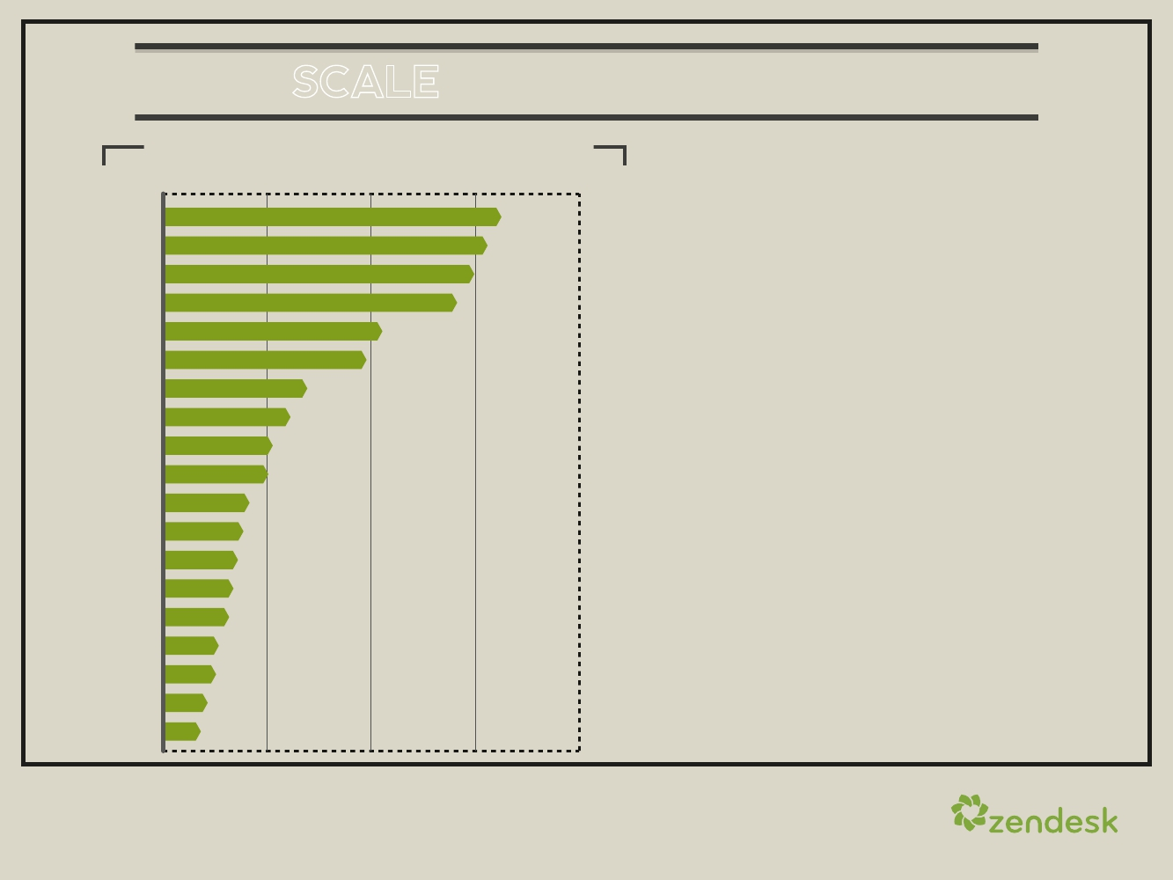
F(X) = SCALE x EFFICIENCY x QUALITY
NUMBER OF TICKETS BY INDUSTRY
0
1,000
2,000
Social Media
Entertainment & Arts
Travel, Hospitality & Tourism
Retail & Wholesale
Marketing
Media & Telecommunications
Web Applications
Financial & Insurance Services
Software
Education
Healthcare
Manufacturing
Technology - Hosting
Technology - Hardware
Personal and Business Support Services
Nonprofit
Professional Services
Real Estate
IT Services & Consultancy
1,625
1,560
1,495
1,413
979
692
675
613
527
505
413
385
360
337
315
267
261
212
181
SIZE MATTERS
Each ticket constitutes a customer
interaction, making it a good
measure of the frequency and
scale of your customer touches.
Customers increasingly serve
themselves via the web through
well-crafted online forums, FAQs
and knowledge bases.
On average, Zendesk-powered
help desks handle more than
600 tickets per month, and
drive more than 2,600 page
views to their online forums.
18

Slide 20
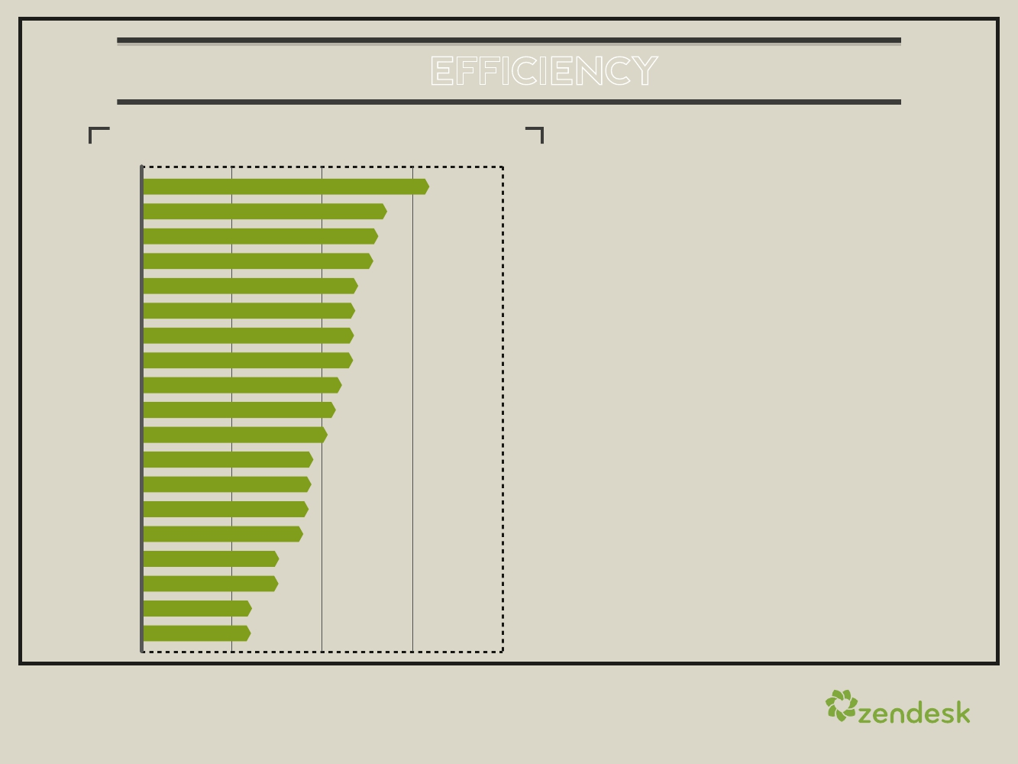
F(X) = SCALE x EFFICIENCY x QUALITY
FIRST RESPONSE TIME BY INDUSTRY
0
12hrs
24hrs
36hrs
48hrs
Manufacturing
Marketing
38.2 hrs
32.7 hrs
Entertainment & Arts
Education
Financial & Insurance Services
Nonprofit
IT Services & Consultancy
Technology - Hardware
Retail & Wholesale
Social Media
Real Estate
Healthcare
Media & Telecommunications
Personal and Bus. Support Services
Software
Professional Services
Web Applications
Travel, Hospitality & Tourism
Technology - Hosting
31.5 hrs
30.8 hrs
28.6 hrs
28.3 hrs
28.2 hrs
28.1 hrs
26.6 hrs
25.9 hrs
24.8 hrs
22.9 hrs
22.7 hrs
22.3 hrs
21.5 hrs
18.2 hrs
18.1 hrs
14.7 hrs
14.5 hrs
We have a limited budget and staff,
so we need to make sure we’re
delighting our customers as
efficiently as possible. This is why
first-response time is a great
efficiency measure. The average
first-response time across all
Zendesk tickets is over 23.6 hours.
Those taking more than a day to
get back to customers may want to
reexamine their processes.
19

Slide 21
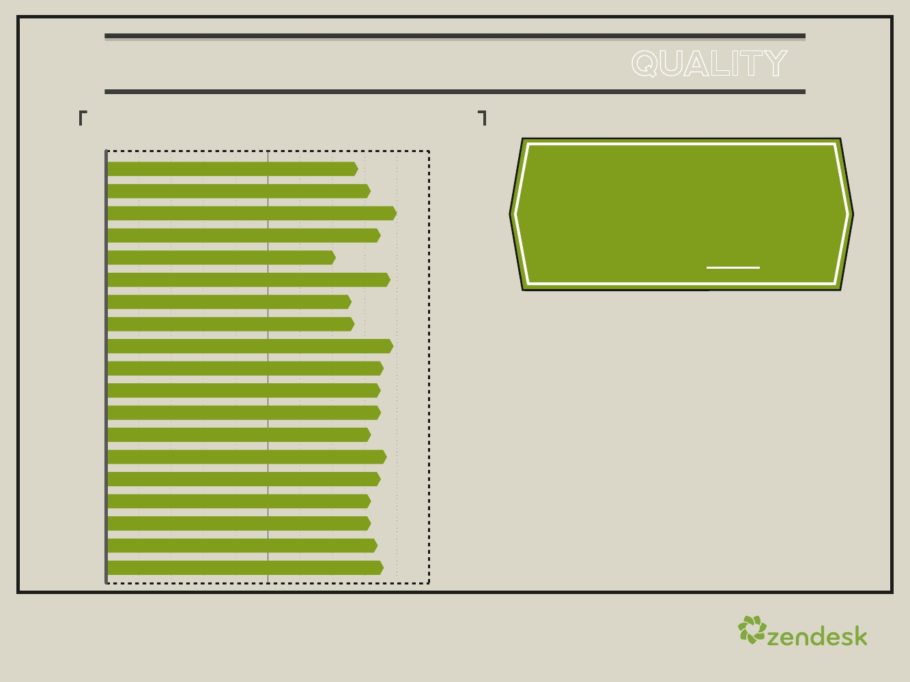
F(X) = SCALE x EFFICIENCY x QUALITY
%OFTICKETSIN1TOUCHBYINDUSTRY
0%
50%
100%
IT Services & Consultancy
Education
Entertainment & Arts
Financial & Insurance services
Technology - Hardware
Healthcare
Technology - Hosting
Manufacturing
Marketing
Media & Telecommunications
Nonprofit
Professional Services
Real Estate
Retail & Wholesale
Social Media
Software
Personal & Business Support Services
Travel, Hospitality & Tourism
Web Applications
78%
82%
90%
85%
71%
88%
76%
77%
89%
86%
85%
85%
82%
87%
85%
82%
82%
84%
86%
The percentage of
tickets resolved in one
touch across all Zendesk
tickets is 85%
Zendesk’s third measure is
quality, which is measured by
one-touch tickets.
“One-touch” tickets are those
resolved with only one service
interaction. The higher your
one-touch percentage, the
higher your service quality.
20

Slide 22
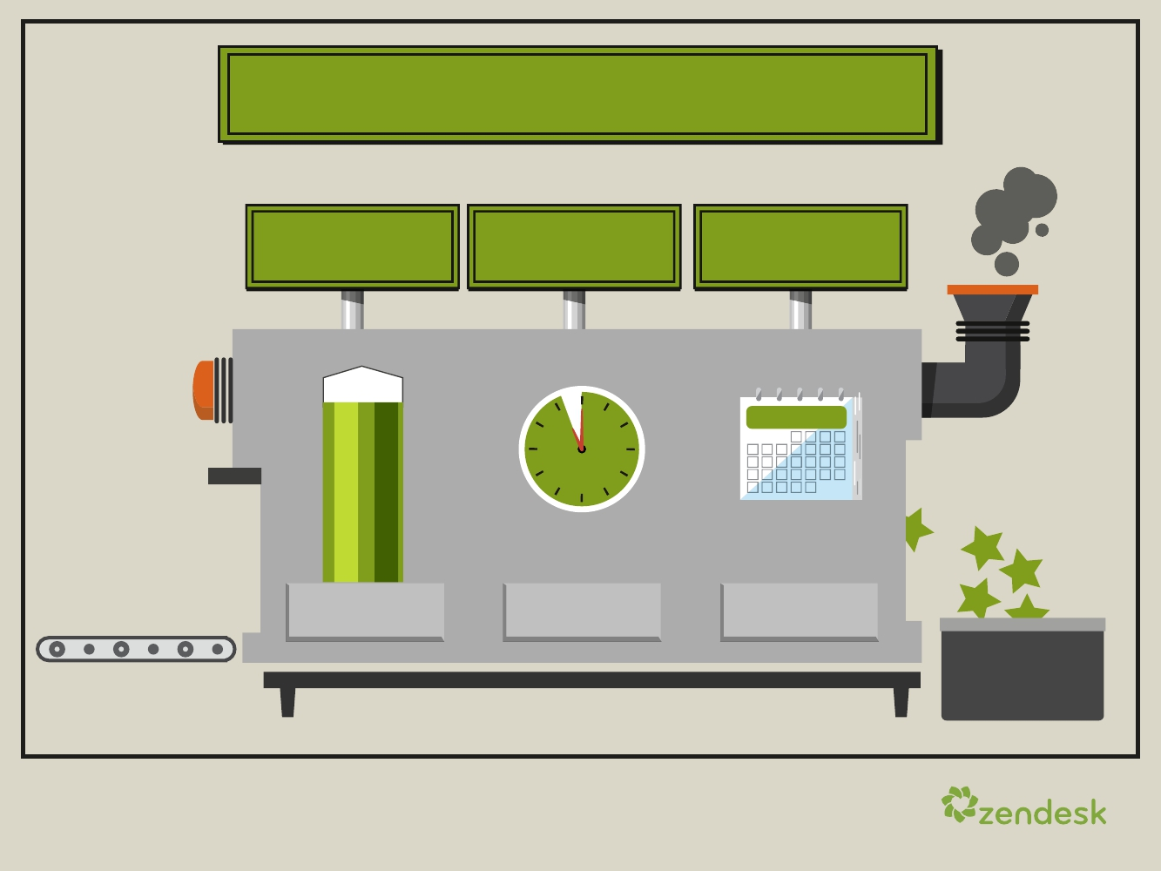
ZENDESK BENCHMARK
Satisfaction
86%
Customer
Satisfaction
Efficiency
23.6hrs
First-Response
Time
Scale
630
Ticketsper
Month
Across 15,000 Global Accounts
21

Slide 23
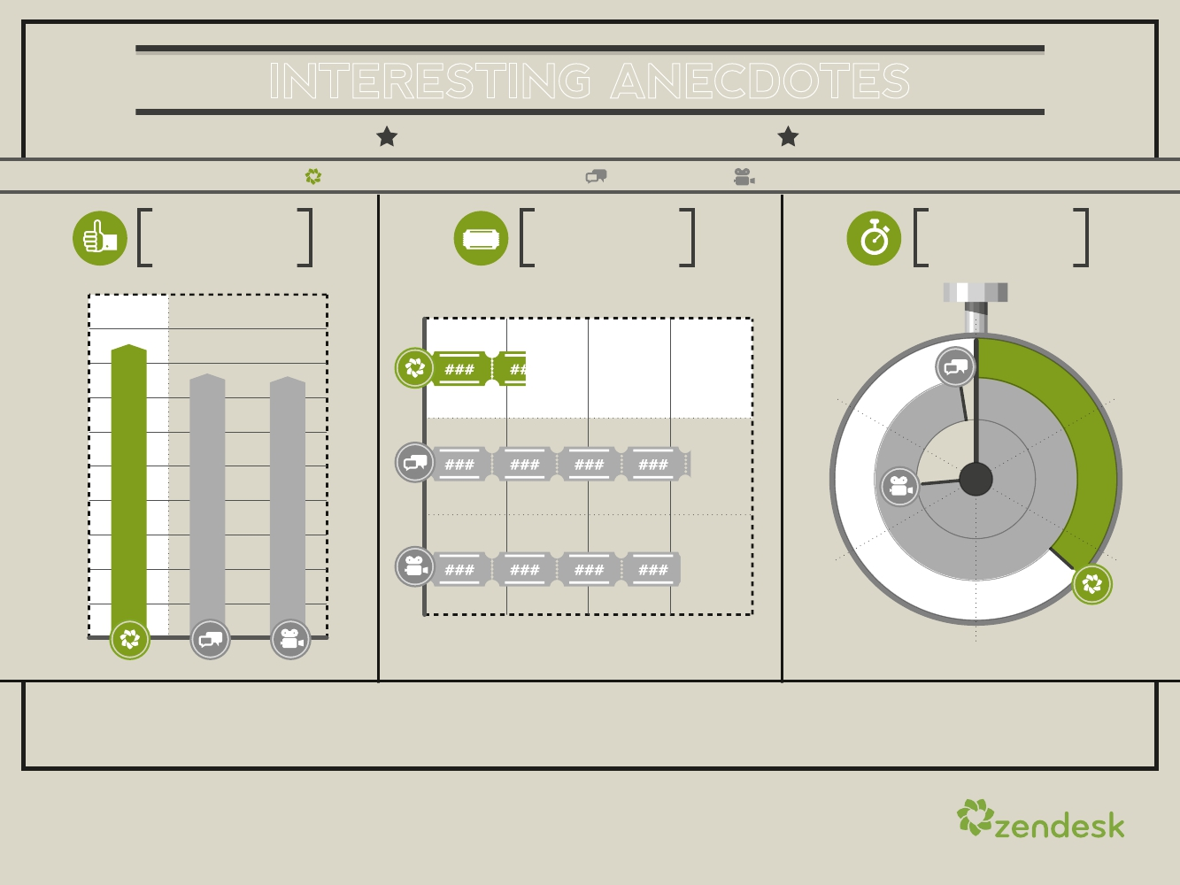
INTERESTING ANECDOTES
ABOUT SATISFACTION SCORE
Zendesk Benchmark Average
Social Media
Entertainment
SATISFACTION SCORE
BY INDUSTRY
NUMBER OF TICKETS
BY INDUSTRY
FIRST RESPONSE TIME
BY INDUSTRY
###
100%
86
0(hrs)
78
77
630
58.9
50
44.6
40
10
20
50%
1,625
1,560 1,560
0(Tkt)
1,000
2,000
23.6
0%
30
Low satisfaction ratings are the result of high ticket volume and slow
first-response time, as evidenced by consumer-facing companies.
22

Slide 24
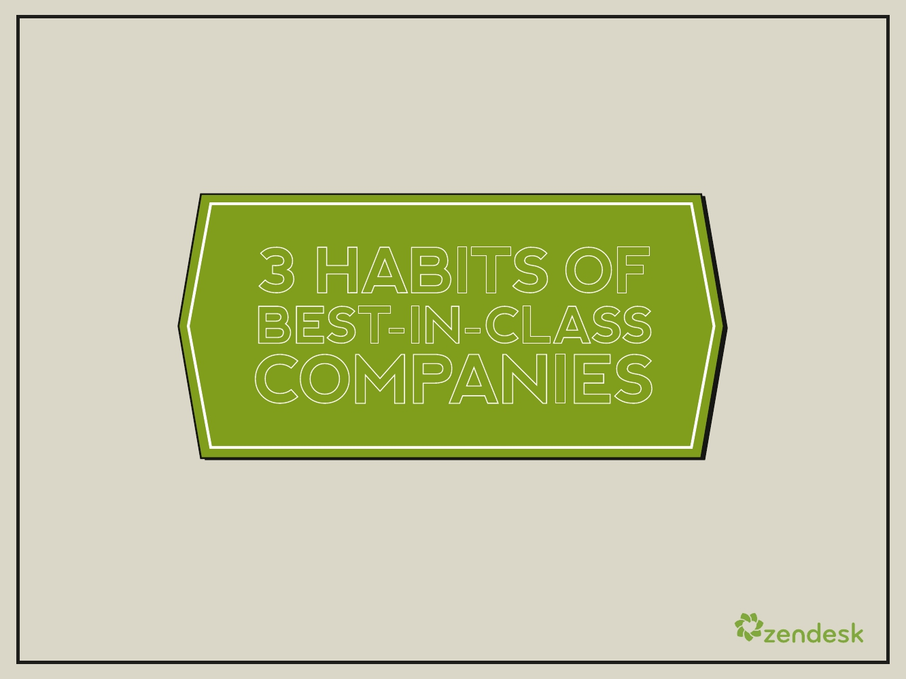
3 HABITS OF
BEST-IN-CLASS
COMPANIES
23

Slide 25
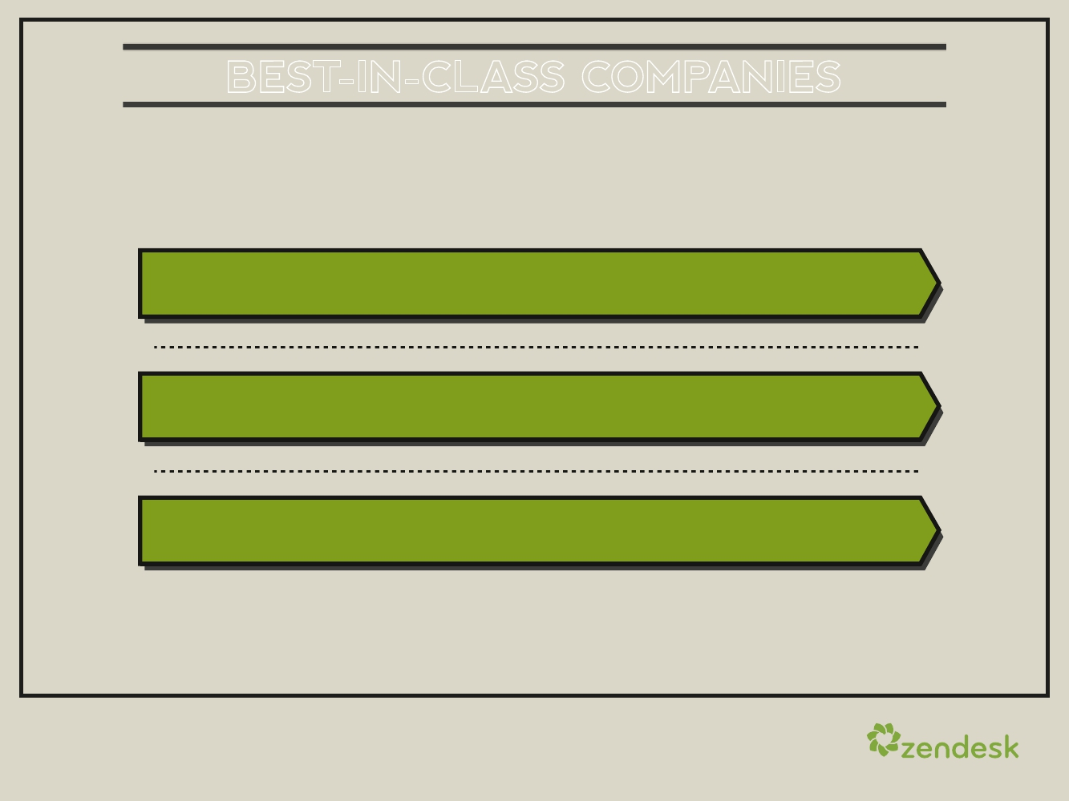
BEST-IN-CLASS COMPANIES
Data can be overwhelming, but there are three clear behaviors that
separate best-in-class companies from the rest:
IMMEDIATE RESPONSE MATTERS
YOU HAVE TO BE WHERE YOUR CUSTOMERS ARE
LET YOUR CUSTOMERS SERVE THEMSELVES
24

Slide 26
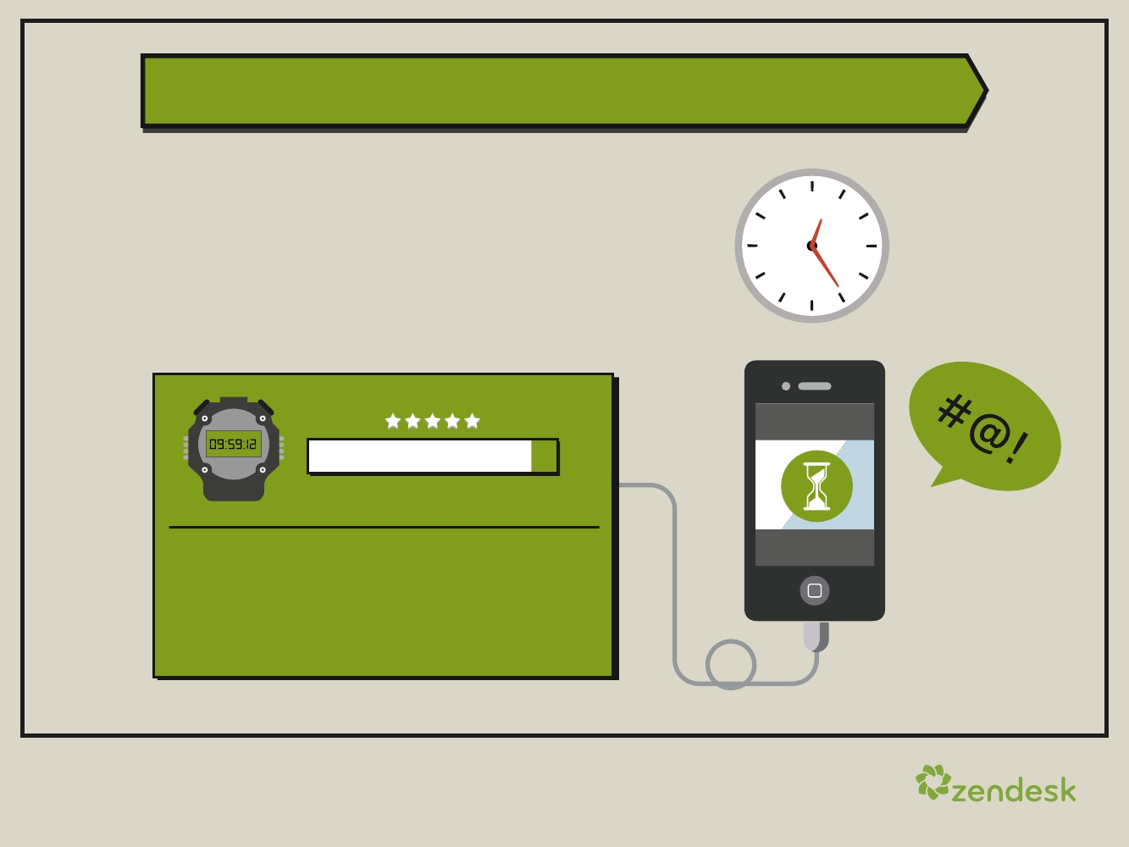
IMMEDIATE RESPONSE
The clock begins ticking the
moment you receive a ticket.
Responding quickly has the single
greatest impact on customer
satisfaction.
ON HOLD
90%
0%
100%
FACTOID:
10:03
Companies with an average first-response
time under 10 hours have customer
satisfaction over 90 percent.
25

Slide 27
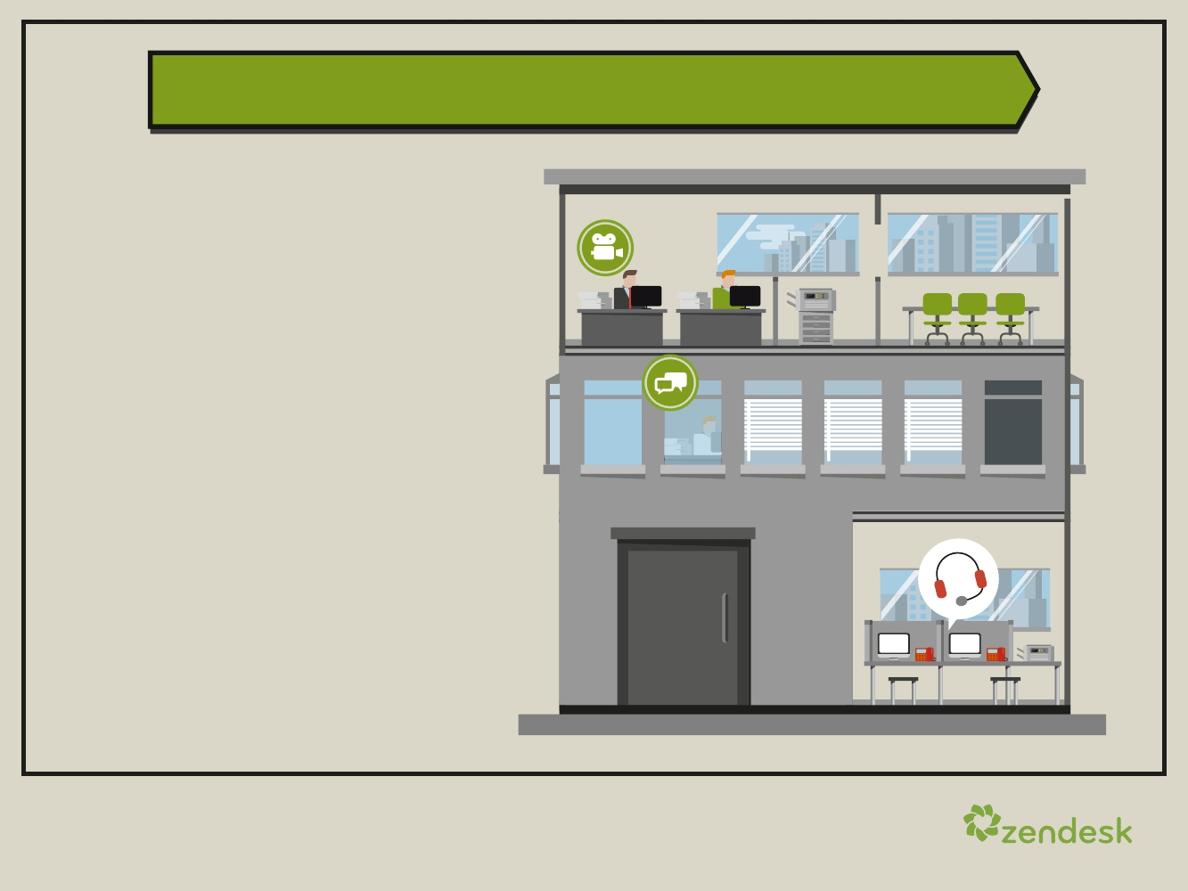
BE WHERE YOUR CUSTOMERS ARE
Today, it’s critical to be
available where your
customers want to reach
you: your website,
Facebook, Twitter, email,
phone or chat.
Companies that support
their customers across
multiple channels drive
higher engagement and
respond faster to customer
inquiries—all increasing
satisfaction.
26

Slide 28
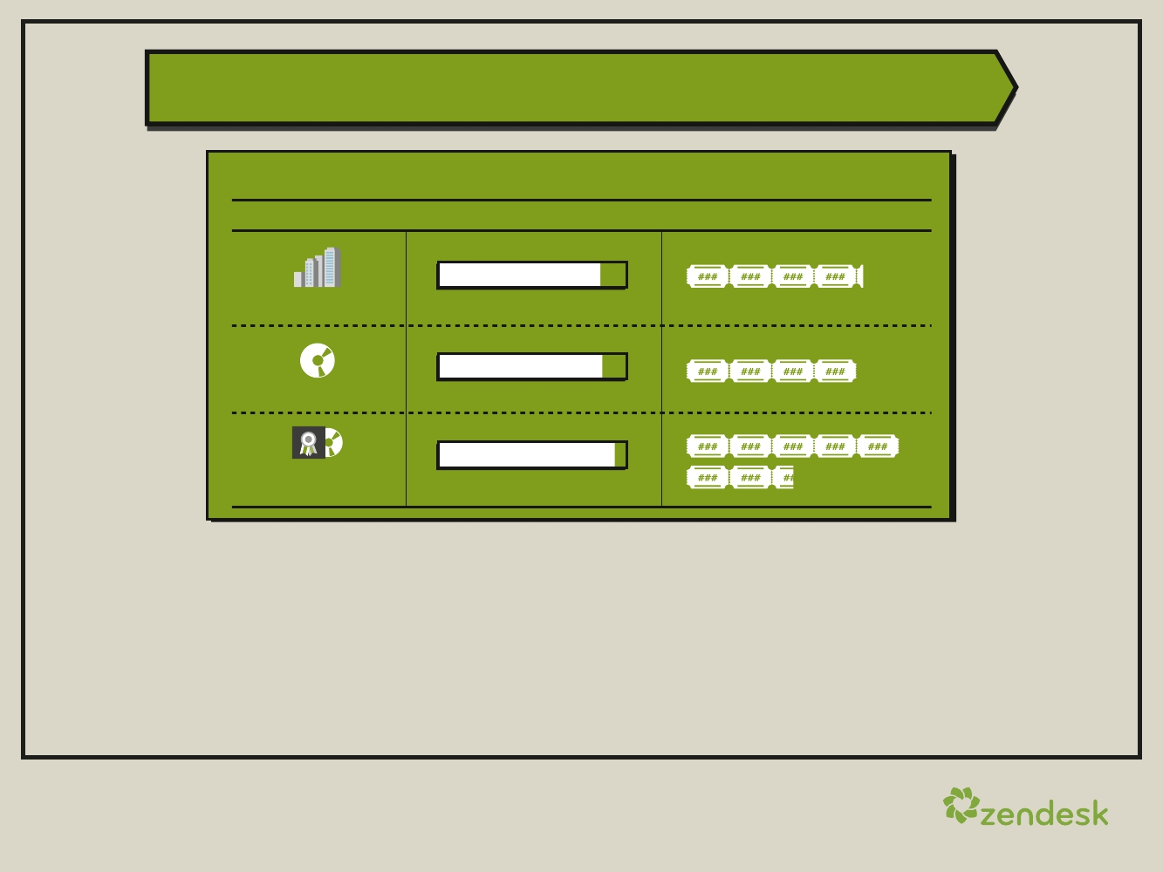
LET CUSTOMERS SERVE THEMSELVES
FORUM VIEW:TICKET RATIO
SATISFACTION
86%
FORUM VIEWS/TICKET
4.2
All Companies
0%
100%
87%
0%
93%
0%
4.0
Software
Best-in-Class
Software
100%
100%
7.5
Companies that offer rich self-service customer support forums
and FAQs have a higher level of customer satisfaction.
Best-in-class companies invest in self-service, and those with
higher forum traffic drive greater satisfaction—especially in the
software industry.
27

Slide 29
ABOUT
THE SCIENCE
ZENDESK BENCHMARK
28

Slide 30
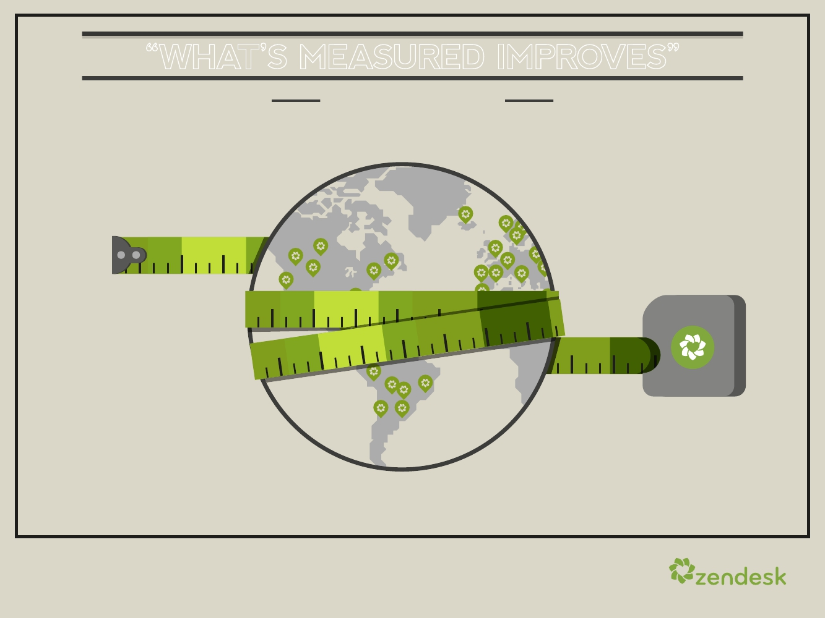
“WHAT’S MEASURED IMPROVES”
PETER DRUCKER
29

Slide 31
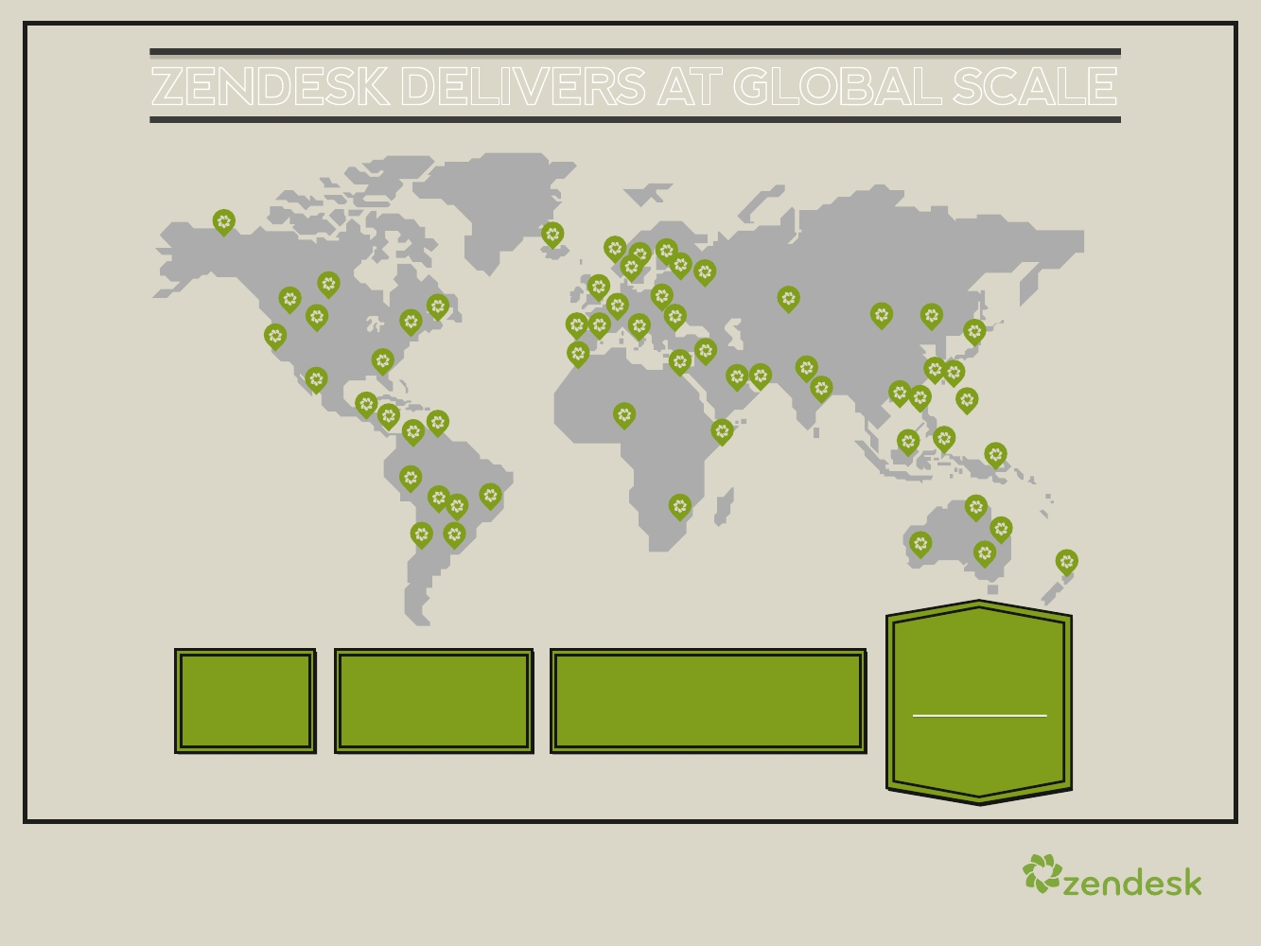
ZENDESK DELIVERS AT GLOBAL SCALE
100
MILLION
SERVICE
INTERACTIONS
PER YEAR
137 15,000 SERVED MILLION
65 CUSTOMERS ENTERPRISES COUNTRIES
30

Slide 32
THE BENCHMARK IS MEASURED BY
INSIGHTS BASED ON ACTUAL HELP DESK USAGE:
We offer the metrics you need to measure your support volume, help
desk efficiency and quality of engagement.
LOADS OF COMPARISONS:
With the Zendesk Benchmark, you can compare yourself to the overall
population of Zendesk-powered help desks, to your industry peers, to
companies of similar size or to companies supporting similar end users.
The Zendesk Benchmark is not your typical “expert” survey. It’s
comprised of metrics based on real product usage and customer
engagement.
31

Slide 33
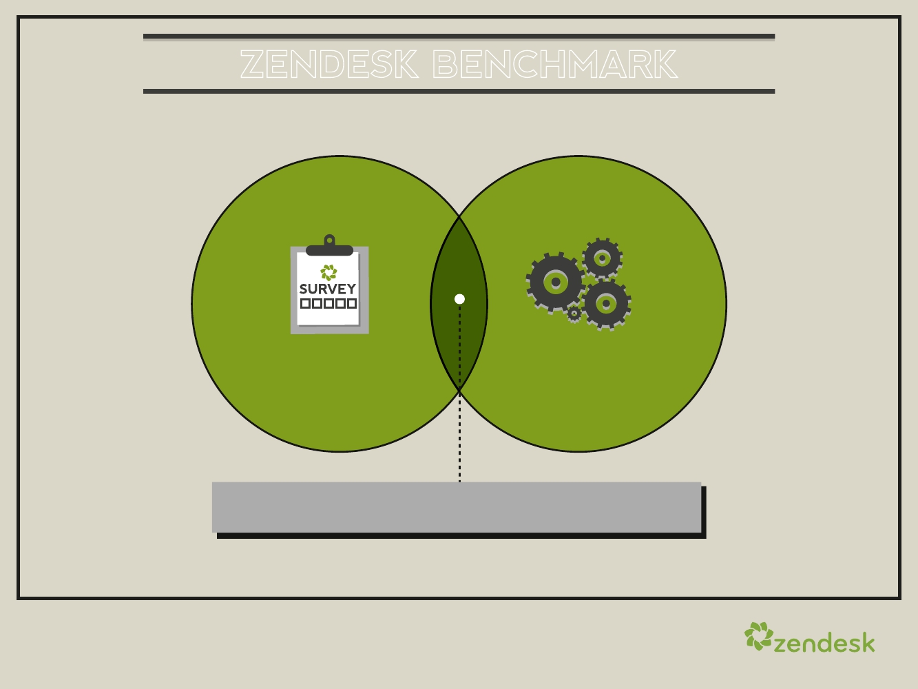
ZENDESK BENCHMARK
DATA COLLECTION FROM MASSIVE CUSTOMER BASE
10,000+
Survey
Respondents
(Accounts)
11,000+
Accounts with
Usage Data
(Q4 2011)
Large-Scale Demographic and Usage Data
32

Slide 34

METRICS THAT MATTER
TICKETS ARE THE CORE OF SUPPORT INTERACTIONS
Customer Satisfaction
# of Tickets per Month
First-Response Time
Tickets per Agent
% of Tickets in One Touch
Satisfaction Rating from End User
Total Volume of New Tickets
First-Response Time During Business Hours
# of Tickets Solved per Active Agent
Tickets Resolved in One Human Interaction
FORUMS DRIVE CUSTOMER SELF-SERVICE
# of Forum Views
Forum View:Ticket Ratio
Forum-Search Effectiveness
33
Overall Monthly Forum Traffic
Measure of Customer Self-Service
Click-Through Rate for Forum Searches

Slide 35
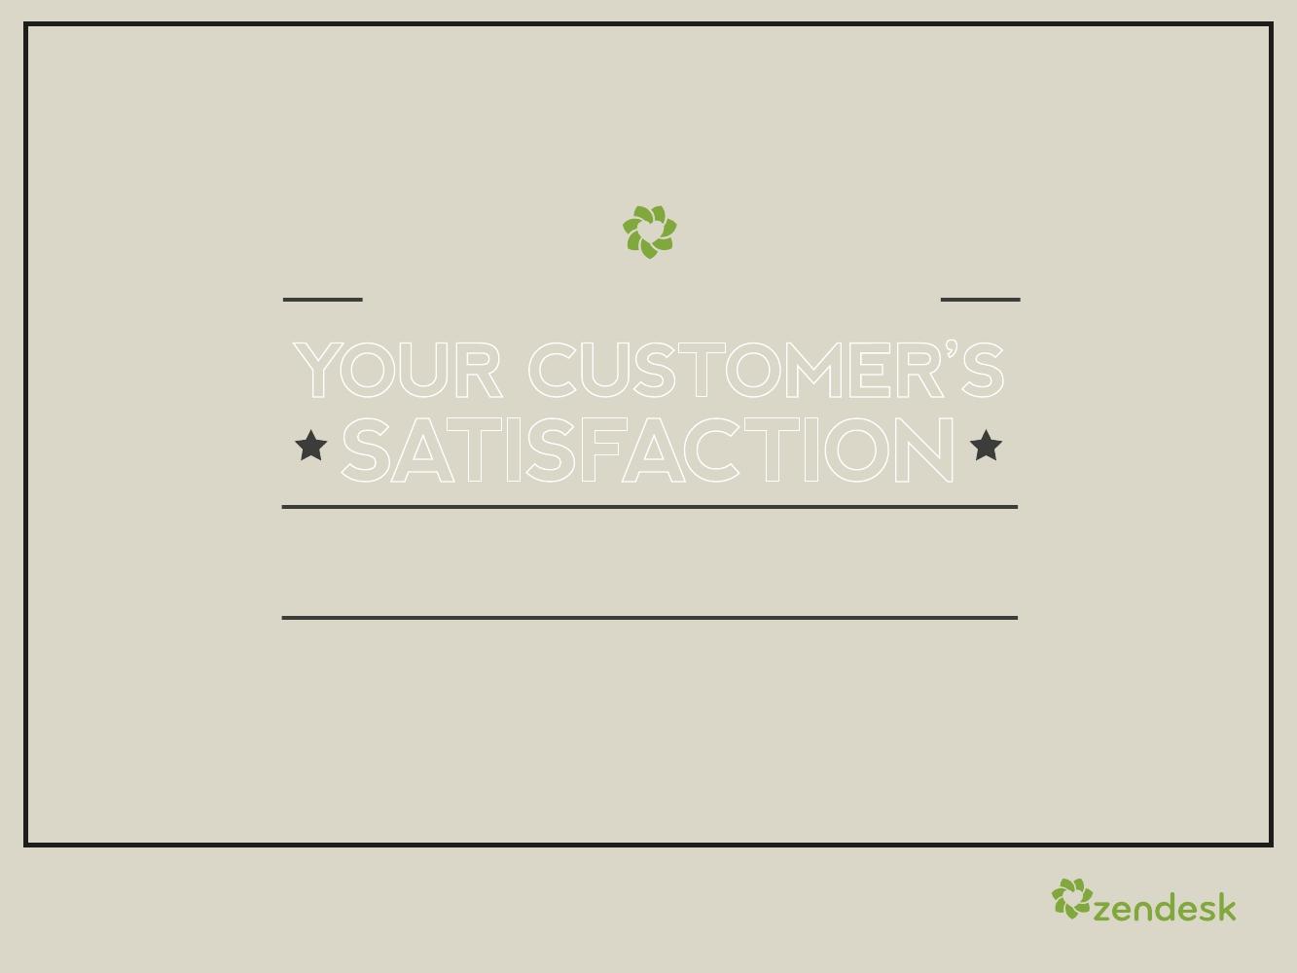
YOU CAN START MEASURING
YOUR CUSTOMER’S
SATISFACTION
WITH ZENDESK
TODAY
34

Slide 36



35

