Slide 1

TRAVEL
ANY WHERE
YOU LIKE
运动会策划案ppt模板
Travel album

Slide 2

SELECT
THE PLACE
TO GO
Pick a place where you'll actually want to linger.

Slide 3
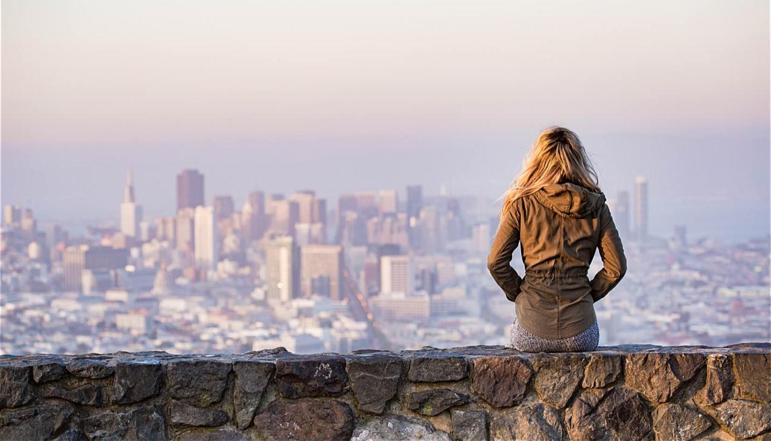
ABOUT
THE STORY OF
OUR TRIP
In the life long journey with many detours, path, dangerous road, dark road, only the strong-willed and never stop the people, will have hopes of reaching the victory away.

Slide 4

WHY
CHOOSE TO
TRAVEL
The meaning of travel is not the trophy how many photos are a few attractions to occupy a few, but, you do more crazy things, and experience which the heartbeat of the moment, and whether to see more.

Slide 5


Title here
THIS IS
A BEAUTIFUL
HOLIDAY
The meaning of travel is not the trophy how many photos are a few attractions to occupy a few, but, you do more crazy things, and experience which the heartbeat of the moment, and whether to see more.

Slide 6
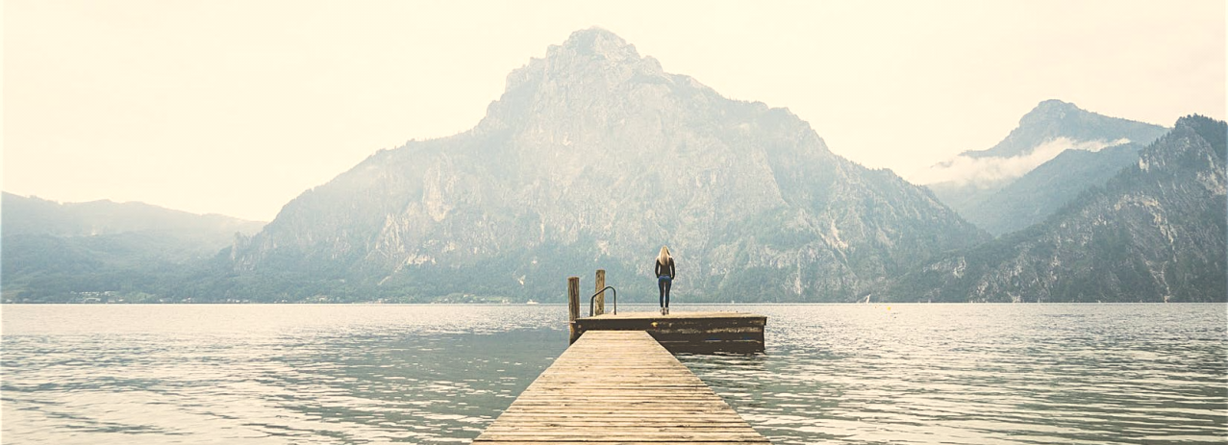
WHY
CHOOSE TO
TRAVEL
Title here
The meaning of travel is not the trophy how many photos are a few attractions to occupy a few, but, you do more crazy things, and experience which the heartbeat of the moment, and whether to see more.

Slide 7


THIS IS
A BEAUTIFUL
HOLIDAY
Title here
The meaning of travel is not the trophy how many photos are a few attractions to occupy a few, but, you do more crazy things, and experience which the heartbeat of the moment, and whether to see more.

Slide 8

THIS IS
A BEAUTIFUL
HOLIDAY
Title here
The meaning of travel is not the trophy how many photos are a few attractions to occupy a few, but, you do more crazy things, and experience which the heartbeat of the moment, and whether to see more.

Slide 9
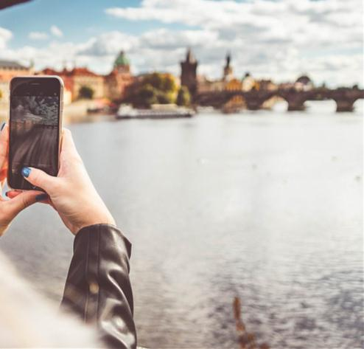
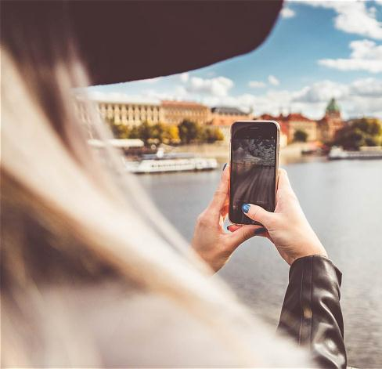
WHY
CHOOSE TO
TRAVEL
Title here
The meaning of travel is not the trophy how many photos are a few attractions to occupy a few, but, you do more crazy things, and experience which the heartbeat of the moment, and whether to see more.

Slide 10

Title here
The meaning of travel is not the trophy how many photos are a few attractions to occupy a few, but, you do more crazy things, and experience which the heartbeat of the moment, and whether to see more.
THIS IS
A BEAUTIFUL
HOLIDAY

Slide 11
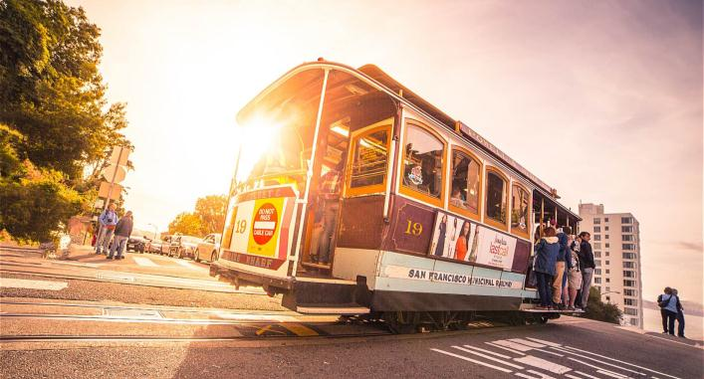

WHY
CHOOSE TO
TRAVEL
Title here
The meaning of travel is not the trophy how many photos are a few attractions to occupy a few, but, you do more crazy things, and experience which the heartbeat of the moment, and whether to see more.

Slide 12



THIS IS
A BEAUTIFUL
HOLIDAY
Title here
The meaning of travel is not the trophy how many photos are a few attractions to occupy a few, but, you do more crazy things, and experience which the heartbeat of the moment, and whether to see more.

Slide 13

WHY
CHOOSE TO
TRAVEL
Title here
The meaning of travel is not the trophy how many photos are a few attractions to occupy a few, but, you do more crazy things, and experience which the heartbeat of the moment, and whether to see more.

Slide 14


THIS IS
A BEAUTIFUL
HOLIDAY
Title here
The meaning of travel is not the trophy how many photos are a few attractions to occupy a few, but, you do more crazy things, and experience which the heartbeat of the moment, and whether to see more.

Slide 15

WHY
CHOOSE TO
TRAVEL
Title here
The meaning of travel is not the trophy how many photos are a few attractions to occupy a few, but, you do more crazy things, and experience which the heartbeat of the moment, and whether to see more.

Slide 16


THIS IS
A BEAUTIFUL
HOLIDAY
Title here
The meaning of travel is not the trophy how many photos are a few attractions to occupy a few, but, you do more crazy things, and experience which the heartbeat of the moment, and whether to see more.

Slide 17

THIS IS
A BEAUTIFUL
HOLIDAY
Title here
The meaning of travel is not the trophy how many photos are a few attractions to occupy a few, but, you do more crazy things, and experience which the heartbeat of the moment, and whether to see more.

Slide 18
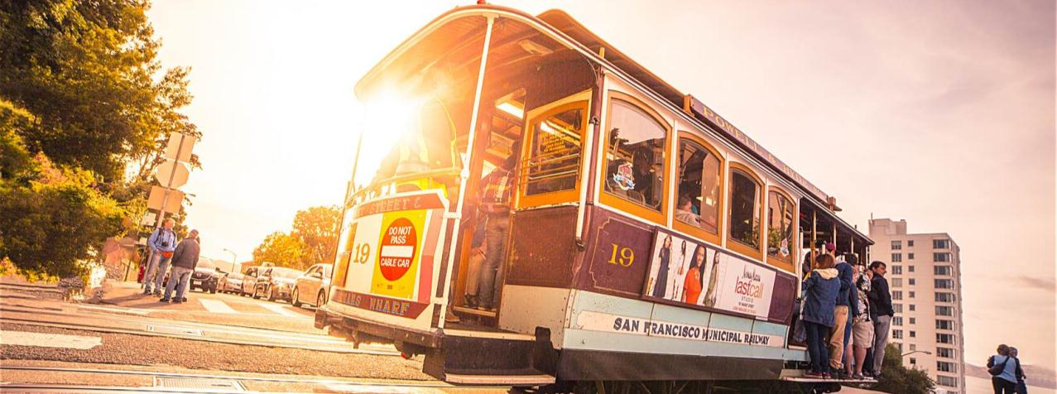
WHY
CHOOSE TO
TRAVEL
Title here
The meaning of travel is not the trophy how many photos are a few attractions to occupy a few, but, you do more crazy things, and experience which the heartbeat of the moment, and whether to see more.

Slide 19

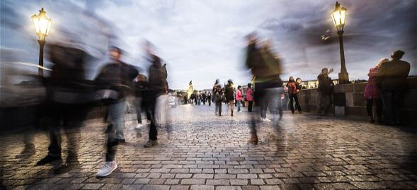

Title here
The meaning of travel is not the trophy how many photos are a few attractions to occupy a few, but, you do more crazy things, and experience which the heartbeat of the moment, and whether to see more.
THIS IS
A BEAUTIFUL
HOLIDAY

Slide 20
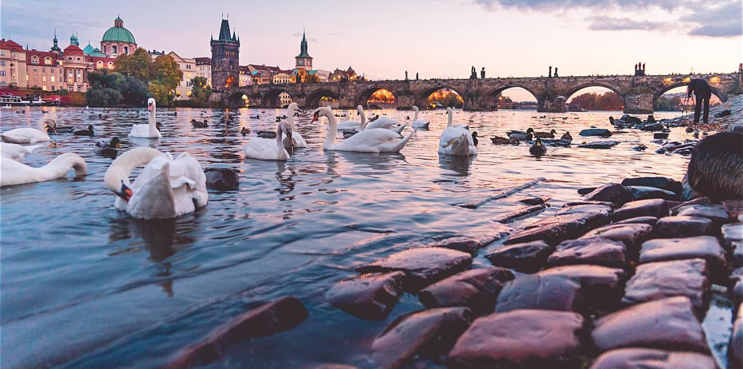
WHY
CHOOSE TO
TRAVEL
Title here
The meaning of travel is not the trophy how many photos are a few attractions to occupy a few, but, you do more crazy things, and experience which the heartbeat of the moment, and whether to see more.

Slide 21

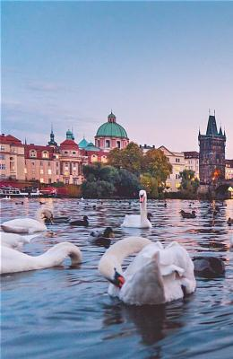

THIS IS
A BEAUTIFUL
HOLIDAY
Title here
The meaning of travel is not the trophy how many photos are a few attractions to occupy a few, but, you do more crazy things, and experience which the heartbeat of the moment, and whether to see more.

Slide 22

WHY
CHOOSE TO
TRAVEL
Title here
The meaning of travel is not the trophy how many photos are a few attractions to occupy a few, but, you do more crazy things, and experience which the heartbeat of the moment, and whether to see more.

Slide 23

THIS IS
A BEAUTIFUL
HOLIDAY
Title here
The meaning of travel is not the trophy how many photos are a few attractions to occupy a few, but, you do more crazy things, and experience which the heartbeat of the moment, and whether to see more.

Slide 24

THIS IS
A BEAUTIFUL
HOLIDAY
Title here
The meaning of travel is not the trophy how many photos are a few attractions to occupy a few, but, you do more crazy things, and experience which the heartbeat of the moment, and whether to see more.

Slide 25
Thank you

