Slide 1
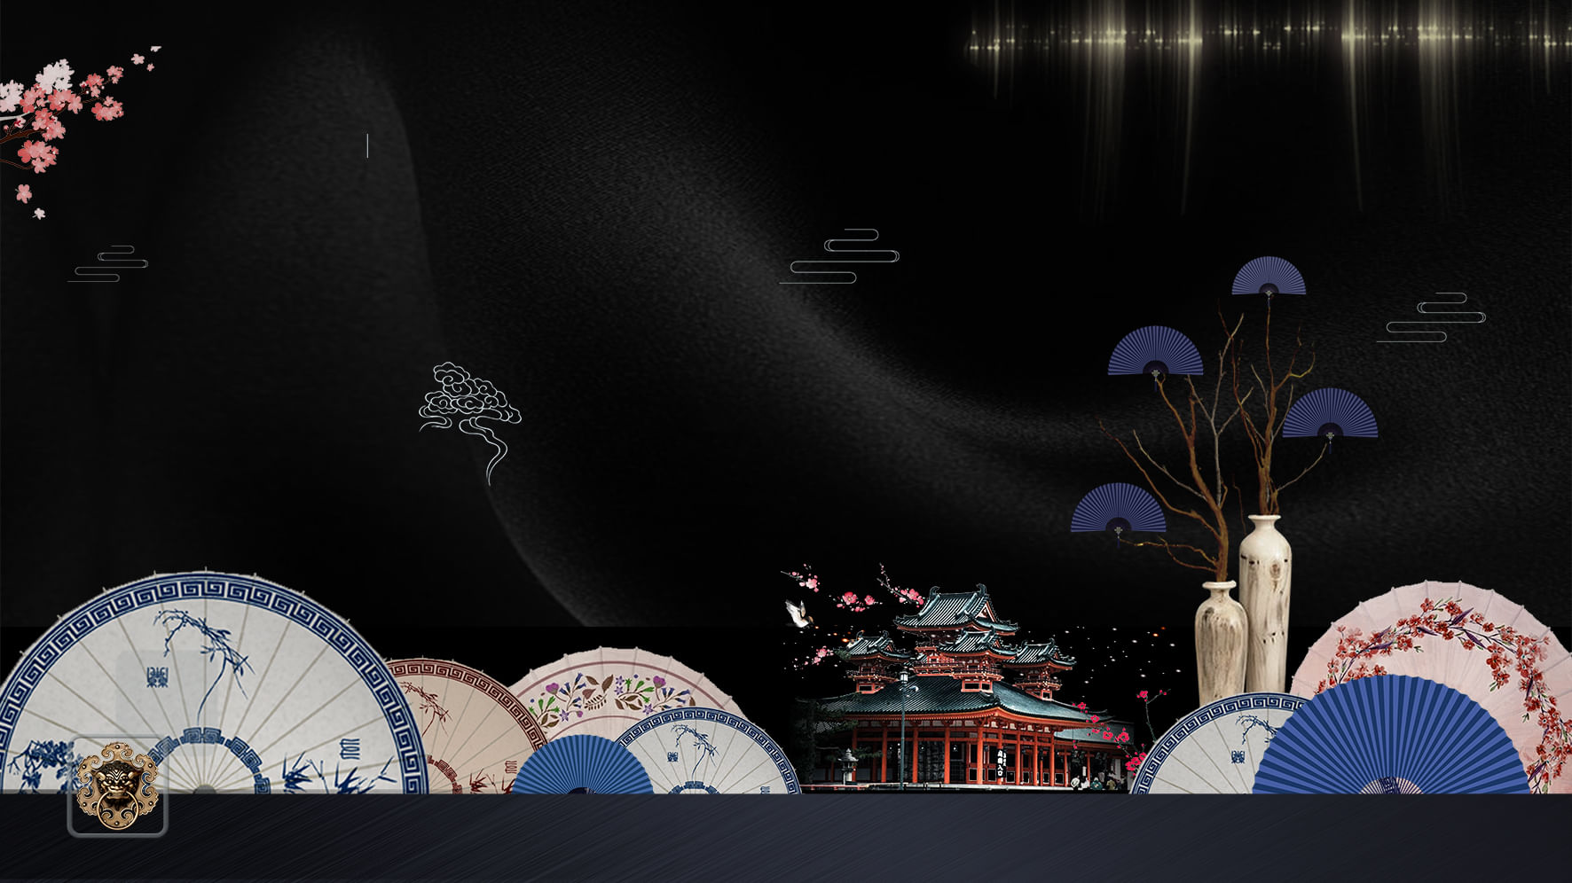
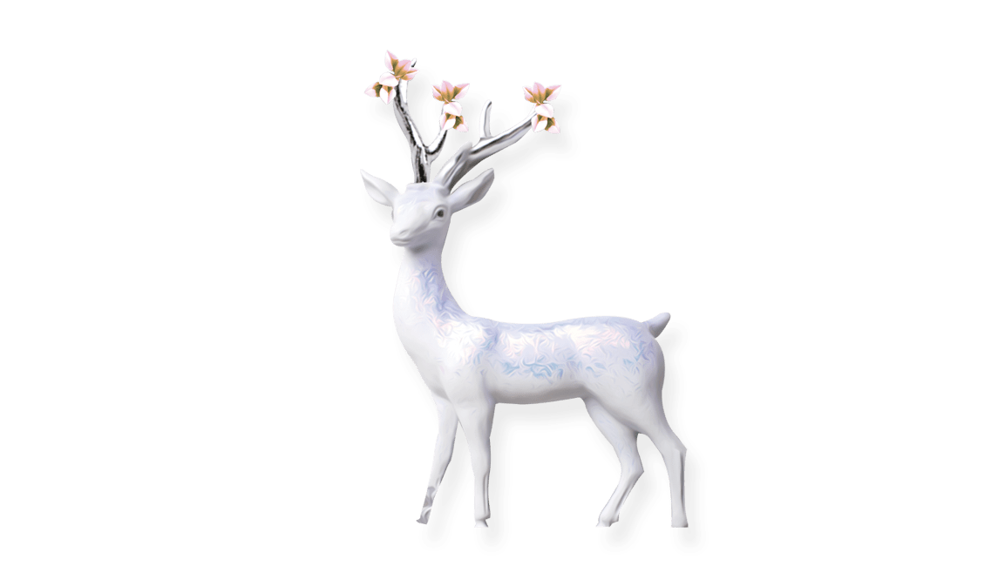
中式古风
溪山掩映斜阳里,楼台影动鸳鸯起.隔岸两三家,出墙红杏花. 绿杨堤下路,早
晚溪边去.三见柳绵飞,离人犹未归.

Slide 2
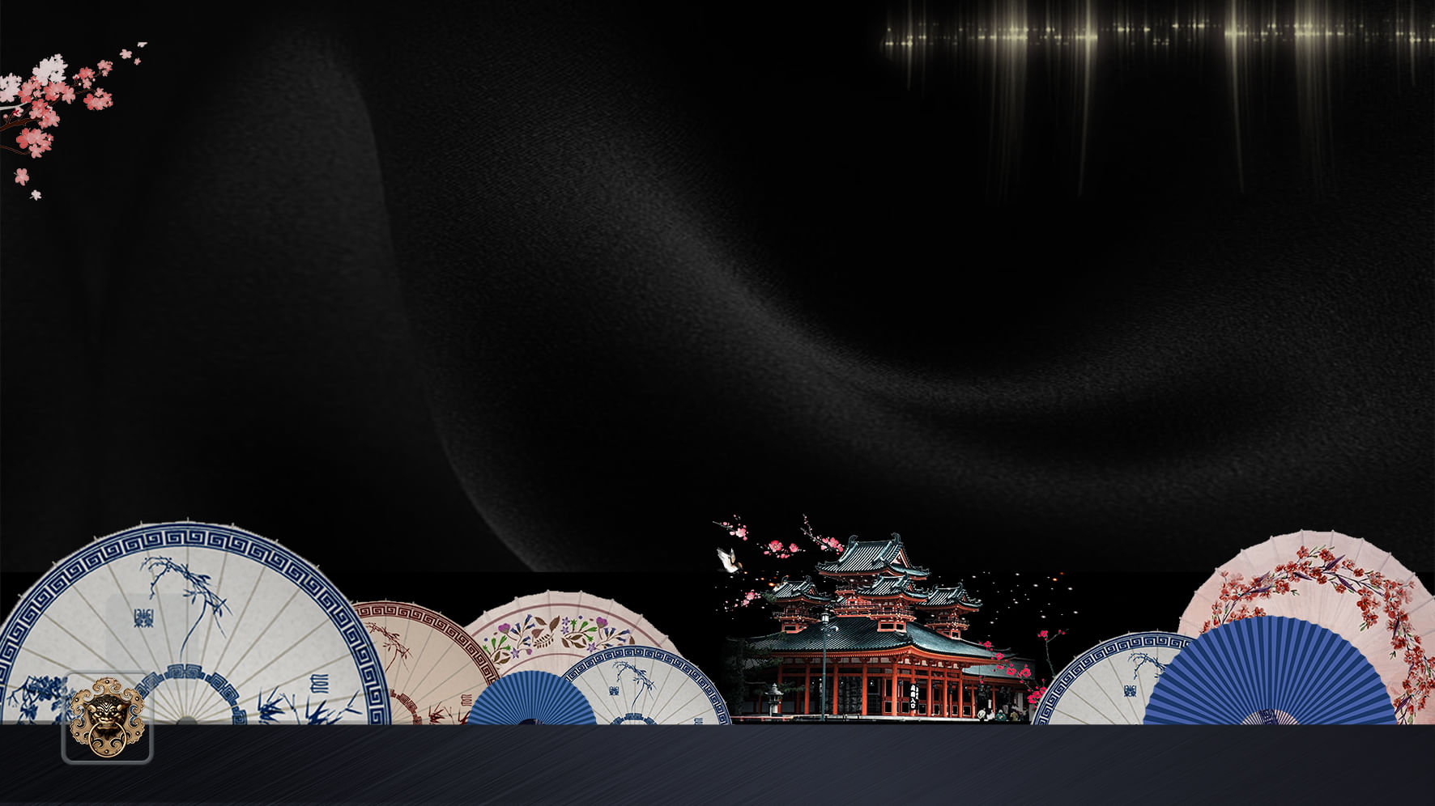
目
录
肆
叁
贰
壹
新中式
中国风
房地产
古风行
CHINA D
CHINA D
CHINA D
CHINA D

Slide 3
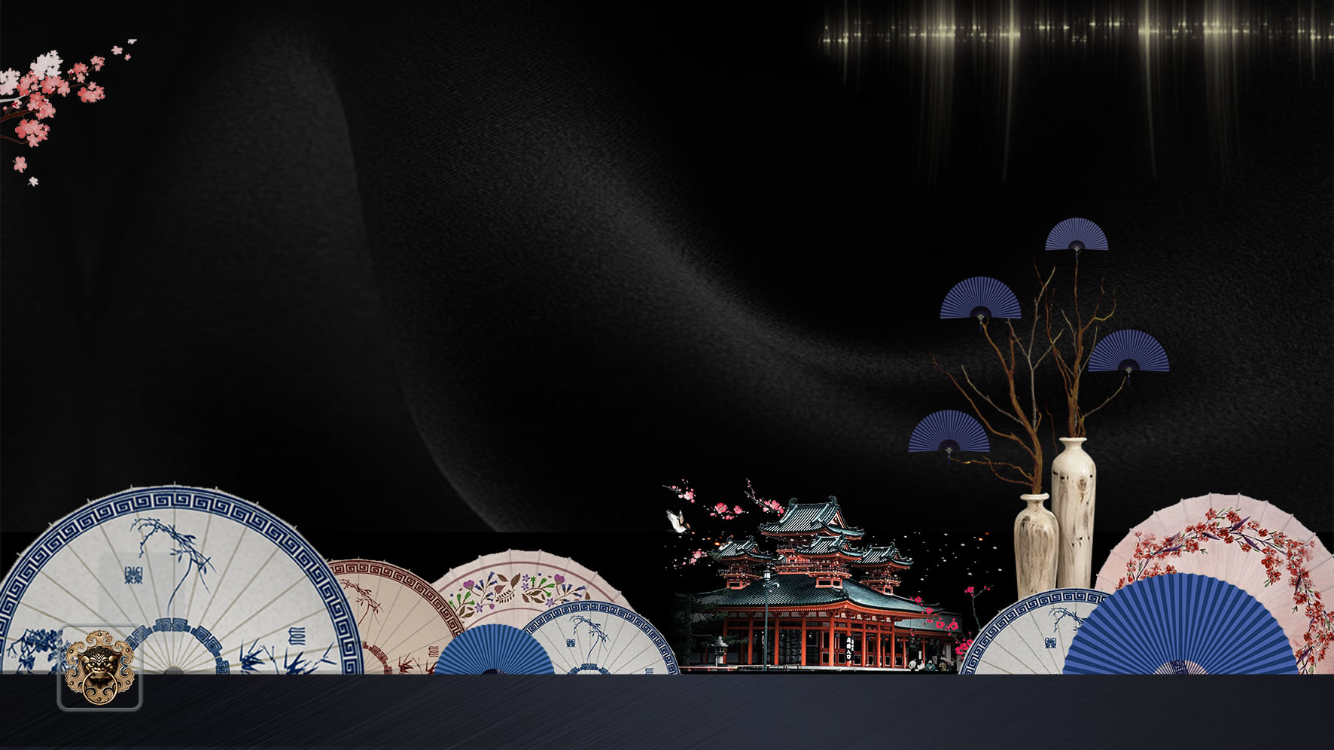

壹
古典 素雅
The activities of a company associ buying and selling a

Slide 4


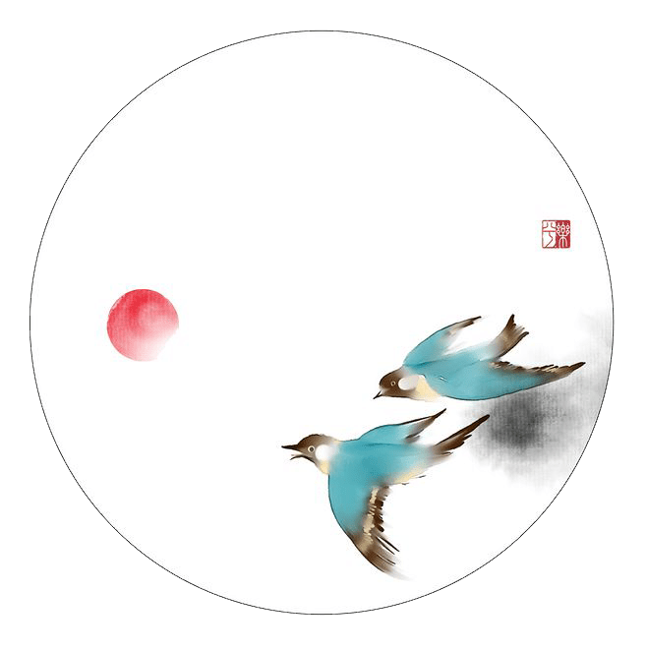
中式
古风
中国风
CHINA Design
2030

Slide 5

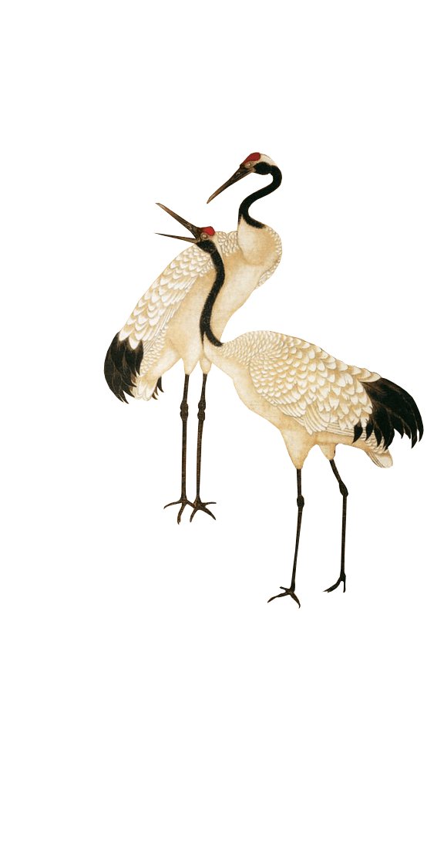
素
雅
古韵
古典 素雅
素
雅
古韵
The activities of a company associ buying and selling a
The activities of a company associated with buying and selling a product or service. It includes advertising, The activities of a company associated with
The activities of a company associated with buying and selling a product or service. It includes advertising, The activities of a company associated with

Slide 6

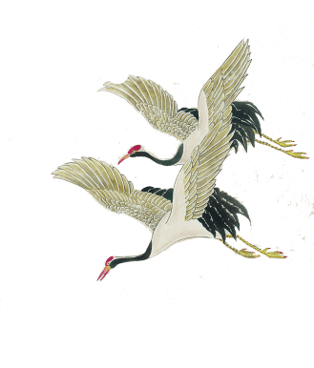
C H I N A
新中式
The activities of a company associated with buying and selling a product or service. It includes advertising, The activities of a company associated with
a product or service. It
delivering
素
雅
古韵
素
雅
古韵
The activities of a company associated with buying and selling a product or service. It includes advertising, The activities of a company associated with
The activities of a company associated with buying and selling a product or service. It includes advertising, The activities of a

Slide 7
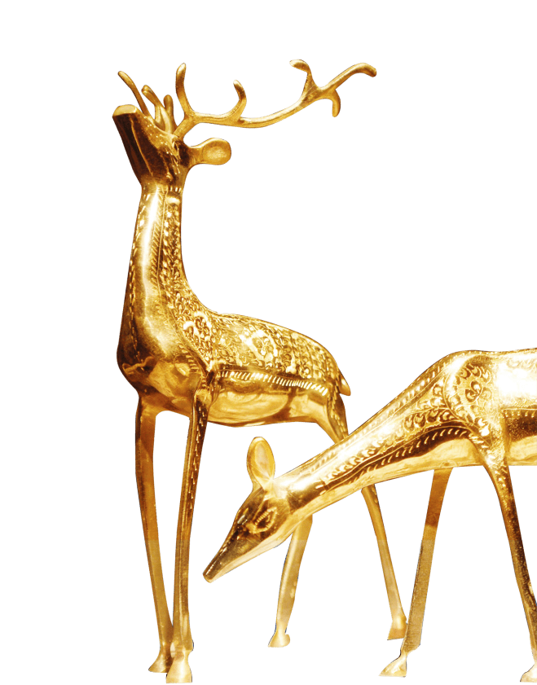
中
国
印
象
，即 格，是建立在中国传统文化的基础上，蕴含大量中国元素并适应全球流行趋势的艺术形式或生活方式。
近年来， 被广泛应用于流行文化领域，如音乐、服饰、电影、广告等。
。 ，即 格，是建立在中国传统文化的基础上，蕴含大量中国元素并适应全球流行趋势的艺术形式或生活方式。
近年来， 被广泛应用于流行文化领域，如音乐、服饰、电影、广告等。
。
CHINA Design

Slide 8
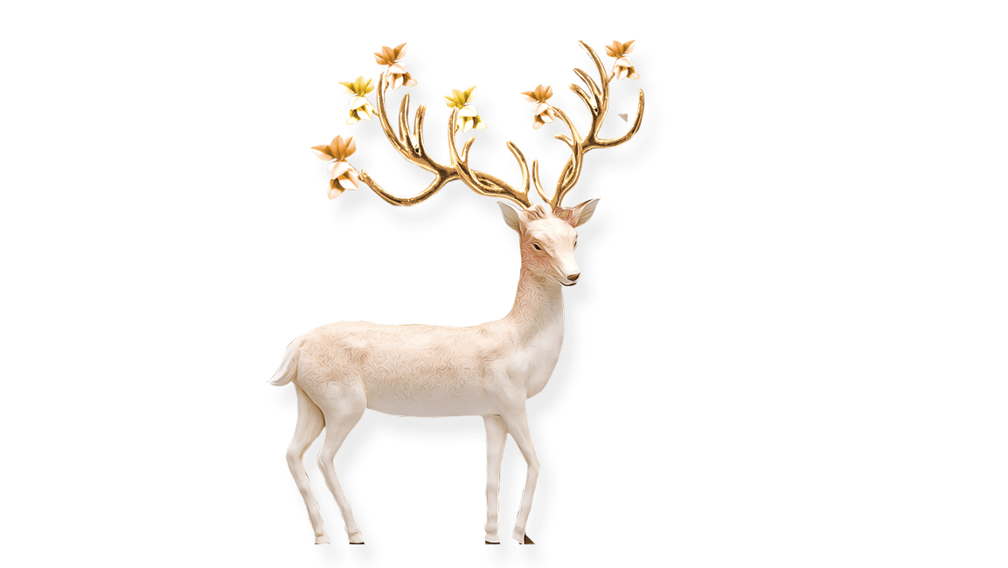
贰
古典 素雅
The activities of a company associ buying and selling a

Slide 9


中承文化
The activities of a company associated with buying and selling a product or service. It includes advertising, The activities of a company associated with
a product or service. It
delivering
CHINA Design

Slide 10


CHINA Design
中国传统
雅
The activities of a company associated with buying and selling a product or service. It includes advertising, The
雅
The activities of a company associated with buying and selling a product or service. It includes advertising, The

Slide 11
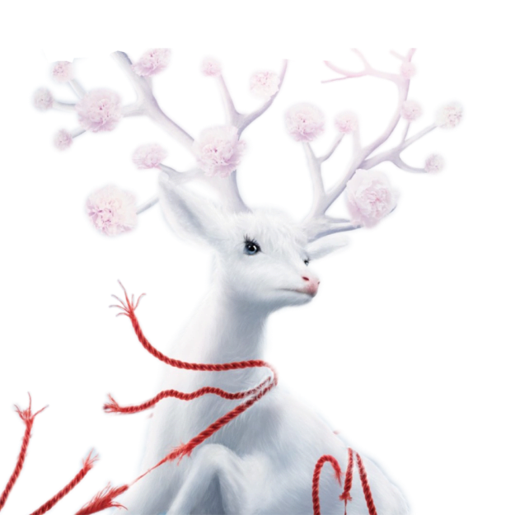
韵春色山
The activities of a company associated with buying and selling a product or service. It includes advertising, The activities of a company associated with
a product odelivering
雅
The activities of a company associated with buying and selling a product or service. It includes advertising, The activities of a company associated with a product or service. It delivering

Slide 12


CHINA Design
雅
中国风
The activities of a company associated with buying and selling a product or service. It includes advertising, The activities of a company associated with
The activities of a company associated with buying and selling a product or service. It includes
CHINA D

Slide 13

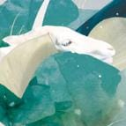
素
雅
The activities of a company as
sociated with a product or service. It
delivering
@
素
雅
The activities of a company as
sociated with a product or service. It
delivering
素
雅
The activities of a company as
sociated with a product or service. It
delivering
A

Slide 14

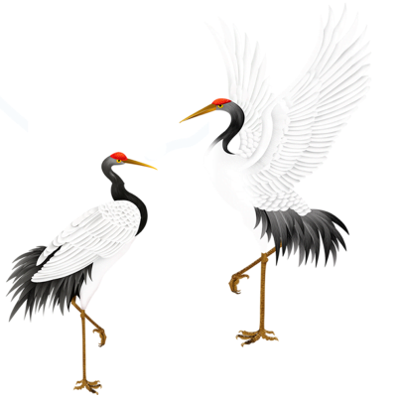

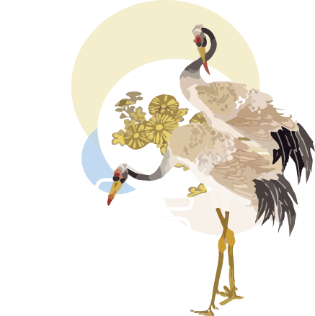

CHINA Design
雅
雅
雅
The activities of a company associated with buying and selling a product or
The activities of a company associated with buying and selling a product or
The activities of a company associated with buying and selling a product or

Slide 15
叁
古典 素雅
The activities of a company associ buying and selling a

Slide 16
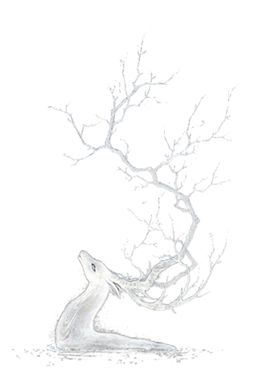
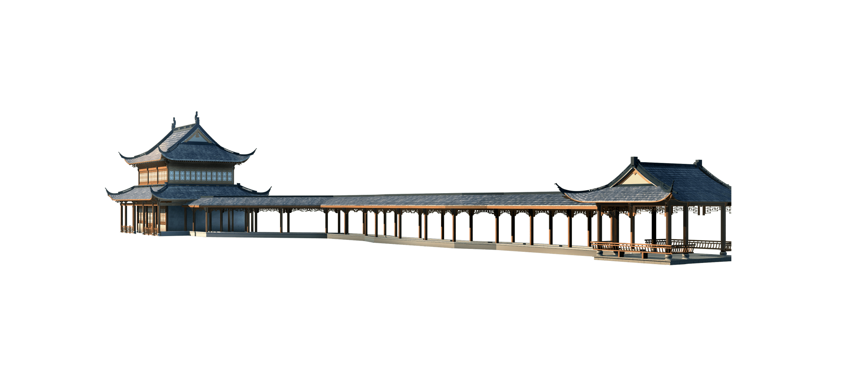
中国风
The activities of a company associated with buying and selling a product or service. It includes advertising, The activities of a company associated with
a product or service. It
delivering
CHINA D

Slide 17




CHINAESE
CHINAESE
雅
雅
The activities of a company associated and selling a product or service. It includes
The activities of a company associated and selling a product or service. It includes

Slide 18

中国风
古风行
古风行
This template is the spring and autumn advertising original, here you can directly modify the content.
This template is the spring and autumn advertising original, here you can directly modify the content.
CHINA D

Slide 19

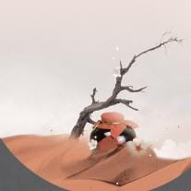
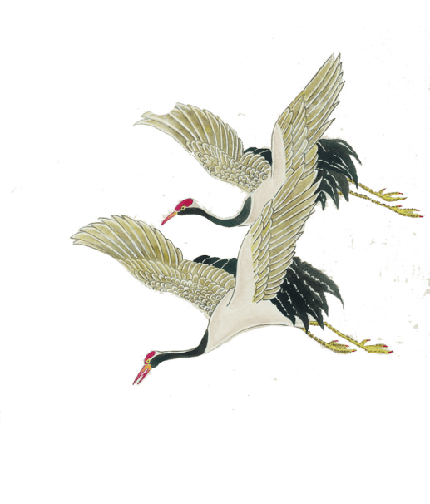

中国风
CHINA Design
2030
CHINAESE
CHINAESE
雅
雅
The activities of a company associated and selling a product or service. It includes
The activities of a company associated and selling a product or service. It includes

Slide 20

The activities of a company associated and selling a product or service. It includesThe activities of a company associated and selling a product or service. It includes
CHINA Design
The activities of a company associated and selling a product or service. It includesThe activities of a company associated and selling a product or service. It includes
CHINA Design
The activities of a company associated and selling a product or service. It includesThe activities of a company associated and selling a product or service. It includes
CHINA Design
简约
CHINA Design

Slide 21

CHINA Design
雅
风
The activities of a associated with product or
The activities of a company associated with buying
The activities of a company associated with buying and selling a product or service. It includes advertising, The activities of a company associated with a product or service. It delivering buying and selling a product or service. It includes

Slide 22


The activities of a company associated with buying and selling a product or service. It includes advertising, The activities of a company associated with The activities of a company associated with buying and selling a product or service. It includes advertising, The activities of a company associated with
填入标题内容
CHINA Design
The activities of a company associated with buying and selling a product or service. It includes advertising, The activities of a company associated with
a product or service. It
delivering

Slide 23
肆
古典 素雅
The activities of a company associ buying and selling a

Slide 24


CHINA Design
雅
The activities of a company associated with buying and selling a product or service. It includes advertising, The activities of a company associated with a product or service. It
CHINAESE
素雅 古韵
The activities of a company associated with buying and selling a product or service. It includes advertisingassociated
cayr
berS
Ading

Slide 25


CHINA Design
雅
The activities of a company associated with buying and selling a product or service. It includes advertising, The activities of a company associated with
a product or service. It
delivering
雅
The activities of a company associated with buying and selling a product or service. It includes advertising, The activities of a company associated with

Slide 26




中国风
The activities of a company associated with buying and selling a product or service. It includes advertising, The activities of a company associated with
delivering
CHINA Design

Slide 27
简约
CHINA Design
The activities of a company associated with buying and selling a product or service. It includes advertising, The activities of a company associated with
The activities of a company associated with buying and selling a product or service. It includes advertising, The activities of a company associated with

Slide 28



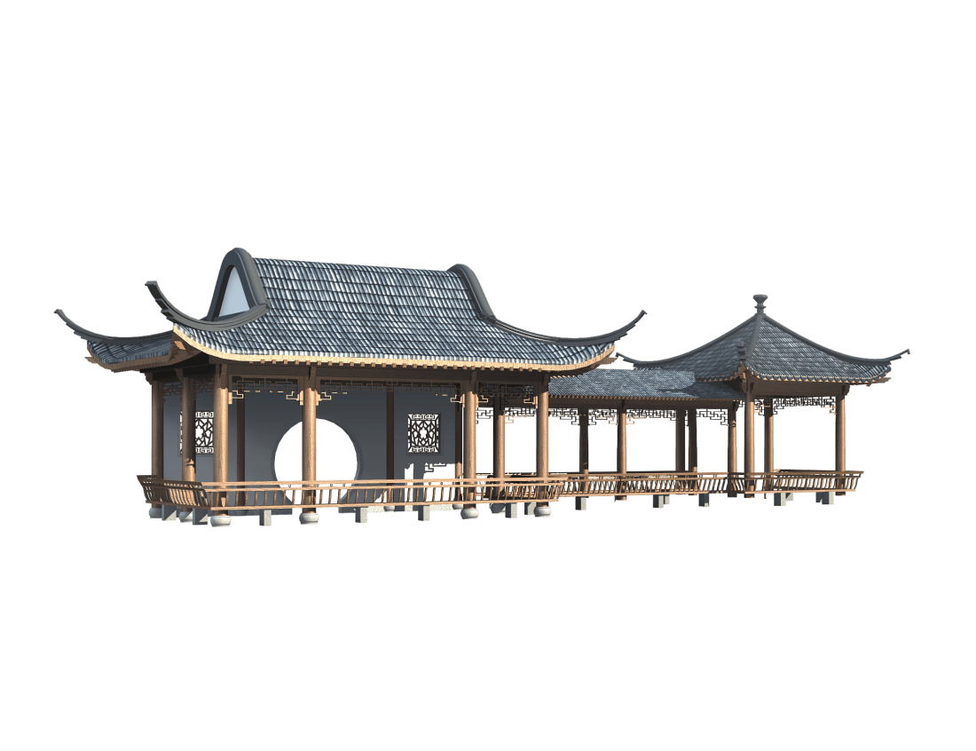
中国风
CHINA Design
CHINAESE
CHINAESE
CHINA
雅
雅
雅
The activities of a company associated and selling a product or service. It includes
The activities of a company associated and selling a product or service. It includes
The activities of a company associated and selling a product or service. It includes

Slide 29
谢谢观看

