Slide 1
土木毕业设计答辩PPT模板
答辩人： 时间：XX年XX月
极简演示

Slide 2
CONTENTS
Life is like a sea, only the strong-willed can reach it
PART 01
选题背景与意义
PART 02
论文框架与内容
PART 01
研究思路与方法
PART 01
研究成果与应用

Slide 3
The analysis of
The background and significance
选题背景与意义
PART 01
01
Life is like a sea, only the strong-willed can reach the other shore. Life is like a sea, only the strong-willed can reach the other shore. Life is like a sea, only the strong-willed can reach the other shore

Slide 4

点击添加标题
The analysis of the
background and significance
Life is like a sea, only the strong-willed can reach the other shore. Life is like a sea, only the strong-willed can reach the other shore
Life is like a sea, only the strong-willed can reach the other shore. Life is like a sea, only the strong-willed can reach the other shore
2018
点击添加标题
Life is like a sea, only the strong-willed can reach the other shore. Life is like a sea, only the strong-willed can reach the other shore

Slide 5


点击添加标题
Life is like a sea, only the strong-willed can reach the other shore. Life is like a sea, only the strong-willed can reach the other shore.
国内
国外
RESEARCH PROCESS
RESEARCH PROCESS
Life is like a sea, only the strong-willed can reach the other shore. Life is like a sea, only the strong-willed can reach the other shore
Life is like a sea, only the strong-willed can reach the other shore. Life is like a sea, only the strong-willed can reach the other shore
Life is like a sea, only the strong-willed can reach the other shore. Life is like a sea, only the strong-willed can reach the other shore. Life is like a sea, only the strong-willed can reach the other shore.
Life is like a sea, only the strong-willed can reach the other shore. Life is like a sea, only the strong-willed can reach the other shore. Life is like a sea, only the strong-willed can reach the other shore.

Slide 6
点击添加标题
Life is like a sea, only the strong-willed can reach the other shore. Life is like a sea, only the strong-willed can reach the other shore.
Significance 03
Significance 03
Life is like a sea, only the strong-willed can reach the other shore. Life is like a sea, only the strong-willed can reach the other shore
Life is like a sea, only the strong-willed can reach the other shore. Life is like a sea, only the strong-willed can reach the other shore
Significance 03
Significance 03
Life is like a sea, only the strong-willed can reach the other shore. Life is like a sea, only the strong-willed can reach the other shore
Life is like a sea, only the strong-willed can reach the other shore. Life is like a sea, only the strong-willed can reach the other shore

Slide 7
The analysis of
The thesis framework and content
论文框架与内容
PART 02
01
Life is like a sea, only the strong-willed can reach the other shore. Life is like a sea, only the strong-willed can reach the other shore. Life is like a sea, only the strong-willed can reach the other shore

Slide 8
点击添加标题
Life is like a sea, only the strong-willed can reach the other shore. Life is like a sea, only the strong-willed can reach the other shore.
FRAMEWORK
FRAMEWORK
FRAMEWORK
FRAMEWORK
Life is like a sea, only the strong-willed can reach the other shore. Life is like a sea, only the strong-willed can reach the other shore. Life is like a sea, only the strong-willed can reach the other shore. Life is like a sea, only the strong-willed can reach the other shore. Life is like a sea, only the strong-willed can reach the other shore. Life is like a sea, only the strong-willed can reach the other shore.
Life is like a sea, only the strong-willed can reach the other shore. Life is like a sea, only the strong-willed can reach the other shore. Life is like a sea, only the strong-willed can reach the other shore. Life is like a sea, only the strong-willed can reach the other shore. Life is like a sea, only the strong-willed can reach the other shore. Life is like a sea, only the strong-willed can reach the other shore.

Slide 9
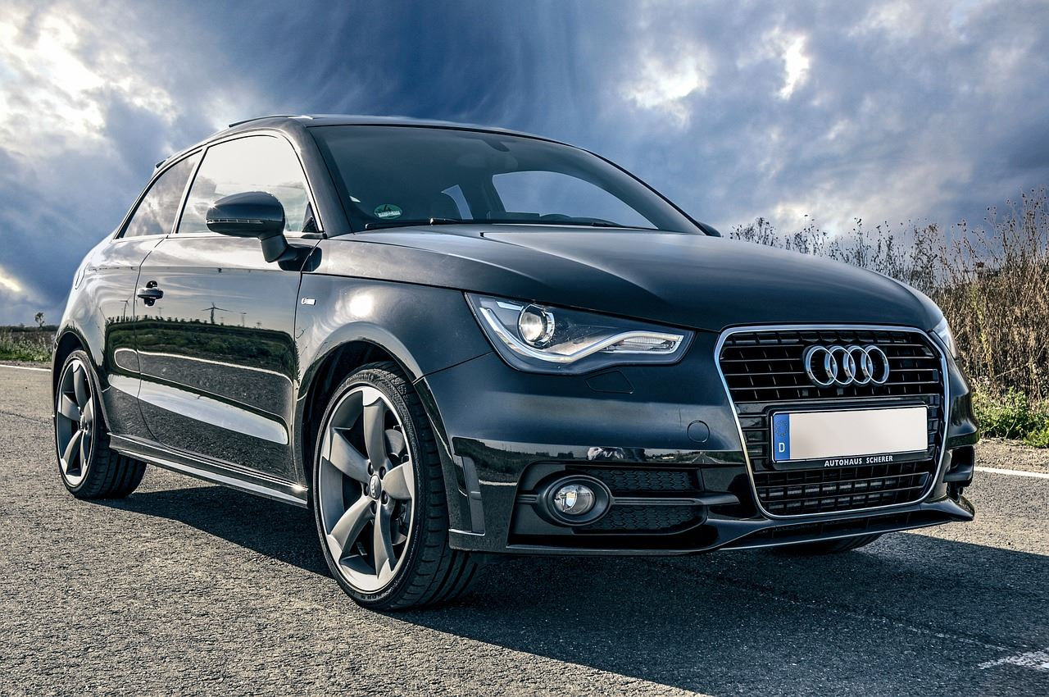
CONTENT 01
Life is like a sea, only the strong-willed can reach the other shore. Life is like a sea, only the strong-willed can reach the other shore. Life is like a sea, only the strong-willed can reach the other shore
LEARN MORE

Slide 10
点击添加标题
Life is like a sea, only the strong-willed can reach the other shore. Life is like a sea, only the strong-willed can reach the other shore.
1
CONTENT 01
2
CONTENT 02
3
CONTENT 03
Life is like a sea, only the strong-willed can reach the other shore. Life is like a sea, only the strong-willed can reach the other shore
Life is like a sea, only the strong-willed can reach the other shore. Life is like a sea, only the strong-willed can reach the other shore
Life is like a sea, only the strong-willed can reach the other shore. Life is like a sea, only the strong-willed can reach the other shore
4
CONTENT 04
5
CONTENT 05
6
CONTENT 06
Life is like a sea, only the strong-willed can reach the other shore. Life is like a sea, only the strong-willed can reach the other shore
Life is like a sea, only the strong-willed can reach the other shore. Life is like a sea, only the strong-willed can reach the other shore
Life is like a sea, only the strong-willed can reach the other shore. Life is like a sea, only the strong-willed can reach the other shore

Slide 11
The analysis of
The research ideas and methods
研究思路与方法
PART 03
01
Life is like a sea, only the strong-willed can reach the other shore. Life is like a sea, only the strong-willed can reach the other shore. Life is like a sea, only the strong-willed can reach the other shore

Slide 12

点击添加标题
Life is like a sea, only the strong-willed can reach the other shore. Life is like a sea, only the strong-willed can reach the other shore.
Life is like a sea, only the strong-willed can reach the other shore. Life is like a sea, only the strong-willed can reach the other shore. Life is like a sea, only the strong-willed can reach the other shore. Life is like a sea, only the strong-willed can reach the other shore. Life is like a sea, only the strong-willed can reach the other shore. Life is like a sea, only the strong-willed can reach the other shore
1
2
RESEARCH IDEAS
RESEARCH IDEAS
Life is like a sea, only the strong-willed can reach the other shore. Life is like a sea, only the strong-willed can reach the other shore
Life is like a sea, only the strong-willed can reach the other shore. Life is like a sea, only the strong-willed can reach the other shore

Slide 13
Only the strong-willed can reach the other shore
Only the strong-willed can reach the other shore
Only the strong-willed can reach the other shore
METHOD 01
METHOD 01
METHOD 01
METHOD 01
METHOD 01
METHOD 01
Only the strong-willed can reach the other shore
Only the strong-willed can reach the other shore
Only the strong-willed can reach the other shore

Slide 14
点击添加标题
Life is like a sea, only the strong-willed can reach the other shore. Life is like a sea, only the strong-willed can reach the other shore.
1
2
3
METHOD 01
METHOD 01
METHOD 01
Life is like a sea, only the strong-willed can reach the other shore. Life is like a sea, only the strong-willed can reach
Life is like a sea, only the strong-willed can reach the other shore. Life is like a sea, only the strong-willed can reach
Life is like a sea, only the strong-willed can reach the other shore. Life is like a sea, only the strong-willed can reach
LEARN MORE
LEARN MORE
LEARN MORE
LEARN MORE
LEARN MORE
LEARN MORE

Slide 15
The analysis of
The research results and application
研究成果与应用
PART 04
01
Life is like a sea, only the strong-willed can reach the other shore. Life is like a sea, only the strong-willed can reach the other shore. Life is like a sea, only the strong-willed can reach the other shore

Slide 16
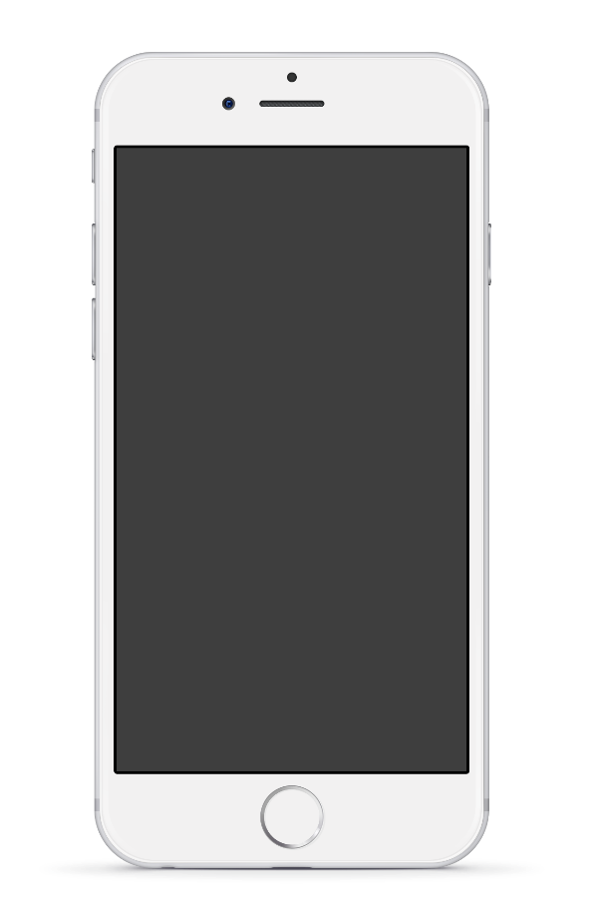
APPLICATION 01
RESEARCH IDEAS
APPLICATION 04
Life is like a sea, only the strong-willed can reach the other shore. Life is like a sea, only the strong-willed can reach the other shore. Life is like a sea, only the strong-willed can reach the other shore
Life is like a sea, only the strong-willed can reach the other shore. Life is like a sea, only the strong-willed can reach the other shore. Life is like a sea, only the strong-willed can reach the other shore
Life is like a sea, only the strong-willed can reach the other shore. Life is like a sea, only the strong-willed can reach the other shore. Life is like a sea, only the strong-willed can reach the other shore
APPLICATION 02
RESEARCH IDEAS
APPLICATION 05
Life is like a sea, only the strong-willed can reach the other shore. Life is like a sea, only the strong-willed can reach the other shore. Life is like a sea, only the strong-willed can reach the other shore
Life is like a sea, only the strong-willed can reach the other shore. Life is like a sea, only the strong-willed can reach the other shore. Life is like a sea, only the strong-willed can reach the other shore
Life is like a sea, only the strong-willed can reach the other shore. Life is like a sea, only the strong-willed can reach the other shore. Life is like a sea, only the strong-willed can reach the other shore
APPLICATION 03
RESEARCH IDEAS
APPLICATION 06
Life is like a sea, only the strong-willed can reach the other shore. Life is like a sea, only the strong-willed can reach the other shore. Life is like a sea, only the strong-willed can reach the other shore
Life is like a sea, only the strong-willed can reach the other shore. Life is like a sea, only the strong-willed can reach the other shore. Life is like a sea, only the strong-willed can reach the other shore
Life is like a sea, only the strong-willed can reach the other shore. Life is like a sea, only the strong-willed can reach the other shore. Life is like a sea, only the strong-willed can reach the other shore

Slide 17
点击添加标题
Life is like a sea, only the strong-willed can reach the other shore. Life is like a sea, only the strong-willed can reach the other shore.
APPLY 01
APPLY 02
APPLY 03
10
300
50
Life is like a sea, only the strong-willed can reach the other shore
Life is like a sea, only the strong-willed can reach the other shore
Life is like a sea, only the strong-willed can reach the other shore
01
02
03
Life is like a sea, only the strong-willed can reach the other shore Life is like a sea, only the strong-willed can reach the other shore. Life is like a sea, only the strong-willed can reach the other shore Life is like a sea, only the strong-willed can reach the other shore.Life is like a sea, only the strong-willed can reach the other shore Life is like a sea, only the strong-willed can reach the other shore. Life is like a sea, only the strong-willed can reach the other shore Life is like a sea, only the strong-willed can reach the other shore.

Slide 18

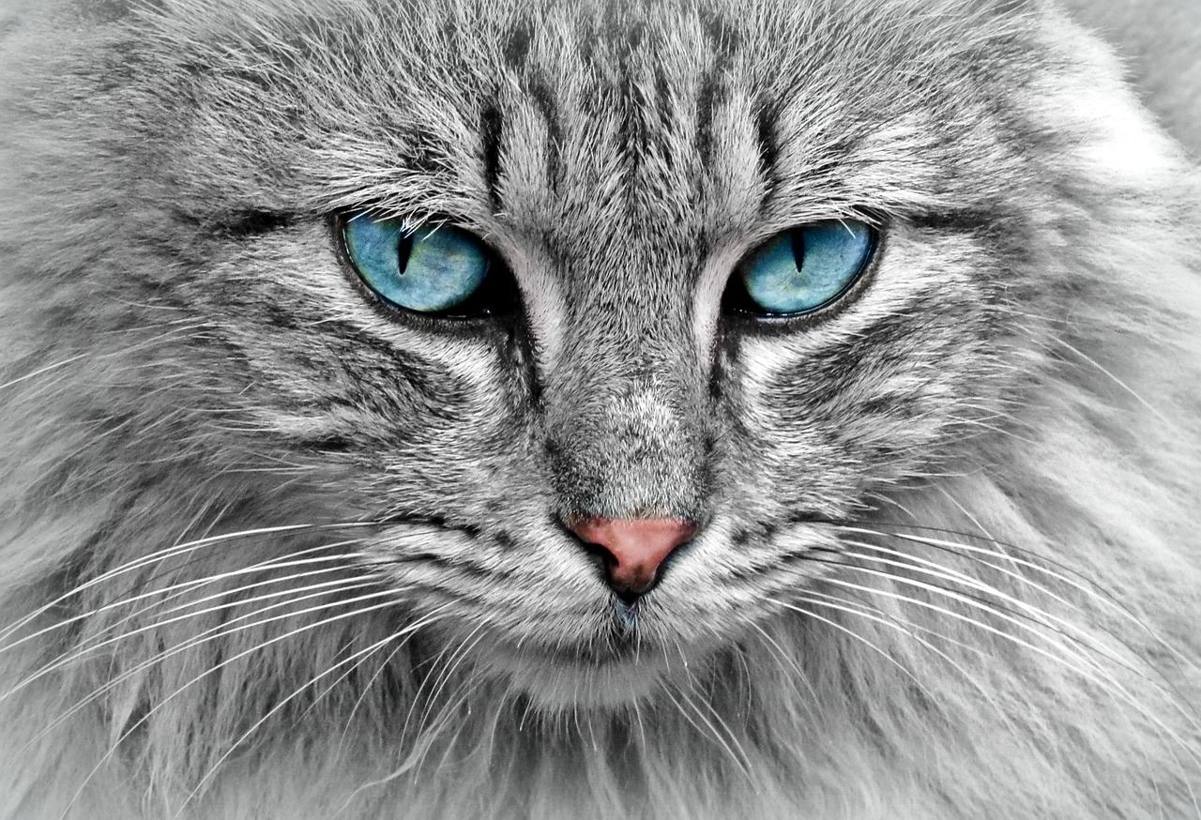


点击添加标题
Life is like a sea, only the strong-willed can reach the other shore. Life is like a sea, only the strong-willed can reach the other shore.
APPLICATION 01
APPLICATION 02
APPLICATION 03
APPLICATION 04
Only the strong-willed can
Only the strong-willed can
Only the strong-willed can
Only the strong-willed can
APPLICATION

Slide 19
感谢各位专家的批评与指正
Thank you for the expert's comment
子沐创意

