Slide 1
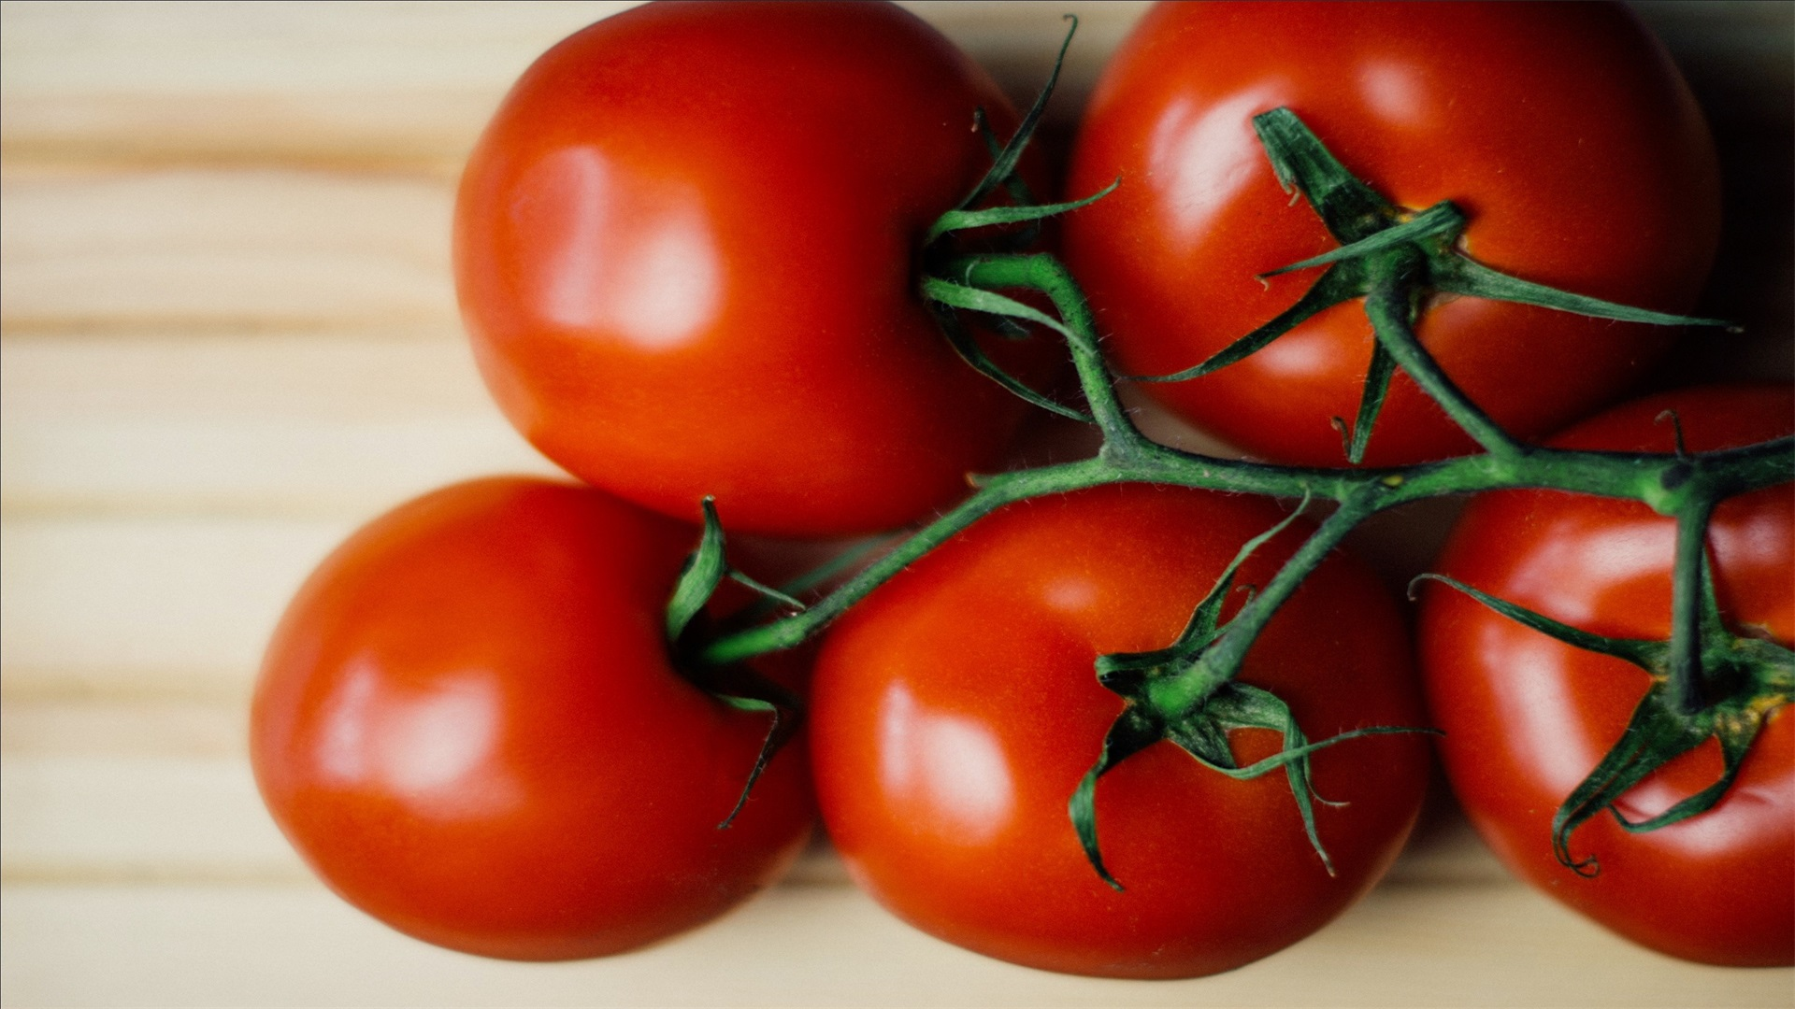
Y
DELICIOUS FOOD
The first wealth is health. He who has good health is young, and he is rich who owes nothing.
Designer
泡泡糖PPT

Slide 2
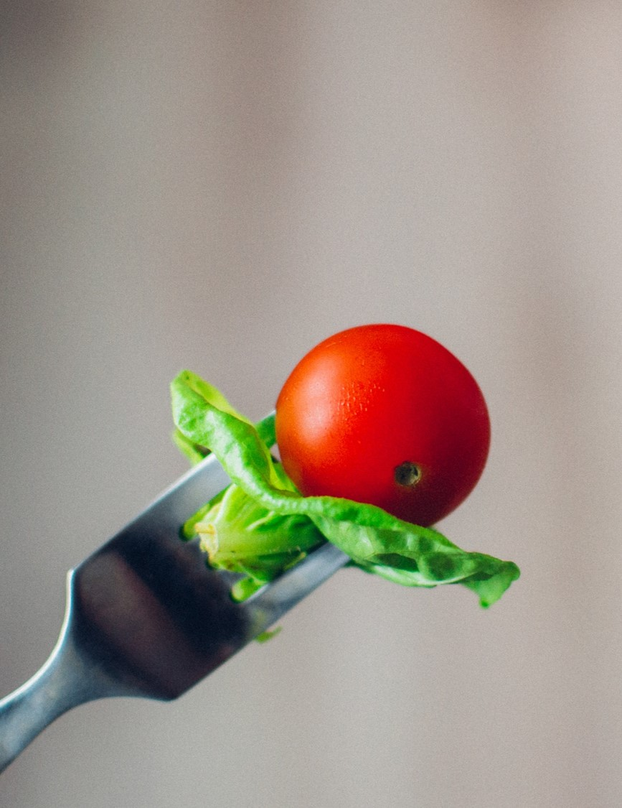
CONTENT
ADD YOUR TITLE
Diet cures more than doctors. Diet cures more than doctors. Diet cures more than doctors. Diet cures more than doctors.
ADD YOUR TITLE
Diet cures more than doctors. Diet cures more than doctors. Diet cures more than doctors. Diet cures more than doctors.
ADD YOUR TITLE
Diet cures more than doctors. Diet cures more than doctors. Diet cures more than doctors. Diet cures more than doctors.
Y

Slide 3

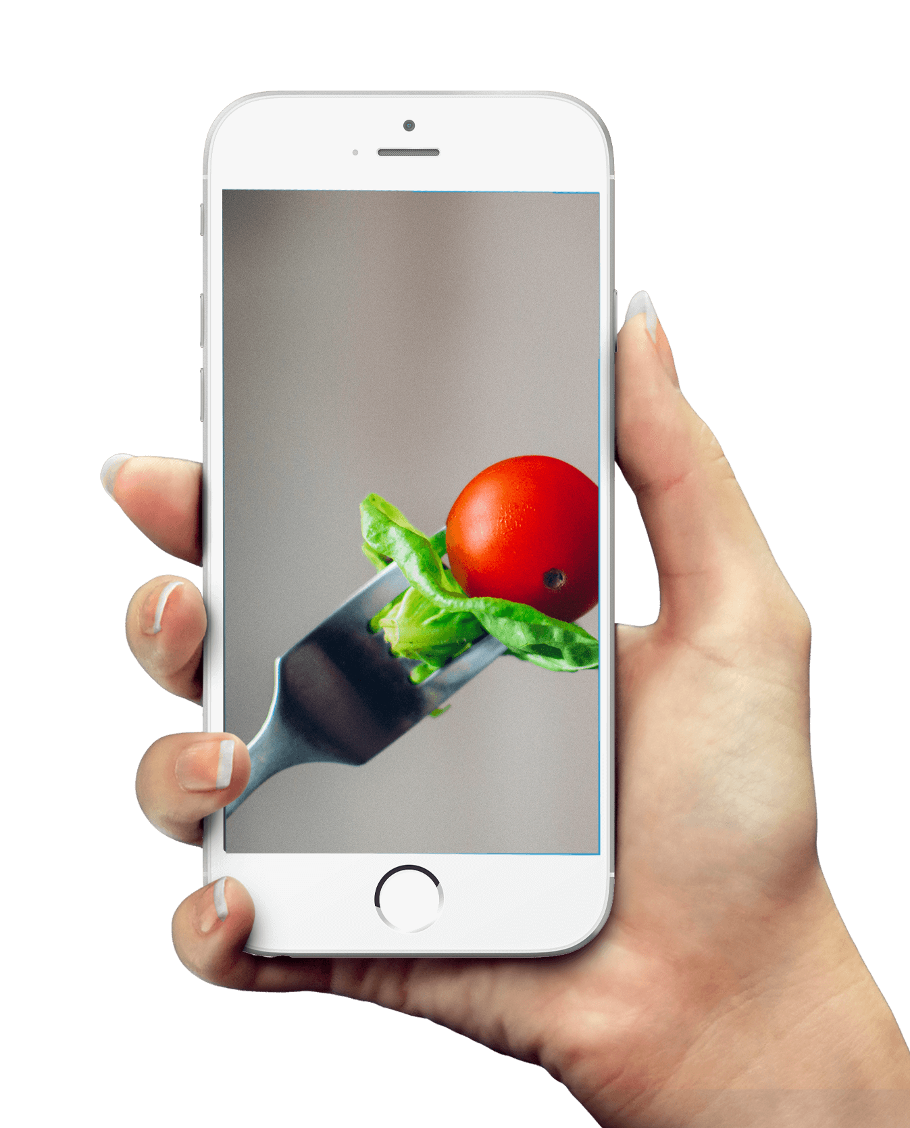
PART ONE
Blessed is the person who is too busy to worry in the daytime, and too sleepy to worry at night. Blessed is the person who is too busy to worry in the daytime, and too sleepy to worry at night.
Delicious

Slide 4
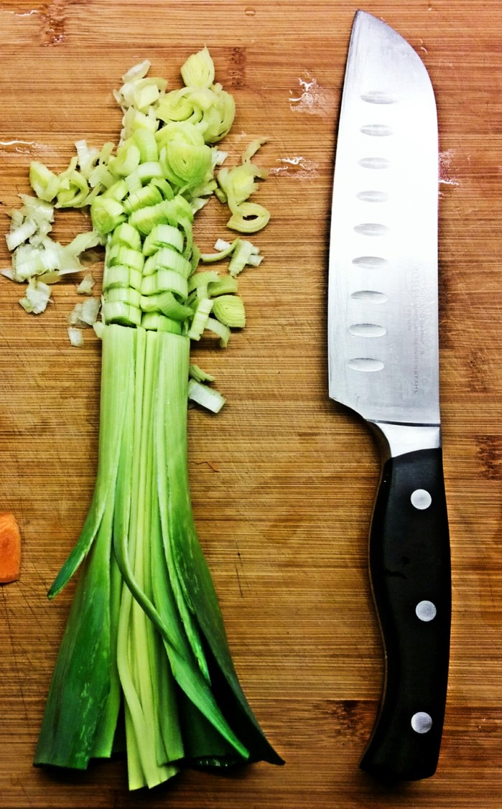
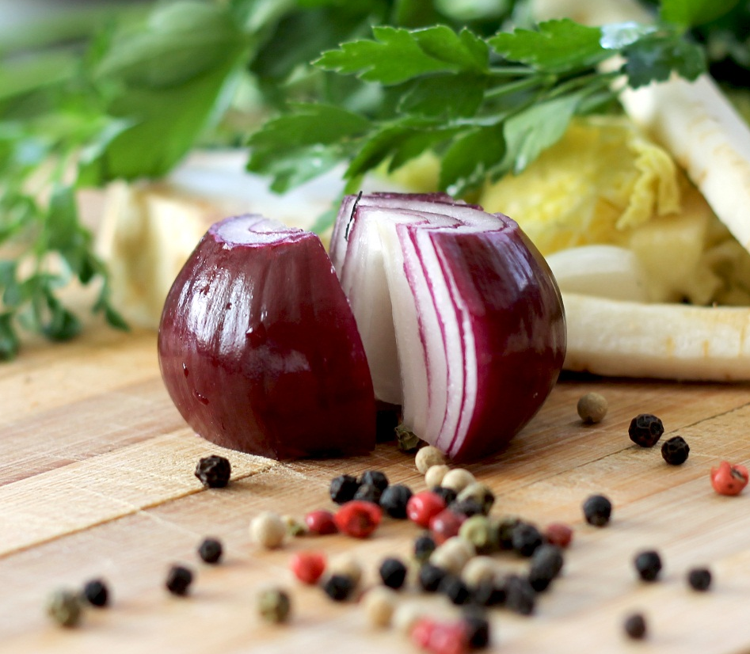
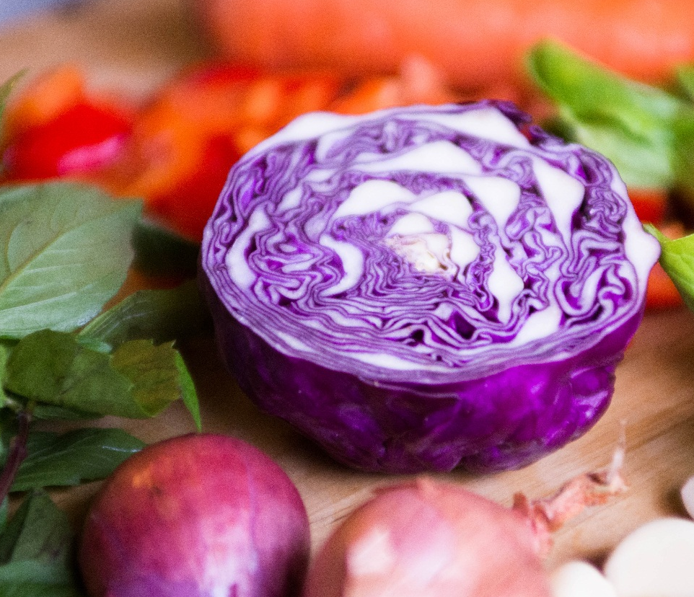
ADD YOUR TITLE
The first wealth is health. He who has good health is young, and he is rich who owes nothing. The first wealth is health. He who has good health is young, and he is rich who owes nothing.
ADD YOUR TITLE
The first wealth is health. He who has good health is young, and he is rich who owes nothing. The first wealth is health. He who has good health is young, and he is rich who owes nothing.
Y

Slide 5
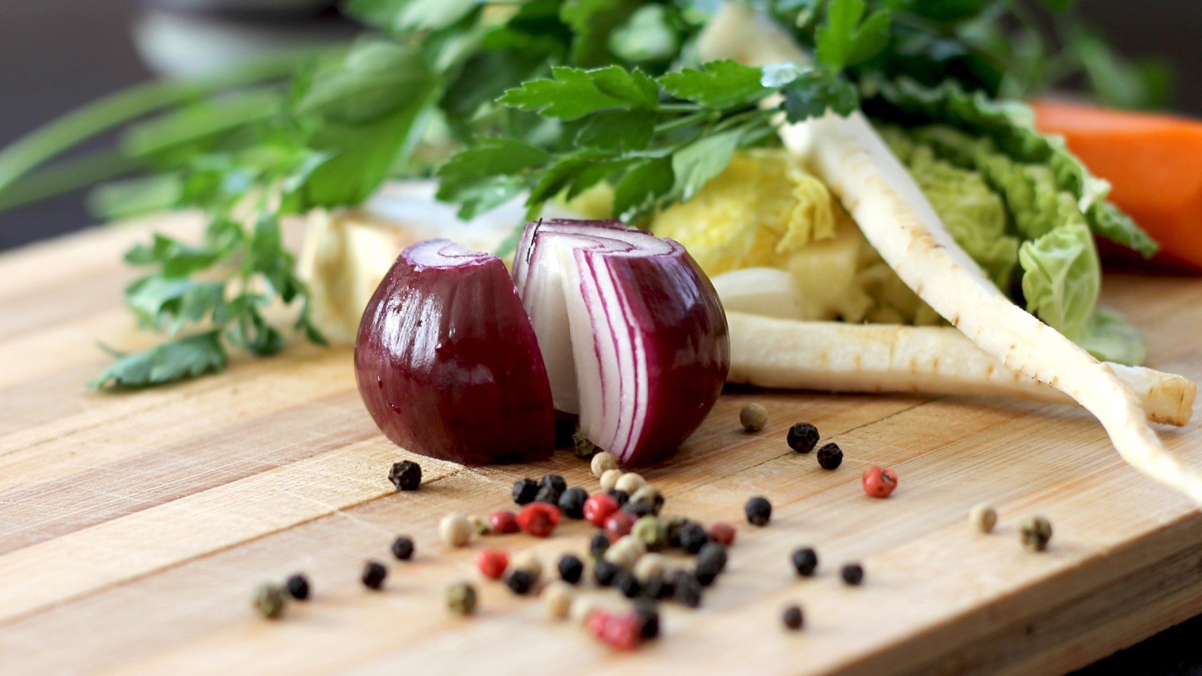
A
Early to bed and early to rise , makes a man healthy , wealthy and wise . Early to bed and early to rise , makes a man healthy , wealthy and wise . Early to bed and early to rise , makes a man healthy , wealthy and wise .
B
Early to bed and early to rise , makes a man healthy , wealthy and wise . Early to bed and early to rise , makes a man healthy , wealthy and wise . Early to bed and early to rise , makes a man healthy , wealthy and wise .
C
Early to bed and early to rise , makes a man healthy , wealthy and wise . Early to bed and early to rise , makes a man healthy , wealthy and wise . Early to bed and early to rise , makes a man healthy , wealthy and wise .
D
Early to bed and early to rise , makes a man healthy , wealthy and wise . Early to bed and early to rise , makes a man healthy , wealthy and wise . Early to bed and early to rise , makes a man healthy , wealthy and wise .
Y

Slide 6
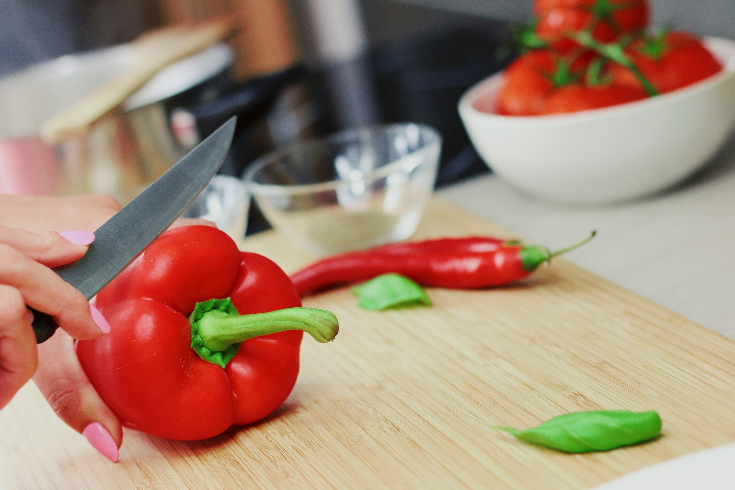

ADD YOUR TITLE
YOUR CONCLUSION
Blessed is the person who is too busy to worry in the daytime, and too sleepy to worry at night.
Early to bed and early to rise , makes a man healthy , wealthy and wise.

Slide 7
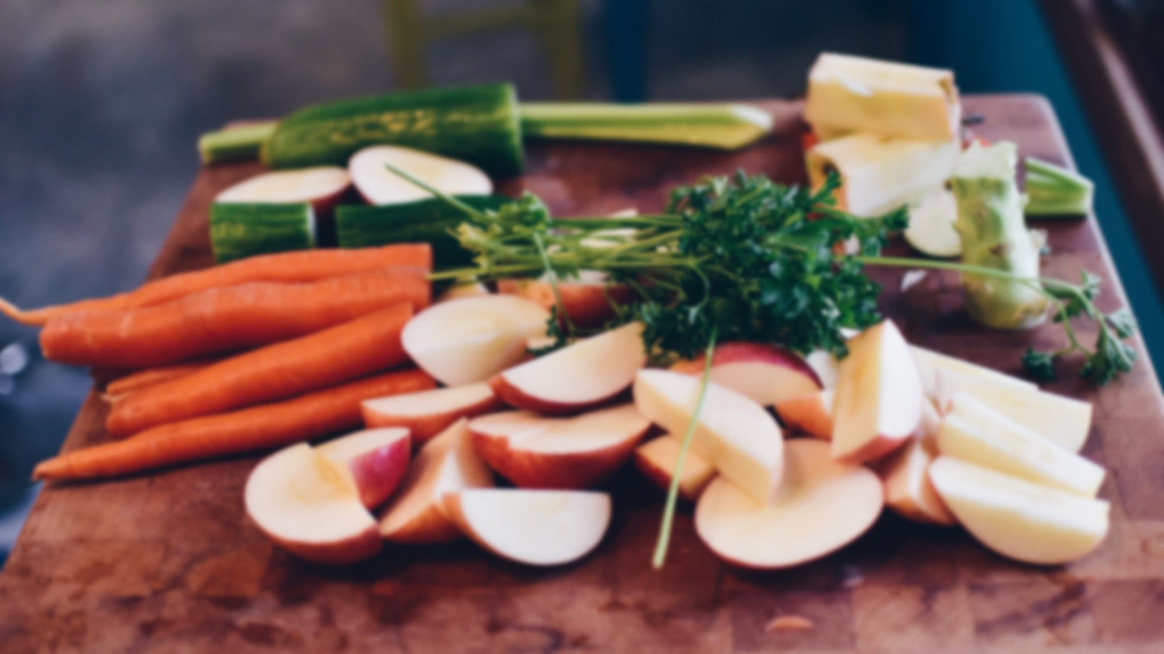

ADD YOUR KEYWORDS
KEYWORDS
KEYWORDS
KEYWORDS
Diet cures more than doctors. Diet cures more than doctors. Diet cures more than doctors.
Diet cures more than doctors. Diet cures more than doctors. Diet cures more than doctors.
Diet cures more than doctors. Diet cures more than doctors. Diet cures more than doctors.

Slide 8
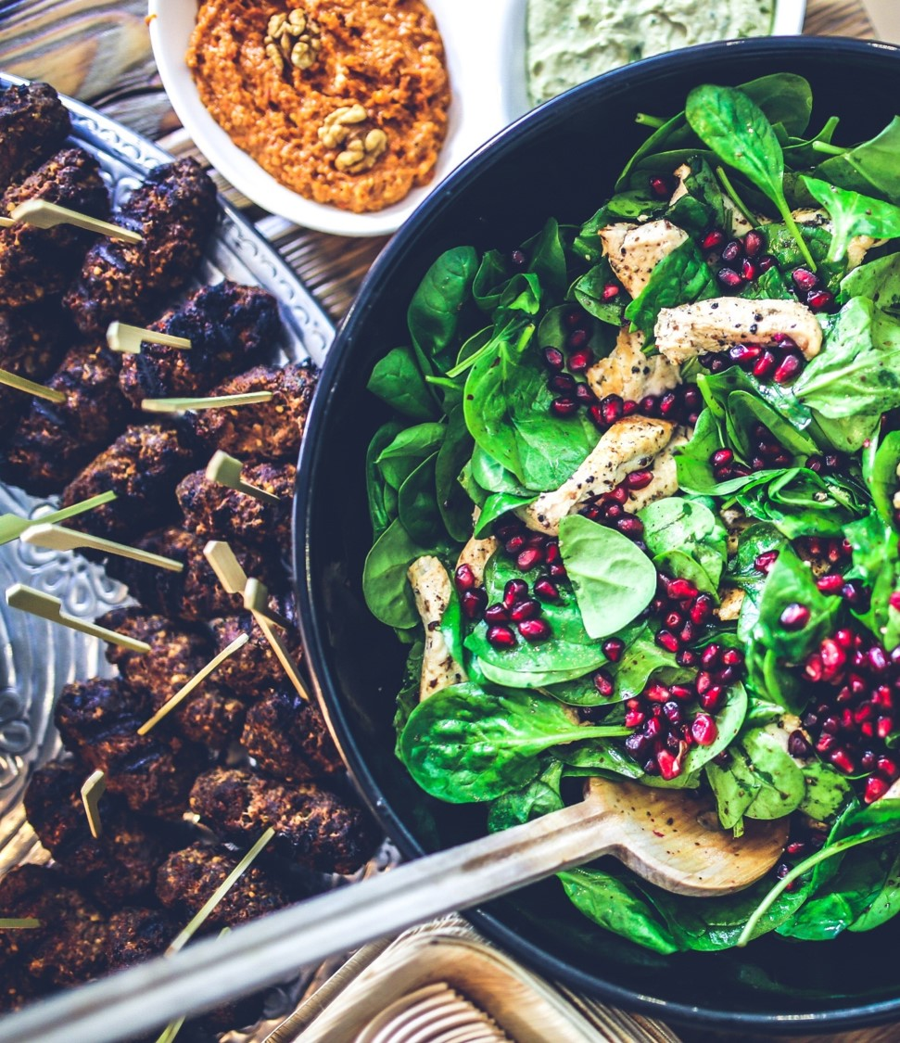
ADD YOUR CONCLUSION
Keywords
Keywords
Keywords
Blessed is the person who is too busy to worry in the daytime, and too sleepy to worry at night. Blessed is the person who is too busy to worry in the daytime, and too sleepy to worry at night.

Slide 9
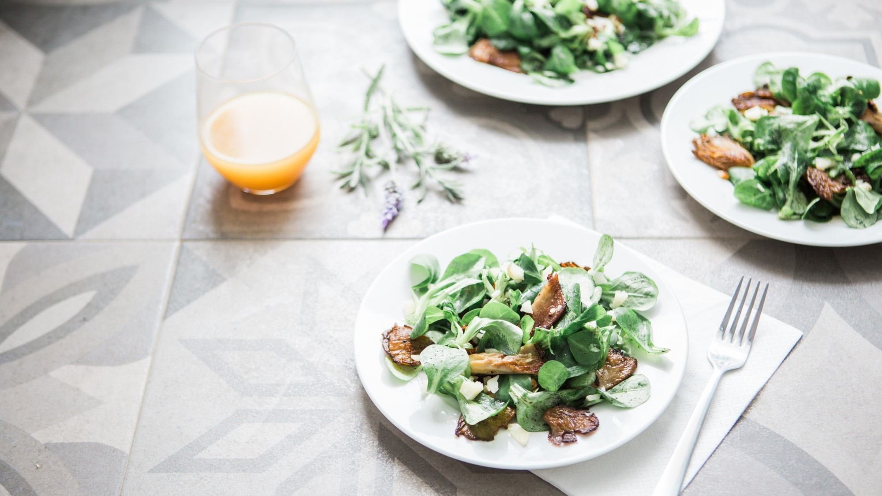
Thank you
Designer
泡泡糖PPT

