Slide 1

建筑业统计工作ppt模板
YOUR LIFE ONLY LASTS FOR A FEW DECADES, SO BE SURE THAT YOU DON‘T LEAVE ANY REGRETS. LAUGH OR CRY OR CRY AS YOU LIKE,AND IT‘S MEANINGLESS TO OPPRESS YOURSELF.
……

Slide 2
目录
CONTENT
Write the first title
01
02
Write the second title
Write the third title
03
04
Write the fourth title

Slide 3
ONE
此处填写第一章标题

Slide 4

ABOUT US
请在此处添加标题
YOUR LIFE ONLY LASTS FOR A FEW DECADES, SO BE SURE THAT YOU DON‘T LEAVE ANY REGRETS.
请在此处添加标题
YOUR LIFE ONLY LASTS FOR A FEW DECADES, SO BE SURE THAT YOU DON‘T LEAVE ANY REGRETS.
请在此处添加标题
YOUR LIFE ONLY LASTS FOR A FEW DECADES, SO BE SURE THAT YOU DON‘T LEAVE ANY REGRETS.

Slide 5
此处填写标题
标题二
标题一
YOUR LIFE ONLY LASTS FOR A FEW DECADES, SO BE SURE THAT YOU DON‘T LEAVE ANY REGRETS.
YOUR LIFE ONLY LASTS FOR A FEW DECADES, SO BE SURE THAT YOU DON‘T LEAVE ANY REGRETS.

Slide 6
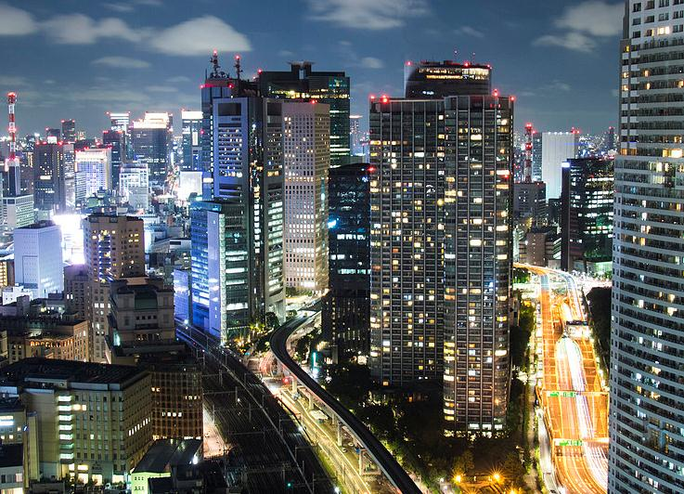
关于我们
PASSION / COURAGE
One needs 3 things to be truly happy living in the world: some thing to do, some one to love, some thing to hope for.

Slide 7

此处请添加标题
Our Solutions
Investment generally results in acquiring an asset, also called an investment. If the asset is available at a price worth investing, it is normally expected either to generate income, or to appreciate in value, so that it can be sold at a higher price invest Investment generally results in acquiring an asset, also called investment.
income, or to appreciate in value, so that it can be sold at a higher price An investor may bear a risk of loss of some or all of their capital invested

Slide 8
此处填写第二章标题
TWO

Slide 9

此处添加标题
One needs 3 things to be truly happy living in the world: some thing to do, some one to love, some thing to hope for.

Slide 10




第一方面
第二方面
第三方面
第四方面
One needs 3 things to be truly happy living in the world
One needs 3 things to be truly happy living in the world
One needs 3 things to be truly happy living in the world
One needs 3 things to be truly happy living in the world

Slide 11
此处添加标题
VIDEO
ADVERTISING
LAYOUTS
LAUNCH
One needs 3 things to be truly happy living in the
One needs 3 things to be truly happy living in the
One needs 3 things to be truly happy living in the
One needs 3 things to be truly happy living in the

Slide 12


Investment generally results in acquiring an asset, also called an investment. If the asset is available at a price worth investing, it is normally expected either to generate income, or to appreciate in value, so that it can be sold at a higher price invest Investment generally results in acquiring an asset, also called investment.
请在此处
添加您的标题

Slide 13
此处填写第三章标题
THREE

Slide 14

OUR TEAM
此处添加标题
There is someone that is coming or passing away in your life around the clock, so you may lose sight of those seen, and forget those remembered. There is gain and loss in your life, so you may catch sight of those unseen, and remember those forgotten. Nevertheless, doesn’t the unseen exist for sure? Will the remembered remain forever.

Slide 15

此处填写姓名
Chief Executive Officer
Remember what should be remembered, and forget what should be forgotten. Alter what is changeable, and accept what is mutable.
Your life only lasts for a few decades, so be sure that you don't leave any regrets. Laugh or cry as you like, and it‘s meaningless to oppress yourself.
Skills:
Photoshop
Illustrator
PowerPoint

Slide 16

第一方面
第二方面
第三方面
Investment generally results in acquiring an asset, also called an investment. If the asset is available at a price worth investing, it is normally expected
Investment generally results in acquiring an asset, also called an investment. If the asset is available at a price worth investing, it is normally expected
Investment generally results in acquiring an asset, also called an investment. If the asset is available at a price worth investing, it is normally expected

Slide 17


PART01
此处添加您的标题
Investment generally results in acquiring an asset, also called an investment. If the asset is available at a price worth investing, it is normally expected
此处请添加您的标题
Investment generally results in acquiring an asset, also called an investment. If the asset is available at a price worth investing, it is normally expected

Slide 18
此处写第四章的标题
FOUR

Slide 19


此处
请添加
标题
Also called investment
Investment generally results in acquiring an asset, also called an investment. If the asset is available at a price worth
Also called investment
Investment generally results in acquiring an asset, also called an investment. If the asset is available at a price worth

Slide 20
NO.2
此处请添加标题
Investment generally results in acquiring an asset, also called an investment. If the asset is available at a price worth investing, it is normally expected. Investment generally results in acquiring an asset, also called an investment. If the asset is available at a price worth investing, it is normally expected
Message 01
Message 02
Message 03

Slide 21
此处请添加标题
EXAMPLE ONE
EXAMPLE TWO
60%
75%
YOUR LIFE ONLY LASTS FOR A FEW DECADES, SO BE SURE THAT YOU DON‘T LEAVE ANY REGRETS.
IF YOU LIKE THIS POWERPOINT TEMPLATE.

Slide 22

THE
FASHION
STYLE
第一方面
第二方面
第三方面
YOUR LIFE ONLY LASTS FOR A FEW DECADES, SO BE SURE THAT YOU DON‘T LEAVE ANY REGRETS.

Slide 23
感谢您的欣赏!
YOUR LIFE ONLY LASTS FOR A FEW DECADES, SO BE SURE THAT YOU DON‘T LEAVE ANY REGRETS. LAUGH OR CRY OR CRY AS YOU LIKE,AND IT‘S MEANINGLESS TO OPPRESS YOURSELF.
……

