Slide 1
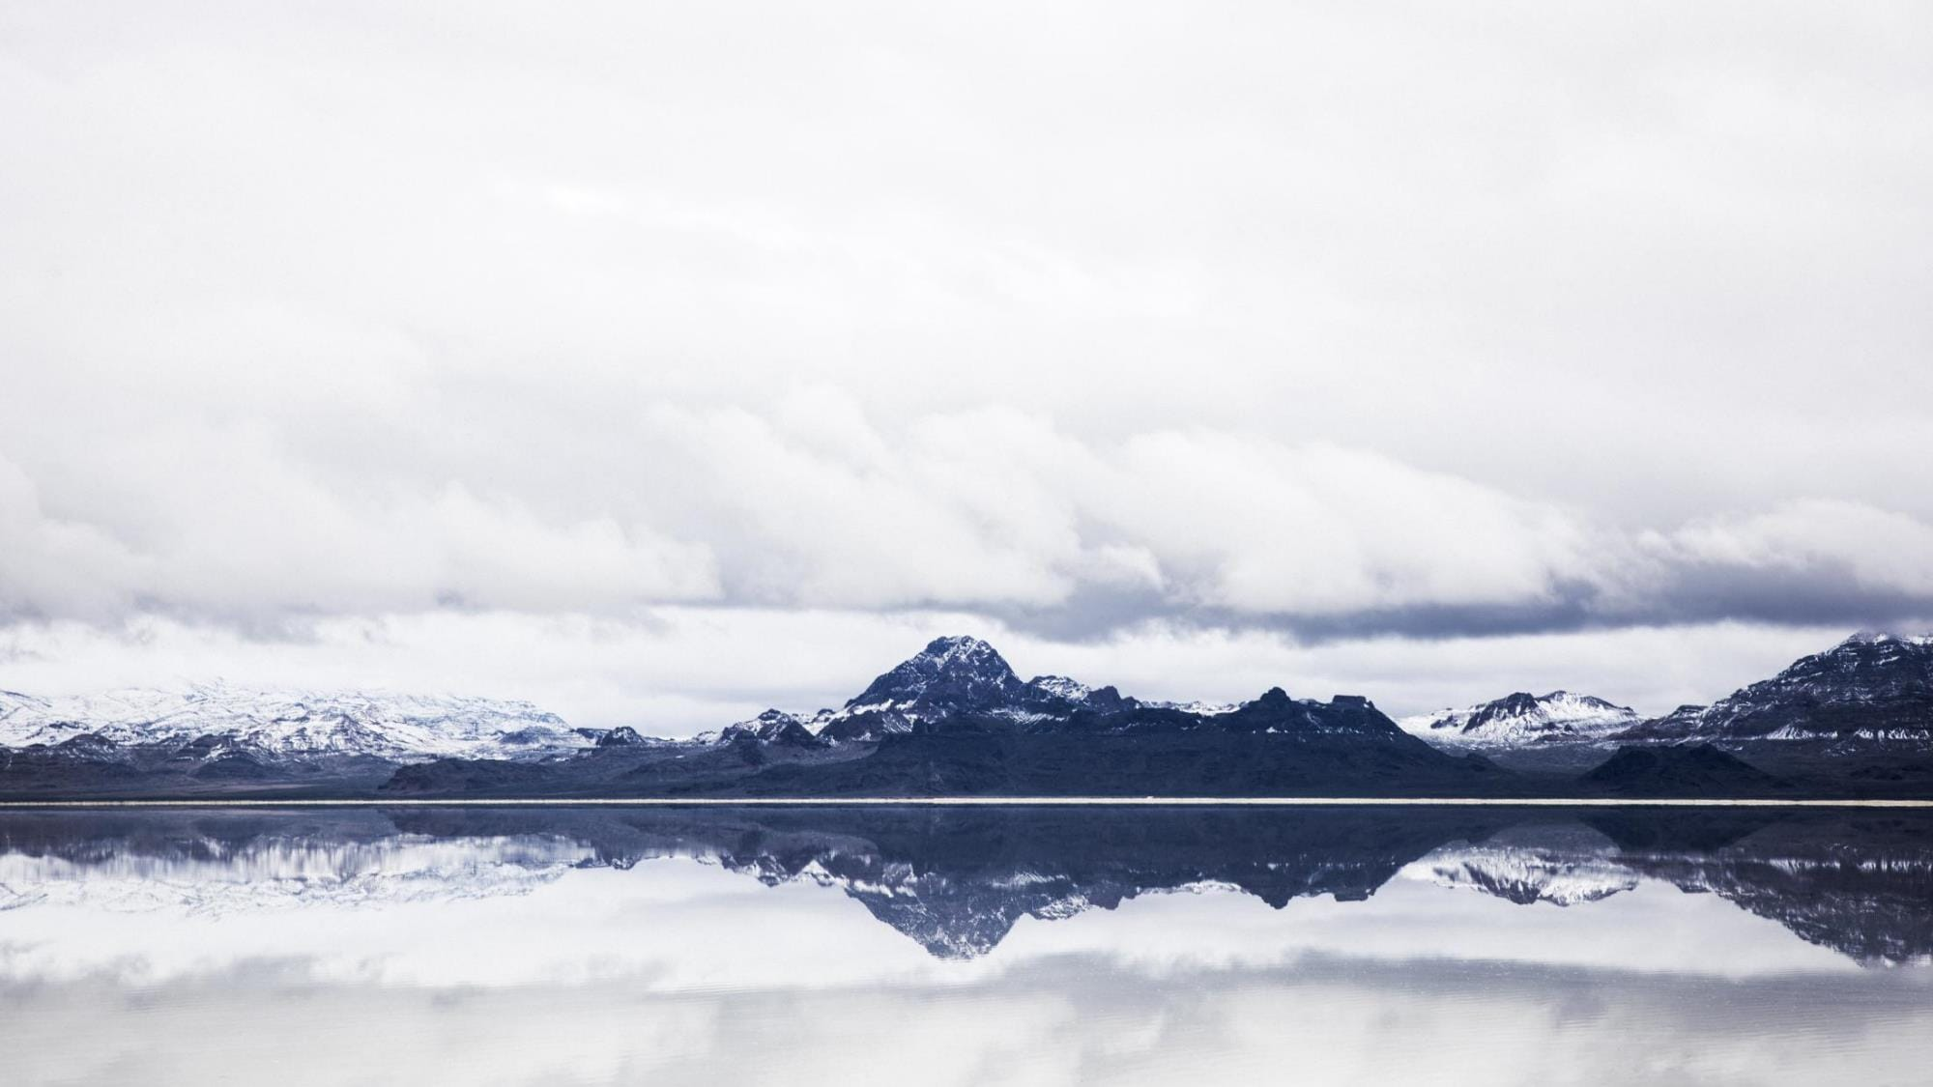
2
0
3
0
物流工作面试自我介绍ppt模板
BUSSINESS POWERPOINT TEMPLATE

Slide 2
目 录 / Contents
01
[ 工作概述 ]
02
[ 完成情况 ]
03
[ 项目展示 ]
04
[ 明年计划 ]

Slide 3
1
工作概述
Life is not waiting for the storm in the past, but learning to dance in the wind and rain.
Part One

Slide 4





01
[ 工 作 概 述 ]
输入此处标题
Would a man running in the rain, also don't want to put into the arms of the false.
输入此处标题
Would a man running in the rain, also don't want to put into the arms of the false.

Slide 5
01
[ 工 作 概 述 ]
Would a man running in the rain, also don't want to put into the arms of the false.
82
76
54
%
%
%

Slide 6
01
[ 工 作 概 述 ]
标题文本预设
Would a man running in the rain, also don't want to put into the arms of the false.
标题文本预设
Would a man running in the rain, also don't want to put into the arms of the false.
标题文本预设
标题
标题
Would a man running in the rain, also don't want to put into the arms of the false.

Slide 7

01
[ 工 作 概 述 ]
在此处添加标题
标题文本预设
Would a man running in the rain, also don't want to put into the arms of the false.
标题文本预设
Would a man running in the rain, also don't want to put into the arms of the false.

Slide 8


2
完成情况
Life is not waiting for the storm in the past, but learning to dance in the wind and rain.
Part TWO

Slide 9


02
[ 完 成 情 况 ]
·输入标题·
·输入标题·
·输入标题·
Would a man running in the rain, also.
Would a man running in the rain, also.
Would a man running in the rain, also.

Slide 10
02
[ 完 成 情 况 ]
Would a man running in the rain, also don't want to put into the arms of the false.
添加文本
Would a man running in the rain, also don't want to put into the arms of the false.
添加文本
添加文本
Would a man running in the rain.
1
2
3
标题文本预设
标题文本预设
标题文本预设

Slide 11
02
[ 完 成 情 况 ]
Would a man running in the rain, also don't want.
Would a man running in the rain, also don't want.
·输入标题·
·输入标题·
·输入标题·
Would a man running in the rain, also don't want.
·输入标题·
Would a man running in the rain, also don't want.

Slide 12

02
[ 完 成 情 况 ]
点击此处添加标
Would a man running in the rain, also don't want to put into the arms of the false.
点击此处添加标
Would a man running in the rain, also don't want to put into the arms of the false.

Slide 13
3
项目展示
Life is not waiting for the storm in the past, but learning to dance in the wind and rain.
Part Three

Slide 14
03
[ 项 目 展 示 ]
01
Would a man running in the rain, also don't want to put into the arms of the false.
02
03
02
Would a man running in the rain, also don't want to put into the arms of the false.
01
03
Would a man running in the rain, also don't want to put into the arms of the false.

Slide 15

03
[ 项 目 展 示 ]
单击编辑标题
Would a man running in the rain, also don't want to put into the arms of the false.
单击编辑标题
Would a man running in the rain, also don't want to put into the arms of the false.

Slide 16

03
[ 项 目 展 示 ]
标题文本预设
标题文本预设
Would a man running in the rain, also don't want to put into the arms of the false.
Would a man running in the rain, also don't want to put into the arms of the false.
01
标题文本预设
02
标题文本预设
Would a man running in the rain, also
Would a man running in the rain, also

Slide 17
03
[ 项 目 展 示 ]
60%
标题文本预设
90%
标题文本预设
Would a man running in the rain, also don't want to put into.
Would a man running in the rain, also don't want to put into.
50%
标题文本预设
80%
标题文本预设
Would a man running in the rain, also don't want to put into.
Would a man running in the rain, also don't want to put into.

Slide 18
4
明年计划
Life is not waiting for the storm in the past, but learning to dance in the wind and rain.
Part Four

Slide 19

04
[ 明 年 计 划 ]
03
标题文本
Would a man running in the rain, also don't want
添加文本
01
Would a man running in the rain, also don‘t want.
标题文本
Would a man running in the rain, also don't want
02
标题文本
Would a man running in the rain, also don't want
添加文本
Would a man running in the rain, also don't want to put into the arms of the false.

Slide 20
04
[ 明 年 计 划 ]
1
2
3
标题文本预设
标题文本预设
标题文本预设
Would a man running in the rain, also don't want to put into.
Would a man running in the rain, also don't want to put into.
Would a man running in the rain, also don't want to put into.

Slide 21
04
[ 明 年 计 划 ]
标题文本预设
标题文本预设
Would a man running in the rain, also don't want.
Would a man running in the rain, also don't want.
02
04
01
03
05
标题文本预设
标题文本预设
标题文本预设
Would a man running in the rain, also don't want.
Would a man running in the rain, also don't want.
Would a man running in the rain, also don't want.

Slide 22

04
[ 明 年 计 划 ]
Would a man running in the rain, also don't want to put into the arms of the false.
Would a man running in the rain, also don't want to put into the arms of the false.
Would a man running in the rain, also don't want to put into the arms of the false.
01
02
03

Slide 23
04
[ 明 年 计 划 ]
标题文本预设
Would a man running in the rain, also don't want to put into the arms of the false.
标题文本预设
Would a man running in the rain, also don't want to put into the arms of the false.

Slide 24
04
[ 明 年 计 划 ]
输入
标题
输入
标题
输入
标题
输入
标题
标题文本预设
Would a man running in the rain, also don't want to put into the arms of the false.

Slide 25
感谢观看
BUSSINESS POWERPOINT TEMPLATE

