Slide 1




创意大气商务通用ppt模板

Slide 2
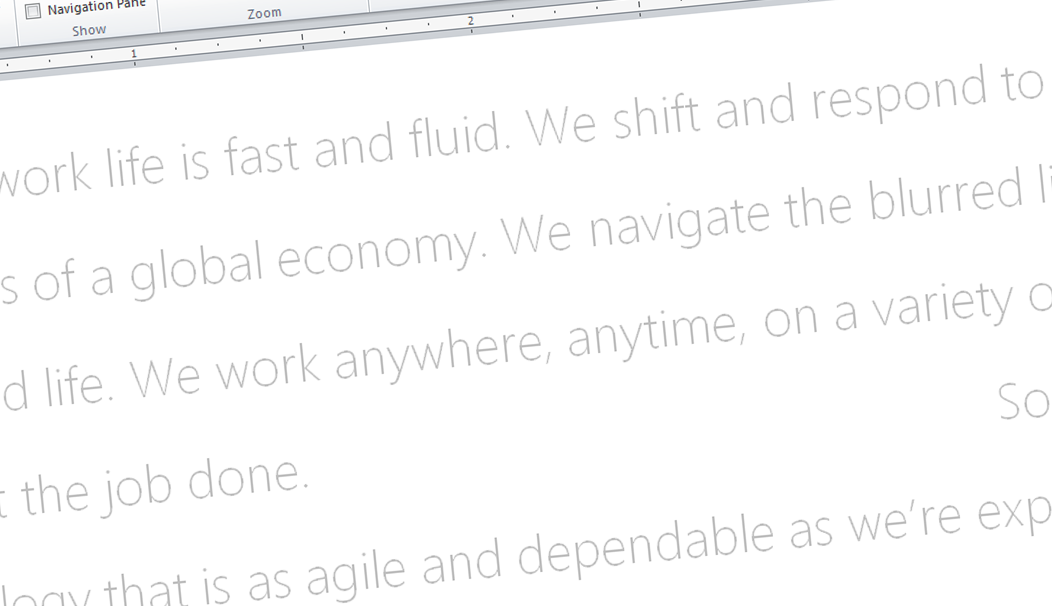
The world of work is changing.

Slide 3
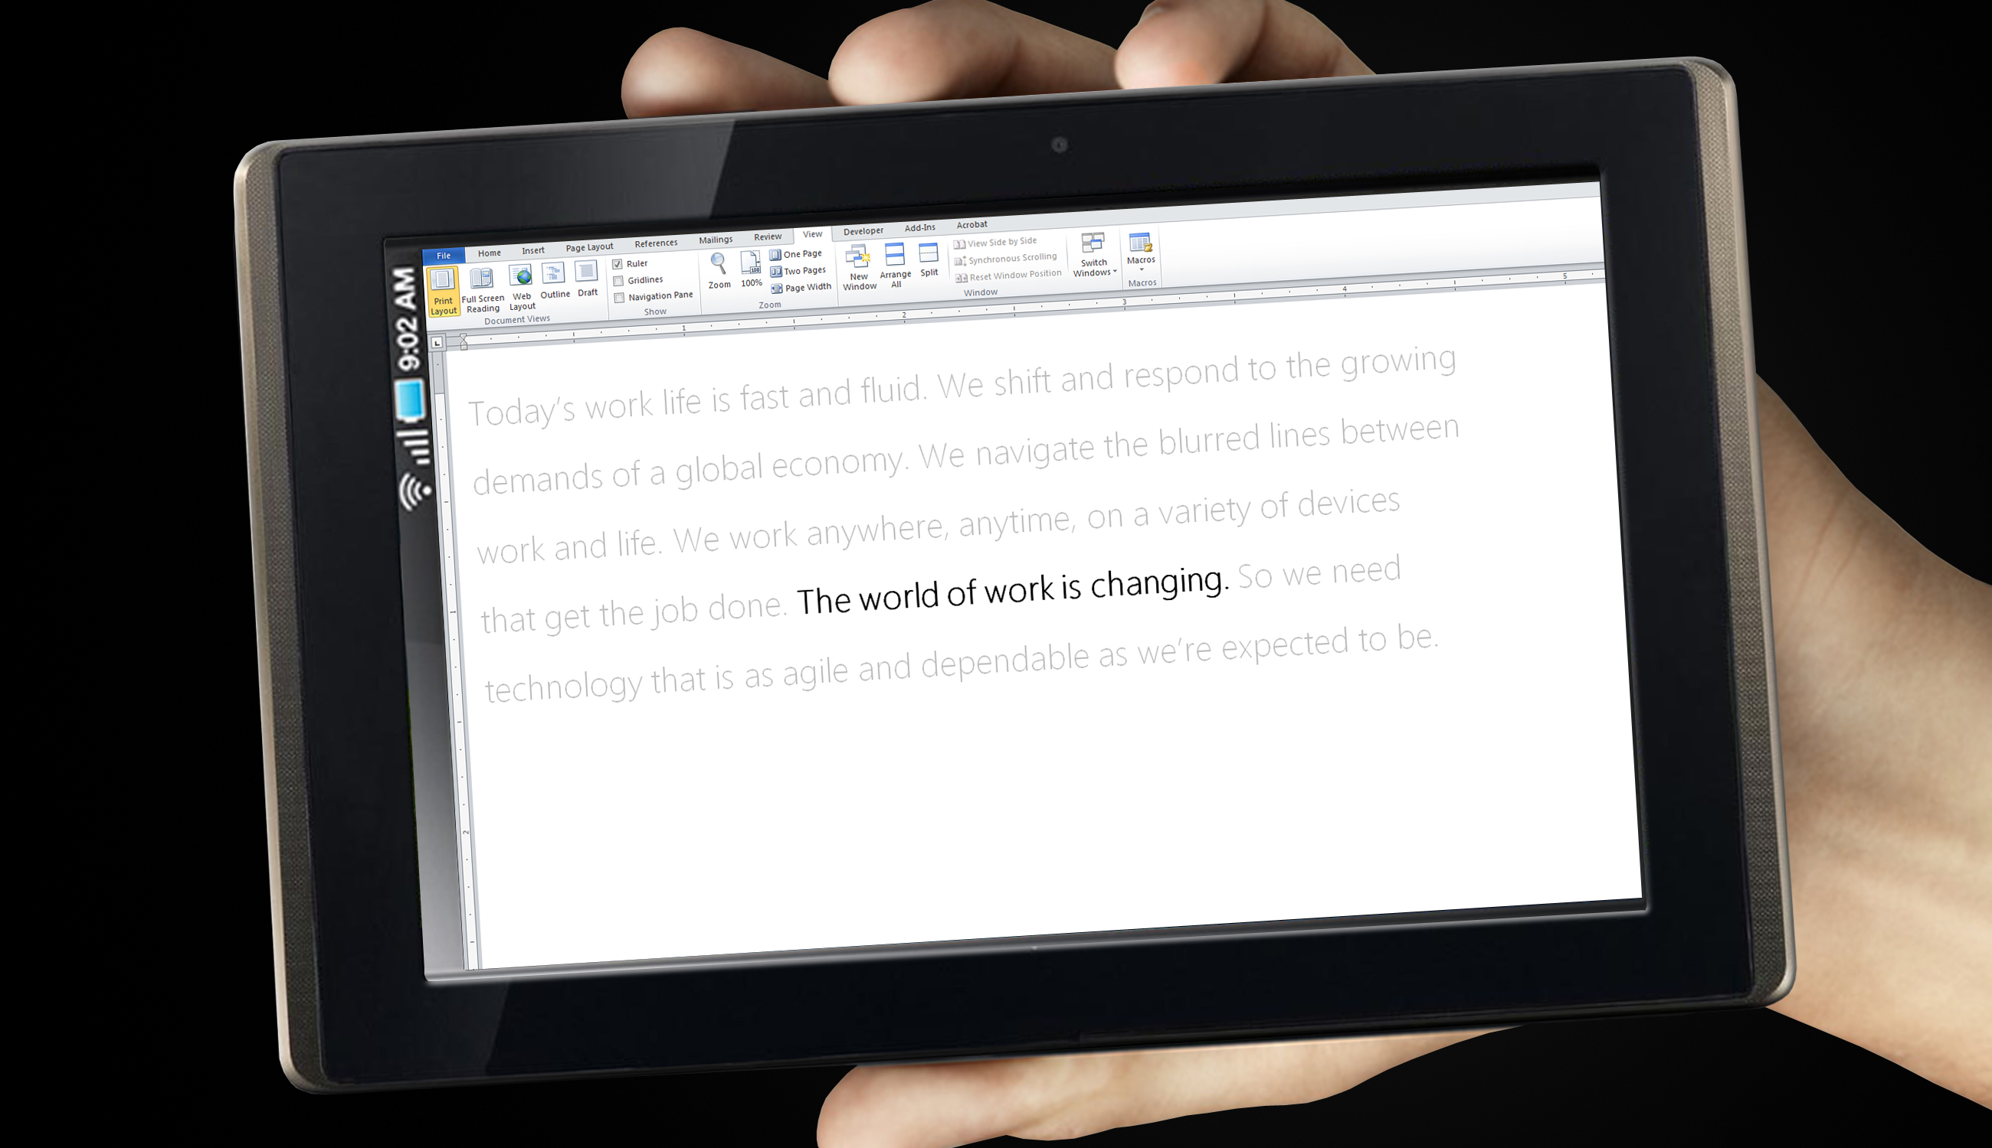
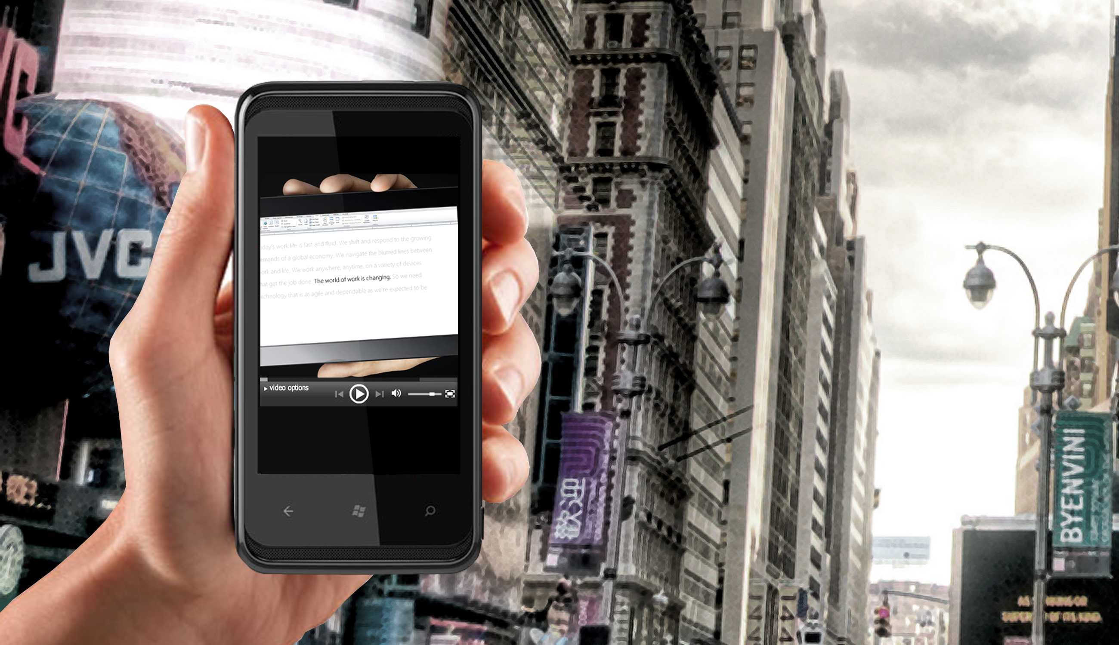
MORE DEVICES
“I love my PC, my phone, and my slate.”
MORE MOBILE
“I want the freedom to work wherever I am, whenever I need to.”

Slide 4



…connecting them at any place…

Slide 5


…to anyone on the planet.

Slide 6









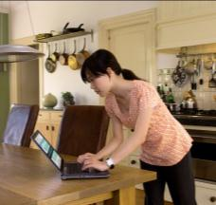
work-life
blur
more mobile
digital generation
multiple devices
tech
savvy
fast
paced

Slide 7







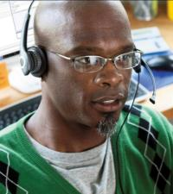

As the world of work is changing, so do our technology needs…

Slide 8













…so your technology strategy is more important than ever.

Slide 9






How do you give safe, secure access to corporate resources,
…anytime, anywhere,
…on a variety of devices,
…while keeping people productive without disruption?

Slide 10
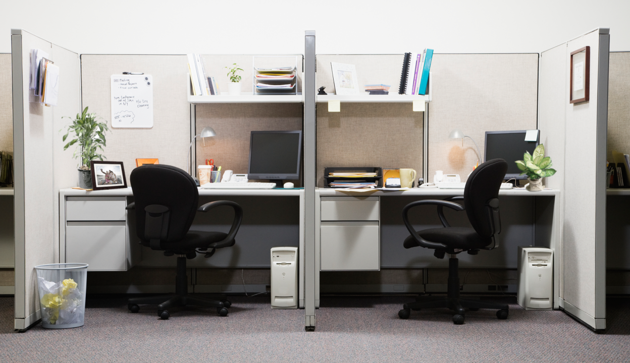
THE OLD WAY…

Slide 11


Slide 12




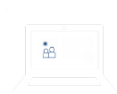
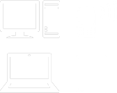







IT
Windows Intune
Flexible Workspace
ANYWHERE
CONNECTION
PERSONAL
EXPERIENCE
INTELLIGENT
INFRASTRUCTURE
Work on the road
Unified management across devices
Work on your own device
Cloud management for Windows devices
Personalized
Windows
devices
Work on your phone
Optimize infrastructure for VDI

Slide 13
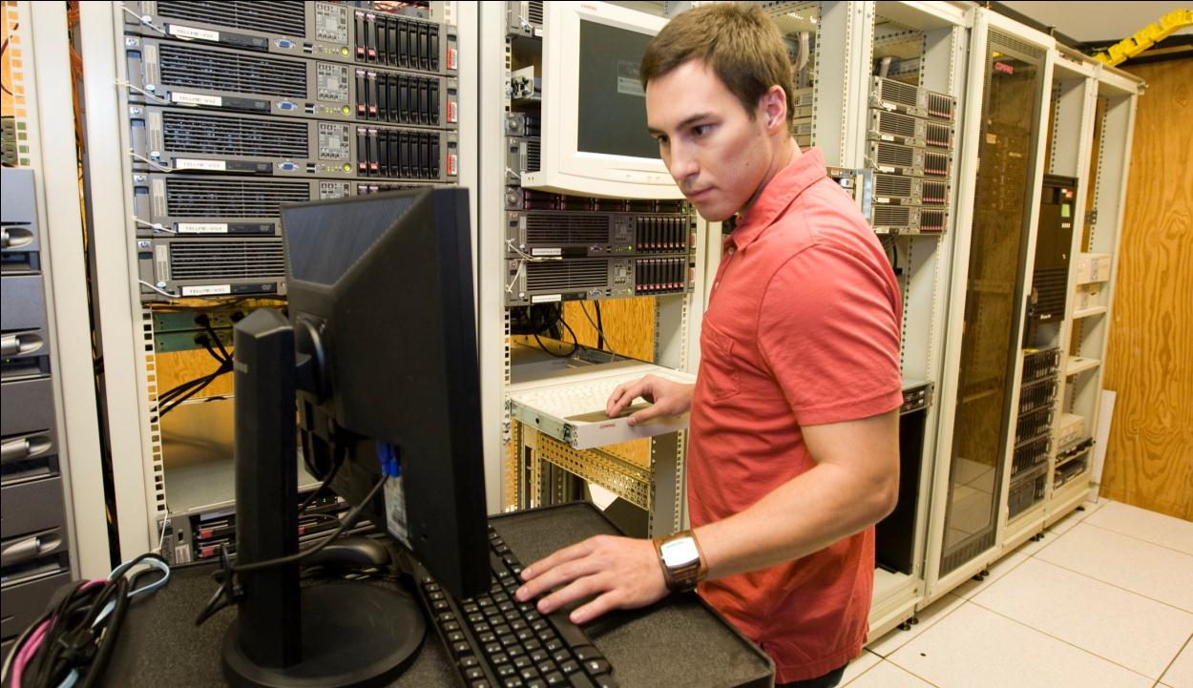
People in Ethan’s organization want to use smartphones, slates, tablets, and laptops to the corporate network.
Can he maintain compliance and ensure corporate data is safe on all devices?

Slide 14
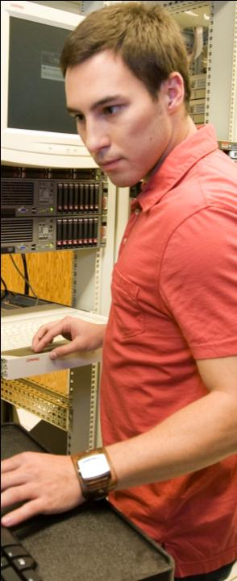






Unified management across devices
  IT can use a single tool to manage & secure multiple devices, including PCs, slates, and phones, enabling users to use a variety of devices at work.
INTELLIGENT
INFRASTRUCTURE
ConfigMgr +
  Benefits
  Single centralized tool to manage updates, identity and security across all user devices
  Increased security and compliance for all devices
  Better visibility into the devices on the network
  Application delivery is user focused, and dependent on device and network capabilities
  Unified, consistent experience makes device management easier for IT
Forefront
MSI
App-V
App-V
RDS

Slide 15

Lisa is very excited about the new slate she just bought. Can she use it for work?

Slide 16
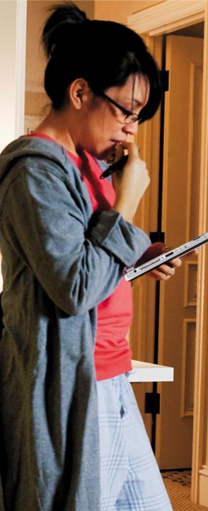








Work on your own device
  Access your corporate workspace using your personal PC
Virtual
Desktop
Office 365
ANYWHERE
CONNECTION
VDI*
FIREWALL
  Benefits
  Secure, fast browsing experience
  Rich user experience
  Centralized management of app & data (IT)
  Enhanced security and compliance (IT)
* VDI for rich, personalized experience.
RDS to access specific corp apps.

Slide 17

Blake is considering using a Windows slate as one of his work machines. How can he easily get up and running on this new device with all the personal things he’s used to from his main PC?

Slide 18



Personalized Windows devices
  Have your personalized corporate PC on any corporate PC device with your settings, data, and apps the moment you log-in.
ConfigManager
App
Virtualization
Folder Redirection, Roaming User Profiles
UNIQUELY
YOURS
  Benefits
  Personalized, rich, consistent, online & offline experience
  Apps, data, settings follow users, not devices
  Great touch, pen, and handwriting
  Centralized management data/apps (IT)
  Local Data is protected (IT)
  Great choice of Windows devices
User Settings
+ Apps
+ Data
User Settings+ Apps + Data
Bitlocker Drive Encryption
Bitlocker Drive Encryption

Slide 19
Demo
Uniquely Yours:
Personalized PC

Slide 20
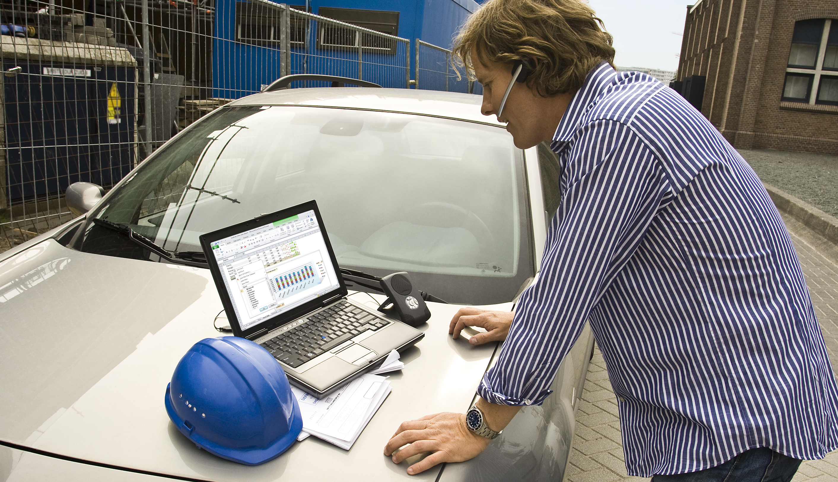
Frank travels a lot for his work. How can he stay connected to everything he needs?

Slide 21








Work on the road
  Get instant, secure access to files, sites, apps, and people from anywhere, with just an internet connection.
Exchange
SharePoint
Lync
DATA
SERVERS
FIREWALL
ANYWHERE
CONNECTION
Direct Access
SkyDrive
  Benefits
  Persistent connection to internet
  Easy and secure access to corporate data behind firewall
  Seamless connection to personal data
  Use one device for life and work when travelling
Mobile Broadband

Slide 22

Holly wants one smartphone for both work and life.
Is there a phone where she can access the same things she does on her PC?

Slide 23


Work from my phone
  Use corporate applications via your phone anywhere you have mobile connection.
Exchange
SharePoint
Lync
Office 365
ANYWHERE
CONNECTION
FIREWALL
  Benefits
  Get real work done – not just viewing, but editing, collaborating
  Works seamlessly with apps on my PC
  Always connected to calendar and email
  ActiveSync Management

Slide 24
Demo
Anywhere Connection:
Work on the Road
Work from your Phone

Slide 25
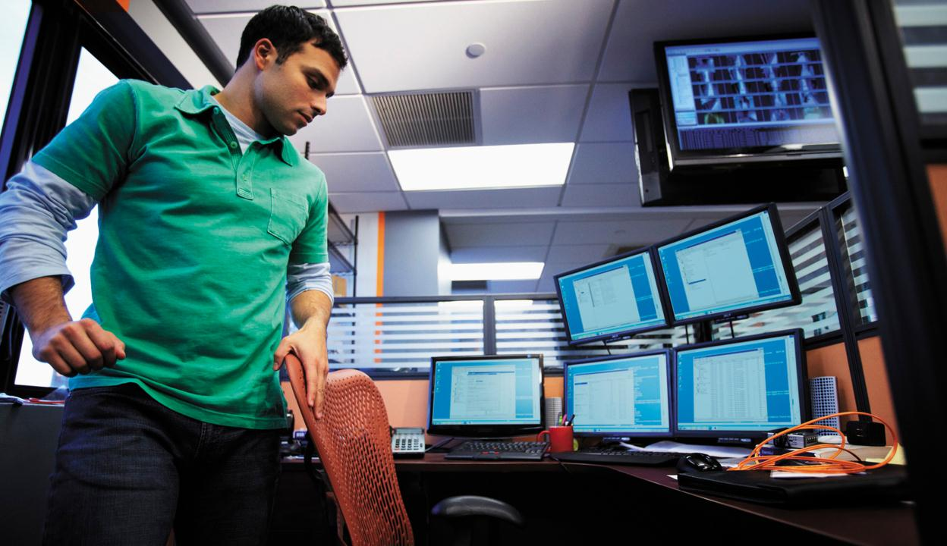
David’s company has groups of users who are remote and not joined to the domain. How can David keep these non-domain joined PCs updated and secure?

Slide 26




Cloud management for Windows devices
  IT can use online services to manage security and updates for Windows PCs.
IT
Windows Intune
INTELLIGENT
INFRASTRUCTURE
Manage Security & Updates
  Benefits
  No on-premises infrastructure required
  Easy monitoring and reporting
  IT can manage security and updates from anywhere with internet connection
  Always up to date

Slide 27
Demo
Intelligent Infrastructure:
Managing Windows PCs from the Cloud

Slide 28








The Flexible Workspace
ANYWHERE
CONNECTION
UNIQUELY
YOURS
INTELLIGENT
INFRASTRUCTURE
Personalized
PC and slate
Unified management
across devices
Work on the road
Bring your own PC
or slate
Cloud management for Windows PC and slates
Work on your phone
Optimized environment for VDI

Slide 29









Flexible Workspace
ON-PREMISES
& PRIVATE CLOUD
PUBLIC CLOUD
USER DEVICES & EXPERIENCES
IT
IT

Slide 30



PATH TO FLEXIBLE WORKSPACE
Assess Your
Business
Needs
Understand
Your Users
Consider the
Essentials
Evaluate Enabling Technologies
Start Pilot
Program
1
2
3
4
5

Slide 31

Related Sessions
SIM214 | Client Management and Security Roadmap and Vision
Monday, May 16 | 1:15 PM - 2:30 PM | Room: B407
VIR201 | Virtualization: State of the Union
Monday, May 16 | 1:15 PM - 2:30 PM | Room: B402
WCL215 | Unleashing the Power of Consumerization: How We Can Help
Tuesday, May 17 | 3:15 PM - 4:30 PM | Room: C205
WCL209 | Windows Intune: PC Management with Cloud Services and Windows 7
Wednesday, May 18 | 3:15 PM - 4:30 PM | Room: B213

Slide 32





Resources
  Connect. Share. Discuss.
http://northamerica.msteched.com
Learning
  Sessions On-Demand & Community
  Microsoft Certification & Training Resources
www.microsoft.com/teched
www.microsoft.com/learning
  Resources for IT Professionals
  Resources for Developers
http://microsoft.com/technet
http://microsoft.com/msdn

Slide 33
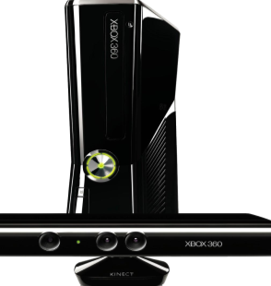
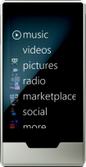
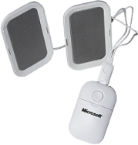


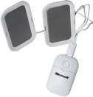






Complete an evaluation on CommNet and
enter to win!

Slide 34

© 2011 Microsoft Corporation. All rights reserved. Microsoft, Windows, Windows Vista and other product names are or may be registered trademarks and/or trademarks in the U.S. and/or other countries.
The information herein is for informational purposes only and represents the current view of Microsoft Corporation as of the date of this presentation. Because Microsoft must respond to changing market conditions, it should not be interpreted to be a commitment
on the part of Microsoft, and Microsoft cannot guarantee the accuracy of any information provided after the date of this presentation. MICROSOFT MAKES NO WARRANTIES, EXPRESS, IMPLIED OR STATUTORY, AS TO THE INFORMATION IN THIS PRESENTATION.

