Slide 1


2019
简约黑白商务演示
商务简约风

Slide 2
Content
1
STRENGTHS
2
STRENGTHS
No unexpected happening of surprising.
No unexpected happening of surprising.
3
STRENGTHS
4
STRENGTHS
No unexpected happening of surprising.
No unexpected happening of surprising.

Slide 3
1
STRENGTHS
No unexpected happening of surprising.

Slide 4

LIFE IS FULL OF CONFUSING AND DISORDERING
Life is full of confusing and disordering Particular time,a particular location,Do the arranged thing of ten million time in the brain,Step by step ,the life is hard to avoid delicacy and stiffness No enthusiasm forever,No unexpected happening of surprising and pleasing So,only silently ask myself in mind Next happiness,when will come?

Slide 5



STRENGTHS
LIFE IS FULL OF CONFUSING AND DISORDERING
Life is full of confusing and disordering Particular time,a particular location,Do the arranged thing of ten million time in the brain,Step by step ,the life is hard to avoid delicacy and stiffness No enthusiasm forever,No unexpected happening of surprising and pleasing So,only silently ask myself in mind Next happiness,when will come?

Slide 6

STRENGTHS
LIFE IS FULL OF CONFUSING
AND DISORDERING
Life is full of confusing and disordering Particular time,a particular location,Do the arranged thing of ten million time in the brain,Step by step ,the life is hard to avoid delicacy and stiffness No enthusiasm forever,No unexpected happening of surprising and pleasing So,only silently ask myself in mind Next happiness,when will come?

Slide 7



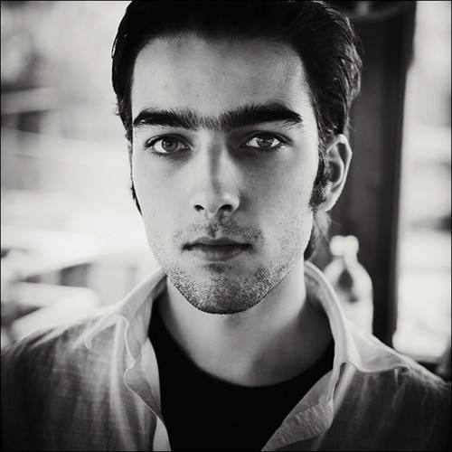
STRENGTHS
Rafael
Ulrica
Quella
Chloe
particular location,Do the arranged thing of ten million time in the brain,Step by step. Noenthusiasmforever,Nounexpectedhappening of surprising and .
particular location,Do the arranged thing of ten million time in the brain,Step by step. Noenthusiasmforever,Nounexpectedhappening of surprising and .
particular location,Do the arranged thing of ten million time in the brain,Step by step. Noenthusiasmforever,Nounexpectedhappening of surprising and .
particular location,Do the arranged thing of ten million time in the brain,Step by step. Noenthusiasmforever,Nounexpectedhappening of surprising and.

Slide 8





STRENGTHS
STRENGTHS
STRENGTHS
No unexpected happening of surprising.
No unexpected happening of surprising.
STRENGTHS
STRENGTHS
No unexpected happening of surprising.
No unexpected happening of surprising.

Slide 9
STRENGTHS
STRENGTHS
LIFE IS FULL OF CONFUSING AND DISORDERING
Life is full of confusing and disordering Particular time,a particular location,Do the arranged thing of ten million time in the brain,Step by step ,the life is hard to avoid delicacy and stiffness No enthusiasm forever,No unexpected happening of surprising and pleasing So,only silently ask myself in mind Next happiness,when will come?

Slide 10





STRENGTHS
Strengths
Opportunities
Weaknesses
Threats
No unexpected happening of surprising and pleasing ,only silently ask myself in mind
No unexpected happening of surprising and pleasing ,only silently ask myself in mind
No unexpected happening of surprising and pleasing ,only silently ask myself in mind
No unexpected happening of surprising and pleasing ,only silently ask myself in mind

Slide 11
STRENGTHS
85%
67%
50%
33%
LIFE IS FULL OF CONFUSING AND DISORDERING
Life is full of confusing and disordering Particular time,a particular location,Do the arranged thing of ten million time in the brain,Step by step ,the life is hard to avoid delicacy and stiffness No enthusiasm forever,No unexpected happening of surprising and pleasing So,only silently ask myself in mind Next happiness,when will come?

Slide 12
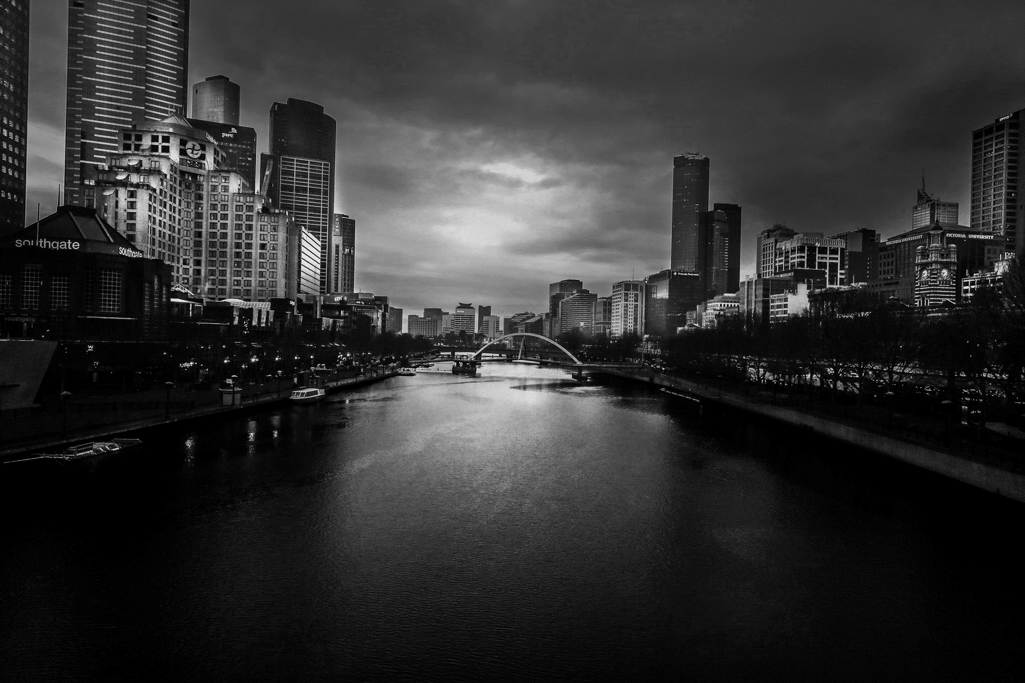



STRENGTHS
Life is full of confusing and disordering Particular time,a particular location,Do the arranged thing of ten million time in the brain.
Life is full of confusing and disordering Particular time,a particular location,Do the arranged thing of ten million time in the brain.
Life is full of confusing and disordering Particular time,a particular location,Do the arranged thing of ten million time in the brain.

Slide 13
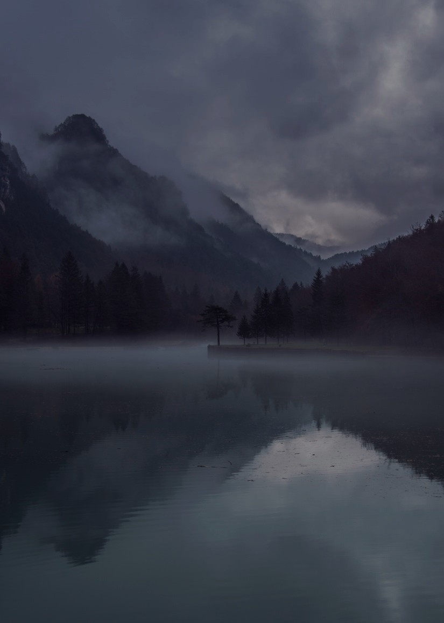
STRENGTHS
Life is full of confusing and disordering Particular time,a particular location,Do the arranged thing of ten million time in the brain.
1
Life is full of confusing and disordering Particular time,a particular location,Do the arranged thing of ten million time in the brain.
2
Life is full of confusing and disordering Particular time,a particular location,Do the arranged thing of ten million time in the brain.
3
PLAN

Slide 14

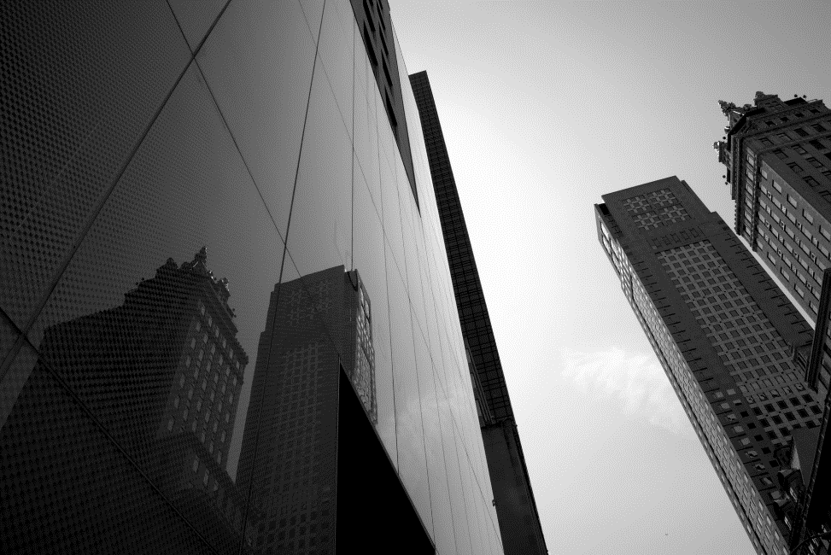
STRENGTHS
LIFE IS FULL OF CONFUSING
Life is full of confusing and disordering Particular time,a particular location,Do the arranged thing of ten million time in the brain,Step by step ,the life is hard to avoid delicacy and stiffness No enthusiasm.
STRENGTHS
LIFE IS FULL OF CONFUSING
Life is full of confusing and disordering Particular time,a particular location,Do the arranged thing of ten million time in the brain,Step by step ,the life is hard to avoid delicacy and stiffness No enthusiasm.

Slide 15
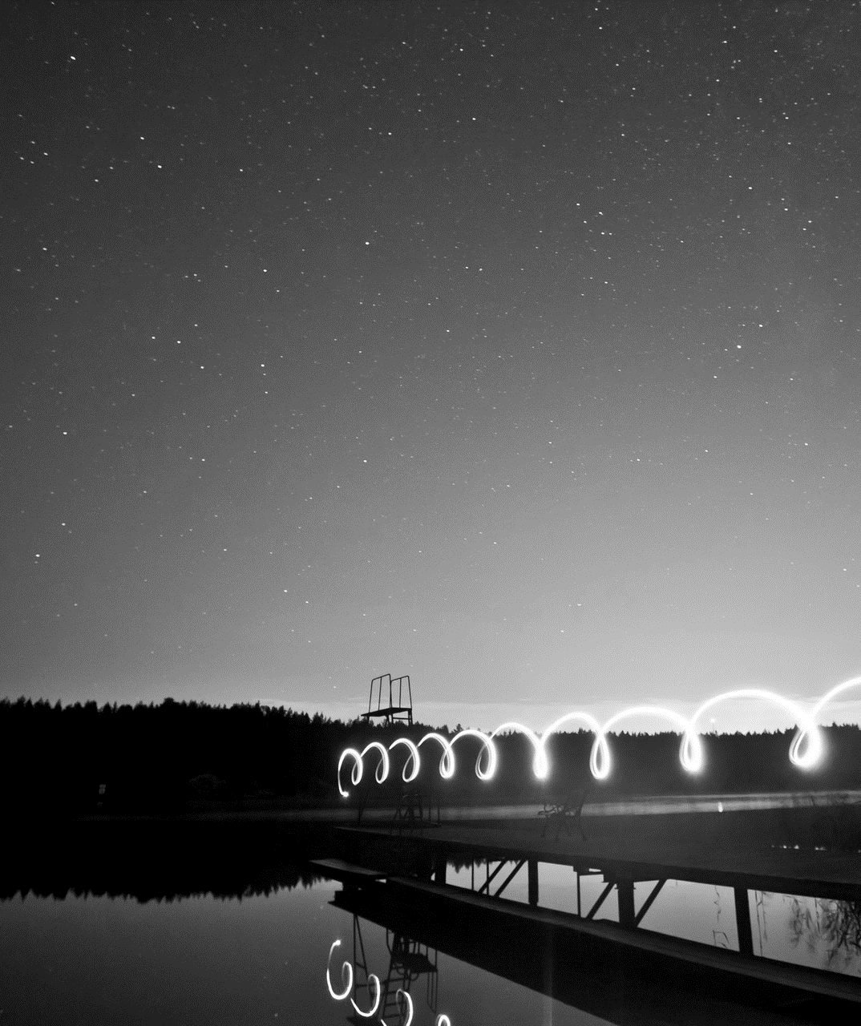



STRENGTHS
Life is full of confusing and disordering Particular time,a particular location,Do the arranged thing of ten million time in the brain.
Life is full of confusing and disordering Particular time,a particular location,Do the arranged thing of ten million time in the brain.
Life is full of confusing and disordering Particular time,a particular location,Do the arranged thing of ten million time in the brain.

Slide 16
STRENGTHS
LIFE IS FULL OF CONFUSING
LIFE IS FULL OF CONFUSING
Life is full of confusing and disordering Particular time,a particular location,Do the arranged thing of ten million time in the brain,Step by step ,the life is hard to avoid delicacy and stiffness No enthusiasm.

Slide 17

STRENGTHS
31%
40%
Life is full of confusing and disordering Particular time,a particular location,Do the arranged thing of ten million time in the brain.
Life is full of confusing and disordering Particular time,a particular location,Do the arranged thing of ten million time in the brain,Step by step ,the life is hard to avoid delicacy and stiffness No enthusiasm.
15%
Life is full of confusing and disordering Particular time,a particular location,Do the arranged thing of ten million time in the brain.
14%

Slide 18
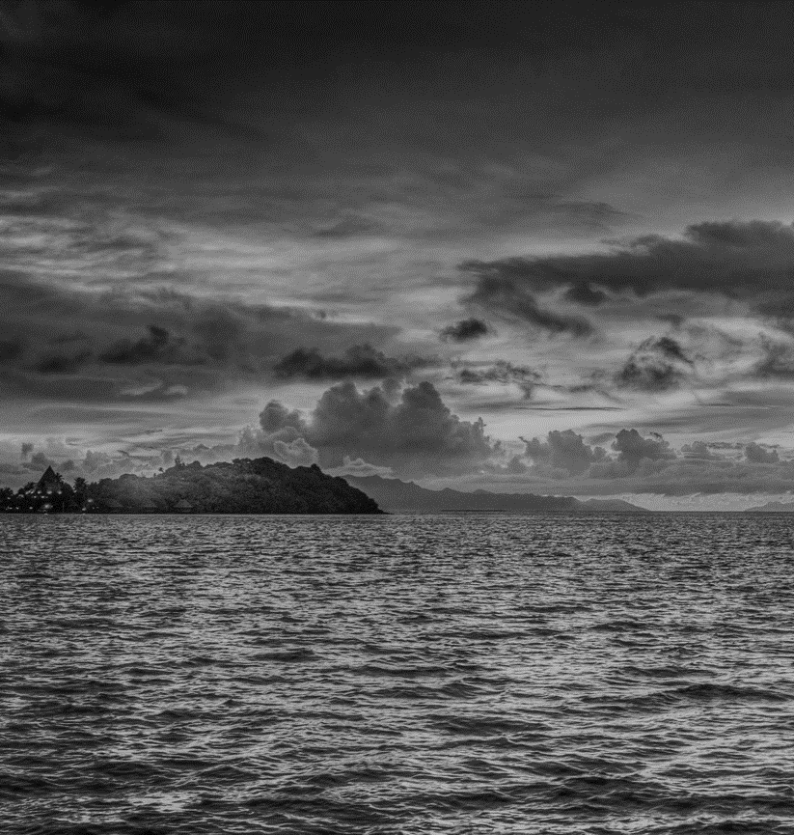
LIFE
IS
FUN
LIVE
IS
BAD
LIFE IS FULL OF CONFUSING
Life is full of confusing and disordering Particular time,a particular location,Do the arranged thing of ten million time in the brain,Step by step ,the life is hard to avoid delicacy and stiffness No enthusiasm forever,No unexpected happening of surprising and pleasing So,only silently ask myself in mind Next happiness,when will come?

Slide 19

STRENGTHS
Life is full of confusing and disordering Particular time,a particular location,Do the arranged thing of ten million time in the brain,Step by step ,the life is hard to avoid delicacy and stiffness No enthusiasm forever,No unexpected happening of surprising and pleasing So,only silently ask myself in mind Next happiness,when will come?

Slide 20
2019
谢谢观看
商务简约风

