Slide 1


Wei
Happy Birthday
2020.7.2

Slide 2
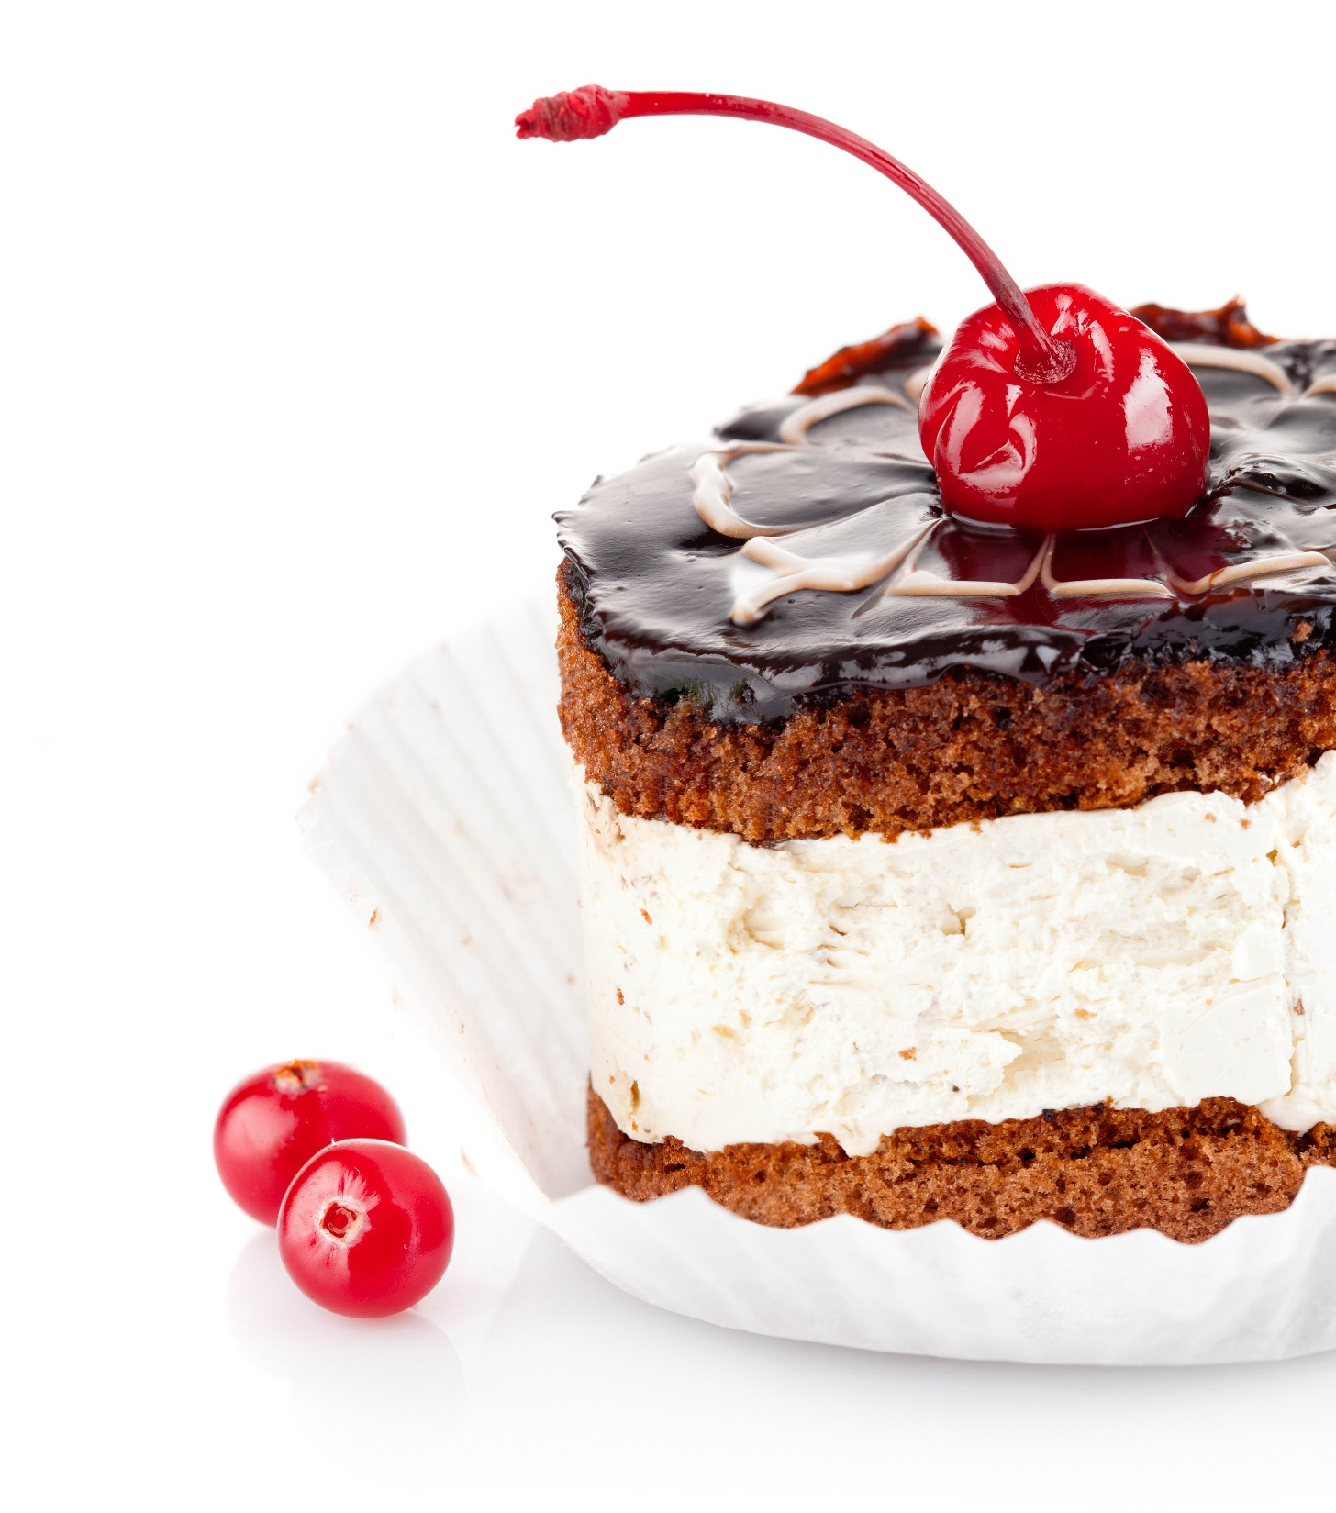

for you

Slide 3
XX
02
03
05
06
08
09
20
04
10
18
16
15
21
19
07
12
01
13
14
17
11
Girl in her

Slide 4
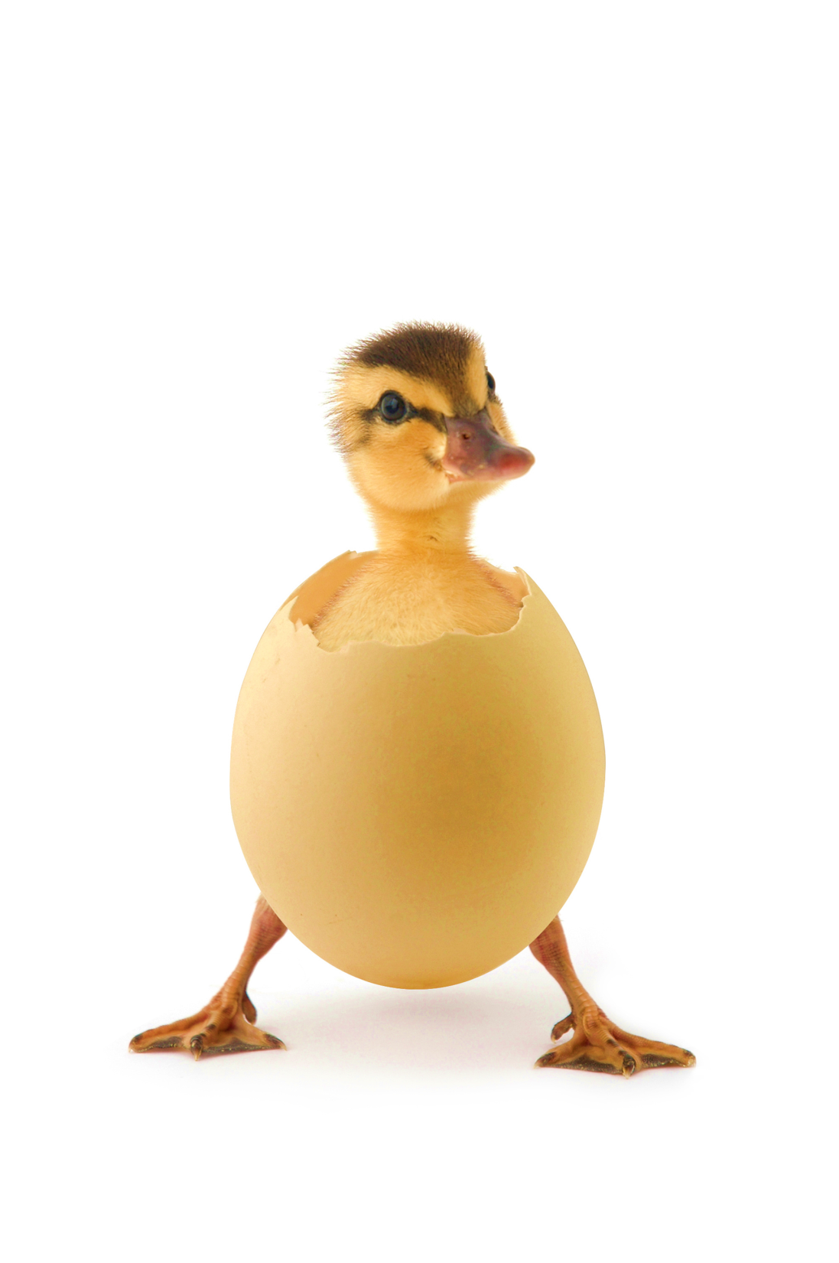
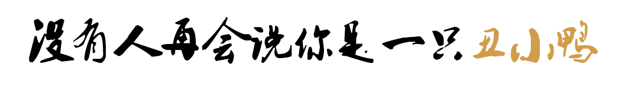
xx

Slide 5
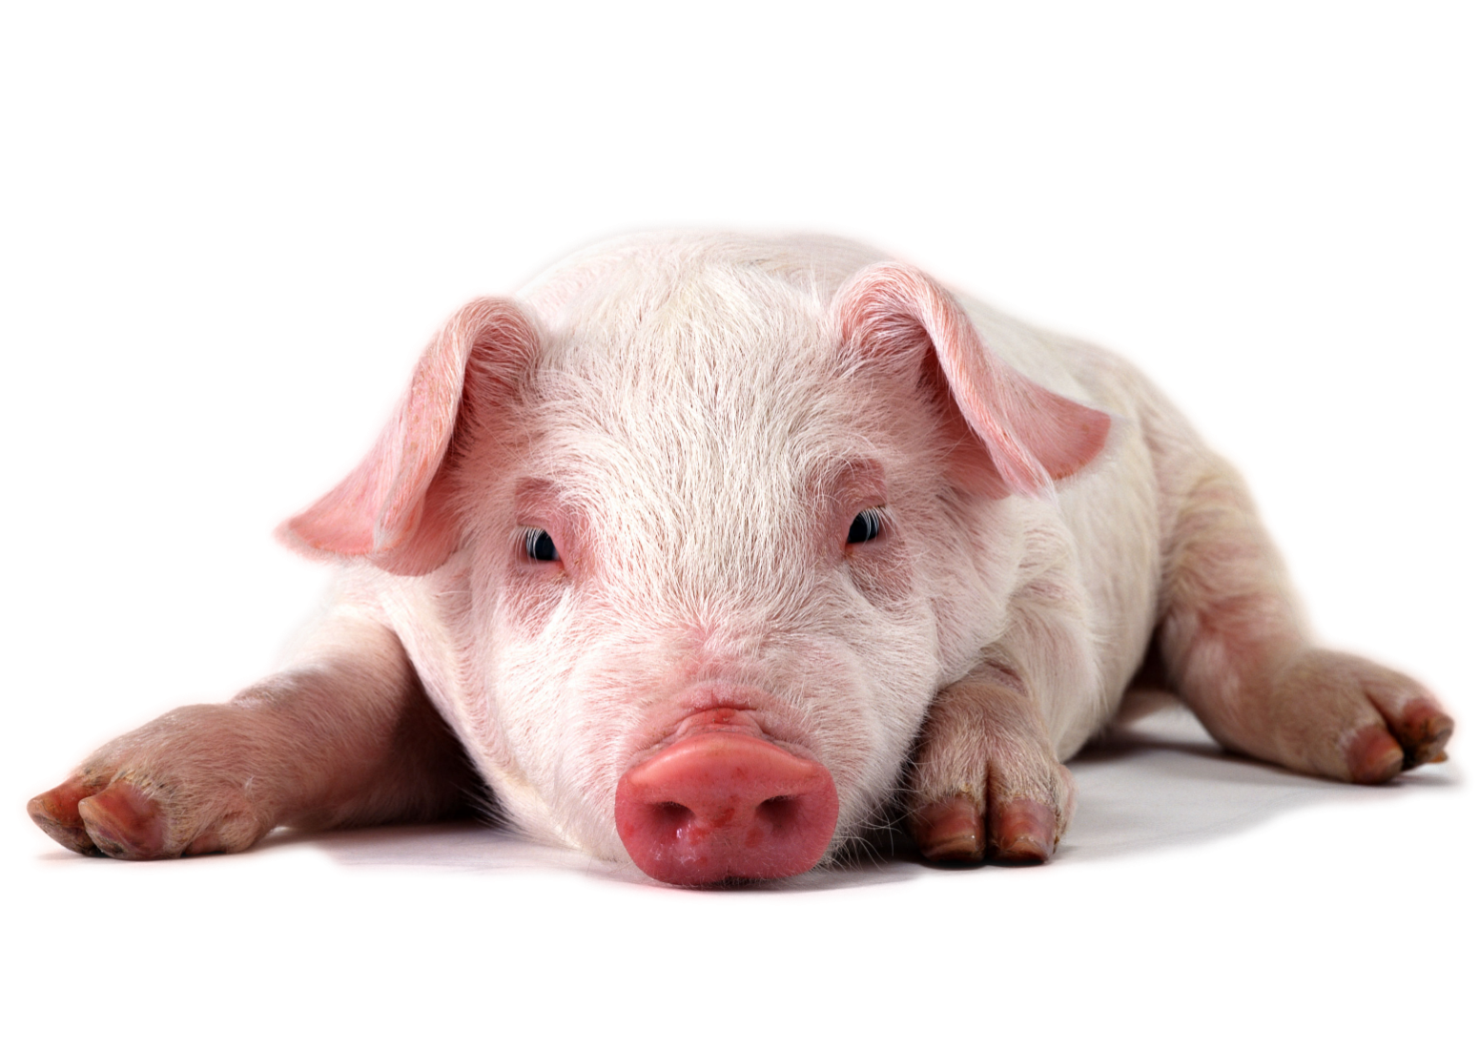
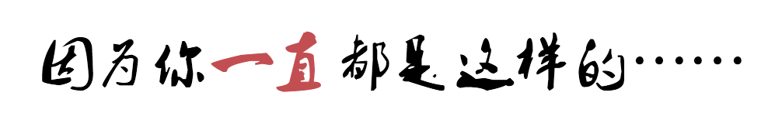

Slide 6



Slide 7

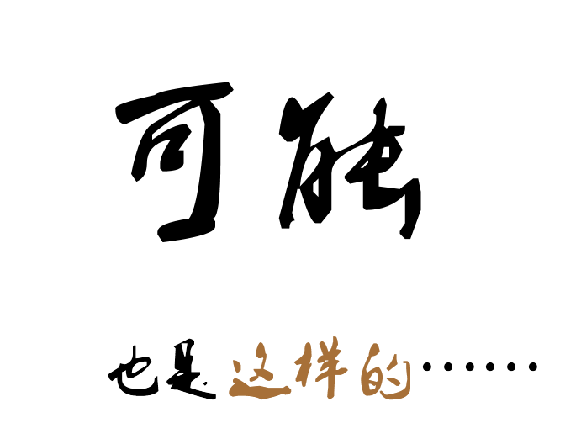

Slide 8
xx
Girl in her

Slide 9
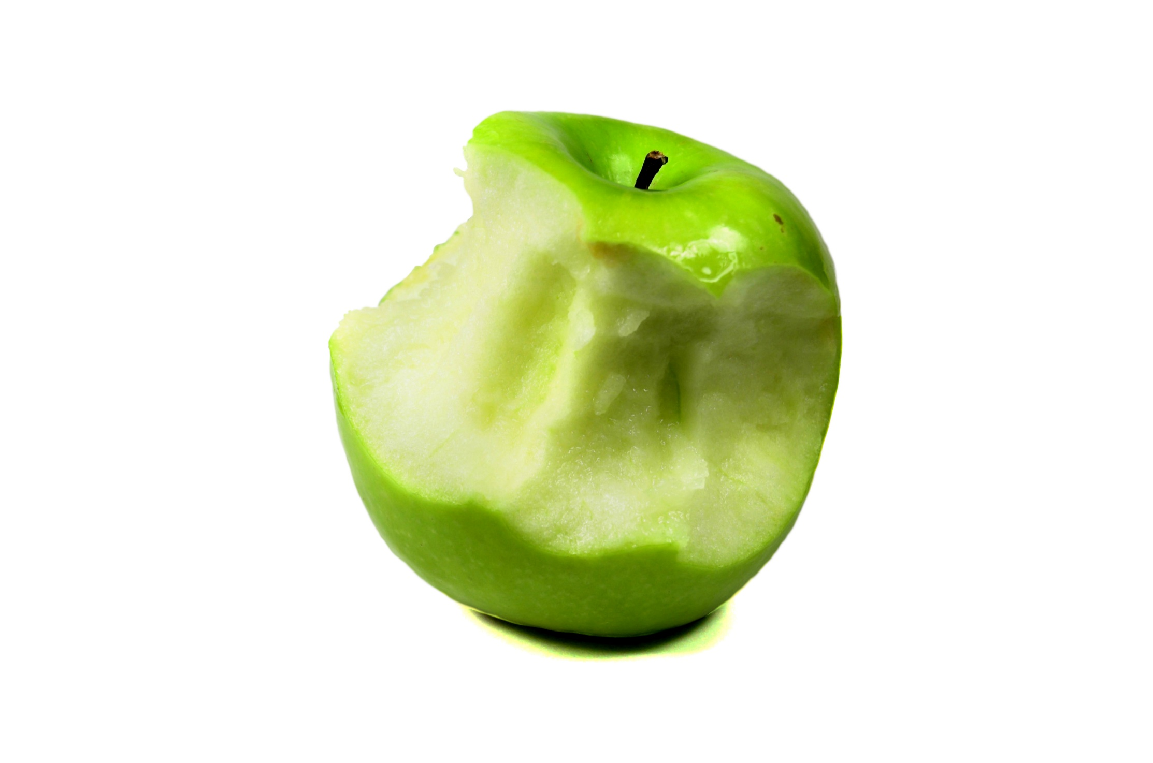
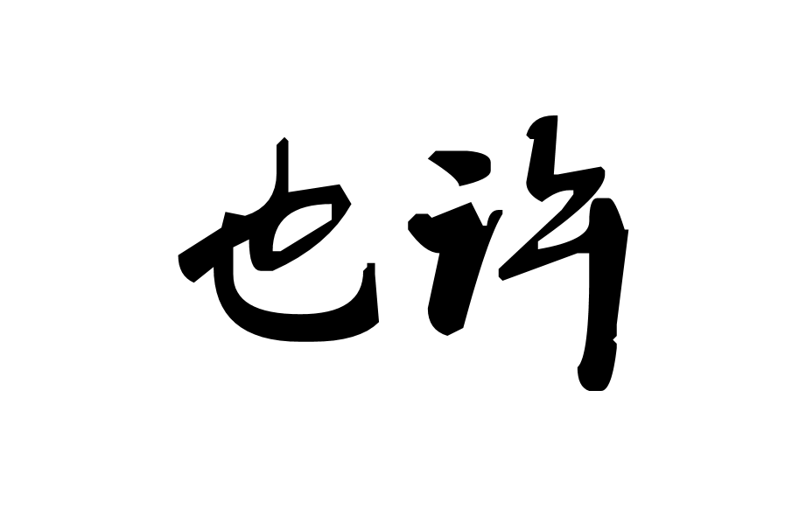
xx
岁
就像一只青苹果，酸酸的带着点甜

Slide 10
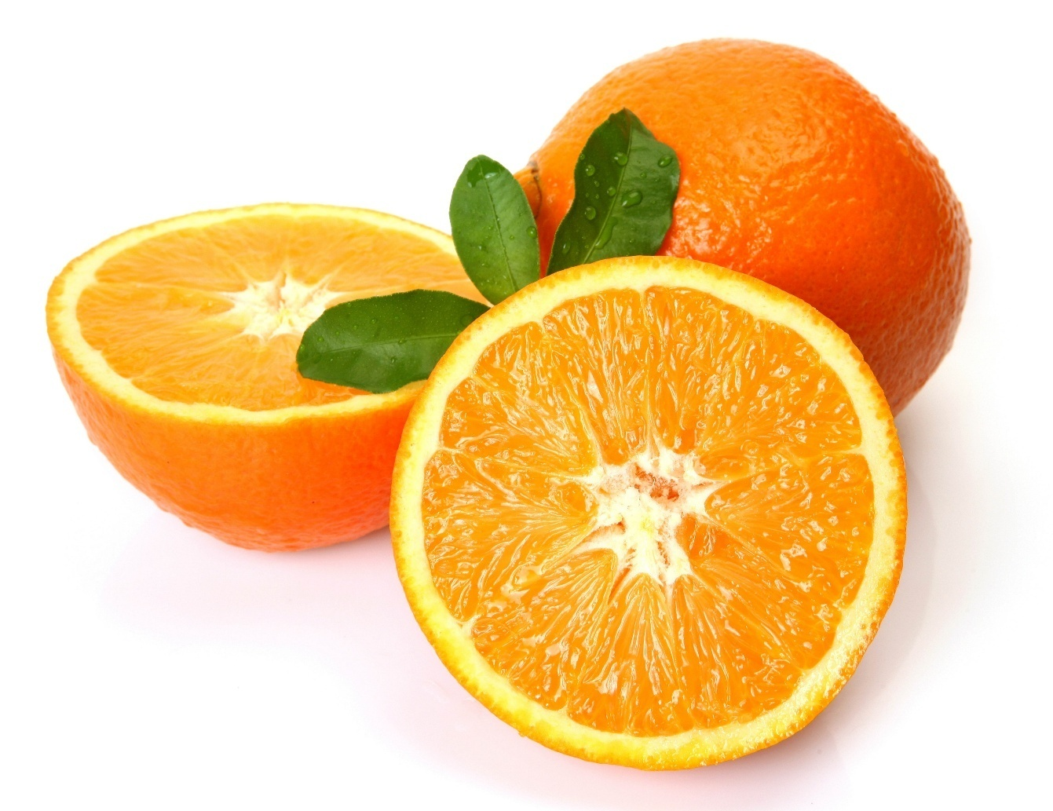
xx
岁
就像一片片橘子肉，意味着与人分享

Slide 11
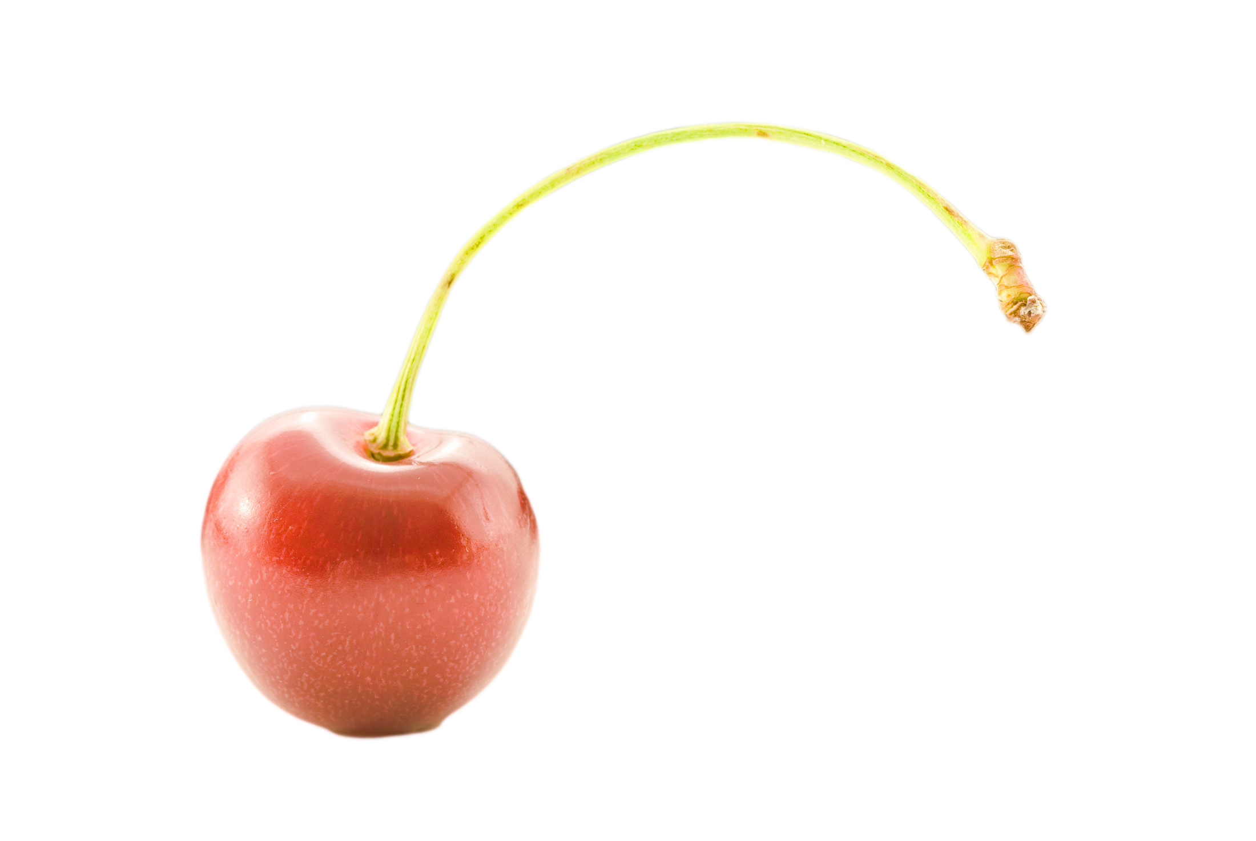
xx
岁
就像Cherry，需要Cherish

Slide 12
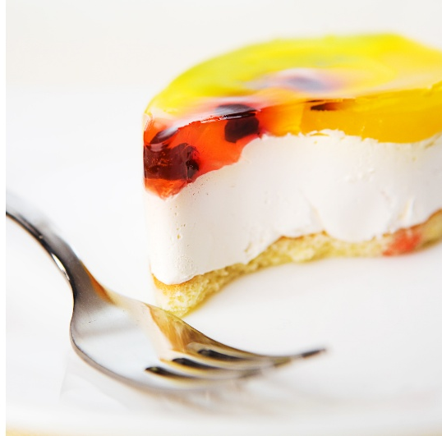
xx
My hope for your day
Carries sunny thoughts your way,
With laughter and celebration
Headed your direction.
May your Birthday today
Be as sweet as honey!

Slide 13
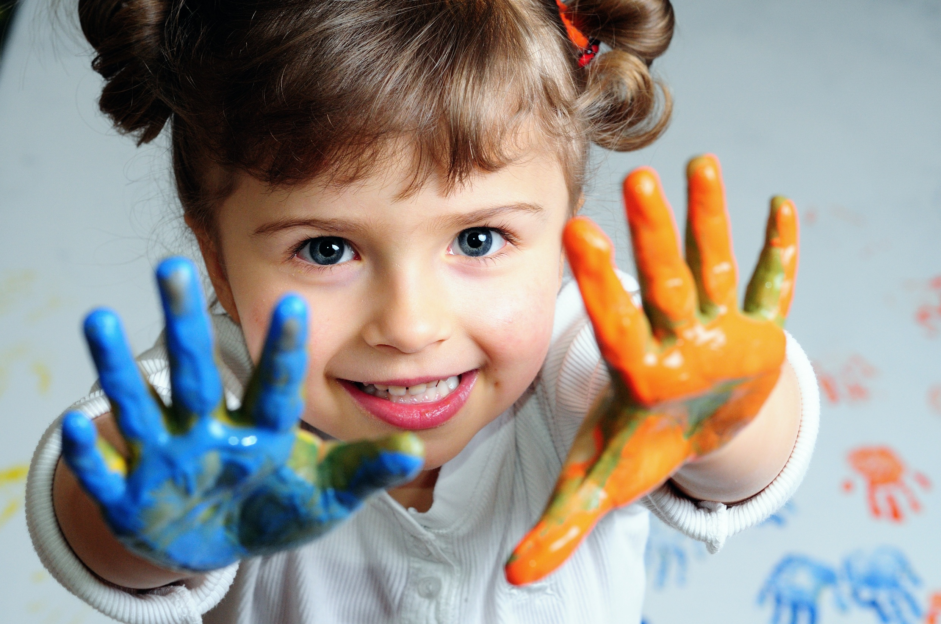
xx
Don't grow up too fast
enjoy being a kid
as long as you can

Slide 14

See u
xx
我的朋友，你的声音飘荡在我心里，
宛如那海水的低吟，
萦绕在聆听着的松林间。
Your voice, my friend, wanders in my heart,
Like the muffled sound of the sea
among these listening pines.

