Slide 1


“Feel The Charm Of Existence
夏日之语
PPT
Street Ball Tournament

Slide 2

CONTENTS
01
夏日之语
A wonderful serenity has taken possession of my entire soul
夏日之语
A wonderful serenity has taken possession of my entire soul, like these sweet mornings of spring which I enjoy with my whole heart. I am alone, and feel the charm of existence in this spot, which was created for the bliss of souls like mine. I am so happy, my dear friend, so absorbed in the exquisite
02
夏日之语
A wonderful serenity has taken possession of my entire soul
03
夏日之语
A wonderful serenity has taken possession of my entire soul
04
夏日之语
A wonderful serenity has taken possession of my entire soul
Let’s Join

Slide 3

第一部分
Presentation Template

Slide 4

$56k
Our University
Your Text Goes Here
夏日之语
A wonderful serenity has taken possession of my entire soul, like these sweet mornings of spring which I enjoy
28%
Your Text Goes Here
A wonderful serenity has taken possession of my entire soul, like these sweet mornings
When, while the lovely valley teems with around me, and the meridian
A wonderful serenity has taken possession of my entire soul, like these sweet mornings of spring which I enjoy with my whole heart.

Slide 5

Creative Business
When, while the lovely valley teems with around me, and the meridian
夏日之语
A wonderful serenity has taken possession of my entire soul, like these sweet mornings of spring which I enjoy with my whole heart. I am alone, and feel the charm of existence in this spot, which was created for the bliss of souls like mine. I am so happy, my dear friend, so absorbed in the exquisite sense of mere tranquil existence, that I neglect my talents.
Which Was Created For The Bliss Of Souls Like Mine. I Am So Happy, My Dear Friend.
$99/Day
A wonderful serenity has taken possession of my entire soul, like these sweet mornings of spring which I enjoy
GET STARTED NOW

Slide 6

Designer
²⁰³⁰
Creative Business
夏日之语
Your Text Goes Here
A wonderful serenity has taken possession of my entire soul, like these sweet mornings
²⁰³⁰
When, while the lovely valley teems with around me, and the meridian
Your Text Goes Here
A wonderful serenity has taken possession of my entire soul, like these sweet mornings of spring which I enjoy with my whole heart. I am alone, and feel the charm of existence in this spot, which was created for the bliss of souls like mine. I am so happy, my dear friend, so absorbed in the exquisite sense of mere tranquil existence, that I neglect my talents.
A wonderful serenity has taken possession of my entire soul, like these sweet mornings
GET STARTED NOW

Slide 7




夏日之语
Graphic River
Themeforest
Photodune
Videohive
A wonderful serenity
A wonderful serenity
A wonderful serenity
A wonderful serenity
5678+
3908+
2009+
1267+
A wonderful serenity has taken possession of my entire soul
A wonderful serenity has taken possession of my entire soul
A wonderful serenity has taken possession of my entire soul
A wonderful serenity has taken possession of my entire soul

Slide 8

第二部分
TWO
Notes:
PPT模板： www.PPT.com/moban/ 行业PPT模板：www.PPT.com/hangye/
节日PPT模板：www.PPT.com/jieri/ PPT素材： www.PPT.com/sucai/
PPT背景图片：www.PPT.com/beijing/ PPT图表： www.PPT.com/tubiao/
优秀PPT下载：www.PPT.com/xiazai/ PPT教程： www.PPT.com/powerpoint/
Word教程： www.PPT.com/word/ Excel教程： www.PPT.com/excel/
个人简历： www.PPT.com/jianli/ PPT课件： www.PPT.com/kejian/
手抄报： www.PPT.com/shouchaobao/ 试题下载： www.PPT.com/shiti/
教案下载： www.PPT.com/jiaoan/ 字体下载： www.PPT.com/ziti/

Slide 9

Creative Business
夏日之语
A wonderful serenity has taken possession of my entire soul, like these sweet mornings of spring which I enjoy with my whole heart. I am alone, and feel the charm of existence in this spot, which was created for the bliss of souls like mine.
1998 serenity has taken possession of my entire soul, like these sweet mornings

Slide 10

Creative Business
夏日之语
A wonderful serenity has taken possession of my entire soul, like these sweet mornings of spring which I enjoy with my whole heart. I am alone
Gender Classification
1500+
A wonderful serenity has taken possession of my entire soul, like these sweet mornings of spring which I enjoy
900+
A wonderful serenity has taken possession of my entire soul, like these sweet mornings of spring which I enjoy

Slide 11

Breaking News
A wonderful serenity has taken possession of my entire soul, like these sweet mornings of spring which I enjoy
A wonderful serenity has taken possession of my entire soul, like these sweet mornings of spring which I enjoy
夏日之语
A wonderful serenity has taken possession of my entire soul, like these sweet mornings of spring which I enjoy with my whole heart. I am alone, and feel the charm of existence in this spot, which was created for the bliss of souls like mine. I am so happy, my dear friend, so absorbed in the exquisite sense of mere tranquil existence, that I neglect my talents.

Slide 12

夏日之语
A wonderful serenity has taken possession of my entire soul, like these sweet mornings of spring which I enjoy with my whole heart. I am alone, and feel the charm of existence in this spot, which was created for the bliss of souls like mine.
90,1
夏日之语
Quis Nostrud exerci tation ullamcorper
A wonderful serenity has taken possession of my entire soul, like these sweet mornings of spring which I enjoy with my whole heart. I am alone, and feel the charm of existence in this spot, which was created for the bliss of souls like mine.
#TwoDifferences

Slide 13
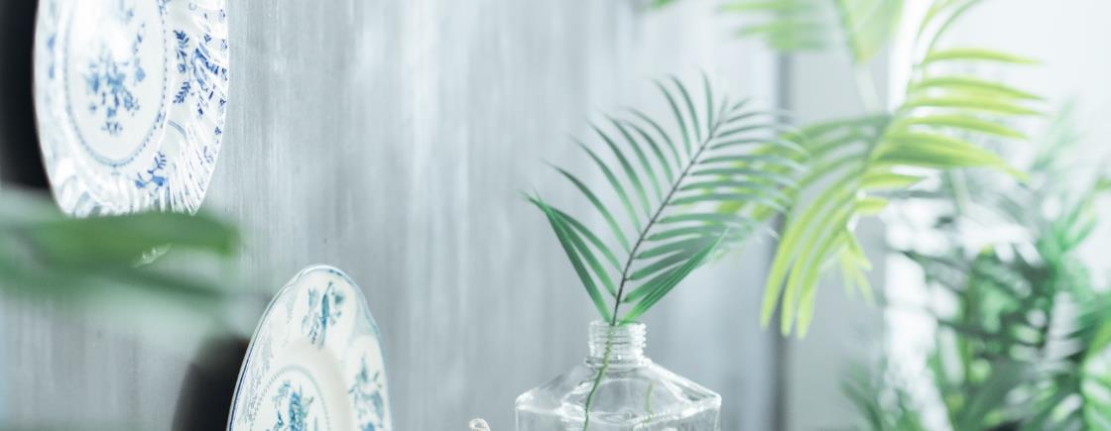
Education
A wonderful serenity has taken possession of my entire soul, like these sweet mornings of spring which I enjoy with my whole heart. I am alone, and feel the charm
夏日之语
OVERVIEW PICTURE
01
20 March 2030
02
20 March 2030
03
20 March 2030

Slide 14
THREE
第三部分
Read More
@IBAOTU
@IBAOTU
@IBAOTU

Slide 15




15
夏日之语
#LetsDoIt
Story Of Success
Campus Life
Inspiring Person
A wonderful serenity has taken possession of my entire soul
A wonderful serenity has taken possession of my entire soul
A wonderful serenity has taken possession of my entire soul

Slide 16
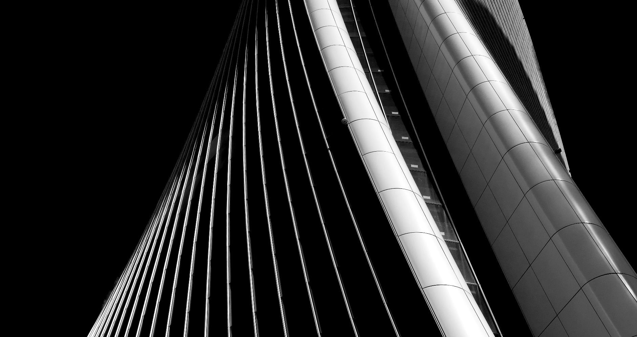
夏日之语
When, while the lovely valley teems with around me, and the meridian
A wonderful serenity has taken possession of my entire soul, like these sweet mornings of spring which I enjoy with my whole heart. I am alone, and feel the charm of existence in this spot, which was created for the bliss of souls like mine. I am so happy, my dear friend, so absorbed in the exquisite sense of mere tranquil existence, that I neglect my talents.
#Campuslife
1500+
A wonderful serenity has taken possession of my entire soul, like these sweet mornings of spring which I enjoy
900+
A wonderful serenity has taken possession of my entire soul, like these sweet mornings of spring which I enjoy

Slide 17


夏日之语
夏日之语
A wonderful serenity has taken possession of my entire soul
A wonderful serenity has taken possession of my entire soul
夏日之语
A wonderful serenity has taken possession of my entire soul, like these sweet mornings of spring which I enjoy with my whole heart. I am alone, and feel the charm of existence in this spot

Slide 18

夏日之语
A wonderful serenity has taken possession of my entire soul, like these sweet mornings of spring which I enjoy with my whole heart. I am alone, and feel the charm of existence in this spot, which was created for the bliss of souls like mine.
@IBAOTUllege
@IBAOTUllege
@IBAOTUllege

Slide 19

Creative Business
夏日之语
34.123
7.700
3.000
3.000
Total Students 2030
New Students 2030
Foreign Student 2030
Graduated 2017

Slide 20
第四部分
FOUR

Slide 21

Creative Business
夏日之语
Title Here #1
Title Here #2
A wonderful serenity has taken possession of my entire soul
A wonderful serenity has taken possession of my entire soul
Title Here #3
Title Here #4
A wonderful serenity has taken possession of my entire soul
A wonderful serenity has taken possession of my entire soul

Slide 22

27 Sep 2017
夏日之语
夏日之语
A wonderful serenity has taken possession of my entire soul, like these sweet mornings of spring which I enjoy with my whole heart.
A wonderful serenity has taken possession of my entire soul, like these sweet mornings of spring which I enjoy with my whole heart.
夏日之语
夏日之语
夏日之语
A wonderful serenity has taken possession of my entire soul, like these sweet mornings of spring which I enjoy with my whole heart. I am alone, and feel the charm of existence in this spot, which was created for the bliss of souls like mine.
A wonderful serenity has taken possession of my entire soul, like these sweet mornings of spring which I enjoy with my whole heart.
A wonderful serenity has taken possession of my entire soul, like these sweet mornings of spring which I enjoy with my whole heart.

Slide 23

Creative Business
夏日之语
When, while the lovely valley teems with around me, and the meridian
A wonderful serenity has taken possession of my entire soul, like these sweet mornings of spring which I enjoy with my whole heart. I am alone, and feel the charm of existence in this spot.
Your Title Here
Your Title Here
Your Title Here
Your Title Here
A wonderful serenity has taken possession of my entire soul
A wonderful serenity has taken possession of my entire soul
A wonderful serenity has taken possession of my entire soul
A wonderful serenity has taken possession of my entire soul

Slide 24



Creative Business
夏日之语
When, while the lovely valley teems with around me, and the meridian
A wonderful serenity has taken possession of my entire soul, like these sweet mornings of spring which I enjoy with my whole heart. I am alone, and feel the charm of existence in this spot, which was created for the bliss of souls like mine. I am so happy, my dear friend, so absorbed in the exquisite sense of mere tranquil existence, that I neglect my talents.

Slide 25
“Feel The Charm Of Existence
谢谢观看
PPT
Street Ball Tournament

