Slide 1


What do you want to write in here?
招商引资汇报ppt模板
——the core IDEA of your PPT
YOUR COMPANY NAME

Slide 2
PART 1
Company Introduction
This is the CORE IDEA

Slide 3

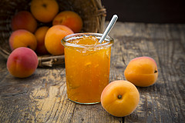

Your Company Name
Company introduction
  It’s the parent company of NanChang Smart BB Co.,Ltd. founded in 2009, after five years of the time the development, the world's first "children accompanied robot" type and complete teaching system and teaching materials of a complete set of kindergarten, create multiple "industry first", was elected to the authority of the state council special kindergarten.
  It’s registered capital of 108 million yuan, as the nanchang city in Jiangxi province high-tech development zone key introduction project, it will be in the heart of the construction of college students and guest (6 universities including Wright state university cooperation with the United States), and the Internet cloud platform construction of nanchang as the headquarters operation center (in collaboration with netease and tencent), and is committed to be based on China, facing the world's leading children's early education brand, close affection of the world's largest Internet service provider.
Product one
Product two
Product three

Slide 4
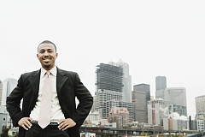
Company Founder —— Mr. XX
Current Post
Ta Niu bi de jing li 1…………………………………………………
Ta Niu bi de jing li 2…………………………………………………
Ta Niu bi de jing li 3…………………………………………………
Ta Niu bi de jing li 4…………………………………………………
Ta Niu bi de jing li 5…………………………………………………
Ta Niu bi de jing li 6…………………………………………………
Board Chairman ：Mr. XX
Ta dou zuo guo shen me yang de xiang mu?………………………………………………………………………………………………
Zai na xie niu bi de qi ye dai guo?……………………………………………………………………………………………………………
Qu de le shen me yang de nong yu?…………………………………………………………………………………………………………

Slide 5



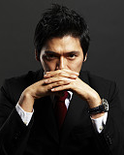

Your Core Team Members
CEO: Zhang XX
CTO: Yao XX
Date of birth: 1982.11 (33)
Education: bachelor of chongqing university of posts and telecommunications, sun yat-sen university lingnan MBA
Main experience:
Guangdong telecom planning design institute of peace, chief engineer, senior project manager in guangdong PMP (04 ~ 08)
Expo - linkage advantage of electronic ticketing, head of the project manager, guangdong mobile wallet, mobile mall (09 ~ 12)
Date of birth:1977.12 (37),
Degree: Xi 'an university of electronic science and technology
Main experience:
Taiwan grain ShenTang group/America's resistance to the Asia, the Internet of things technology, head of research & development (03-08)
Head of the Bestom intelligent platform (08-10)
Date of birth: 1982.5 (33)
Main experience:
Have job in several well-known planning company, any marketing director, electric dealer market director, division general manager, etc., served a number of well-known domestic enterprises.Too much home first-line brand operation and service, including panlong sea of clouds, wuliangye, E E this, proper living water, the company, AOBO, guizhou yi hundred, KOWA period, etc.
Degree:Self-control, record of formal schooling, Tsinghua university
Main experience:
Zhuhai municipal organization department, personnel bureau, will for the expert panel members
The former general manager assistant general manager of the zhuhai tsinghua science park, sg company
Bachelor degree: Guangdong foreign studies university
Main experience:
Hance education CTO (08 ~ 12)
Guangdong - had Ren Guangdong nine network CTO, baidu company system engineer, manata education electronic product manager, etc., 15 years relative working experience in IT product development and the Internet
Marketing Director
Wang XXXX
Research Director
Wang XXXX
Product Manager
Wu XXXX

Slide 6
Your Core Competitiveness
What’s your company’s core competitiveness?
Your bigger title
Your little title
The International Montessori
5 q series, more than 600 copies
Children's picture books (multimedia) books more than 300 copies
Children's picture books (digital) books more than 5300 copies
Famous speech story in more than 2800 (> 500 hours)
anime story and courseware more than 2500 sets
Course 350 classes, parent-child interaction
About 500 g • ZhongShaoShe digital library digital content
classics and ballad singing programs about more than 9000 sets
About more than 1, 2000, drama and music
…………
China Children's Press&publication Group
Beijing Normal University Publish Group
North Liaoning Publishing Group
The State Council Kindergarten

Slide 7

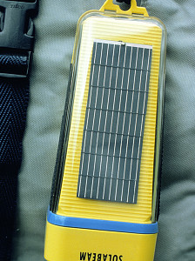
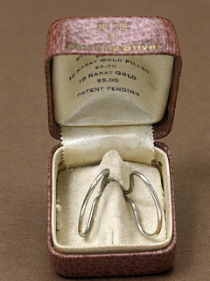





Company’s Independent Intellectual Property Rights
3 counts of software copyright
3 appearance design patent certificate
2 invention patent certificate
11 is applying for acceptance

Slide 8








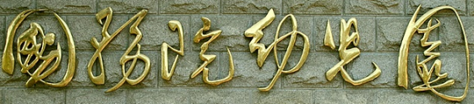





Many Powerful Partners

Slide 9
PART 2
Product Presentation
Your product name

Slide 10

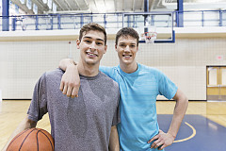

What’s your product name?
You zhe shen me yang de niu bi gong neng ?
YOUR BIGGER TITLE
YOUR BIGGER TITLE
YOUR BIGGER TITLE
Having the passions - pleasure, anger, sorrow, joy and all facial expressions, available for emotion communication
Children have multidimensional and interactive learning in games
Huge amounts of videos and stories, One-stop solution to the problem of early child education

Slide 11
3
Product Competitive Advantages
Your shen yi yang de title
Your shen yi yang de title
Your shen yi yang de title

Slide 12
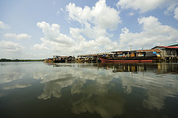

PCA NO.1: Shen yi yang de title
Shen yi yang de title, Shen yi yang de title, Shen yi yang de title, Shen yi yang de title, Shen yi yang de title, Shen yi yang de title, Shen yi yang de title, Shen yi yang de title.
Far away, then know to cherish every second together with your child

Slide 13


PCA NO.2: Shen yi yang de title
Shen yi yang de title, Shen yi yang de title, Shen yi yang de title, Shen yi yang de title, Shen yi yang de title, Shen yi yang de title!
Your TITLE
Ji Ta Ji Ta Ji Ta
Ji Ta Ji Ta Ji Ta
Ji Ta Ji Ta Ji Ta
Ji Ta Ji Ta Ji Ta
Ji Ta Ji Ta Ji Ta
Ji Ta Ji Ta Ji Ta
…………
Jsutl like“The British Library”; Besides，it provides fresh content for on-demand every day!

Slide 14

PCA NO.3: Shen yi yang de title
WO ZHI SHI XIANG YAO YI GE
BIGGER TITLE!
TITLE :nei rong nei rong nei rong nei rong nei rong nei rong nei rong
TITLE :nei rong nei rong nei rong nei rong nei rong nei rong
TITLE :nei rong nei rong nei rong nei rong nei rong nei rong
TITLE :nei rong nei rong nei rong nei rong nei rong nei rong
TITLE :nei rong nei rong nei rong nei rong nei rong nei rong

Slide 15
PART 3
Investment policy
Wei shen me yao tou qian gei ni

Slide 16
The Huge Market Prospect
Chui shi chang niu bi da fa Chui shi chang niu bi da fa Chui shi chang niu bi da fa
Chui shi chang niu bi da fa Chui shi chang niu bi da fa Chui shi chang niu bi da fa Chui shi chang niu bi da fa Chui shi chang niu bi da fa Chui shi chang niu bi da fa
Chui shi chang niu bi da fa Chui shi chang niu bi da fa Chui shi chang niu bi da faChui shi chang niu bi da fa Chui shi chang niu bi da fa Chui shi chang niu bi da fa
Chui shi chang niu bi da fa Chui shi chang niu bi da fa Chui shi chang niu bi da faChui shi chang niu bi da fa Chui shi chang niu bi da fa Chui shi chang niu bi da fa
Chui shi chang niu bi da fa Chui shi chang niu bi da fa Chui shi chang niu bi da faChui shi chang niu bi da fa Chui shi chang niu bi da fa Chui shi chang niu bi da fa

Slide 17
Your niu bi de TITLE
YOUR TITLLE
Television advertising, Online advertising, WeChat new media advertising, etc
Open
platform
Win-win
wealth
YOUR TITLLE
YOUR TITLLE
The kindergarten of the state council, China Children's Press & Publication Group, international montessori, etc
All over the country provinces and cities offer door-to-door delivery
YOUR TITLLE
YOUR TITLLE
Click on the website link to read more detailed information
www.niubi.cn

Slide 18

A Reasonable Retail Price System
YOUR BIGGER TITLE
YOUR BIGGER TITLE
1280 RMB
399 RMB
unified national retail price
unified national retail price

Slide 19
PART 4
BIGGER TITLE
HE ZUO HE ZUO HE ZUO

Slide 20
Brand development
2009.09:The first generation product on the market
BIGGER
TITLE
(2009-2012)
2010.01:Joint 6 universities develop excellent children's program "IDEAS"
2011.08:Association with blue arc anime, making animated film Xing Yu Xing Yuan
2013.01.01-01.03:Hosted one thousand "international children's raising and development BBS"
BIGGER
TITLE
(2013-2014)
2013.04.17:Custom ”Xing Yu Xing Yuan” animation broadcast on CCTV children's channel
2013.05.09:Kindergarten intelligent make experimental classes under the state council official classes
2013.06.01:Beijing, Shanghai, xian, shenzhen, nanjing and other experience store opened
BIGGER
TITLE
(2014-2014)
2014.06.20:WeChat and clever to make cooperative development made WeChat treasure
2015.02:Obtain ten million yuan of first round funding by GSR Ventures and Hongseong Capital
2015.04.20:As Nanchang government focus on introducing project, move to Nanchang

Slide 21


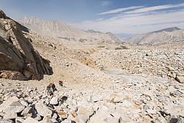
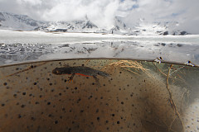
Big events reported
Your nei rong nei rong nei rong nei rong nei rong nei rong
the kindergarten wen-ping Chen director in the speech
Well-known education experts Zheng Wei keynote speech
The honored guests had a group photo taken
Your nei rong nei rong nei rong nei rong nei rong nei rong

Slide 22





Extensive Media Coverage
Authority under the state council, the kindergarten kindergarten classes with smart to make education technology co., LTD. Cooperation will open a new model of children's early education.
Smart funny parent-child type with education since the date of birth and cause the attention of the education industry experts, scholars, and successfully use teaching AIDS to be designated as state department kindergarten classes.
We don't need children to adapt to the playmate, but for a playmate to adapt to children, this is wise to make the concept of early education products.
Happy smart funny advocated earlier education electronic product the best usage of the parents accompany children play together, create belong to the parents and children's unique experience!
Subversion and innovation have smart to make jinsha river and hongseong capital tens of millions of yuan to A round of funding

