Slide 1







四 年 级 家 长 会 模 板
幼儿园课件/小学生家长会/幼儿教育/学校课件
汇报人：XXX
汇报人时间：20XX.12

Slide 2

CONTENTS
0 1
0 2
0 3
0 4
家 长 会 意义
班级介绍
给家长的建议
新学期安排

Slide 3

PART ONE
家 长 会 意义
No matter how long the rain lasts, there will be a rainbow in the end. No matter how sad you may be.

Slide 4


01 家 长 会 意义
输入此处标题
No matter how long the rain lasts, there will be a rainbow in the end. No matter how sad you may be.
输入此处标题
No matter how long the rain lasts, there will be a rainbow in the end. No matter how sad you may be.

Slide 5
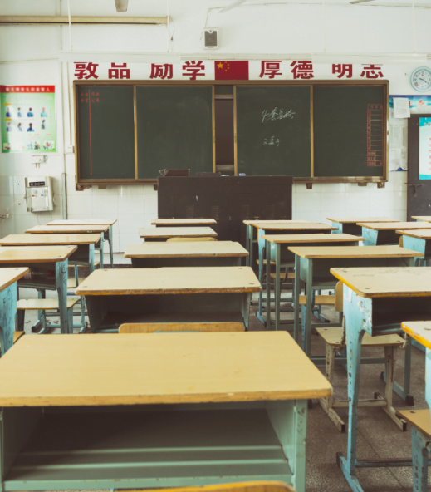
01 家 长 会 意义
输入您的标题
Parents' meeting
输入您的标题
Parents' meeting
No matter how long the rain lasts, there will be a rainbow in the end.
No matter how long the rain lasts, there will be a rainbow in the end.

Slide 6
01 家 长 会 意义
01
02
03
04
输入标题
输入标题
输入标题
输入标题
No matter how long the rain lasts, there will be a rainbow in the end.
No matter how long the rain lasts, there will be a rainbow in the end.
No matter how long the rain lasts, there will be a rainbow in the end.
No matter how long the rain lasts, there will be a rainbow in the end.

Slide 7
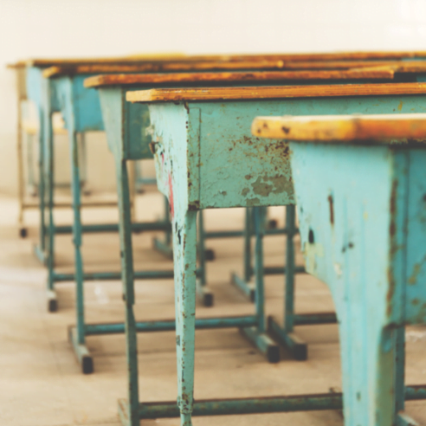
01 家 长 会 意义
输入标题
输入标题
No matter how long the rain lasts, there will be a rainbow in the end.
No matter how long the rain lasts, there will be a rainbow in the end.
输入标题
输入标题
No matter how long the rain lasts, there will be a rainbow in the end.
No matter how long the rain lasts, there will be a rainbow in the end.

Slide 8
PART TWO
班 级 介 绍
No matter how long the rain lasts, there will be a rainbow in the end. No matter how sad you may be.

Slide 9
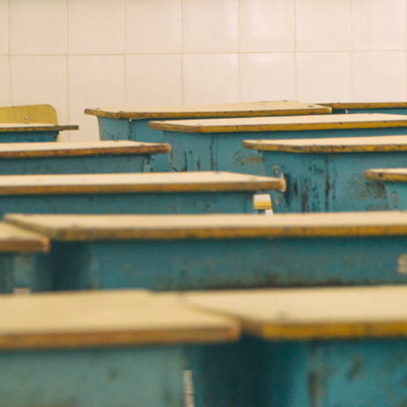

02 班 级 介 绍
输入您的标题
No matter how long the rain lasts, there will be a rainbow in the end.
40%
输入您的标题
No matter how long the rain lasts, there will be a rainbow in the end.
50%
输入您的标题
No matter how long the rain lasts, there will be a rainbow in the end.
70%

Slide 10
02 班 级 介 绍
输入标题
输入标题
输入标题
No matter how long the rain lasts, there will be a rainbow in the end.
No matter how long the rain lasts, there will be a rainbow in the end.
No matter how long the rain lasts, there will be a rainbow in the end.

Slide 11
02 班 级 介 绍
输入您的标题
No matter how long the rain lasts, there will be a rainbow in the end.
输入您的标题
No matter how long the rain lasts, there will be a rainbow in the end.
输入您的标题
No matter how long the rain lasts, there will be a rainbow in the end.
输入您的标题
No matter how long the rain lasts, there will be a rainbow in the end.
输入您的标题
No matter how long the rain lasts, there will be a rainbow in the end.

Slide 12
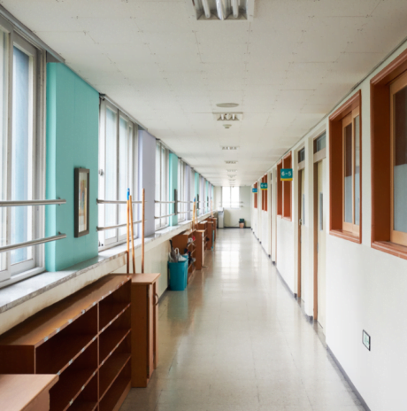
02 班 级 介 绍
01
02
03
输入您的标题
No matter how long the rain lasts, there will be a rainbow in the end.
输入您的标题
No matter how long the rain lasts, there will be a rainbow in the end.
输入您的标题
No matter how long the rain lasts, there will be a rainbow in the end.

Slide 13
PART THREE
给家长的建议
No matter how long the rain lasts, there will be a rainbow in the end. No matter how sad you may be.

Slide 14
03 给 家 长 的 建 议
输入您的标题
No matter how long the rain lasts, there will be a rainbow in the end.
02
04
输入您的标题
No matter how long the rain lasts, there will be a rainbow in the end.
01
03
05
输入您的标题
No matter how long the rain lasts, there will be a rainbow in the end.
输入您的标题
No matter how long the rain lasts, there will be a rainbow in the end.

Slide 15
03 给 家 长 的 建 议
标题文字添加
标题文字添加
No matter how long the rain lasts, there will be a rainbow in the end. No matter how sad you may be, believe.
No matter how long the rain lasts, there will be a rainbow in the end. No matter how sad you may be, believe.
标题文字添加
标题文字添加
No matter how long the rain lasts, there will be a rainbow in the end. No matter how sad you may be, believe.
No matter how long the rain lasts, there will be a rainbow in the end. No matter how sad you may be, believe.

Slide 16


03 给 家 长 的 建 议
输入您的标题
No matter how long the rain lasts, there will be a rainbow in the end.
输入此处标题
输入此处标题
No matter how long the rain lasts, there will be a rainbow in the end. No matter how sad you may be.
No matter how long the rain lasts, there will be a rainbow in the end. No matter how sad you may be.

Slide 17
03 给 家 长 的 建 议
输入您标题
No matter how long the rain lasts.
输入您标题
No matter how long the rain lasts.
输入您标题
No matter how long the rain lasts, there will be a rainbow in the end.
输入您标题
No matter how long the rain lasts, there will be a rainbow in the end.
输入您标题
No matter how long the rain lasts, there will be a rainbow in the end.

Slide 18
PART FOUR
新学期安排
No matter how long the rain lasts, there will be a rainbow in the end. No matter how sad you may be.

Slide 19
04 新 学 期 安 排

Slide 20
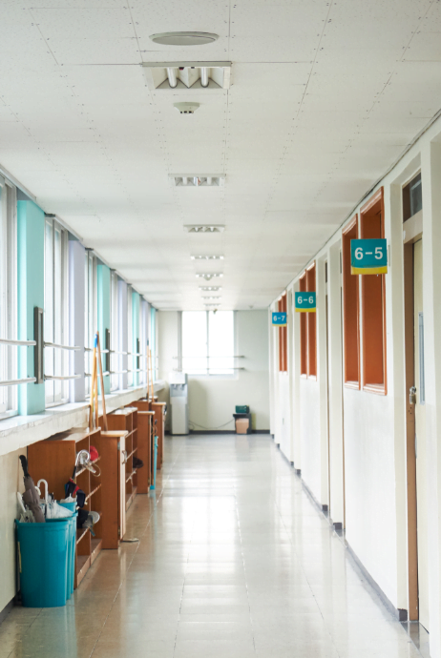
04 新 学 期 安 排
输入您标题
Parents' meeting
输入您标题
Parents' meeting
No matter how long the rain lasts, there will.
No matter how long the rain lasts, there will.
输入您标题
Parents' meeting
输入您标题
Parents' meeting
No matter how long the rain lasts, there will.
No matter how long the rain lasts, there will.

Slide 21
04 新 学 期 安 排
01
02
03
04
输入标题
输入标题
输入标题
输入标题
No matter how long the rain lasts, there will be a rainbow.
No matter how long the rain lasts, there will be a rainbow.
No matter how long the rain lasts, there will be a rainbow.
No matter how long the rain lasts, there will be a rainbow.

Slide 22
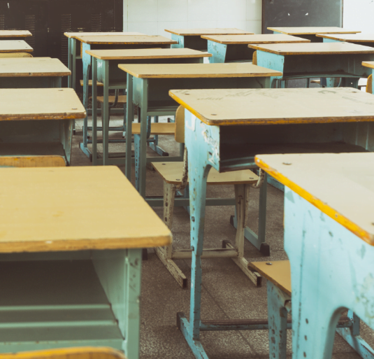
04 新 学 期 安 排
标题文字添加
No matter how long the rain lasts, there will be a rainbow in the end. ，
标题文字添加
No matter how long the rain lasts, there will be a rainbow in the end.
标题文字添加
No matter how long the rain lasts, there will be a rainbow in the end.

Slide 23

04 新 学 期 安 排
标题文字添加
标题文字添加
No matter how long the rain lasts, there will be a rainbow in the end.
No matter how long the rain lasts, there will be a rainbow in the end.
01
02
标题文字添加
标题文字添加
No matter how long the rain lasts, there will be a rainbow in the end.
No matter how long the rain lasts, there will be a rainbow in the end.

Slide 24
04 新 学 期 安 排
63%
输入您的标题
No matter how long the rain lasts, there will be a rainbow in the end.
35%
输入您的标题
No matter how long the rain lasts, there will be a rainbow in the end.
84%
输入您的标题
No matter how long the rain lasts, there will be a rainbow in the end.
67%

Slide 25
感谢您欣赏
幼儿园课件/小学生家长会/幼儿教育/学校课件
汇报人：XXX
汇报人时间：20XX.12

