Slide 1
201X
英语故事教学讲座ppt模板

Slide 2

目 录
CONTENS
PART ONE
PART TWO
PART THREE
PART FOUR

Slide 3

Someday, when we are no longer teachers, but the representatives of the world’s largest educational service cooperation, you may finally show us the respect we deserve, we won’t have to rely on lawsuit to communicate with each other .
01
PART ONE

Slide 4
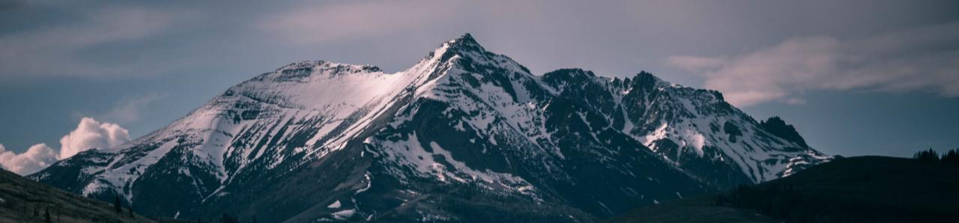
YOUR POINT
01
02
03
04
Click Here
Click Here
Click Here
Click Here
Someday, when we are no longer teachers, but the representatives of the world’s largest educational service cooperation, you may finally show us the respect we deserve, we won’t have to rely on lawsuit to communicate with each other .

Slide 5
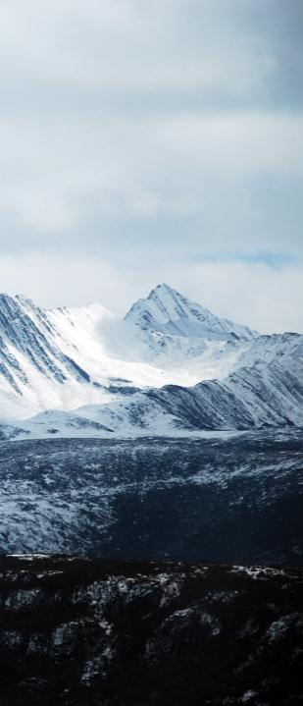
Click Here Add Your Point
Click Here
Someday, when we are no longer teachers, but the representative of the world’s largest educational service cooperation, you may finally show us the respect we deserve.
Click Here
Someday, when we are no longer teachers, but the representative of the world’s largest educational service cooperation, you may finally show us the respect we deserve.
Click Here
Someday, when we are no longer teachers, but the representative of the world’s largest educational service cooperation, you may finally show us the respect we deserve.

Slide 6
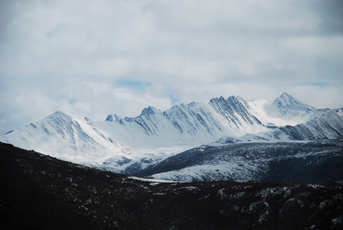
Click Here Add Your Point
Someday, when we are no longer teachers, but the representatives of the world’s largest educational service cooperation, you may finally show us the respect we deserve, we won’t have to rely on lawsuit to communicate with each other .
Click Here
Someday, when we are no longer teachers, but the representative of the world’s largest educational service cooperation, you may finally show us the respect we deserve.

Slide 7
Someday, when we are no longer teachers, but the representatives of the world’s largest educational service cooperation, you may finally show us the respect we deserve, we won’t have to rely on lawsuit to communicate with each other .
02
PART ONE

Slide 8
Click Here Add Your Point
Click Here
Someday, when we are no longer teachers, but the representative of the world’s largest educational service cooperation, you may finally show us the respect we deserve.
Click Here
Now, I am standing here, terrified even as we speak, but as my friend once said, some things are so important that they force us to overcome our fears.

Slide 9
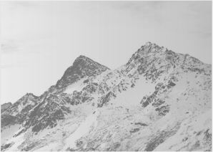
Click Here Add Your Point
Click Here
Now, I am standing here, terrified even as we speak, but as my friend once said, some things are so important that they force us to overcome our fears.
Click Here
Click Here
Click Here
Now, I am standing here, terrified even as we speak, but as my friend once said, some things are so important that they force us to overcome our fears.
Now, I am standing here, terrified even as we speak, but as my friend once said, some things are so important that they force us to overcome our fears.

Slide 10

Click Here Add Your Point
Click Here
Now, I am standing here, terrified even as we speak, but as my friend once said, some things are so important that they force us to overcome our fears.
Click Here
Now, I am standing here, terrified even as we speak, but as my friend once said, some things are so important that they force us to overcome our fears.
Click Here
But as my friend once said, some things are so important that they force us to overcome our fears.

Slide 11
Someday, when we are no longer teachers, but the representatives of the world’s largest educational service cooperation, you may finally show us the respect we deserve, we won’t have to rely on lawsuit to communicate with each other .
03
PART ONE

Slide 12
Click Here Add Your Point
25%
45%
30%
65%
Click Here
Click Here
Click Here
Click Here
Someday, when we are no longer teachers, but the representative of the world’s largest educational service cooperation, you may finally show us the respect we deserve.

Slide 13
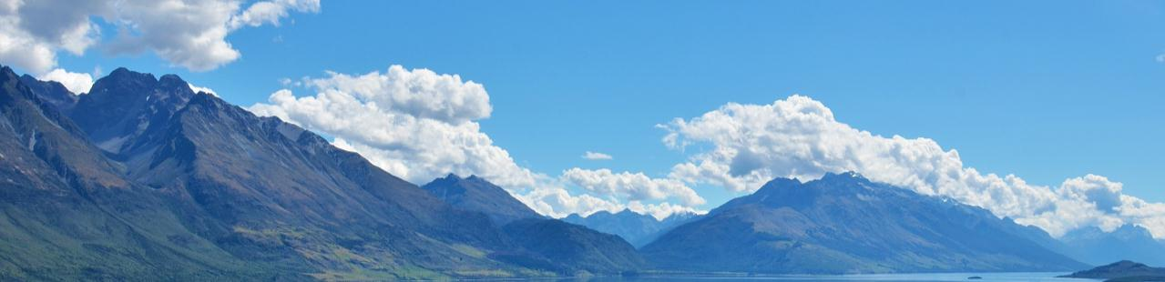
Click Here Add Your Point
Click Here
Now, I am standing here, terrified even as we speak, but as my friend once said, some things are so important that they force us to overcome our fears.
Click Here
Click Here
Click Here
Someday, when we are no longer teachers, but the representative of the world’s largest educational service cooperation, you may finally show us the respect we deserve.

Slide 14
Click Here Add Your Point
S
W
Strengths
Weakness
Now, I am standing here, terrified even as we speak.
Now, I am standing here, terrified even as we speak.
Threats
Opportunities
T
O
Now, I am standing here, terrified even as we speak.
Now, I am standing here, terrified even as we speak.
Now, I am standing here, terrified even as we speak, but as my friend once said, some things are so important that they force us to overcome our fears.

Slide 15
Someday, when we are no longer teachers, but the representatives of the world’s largest educational service cooperation, you may finally show us the respect we deserve, we won’t have to rely on lawsuit to communicate with each other .
04
PART ONE

Slide 16
Click Here Add Your Point
01 Click Here
02 Click Here
Now, I am standing here, terrified even as we speak.
Now, I am standing here, terrified even as we speak.
04
03
02
01
03 Click Here
04 Click Here
Now, I am standing here, terrified even as we speak.
Now, I am standing here, terrified even as we speak.

Slide 17
Click Here Add Your Point
Click Here
Now, I am standing here, terrified even as we speak, but as my friend once said, some things are so important that they force us to overcome our fears.
Click Here
Now, I am standing here, terrified even as we speak, but as my friend once said, some things are so important that they force us to overcome our fears.

Slide 18
THANKS

