Slide 1



剪
花
纸
卉
绿杨芳草长亭路。年少抛人容易去。楼头残梦五更钟，花底离情八月雨。无情不似多情苦。一寸还成千万缕。天涯地角有穷时，只有相思无尽处。

Slide 2

目
录
章节肆
章节叁
章节贰
章节壹
请添加章节标题
请添加章节标题
请添加章节标题
请添加章节标题

Slide 3
第
部
壹
分
绿杨芳草长亭路。年少抛人容易去。楼头残梦五更钟，花底离情八月雨。无情不似多情苦。一寸还成千万缕。天涯地角有穷时，只有相思无尽处。

Slide 4


在此输入标题
这里输入文字标题
Summer a lot of things began to trivial for example, I hide in behind the morning in a hurry to eat text, breathed
这里输入文字标题
这里输入文字标题
Summer a lot of things began to trivial for example, I hide in behind the morning in a hurry to eat text, breathed
Summer a lot of things began to trivial for example, I hide in behind the morning in a hurry to eat text, breathed

Slide 5

在此输入标题
这里输入文字标题
Summer a lot of things began to trivial for example, I hide in behind the morning in a hurry to eat text, breathed life back to the story, then through these years of ladder to update a day in and day

Slide 6

在此输入标题
画堂八月初八日
画堂八月初八日，絮扑窗纱燕拂檐。莲子数杯尝冷酒，柘枝一曲试春衫。，
絮扑窗纱燕拂檐，
画堂八月初八日，絮扑窗纱燕拂檐。莲子数杯尝冷酒，柘枝一曲试春衫。，
莲子数杯尝冷酒，柘枝一曲试春衫。
画堂八月初八日，絮扑窗纱燕拂檐。莲子数杯尝冷酒，柘枝一曲试春衫。，

Slide 7
在此输入标题
这里输入文字标题
这里输入文字标题
Summer a lot of things began to trivial for example, I hide in behind the morning in a hurry to eat text, breathed
Summer a lot of things began to trivial for example, I hide in behind the morning in a hurry to eat text, breathed
这里输入文字标题
这里输入文字标题
Summer a lot of things began to trivial for example, I hide in behind the morning in a hurry to eat text, breathed
Summer a lot of things began to trivial for example, I hide in behind the morning in a hurry to eat text, breathed

Slide 8
在此输入标题
文本内容
画堂八月初八日，絮扑窗纱燕拂檐。莲子数杯尝冷酒，柘枝一曲试春衫。，
文本内容
画堂八月初八日，絮扑窗纱燕拂檐。莲子数杯尝冷酒，柘枝一曲试春衫。，
文本内容
画堂八月初八日，絮扑窗纱燕拂檐。莲子数杯尝冷酒，柘枝一曲试春衫。，

Slide 9
第
部
贰
分
绿杨芳草长亭路。年少抛人容易去。楼头残梦五更钟，花底离情八月雨。无情不似多情苦。一寸还成千万缕。天涯地角有穷时，只有相思无尽处。

Slide 10
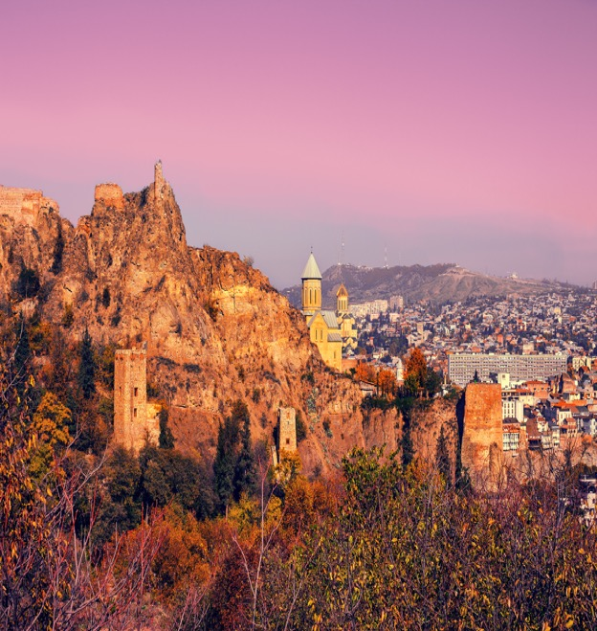

在此输入标题
絮扑窗纱燕拂檐，
画堂三月初三日，絮扑窗纱燕拂檐。莲子数杯尝冷酒，柘枝一曲试春衫。，

Slide 11


在此输入标题
这里输入文字标题
这里输入文字标题
剪纸
Summer a lot of things began to trivial for example, I hide in behind the morning in a hurry to eat text, breathed life back to the story, then through these years of ladder to update a day in and day out of
Summer a lot of things began to trivial for example, I hide in behind the morning in a hurry to eat text, breathed life back to the story, then through these years of ladder to update a day in and day out of

Slide 12



在此输入标题
八月八
八月八
画堂八月初八日
絮扑窗纱燕拂檐
莲子数杯尝冷酒
柘枝一曲试春衫
画堂八月初八日
絮扑窗纱燕拂檐
莲子数杯尝冷酒
柘枝一曲试春衫
Blue And White Porcelain
Blue And White Porcelain
八月八
画堂八月初八日
絮扑窗纱燕拂檐
莲子数杯尝冷酒
柘枝一曲试春衫
Blue And White Porcelain

Slide 13

在此输入标题
这里输入文字标题
Summer a lot of things began to trivial for example, I hide in behind the morning in a hurry to eat text, breathed life back to the story, then through these years of ladder to update a day in and day out of
这里输入文字标题
Summer a lot of things began to trivial for example, I hide in behind the morning in a hurry to eat text, breathed life back to the story, then through these years of ladder to update a day in and day out of

Slide 14

在此输入标题
画堂八月初八日
画堂八月初八日，絮扑窗纱燕拂檐。莲子数杯尝冷酒，柘枝一曲试春衫。，
1
絮扑窗纱燕拂檐，
PART 2
画堂八月初八日，絮扑窗纱燕拂檐。莲子数杯尝冷酒，

Slide 15
第
部
叁
分
绿杨芳草长亭路。年少抛人容易去。楼头残梦五更钟，花底离情八月雨。无情不似多情苦。一寸还成千万缕。天涯地角有穷时，只有相思无尽处。

Slide 16
在此输入标题
这里输入文字标题
Summer a lot of things began to trivial for example, I hide in behind the morning in a hurry to eat text, breathed
这里输入文字标题
Summer a lot of things began to trivial for example, I hide in behind the morning in a hurry to eat text, breathed

Slide 17
在此输入标题
这里输入文字标题
Summer a lot of things began to trivial for example, I hide in behind the morning in a hurry to eat text, breathed
这里输入文字标题
Summer a lot of things began to trivial for example, I hide in behind the morning in a hurry to eat text, breathed

Slide 18


在此输入标题
壹
贰
叁
肆
剪纸花卉
这里输入标题
这里输入标题
这里输入标题
这里输入标题

Slide 19
第
部
肆
分
绿杨芳草长亭路。年少抛人容易去。楼头残梦五更钟，花底离情八月雨。无情不似多情苦。一寸还成千万缕。天涯地角有穷时，只有相思无尽处。

Slide 20

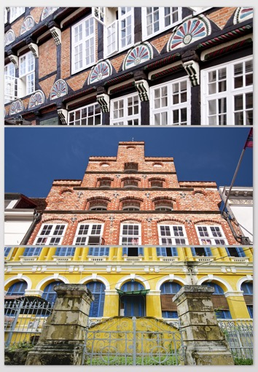
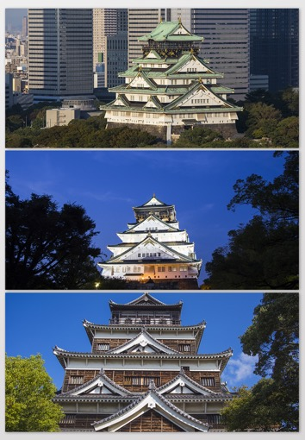
在此输入标题
请在这里
输入标题

Slide 21



在此输入标题
点击输入文本内容
在这里输入副标题
点击添加标题
我说你是人间的四月天，
笑声点亮了四面风，
轻灵在春的光焰中交舞着变换。
你是四月早天里的云烟。
点击添加标题
我说你是人间的四月天，
笑声点亮了四面风，
轻灵在春的光焰中交舞着变换。
你是四月早天里的云烟。

Slide 22
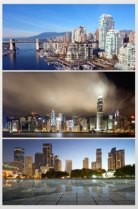

在此输入标题
输入文字
Summer a lot of things began to trivial for example, I hide in behind the morning in a hurry to eat text,
点击此处输入您的内容与此小标题
点击此处输入您的内容与此小标题
点击此处输入您的内容与此小标题
点击此处输入您的内容与此小标题
点击此处输入您的内容与此小标题
点击此处输入您的内容与此小标题
点击此处输入您的内容与此小标题
点击此处输入您的内容与此小标题

Slide 23

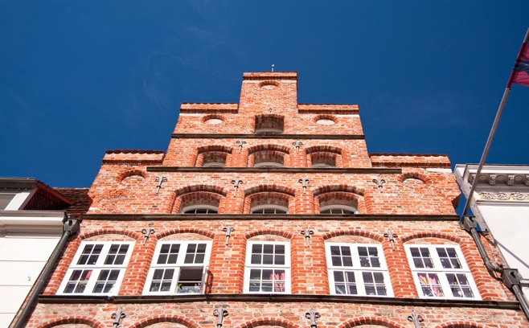
在此输入标题
这里输入文字标题
Summer a lot of things began to trivial for example, I hide in behind the morning in a hurry to eat text, breathed life back to the story, then through these years of ladder to update a day in and day
这里输入文字标题
Summer a lot of things began to trivial for example, I hide in behind the morning in a hurry to eat text, breathed life back to the story, then through these years of ladder to update a day in and day

Slide 24
在此输入标题
输入文字标题
Summer a lot of things began to trivial for example, I hide in behind the morning in a hurry to eat text,
输入文字标题
Summer a lot of things began to trivial for example, I hide in behind the morning in a hurry to eat text,

Slide 25
再
会
绿杨芳草长亭路。年少抛人容易去。楼头残梦五更钟，花底离情八月雨。无情不似多情苦。一寸还成千万缕。天涯地角有穷时，只有相思无尽处。

