Slide 1




企业年终总结誓师大会
汇报人：xxx 时间：XX年XX月

Slide 2


领导致辞
新年伊始，让我们把一切所经历过的，统统成为过去吧！以往的成功也好，失败也罢，让我们卸下沉重的包袱轻装上阵。新的一年，翻开新的一页，所有的期待与希望、向往与憧憬向我们走来。生活还要继续，梦想不断延伸，脚步依旧执着。整理好行囊，带上健康与平安，因为健康是幸福的起点，平安是最单纯的快乐，伴着一份好心情，微笑着出发，脚步轻盈，且歌且行。

Slide 3


晚 会 流 程
2017业绩回顾
优秀员工颁奖
文艺演出汇报
2018展望规划

Slide 4

【第一章】
业绩回顾
The user can demonstrate on a projector or computer, or print the presentation and make it into a film to be used in a wider field. Using PowerPoint, not only can you create presentations, you can also hold face-to-face meetings, teleconferencing, or presentations on the Internet

Slide 5

业绩回顾
标题文字添加
print the presentation and make it into a film to be used in a wider field
标题
添加
标题文字添加
print the presentation and make it into a film to be used in a wider field
标题文字添加
print the presentation and make it into a film to be used in a wider field

Slide 6
业绩回顾
标题文字添加
标题文字添加
print the presentation and make it into a film to be used in a wider field
print the presentation and make it into a film to be used in a wider field
标题
添加
标题文字添加
标题文字添加
print the presentation and make it into a film to be used in a wider field
print the presentation and make it into a film to be used in a wider field

Slide 7
业绩回顾
标题文字添加
标题文字添加
标题文字添加
标题文字添加
print the presentation and make it into a film to be used in a wider field
print the presentation and make it into a film to be used in a wider field
print the presentation and make it into a film to be used in a wider field
print the presentation and make it into a film to be used in a wider field

Slide 8
业绩回顾
标题文字添加
标题文字添加
print the presentation and make it into a film to be used in a wider field
print the presentation and make it into a film to be used in a wider field
标题文字添加
标题文字添加
print the presentation and make it into a film to be used in a wider field
标题文字添加
print the presentation and make it into a film to be used in a wider field
print the presentation and make it into a film to be used in a wider field

Slide 9
【第二章】
颁奖盛典
The user can demonstrate on a projector or computer, or print the presentation and make it into a film to be used in a wider field. Using PowerPoint, not only can you create presentations, you can also hold face-to-face meetings, teleconferencing, or presentations on the Internet

Slide 10

最佳贡献奖
新年伊始，让我们把一切所经历过的，统统成为过去吧！以往的成功也好，失败也罢，让我们卸下沉重的包袱轻装上阵。新的一年，翻开新的一页，所有的期待与希望、向往与憧憬向我们走来

Slide 11




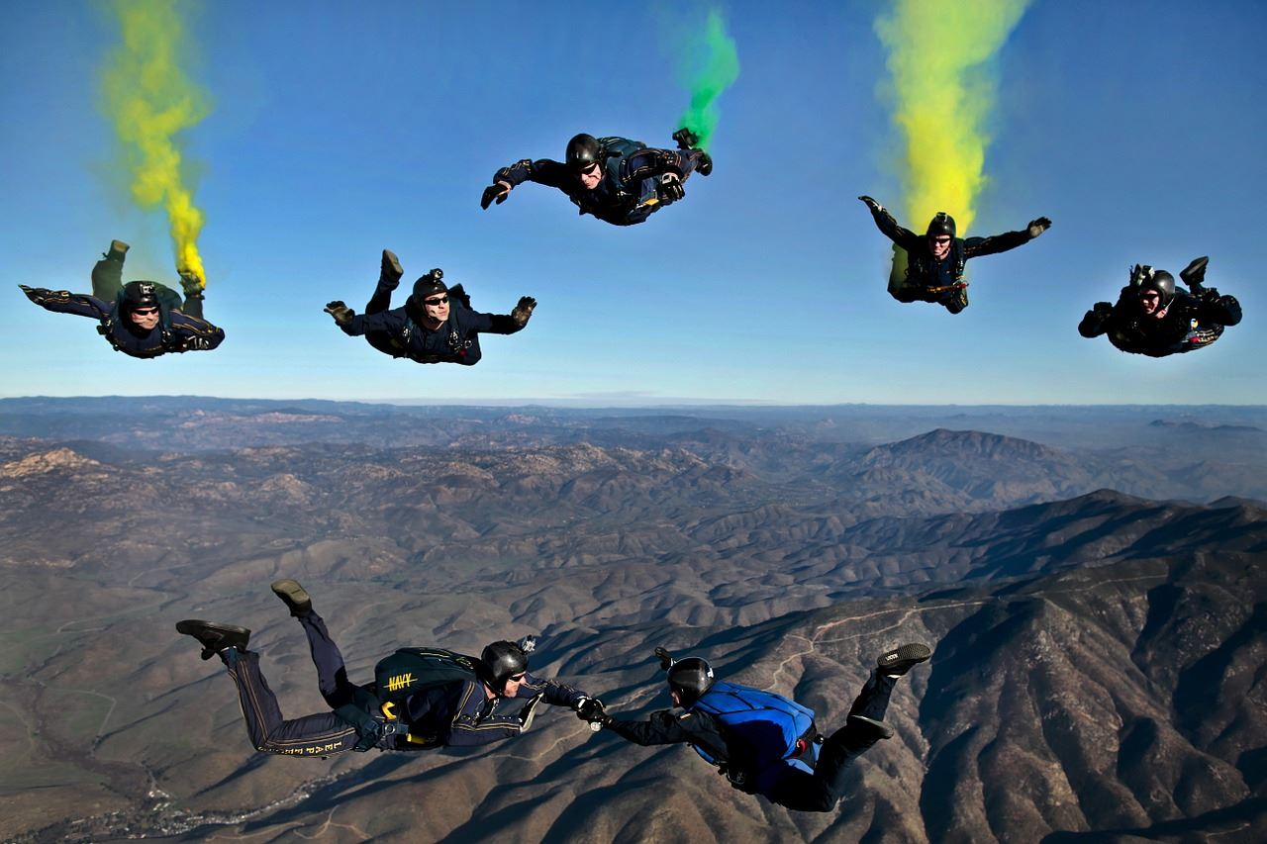


【XXXX】
【XXXX】
【XXXX】
【XXXX】

Slide 12
最佳贡献奖
新年伊始，让我们把一切所经历过的，统统成为过去吧！以往的成功也好，失败也罢，让我们卸下沉重的包袱轻装上阵。新的一年，翻开新的一页，所有的期待与希望、向往与憧憬向我们走来

Slide 13


【XXXX】
【XXXX】

Slide 14
最佳贡献奖
新年伊始，让我们把一切所经历过的，统统成为过去吧！以往的成功也好，失败也罢，让我们卸下沉重的包袱轻装上阵。新的一年，翻开新的一页，所有的期待与希望、向往与憧憬向我们走来

Slide 15



【XXXX】
【XXXX】
【XXXX】

Slide 16
【第三章】
节目汇演
The user can demonstrate on a projector or computer, or print the presentation and make it into a film to be used in a wider field. Using PowerPoint, not only can you create presentations, you can also hold face-to-face meetings, teleconferencing, or presentations on the Internet

Slide 17

歌曲演唱
表演者：财务部、销售部、工程部

Slide 18
舞蹈表演
表演者：财务部、销售部、工程部

Slide 19
话剧演出
表演者：财务部、销售部、工程部

Slide 20


幸运大抽奖
The user can demonstrate on a projector or computer, or print the presentation and make it into a film to be used in a wider field. Using PowerPoint, not only can you create presentations, you can also hold face-to-face meetings, teleconferencing, or presentations on the Internet

Slide 21
【第四章】
领导寄语
The user can demonstrate on a projector or computer, or print the presentation and make it into a film to be used in a wider field. Using PowerPoint, not only can you create presentations, you can also hold face-to-face meetings, teleconferencing, or presentations on the Internet

Slide 22

业绩回顾
标题文字添加
print the presentation and make it into a film to be used in a wider field
标题文字添加
print the presentation and make it into a film to be used in a wider field
标题文字添加
print the presentation and make it into a film to be used in a wider field

Slide 23
业绩回顾
标题文字添加
标题文字添加
标题文字添加
标题文字添加
print the presentation and make it into a film to be used in a wider field
print the presentation and make it into a film to be used in a wider field
print the presentation and make it into a film to be used in a wider field
print the presentation and make it into a film to be used in a wider field

Slide 24


新年伊始，让我们把一切所经历过的，统统成为过去吧！以往的成功也好，失败也罢，让我们卸下沉重的包袱轻装上阵。新的一年，翻开新的一页，所有的期待与希望、向往与憧憬向我们走来。生活还要继续，梦想不断延伸，脚步依旧执着。整理好行囊，带上健康与平安，因为健康是幸福的起点，平安是最单纯的快乐，伴着一份好心情，微笑着出发，脚步轻盈，且歌且行。

Slide 25
晚会到此结束

