Slide 1

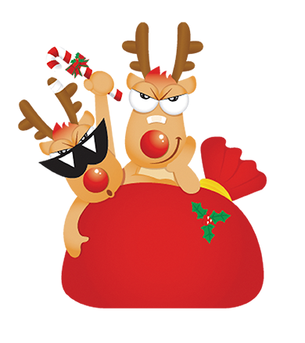







奶茶圣诞节活动方案ppt模板

Slide 2


New year
新年
Christmas
圣诞
Silent Night
平安夜

Slide 3




亲爱的XXX：
在冰雪还没飘下，圣诞老人还没睡醒，圣诞树还未长高，袜子还没挂上窗前，礼物还未准备好，大家的祝福还没有漫天弥漫之前，先祝你圣诞快乐，天天开心!
December 25th is the day of celebration and of fun and frolic. As the long awaited winter holidays arrive, Christmas spirit builds up.

Slide 4
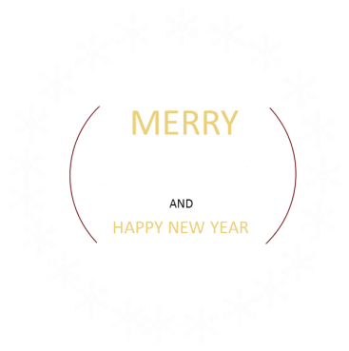

December 25th is the day of celebration and of fun and frolic. As the long awaited winter holidays arrive, Christmas spirit builds up.
圣诞节本来是基督教徒的节日，由于人们格外重视，它便成为一个全民性的节日，国家一年中最盛大的节日，可以和新年相提并论，类似我国过春节。

Slide 5
The lovely snowflakes,
our dear Santa, decorated homes complete with whole range of
Christmas star, mistletoe, the good-luck plant, ivy, laurels and not the least the beautifully decorated
and illuminated Christmas tree are some of the inseparable parts of the picture.

Slide 6
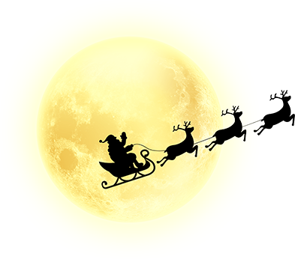


Dear：
The soft music of the Christmas carols and children eager to open their gifts certainly lend unique warmth to the coldest day of the year.

Slide 7


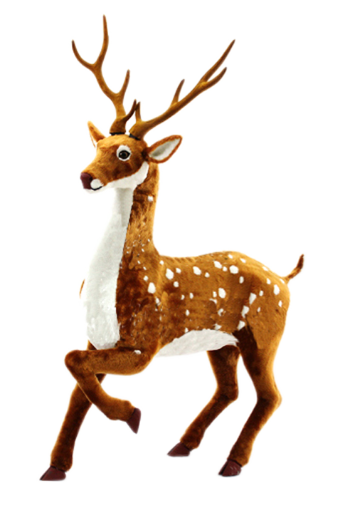
Dear：
People visit their families
and arrange some of the most
lavish parties. The most awaited festival, the Christmas signifies love and kindness, joy and happiness. The holiday spirit of the season in one word is - infectious!

Slide 8
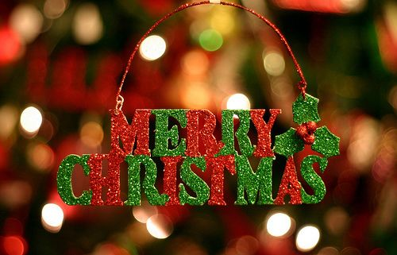
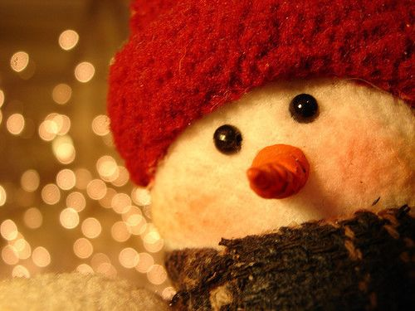
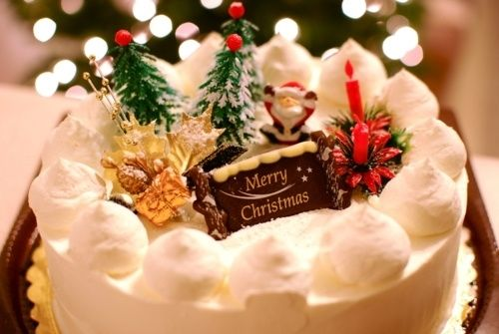
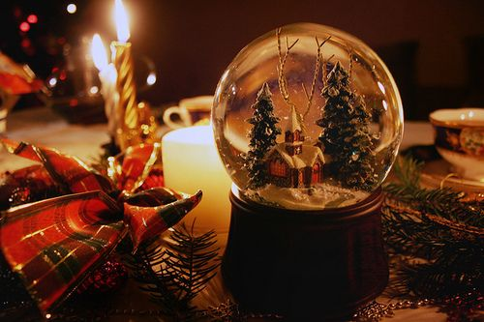
I love you
MERRY
CHRISTMAS

Slide 9

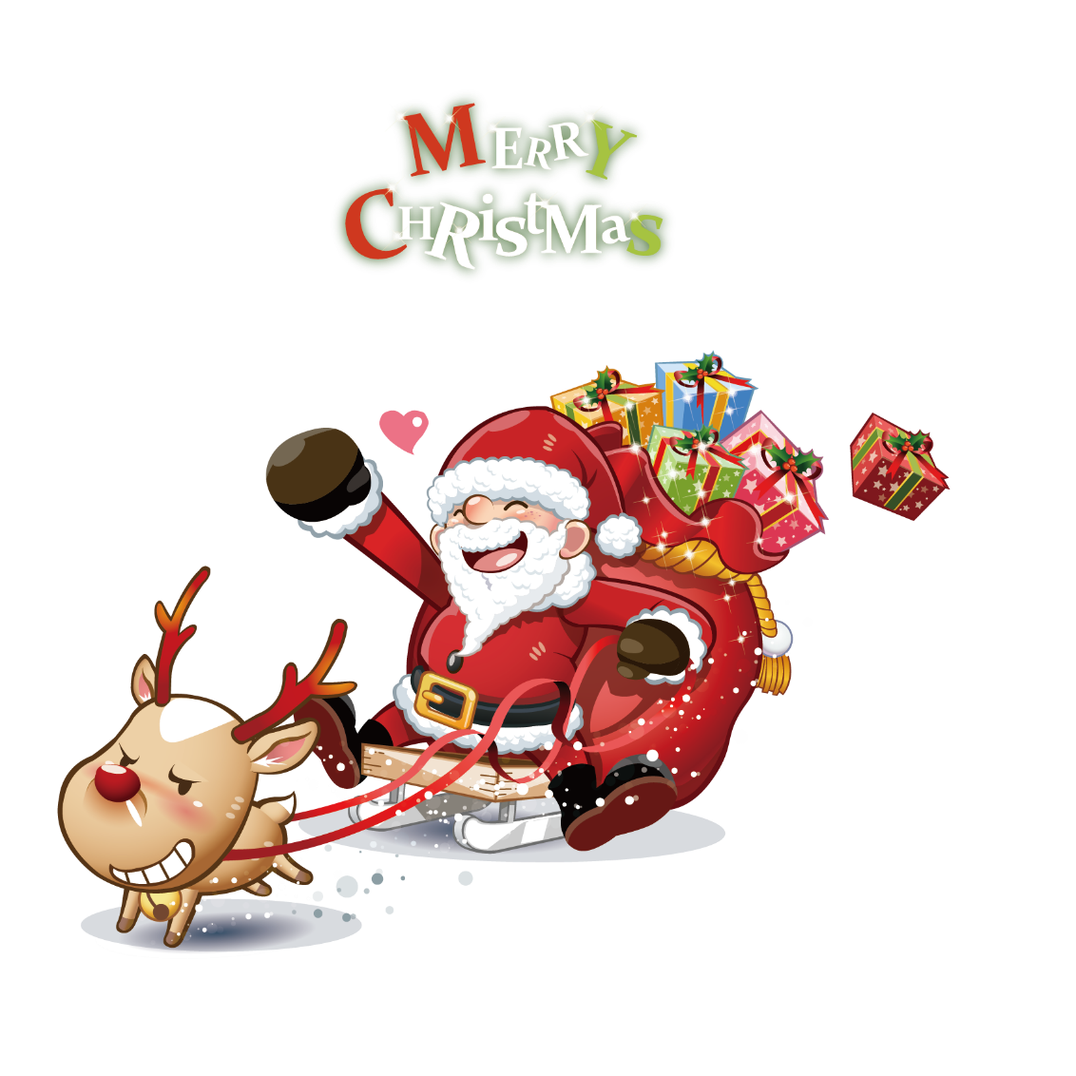
Dear:
Silent Night，Silent night Holy night ，All is calm all is bright ，Round you virgin Mother and Child ，Holy infant so tender and mild，Sleep in heavenly peace ，Sleep in heavenly peace.

Slide 10






