Slide 1


浪漫
情人节相册
执之子手，与子偕老。
我爱你

Slide 2

01 添加标题
Please add title content
02 添加标题
Please add title content
03 添加标题
Please add title content
04 添加标题
Please add title content

Slide 3

Part 01
Don't you be afraid whether old ugly sick I love you

Slide 4


Yes ,I do!
（You er the only one in my heart）
期待爱情最美丽的那刻，你我在爱的名义下步入圣殿，接受全世界
最诚心的祝福,SAY YES！这是我们彼此的共鸣......

Slide 5


美
好
时
光
May Jesus Christ always be at the center of the new lives you are now starting to build together, that you may know the ways of true love and kindness.
你好，幸福！
HELLO
HAPPINESS !

Slide 6

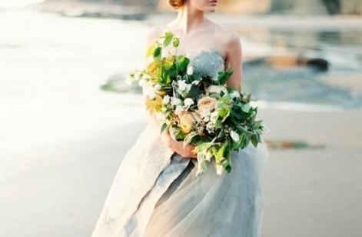

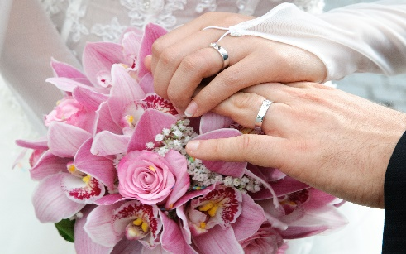


亲爱的，我已病入膏肓，因为不知道怎么了
我的眼睛里只能看到你的身影，耳朵里只能听得到你的声音，脑海里只有你的记忆，心中塞满了你的名字
You two are a perfect match. Here's wishing you both a lifetime of happiness.
无论你在何时，无论你在何处
无论你做什么；请记住：我永远支持你，
无时无刻不着你，因为你是我最爱的人！

Slide 7

背上我的行囊
我要把你寻找
May Jesus Christ always be at the center of the new lives you are now starting to build together, that you may know the ways of true love and kindness.
你好，幸福！
HELLOHAPPINESS !

Slide 8
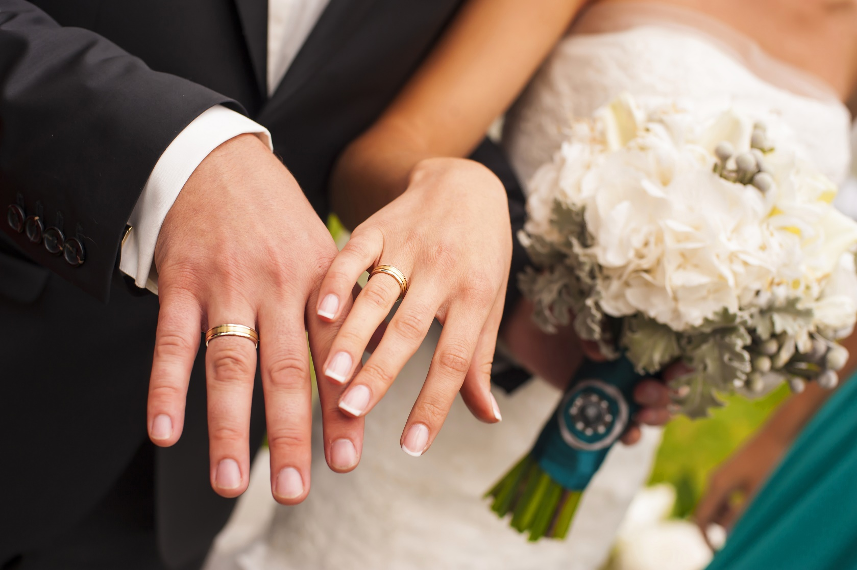
Part 02
Don't you be afraid whether old ugly sick I love you

Slide 9



May Jesus Christ always be at the center of the new lives you are now starting to build together, that you may know the ways of true love and kindness.
你好，幸福！
HELLO
HAPPINESS !

Slide 10
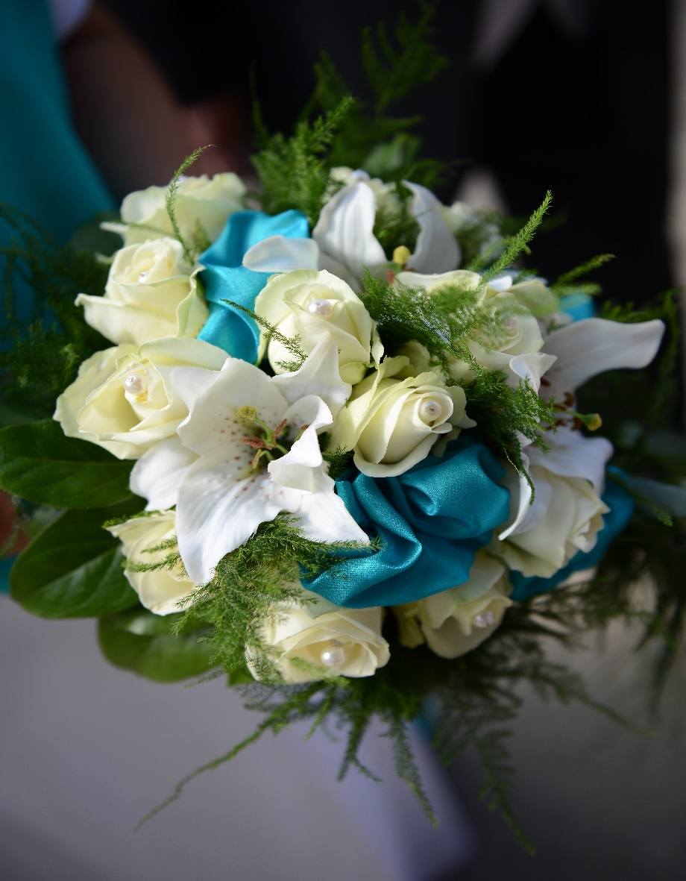
两颗心， 一种爱
BELONGS ONLY TO YOU MY ROMANCE
If you were a teardrop;
In my eye,For fear of losing you,I would never cry.
And if the golden sun,Should cease to shine its light,Just one smile from you,Would make my whole world bright. Hannah Jo Keen.

Slide 11

你好，幸福！
HELLO
HAPPINESS !
May Jesus Christ, our Lord and Savior ,always be at the center of the new lives you are now starting to build together, that you may know the ways of true love and kindness. May the Lord bless you both all the days of your lives and fill you with his joy. Amen.

Slide 12

My Lover！
2017
May Jesus Christ always be at the center of the new lives you are now starting to build together, that you may know the ways of true love and kindness.
你好，幸福！
HELLO
HAPPINESS !

Slide 13
Part 03
Don't you be afraid whether old ugly sick I love you

Slide 14

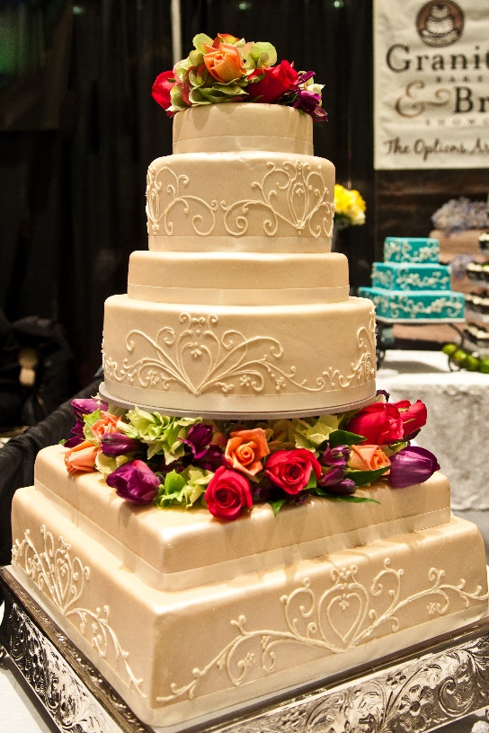

调皮的你
You Naughty
当你开心的时候，我也会不知不觉笑出来；当你难过的时候，我的心比你更痛苦。我很喜欢你笑的样子，真希望自己能够永远珍藏你的笑容。请你嫁给我吧，我一定会让你永远幸福快乐！
“
”

Slide 15
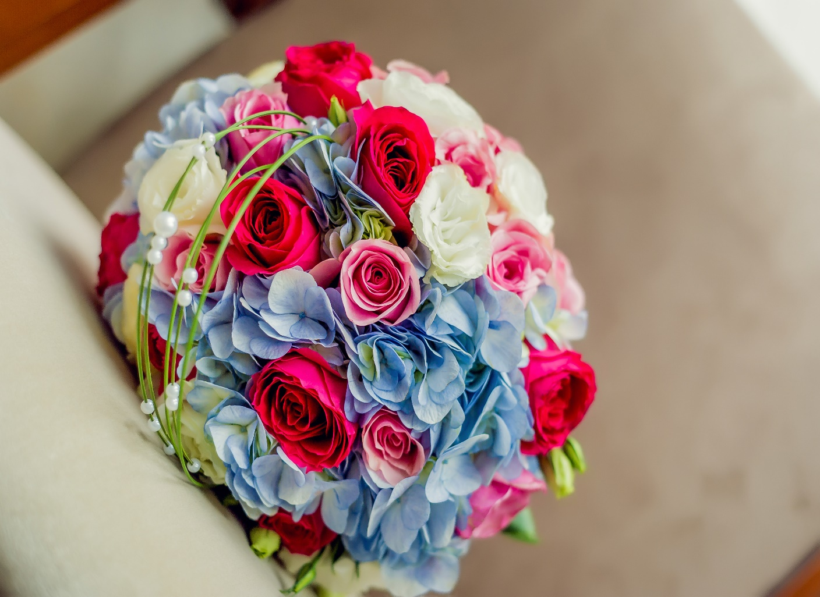
God bless you and yours, and surround you ever with his blessing.
I LOVE YOU !
May the joy you share on your wedding day .Be the kind you'll share all along life's way. May the joy you share on your wedding

Slide 16


OUR LOVE STORY

Slide 17

Part 04
Don't you be afraid whether old ugly sick I love you

Slide 18


相识
acquaintance
某日
充满阳光的教室
初次相遇
刺眼的阳光温暖了我们
此生注定我们在一起

Slide 19

相恋
Fall in love
某日
第一次想你
想着你甜甜的笑容
想着了你
嗯 ，只能想着你

Slide 20
相守
wedding
望有一天
我能站在教堂的一端
等着你来到我身边
在别人的见证下
许下一生的承诺
我爱你
太阳

Slide 21


这一刻，
爱吧

