Slide 1


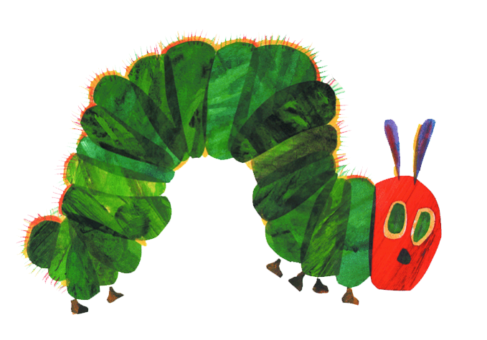
亲亲我的宝贝·儿童系列绘本故事
好饿好饿的毛毛虫

Slide 2

目录
contents
01
HEAD INFO HERE
We have many PowerPoint templates that has been specifically designed.
02
HEAD INFO HERE
We have many PowerPoint templates that has been specifically designed.
03
HEAD INFO HERE
We have many PowerPoint templates that has been specifically designed.
04
HEAD INFO HERE
We have many PowerPoint templates that has been specifically designed.

Slide 3
01
HEAD INFO HERE
We have many PowerPoint templates that has been specifically designed.

Slide 4

01
Write your great title here
毛毛虫

Slide 5


01
Write your great title here

Slide 6
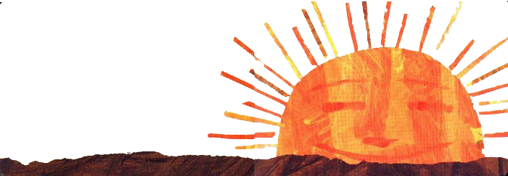
01
Write your great title here
看看谁出来了？

Slide 7
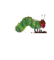
01
Write your great title here
一个星期天的早晨，暖暖的太阳升起来了——啪！
——从卵壳里钻出一条又瘦又饿的毛毛虫。

Slide 8
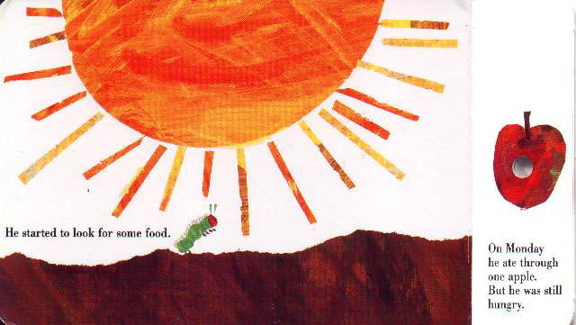
01
Write your great title here
他四下寻找着可以吃的东西……

Slide 9
02
HEAD INFO HERE
We have many PowerPoint templates that has been specifically designed.

Slide 10
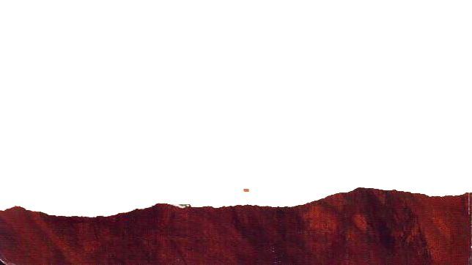
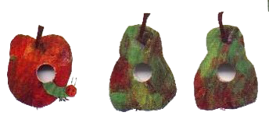
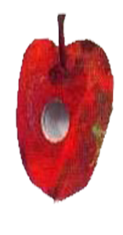
01
Write your great title here
星期一，他啃穿了一个苹果。
可他还是觉得饿。

Slide 11
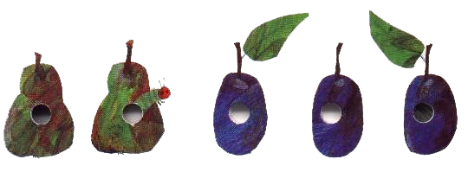
01
Write your great title here
星期二，他啃穿了两个梨子，可他还是觉得饿。

Slide 12
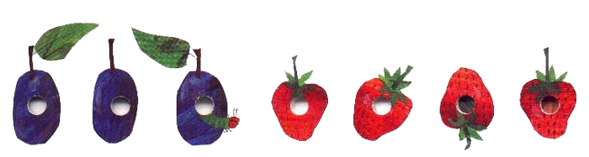
星期三
星期三，他啃穿了三个李子，可他还是饿。

Slide 13
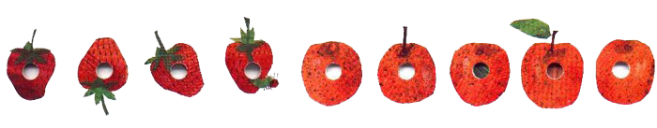
星期四
星期四，他啃穿了四个草莓，可他还是饿得受不了。

Slide 14
星期五
星期五，他啃穿了五个桔子，可他还是饿呀。

Slide 15
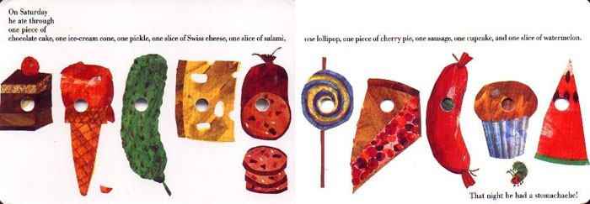
星期六

Slide 16

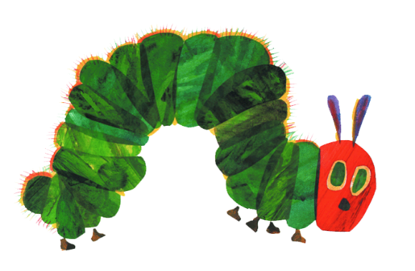
星期六，他啃穿了一块巧克力蛋糕，一个冰淇淋蛋筒，一条酸黄瓜，一片瑞士奶酪，一截萨拉米香肠，一根棒棒糖，一角樱桃馅饼，一段红肠，一只杯形蛋糕，还有一块甜西瓜。

Slide 17
到了晚上，他就胃痛起来………

Slide 18
03
HEAD INFO HERE
We have many PowerPoint templates that has been specifically designed.

Slide 19
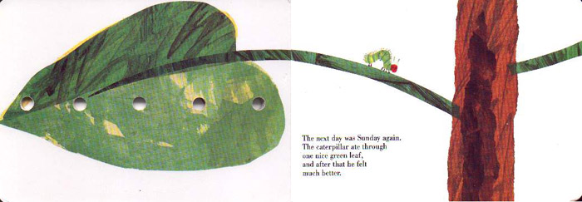
第二天，又是星期天。
毛毛虫啃穿了一片可爱的绿树叶，这一回他感觉好多了。

Slide 20
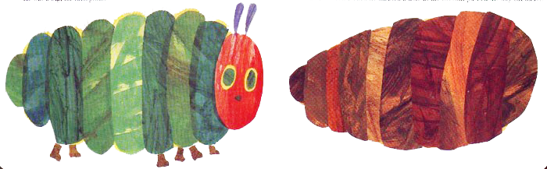
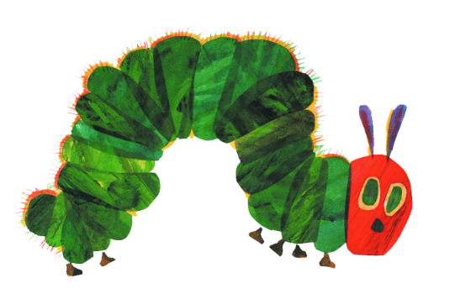
现在他一点儿也不饿了——他也不再是一条小毛虫了。他是一条胖嘟嘟的大毛虫了。

Slide 21
他绕着自己的身子，造了一座叫做“茧”的小房子。他在那里面呆了两个多星期。

Slide 22
然后，他就在茧壳上啃出一个洞洞，钻了出来……

Slide 23

他已经是一只美丽的蝴蝶了！

Slide 24
04
HEAD INFO HERE
We have many PowerPoint templates that has been specifically designed.

Slide 25
02
Write your great title here
Head Title
We have many PowerPoint templates that has been specifically designed to help anyone that is stepping into the world of PowerPoint for the very first time.
Head Title
We have many PowerPoint templates that has been specifically designed to help anyone that is stepping into the world of PowerPoint for the very first time.
Head Title
We have many PowerPoint templates that has been specifically designed to help anyone that is stepping into the world of PowerPoint for the very first time.
Head Title
We have many PowerPoint templates that has been specifically designed to help anyone that is stepping into the world of PowerPoint for the very first time.

Slide 26
02
Write your great title here
We have many PowerPoint templates that has been specifically designed to help anyone that is stepping into the world of PowerPoint for the very first time.
We have many PowerPoint templates that has been specifically designed to help anyone that is stepping into the world of PowerPoint for the very first time.
We have many PowerPoint templates that has been specifically designed to help anyone that is stepping into the world of PowerPoint for the very first time.
We have many PowerPoint templates that has been specifically designed to help anyone that is stepping into the world of PowerPoint for the very first time.
We have many PowerPoint templates that has been specifically designed to help anyone that is stepping into the world of PowerPoint for the very first time.
We have many PowerPoint templates that has been specifically designed to help anyone that is stepping into the world of PowerPoint for the very first time.

Slide 27
谢谢聆听！

