Slide 1

BUSINESS
2018
工作汇报/年终总结
The user can demonstrate on a projector or computer, or print the presentation and make it into a film to be used in a wider field
汇报人：

Slide 2
目 录
CONTENTS
年度工作概述
工作完成情况
工作存在不足
明年工作计划
print the presentation and make it into a film a wider field
print the presentation and make it into a film a wider field
print the presentation and make it into a film a wider field
print the presentation and make it into a film a wider field
< 01 >

Slide 3

0
1
PART 01
年度工作概述
The user can demonstrate on a projector or computer, or print the presentation and make it into a film to be used in a wider field

Slide 4

年度工作概述
The user can demonstrate on a projector or computer, or print the presentation and make it into a film to be used in a wider field
标题文字添加
标题文字添加
print the presentation and make it film to be used in a wider field
print the presentation and make it film to be used in a wider field
标题文字添加
标题文字添加
print the presentation and make it film to be used in a wider field
print the presentation and make it film to be used in a wider field

Slide 5

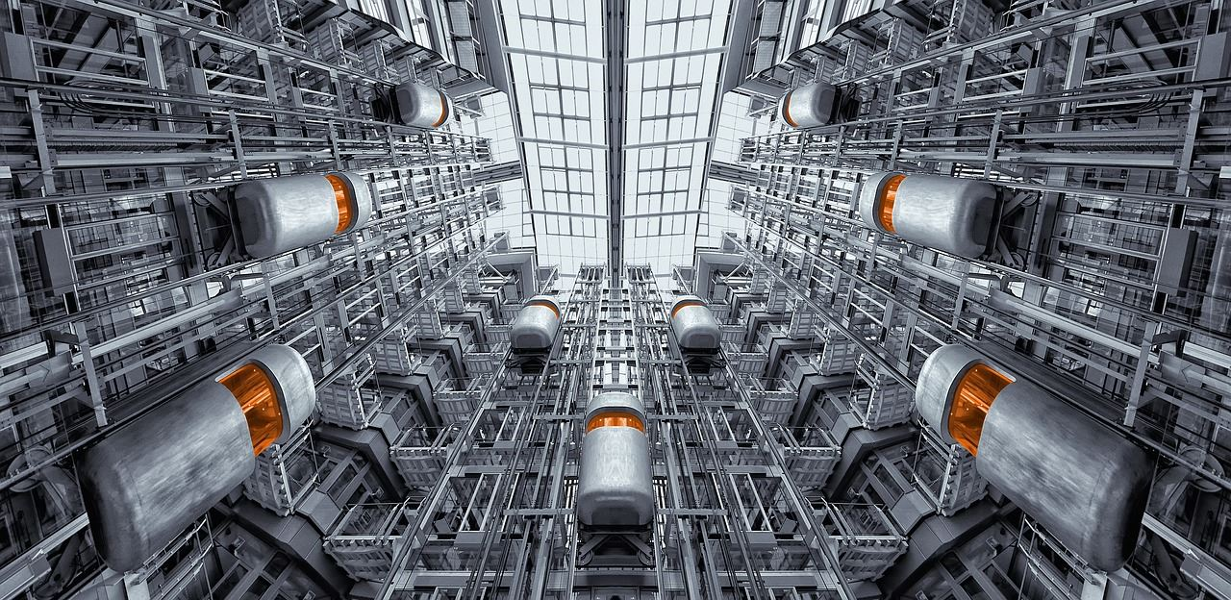

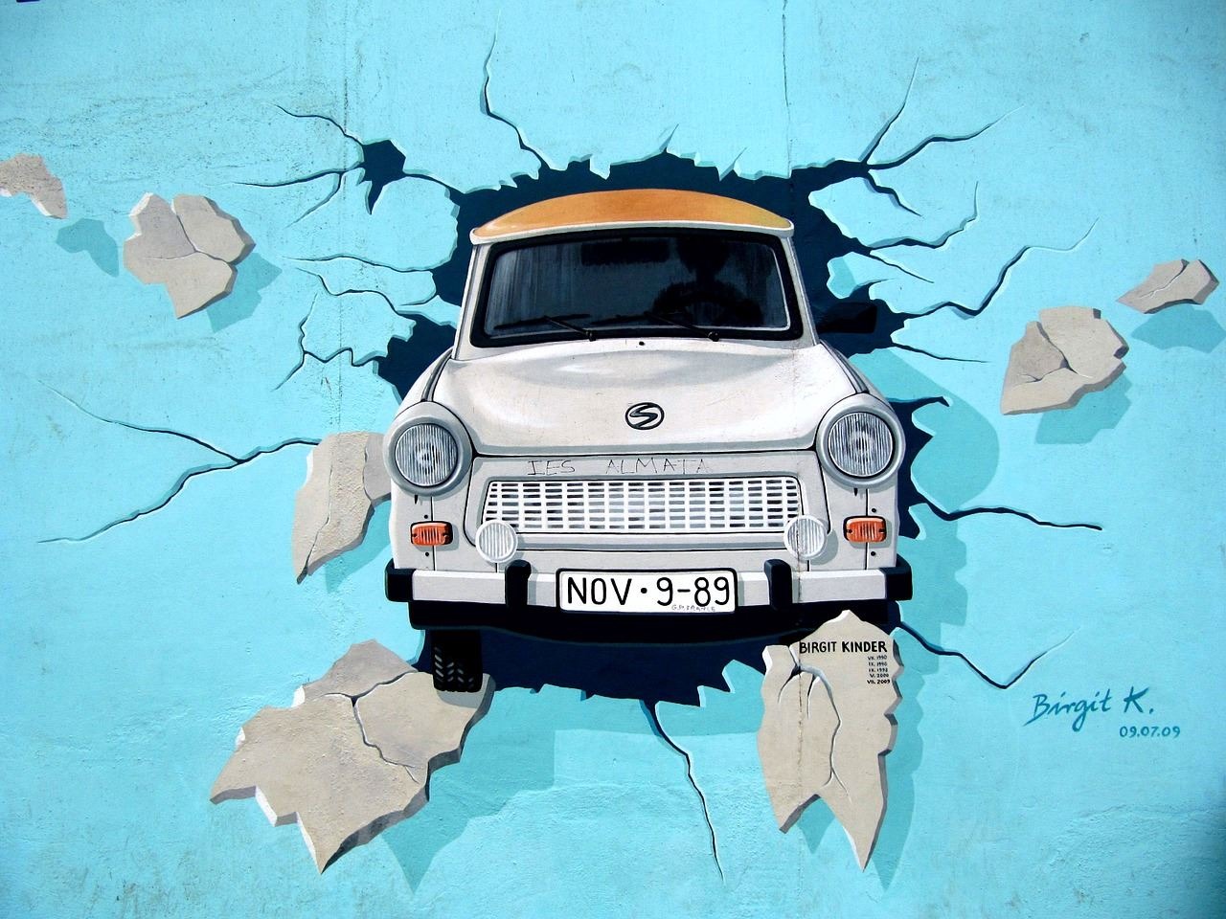
年度工作概述
The user can demonstrate on a projector or computer, or print the presentation and make it into a film to be used in a wider field
标题文字添加
标题文字添加
The user can demonstrate on a projector or computer, or presentation and make it film to be used in a wider field
The user can demonstrate on a projector or computer, or presentation and make it film to be used in a wider field
标题文字添加
标题文字添加
The user can demonstrate on a projector or computer, or presentation and make it film to be used in a wider field
The user can demonstrate on a projector or computer, or presentation and make it film to be used in a wider field

Slide 6


年度工作概述
The user can demonstrate on a projector or computer, or print the presentation and make it into a film to be used in a wider field
标题文字添加
标题文字添加
The user can demonstrate on a projector or computer, or print the presentation and make it film to be used in a wider field
The user can demonstrate on a projector or computer, or print the presentation and make it film to be used in a wider field
标题文字添加
标题文字添加
The user can demonstrate on a projector or computer, or print the presentation and make it film to be used in a wider field
The user can demonstrate on a projector or computer, or print the presentation and make it film to be used in a wider field

Slide 7

年度工作概述
The user can demonstrate on a projector or computer, or print the presentation and make it into a film to be used in a wider field
标题文字添加
标题文字添加
The user can demonstrate on a projector or computer, or presentation and make
The user can demonstrate on a projector or computer, or presentation and make

Slide 8
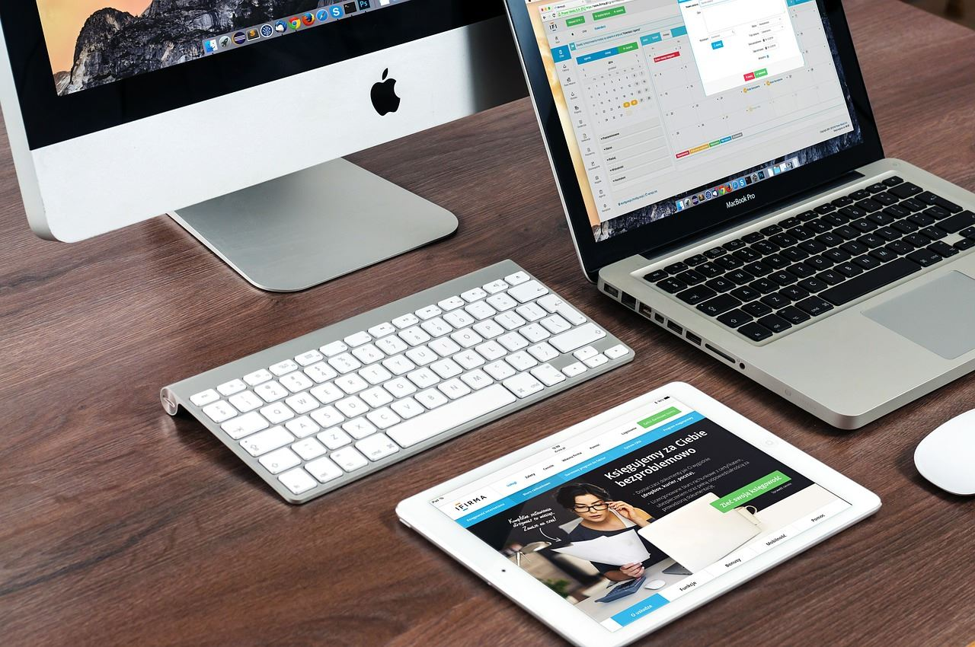


年度工作概述
The user can demonstrate on a projector or computer, or print the presentation and make it into a film to be used in a wider field
1
2
3
标题文字添加
标题文字添加
标题文字添加
The user can demonstrate on a projector or computer, or presentation and make it film to be ua wider field
The user can demonstrate on a projector or computer, or presentation and make it film to be ua wider field
The user can demonstrate on a projector or computer, or presentation and make it film to be ua wider field

Slide 9
0
2
PART 02
工作完成情况
The user can demonstrate on a projector or computer, or print the presentation and make it into a film to be used in a wider field

Slide 10
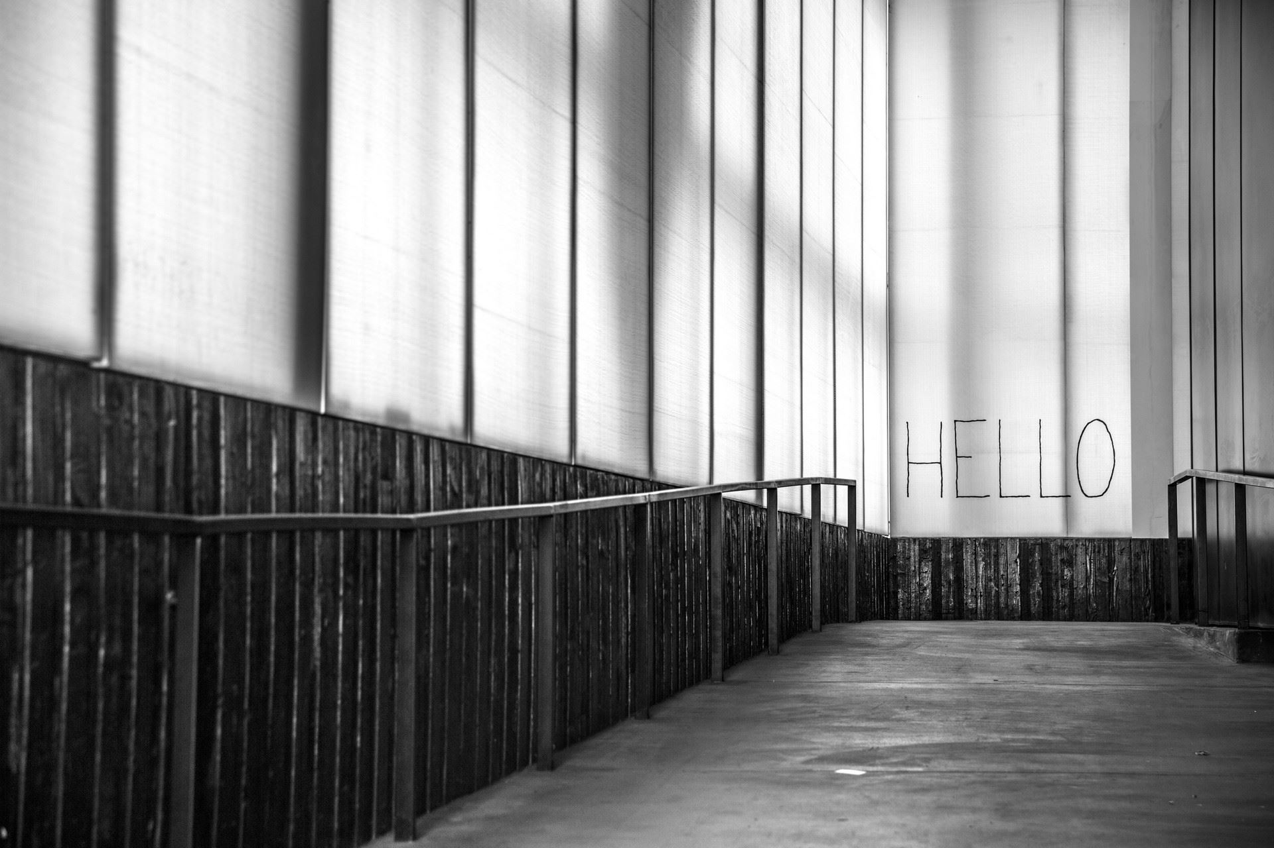

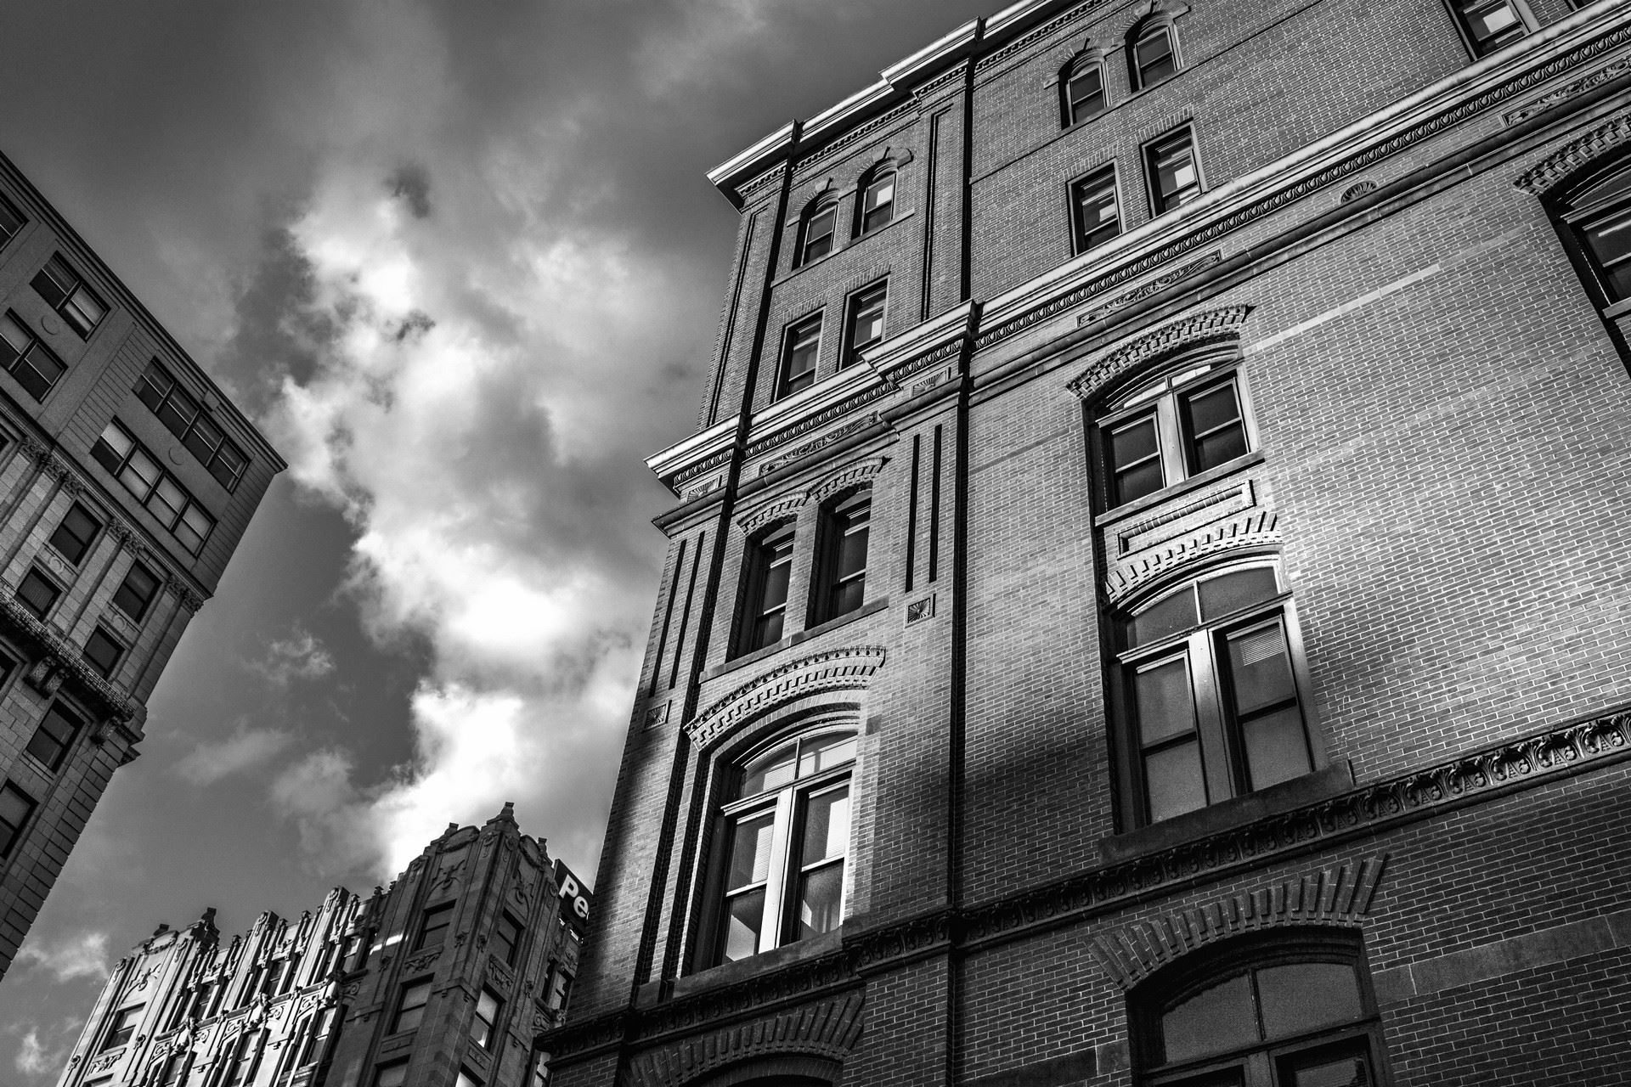
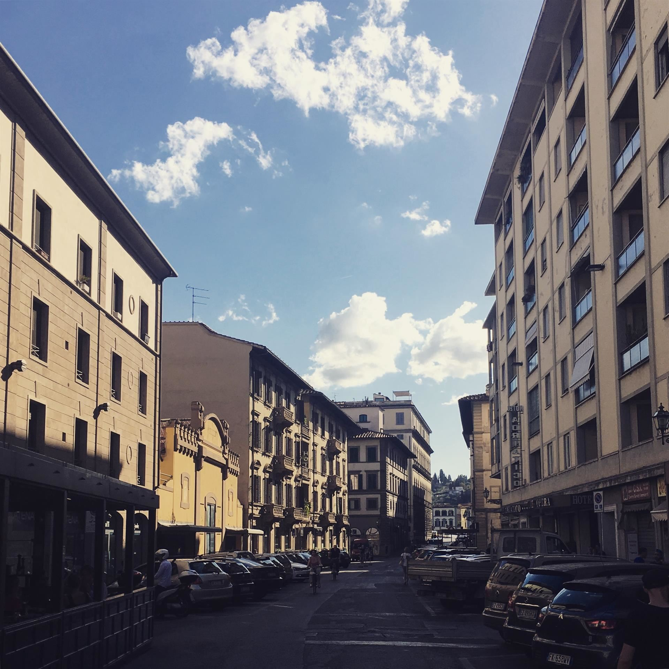
工作完成情况
The user can demonstrate on a projector or computer, or print the presentation and make it into a film to be used in a wider field
标题文字添加
标题文字添加
print the presentation and make it into a film to be used in a wider field
print the presentation and make it into a film to be used in a wider field
标题文字添加
标题文字添加
print the presentation and make it into a film to be used in a wider field
print the presentation and make it into a film to be used in a wider field

Slide 11
工作完成情况
The user can demonstrate on a projector or computer, or print the presentation and make it into a film to be used in a wider field
标题文字添加
The user can demonstrate on a projector or computer, or print the presentation and make it into a film to be used in a wider fieldThe user can demonstrate on a projector or computer, or print the presentation and make it into a film to be used in a wider field
标题文字添加
标题文字添加
标题文字添加

Slide 12
工作完成情况
The user can demonstrate on a projector or computer, or print the presentation and make it into a film to be used in a wider field
标题文字添加
print the presentation and make it film to be used in a wider field
标题文字添加
标题文字添加
print the presentation and make it film to be used in a wider field
print the presentation and make it film to be used in a wider field
标题文字添加
print the presentation and make it film to be used in a wider field

Slide 13
工作完成情况
The user can demonstrate on a projector or computer, or print the presentation and make it into a film to be used in a wider field
标题文字添加
标题文字添加
The user can demonstrate on a projector or computer, or print the presentation and make it film to be used in a wider field
The user can demonstrate on a projector or computer, or print the presentation and make it film to be used in a wider field
标题文字添加
标题文字添加
The user can demonstrate on a projector or computer, or print the presentation and make it film to be used in a wider field
The user can demonstrate on a projector or computer, or print the presentation and make it film to be used in a wider field

Slide 14
工作完成情况
The user can demonstrate on a projector or computer, or print the presentation and make it into a film to be used in a wider field
关键词
标题文本预设
1
2
3
4
5
6
7
8
9
10
11
12
13
14
15
16
17
18
19
20
21
关键词
关键词
关键词
关键词
标题文字添加
The user can demonstrate on a projector or computer, or presentation and make it film to be used in a wider field

Slide 15
0
3
PART 03
工作存在不足
The user can demonstrate on a projector or computer, or print the presentation and make it into a film to be used in a wider field

Slide 16
工作存在不足
The user can demonstrate on a projector or computer, or print the presentation and make it into a film to be used in a wider field
标题文字添加
标题文字添加
标题文字添加
标题文字添加
标题文字添加
标题文字添加
标题文字添加
标题文字添加

Slide 17
工作存在不足
The user can demonstrate on a projector or computer, or print the presentation and make it into a film to be used in a wider field
关键词
关键词
关键词
关键词
1
2
3
4
标题文字添加
标题文字添加
标题文字添加
标题文字添加
print the presentation and make it into a film to be used in a wider field
print the presentation and make it into a film to be used in a wider field
print the presentation and make it into a film to be used in a wider field
print the presentation and make it into a film to be used in a wider field

Slide 18
工作存在不足
The user can demonstrate on a projector or computer, or print the presentation and make it into a film to be used in a wider field
文字添加
The user can demonstrate on a projector or computer, or presentation and make it film to be used in a wider field
文字添加
文字添加
The user can demonstrate on a projector or computer, or presentation and make it film to be used in a wider field
The user can demonstrate on a projector or computer, or presentation and make it film to be used in a wider field

Slide 19
工作存在不足
The user can demonstrate on a projector or computer, or print the presentation and make it into a film to be used in a wider field
The user can demonstrate on a projector or computer, or presentation and make it film to be used in a wider field
The user can demonstrate on a projector or computer, or presentation and make it film to be used in a wider field
The user can demonstrate on a projector or computer, or presentation and make it film to be used in a wider field
The user can demonstrate on a projector or computer, or presentation and make it film to be used in a wider field
标题文字添加
标题文字添加
标题文字添加
标题文字添加

Slide 20
0
4
PART 04
明年工作计划
The user can demonstrate on a projector or computer, or print the presentation and make it into a film to be used in a wider field

Slide 21
明年工作计划
The user can demonstrate on a projector or computer, or print the presentation and make it into a film to be used in a wider field
79%
44%
53%
82%
92%
74%
标题文字添加
标题文字添加
标题文字添加
The user can demonstrate on a projector or computer, or print the presentation and make it film
The user can demonstrate on a projector or computer, or print the presentation and make it film
The user can demonstrate on a projector or computer, or print the presentation and make it film

Slide 22
明年工作计划
The user can demonstrate on a projector or computer, or print the presentation and make it into a film to be used in a wider field
53%
30%
82%
标题文字添加
标题文字添加
标题文字添加
The user can demonstrate on a projector or computer or print
The user can demonstrate on a projector or computer or print
The user can demonstrate on a projector or computer or print

Slide 23
明年工作计划
The user can demonstrate on a projector or computer, or print the presentation and make it into a film to be used in a wider field
69%
标题文字添加
The user can demonstrate on a projector or computer, or presentation and make it film to be used in a wider field
44%
标题文字添加
The user can demonstrate on a projector or computer, or presentation and make it film to be used in a wider field
88%
标题文字添加
The user can demonstrate on a projector or computer, or presentation and make it film to be used in a wider field

Slide 24
明年工作计划
The user can demonstrate on a projector or computer, or print the presentation and make it into a film to be used in a wider field
40%
30%
85%
65%
35%
标题文字添加
标题文字添加
标题文字添加
标题文字添加
标题文字添加

Slide 25
BUSINESS
THANKS
工作汇报/年终总结
The user can demonstrate on a projector or computer, or print the presentation and make it into a film to be used in a wider field
汇报人：

