Slide 1





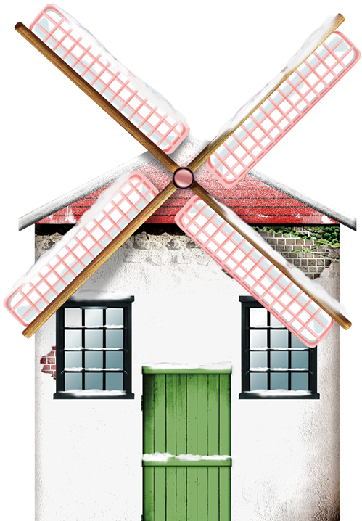












Merry
Christmas
圣诞节英文介绍
汇报人：xxx 汇报时间：XX年XX月

Slide 2



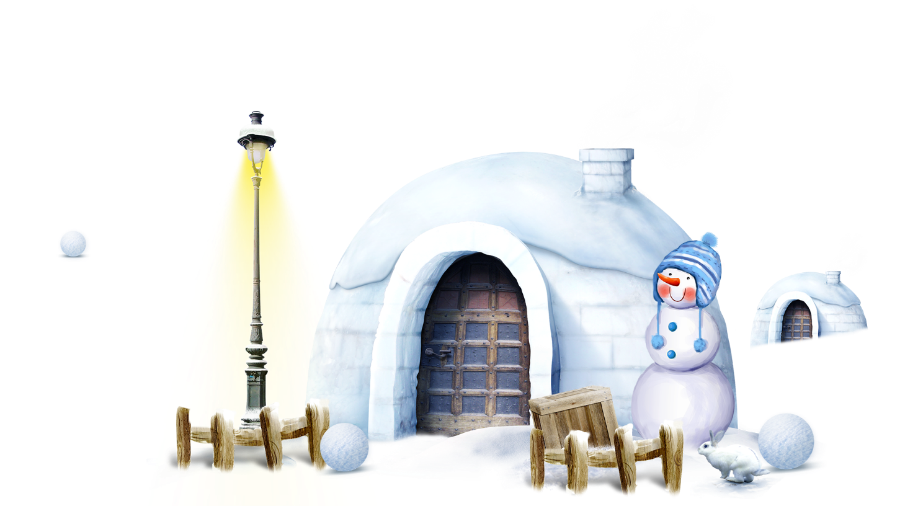
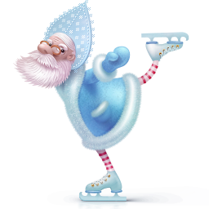
December 25 each year, is the day Christians commemorate the birth of Jesus, known as Christmas.
每年12月25日，这一天基督徒纪念耶稣的诞生，为圣诞节而闻名。

Slide 3

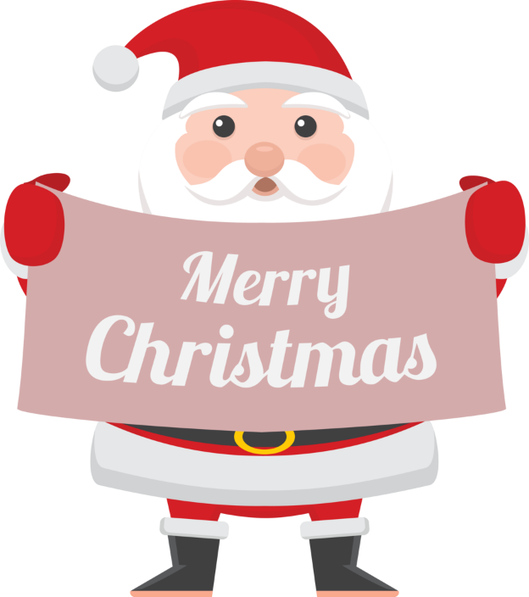
Christmas is the holiday celebrating the birth of Jesus Christ. Although it is a religious holiday , many modern customs and practices associated with it were carried over from other festivals-some religious , some not. What follows is a little background , history and development of the American Christmas celebration.
圣诞节是节日庆祝耶稣基督的诞生。虽然这是一个宗教节日，许多现代的习惯和做法进行与之相关的其他节日，一些宗教，有的没有结束。以下是一些背景，历史和美国的圣诞节庆祝活动的发展。

Slide 4

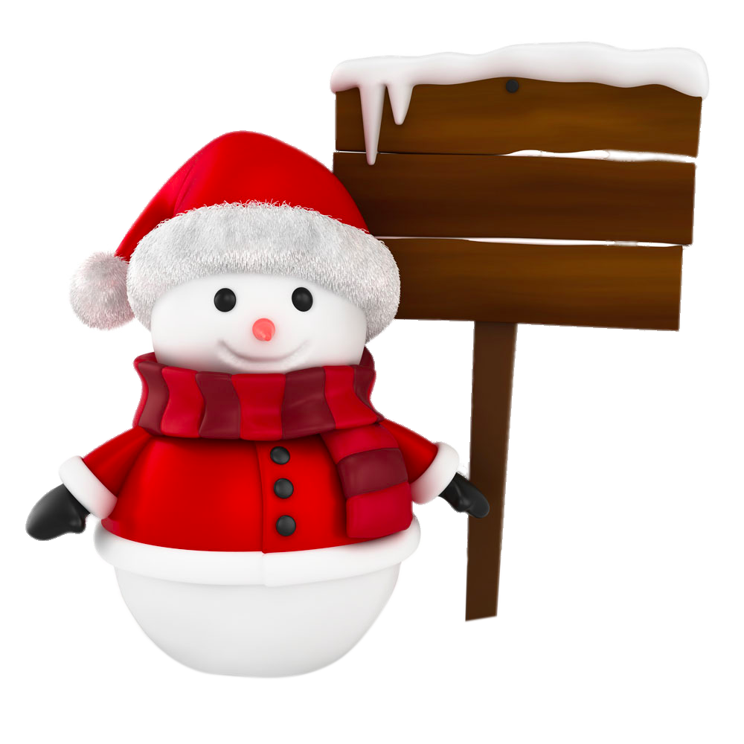

The birth of Jesus in Bethlehem signaled the fulfillment of a long awaited promise that God would send someone , his personal representative, to remove the negative effects of personal evil in the world . Jesus was that representative. Thus his arrival on the human scene , announced by a night sky full of angels ( Luke2:9-14), was good news.
耶稣在伯利恒诞生标志着一场期待已久的承诺的履行，上帝会派一个人，他的个人代表，以消除世界上的个人邪恶的负面影响。耶稣是代表。因此，他的到来对人类的场景，由夜空的天使（路加福音2:9-14）全部公布，是个好消息。
起 源
ORIGIN
Of Christmas

Slide 5
In A.D. 336 the of Christ's birth,obviously trying to reorient the holiday for Christians.When the Empire split between east and west,the church in the east(Eastern Orthodox)recognized January 6th as the celebration date.In many countries January 6th is still honored as the "official"birth date of Chist.The time between December 25th and January 6th forms what has become known as the "12Days of Christmas.“
在公元336基督的诞生，显然是想为基督教徒重新调整假期。当帝国分裂为东部和西部,教会在东方(东正教)承认1月6日的庆祝活动日期。在许多国家1月6日仍誉为“官方”基督出生日期的12月25日之间的时间1月6日形式,已成为众所周知的“12天的圣诞。”
起 源
ORIGIN
Of Christmas

Slide 6


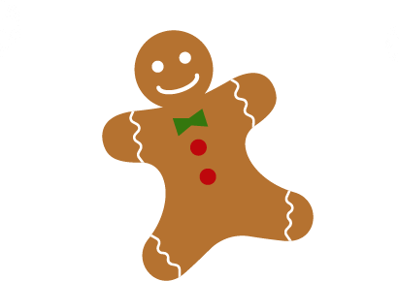

Contents
PART 1
Christmas tree
PART 2
Christmas carols
PART 3
Santa Claus
PART 4
Christmas dinner

Slide 7
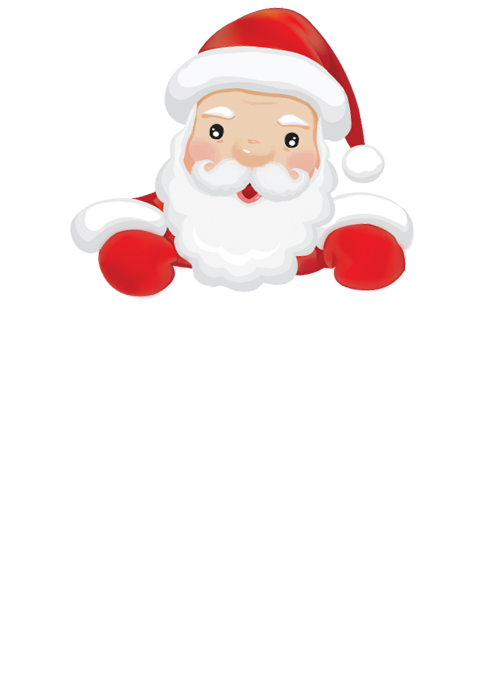


Christmas tree

Slide 8



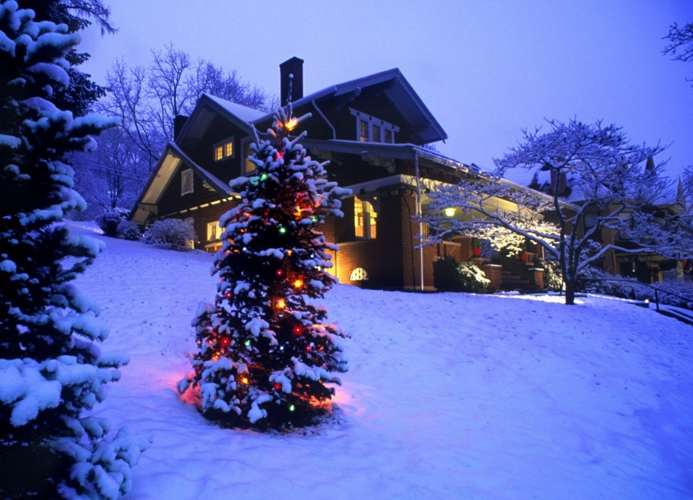





Enhance the festive atmosphere（['ætmə,sfiə] 气氛）
Christmas tree
Be made of evergreen such as cypress （['saipris]柏树）
Decorated with a variety of candles ,flowers ,toys ,stars…

Slide 9


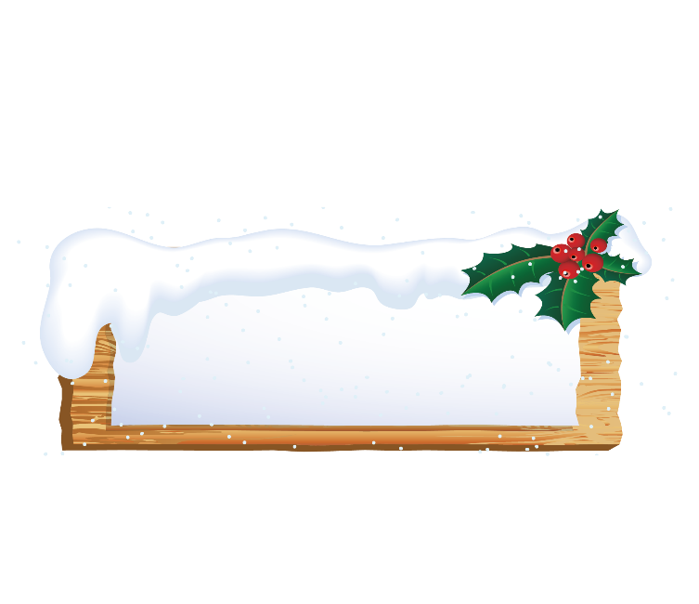
Christmas tree
Westerners with red, green and white color for the Christmas colors, Christmas comes every household is decorated with Christmas colors. Red
Colored with Christmas flowers and Christmas candles. Green is the Christmas tree. It is the main Christmas ornaments, with the cut to the cedar (['si:də] 雪松）, cypress （['saipris]柏树）tower was a class of decorated evergreen tree. Hanging above the colorful lights, gifts and paper flowers, but also lit the Christmas candles.
西方人以红、绿、白三色为圣诞色，圣诞节来临时家家户户都要用圣诞色来装饰。红色的有圣诞花和圣诞蜡烛。绿色的是圣诞树。它是圣诞节的主要装饰品，用砍伐来的杉、 柏一类呈塔形的常青树装饰而成。上面悬挂着五颜六色的彩灯、礼物和纸花，还点燃着圣诞蜡烛。

Slide 10

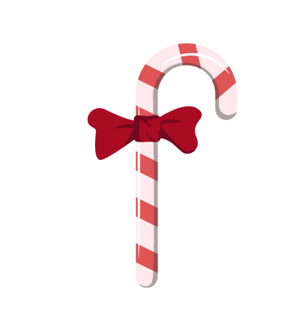
Christmas carols

Slide 11
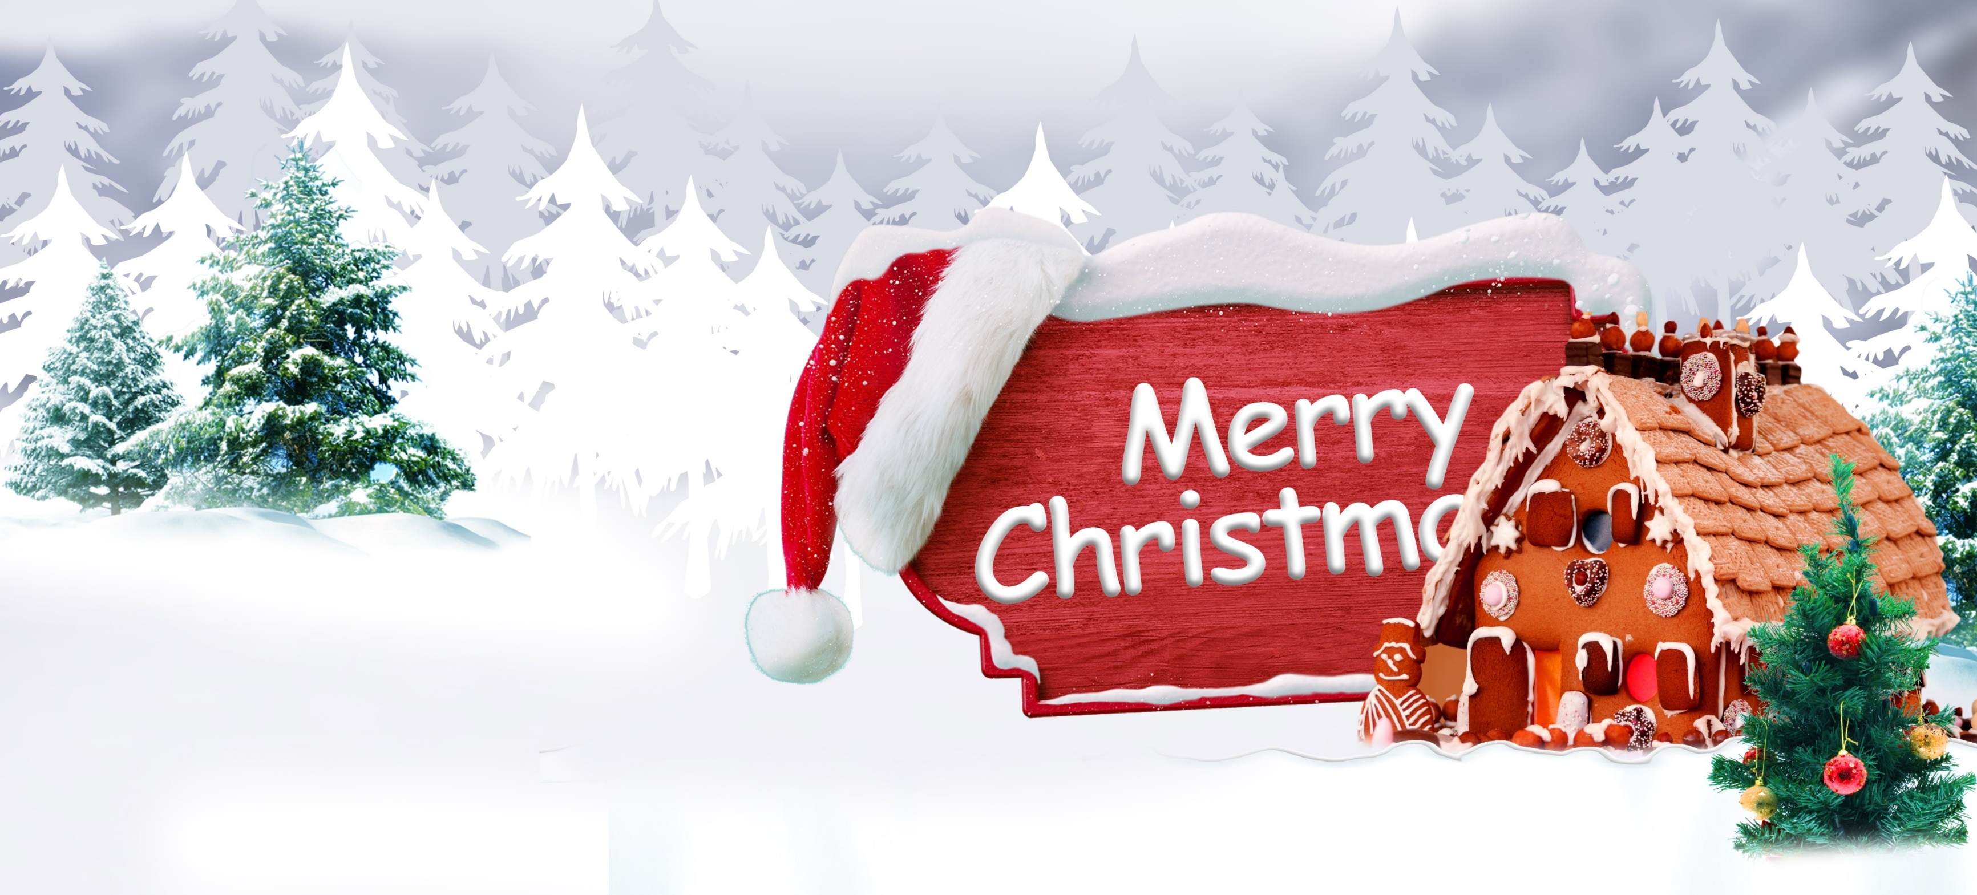

Christmas carols
An indispensable program on Christmas Eve
A team=
twenty young people+ an angel +Santa Claus
Sing familiar Christmas carols
All of people pray
Santa deliver the gifts
Until four o’clock the next morning

Slide 12
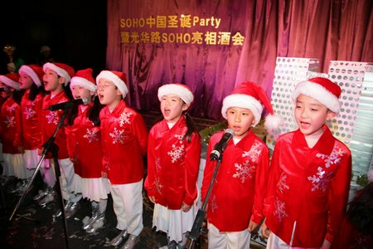
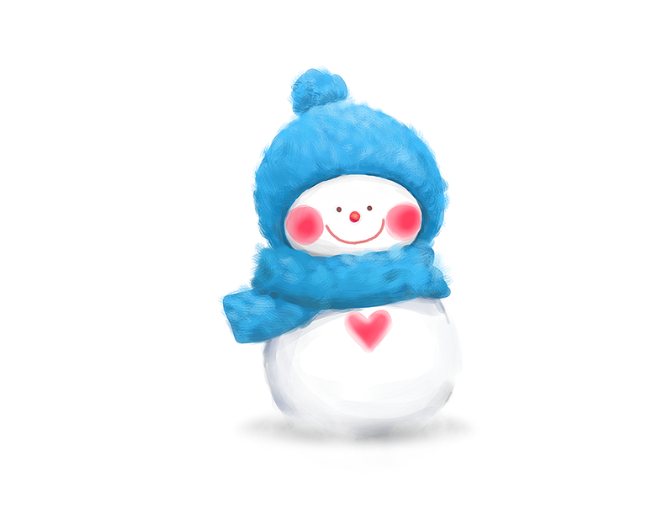
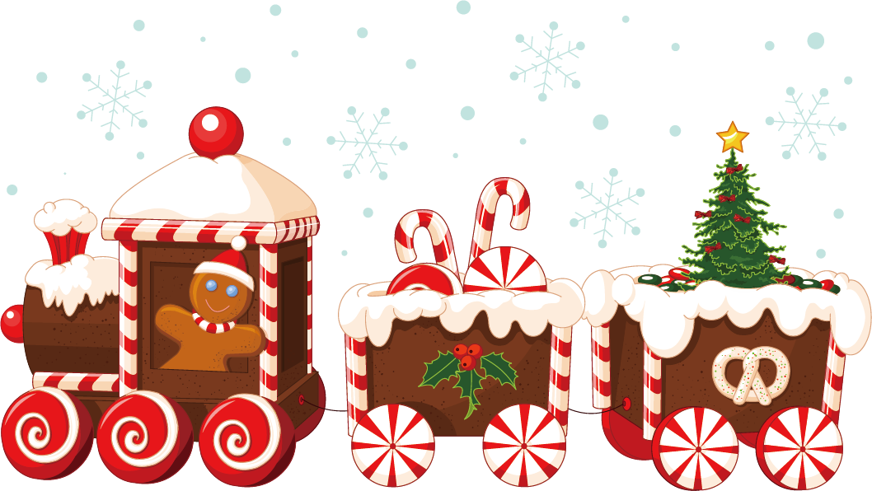
Christmas carols
The first Christmas hymns were written in the 5th Century .Originally composed in Latin,they contained primarily theological（ [θi:ə'lɔdʒikəl]神学的） topics.
第一个圣诞节赞美诗写于公元前5世纪。原本用拉丁文组成，他们中主要神学议题。

Slide 13

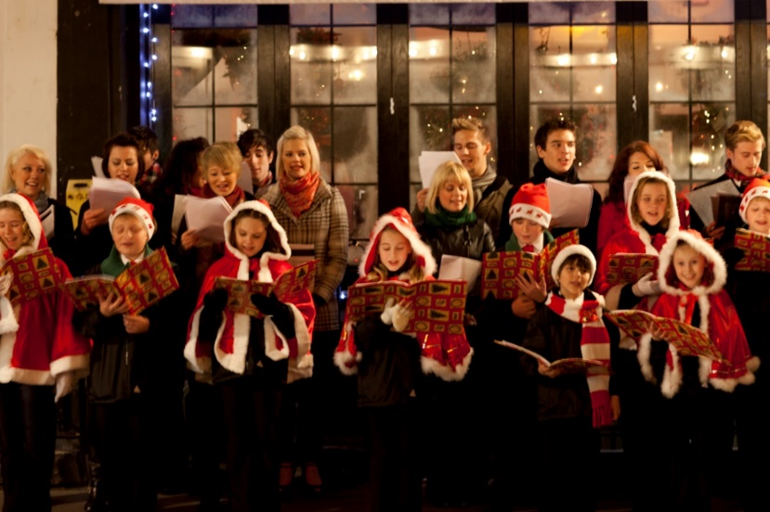
Jingle Bells
Jingle bells,Jingle bells
Jingle all the way
Oh what fun it is to ride
In a one horse open sleigh
Dashing through the snow
On a one-horse open sleigh
Over the fields we go
Laughing all the way
Bells on bob-tail ring
Making spirits bright
What fun it is to ride and sing
A sleighing song tonight
Jingle bells, Jingle bells
Jingle all the way
Oh what fun it is to ride
In a one-horse open sleigh
Christmas carols

Slide 14

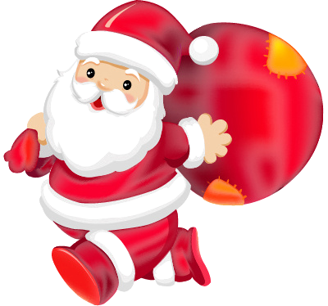
Christmas Claus

Slide 15

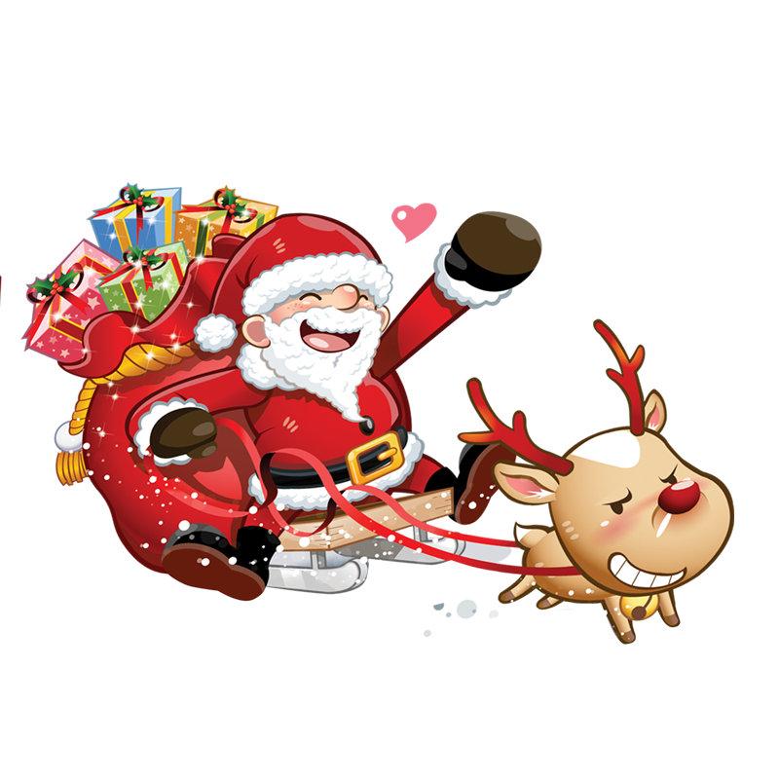

Father Christmas (another name)
Saint Nicholas
imaginary figure
A happy old man with a long white beard and a long red robe

Slide 16
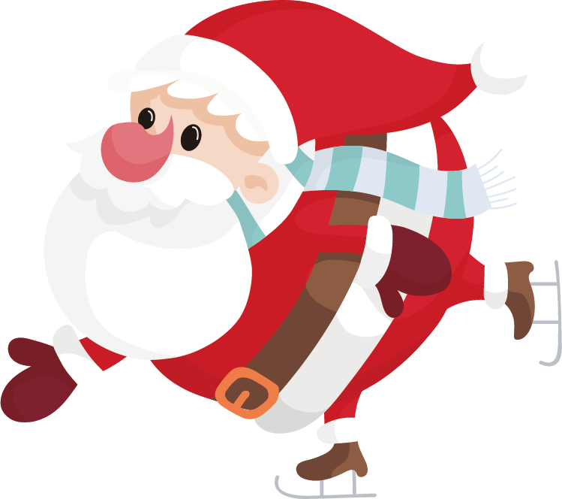
Christmas Claus
One specifically for the boy to send a gift on Christmas Eve the mysterious figure. Legend to December 24 every night, a mysterious people driving by the 12 reindeer sleigh, going door to door into the house from the chimney, and then secretly put presents under the bed of the socks boy, or heap under the Christmas tree near the fireplace. While no one really ever seen the man look like, but people often dress up as wearing a red Christmas hat, big white beard, a red coat, wearing red boots look like, because there are always gifts on Christmas Eve, so accustomed to call him "Santa Claus.“
一位专门为好孩子在圣诞节前夜送上礼物的神秘人物。传说每到12月24日晚上，有个神秘人会驾乘由12只驯鹿拉的雪橇，挨家挨户地从烟囱进入屋里，然后偷偷把礼物放在好孩子床头的袜子里，或者堆在壁炉旁的圣诞树下。虽然没有人真的见过神秘人的样子，但是人们通常装扮成头戴红色圣诞帽子，大大的白色胡子，一身红色棉衣，脚穿红色靴子的样子，因为总在圣诞节前夜出现派发礼物，所以习惯地称他为"圣诞老人"。

Slide 17
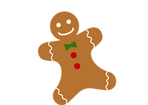
Christmas dinner

Slide 18
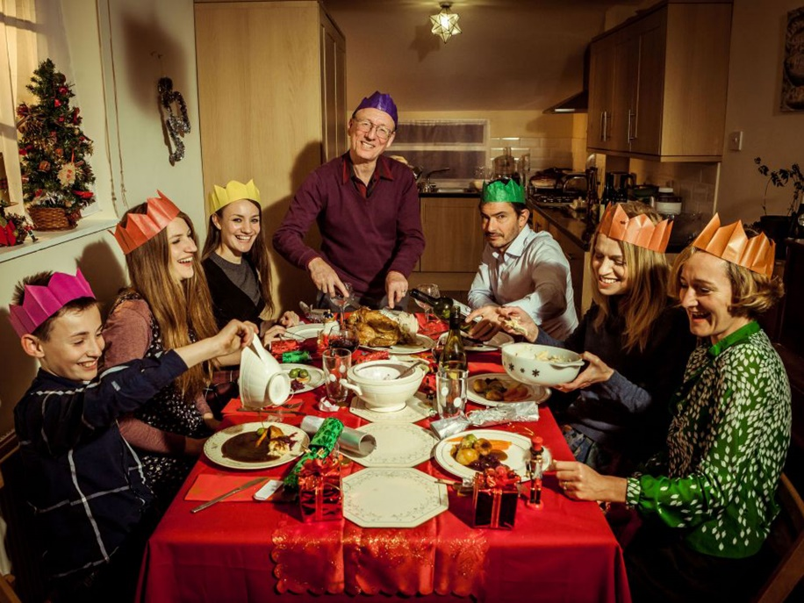
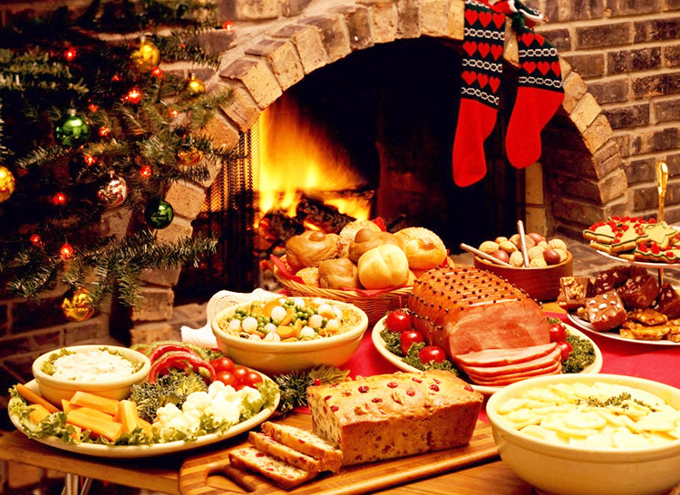
Christmas dinner
Major food:
Turkey
Roast goose
Puddings
Cookies, Fruit
Eating turkey is popular in the Unite States from 1620.
Christmas Dinner For Family
And enjoy a splendid dinner

Slide 19
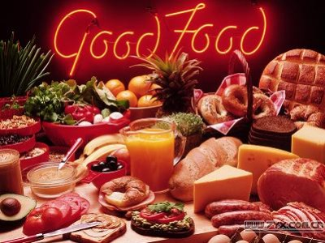
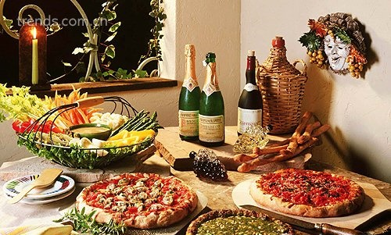
Christmas dinner
Although the foods served for Christmas dinner may vary from family to family(and from country to country),typical items usually found at an American family's Christmas dinner would include turkey and dressing (or sometimes chicken,duck, goose or ham), potatoes and gravy,sweet potatoes,green vegetables,cranberry,sauce,nuts,fruits,fruit-cake,plum pudding,pumpkin and/or mincemeat pies and sweets.Eggnog is usually the favorite drink for the whole family.
尽管提供食品服务的圣诞大餐可能会有所变动,从每个家庭的(从国家),最典型的项目通常发现，在美国家庭的圣诞晚餐包括土耳其和敷料(或有时鸡、鸭、鹅或火腿)、土豆和肉汤、甜薯、青菜、小红莓、酱油、坚果、水果、水果蛋糕、李子布丁、南瓜和/或苹果派和糖果。蛋奶酒通常是全家最喜欢喝。

Slide 20
The specifics of family Christmas celebrations can have as many variations as there are families.Typically families will open presents either on Christmas Eve or Christmas Day.Members may open them at the same time , one at a time, or have some other type of family tradition.Many Christian families will have a birthday cake for Jesus,and sing"Happy Birthday "to Him,in keeping with American birthday celebrations.Christmas is a season where humanity says"Thank you"for God's love by sharing it with and showing it to others.
欢乐的圣诞庆祝活动的细节可以有许多因为不同的家庭。典型的家庭就会打开礼物或者在圣诞前夜或圣诞节的日子。成员可打开他们的同时,一次一件,或者有一些其他类型的家庭的传统很多基督徒家庭将举办一个生日蛋糕给耶稣,唱“生日快乐”,以保持他与美国生日庆祝圣诞节是一个人类中说“谢谢”因为神的爱,分享它、展示它给别人。
庆祝活动
Celebrations
Of Christmas

Slide 21
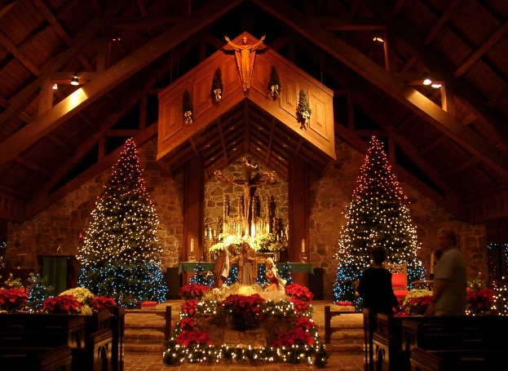
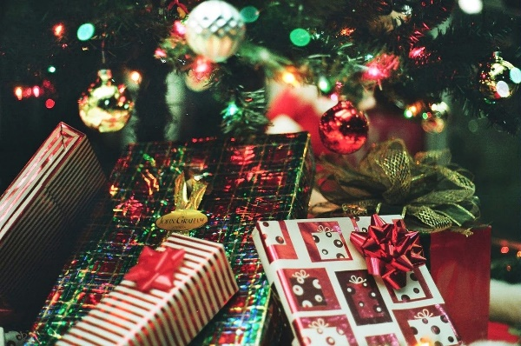
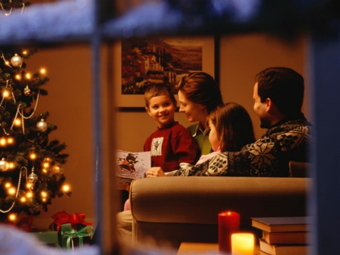
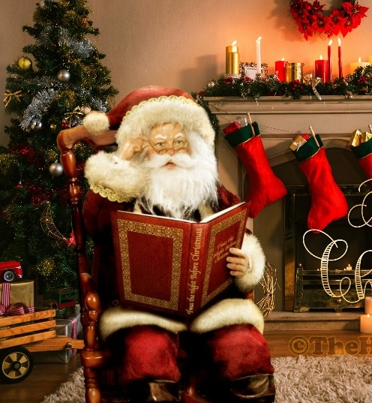
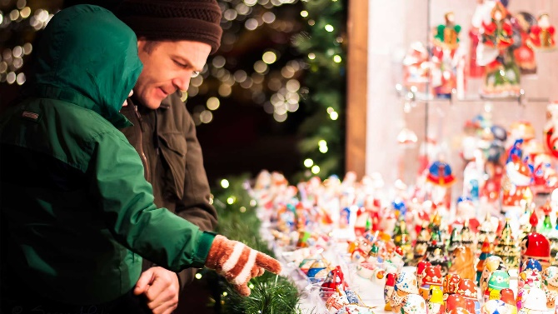
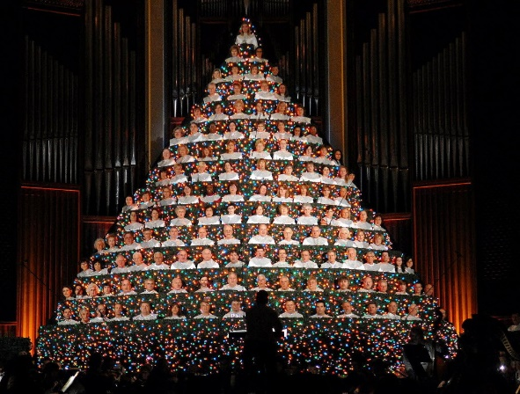
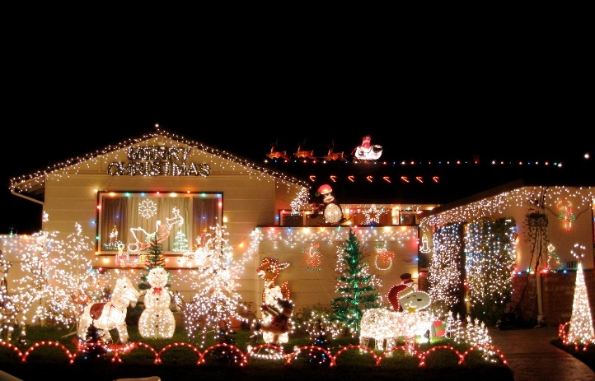
Celebrations Of Christmas
Christmas
Christmas & Church
Christmas and Chinese
Chinese Old Man
Christmas and CHURCH
Christmas
Children

Slide 22
For many Chineses,Christmas mean a time for joy and fun rather than a religious event.It’s popular with the young people and they are excited about shopping,eating ,dating and having parties and holding Christmas eve festivity.And of course,Children are eager to receive gifts from Santa Claus.
It’s a good opportunity for restaurants,hotels and stores promote their products or services,so these places have been beautifully decorated with Christmas trees and ornament.Of course,it is also a good chance to futher promote service or products online through search engine optimization and marketing.Many hotels and restaurants offer reservations for Christmas eve dinners,and department stores have prepared enough festive goods to satisfy customers’ shopping needs in China.
对于许多华人,圣诞节意味着时间喜悦和乐趣,而不是一种宗教活动这是受年轻人和他们兴奋的购物、饮食、约会和参加聚会,拿着圣诞夜节日当然,孩子们很愿意收到礼物圣诞老人。
这是一个很好的机会让酒店、宾馆、商店宣传推销它们的产品或服务,所以这些地方都装饰精美的用圣诞树和点缀当然这也是一个很好的机会来进一步促进服务或产品在网上通过搜索引擎优化和销售。许多酒店和餐馆提供预订了圣诞夜晚餐,百货公司已经准备好了节日的货物以满足顾客的购物需要在中国。
圣诞节
在中国
Celebrations
Of Christmas

Slide 23
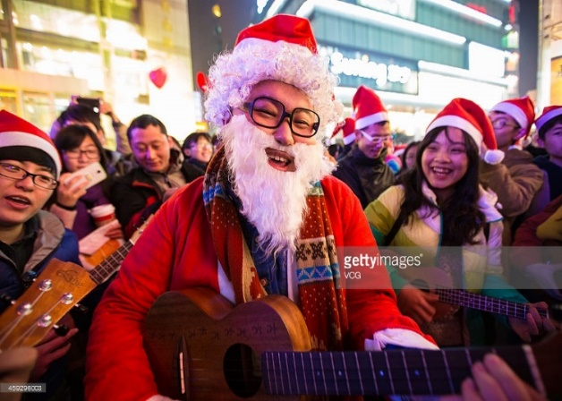
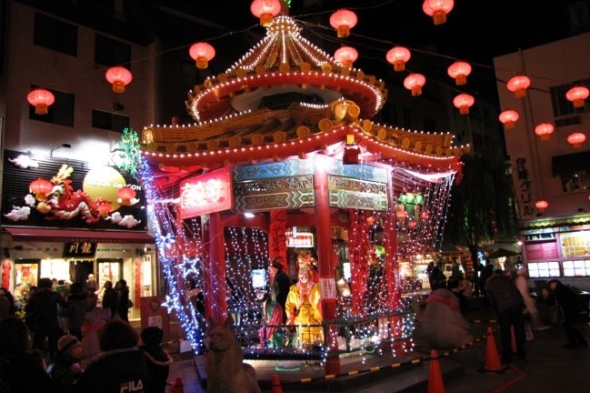
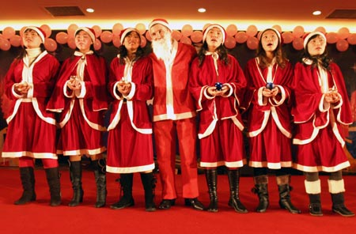
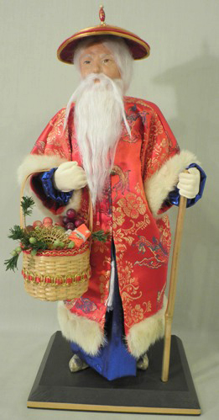
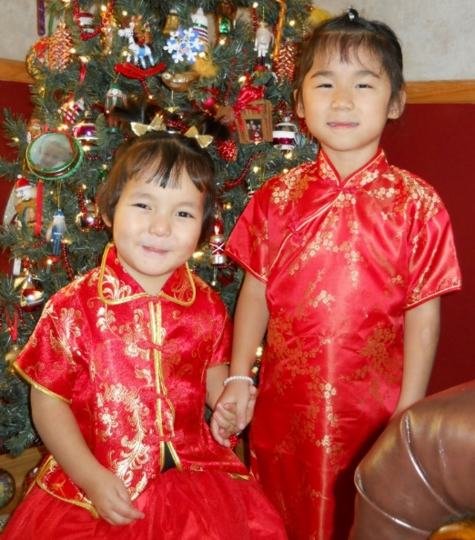
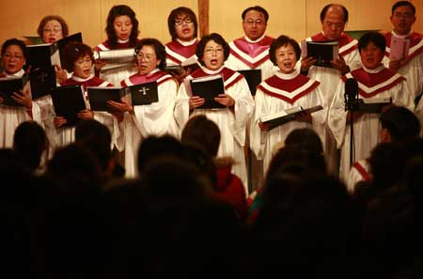
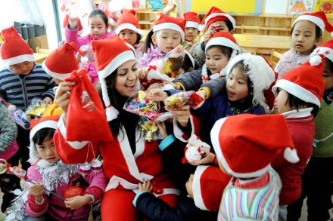
Christmas and Chinese
Christmas in China
Christmas in China
Chinese Old Man
Christmas in China
Christmas and Girl
Church in China
Children in China

Slide 24
Merry
Christmas
感谢您的观看！

