Slide 1

Hello
It was the best of times, it was the worst of times; it was the age of wisdom, it was the age of foolishness.

Slide 2
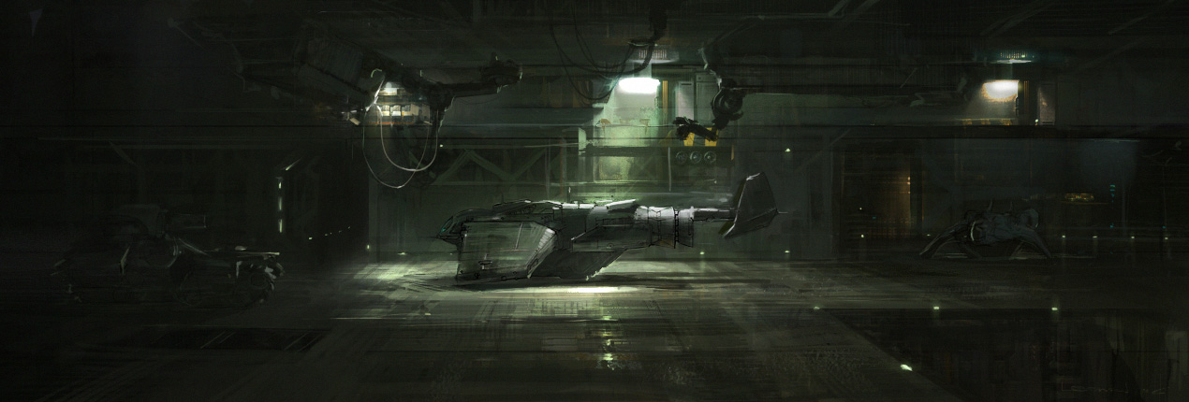

CONTANTS
TEXT
HERE
TEXT
HERE
TEXT
HERE
TEXT
HERE
TEXT
HERE
It was the best of times, it was the worst of times; it was the age of wisdom, it was the age of foolishness.

Slide 3

ONE
TWO
THERE
FOUR
It was the best of times, it was the worst of times; it was the age of wisdom, it was the age of foolishness.
It was the best of times, it was the worst of times; it was the age of wisdom, it was the age of foolishness.
It was the best of times, it was the worst of times; it was the age of wisdom, it was the age of foolishness.
It was the best of times, it was the worst of times; it was the age of wisdom, it was the age of foolishness.
It was the best of times, it was the worst of times; it was the age of wisdom, it was the age of foolishness.

Slide 4

PART ONE
It was the best of times, it was the worst of times; it was the age of wisdom, it was the age of foolishness.

Slide 5

starcraft
It was the best of times, it was the worst of times; it was the age of wisdom, it was the age of foolishness. It was the epoch of belief, and it was the epoch of incredulity. It was the season of light, and it was the season of darkness. It was the spring of hope, and it was the winter of despair.
It was the best of times, it was the worst of times; it was the age of wisdom, it was the age of foolishness. It was the epoch of belief, and it was the epoch of incredulity. It was the season of light, and it was the season of darkness. It was the spring of hope, and it was the winter of despair.

Slide 6
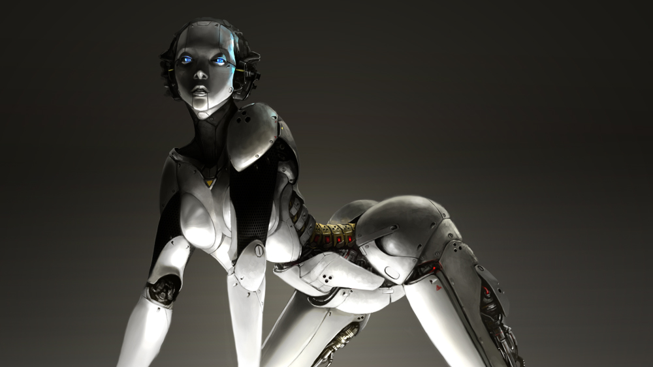

NUOWA

Slide 7

PART TWO
It was the best of times, it was the worst of times; it was the age of wisdom, it was the age of foolishness. It was the epoch of belief, and it was the epoch of incredulity. It was the season of light, and it was the season of darkness. It was the spring of hope, and it was the winter of despair.

Slide 8

TEXT
TEXT
It was the best of times, it was the worst of times; it was the age of wisdom, it was the age of foolishness. It was the epoch of belief, and it was the epoch of incredulity. It was the season of light, and it was the season of darkness. It was the spring of hope, and it was the winter of despair.
It was the best of times, it was the worst of times; it was the age of wisdom, it was the age of foolishness. It was the epoch of belief, and it was the epoch of incredulity. It was the season of light, and it was the season of darkness. It was the spring of hope, and it was the winter of despair.

Slide 9
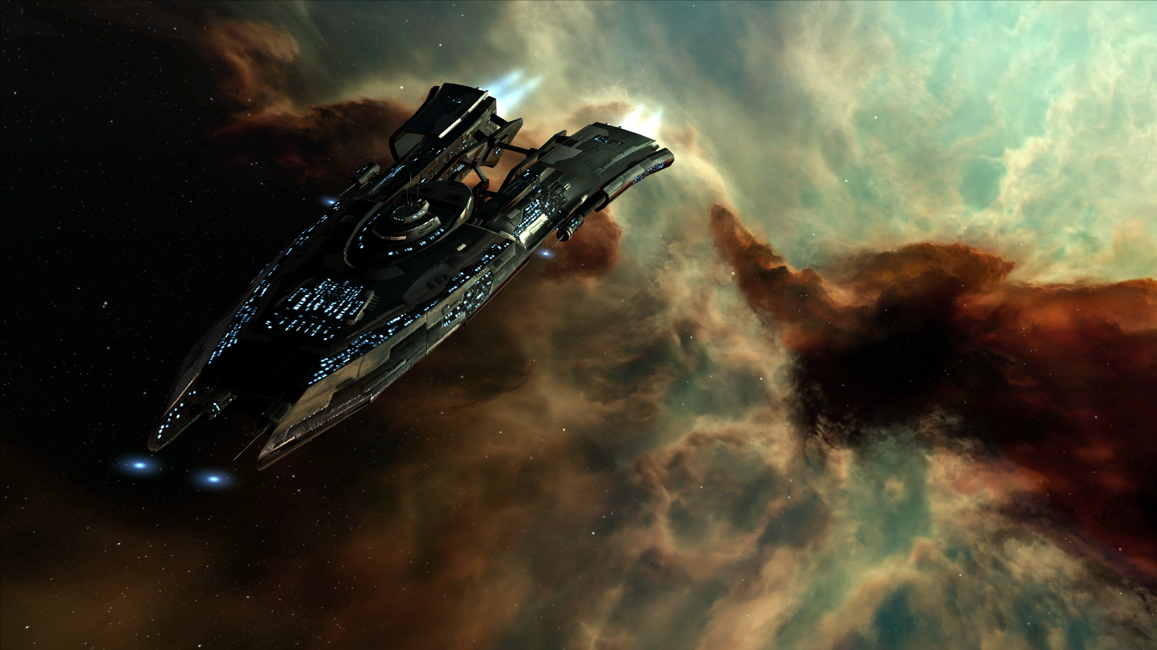
It was the best of times, it was the worst of times; it was the age of wisdom, it was the age of foolishness. It was the epoch of belief, and it was the epoch of incredulity. It was the season of light, and it was the season of darkness. It was the spring of hope, and it was the winter of despair.
It was the best of times, it was the worst of times; it was the age of wisdom, it was the age of foolishness. It was the epoch of belief, and it was the epoch of incredulity. It was the season of light, and it was the season of darkness. It was the spring of hope, and it was the winter of despair.

Slide 10
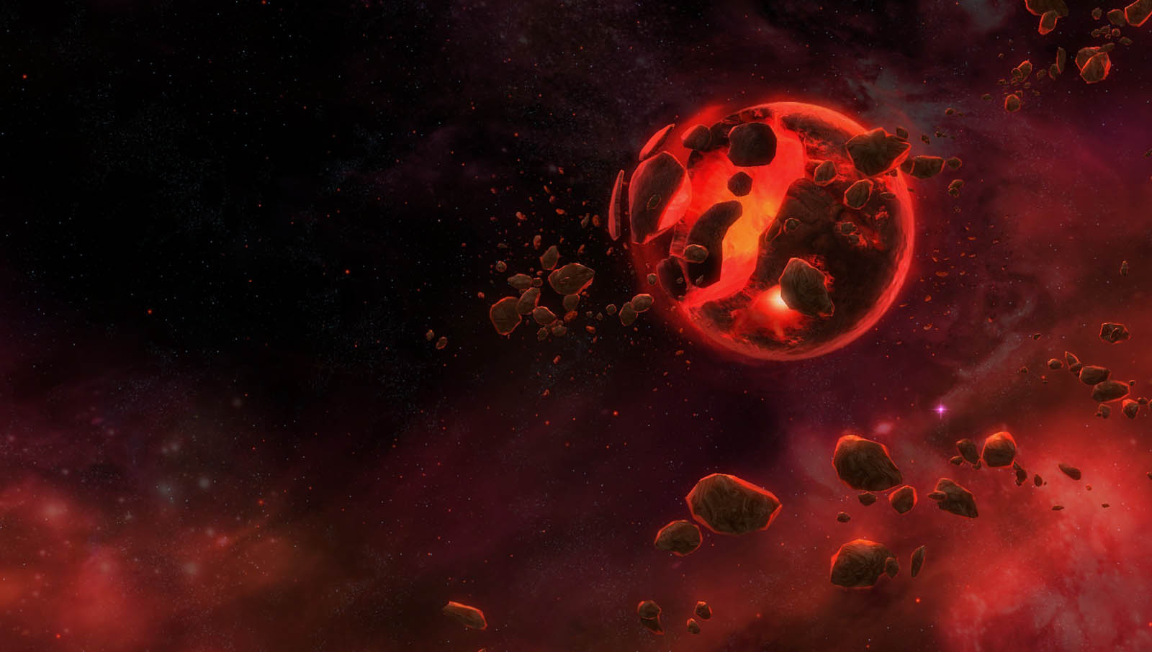
PART Three
It was the best of times, it was the worst of times; it was the age of wisdom, it was the age of foolishness. It was the epoch of belief, and it was the epoch of incredulity. It was the season of light, and it was the season of darkness. It was the spring of hope, and it was the winter of despair.

Slide 11

It was the best of times, it was the worst of times; it was the age of wisdom, it was the age of foolishness.

Slide 13
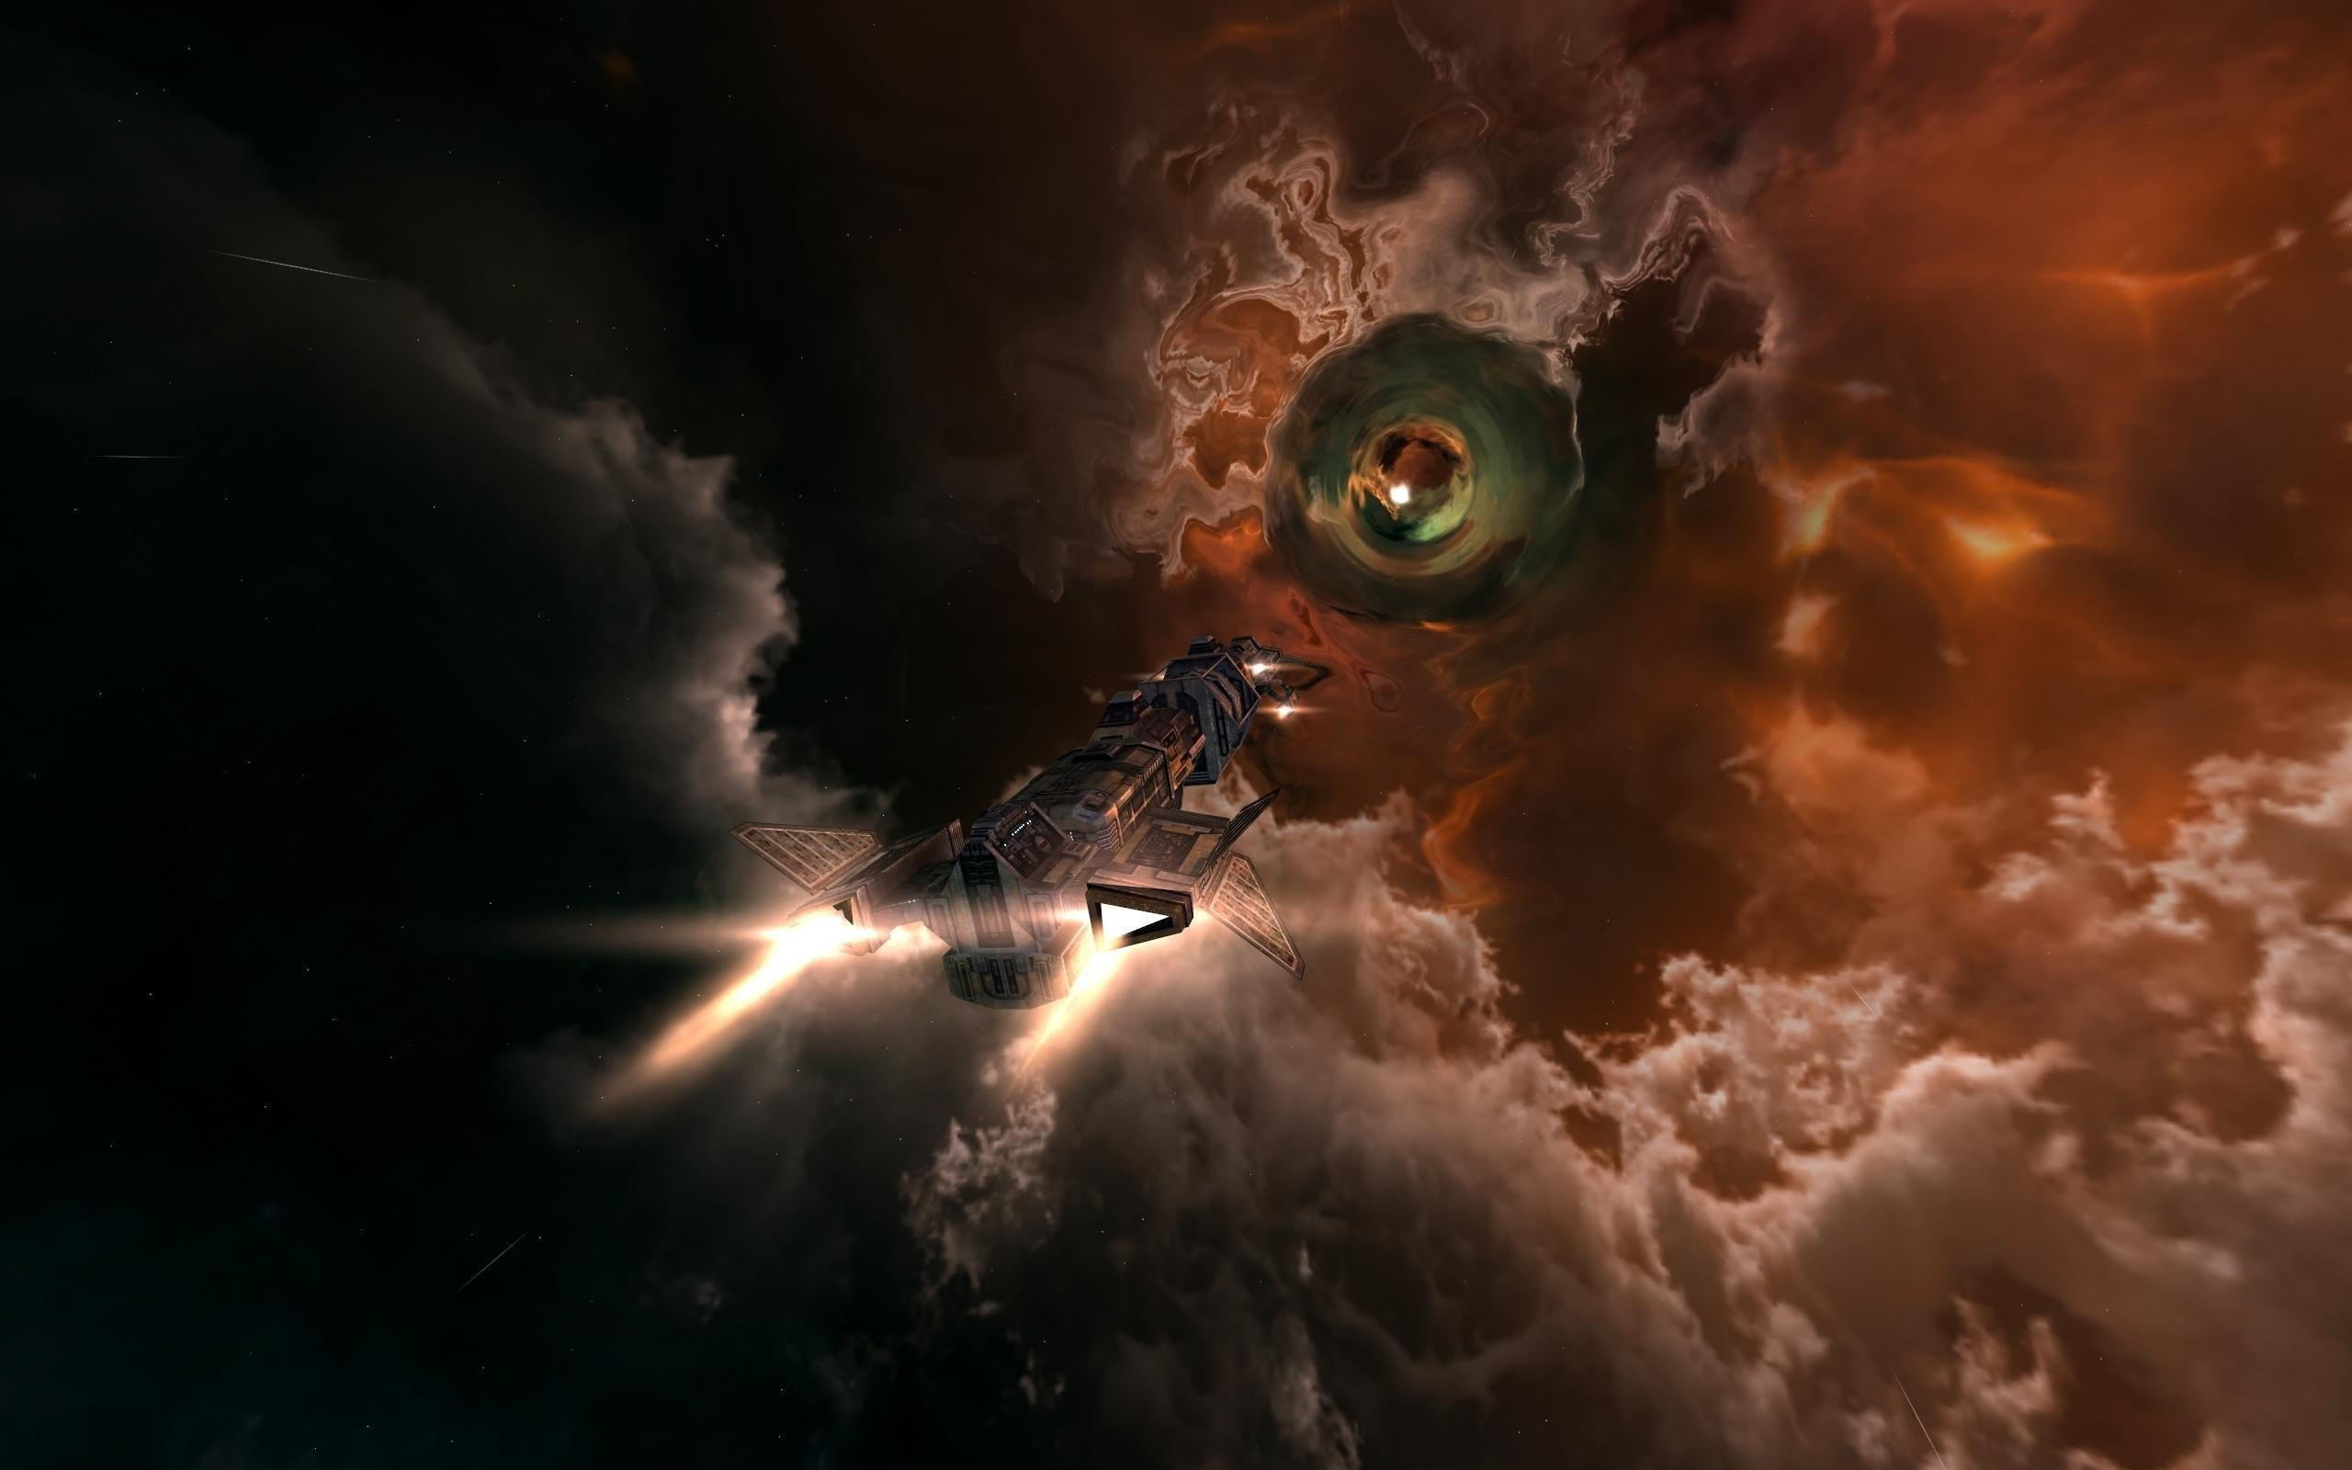
PART FOUR
It was the best of times, it was the worst of times; it was the age of wisdom, it was the age of foolishness. It was the epoch of belief, and it was the epoch of incredulity. It was the season of light, and it was the season of darkness. It was the spring of hope, and it was the winter of despair.

Slide 14

ONE
It was the best of times, it was the worst of times; it was the age of wisdom, it was the age of foolishness. It was the epoch of belief, and it was the epoch of incredulity. It was the season of light, and it was the season of darkness. It was the spring of hope, and it was the winter of despair.
It was the best of times, it was the worst of times; it was the age of wisdom, it was the age of foolishness. It was the epoch of belief, and it was the epoch of incredulity. It was the season of light, and it was the season of darkness. It was the spring of hope, and it was the winter of despair.
TWO

Slide 15
Three
It was the best of times, it was the worst of times; it was the age of wisdom, it was the age of foolishness. It was the epoch of belief, and it was the epoch of incredulity. It was the season of light, and it was the season of darkness. It was the spring of hope, and it was the winter of despair.
four
It was the best of times, it was the worst of times; it was the age of wisdom, it was the age of foolishness. It was the epoch of belief, and it was the epoch of incredulity. It was the season of light, and it was the season of darkness. It was the spring of hope, and it was the winter of despair.

Slide 16
TEXT

Slide 17
THANKS

