Slide 1

工作总结
商务汇报
述职报告
商务规划
开发创意产品介绍ppt模板
The user can demonstrate on a projector or computer, or print the presentation and make it into a film to be used in a wider field The user can demonstrate

Slide 2
01
年度工作概述
print the presentation and make it into a film a wider field
目 录
02
工作完成情况
print the presentation and make it into a film a wider field
CONTENT
03
工作存在不足
print the presentation and make it into a film a wider field
04
明年工作计划
print the presentation and make it into a film a wider field

Slide 3

PART 01
年度工作概述
The user can demonstrate on a projector or computer, or print the presentation and make it into a film to be used in a wider field The user can demonstrate

Slide 4


年度工作概述
print the presentation and make it into a film a wider field
标题文字添加
The user can demonstrate on a projector or computer, or print the presentation and make it into a film to be used in a wider field.
标题文字添加
The user can demonstrate on a projector or computer, or print the presentation and make it into a film to be used in a wider field.
工作总结
商务汇报
述职报告
商务规划

Slide 5

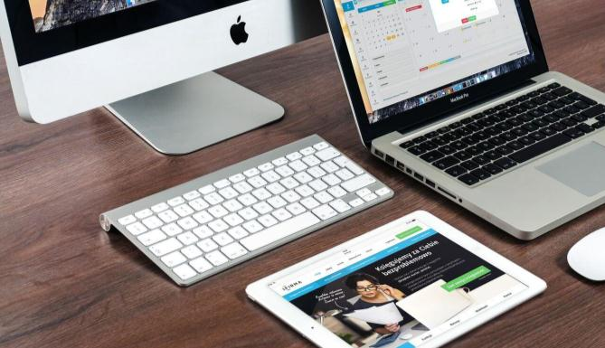
年度工作概述
print the presentation and make it into a film a wider field
标题文字添加
标题文字添加
The user can demonstrate on a projector or computer, or print the presentation and make it into a film to be used in a wider field.
The user can demonstrate on a projector or computer, or print the presentation and make it into a film to be used in a wider field.
工作总结
商务汇报
述职报告
商务规划

Slide 6


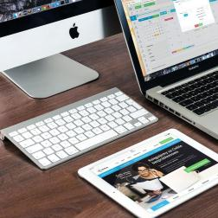

年度工作概述
print the presentation and make it into a film a wider field
标题文字添加
标题文字添加
The user can demonstrate on a projector or computer, or print the presentation and make it into a film to be used in a wider field.
The user can demonstrate on a projector or computer, or print the presentation and make it into a film to be used in a wider field.
标题文字添加
标题文字添加
The user can demonstrate on a projector or computer, or print the presentation and make it into a film to be used in a wider field.
The user can demonstrate on a projector or computer, or print the presentation and make it into a film to be used in a wider field.
工作总结
商务汇报
述职报告
商务规划

Slide 7

年度工作概述
print the presentation and make it into a film a wider field
文字添加
80%
The user can demonstrate on a projector or computer, or print the presentation and make it into a film to be used in a wider field.
文字添加
62%
The user can demonstrate on a projector or computer, or print the presentation and make it into a film to be used in a wider field.
文字添加
84%
The user can demonstrate on a projector or computer, or print the presentation and make it into a film to be used in a wider field.
文字添加
91%
The user can demonstrate on a projector or computer, or print the presentation and make it into a film to be used in a wider field.
工作总结
商务汇报
述职报告
商务规划

Slide 8
年度工作概述
print the presentation and make it into a film a wider field
70%
50%
40%
35%
30%
30%
标题文字添加
The user can demonstrate on a projector or computer, or print the presentation and make it into a film to be used in a wider fieldThe user can demonstrate on a projector or computer, or print the presentation and make it into a film to be used in a wider field..
工作总结
商务汇报
述职报告
商务规划

Slide 9
PART 02
工作完成情况
The user can demonstrate on a projector or computer, or print the presentation and make it into a film to be used in a wider field The user can demonstrate

Slide 10
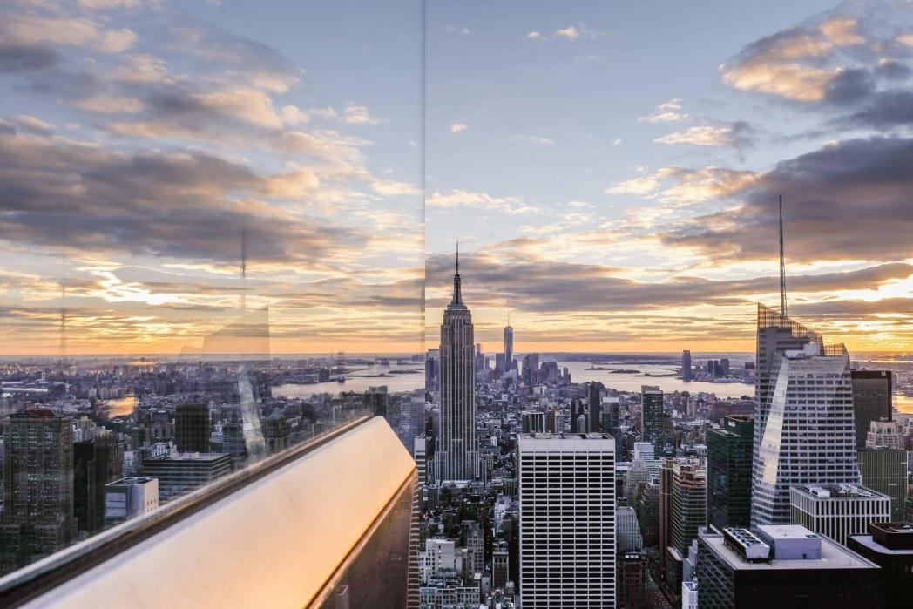
工作完成情况
print the presentation and make it into a film a wider field
标题文字添加
The user can demonstrate on a projector or computer, or print the presentation and make it into a film to be used in a wider field.
标题文字添加
The user can demonstrate on a projector or computer, or print the presentation and make it into a film to be used in a wider field.
工作总结
商务汇报
述职报告
商务规划

Slide 11



工作完成情况
print the presentation and make it into a film a wider field
标题文字添加
标题文字添加
标题文字添加
The user can demonstrate on a projector or computer, or print the presentation and make it into a film to be used in a wider field.
The user can demonstrate on a projector or computer, or print the presentation and make it into a film to be used in a wider field.
The user can demonstrate on a projector or computer, or print the presentation and make it into a film to be used in a wider field.
工作总结
商务汇报
述职报告
商务规划

Slide 12


工作完成情况
print the presentation and make it into a film a wider field
标题文字添加
标题文字添加
The user can demonstrate on a projector or computer, or print the presentation and make it into a film to be used in a wider field.
The user can demonstrate on a projector or computer, or print the presentation and make it into a film to be used in a wider field.
标题文字添加
标题文字添加
标题文字添加
标题文字添加
标题文字添加
The user can demonstrate on a projector or computer, or print the presentation and make it into a film to be used in a wider field.
标题文字添加
The user can demonstrate on a projector or computer, or print the presentation and make it into a film to be used in a wider field.
工作总结
商务汇报
述职报告
商务规划

Slide 13
工作完成情况
print the presentation and make it into a film a wider field
The user can demonstrate on a projector or computer, or print the presentation and make it into a film to be used in a wider field.
The user can demonstrate on a projector or computer, or print the presentation and make it into a film to be used in a wider field.
The user can demonstrate on a projector or computer, or print the presentation and make it into a film to be used in a wider field.
The user can demonstrate on a projector or computer, or print the presentation and make it into a film to be used in a wider field.
标题文本预设
标题文本预设
标题文本预设
标题文本预设
工作总结
商务汇报
述职报告
商务规划

Slide 14
工作完成情况
print the presentation and make it into a film a wider field
标题文字添加
标题文字添加
The user can demonstrate on a projector or computer, or print the presentation and make it into a film to be used in a wider field.
The user can demonstrate on a projector or computer, or print the presentation and make it into a film to be used in a wider field.
The user can demonstrate on a projector or computer, or print the presentation and make it into a film to be used in a wider field.
The user can demonstrate on a projector or computer, or print the presentation and make it into a film to be used in a wider field.
The user can demonstrate on a projector or computer, or print the presentation and make it into a film to be used in a wider field.
The user can demonstrate on a projector or computer, or print the presentation and make it into a film to be used in a wider field.
工作总结
商务汇报
述职报告
商务规划

Slide 15
PART 03
工作存在不足
The user can demonstrate on a projector or computer, or print the presentation and make it into a film to be used in a wider field The user can demonstrate

Slide 16
工作存在不足
print the presentation and make it into a film a wider field
标题文字添加
标题文字添加
The user can demonstrate on a projector or computer, or print the presentation and make it into a film to be used in a wider field.
The user can demonstrate on a projector or computer, or print the presentation and make it into a film to be used in a wider field.
标题文字添加
标题文字添加
The user can demonstrate on a projector or computer, or print the presentation and make it into a film to be used in a wider field.
The user can demonstrate on a projector or computer, or print the presentation and make it into a film to be used in a wider field.
标题文字添加
标题文字添加
The user can demonstrate on a projector or computer, or print the presentation and make it into a film to be used in a wider field.
The user can demonstrate on a projector or computer, or print the presentation and make it into a film to be used in a wider field.
工作总结
商务汇报
述职报告
商务规划

Slide 17

工作存在不足
print the presentation and make it into a film a wider field
标题文字添加
标题文字添加
The user can demonstrate on a projector or computer, or print the presentation and make it into a film to be used in a wider field.
The user can demonstrate on a projector or computer, or print the presentation and make it into a film to be used in a wider field.
标题文字添加
标题文字添加
The user can demonstrate on a projector or computer, or print the presentation and make it into a film to be used in a wider field.
The user can demonstrate on a projector or computer, or print the presentation and make it into a film to be used in a wider field.
标题文字添加
标题文字添加
The user can demonstrate on a projector or computer, or print the presentation and make it into a film to be used in a wider field.
The user can demonstrate on a projector or computer, or print the presentation and make it into a film to be used in a wider field.
工作总结
商务汇报
述职报告
商务规划

Slide 18
工作存在不足
print the presentation and make it into a film a wider field
标题文字添加
The user can demonstrate on a projector or computer, or print the presentation and make it into a film to be used in a wider field.
标题文字添加
The user can demonstrate on a projector or computer, or print the presentation and make it into a film to be used in a wider field.
标题文字添加
The user can demonstrate on a projector or computer, or print the presentation and make it into a film to be used in a wider field.
工作总结
商务汇报
述职报告
商务规划

Slide 19





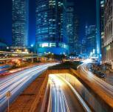
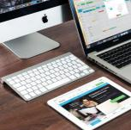
工作存在不足
print the presentation and make it into a film a wider field
标题文字添加
01
The user can demonstrate on a projector or computer, or print the presentation
标题文字添加
02
The user can demonstrate on a projector or computer, or print the presentation
标题文字添加
03
The user can demonstrate on a projector or computer, or print the presentation
标题文字添加
04
The user can demonstrate on a projector or computer, or print the presentation
工作总结
商务汇报
述职报告
商务规划

Slide 20
PART 04
明年工作计划
The user can demonstrate on a projector or computer, or print the presentation and make it into a film to be used in a wider field The user can demonstrate

Slide 21
明年工作计划
print the presentation and make it into a film a wider field
标题文字添加
标题文字添加
标题文字添加
标题文字添加
The user can demonstrate on a projector or computer, or print the presentation and make it into a film to be used in a wider field.
The user can demonstrate on a projector or computer, or print the presentation and make it into a film to be used in a wider field.
The user can demonstrate on a projector or computer, or print the presentation and make it into a film to be used in a wider field.
The user can demonstrate on a projector or computer, or print the presentation and make it into a film to be used in a wider field.
工作总结
商务汇报
述职报告
商务规划

Slide 22
明年工作计划
print the presentation and make it into a film a wider field
标题文字添加
标题文字添加
The user can demonstrate on a projector or computer, or print the presentation and make it into a film to be used in a wider field.
The user can demonstrate on a projector or computer, or print the presentation and make it into a film to be used in a wider field.
02
06
标题文字添加
03
标题文字添加
The user can demonstrate on a projector or computer, or print the presentation and make it into a film to be used in a wider field.
The user can demonstrate on a projector or computer, or print the presentation and make it into a film to be used in a wider field.
01
05
04
标题文字添加
标题文字添加
The user can demonstrate on a projector or computer, or print the presentation and make it into a film to be used in a wider field.
The user can demonstrate on a projector or computer, or print the presentation and make it into a film to be used in a wider field.
工作总结
商务汇报
述职报告
商务规划

Slide 23
明年工作计划
print the presentation and make it into a film a wider field
标题文字添加
标题文字添加
标题文字添加
The user can demonstrate on a projector or computer, or print the presentation and make it into a film to be used in a wider field.
The user can demonstrate on a projector or computer, or print the presentation and make it into a film to be used in a wider field.
The user can demonstrate on a projector or computer, or print the presentation and make it into a film to be used in a wider field.
标题文字添加
标题文字添加
标题文字添加
The user can demonstrate on a projector or computer, or print the presentation and make it into a film to be used in a wider field.
The user can demonstrate on a projector or computer, or print the presentation and make it into a film to be used in a wider field.
The user can demonstrate on a projector or computer, or print the presentation and make it into a film to be used in a wider field.
工作总结
商务汇报
述职报告
商务规划

Slide 24


明年工作计划
print the presentation and make it into a film a wider field
标题文字添加
标题文字添加
The user can demonstrate on a projector or computer, or print the presentation and make it into a film to be used in a wider field.
The user can demonstrate on a projector or computer, or print the presentation and make it into a film to be used in a wider field.
工作总结
商务汇报
述职报告
商务规划

Slide 25
工作总结
商务汇报
述职报告
商务规划
感谢您的观看
The user can demonstrate on a projector or computer, or print the presentation and make it into a film to be used in a wider field The user can demonstrate

