Slide 1

工作开展工作计划PPT模板
The user can demonstrate on a projector or computer, or print the presentation and make it into a film

Slide 2
CONTENTS
01
02
03
04
年度工作概述
工作完成情况
工作存在不足
明年工作计划
The user can demonstrate on a projector
The user can demonstrate on a projector
The user can demonstrate on a projector
The user can demonstrate on a projector

Slide 3
01
年度工作概述
The user can demonstrate on a projector or computer, or print the presentation and make it into a film

Slide 4

年度工作概述
标题文字添加
The user can demonstrate on a projector or computer, or print the presentation and make it into a film to be used in a wider field. Using PowerPoint,
标题文字添加
The user can demonstrate on a projector or computer, or print the presentation and make it into a film to be used in a wider field. Using PowerPoint,
标题文字添加
The user can demonstrate on a projector or computer, or print the presentation and make it into a film to be used in a wider field. Using PowerPoint,

Slide 5

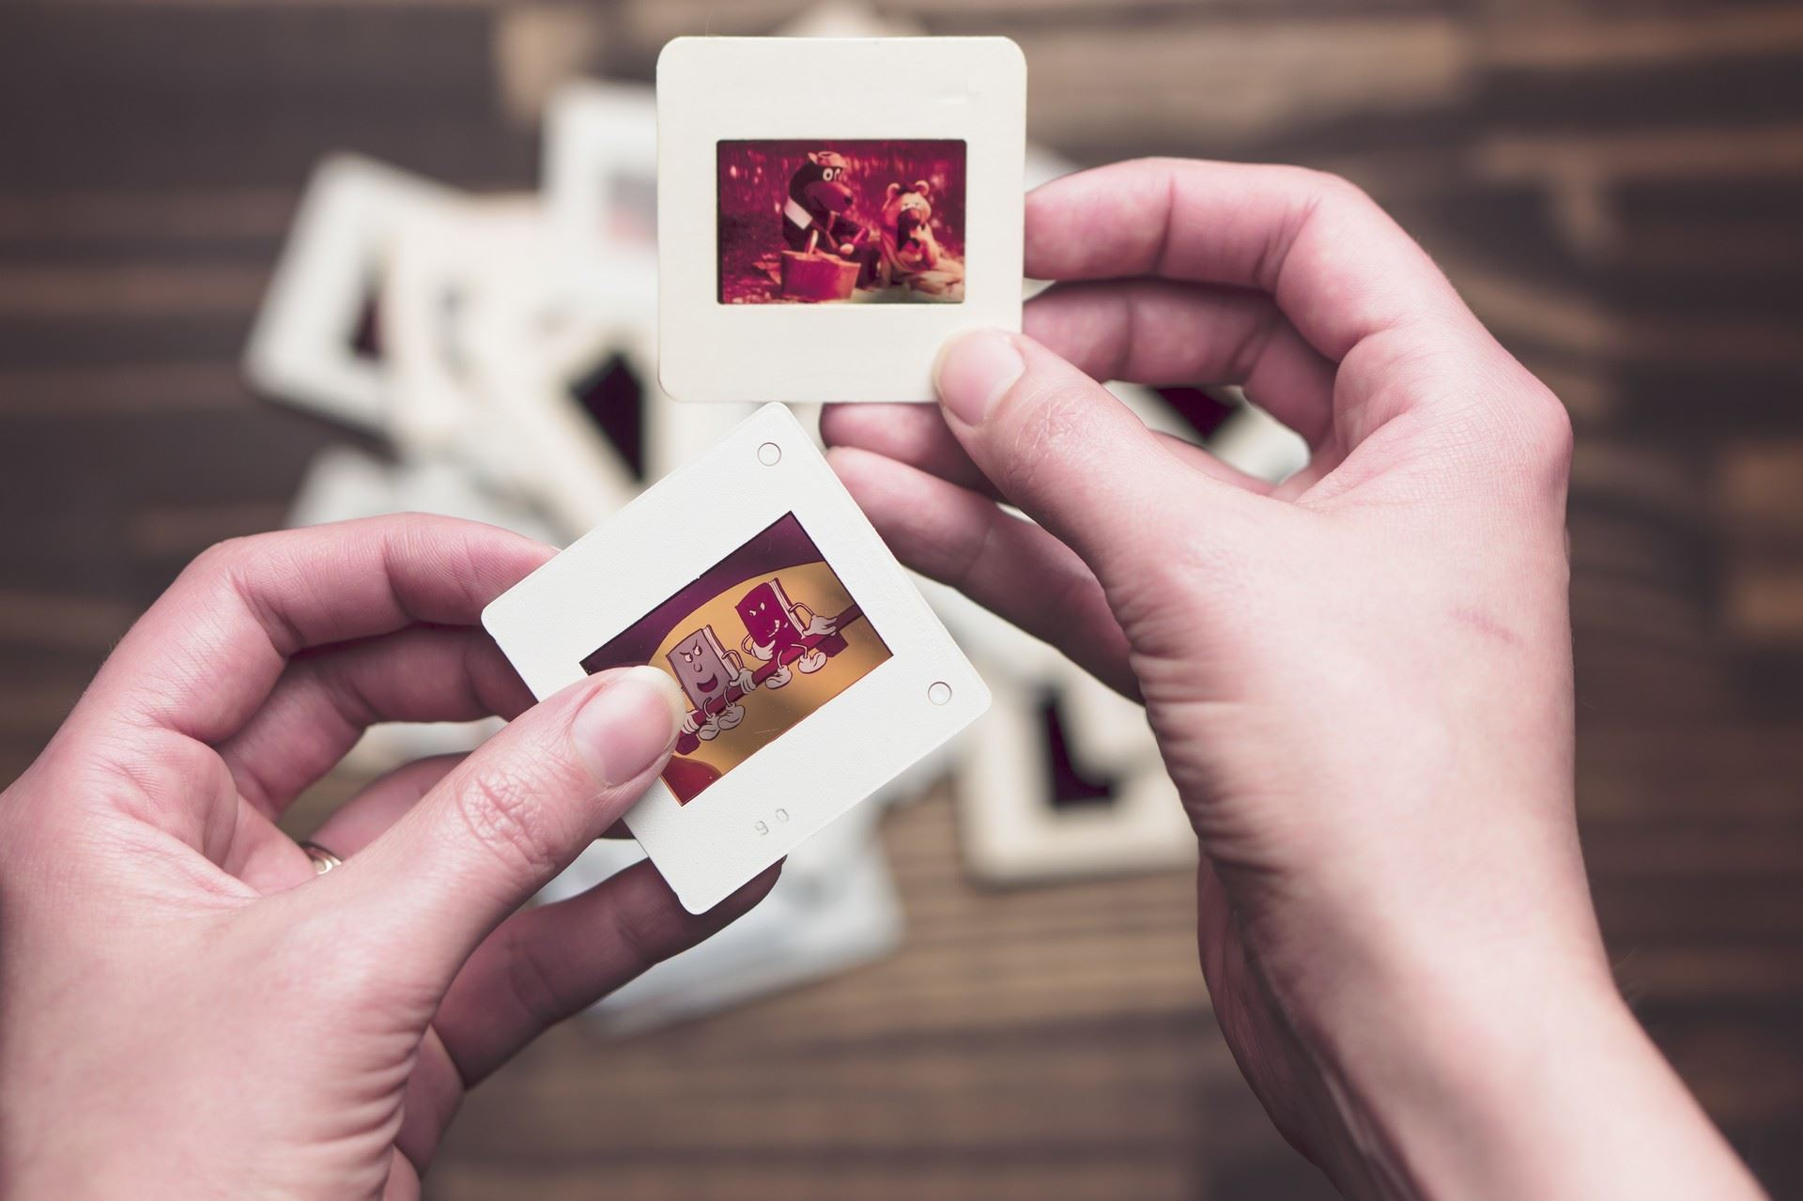
年度工作概述
标题文字添加
标题文字添加
标题文字添加
The user can demonstrate on a projector or computer, or print the presentation and make it into a film to be used in a wider field
The user can demonstrate on a projector or computer, or print the presentation and make it into a film to be used in a wider field
The user can demonstrate on a projector or computer, or print the presentation and make it into a film to be used in a wider field

Slide 6
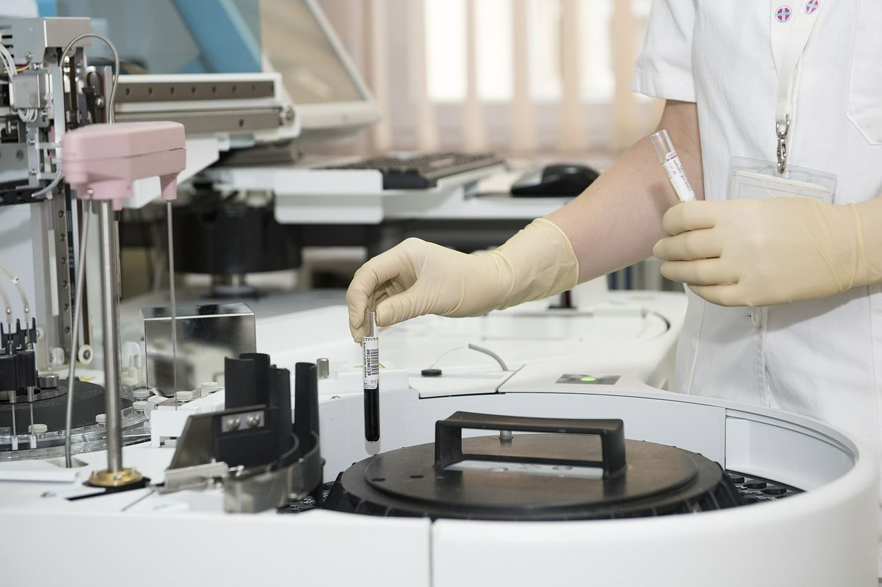

年度工作概述
标题文字添加
The user can demonstrate on a projector or computer, or print the presentation and make it into a film to be used in a wider field. Using PowerPoint, The user can demonstrate on a projector or computer, or print the presentation and make it into a film to be used in a wider field. Using PowerPoint,
标题文字添加
The user can demonstrate on a projector or computer, or print the presentation and make it into a film to be used in a wider field. Using PowerPoint, The user can demonstrate on a projector or computer, or print the presentation and make it into a film to be used in a wider field. Using PowerPoint,

Slide 7


年度工作概述
标题文字添加
标题文字添加
The user can demonstrate on a projector or computer, or print the presentation and make it into a film to be used in a wider field. Using PowerPoint,
The user can demonstrate on a projector or computer, or print the presentation and make it into a film to be used in a wider field. Using PowerPoint,

Slide 8
年度工作概述
标题文字添加
标题文字添加
The user can demonstrate on a projector or computer, or print the presentation and make it into a film to be used in a wider field. Using PowerPoint,
The user can demonstrate on a projector or computer, or print the presentation and make it into a film to be used in a wider field. Using PowerPoint,
标题文字添加
标题文字添加
The user can demonstrate on a projector or computer, or print the presentation and make it into a film to be used in a wider field. Using PowerPoint,
The user can demonstrate on a projector or computer, or print the presentation and make it into a film to be used in a wider field. Using PowerPoint,

Slide 9
02
工作完成情况
The user can demonstrate on a projector or computer, or print the presentation and make it into a film

Slide 10
工作完成情况
2018
标题文字添加
2017
The user can demonstrate on a projector or computer, or print the presentation and make it into a film to be used
标题文字添加
2016
The user can demonstrate on a projector or computer, or print the presentation and make it into a film to be used
标题文字添加
2015
The user can demonstrate on a projector or computer, or print the presentation and make it into a film to be used
标题文字添加
The user can demonstrate on a projector or computer, or print the presentation and make it into a film to be used

Slide 11





工作完成情况
标题文字添加
The user can demonstrate on a projector or computer, or print the presentation and make it into a film to be used in a wider field. Using PowerPoint,
The user can demonstrate on a projector or computer, or print the presentation and make it into a film to be used in a wider field. Using PowerPoint,
文字添加
文字添加
文字添加
文字添加
文字添加
文字添加
文字添加

Slide 12



工作完成情况
The user can demonstrate on a projector or computer, or print the presentation and make it into a film to be used in a wider field. Using PowerPoint,
The user can demonstrate on a projector or computer, or print the presentation and make it into a film to be used in a wider field. Using PowerPoint,
The user can demonstrate on a projector or computer, or print the presentation and make it into a film to be used in a wider field. Using PowerPoint,
The user can demonstrate on a projector or computer, or print the presentation and make it into a film to be used in a wider field. Using PowerPoint,
The user can demonstrate on a projector or computer, or print the presentation and make it into a film to be used in a wider field. Using PowerPoint,

Slide 13


工作完成情况
1
2
标题文字添加
标题文字添加
标题文字添加
3
The user can demonstrate on a projector or computer, or print the presentation and make it into a film to be used in a wider field. Using PowerPoint,
The user can demonstrate on a projector or computer, or print the presentation and make it into a film to be used in a wider field. Using PowerPoint,
The user can demonstrate on a projector or computer, or print the presentation and make it into a film to be used in a wider field. Using PowerPoint,

Slide 14
工作完成情况
文字添加
文字添加
文字添加
The user can demonstrate on a projector or computer, or print the presentation and make it into a film to be used in a wider field. Using PowerPoint,
The user can demonstrate on a projector or computer, or print the presentation and make it into a film to be used in a wider field. Using PowerPoint,
The user can demonstrate on a projector or computer, or print the presentation and make it into a film to be used in a wider field. Using PowerPoint,
文字添加
文字添加
The user can demonstrate on a projector or computer, or print the presentation and make it into a film to be used in a wider field. Using PowerPoint,
The user can demonstrate on a projector or computer, or print the presentation and make it into a film to be used in a wider field. Using PowerPoint,

Slide 15
03
工作存在不足
The user can demonstrate on a projector or computer, or print the presentation and make it into a film

Slide 16
工作存在不足
标题文字添加
标题文字添加
The user can demonstrate on a projector or computer, or print the presentation and make it into a film to be used in a wider field. Using PowerPoint,
The user can demonstrate on a projector or computer, or print the presentation and make it into a film to be used in a wider field. Using PowerPoint,
标题文字添加
标题文字添加
The user can demonstrate on a projector or computer, or print the presentation and make it into a film to be used in a wider field. Using PowerPoint,
The user can demonstrate on a projector or computer, or print the presentation and make it into a film to be used in a wider field. Using PowerPoint,

Slide 17
工作存在不足
标题文字添加
标题文字添加
The user can demonstrate on a projector or computer, or print the presentation and make it into a film to be used in a wider field. Using PowerPoint,
The user can demonstrate on a projector or computer, or print the presentation and make it into a film to be used in a wider field. Using PowerPoint,
标题文字添加
标题文字添加
The user can demonstrate on a projector or computer, or print the presentation and make it into a film to be used in a wider field. Using PowerPoint,
The user can demonstrate on a projector or computer, or print the presentation and make it into a film to be used in a wider field. Using PowerPoint,

Slide 18
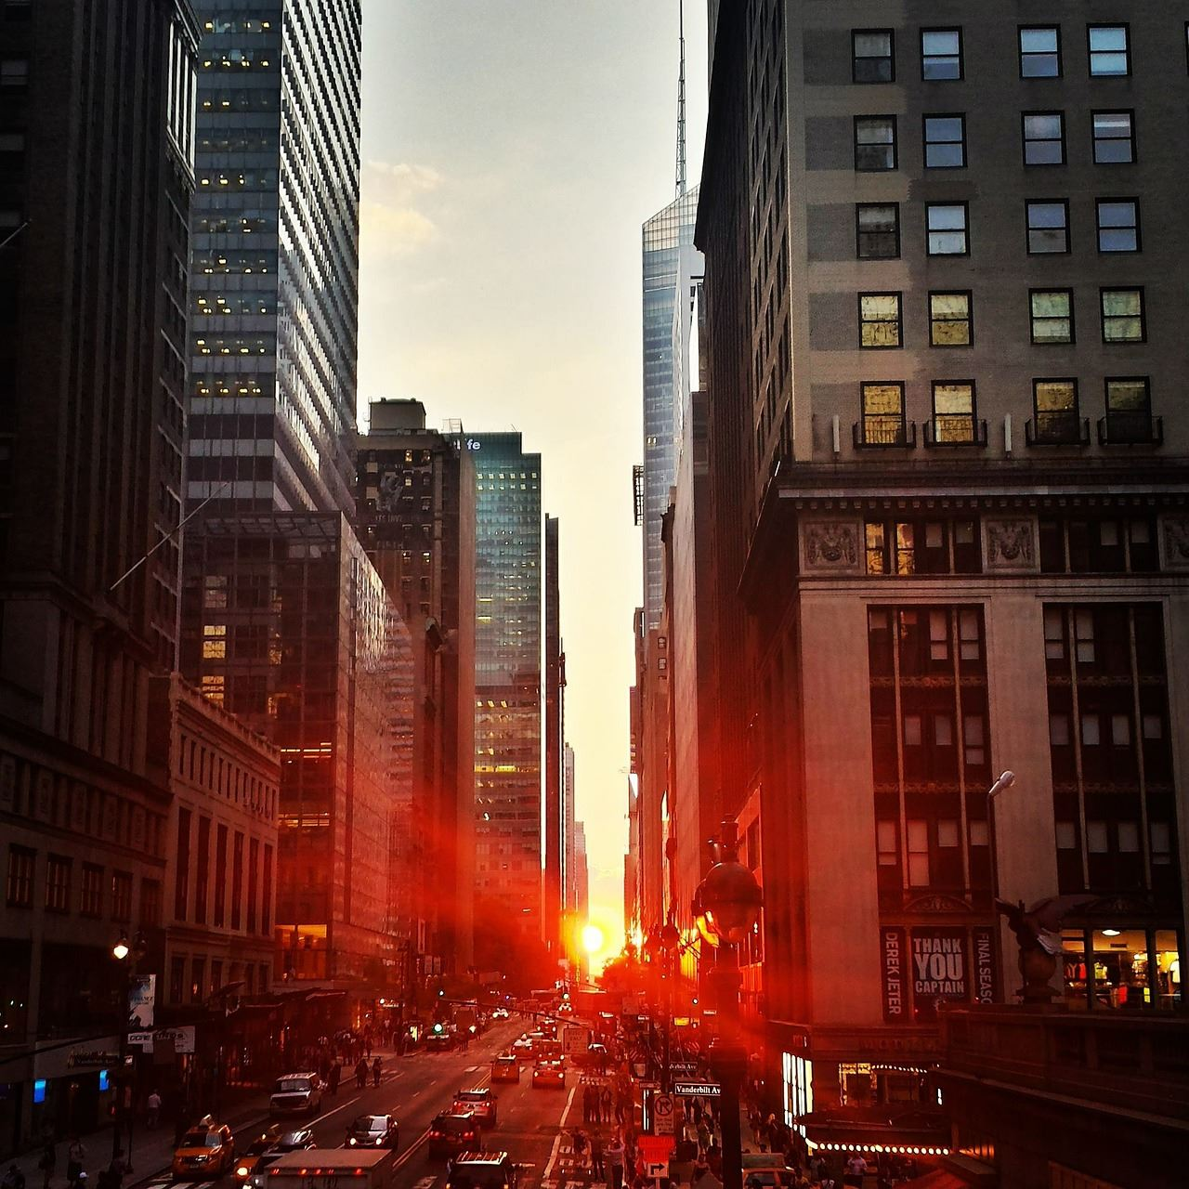


工作存在不足
1
The user can demonstrate on a projector or computer, or print the presentation and make it into a film to be used in a wider field. Using PowerPoint,
2
The user can demonstrate on a projector or computer, or print the presentation and make it into a film to be used in a wider field. Using PowerPoint,
3
The user can demonstrate on a projector or computer, or print the presentation and make it into a film to be used in a wider field. Using PowerPoint,
The user can demonstrate on a projector or computer, or print the presentation and make it into a film to be used in a wider field. Using PowerPoint,
The user can demonstrate on a projector or computer, or print the presentation and make it into a film to be used in a wider field. Using PowerPoint,
The user can demonstrate on a projector or computer, or print the presentation and make it into a film to be used in a wider field. Using PowerPoint,
4
5
6

Slide 19
工作存在不足
标题文字添加
The user can demonstrate on a projector or computer, or print the presentation and make it into a film to be used in a wider field. Using PowerPoint,
The user can demonstrate on a projector or computer, or print the presentation and make it into a film to be used in a wider field. Using PowerPoint,
The user can demonstrate on a projector or computer, or print the presentation and make it into a film to be used in a wider field. Using PowerPoint,
The user can demonstrate on a projector or computer, or print the presentation and make it into a film to be used in a wider field. Using PowerPoint,
The user can demonstrate on a projector or computer, or print the presentation and make it into a film to be used in a wider field. Using PowerPoint,

Slide 20
04
明年工作计划
The user can demonstrate on a projector or computer, or print the presentation and make it into a film

Slide 21
明年工作计划
标题文字添加
The user can demonstrate on a projector or computer, or print the presentation and make it into a film to be used in a wider field. Using PowerPoint, The user can demonstrate on a projector or computer, or print the presentation and make it into a film to be used in a wider field. Using PowerPoint, The user can demonstrate on a projector or computer, or print the presentation and make it into a film to be used in a wider field. Using PowerPoint,
标题文字添加
标题文字添加
The user can demonstrate on a projector or computer, or print the presentation and make it into a film to be used in a wider field. Using PowerPoint,
The user can demonstrate on a projector or computer, or print the presentation and make it into a film to be used in a wider field. Using PowerPoint,

Slide 22

明年工作计划
标题文字添加
The user can demonstrate on a projector or computer, or print the presentation and make it into a film to be used in a wider field. Using PowerPoint,
标题文字添加
The user can demonstrate on a projector or computer, or print the presentation and make it into a film to be used in a wider field. Using PowerPoint,
标题文字添加
The user can demonstrate on a projector or computer, or print the presentation and make it into a film to be used in a wider field. Using PowerPoint,
标题文字添加
The user can demonstrate on a projector or computer, or print the presentation and make it into a film to be used in a wider field. Using PowerPoint,

Slide 23
明年工作计划
The user can demonstrate on a projector or computer, or print the presentation and make it into a film to be used in a wider field. Using PowerPoint, The user can demonstrate on a projector or computer, or print the presentation and make it into a film to be used in a wider field. Using PowerPoint, The user can demonstrate on a projector or computer, or print the presentation and make it into a film to be used in a wider field. Using PowerPoint, The user can demonstrate on a projector or computer, or print the presentation
标题文字添加
标题文字添加
标题文字添加
标题文字添加
标题文字添加
标题文字添加
标题文字添加
标题文字添加
标题文字添加
标题文字添加
标题文字添加
标题文字添加

Slide 24
明年工作计划
标题文字添加
标题文字添加
标题文字添加
标题文字添加
The user can demonstrate on a projector or computer, or print the presentation and make it into a film to be used in a wider field. Using PowerPoint,
The user can demonstrate on a projector or computer, or print the presentation and make it into a film to be used in a wider field. Using PowerPoint,
The user can demonstrate on a projector or computer, or print the presentation and make it into a film to be used in a wider field. Using PowerPoint,
The user can demonstrate on a projector or computer, or print the presentation and make it into a film to be used in a wider field. Using PowerPoint,

Slide 25
演示完毕感谢您的观看
The user can demonstrate on a projector or computer, or print the presentation and make it into a film

