Slide 1

PERSONAL CV
求 职
简 历
工作岗位人才竞聘ppt模板

Slide 2

HELLO, HERE I AM
对不起啊
我来晚了
NICE TO MEET YOU

Slide 3
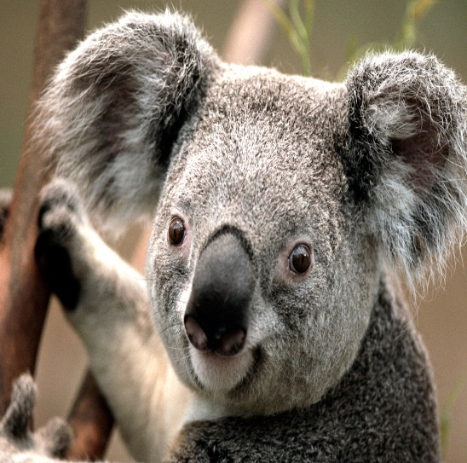
MY NAME IS XXX
MY NAME IS XXX
您好！
我叫XX
90后小伙
您好！
我叫XX
90后小伙
I WAS BORN AT SETP. 1990
I WAS BORN AT SETP. 1990

Slide 4
（最后一页附可编辑版）

Slide 5
I AM PART OF 90S
我和他们一样
却又不太一样
BUT I HAVE MY UNIQUE SIDES

Slide 6
I STARTED TO STUDY AT 5 YEARS OLD
我搭了趟早班车
和后80们同上学
CLASSMATED WITH 80S , SO I AM ALSO PART OF 80S

Slide 7
I AM A HALF-GIFTED STUDENT
我是一个半资优生
成绩优秀却不突出
PERFORMING GOOD BUT NOT PROMINENT

Slide 8
I LIKE RUNNING SWIMMING &PHOTOGRAPHY
喜欢跑步游泳摄影
偶尔还能写写小说
AND ALSO WRITTING NOVELS SOMETIMES

Slide 9

S18’09’’ ,E49’25’’
马达加斯加
渔人与船

Slide 10
STUDIED IN GUANGXI UNIVERSITY FROM 2008
2008-2012年就读于
广西大学XXXXX专业
MAJORED IN TCSL OF COLLEGE OF LITERATURE

Slide 11
NEVER STOPPED STUDYING MAJOR COURSES
努力学习专业知识
曾获得专业二等奖
BE AWARDED THE 2ND PLACE OF MAJOR

Slide 12
PASSED EXAMS OF CET6 / MANDARIN 2ND LEVEL
英语六级普通话二甲
秘书三级计算机一级
WON THE SECRETARY 3RD LEVEL / NCRE 1ST LEVEL

Slide 13
I TOOK AN ACTIVE PART IN STUDENT CLUB ACTIVITIES
大学期间积极参加
各种学生社团活动
ENJOYED A WONDERFUL COLLEGE LIFE

Slide 14
USED TO BE AN EDITOR OF STUDENT WEBSIDE
曾任学生网站编辑
和校刊编辑部助理
AND ASSISTANT OF SCHOOL MAGAZINE

Slide 15
I USED TO JOIN IN JIA VOLUNTEER WORKCAMP
赴麻风病康复村
志愿服务120小时
AND SERVICED LEPERS OVER 120 HOURS

Slide 16
USED TO PLAY A ROLE IN CLASS’ DRAMA IN 2009
也曾参演班级话剧
和同学筹拍微电影
AND SHOOT A DV WITH MY CLASSMATES IN 2011

Slide 17
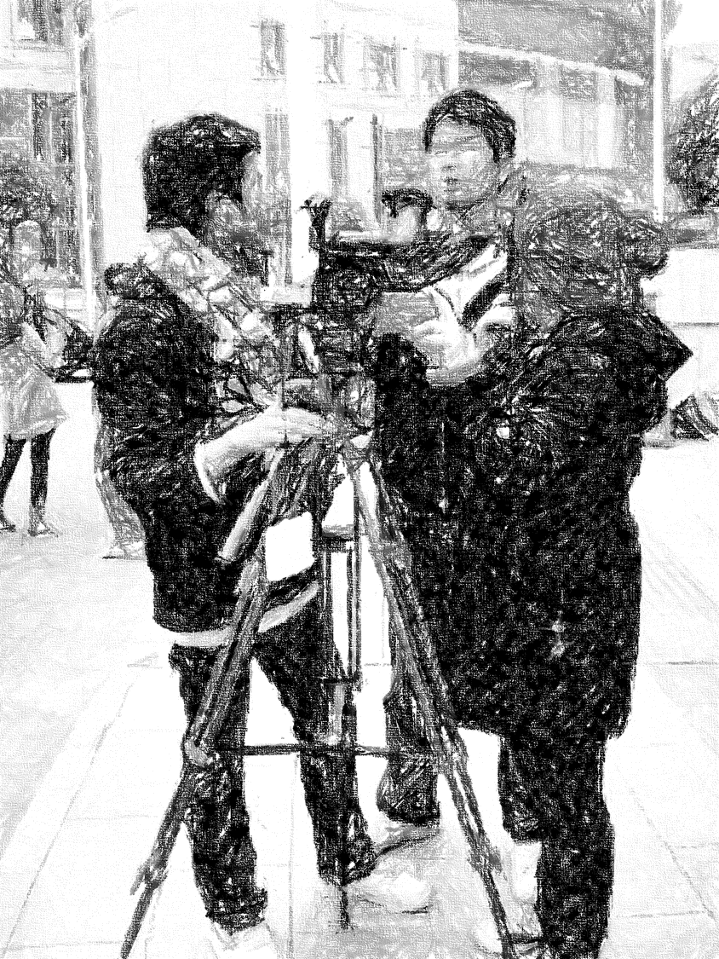
2011年1月
南宁·地王大厦
短剧《向光》拍摄中

Slide 18
I PAID MY EFFORT TO IMPROVE MY SKILLS
努力提升各项技能
办公剪辑软件泰语
OFFICE SOFTWARE / FILM EDITING / THAI

Slide 19
WORKED AS A VOLUNTEER CHINESE TEACHER
毕业后赴XXXXXX及
XX做汉语教师志愿者
IN THAILAND(2012-2013) & MADAGASCAR(2013-2014)

Slide 20
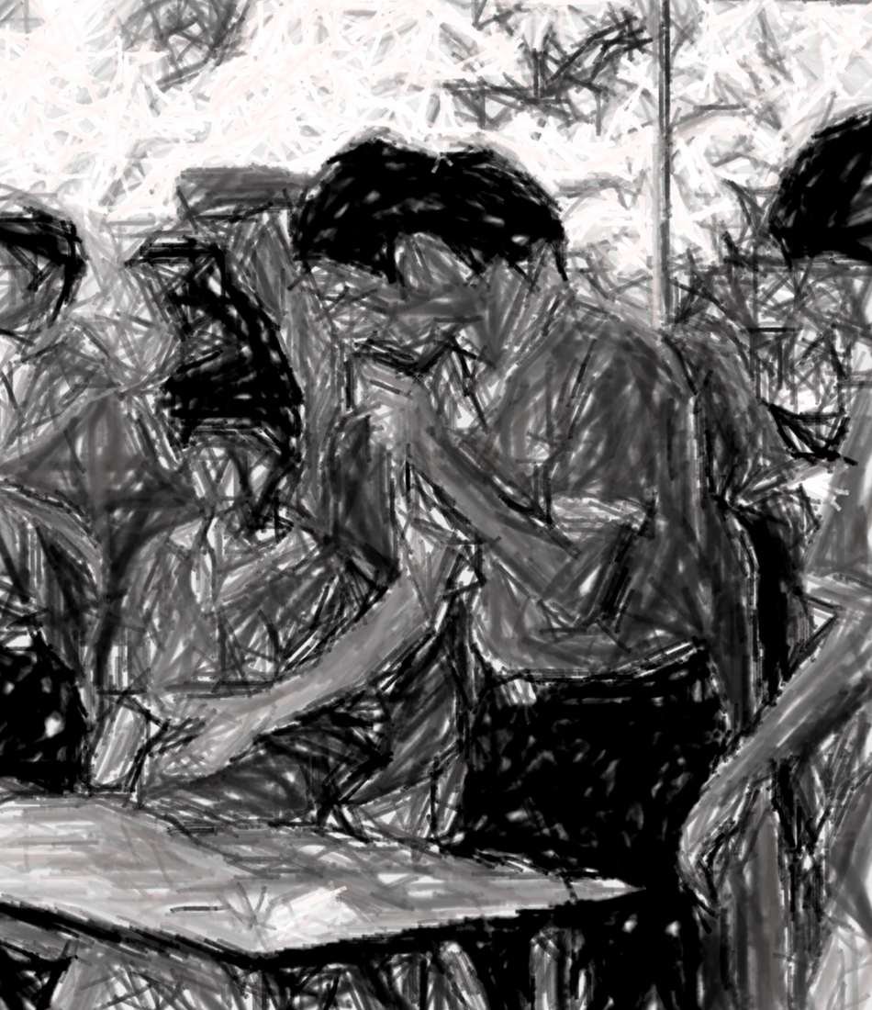
2012年9月
泰国巴吞他尼府Sathit学校
汉语知识竞赛

Slide 21
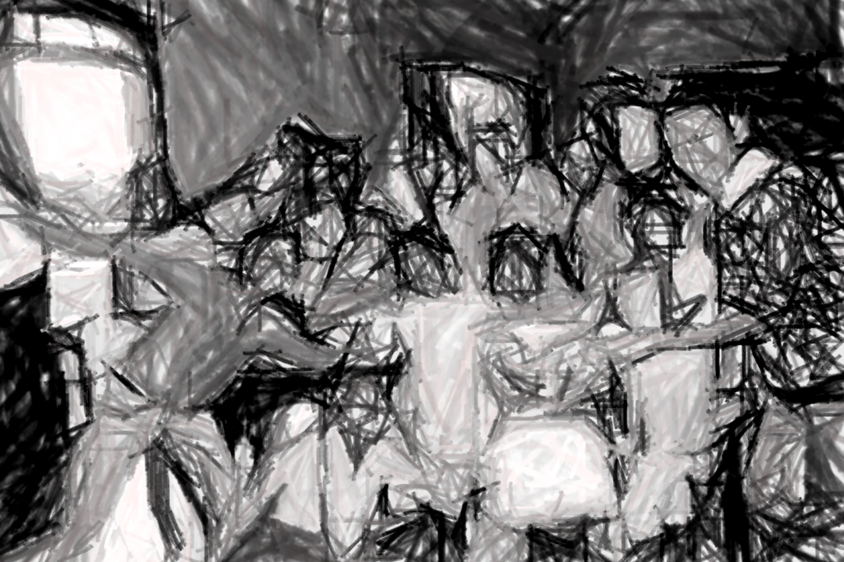
2014年7月
马达加斯加·中山学校
期末结业典礼

Slide 22
AFTER RETURNING I WORKED AS AN ASSISTANT IN GUANGXI
回国后在广西南宁市
XXXX公司做助理
NANNING XXXXX COMPANY UNTIL FEBR. 2015

Slide 23
I DECIDED TO RUN AN ONLINE STORE AFTER QUITING THE JOB
辞职后创业开网店
可惜效果不太理想
BUT THINGS TURNS TO NOT THAT MUCH IDEAL AS I EXPECTED

Slide 24
UNCONTROLLABLE FACTORS PUZZLES ME
有各种不可控因素
我决定重新找工作
SO I DECIDE TO RESTART TO FIND A JOB

Slide 25
FURTUNATELY I FOUND THAT YOU ARE HIRING NEW BLOOD
看到贵公司的招聘计划后
对XXXX一职颇感兴趣
I AM INTERESTED IN THE POSITION OF XXXX

Slide 26
SO I TAKE THE LIBERTY OF SENDING MY PERSONAL CV
因此冒昧投递简历
希望能有机会一试
HOPING FOR THE CHANCE OF HAVING AN INTERVIEW

Slide 27
30
65
85
80
岗位经验
文案能力
协作能力
学习能力
I MIGHT NOT BE THE MOST OUTSTANDING ONE
我也许不是最杰出的
但我会努力变得优秀
BUT I HAVE THE CONFIDENCE TO BE ONE OF THEM

