Slide 1


2
0
1
8
工作总结 新年计划
The user can demonstrate on a projector or computer, or print the presentation and make it into a film

Slide 2

01
年度工作概述
The user can demonstrate on a projector
02
工作完成情况
目 录
The user can demonstrate on a projector
CONTENT
工作存在不足
03
The user can demonstrate on a projector
04
明年工作计划
The user can demonstrate on a projector

Slide 3
01
年度工作概述
The user can demonstrate on a projector

Slide 4

01
年度工作概述
The user can demonstrate on a projector
标题文字添加
The user can demonstrate on a projector or computer, or print the presentation and make it into a film to be used in a wider field
标题文字添加
The user can demonstrate on a projector or computer, or print the presentation and make it into a film to be used in a wider field
标题文字添加
The user can demonstrate on a projector or computer, or print the presentation and make it into a film to be used in a wider field
标题文字添加
The user can demonstrate on a projector or computer, or print the presentation and make it into a film to be used in a wider field

Slide 5

01
年度工作概述
The user can demonstrate on a projector
标题文字添加
标题文字添加
标题文字添加
The user can demonstrate on a projector or computer, or print the presentation and make it into a film to be used
The user can demonstrate on a projector or computer, or print the presentation and make it into a film to be used
The user can demonstrate on a projector or computer, or print the presentation and make it into a film to be used

Slide 6

01
年度工作概述
The user can demonstrate on a projector
标题文字添加
The user can demonstrate on a projector or computer, or print the presentation and make it into a film to be used
标题文字添加
The user can demonstrate on a projector or computer, or print the presentation and make it into a film to be used
标题文字添加
The user can demonstrate on a projector or computer, or print the presentation and make it into a film to be used

Slide 7
01
年度工作概述
The user can demonstrate on a projector
标题文字添加
标题文字添加
The user can demonstrate on a projector or computer, or print the presentation and make it into a film to be used in a wider field. Using PowerPoint,
The user can demonstrate on a projector or computer, or print the presentation and make it into a film to be used in a wider field. Using PowerPoint,
标题文字添加
标题文字添加
The user can demonstrate on a projector or computer, or print the presentation and make it into a film to be used in a wider field. Using PowerPoint,
The user can demonstrate on a projector or computer, or print the presentation and make it into a film to be used in a wider field. Using PowerPoint,

Slide 8
01
年度工作概述
The user can demonstrate on a projector
标题文字添加
标题文字添加
标题文字添加
The user can demonstrate on a projector or computer, or print the presentation and make it into a film to
The user can demonstrate on a projector or computer, or print the presentation and make it into a film to
The user can demonstrate on a projector or computer, or print the presentation and make it into a film to
标题文字添加
标题文字添加
标题文字添加
The user can demonstrate on a projector or computer, or print the presentation and make it into a film
The user can demonstrate on a projector or computer, or print the presentation and make it into a film
The user can demonstrate on a projector or computer, or print the presentation and make it into a film

Slide 9
02
工作完成情况
The user can demonstrate on a projector

Slide 10

02
工作完成情况
The user can demonstrate on a projector
标题文字添加
标题文字添加
标题文字添加
标题文字添加
The user can demonstrate on a projector or computer, or print the presentation and make it into a film to be used in a wider field. Using PowerPoint,
The user can demonstrate on a projector or computer, or print the presentation and make it into a film to be used in a wider field. Using PowerPoint,
The user can demonstrate on a projector or computer, or print the presentation and make it into a film to be used in a wider field. Using PowerPoint,
The user can demonstrate on a projector or computer, or print the presentation and make it into a film to be used in a wider field. Using PowerPoint,

Slide 11
02
工作完成情况
The user can demonstrate on a projector
标题文字添加
标题文字添加
The user can demonstrate on a projector or computer, or print the presentation and make it into a film to be used
The user can demonstrate on a projector or computer, or print the presentation and make it into a film to be used
标题文字添加
标题文字添加
The user can demonstrate on a projector or computer, or print the presentation and make it into a film to be used
The user can demonstrate on a projector or computer, or print the presentation and make it into a film to be used

Slide 12

02
工作完成情况
The user can demonstrate on a projector
标题文字添加
标题文字添加
The user can demonstrate on a projector or computer, or print the presentation and make it into a film to be used in a wider field. Using PowerPoint,
标题文本预设
The user can demonstrate on a projector or computer, or print the presentation and make it into a film to be used in a wider field. Using PowerPoint,
标题文本预设
标题文字添加
标题文字添加
The user can demonstrate on a projector or computer, or print the presentation and make it into a film to be used in a wider field. Using PowerPoint,
The user can demonstrate on a projector or computer, or print the presentation and make it into a film to be used in a wider field. Using PowerPoint,

Slide 13

02
工作完成情况
The user can demonstrate on a projector
标题文字添加
标题文字添加
标题文字添加
The user can demonstrate on a projector or computer, or print the presentation and make it into a film to be used in a wider field. Using PowerPoint,
The user can demonstrate on a projector or computer, or print the presentation and make it into a film to be used in a wider field. Using PowerPoint,
The user can demonstrate on a projector or computer, or print the presentation and make it into a film to be used in a wider field. Using PowerPoint,

Slide 14


02
工作完成情况
The user can demonstrate on a projector
标题文字添加
标题文字添加
标题文字添加
标题文字添加
The user can demonstrate on a projector or computer, or print the presentation and make it into a film to be used in a wider field. Using PowerPoint,
The user can demonstrate on a projector or computer, or print the presentation and make it into a film to be used in a wider field. Using PowerPoint,
The user can demonstrate on a projector or computer, or print the presentation and make it into a film to be used in a wider field. Using PowerPoint,
The user can demonstrate on a projector or computer, or print the presentation and make it into a film to be used in a wider field. Using PowerPoint,

Slide 15
03
工作存在不足
The user can demonstrate on a projector

Slide 16
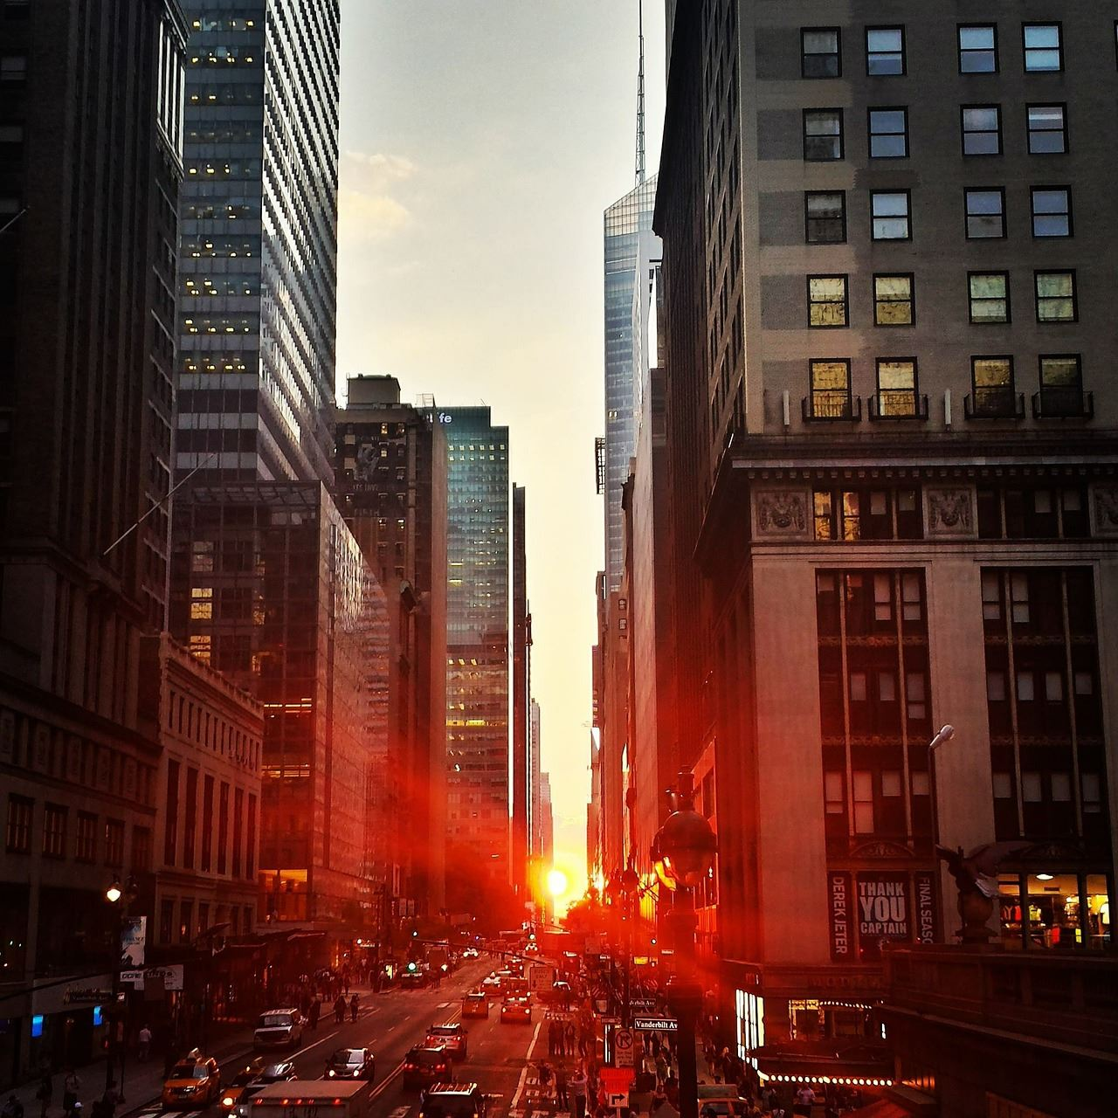
03
工作存在不足
The user can demonstrate on a projector
标题文字添加
The user can demonstrate on a projector or computer, or print the presentation and make it into a film to be used in a wider field. Using PowerPoint,
标题文字添加
The user can demonstrate on a projector or computer, or print the presentation and make it into a film to be used in a wider field. Using PowerPoint,
标题文字添加
The user can demonstrate on a projector or computer, or print the presentation and make it into a film to be used in a wider field. Using PowerPoint,
标题文字添加
The user can demonstrate on a projector or computer, or print the presentation and make it into a film to be used in a wider field. Using PowerPoint,

Slide 17
03
工作存在不足
The user can demonstrate on a projector
标题文字添加
标题文字添加
The user can demonstrate on a projector or computer, or print the presentation and make it into a film to be used in a wider field. Using PowerPoint,
The user can demonstrate on a projector or computer, or print the presentation and make it into a film to be used in a wider field. Using PowerPoint,
标题文字添加
标题文字添加
The user can demonstrate on a projector or computer, or print the presentation and make it into a film to be used in a wider field. Using PowerPoint,
The user can demonstrate on a projector or computer, or print the presentation and make it into a film to be used in a wider field. Using PowerPoint,

Slide 18

03
工作存在不足
The user can demonstrate on a projector
标题文字添加
标题文字添加
标题文字添加
标题文字添加
The user can demonstrate on a projector or computer, or print the presentation and make it into a film to be used in a wider field. Using PowerPoint,
The user can demonstrate on a projector or computer, or print the presentation and make it into a film to be used in a wider field. Using PowerPoint,
The user can demonstrate on a projector or computer, or print the presentation and make it into a film to be used in a wider field. Using PowerPoint,
The user can demonstrate on a projector or computer, or print the presentation and make it into a film to be used in a wider field. Using PowerPoint,

Slide 19
03
工作存在不足
The user can demonstrate on a projector
标题文字添加
The user can demonstrate on a projector or computer, or print the presentation and make it into a film to be used in a wider field. Using PowerPoint,
标题文字添加
标题文字添加
The user can demonstrate on a projector or computer, or print the presentation and make it into a film to be used in a wider field. Using PowerPoint,
The user can demonstrate on a projector or computer, or print the presentation and make it into a film to be used in a wider field. Using PowerPoint,
标题文字添加
标题文字添加
The user can demonstrate on a projector or computer, or print the presentation and make it into a film to be used in a wider field. Using PowerPoint,
The user can demonstrate on a projector or computer, or print the presentation and make it into a film to be used in a wider field. Using PowerPoint,

Slide 20
04
明年工作计划
The user can demonstrate on a projector

Slide 21
04
明年工作计划
The user can demonstrate on a projector
标题文字添加
The user can demonstrate on a projector or computer, or print the presentation and make it into a film to be used in a wider field. Using PowerPoint, The user can demonstrate on a projector or computer, or print the presentation and make it into a film to be used in a wider field. Using PowerPoint, The user can demonstrate on a projector or computer, or print the presentation and make it into a film to be used in a wider field. Using PowerPoint,
01
02
03
04
The user can demonstrate on a projector or computer, or print the presentation and make it into a film to be used in a wider field. Using PowerPoint,
The user can demonstrate on a projector or computer, or print the presentation and make it into a film to be used in a wider field. Using PowerPoint,
The user can demonstrate on a projector or computer, or print the presentation and make it into a film to be used in a wider field. Using PowerPoint,
The user can demonstrate on a projector or computer, or print the presentation and make it into a film to be used in a wider field. Using PowerPoint,

Slide 22
04
明年工作计划
The user can demonstrate on a projector
标题文字添加
标题文字添加
标题文字添加
标题文字添加
标题文字添加
01
02
03
04
05
The user can demonstrate on a projector or computer, or print the presentation and make it into a film to be used in a wider field. Using PowerPoint,
The user can demonstrate on a projector or computer, or print the presentation and make it into a film to be used in a wider field. Using PowerPoint,
The user can demonstrate on a projector or computer, or print the presentation and make it into a film to be used in a wider field. Using PowerPoint,
The user can demonstrate on a projector or computer, or print the presentation and make it into a film to be used in a wider field. Using PowerPoint,
The user can demonstrate on a projector or computer, or print the presentation and make it into a film to be used in a wider field. Using PowerPoint,

Slide 23


04
明年工作计划
The user can demonstrate on a projector
标题文字添加
The user can demonstrate on a projector or computer, or print the presentation and make it into a film to be used in a wider field. Using PowerPoint,
The user can demonstrate on a projector or computer, or print the presentation and make it into a film to be used in a wider field. Using PowerPoint,
The user can demonstrate on a projector or computer, or print the presentation and make it into a film to be used in a wider field. Using PowerPoint,

Slide 24
04
明年工作计划
The user can demonstrate on a projector
标题文字添加
标题文字添加
标题文字添加
The user can demonstrate on a projector or computer, or print the presentation and make it into a film to be used in a wider field. Using PowerPoint,
The user can demonstrate on a projector or computer, or print the presentation and make it into a film to be used in a wider field. Using PowerPoint,
The user can demonstrate on a projector or computer, or print the presentation and make it into a film to be used in a wider field. Using PowerPoint,

Slide 25
2
0
1
8
演示完毕 感谢聆听
The user can demonstrate on a projector or computer, or print the presentation and make it into a film

