Slide 1





婚礼进行时模板
L
&
Q

Slide 2
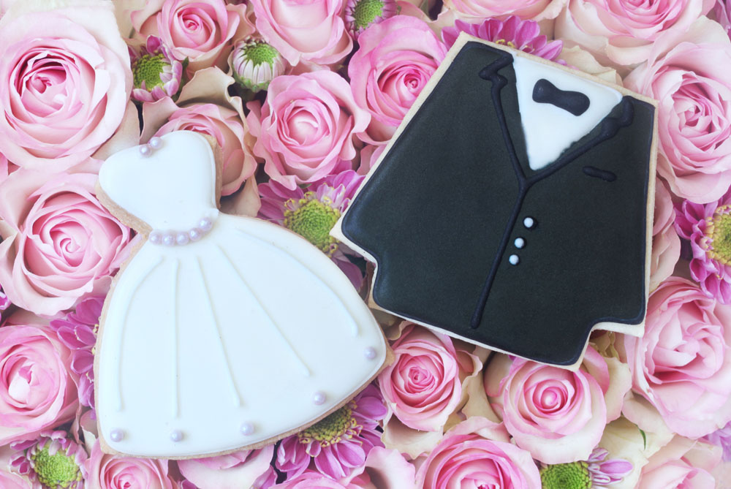
Groom : Carl
Bride : Shirley

Slide 3


Since the first time I saw you,I felt something inside,I don't know if it's love at first sight,I do know I really like you a lot. Tanya C Medeiros

Slide 4



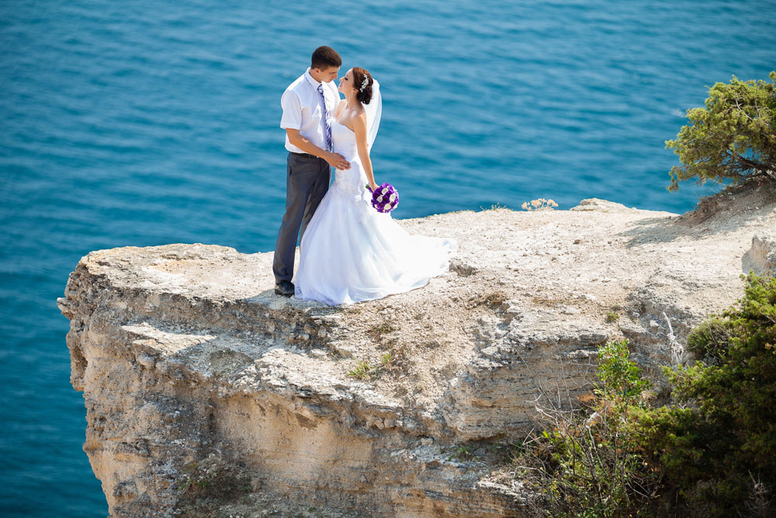

Slide 5

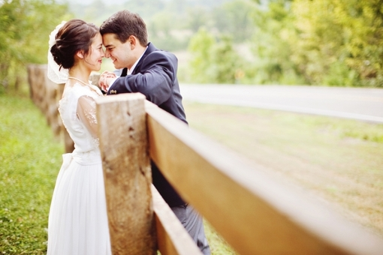
Since the first time I saw you,I felt something inside,I don't know if it's love at first sight,I do know I really like you a lot. Tanya C Medeiros
Married

Slide 6
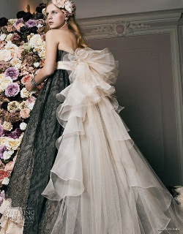

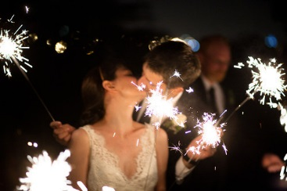

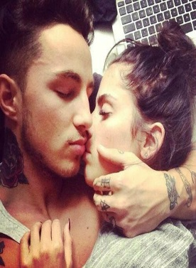

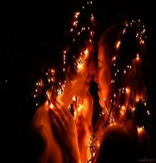


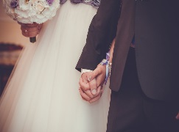
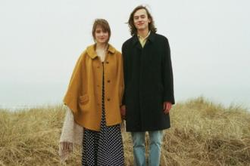


Slide 7




Sweetheart,
My thoughts are deep into you
From the moment that I wake up
And to the whole day through

Slide 8

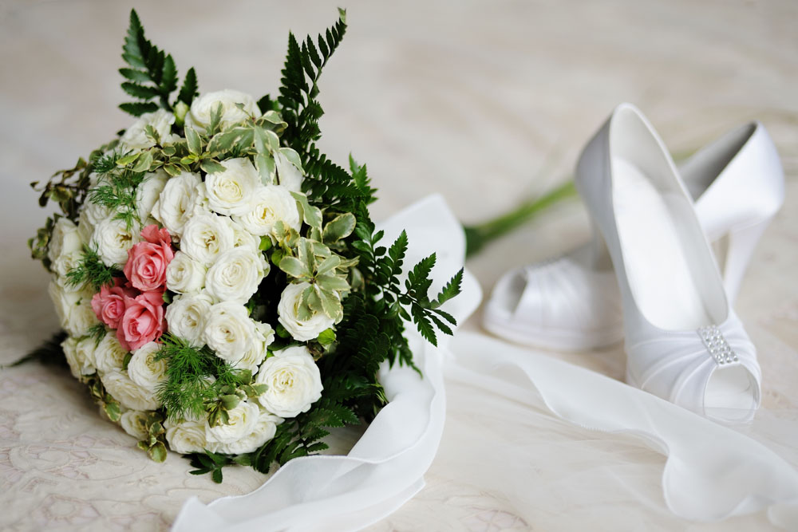
Married 10.1
I Love You

Slide 9


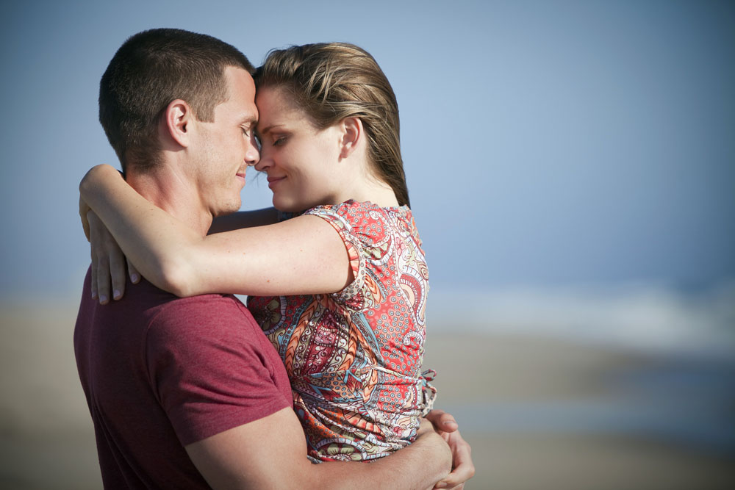
Since the first time I saw you,I felt something inside,I don't know if it's love at first sight,I do know I really like you a lot. Tanya C Medeiros

Slide 10



Slide 11



执子之手 与子偕老

Slide 12



Since the first time I saw you,I felt something inside,I don't know if it's love at first sight,I do know I really like you a lot. Tanya C Medeiros

Slide 13
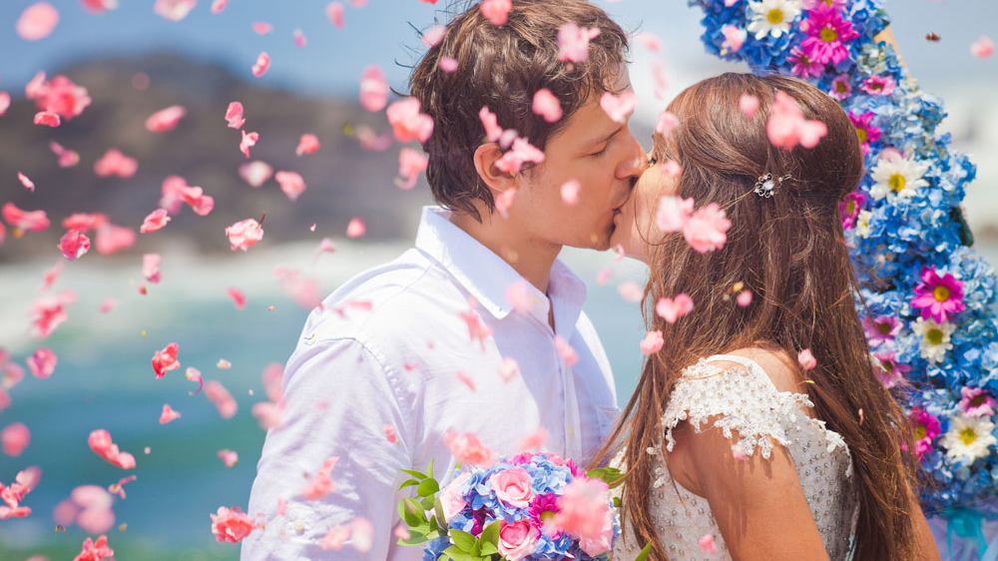
Love You

Slide 14


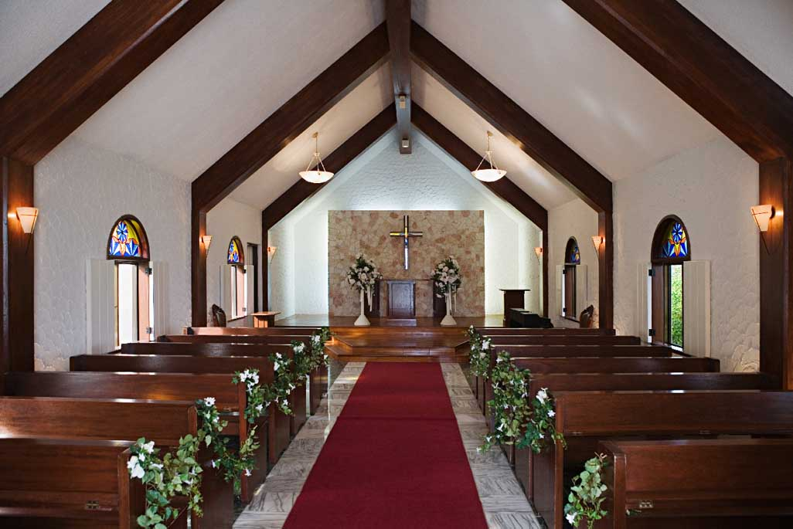
Since the first time I saw you,I felt something inside,I don't know if it's love at first sight,I do know I really like you a lot. Tanya C Medeiros

Slide 15


Since the first time I saw you,I felt something inside,I don't know if it's love at first sight,I do know I really like you a lot. Tanya C Medeiros

Slide 16





Since the first time I saw you,I felt something inside,I don't know if it's love at first sight,I do know I really like you a lot. Tanya C Medeiros

Slide 17
Since the first time I saw you,I felt something inside,I don't know if it's love at first sight,I do know I really like you a lot. Tanya C Medeiros

Slide 18




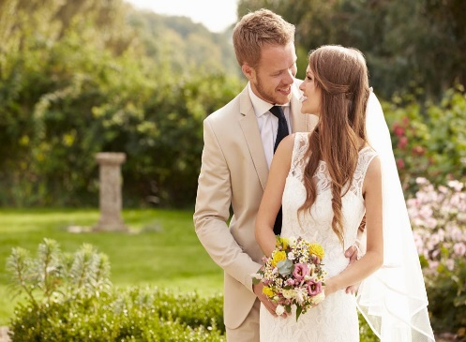




Since the first time I saw you,I felt something inside,I don't know if it's love at first sight,I do know I really like you a lot. Tanya C Medeiros

Slide 19
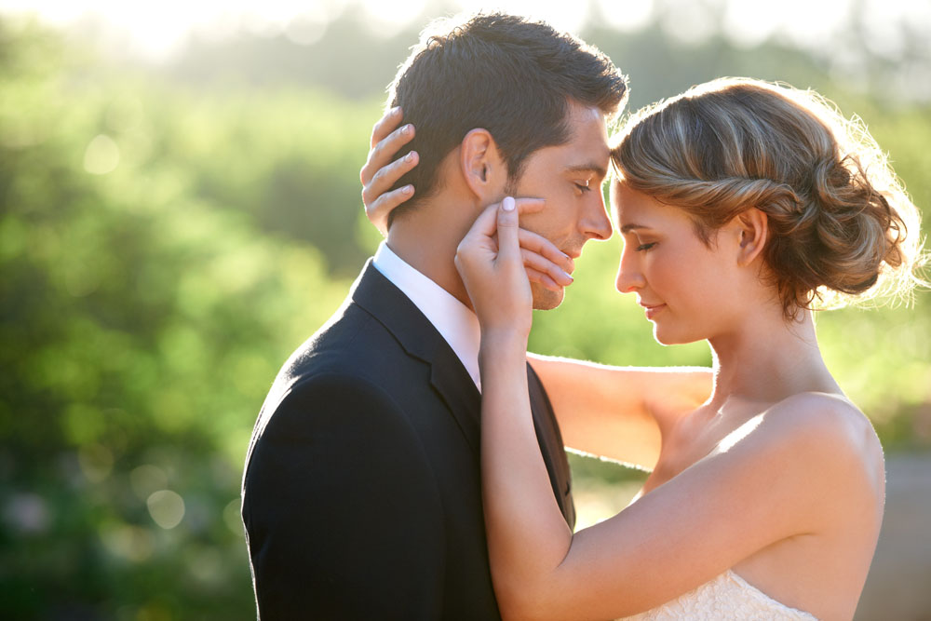
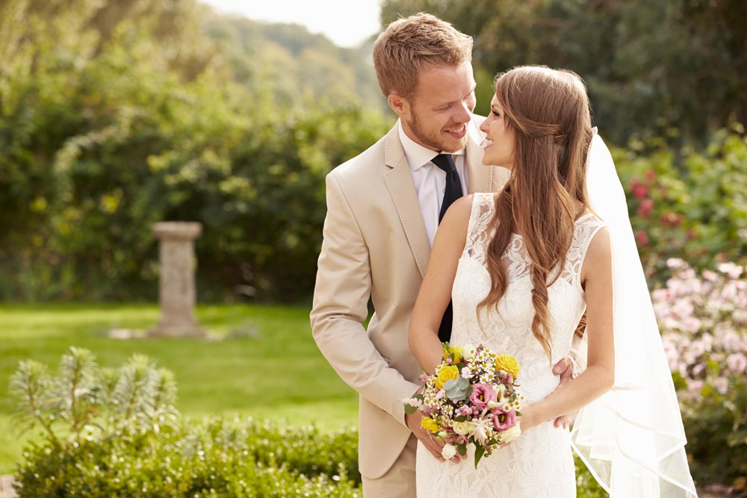
Since the first time I saw you,I felt something inside,I don't know if it's love at first sight,I do know I really like you a lot. Tanya C Medeiros

Slide 20

Love You Forever

