Slide 1















浪漫婚礼相册ppt模板

Slide 2


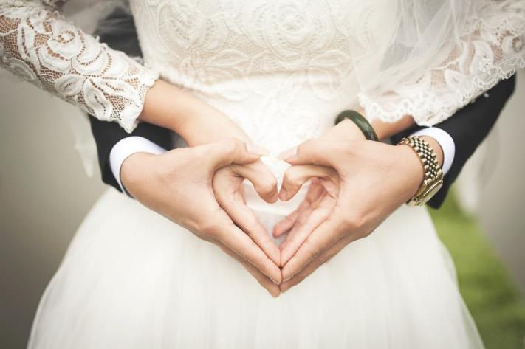
01 添加标题
02 添加标题
03 添加标题
04 添加标题

Slide 3




Slide 4


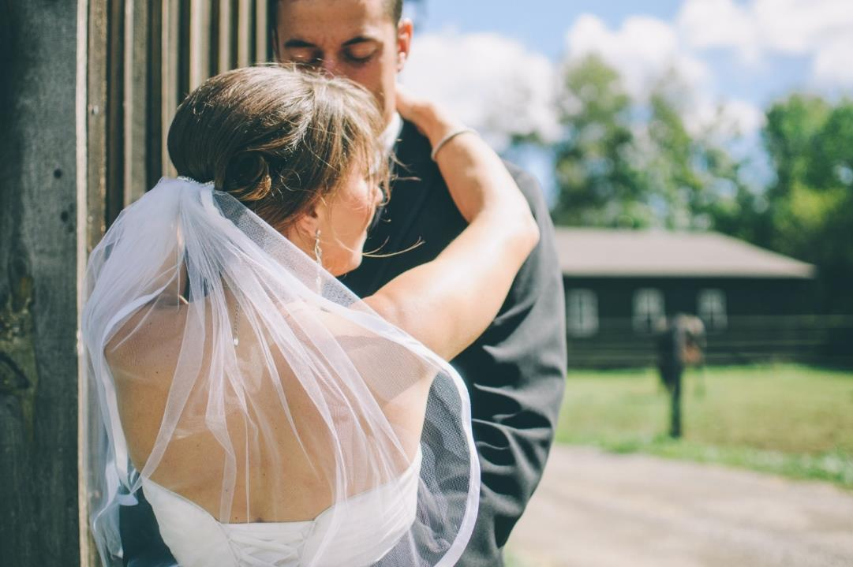


Part 01
Don't you be afraid whether old ugly sick I love you

Slide 5


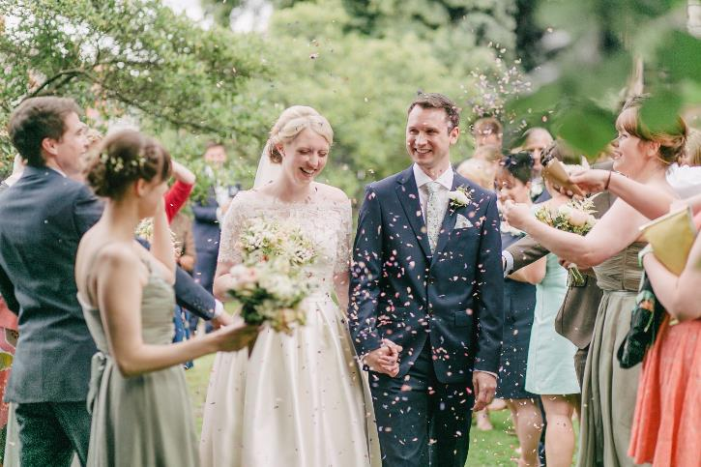

今天
是我们相恋的第588天！
未来
我们将一起携手共度无数
美好时光！
Yes ,I do!
（You er the only one in my heart）
期待爱情最美丽的那刻，你我在爱的名义下步入圣殿，接受全世界
最诚心的祝福,SAY YES！这是我们彼此的共鸣......

Slide 6
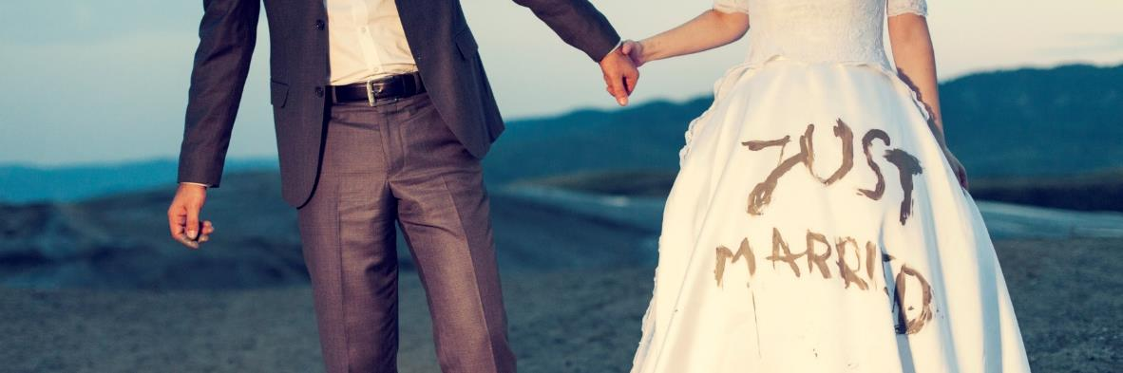
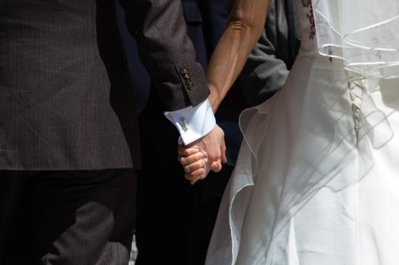
好
May Jesus Christ always be at the center of the new lives you are now starting to build together, that you may know the ways of true love and kindness.
美
时
光
你好，幸福！

Slide 7

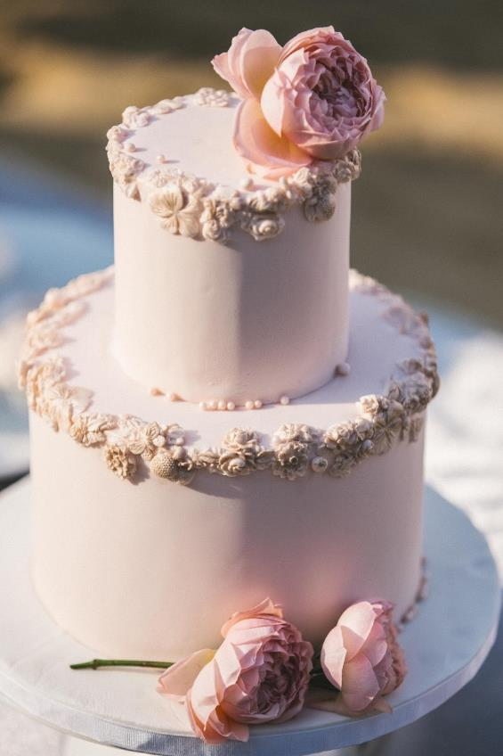
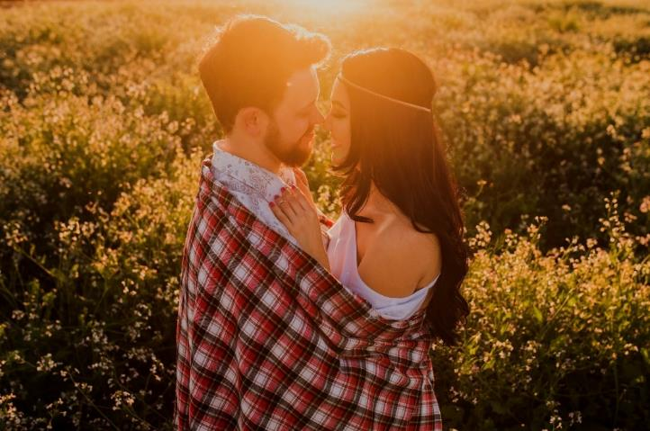

绿杨芳草长亭路。年少抛人容易去。楼头残梦五更钟，花底离情三月雨。无情不似多情苦。一寸还成千万缕。天涯地角有穷时，只有相思无尽处。

Slide 8
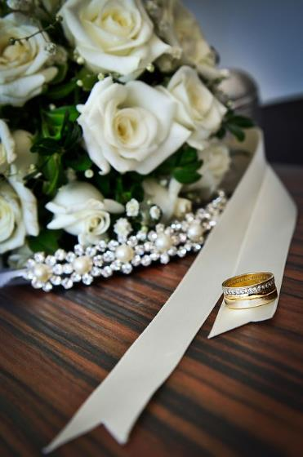
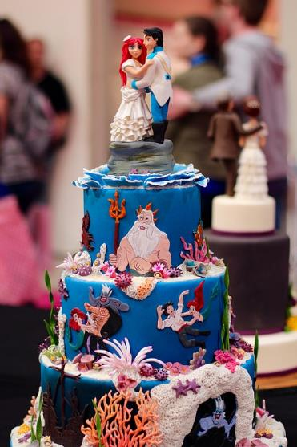
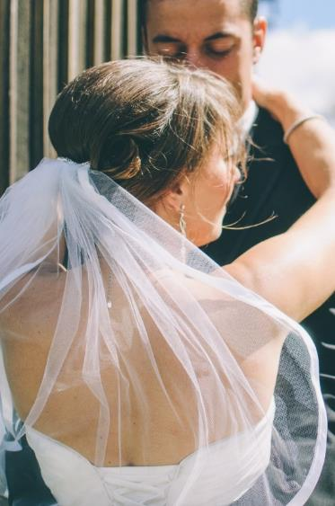
当你开心的时候，我也会不知不觉笑出来；当你难过的时候，我的心比你更痛苦。我很喜欢你笑的样子，真希望自己能够永远珍藏你的笑容。请你嫁给我吧，我一定会让你永远幸福快乐！
调皮的你
You Naughty

Slide 9




这里输入文字标题
Summer a lot of things began to trivial for example, I hide in behind the morning in a hurry to eat text, breathed life back to the story, then through these years of ladder to update a day in and day
out ofupdate a day in and day out of

Slide 10





















年华似水，岁月如歌，时间总在不经意间流逝。回忆亦随着时间的流动慢慢地遗忘了许多，那曾经熟悉的美丽容颜，也变得渐渐模糊。只剩下一些
凋零的记忆，随风飘落成一地的斑驳

Slide 11

Part 02
Don't you be afraid whether old ugly sick I love you

Slide 12
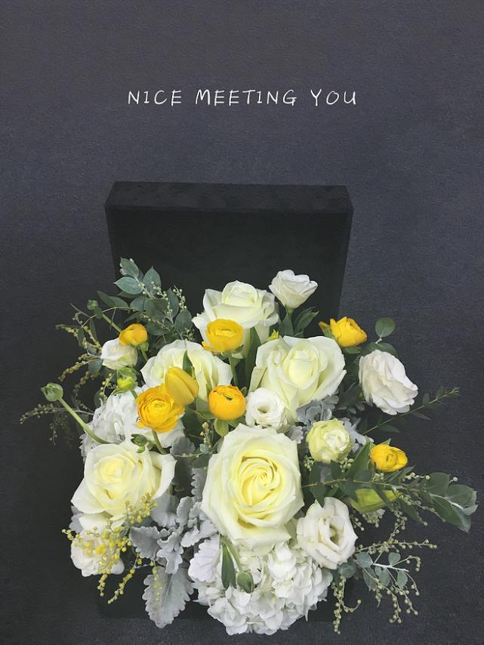

相识
acquaintance
某日
充满阳光的教室
初次相遇
刺眼的阳光温暖了我们
此生注定我们在一起

Slide 13
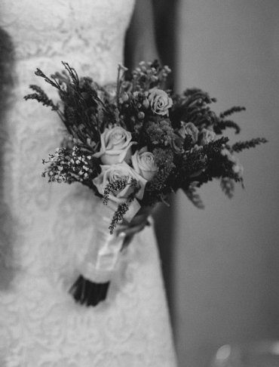

相恋
Fall in love
某日
第一次想你
想着你甜甜的笑容
想着了你
嗯 ，只能想着你

Slide 14

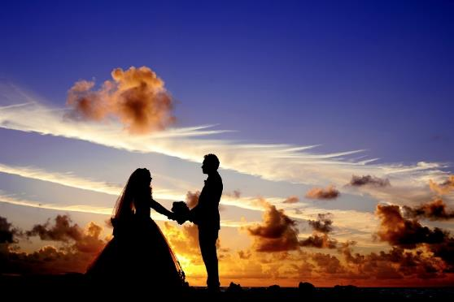
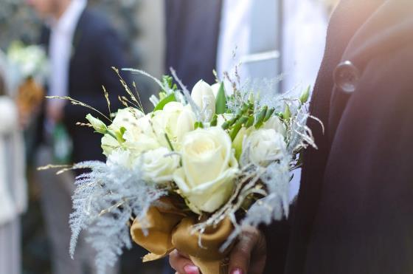
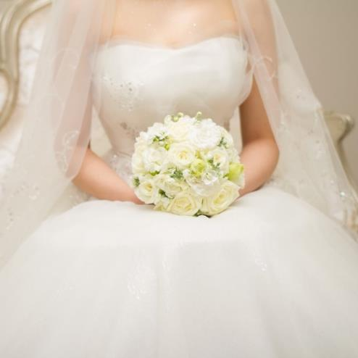
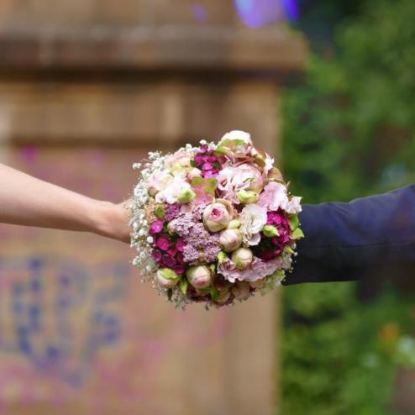

Slide 15
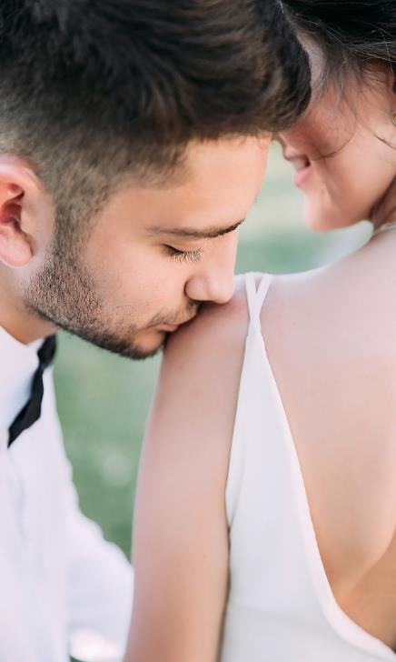
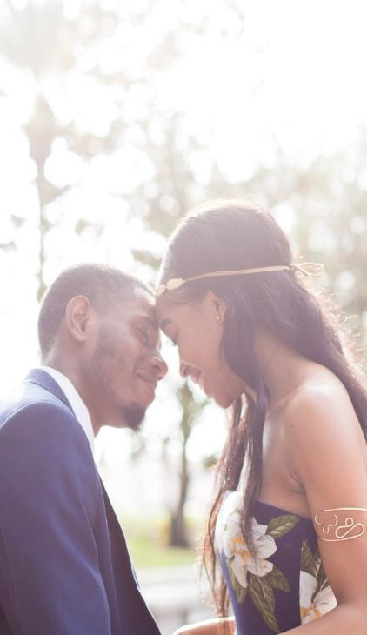
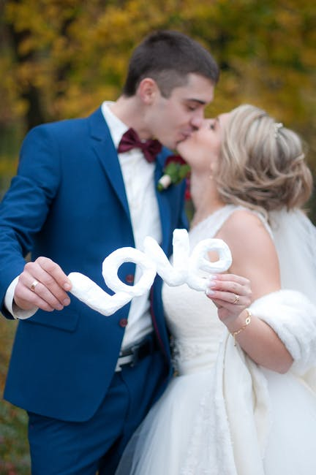

Slide 16
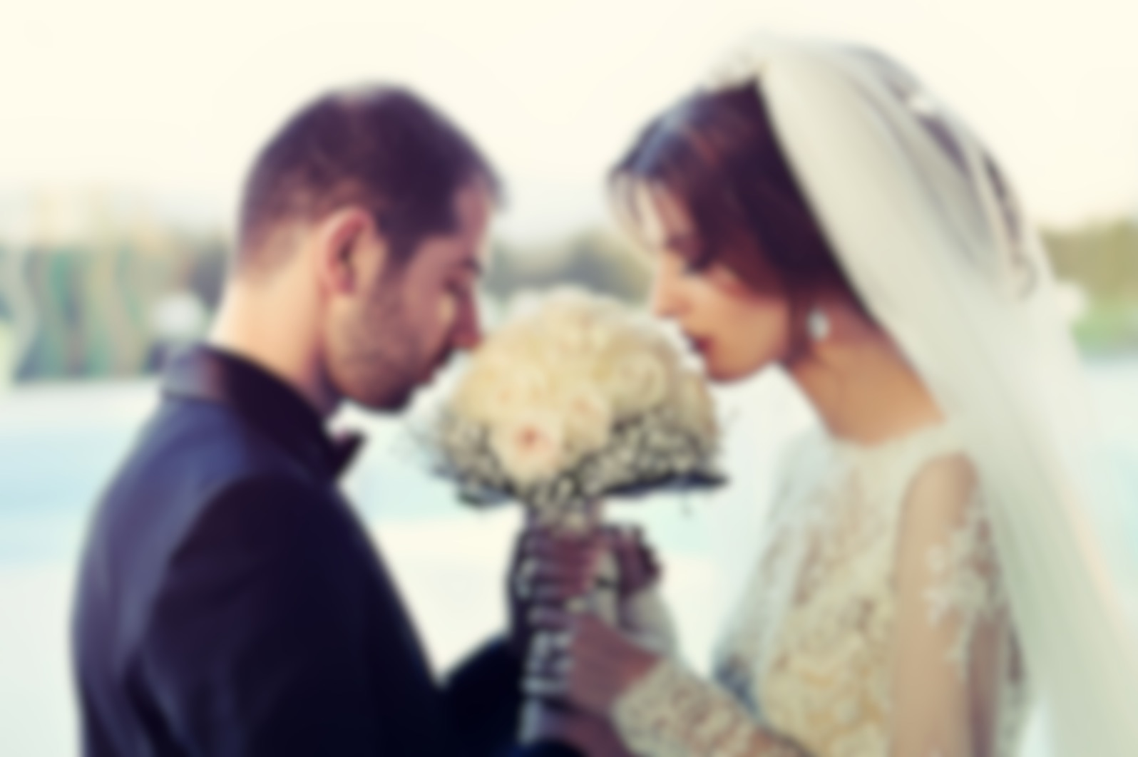
Part 03
Don't you be afraid whether old ugly sick I love you

Slide 17
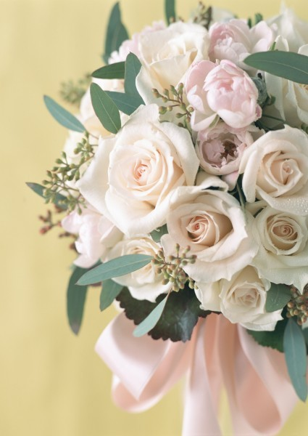
相 守
wedding
望有一天
我能站在教堂的一端
等着你来到我身边
在别人的见证下
许下一生的承诺
我爱你
太阳

Slide 18


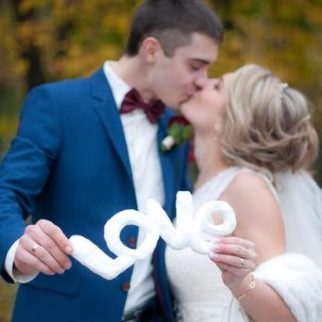
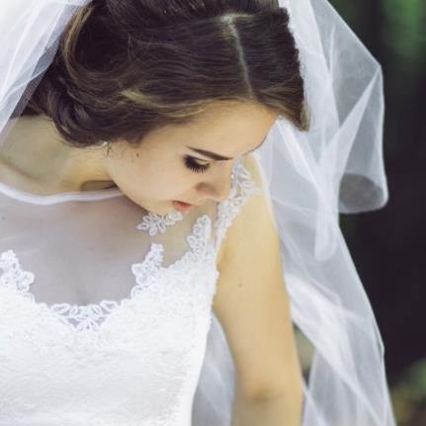
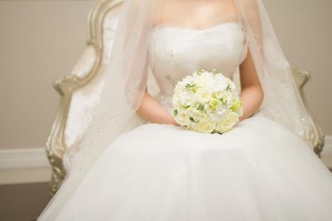
年华似水，岁月如歌，时间总在不经意间流逝。回忆亦随着时间的流动慢慢地遗忘了许多，那曾经熟悉的美丽容颜，也变得渐渐模糊。只剩下一些凋零的记忆，随风飘落成一地的斑驳

Slide 19
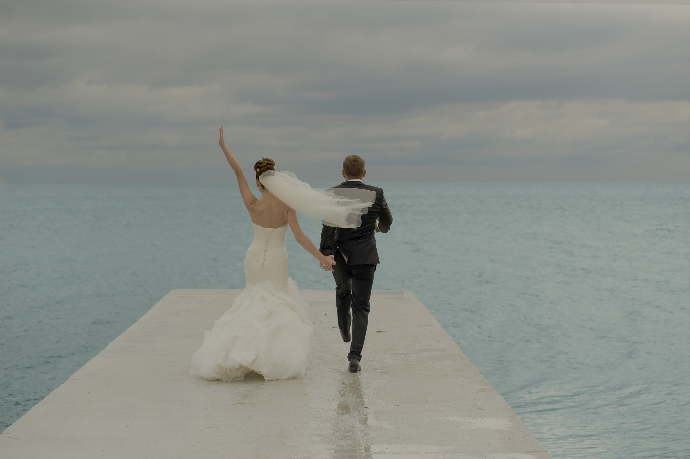
携
手
当你接过那枚戒指，
含泪的目光幸福的注释这我，
我再也抑制不住将你拥入怀中

Slide 20

Part 04
Don't you be afraid whether old ugly sick I love you

Slide 21

今天我们一起步入婚姻的殿堂！开启美好幸福生活!

Slide 22
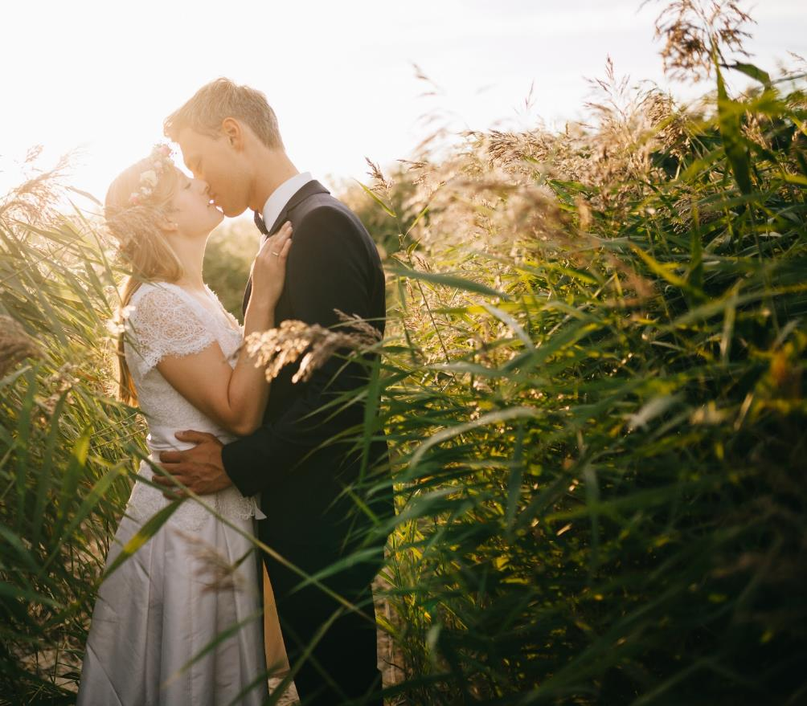
love you
I love you takes one and a half hours to think about what to eat, and only one sandwich at the end.I love you makes wrinkles out of my nose when I look at me like I'm a fool.I love you is the perfume of my clothes after I meet.Before you go to bed, you are the one I most want to talk to.I'm not here because I'm lonely, or because it's New Year's eve, because if you want to spend the rest of your life with someone, you want to start the rest of your life as early as possible."

Slide 23

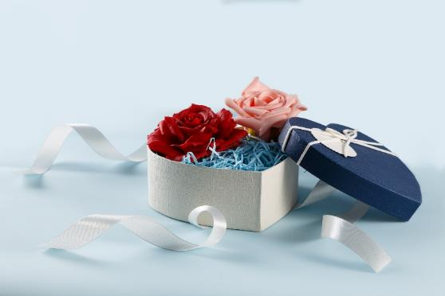
love
you
I love you takes one and a half hours to think about what to eat, and only one sandwich at the end.I love you makes wrinkles out of my nose when I look at me like I'm a fool.I love you is the perfume of my clothes

Slide 24

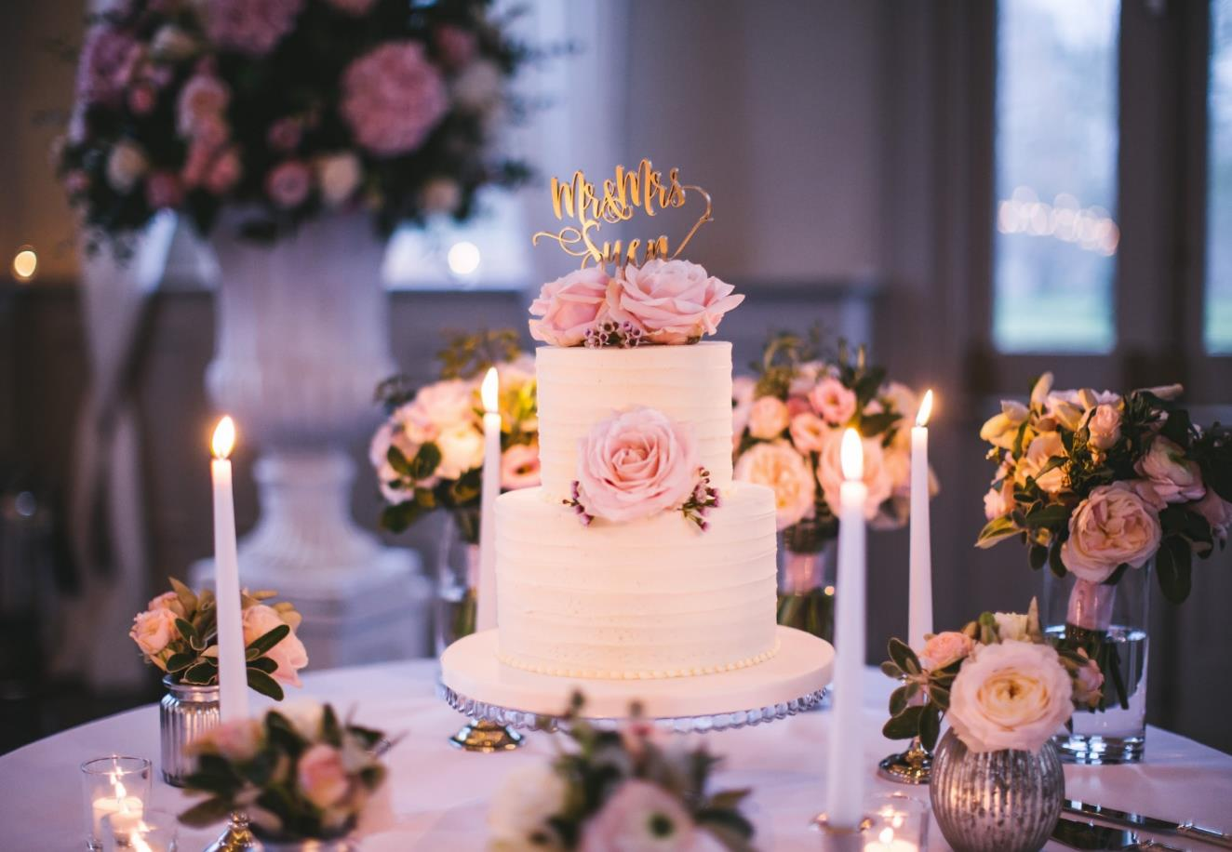
幸福一辈子！
谢谢大家！

Slide 25


Sally & John 诚邀您的光临

