Slide 1


工作总结
商务汇报
述职报告
商务规划
跨越2018
The user can demonstrate on a projector or computer, or print and make it into a film the presentation to be used in a wider field
汇报人：

Slide 2
工作总结
商务汇报
述职报告
商务规划
跨越2018
The user can demonstrate on a projector or computer, or print and make it into a film the presentation to be used in a wider field
汇报人：

Slide 3

明年工作计划
The print the presentation and make it into a film to be used in a wider field. Using PowerPoint,
年度工作概述
工作完成情况
工作存在不足
明年工作计划
print the presentation and make it into a film a wider field
print the presentation and make it into a film a wider field
print the presentation and make it into a film a wider field
print the presentation and make it into a film a wider field

Slide 4
01
年度工作概述
The user can demonstrate on a projector or computer, or print and make it into a film the presentation to be used

Slide 5


明年工作计划
The print the presentation and make it into a film to be used in a wider field. Using PowerPoint,
标题文字添加
标题文字添加
标题文字添加
标题文字添加
The user can demonstrate on a projector or computer, or print the presentation and make it into a film to be used in a wider field. Using PowerPoint,
The user can demonstrate on a projector or computer, or print the presentation and make it into a film to be used in a wider field. Using PowerPoint,
The user can demonstrate on a projector or computer, or print the presentation and make it into a film to be used in a wider field. Using PowerPoint,
The user can demonstrate on a projector or computer, or print the presentation and make it into a film to be used in a wider field. Using PowerPoint,

Slide 6


明年工作计划
The print the presentation and make it into a film to be used in a wider field. Using PowerPoint,
标题文字添加
The user can demonstrate on a projector or computer, or print the presentation and make it into a film to be used in a wider field. Using PowerPoint,
The user can demonstrate on a projector or computer, or print the presentation and make it into a film to be used in a wider field. Using PowerPoint,
The user can demonstrate on a projector or computer, or print the presentation and make it into a film to be used in a wider field. Using PowerPoint,

Slide 7





明年工作计划
The print the presentation and make it into a film to be used in a wider field. Using PowerPoint,
标题文字添加
The user can demonstrate on a projector or computer, or print the presentation and make it into a film to be used in a wider field. Using PowerPoint,
The user can demonstrate on a projector or computer, or print the presentation and make it into a film to be used in a wider field. Using PowerPoint,
文字添加
文字添加
文字添加
文字添加
文字添加
文字添加
文字添加

Slide 8
明年工作计划
The print the presentation and make it into a film to be used in a wider field. Using PowerPoint,
标题文字添加
标题文字添加
The user can demonstrate on a projector or computer, or print the presentation and make it into a film to be used in a wider field. Using PowerPoint,
01
02
The user can demonstrate on a projector or computer, or print the presentation and make it into a film to be used in a wider field. Using PowerPoint,
03
04
标题文字添加
标题文字添加
The user can demonstrate on a projector or computer, or print the presentation and make it into a film to be used in a wider field. Using PowerPoint,
The user can demonstrate on a projector or computer, or print the presentation and make it into a film to be used in a wider field. Using PowerPoint,
Notes:
小芥末素材 rosyhouse.Taobao.com

Slide 9

明年工作计划
The print the presentation and make it into a film to be used in a wider field. Using PowerPoint,
标题文字添加
标题文字添加
The user can demonstrate on a projector or computer, or print the presentation and make it into a film to be used in a wider field. Using PowerPoint,
The user can demonstrate on a projector or computer, or print the presentation and make it into a film to be used in a wider field. Using PowerPoint,
标题文字添加
标题文字添加
The user can demonstrate on a projector or computer, or print the presentation and make it into a film to be used in a wider field. Using PowerPoint,
The user can demonstrate on a projector or computer, or print the presentation and make it into a film to be used in a wider field. Using PowerPoint,

Slide 10
02
工作完成情况
The user can demonstrate on a projector or computer, or print and make it into a film the presentation to be used

Slide 11

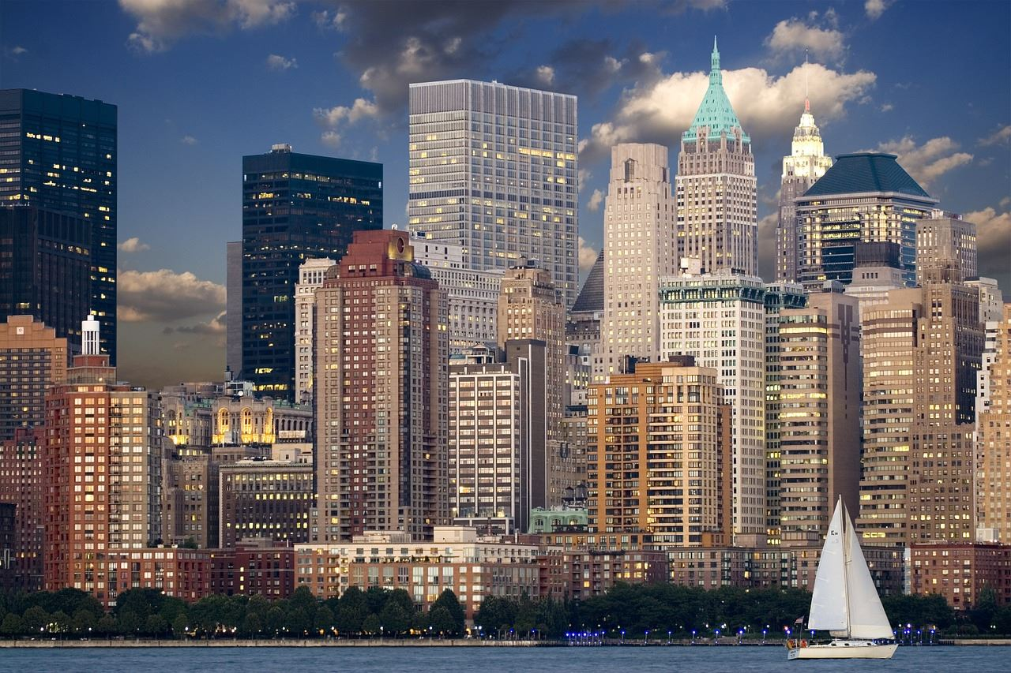
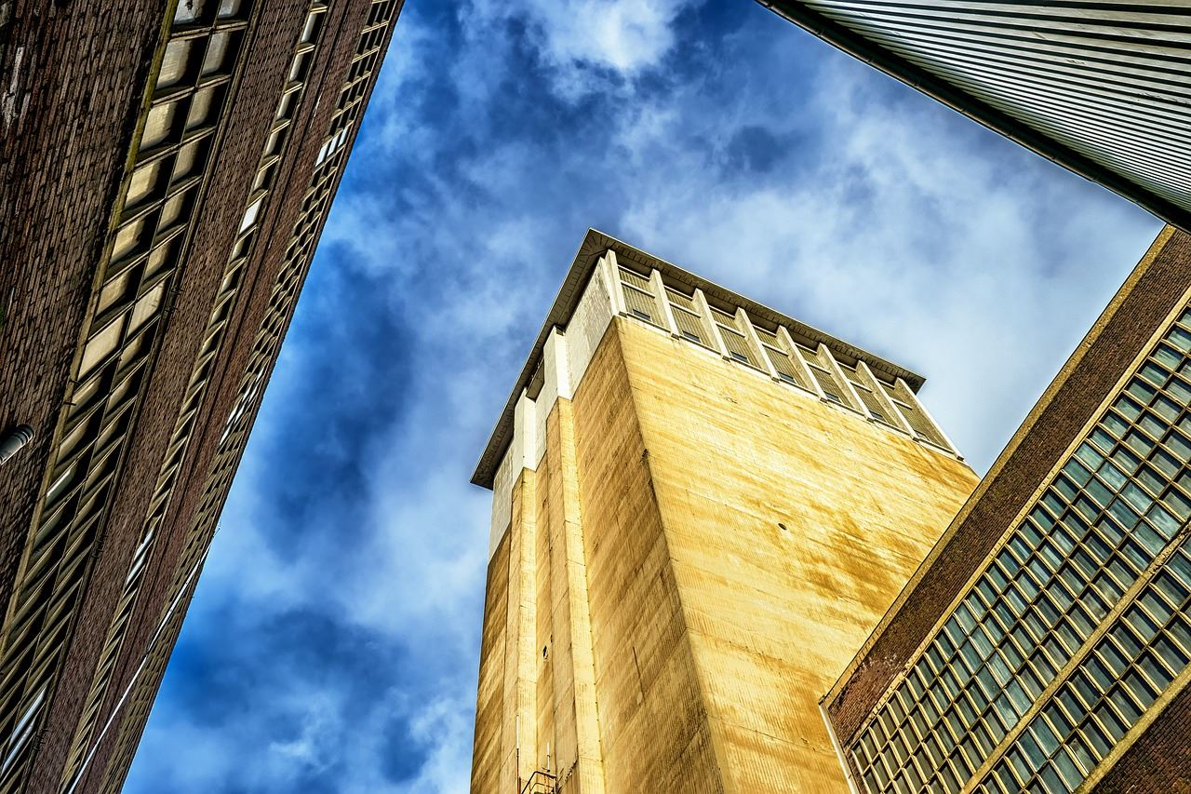

明年工作计划
The print the presentation and make it into a film to be used in a wider field. Using PowerPoint,
标题文字添加
标题文字添加
The user can demonstrate on a projector or computer, or print the presentation and make it into a film to be used in a wider field. Using PowerPoint,
The user can demonstrate on a projector or computer, or print the presentation and make it into a film to be used in a wider field. Using PowerPoint,
标题文字添加
标题文字添加
The user can demonstrate on a projector or computer, or print the presentation and make it into a film to be used in a wider field. Using PowerPoint,
The user can demonstrate on a projector or computer, or print the presentation and make it into a film to be used in a wider field. Using PowerPoint,

Slide 12
明年工作计划
The print the presentation and make it into a film to be used in a wider field. Using PowerPoint,
标题文字添加
标题文字添加
The user can demonstrate on a projector or computer, or print the presentation and make it into a film to be used in a wider field. Using PowerPoint,
标题文本预设02
The user can demonstrate on a projector or computer, or print the presentation and make it into a film to be used in a wider field. Using PowerPoint,
标题文本预设01
标题文本预设03
标题文字添加
标题文本预设04
标题文字添加
The user can demonstrate on a projector or computer, or print the presentation and make it into a film to be used in a wider field. Using PowerPoint,
The user can demonstrate on a projector or computer, or print the presentation and make it into a film to be used in a wider field. Using PowerPoint,

Slide 13
明年工作计划
The print the presentation and make it into a film to be used in a wider field. Using PowerPoint,
标题文字添加
The user can demonstrate on a projector or computer, or print the presentation and make it into a film to be used in a wider field. Using PowerPoint,
标题文字添加
标题文字添加
The user can demonstrate on a projector or computer, or print the presentation and make it into a film to be used in a wider field. Using PowerPoint,
The user can demonstrate on a projector or computer, or print the presentation and make it into a film to be used in a wider field. Using PowerPoint,
标题文字添加
标题文字添加
The user can demonstrate on a projector or computer, or print the presentation and make it into a film to be used in a wider field. Using PowerPoint,
The user can demonstrate on a projector or computer, or print the presentation and make it into a film to be used in a wider field. Using PowerPoint,

Slide 14
明年工作计划
The print the presentation and make it into a film to be used in a wider field. Using PowerPoint,
标题文字添加
标题文字添加
The user can demonstrate on a projector or computer, or print the presentation and make it into a film to be used in a wider field. Using PowerPoint,
The user can demonstrate on a projector or computer, or print the presentation and make it into a film to be used in a wider field. Using PowerPoint,
标题文字添加
标题文字添加
The user can demonstrate on a projector or computer, or print the presentation and make it into a film to be used in a wider field. Using PowerPoint,
The user can demonstrate on a projector or computer, or print the presentation and make it into a film to be used in a wider field. Using PowerPoint,

Slide 15
明年工作计划
The print the presentation and make it into a film to be used in a wider field. Using PowerPoint,
标题文字添加
标题文字添加
标题文字添加
标题文字添加
The user can demonstrate on a projector or computer, or print the presentation and make it into a film to be used in a wider field.
The user can demonstrate on a projector or computer, or print the presentation and make it into a film to be used in a wider field.
The user can demonstrate on a projector or computer, or print the presentation and make it into a film to be used in a wider field.
The user can demonstrate on a projector or computer, or print the presentation and make it into a film to be used in a wider field.
The user can demonstrate on a projector or computer, or print the presentation and make it into a film to be used in a wider field.
The user can demonstrate on a projector or computer, or print the presentation and make it into a film to be used in a wider field.
The user can demonstrate on a projector or computer, or print the presentation and make it into a film to be used in a wider field.
The user can demonstrate on a projector or computer, or print the presentation and make it into a film to be used in a wider field.
标题文字添加
标题文字添加
标题文字添加
标题文字添加
Notes:
小芥末素材 rosyhouse.Taobao.com

Slide 16
03
工作存在不足
The user can demonstrate on a projector or computer, or print and make it into a film the presentation to be used

Slide 17
明年工作计划
The print the presentation and make it into a film to be used in a wider field. Using PowerPoint,
key words
key words
标题文字添加
The user can demonstrate on a projector or computer, or print the presentation and make it into a film to be used in a wider field. Using PowerPoint, The user can demonstrate on a projector or computer, or print the presentation and make it into a film to be used in a wider field. Using PowerPoint, The user can demonstrate on a projector or computer, or print the presentation and make it into a film to be used in a wider field. Using PowerPoint,
key words
key words
标题文字添加
标题文字添加
2018
The user can demonstrate on a projector or computer, or print the presentation and make it into a film to be used in a wider field. Using PowerPoint,
The user can demonstrate on a projector or computer, or print the presentation and make it into a film to be used in a wider field. Using PowerPoint,
REPORT

Slide 18

明年工作计划
The print the presentation and make it into a film to be used in a wider field. Using PowerPoint,
01
标题文字添加
The user can demonstrate on a projector or computer, or print the presentation and make it into a film to be used in a wider field. Using PowerPoint,
02
标题文字添加
The user can demonstrate on a projector or computer, or print the presentation and make it into a film to be used in a wider field. Using PowerPoint,
03
标题文字添加
The user can demonstrate on a projector or computer, or print the presentation and make it into a film to be used in a wider field. Using PowerPoint,
04
标题文字添加
The user can demonstrate on a projector or computer, or print the presentation and make it into a film to be used in a wider field. Using PowerPoint,

Slide 19
明年工作计划
The print the presentation and make it into a film to be used in a wider field. Using PowerPoint,
标题文字添加
标题文字添加
The user can demonstrate on a projector or computer, or print the presentation and make it into a film to be used in a wider field. Using PowerPoint,
The user can demonstrate on a projector or computer, or print the presentation and make it into a film to be used in a wider field. Using PowerPoint,
标题文字添加
标题文字添加
标题文字添加
The user can demonstrate on a projector or computer, or print the presentation and make it into a film to be used in a wider field. Using PowerPoint,
The user can demonstrate on a projector or computer, or print the presentation and make it into a film to be used in a wider field. Using PowerPoint,
The user can demonstrate on a projector or computer, or print the presentation and make it into a film to be used in a wider field. Using PowerPoint,
Notes:
小芥末素材 rosyhouse.Taobao.com

Slide 20
明年工作计划
The print the presentation and make it into a film to be used in a wider field. Using PowerPoint,
标题文字添加
标题文字添加
The user can demonstrate on a projector or computer, or print the presentation and make it into a film to be used in a wider field. Using PowerPoint,
The user can demonstrate on a projector or computer, or print the presentation and make it into a film to be used in a wider field. Using PowerPoint,
标题文字添加
标题文字添加
The user can demonstrate on a projector or computer, or print the presentation and make it into a film to be used in a wider field. Using PowerPoint,
The user can demonstrate on a projector or computer, or print the presentation and make it into a film to be used in a wider field. Using PowerPoint,
标题文字添加
标题文字添加
The user can demonstrate on a projector or computer, or print the presentation and make it into a film to be used in a wider field. Using PowerPoint,
The user can demonstrate on a projector or computer, or print the presentation and make it into a film to be used in a wider field. Using PowerPoint,

Slide 21
04
明年工作计划
The user can demonstrate on a projector or computer, or print and make it into a film the presentation to be used

Slide 22
明年工作计划
The print the presentation and make it into a film to be used in a wider field. Using PowerPoint,
标题文字添加
The user can demonstrate on a projector or computer, or print the presentation and make it into a film to be used in a wider field. Using PowerPoint, The user can demonstrate on a projector or computer, or print the presentation and make it into a film to be used in a wider field. Using PowerPoint, The user can demonstrate on a projector or computer, or print the presentation and make it into a film to be used in a wider field. Using PowerPoint,
标题文字添加
标题文字添加
The user can demonstrate on a projector or computer, or print the presentation and make it into a film to be used in a wider field. Using PowerPoint,
The user can demonstrate on a projector or computer, or print the presentation and make it into a film to be used in a wider field. Using PowerPoint,

Slide 23

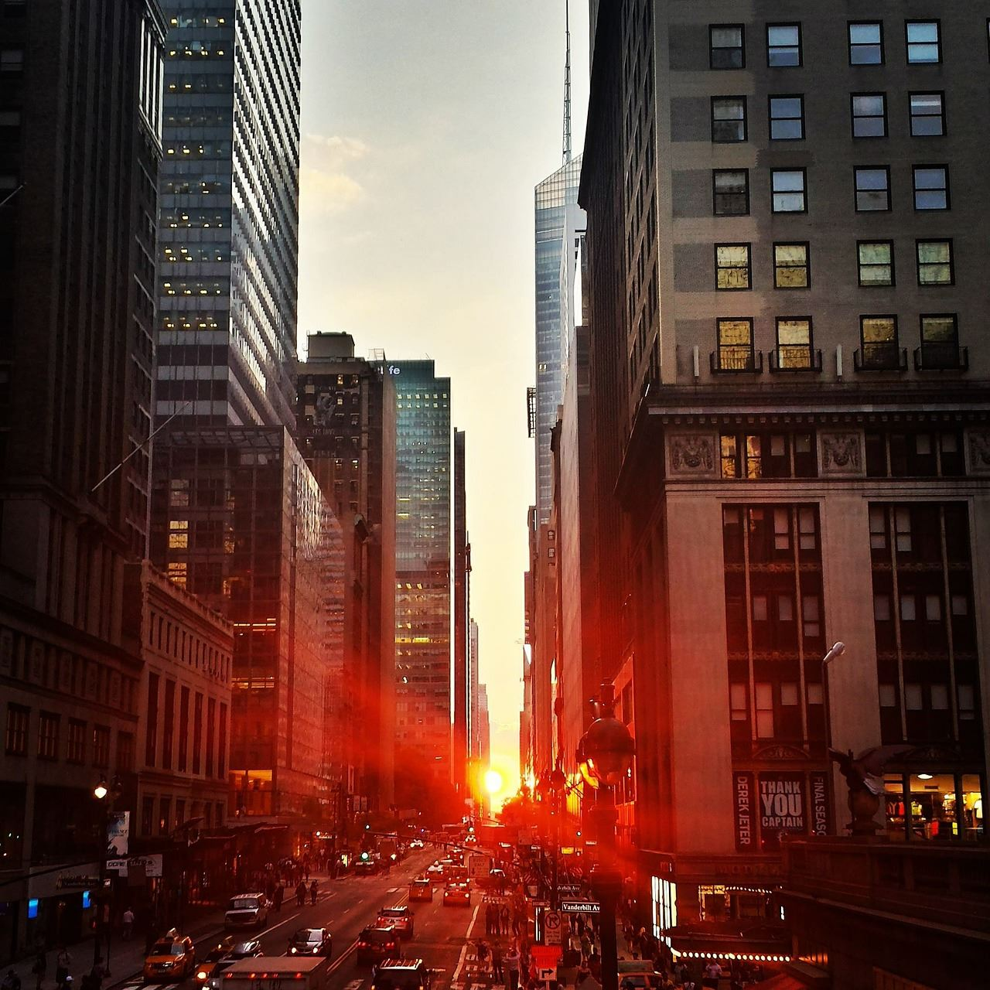

明年工作计划
The print the presentation and make it into a film to be used in a wider field. Using PowerPoint,
1
The user can demonstrate on a projector or computer, or print the presentation and make it into a film to be used in a wider field. Using PowerPoint,
2
The user can demonstrate on a projector or computer, or print the presentation and make it into a film to be used in a wider field. Using PowerPoint,
3
The user can demonstrate on a projector or computer, or print the presentation and make it into a film to be used in a wider field. Using PowerPoint,
The user can demonstrate on a projector or computer, or print the presentation and make it into a film to be used in a wider field. Using PowerPoint,
The user can demonstrate on a projector or computer, or print the presentation and make it into a film to be used in a wider field. Using PowerPoint,
The user can demonstrate on a projector or computer, or print the presentation and make it into a film to be used in a wider field. Using PowerPoint,
4
5
6

Slide 24

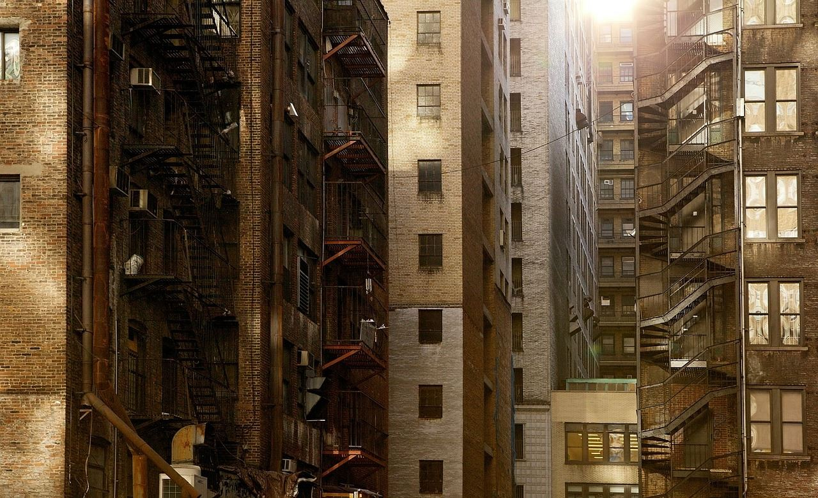

明年工作计划
The print the presentation and make it into a film to be used in a wider field. Using PowerPoint,
标题文字添加
标题文字添加
标题文字添加
标题文字添加
The user can demonstrate on a projector or computer, or print the presentation and make it into a film to be used in a wider field. Using PowerPoint,
The user can demonstrate on a projector or computer, or print the presentation and make it into a film to be used in a wider field. Using PowerPoint,
The user can demonstrate on a projector or computer, or print the presentation and make it into a film to be used in a wider field. Using PowerPoint,
The user can demonstrate on a projector or computer, or print the presentation and make it into a film to be used in a wider field. Using PowerPoint,

Slide 25

明年工作计划
The print the presentation and make it into a film to be used in a wider field. Using PowerPoint,
标题文字添加
The user can demonstrate on a projector or computer, or print the presentation and make it into a film to be used in a wider field
标题文字添加
The user can demonstrate on a projector or computer, or print the presentation and make it into a film to be used in a wider field
标题文字添加
The user can demonstrate on a projector or computer, or print the presentation and make it into a film to be used in a wider field
标题文字添加
The user can demonstrate on a projector or computer, or print the presentation and make it into a film to be used in a wider field
Notes:
小芥末素材 rosyhouse.Taobao.com

Slide 26
工作总结
商务汇报
述职报告
商务规划
谢谢观看
The user can demonstrate on a projector or computer, or print and make it into a film the presentation to be used in a wider field
汇报人：

