Slide 1


毕
业
季
Summer a lot of things began to trivial for example, I hide in behind the morning in a hurry to eat text, breathed life back to the story, then through these years of ladder to update a day in and day out of
MISSING YOU

Slide 2

我们的大家庭

Slide 3





Slide 4




Slide 5






Notes:
小芥末素材 rosyhouse.Taobao.com

Slide 6






Slide 7





Slide 8




Slide 9







Slide 10




Slide 11





Slide 12



Slide 13





Slide 14

Notes:
小芥末素材 rosyhouse.Taobao.com

Slide 15





Slide 16







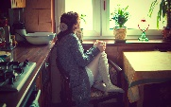



Slide 17
那年夏天，
我们不说再见！

