Slide 1

POWER
欧美风商务计划书
The user can demonstrate on a projector or computer, or print the presentation and make it into a film to be used in a wider field
汇报人：优品PPT

Slide 2
CONTENTS
1
2
3
4
标题添加此处
标题添加此处
标题添加此处
标题添加此处

Slide 3

1
标题添加此处
The user can demonstrate on a projector or computer, or print the presentation and make it into

Slide 4

POWER POINT
标题添加此处
The user can demonstrate on a projector or computer, or print the presentation and make it intoThe user can demonstrate on a projector or computer, or print the presentation and make it intoThe user can demonstrate on a projector or computer, or print the presentation and make it intoThe user can demonstrate on a projector or computer, or print the presentation and make it into

Slide 5
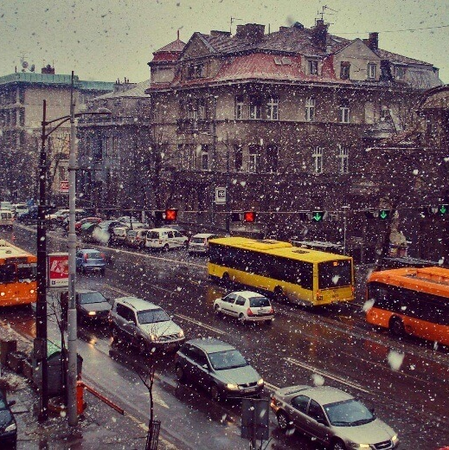


POWER POINT
标题添加此处
标题添加此处
标题添加此处
The user can demonstrate on a projector or computer, or print the presentation and make it into
The user can demonstrate on a projector or computer, or print the presentation and make it into
The user can demonstrate on a projector or computer, or print the presentation and make it into

Slide 6









POWER POINT
标题添加此处
The user can demonstrate on a projector or computer, or print the presentation and make it intoThe user can demonstrate on a projector or computer, or print the presentation and make it intoThe user can demonstrate on a projector or computer, or print the presentation and make it intoThe user can demonstrate on a projector or computer, or print the presentation and make it intoThe user can demonstrate on a projector or computer, or print the presentation and make it intoThe user can demonstrate on a projector or computer, or print the presentation and make it into

Slide 7
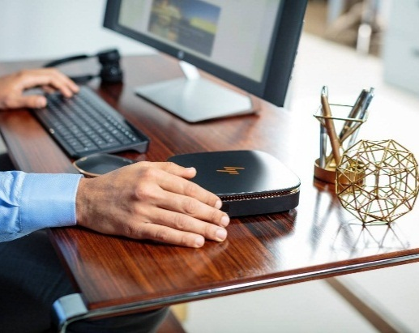

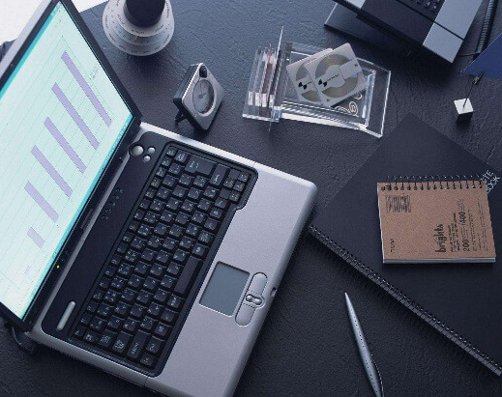
POWER POINT
The user can demonstrate on a projector or computer, or print the presentation and make it intoThe user can demonstrate on a projector or computer, or print the presentation and make it intoThe user can demonstrate on a projector or computer, or print the presentation and make it intoThe user can demonstrate on a projector or computer, or print the presentation and make it intoThe user can demonstrate on a projector or computer, or print the presentation and make it intoThe user can demonstrate
标题添加此处
标题添加此处
标题添加此处
标题添加此处
标题添加此处
标题添加此处
标题添加此处
标题添加此处
标题添加此处

Slide 8

POWER POINT
标题添加此处
The user can demonstrate on a projector or computer, or print the presentation and make it intoThe user can demonstrate on a projector or computer, or print the presentation and make it intoThe user can demonstrate on a projector or computer, or print the presentation and make it into

Slide 9
2
标题添加此处
The user can demonstrate on a projector or computer, or print the presentation and make it into

Slide 10



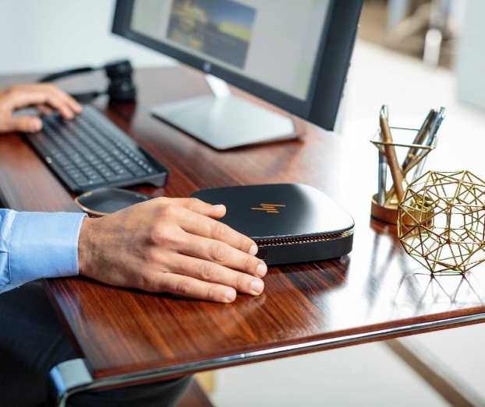
POWER POINT
标题添加此处
标题添加此处
标题添加此处
标题添加此处
The user can demonstrate on a projector or computer, or print the presentation and make it into
The user can demonstrate on a projector or computer, or print the presentation and make it into
The user can demonstrate on a projector or computer, or print the presentation and make it into
The user can demonstrate on a projector or computer, or print the presentation and make it into

Slide 11




POWER POINT
标题
添加
标题
添加
标题
添加
标题
添加
The user can demonstrate on a projector or computer, or print the presentation and make it into
The user can demonstrate on a projector or computer, or print the presentation and make it into
The user can demonstrate on a projector or computer, or print the presentation and make it into
The user can demonstrate on a projector or computer, or print the presentation and make it into

Slide 12

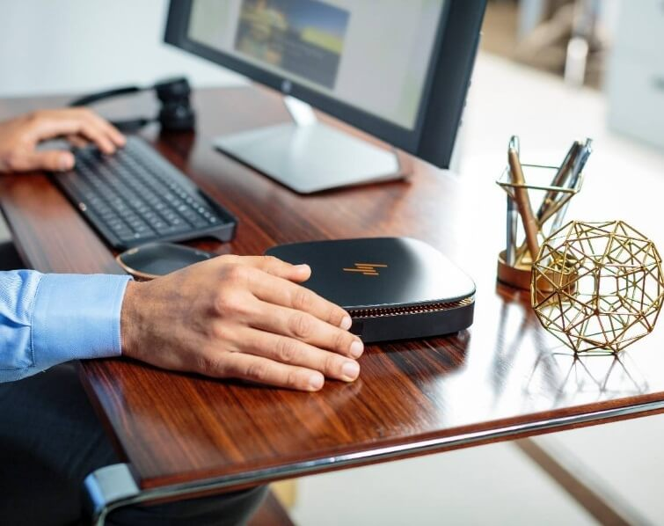



Slide 13

POWER POINT
标题添加此处
The user can demonstrate on a projector or computer, or print the presentation and make it intoThe user can demonstrate on a projector or computer, or print the presentation and make it intoThe user can demonstrate on a projector or computer, or print the presentation and make it intoThe user can demonstrate on a projector or computer, or print the presentation and make it intoThe user can demonstrate on a projector or computer, or print the presentation and make it intoThe user can demonstrate on a projector or computer, or print the presentation and make it into

Slide 14
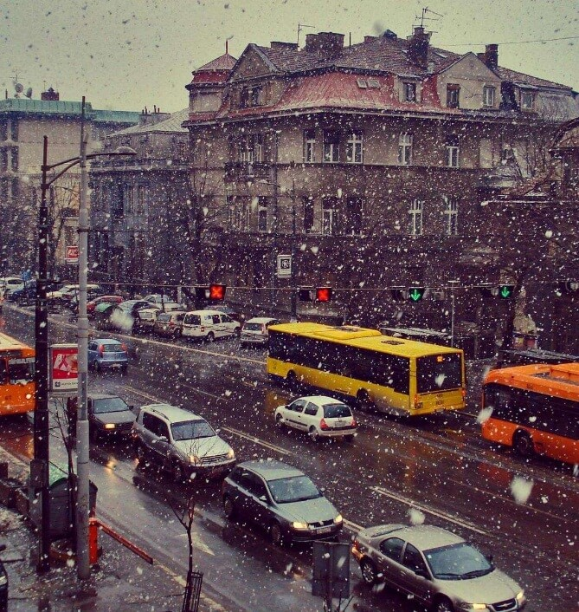


POWER POINT
标题添加此处
The user can demonstrate on a projector or computer, or print the presentation and make it intoThe user can demonstrate on a projector or computer, or print the presentation and make it intoThe user can demonstrate on a projector or computer, or print the presentation and make it intoThe user can demonstrate on a projector or computer, or print the presentation and make it intoThe user can demonstrate on a projector or computer, or print the presentation and make it intoThe user can demonstrate on a projector or computer, or print the presentation and make it into

Slide 15
3
标题添加此处
The user can demonstrate on a projector or computer, or print the presentation and make it into

Slide 16
POWER POINT
此部分内容作为文字排版占位显示
标题添加此处
标题添加此处
The user can demonstrate on a projector or computer, or print the presentation and make it into
标题文本预设
The user can demonstrate on a projector or computer, or print the presentation and make it into

Slide 17
POWER POINT
The user can demonstrate on a projector or computer, or print the presentation and make it into
标题
添加此处
The user can demonstrate on a projector or computer, or print the presentation and make it into
The user can demonstrate on a projector or computer, or print the presentation and make it into

Slide 18









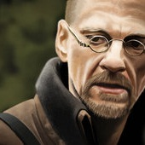

Slide 19
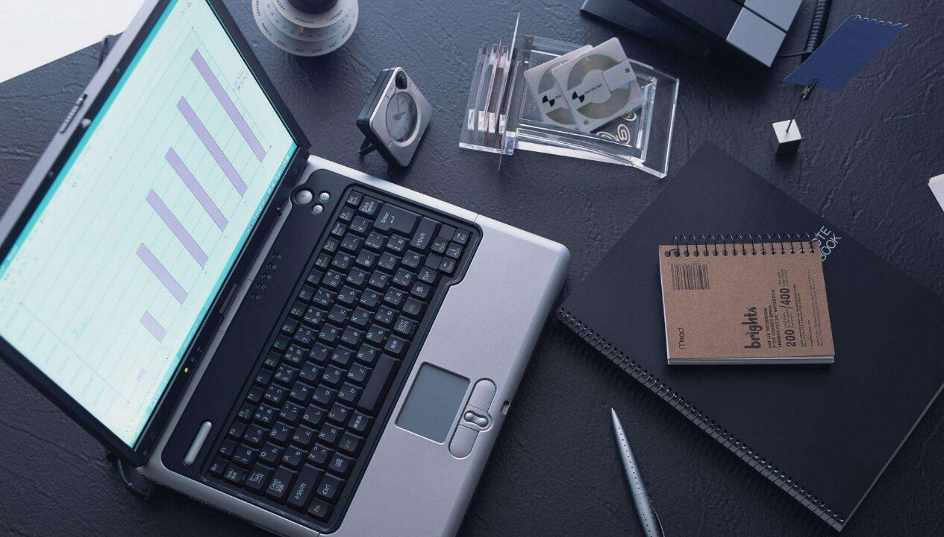
POWER POINT
标题添加此处
The user can demonstrate on a projector or computer, or print the presentation and make it intoThe user can demonstrate on a projector or computer, or print the presentation and make it intoThe user can demonstrate on a projector or computer, or print the presentation and make it intoThe user can demonstrate on a projector or computer, or print the presentation and make it intoThe user can demonstrate on a projector or computer, or print the presentation and make it intoThe user can demonstrate on a projector or computer, or print the presentation and make it into

Slide 20
4
标题添加此处
The user can demonstrate on a projector or computer, or print the presentation and make it into

Slide 21
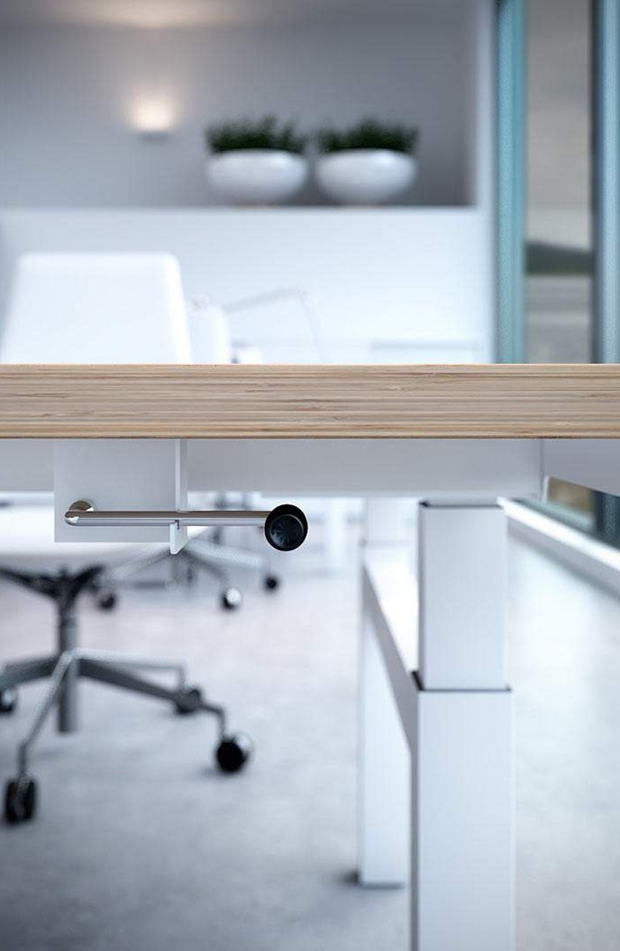
POWER POINT
标题添加此处
The user can demonstrate on a projector or computer, or print the presentation and make it into
标题添加此处
The user can demonstrate on a projector or computer, or print the presentation and make it into
标题添加此处
The user can demonstrate on a projector or computer, or print the presentation and make it into
标题添加此处
The user can demonstrate on a projector or computer, or print the presentation and make it into

Slide 22

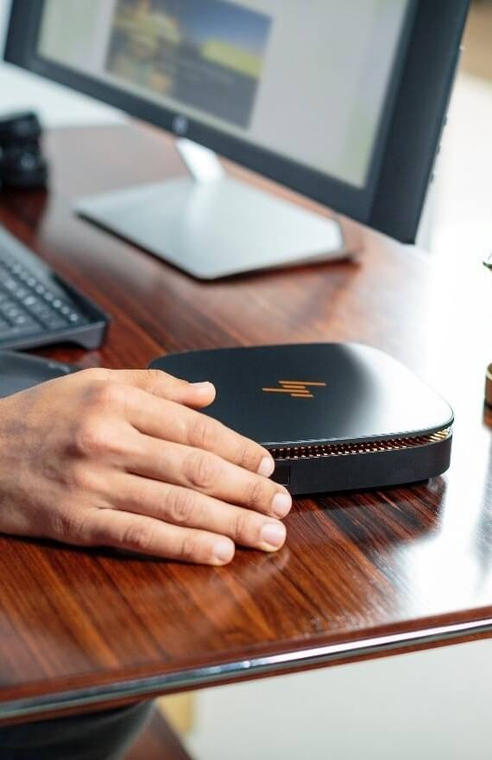
标题添加此处
The user can demonstrate on a projector or computer, or print the presentation and make it into
标题添加此处
The user can demonstrate on a projector or computer, or print the presentation and make it into
标题添加此处
The user can demonstrate on a projector or computer, or print the presentation and make it into

Slide 23
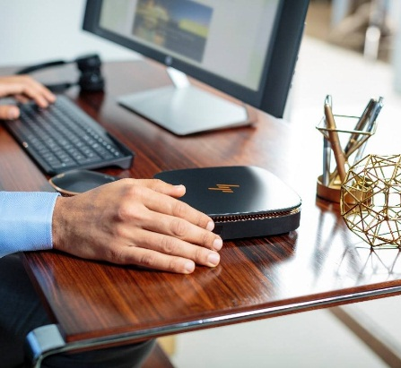



POWER POINT
标题添加此处
标题添加此处
The user can demonstrate on a projector or computer, or print the presentation and make it into
The user can demonstrate on a projector or computer, or print the presentation and make it into
标题添加此处
标题添加此处
The user can demonstrate on a projector or computer, or print the presentation and make it into
The user can demonstrate on a projector or computer, or print the presentation and make it into

Slide 24

标题添加此处
The user can demonstrate on a projector or computer, or print the presentation and make it intoThe user can demonstrate on a projector or computer, or print the presentation and make it intoThe user can demonstrate on a projector or computer, or print the presentation and make it intoThe user can demonstrate on a projector or computer, or print the presentation and make it intoThe user can demonstrate on a projector or computer, or print the presentation and make it intoThe user can demonstrate on a projector or computer, or print the presentation and make it into

Slide 25
POWER
感谢您的观看
The user can demonstrate on a projector or computer, or print the presentation and make it into a film to be used in a wider field
汇报人：菲迩设计

Slide 26
更多精品PPT资源尽在—优品PPT！
www.ypppt.com
PPT模板下载：www.ypppt.com/moban/ 节日PPT模板：www.ypppt.com/jieri/
PPT背景图片：www.ypppt.com/beijing/ PPT图表下载：www.ypppt.com/tubiao/
PPT素材下载： www.ypppt.com/sucai/ PPT教程下载：www.ypppt.com/jiaocheng/
字体下载：http://www.ypppt.com/ziti/ 绘本故事PPT：http://www.ypppt.com/gushi/
Notes:
模板来自于 http://www.ypppt.com

