Slide 1

2019
蓝色2.5D工作总结PPT模板
However, the film and TV series often appear the wrong lens, "dear" this drama is no exception, because the shooting time is in the summer, but the time is in the winter, so inevitably encounter passers-by wear short sleeves, actors wear down jackets.
汇报人：阿豆

Slide 2
目录
请输入标题
01
However, the film and TV series often appear the wrong lens, "dear" this drama is no exception, because the
请输入标题
02
However, the film and TV series often appear the wrong lens, "dear" this drama is no exception, because the
请输入标题
03
However, the film and TV series often appear the wrong lens, "dear" this drama is no exception, because the
请输入标题
04
However, the film and TV series often appear the wrong lens, "dear" this drama is no exception, because the

Slide 3
01
请输入标题
However, the film and TV series often appear the wrong lens, "dear" this drama is no exception, because the

Slide 4

请输入标题
However, the film and TV series often appear the wrong lens, "dear" this drama is no exception, because the shooting time is in the summer, but the time is in the winter, so inevitably encounter passers-by wear short sleeves, actors wear down jackets.
请输入标题
However, the film and TV series often appear the wrong lens, "dear" this drama is no exception, because the shooting time is in the summer, but the time is in the winter, so inevitably encounter passers-by wear short sleeves, actors wear down jackets.

Slide 5
请输入标题
However, the film and TV series often appear the wrong lens, "dear" this drama is no exception, because the shooting time is in the summer, but the time is in the winter, so inevitably encounter passers-by wear short sleeves, actors wear down jackets.
请输入标题
However, the film and TV series often appear the wrong lens, "dear" this drama is no exception, because the shooting time is in the summer, but the time is in the winter, so inevitably encounter passers-by wear short sleeves, actors wear down jackets.

Slide 6

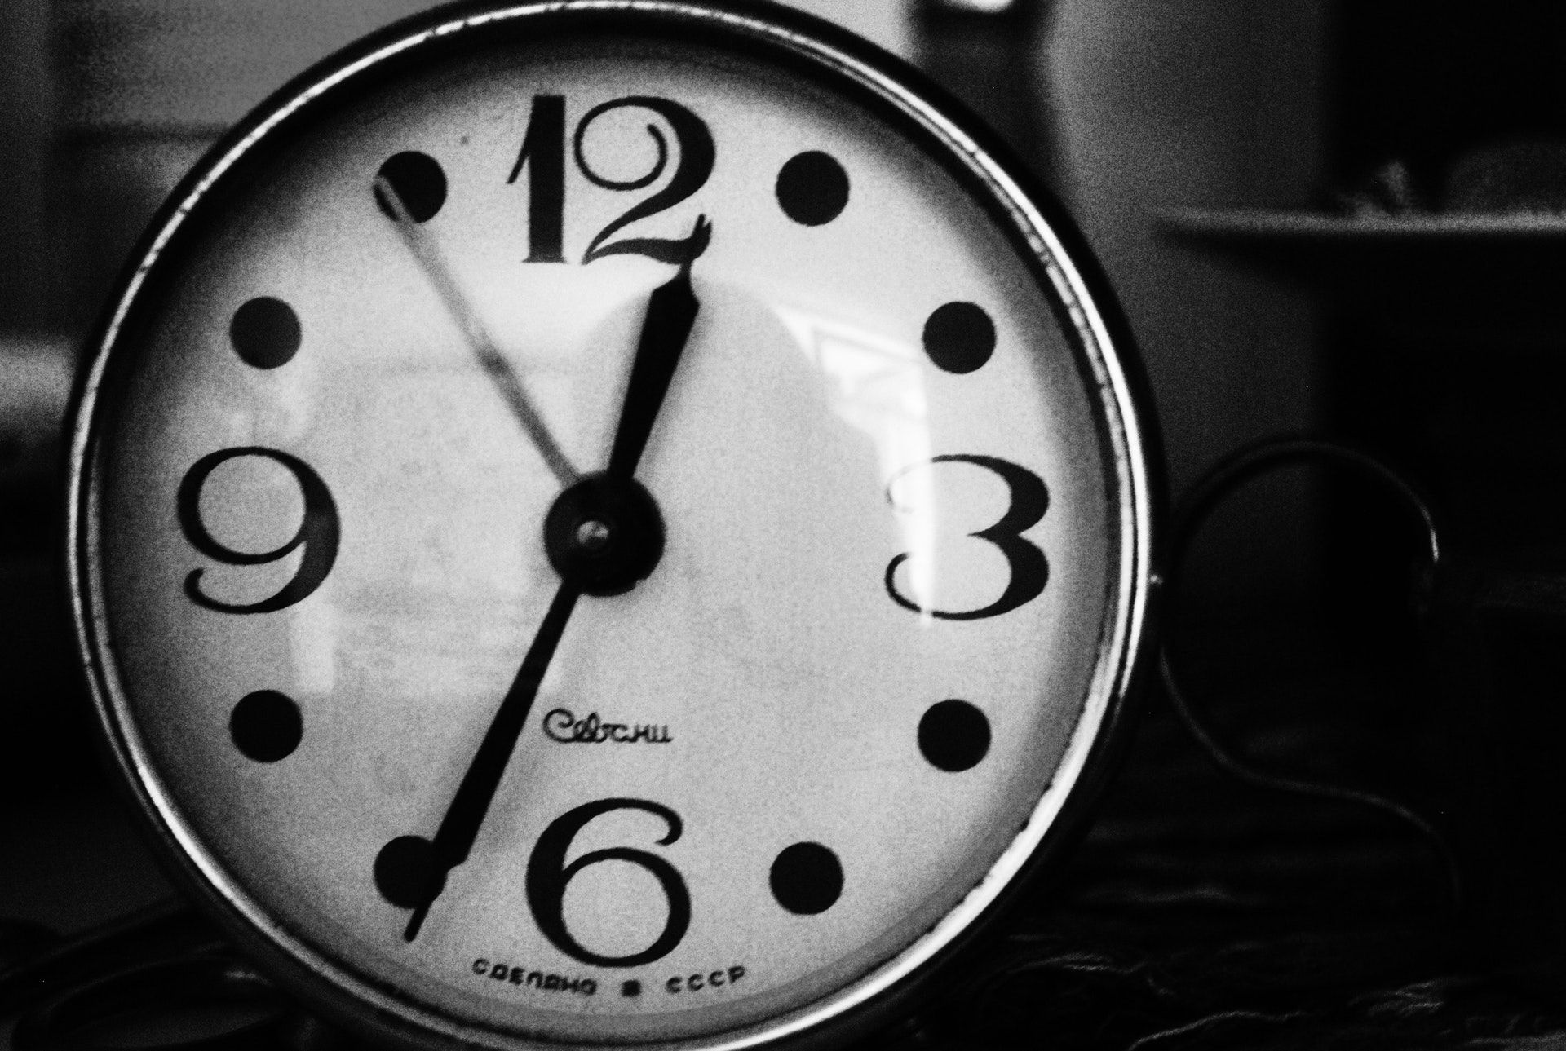
请输入标题
请输入标题
However, the film and TV series often appear the wrong lens, "dear" this drama is no exception, because the shooting time is in the summer, but the time is in the winter, so inevitably
However, the film and TV series often appear the wrong lens, "dear" this drama is no exception, because the shooting time is in the summer, but the time is in the winter, so inevitably

Slide 7
请输入标题
请输入标题
请输入标题
However, the film and TV series often appear the wrong lens, "dear" this drama is no exception, because the shooting time is in the summer, but the time is in the winter, so inevitably
However, the film and TV series often appear the wrong lens, "dear" this drama is no exception, because the shooting time is in the summer, but the time is in the winter, so inevitably
However, the film and TV series often appear the wrong lens, "dear" this drama is no exception, because the shooting time is in the summer, but the time is in the winter, so inevitably

Slide 8
02
请输入标题
However, the film and TV series often appear the wrong lens, "dear" this drama is no exception, because the

Slide 9
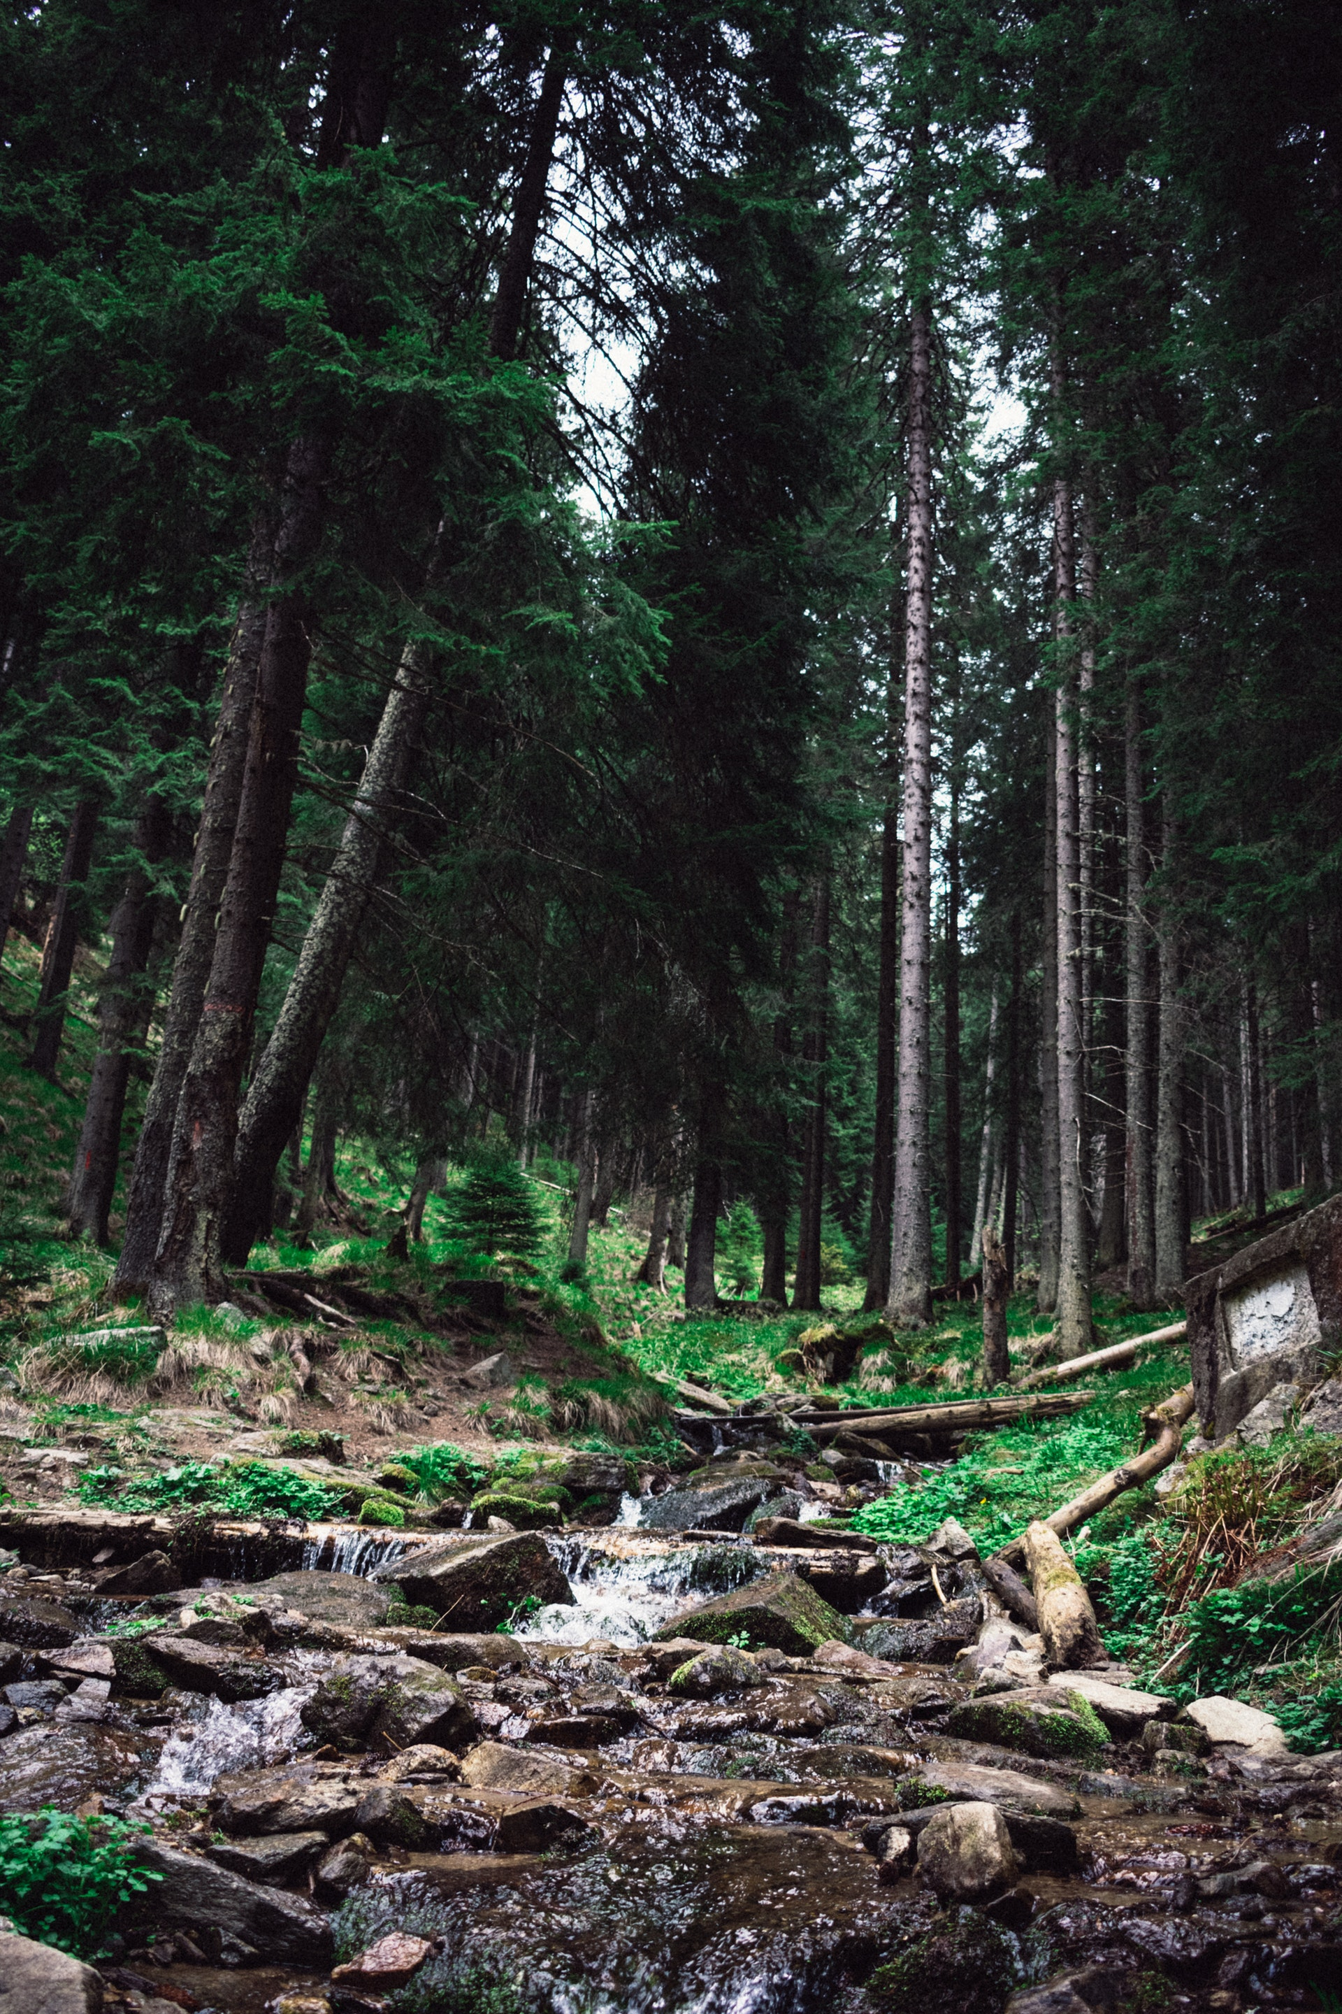
请输入标题
However, the film and TV series often appear the wrong lens, "dear" this drama is no exception, because the shooting time is in the summer, but the time is in the winter, so inevitablyHowever, the film and TV series often appear the wrong lens, "dear" this drama is no exception, because the shooting time is in the summer, but the time is in the winter, so inevitably

Slide 10
请输入标题
However, the film and TV series often appear the wrong lens, "dear" this drama is no exception, because the shooting time is in the summer, but the time is in the winter, so inevitably
请输入标题
However, the film and TV series often appear the wrong lens, "dear" this drama is no exception, because the shooting time is in the summer, but the time is in the winter, so inevitably

Slide 11

请输入标题
请输入标题
However, the film and TV series often appear the wrong lens, "dear" this drama is no exception, because the shooting time is in the summer, but the time is in the winter, so inevitably
However, the film and TV series often appear the wrong lens, "dear" this drama is no exception, because the shooting time is in the summer, but the time is in the winter, so inevitably

Slide 12
请输入标题
However, the film and TV series often appear the wrong lens, "dear" this drama is no exception, because the shooting time is in the summer, but the time is in the winter, so inevitably
请输入标题
However, the film and TV series often appear the wrong lens, "dear" this drama is no exception, because the shooting time is in the summer, but the time is in the winter, so inevitably

Slide 13
03
请输入标题
However, the film and TV series often appear the wrong lens, "dear" this drama is no exception, because the

Slide 14
01
02
03
请输入标题
请输入标题
请输入标题
However, the film and TV series often appear the wrong lens, "dear" this drama is no exception, because the
However, the film and TV series often appear the wrong lens, "dear" this drama is no exception, because the
However, the film and TV series often appear the wrong lens, "dear" this drama is no exception, because the

Slide 15
请输入标题
However, the film and TV series often appear the wrong lens, "dear" this drama is no exception, because the shooting time is in the summer, but the time is in the winter, so inevitablyHowever, the film and TV series often appear the wrong lens, "dear" this drama is no exception, because the shooting time is in the summer, but the time is in the winter, so inevitably

Slide 16
58%
TEXT HERE
请输入标题
Supporting text here
However, the film and TV series often appear the wrong lens, "dear" this drama is no exception, because the shooting time is in the summer, but the time is in the winter, so inevitablyHowever, the film and TV series often appear the wrong lens, "dear" this drama is no exception, because the shooting time is in the summer, but the time is in the winter, so inevitably

Slide 17
请输入标题
However, the film and TV series often appear the wrong lens, "dear" this drama is no exception, because the shooting time is in the summer, but the time is in the winter, so inevitablyHowever, the film and TV series often appear the wrong lens, "dear" this drama is no exception, because the shooting time is in the summer, but the time is in the winter, so inevitably

Slide 18
04
请输入标题
However, the film and TV series often appear the wrong lens, "dear" this drama is no exception, because the

Slide 19
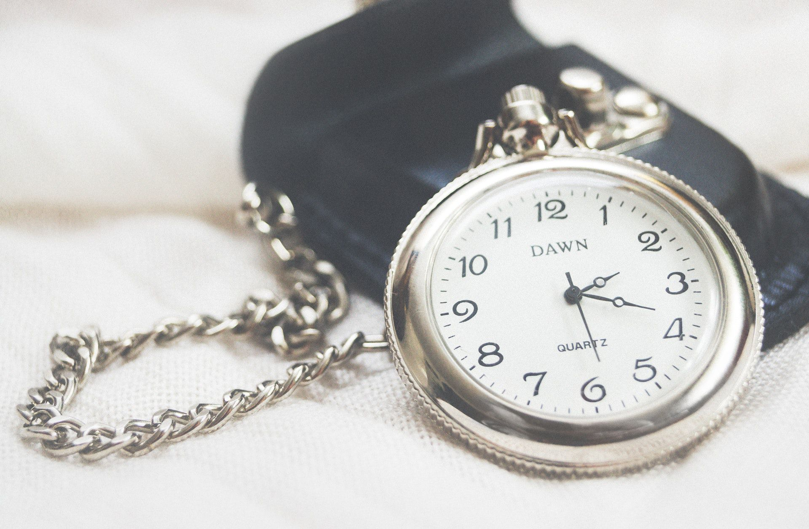
请输入标题
请输入标题
However, the film and TV series often appear the wrong lens, "dear" this drama is no exception, because the shooting time is in the summer, but the time is in the winter, so inevitably
However, the film and TV series often appear the wrong lens, "dear" this drama is no exception, because the shooting time is in the summer, but the time is in the winter, so inevitably

Slide 20
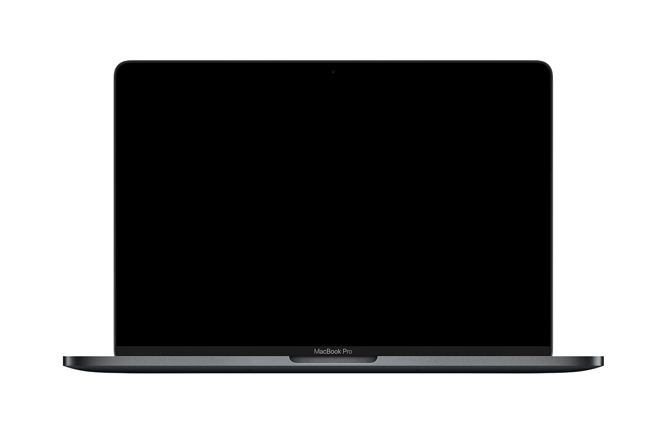
请输入标题
However, the film and TV series often appear the wrong lens, "dear" this drama is no exception, because the shooting time is in the summer, but the time is in the winter, so inevitablyHowever, the film and TV series often appear the wrong lens, "dear" this drama is no exception, because the shooting time is in the summer, but the time is in the winter, so inevitably

Slide 21
However, the film and TV series often appear the wrong lens, "dear" this drama is no
However, the film and TV series often appear the wrong lens, "dear" this drama is no
2020
2018
2019
However, the film and TV series often appear the wrong lens, "dear" this drama is no
2017
However, the film and TV series often appear the wrong lens, "dear" this drama is no

Slide 22
2019
谢谢观看
However, the film and TV series often appear the wrong lens, "dear" this drama is no exception, because the shooting time is in the summer, but the time is in the winter, so inevitably encounter passers-by wear short sleeves, actors wear down jackets.
汇报人：阿豆

Slide 23

微信公众号：帅气的小阿豆
领取优质模板，每天更新
各种风格素材，每天更新

Slide 24
阿豆PPT 作品
51PPT模板网 www.51pptmoban.com 授权发布

