Slide 1

2019.09.14
Reporting on activities report
Life if only such as first see, what autumn wind sad painting fan. It is easy to change, but it is easy to change.. Life if only such as first see, what autumn wind sad painting fan. It is easy to change, but it is easy to change.

Slide 2


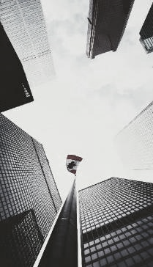
年度工作概述
工作成果展示
未来发展规划

Slide 3

2
0
年度工作概述

Slide 4

Please enter title
Life if only such as first see, what autumn wind sapainting fan. It is easy to change, but it is easy to change.. Life if only such as first see, what autumn wind sad painting fan. It is easy to change, but it is easy to change.
Please enter title
Life if only such as first see, what autumn wind sapainting fan. It is easy to change, but it is easy to change.. Life if only such as first see, what autumn wind sad painting fan. It is easy to change, but it is easy to change.

Slide 5
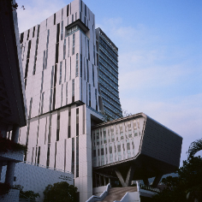
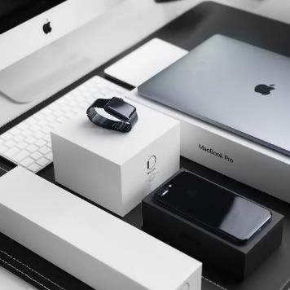
2
0
Please enter title
Life if only such as first see, what autumn wind sapainting fan. It is easy to change, but it is easy to change.. Life if only such as first see, what autumn wind sad painting fan. It is easy to change, but it is easy to change.
Please enter title
Life if only such as first see, what autumn wind sapainting fan. It is easy to change, but it is easy to change.. Life if only such as first see, what autumn wind sad painting fan. It is easy to change, but it is easy to change.

Slide 6
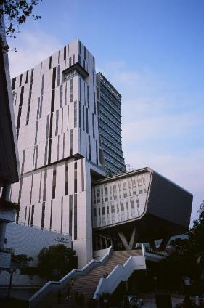
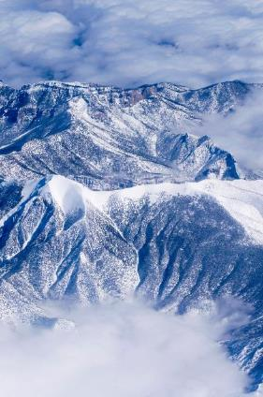

Please enter title
Please enter title
Please enter title
Life if only such as first see, what autumn wind sapainting fan. It is easy
Life if only such as first see, what autumn wind sapainting fan. It is easy
Life if only such as first see, what autumn wind sapainting fan. It is easy

Slide 7
2
0
工作完成情况

Slide 8

Please enter title
Please enter title
Life if only such as first see, what autumn wind sapainting fan. It is easy to change, but it is easy to change.. Life if only such as first see, what autumn wind sad painting fan. It is easy to change, but it is easy to change.
Life if only such as first see, what autumn wind sapainting fan. It is easy to change, but it is easy to change.. Life if only such as first see, what autumn wind sad painting fan. It is easy to change, but it is easy to change.

Slide 9

Please enter title
Life if only such as first see, what autumn wind sapainting fan. It is easy to change, but it is easy to change.. Life if only such as first see, what autumn wind sad painting fan. It is easy to change, but it is easy to change.
Please enter title
Life if only such as first see, what autumn wind sapainting fan. It is easy to change, but it is easy to change.. Life if only such as first see, what autumn wind sad painting fan. It is easy to change, but it is easy to change.

Slide 10

Please enter title
Life if only such as first see, what autumn wind sapainting fan. It is easy
Please enter title
Life if only such as first see, what autumn wind sapainting fan. It is easy
Please enter title
Please enter title
Life if only such as first see, what autumn wind sapainting fan. It is easy
Life if only such as first see, what autumn wind sapainting fan. It is easy

Slide 11
2
0
工作存在不足

Slide 12
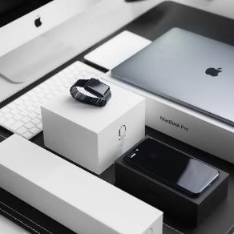
Please enter title
Life if only such as first see, what autumn wind sapainting fan. It is easy
Please enter title
Please enter title
Life if only such as first see, what autumn wind sapainting fan. It is easy
Life if only such as first see, what autumn wind sapainting fan. It is easy
Please enter title
Life if only such as first see, what autumn wind sapainting fan. It is easy

Slide 13
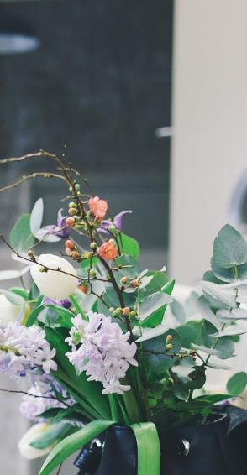
Please enter title
Life if only such as first see, what autumn wind sapainting fan. It is easy to change, but it is easy to change.. Life if only such as first see, what autumn wind sad painting fan. It is easy to change, but it is easy to change.
70%
75%

Slide 14

Please enter title
Life if only such as first see, what autumn wind sapainting fan. It is easy
Please enter title
Please enter title
Life if only such as first see, what autumn wind sapainting fan. It is easy to change, but it is easy to change.. Life if only such as first see, what autumn wind sad painting fan. It is easy to change, but it is easy to change.
Life if only such as first see, what autumn wind sapainting fan. It is easy to change, but it is easy to change.. Life if only such as first see, what autumn wind sad painting fan. It is easy to change, but it is easy to change.

Slide 15
2
0
未来发展计划

Slide 16
Please enter title
Please enter title
Life if only such as first see, what autumn wind sapainting fan. It is easy to change, but it is easy to change.. Life if only such as first see, what autumn wind sad painting fan. It is easy to change, but it is easy to change.
Life if only such as first see, what autumn wind sapainting fan. It is easy to change, but it is easy to change.. Life if only such as first see, what autumn wind sad painting fan. It is easy to change, but it is easy to change.

Slide 17

Please enter title
Life if only such as first see, what autumn wind sapainting fan. It is easy to change, but it is easy to change.. Life if only such as first see, what autumn wind sad painting fan. It is easy to change, but it is easy to change.
Please enter title
Life if only such as first see, what autumn wind sapainting fan. It is easy to change, but it is easy to change.. Life if only such as first see, what autumn wind sad painting fan. It is easy to change, but it is easy to change.

Slide 18

Please enter title
Please enter title
Life if only such as first see, what autumn wind sapainting fan. It is easy to change, but it is easy to change.. Life if only such as first see, what autumn wind sad painting fan. It is easy to change, but it is easy to change.
Life if only such as first see, what autumn wind sapainting fan. It is easy to change, but it is easy to change.. Life if only such as first see, what autumn wind sad painting fan. It is easy to change, but it is easy to change.

Slide 19
2019.09.14
Thanks for watching
Life if only such as first see, what autumn wind sad painting fan. It is easy to change, but it is easy to change.. Life if only such as first see,

