Slide 1


面试流程英文介绍ppt模板

Slide 2
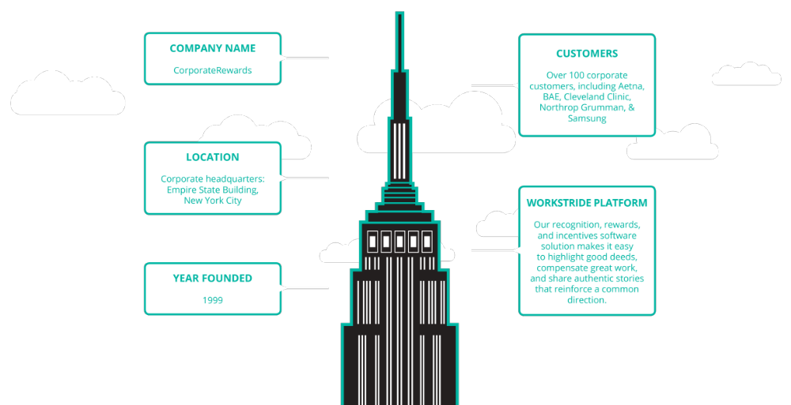
About Us

Slide 3




Our Clients

Slide 4



Slide 5
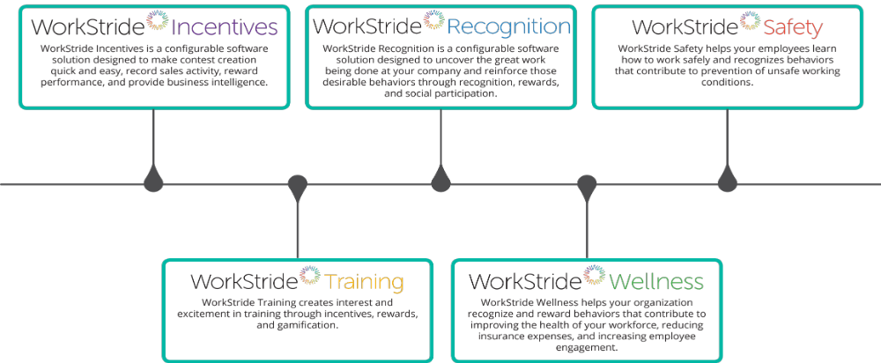
Our Products

Slide 6
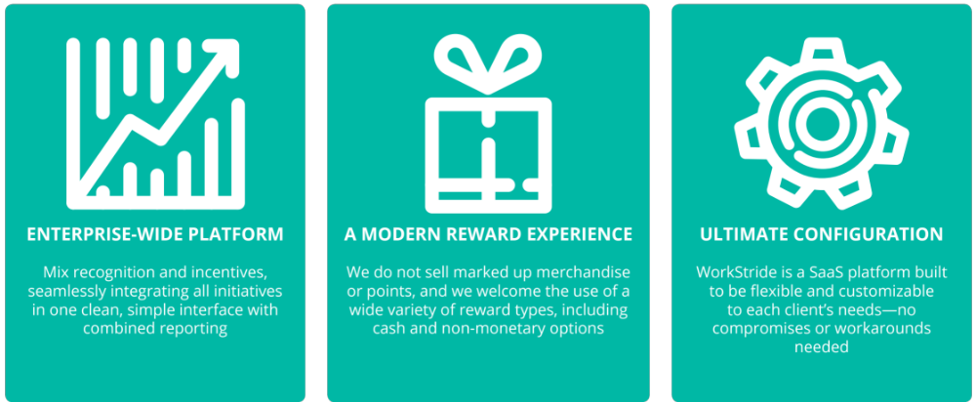
The WorkStride Difference

Slide 7
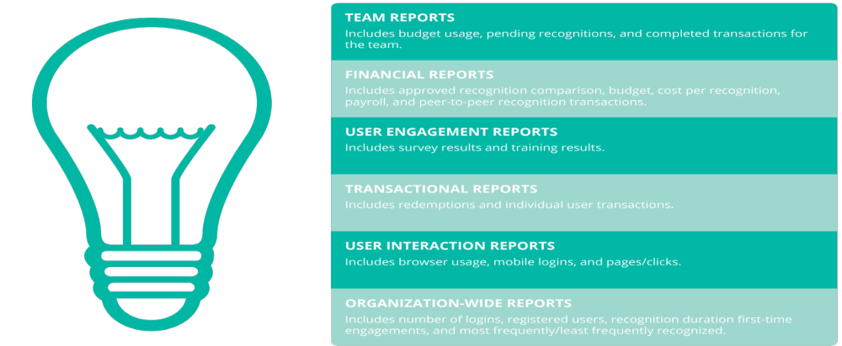
Reporting and Business Intelligence

Slide 8
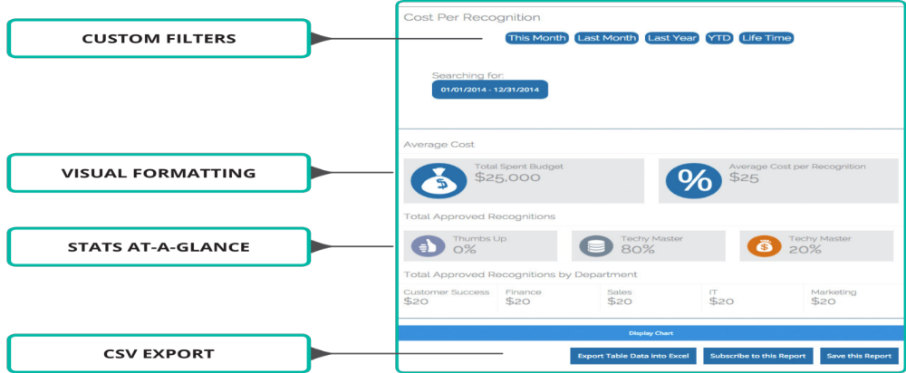
Intuitive Reporting

Slide 9
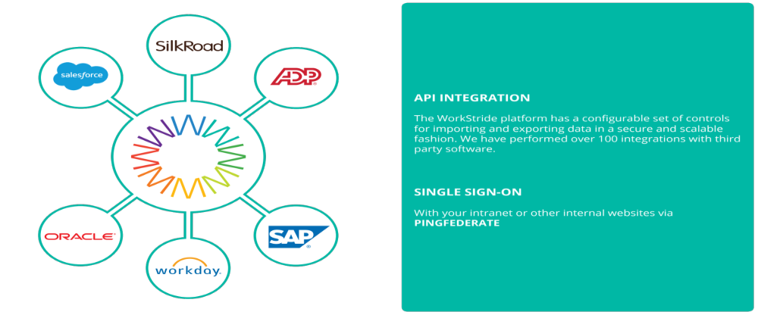
Integration

Slide 10
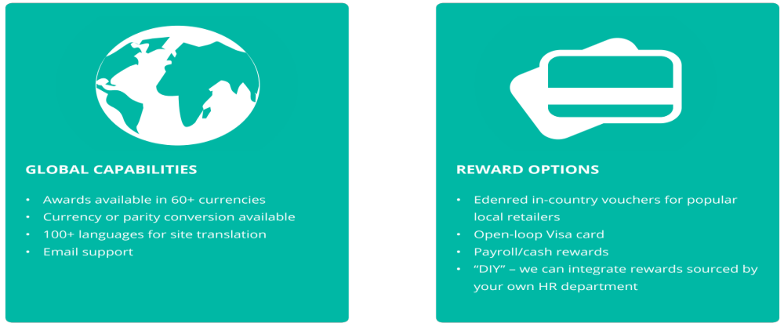
The WorkStride Difference

Slide 11
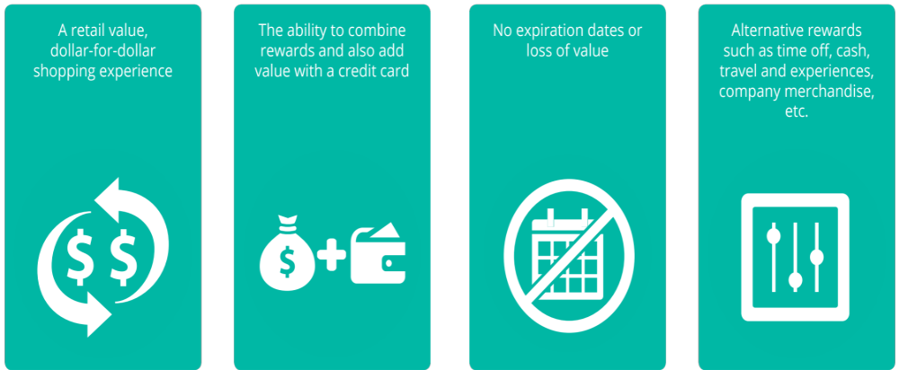
A Modern Rewards Experience

Slide 12
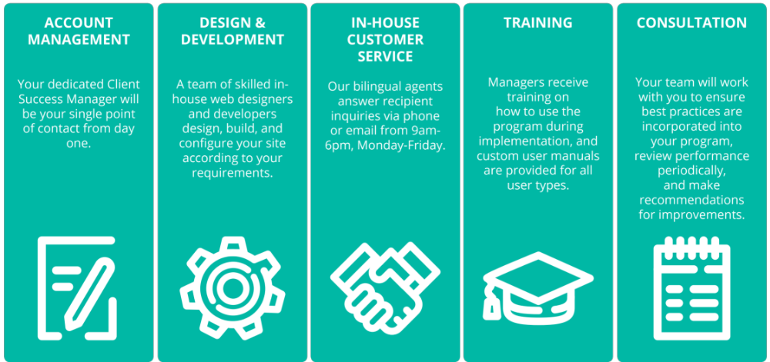
Services Included with Your Program

Slide 13
