Slide 1

工程进度周报ppt模板
点击开始吧
In this part you should describe your business to the investor. You have to make sure he can make it clear

Slide 2

点击
添加标题
In this part you should describe your business to the investor. You have to make sure he can make it clearIn this part you should describe your business to the investor. You have to make sure he can make it clear
In this part you should describe your business to the investor. You have to make sure he can make it

Slide 3

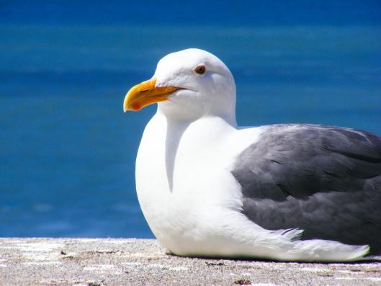
添加标题
In this part you should describe your business to the investor. You have to make sure he can make it clear
点击添加标题
In this part you should describe your business to the investor. You have to make sure he can make it clearIn this part you should describe your business to the investor. You have to make sure he can make it clear
In this part you should describe your business to the investor. You have to make sure he can make it clear

Slide 4

点击添加标题
In this part you should describe your business to the investor. You have to make sure he can make it clearIn this part you
In this part you should describe your business to the investor. You have to make sure he can make it clearIn this part you should describe your business to the investor. You have to make sure he can make it clear
In this part you should describe your business to the investor. You have to make sure he can make it

Slide 5


添加标题
In this part you should describe your business to the investor. You have to make sure he can make it clearIn this part you

Slide 6


添加标题
In this part you should describe your business to the investor. You have to make sure he can make it clearIn this part you
In this part you should describe your business to the investor. You have to make sure he can make it clearIn this part you

Slide 7



点击
添加标题
In this part you should describe your business to the investor. You have to make sure he can make it clearIn this part you should describe your business to the investor. You have to make sure he can make it clear
In this part you should describe your business to the investor. You have to make sure he can make it

Slide 8

点击
添加标题
In this part you should describe your business to the investor. You have to make sure he can make it clearIn this part you should describe your business to the investor. You have to make sure he can make it clear
In this part you should describe your business to the investor. You have to make sure he can make it

Slide 9

添加标题
In this part you should describe your business to the investor. You have to make sure he can make it clearIn this part you should describe your business to the investor. You have to make sure he can make it clear
In this part you should describe your business to the investor. You have to make sure he can make it

Slide 10
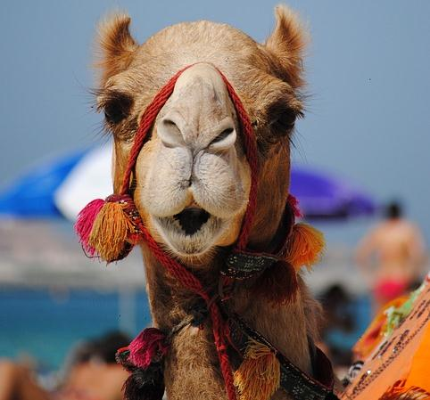
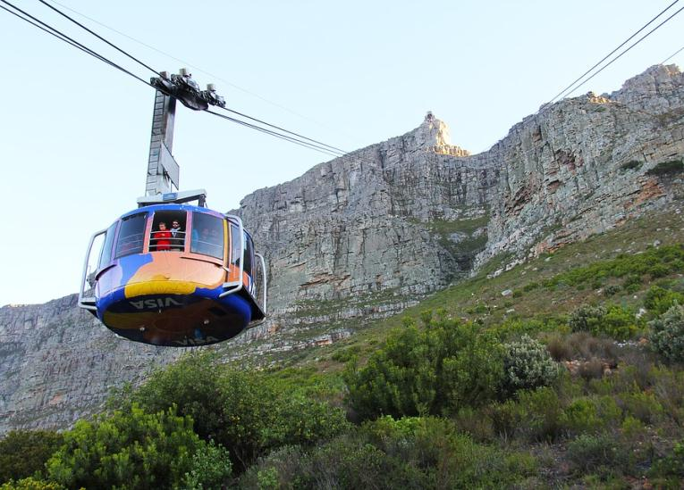
添加标题
In this part you should describe your business to the investor. You have to make sure he can make it clearIn this part you
7/20/2019

Slide 11
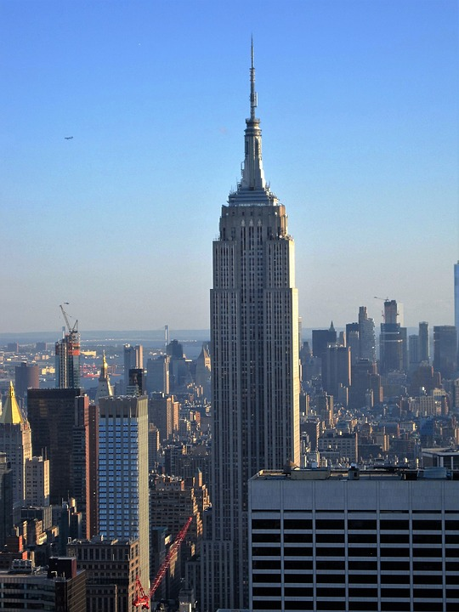
点击添加标题
In this part you should describe your business to the investor. You have to make sure he can make it clearIn this part you should describe your business to the investor. You have to make sure he can make it clear
In this part you should describe your business to the investor. You have to make sure he can make it
In this part you should describe your business to the investor. You have to make sure he can make it clearIn this part you should describe your business to the investor. You have to make sure he can make it clear
In this part you should describe your business to the investor. You have to make sure he can make it

Slide 12

添加标题
In this part you should describe your business to the investor. You have to make sure he can make it clearIn this part you

Slide 13

添加标题
In this part you should describe your business to the investor. You have to make sure he can make it clearIn this part you should describe your business to the investor. You have to make sure he can make it clear
In this part you should describe your business to the investor. You have to make sure he can make it

Slide 14

添加标题
In this part you should describe your business to the investor. You have to make sure he can make it clearIn this part you should describe your business to the investor. You have to make sure he can make it clear
In this part you should describe your business to the investor. You have to make sure he can make it

Slide 15


添加标题
In this part you should describe your business to the investor.

Slide 16

”
添加标题
In this part you should describe your business to the investor. You have to make sure he can make it clearIn this part you should describe your business to the investor. You have to make sure he can make it clear
In this part you should describe your business to the investor. You have to make sure he can make it

Slide 17


添加标题
In this part you should describe your business to the investor. You have to make sure he can make it clearIn this part you should describe your business to the investor. You have to make sure he can make it clear
In this part you should describe your business to the investor. You have to make

Slide 18

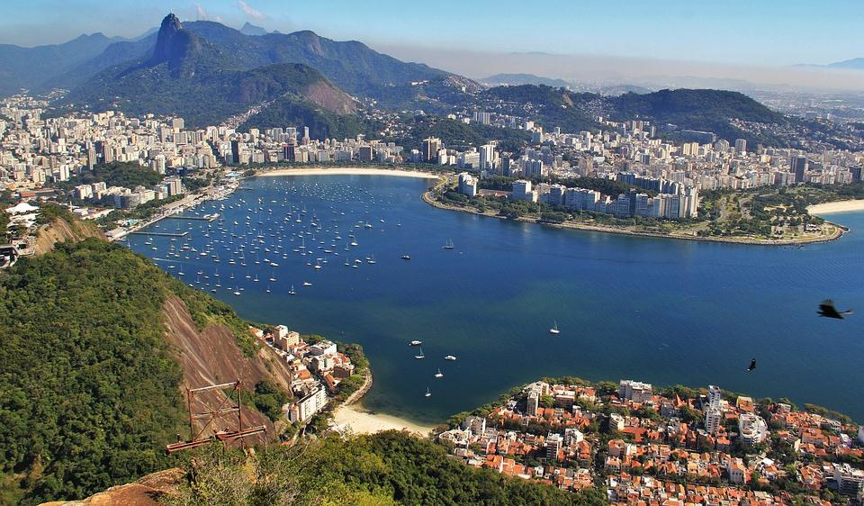
添加标题
In this part you should describe your business to the investor. You have to make sure he can make it clearIn this part you should describe your business
添加标题
In this part you should describe your business to the investor. You have to make sure he can make it clearIn this part you should describe your business

Slide 19
谢谢观看！
Thanks！
In this part you should describe your business to the investor. You have to make sure he can make it clear

