Slide 1






员工入职培训PPT
汇报人：XXX
汇报时间：20xx年xx月

Slide 2









目录
1
公司介绍
2
团队人员
3
管理制度
4
职员规划

Slide 3




公司介绍
公司简介
1
发展历程
产品介绍

Slide 4



公司简介
The past is gone and static. Nothing we can do will change it. The future is before us and dynamic. Everything we do will affect it.The past is gone and

Slide 5

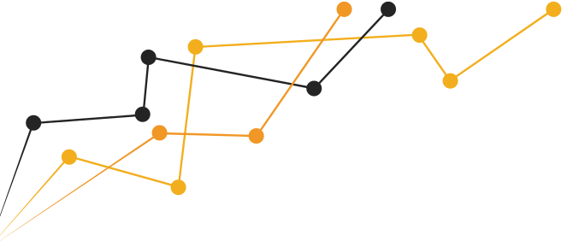
2017
发展历程
The past is gone and static.
2014
The past is gone and static.
2010
The past is gone and static.
2006
The past is gone and static.
2003
The past is gone and static.

Slide 6

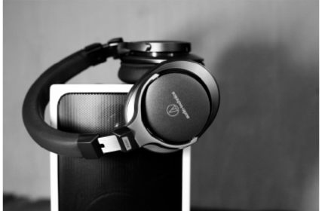
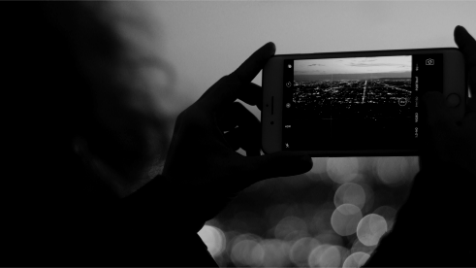
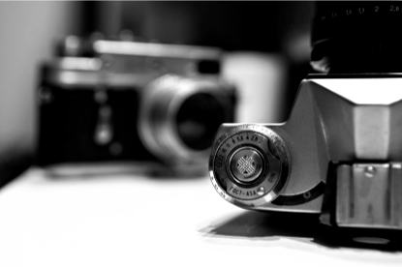


产品介绍
The past is gone and static. Nothing we can do will change it. The future is before us and dynamic. Everything we do will affect it. The past is gone and static. Nothing we can do will change it. The future is before us and

Slide 7

团队人员
2
领导团队
员工风采
部门介绍
核心成员
员工队伍

Slide 8


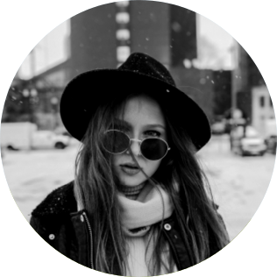
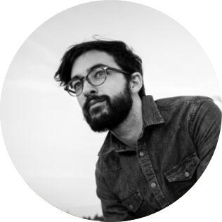
领导团队
董事长
副董事长
总经理
The past is gone and static. Nothing we can do will change it. Thefuture is before us and dynamic. Everything we do will affect it. The past is gone and static.Nothing

Slide 9







部门介绍
设计管理部
销售部
人力资源部
行政部
市场部
开发部

Slide 10

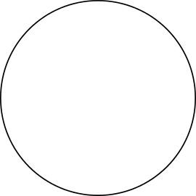
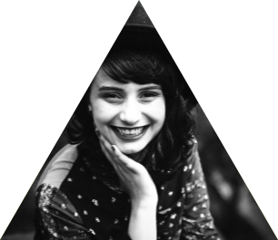








核心成员
The past is gone and static.
The past is gone and static.
The past is gone and static.
The past is gone and static.
The past is gone and static.

Slide 11
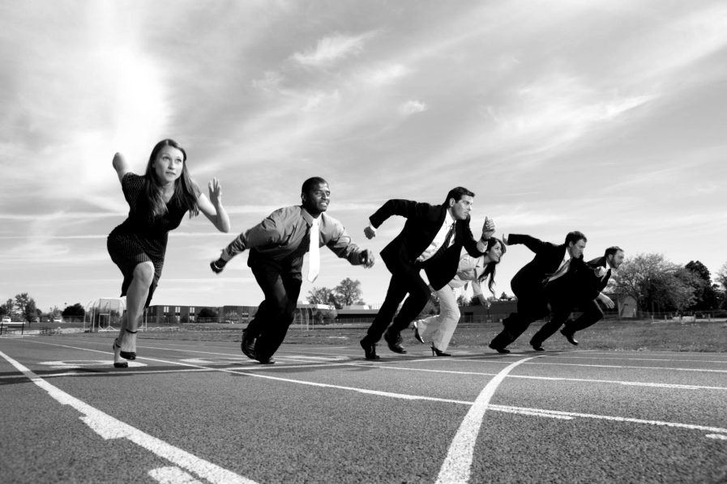



员工风采
The past is gone and static.
The past is gone and static.
The past is gone and static.

Slide 12





员工成长
自我评估
3
职业规划

Slide 13



自我评估
1
The past is gone and static.
2
The past is gone and static.
3
The past is gone and static.
4
The past is gone and static.

Slide 14







职业规划
培训计划
The past is gone and static.
考核与发展
The past is gone and static.

Slide 15



4
管理制度
考勤管理
薪酬管理
奖励处罚管理

Slide 16



考勤管理
1
The past is gone and static. Nothing we can do will change it. Thefuture is before us and dynamic. Everything we do will affect it. The past is gone and static.
The past is gone and static. Nothing we can do will change it. Thefuture is before us and dynamic. Everything we do will affect it. The past is gone and static.The past is gone and static. Nothing we can do will change it. Thefuture is before us and dynamic. Everything we do will affect it. The past is gone and static.
2
The past is gone and static. Nothing we can do will change it. Thefuture is before us and dynamic. Everything we do will affect it. The past is gone and static.

Slide 17
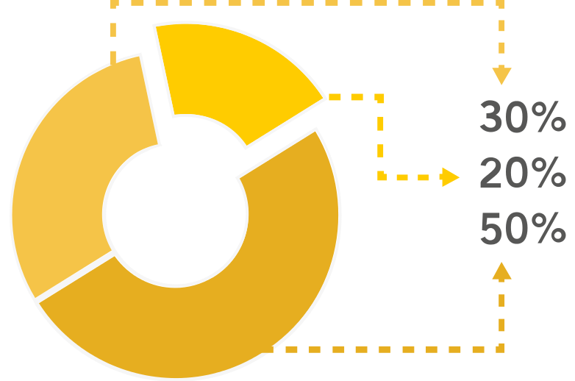
薪酬管理
绩效工资
福利工资
基本工资

Slide 18


奖励及处罚
奖励制度
处罚制度
The past is gone and static. Nothing we can do will change it. Thefuture is before us and dynamic. Everything we do will affect it. The past is gone and static.
The past is gone and static. Nothing we can do will change it. Thefuture is before us and dynamic. Everything we do will affect it. The past is gone and static.

Slide 19




总结
The past is gone and static. Nothing we can do will change it. Thefuture is before us and dynamic. Everything we do will affect it. The past is gone and static.

Slide 20




谢谢观看

