Slide 1

No.19 Primary School
Rebecca
Module 10 Body
Unit 1 This is his head.

Slide 2
The ABC Song

Slide 3

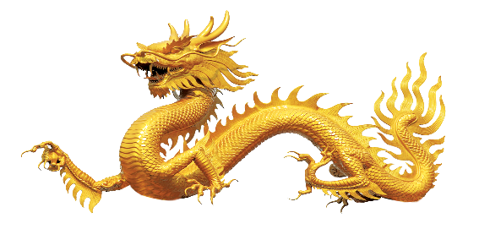

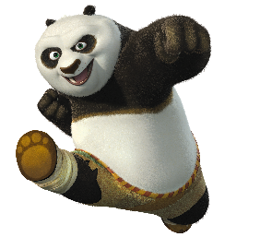

Unit 1 This is his head.
dog
dragon
cat
panda

Slide 4

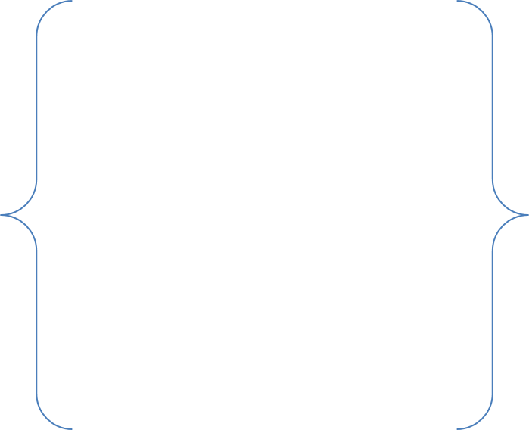
Unit 1 This is his head.
head
hands
hand
arm
legs
body
arms
leg
foot
feet

Slide 5

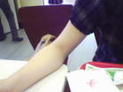
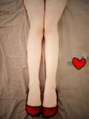

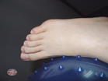
Unit 1 This is his head.
legs
arm
hand
foot
head

Slide 6
火眼金睛识单词
leg
head
arm
body
hand
foot

Slide 7

Listen and answer the question:
  What is it？
  It`s a panda.

Slide 8
  Let's read !
  Let's read !
  Let's read !
  Let's read !

Slide 9

Listen and answer the question:
He is Panpan.
head
arm
hand
body
foot
leg
This is his ____.

Slide 10
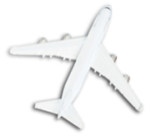
Pairwork time:
This is my ____.
This is my ____.
This is ____ ____.
This is ____ ____.
This ____ ____ ____.
This is me.

Slide 11

Chant and Point:
Body, body, body. This is my body.
Head, head, head. This is my head.
Arm, arm, arm. This is my arm.
Leg, leg, leg. This is my leg.
Hand, hand, hand. This is my hand.
Foot, foot, foot, This is my foot.
STEP
05
STEP
STEP
01
04
STEP
STEP
02
03

Slide 12
Let`s point!

Slide 13

Let`s sing!
Head and hands, arms and legs, feet and body.
Head and hands, arms and legs, feet and body.
Head and hands and arms and legs.
Head and hands, arms and legs, feet and body.

Slide 14


Homework:
Draw a picture of an animal and write
the parts of its body.
画一副动物图片，并且标出它的身体部位。

Slide 15
Thank you

