Slide 1

PPT工作室

Slide 2


PPT工作室
If the day is done
PPT工作室
If birds sing no more
If the wind has fiagged tired
PPT工作室
Then draw the veil
of darkness thick upon me

Slide 3







Then draw the veil of
PPT工作室
darkness thick upon me

Slide 4

Then draw thePPT工作室 veil of darkness thick upon me
Even as thou hast wrapt the earth withPPT工作室
The coverletPPT工作室of sleep and tenderly closed
The petals ofthe drooping lotus at dusk
PPT工作室
If the day is done If birds sing no more
If the wind has fiaged tired

Slide 5

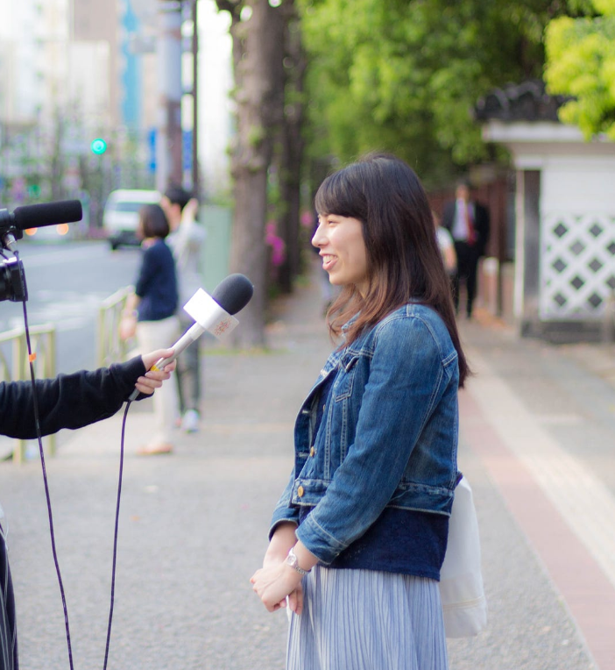
PPT工作室
If birds sing no more
If the day is donePPT工作室
If the wind has fiagged tired
If birds sing no more
If the day is donePPT工作室
If the wind has fiagged tired
PPT工作室

Slide 6


PPT工作室
Whose sack of provisions is empty before the voyage is endedPPT工作室
Whose garment is torn and dust-laden

Slide 7

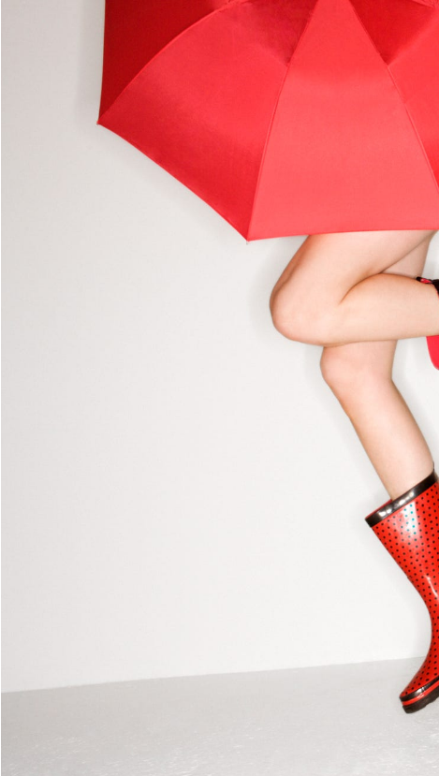
PPT工作室
PPT工作室Whose sack of provisions is empty before the voyage is ended
Whose garment isPPT工作室torn and dust-laden

Slide 8


Whose sack of provisions is empty before the voyage is endedPPT工作室
WhosePPT工作室garment is torn and dust-laden
PPT工作室

Slide 9

PPT工作室
IF THE DAY IS DONE
PPT工作室Whose sack of provisions is empty before the voyage is ended
Whose garment is torn andPPT工作室 dust-laden
Whose strengthPPT工作室 is exhausted remove shame and poverty

Slide 10

PPT工作室
Whose sack of provisions is empty before the voyage is ended
Whose garment isPPT工作室torn and dust-laden
PPT工作室Whose strength is exhausted remove shame and poverty

Slide 11









PPT工作室And renew his life like a flower under
The cover of thy kindly night
PPT工作室

Slide 12


IF THE DAY IS DONE
Whose sack of provisions is empty before the voyage is ended
PPT工作室Whose garment is torn and dust-laden
Whose strength is exhaustedPPT工作室remove shame and poverty
PPT工作室

Slide 13

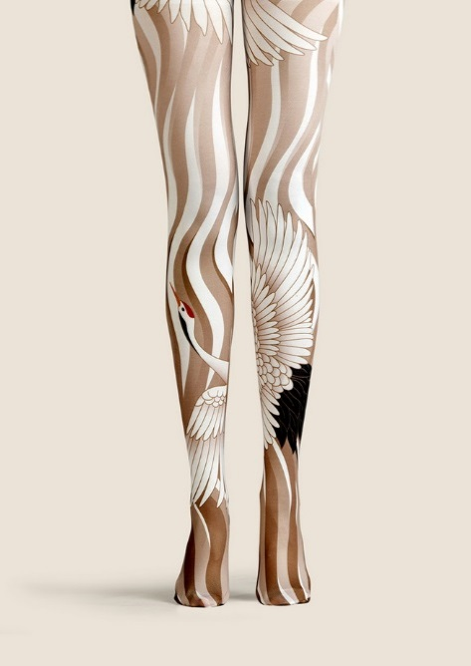
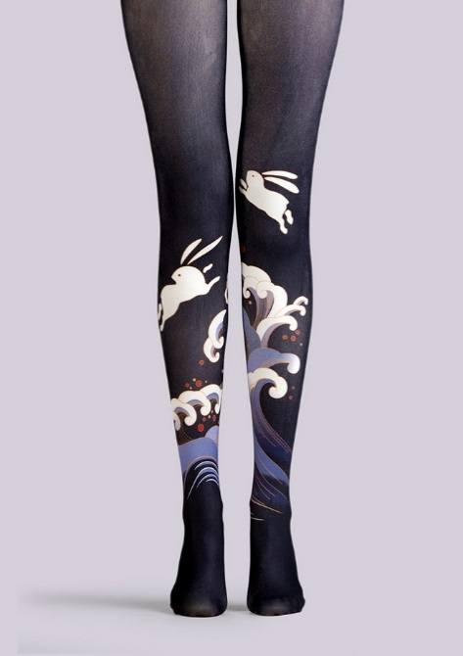
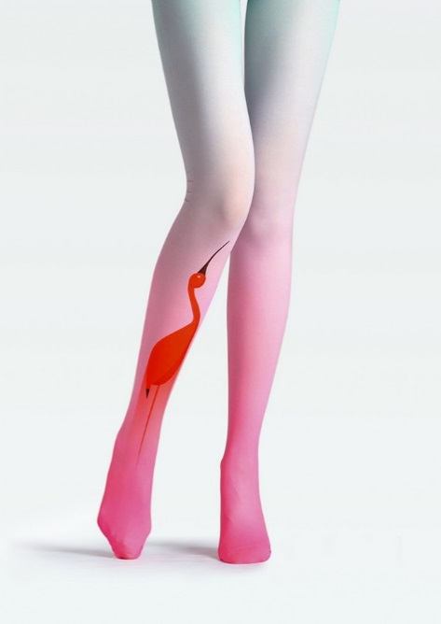
PPT工作室
PPT工作室
PPT工作室
If the day is done
If birds sing no more
If the day is done
If birds sing no more
If the day is done
If birds sing no more

Slide 14
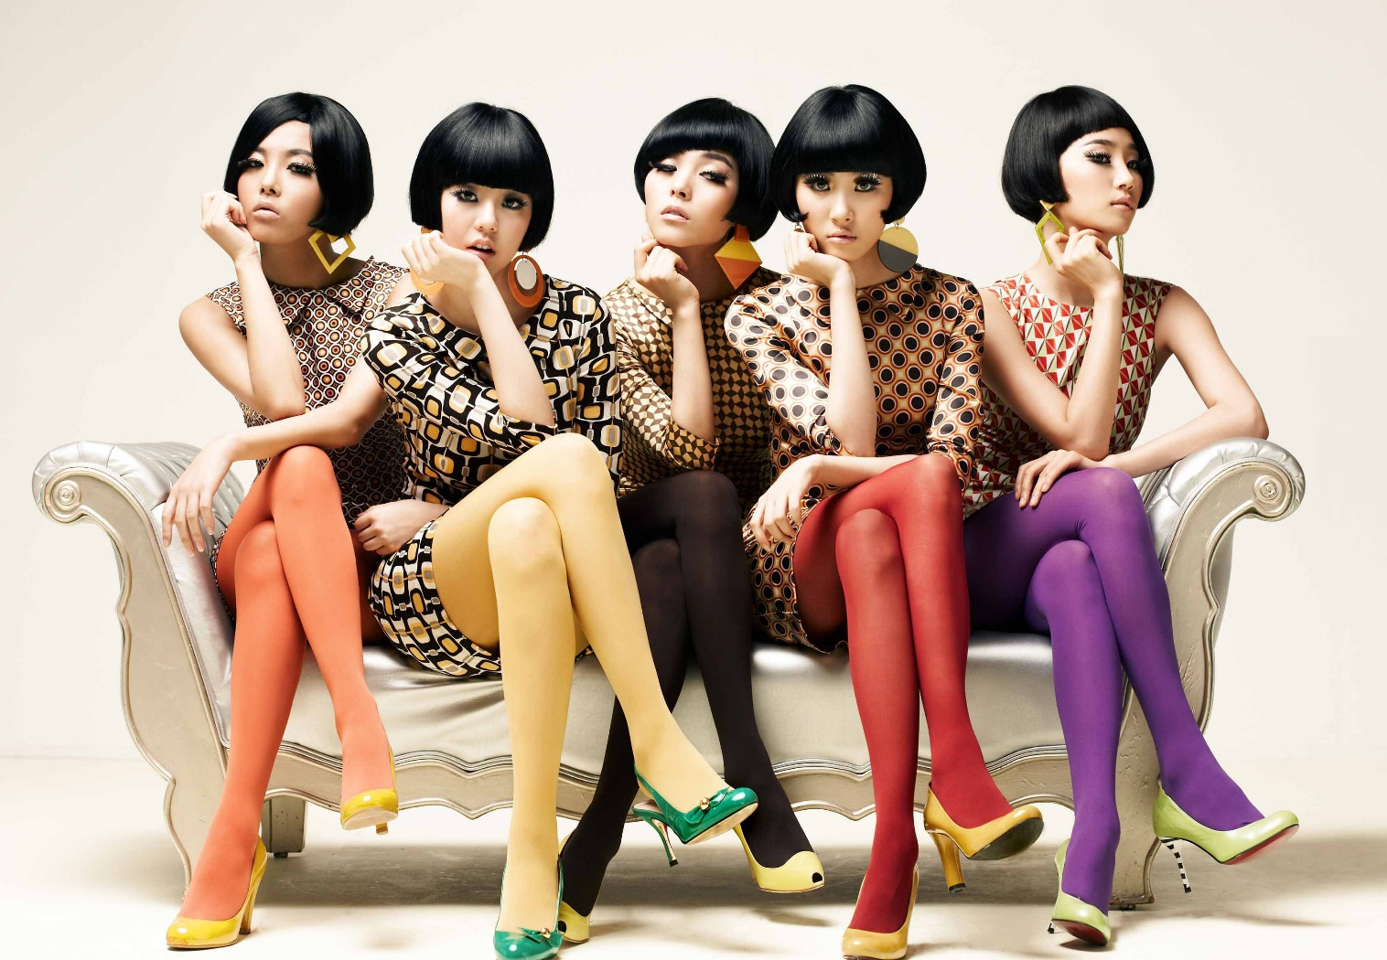
PPT工作室
PPT工作室

Slide 15





PPT工作室
Whose sackPPT工作室of provisions is empty before the voyage is ended
Whose夕瑶设计garment is torn and dust-laden
Whose strength is exhausted remove shamePPT工作室and poverty

Slide 16



PPT工作室
THE DAY IS DONE
If birds sing no more
If the day夕瑶设计is done
If the wind has fiagged tired

Slide 17
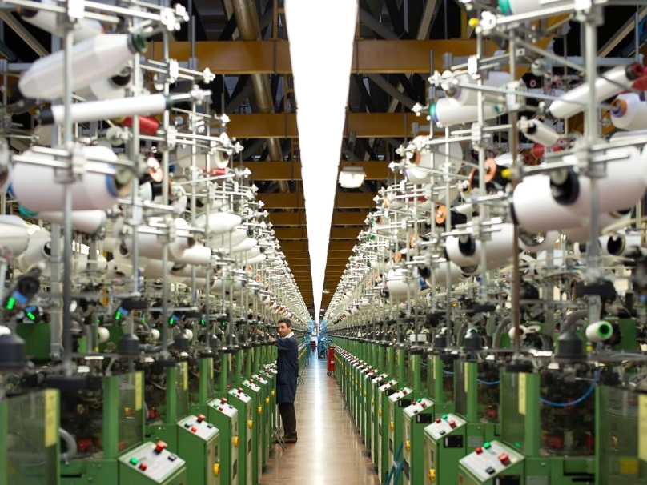
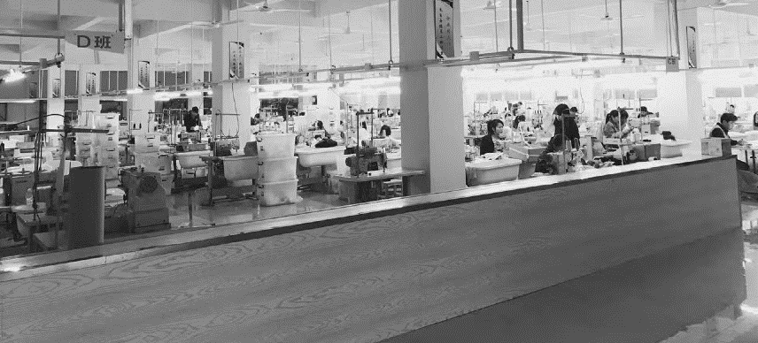
IF THE DAY IS DONE
PPT工作室
Whose sack of provisions is empty before夕瑶设计the voyage is ended
Whose garment夕瑶设计is torn and dust-laden

Slide 18

PPT工作室

