Slide 1


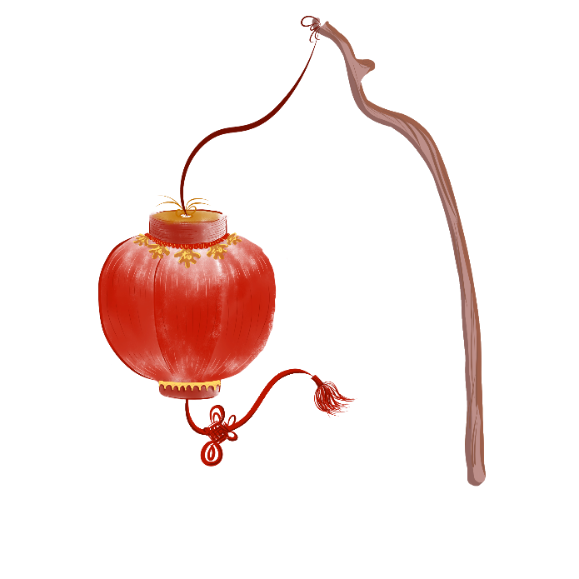


现代喜庆中国风通用PPT模板
Give me a brief overview of the company and your vision for the future，Give me a brief overview of the company and your vision for the future
2020.10.08

Slide 2
请输入标题
请输入标题
01
02
Life if only such as first see, what autumn wind sad painting fan. It.
Life if only such as first see, what autumn wind sad painting fan. It.
请输入标题
请输入标题
03
04
Life if only such as first see, what autumn wind sad painting fan. It.
Life if only such as first see, what autumn wind sad painting fan. It.

Slide 3
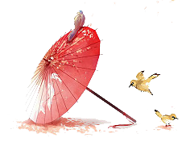
PART 01
请输入标题
Life if only such as first see, what autumn wind sad painting fan. It is easy to change, but it is easy to change.

Slide 4


请输入标题
Life if only such as first see, what autumn wind sad paintingan. ILife if only such as first see, what autumn wind sad painting fan. It. ife if only such as first see, what autumn wind sad painting fan. It.
t.
请输入标题
Life if only such as first see, what autumn wind sad paintingan. ILife if only such as first see, what autumn wind sad painting fan. It. ife if only such as first see, what autumn wind sad painting fan. It.
t.

Slide 5

请输入标题
Life if only such as first see, what autumn wind sad paintingan. ILife if only such as first see, what autumn wind sad painting fan. It. ife if only such as first see, what autumn wind sad painting fan. It.
t.
请输入标题
Life if only such as first see, what autumn wind sad paintingan. ILife if only such as first see, what autumn wind sad painting fan. It. ife if only such as first see, what autumn wind sad painting fan. It.
t.

Slide 6

请输入标题
请输入标题
Life if only such as first see, what autumn wind sad paintingan. ILife if only such as first see, what autumn wind sad painting fan. It. ife if only such as first see, what autumn wind sad painting fan. It.
t.
Life if only such as first see, what autumn wind sad paintingan. ILife if only such as first see, what autumn wind sad painting fan. It. ife if only such as first see, what autumn wind sad painting fan. It.
t.

Slide 7
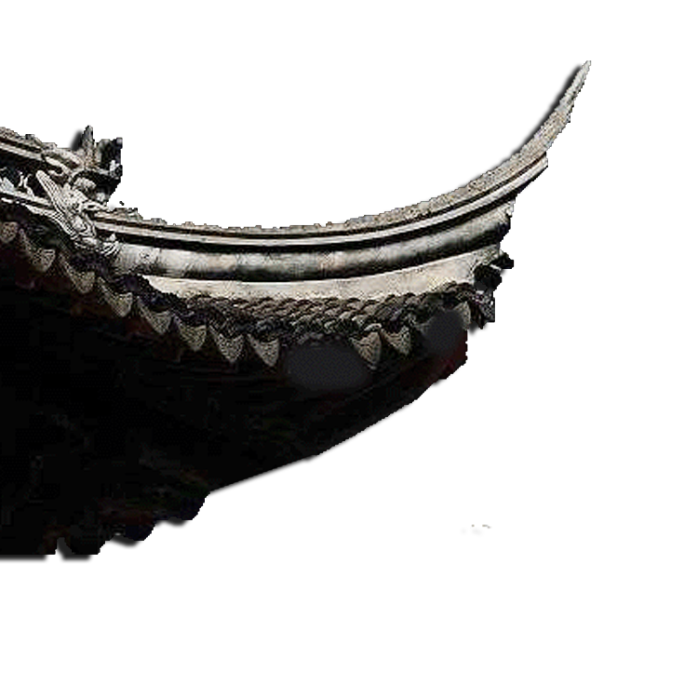
请输入标题
Life if only such as first see, what autumn wind sad paintingan. ILife if only such as first see, what autumn wind sad painting fan. It. ife if only such as first see, what autumn wind sad painting fan. It.
t.
请输入标题
Life if only such as first see, what autumn wind sad paintingan. ILife if only such as first see, what autumn wind sad painting fan. It. ife if only such as first see, what autumn wind sad painting fan. It.
t.
请输入标题
Life if only such as first see, what autumn wind sad paintingan. ILife if only such as first see, what autumn wind sad painting fan. It. ife if only such as first see, what autumn wind sad painting fan. It.
t.

Slide 8

PART 02
请输入标题
Life if only such as first see, what autumn wind sad painting fan. It is easy to change, but it is easy to change.

Slide 9
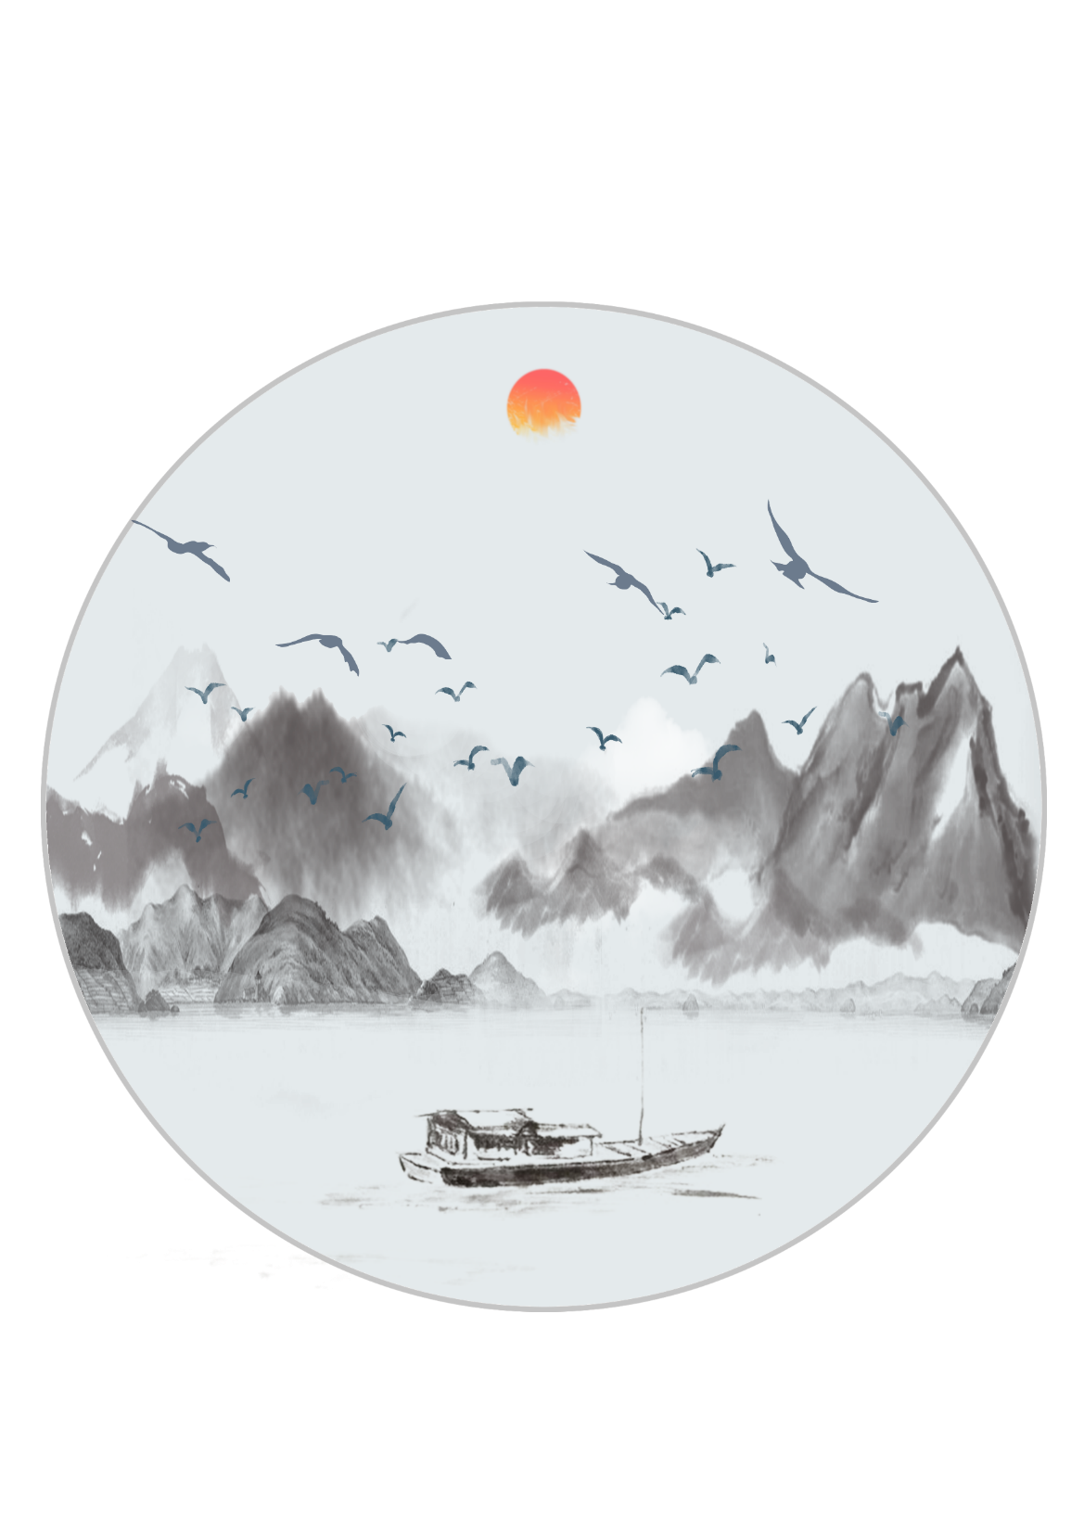
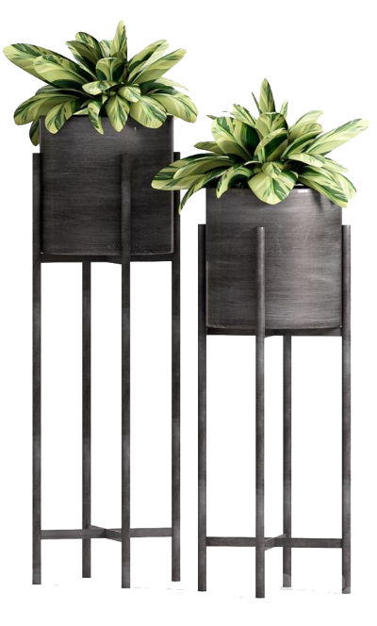
请输入标题
Life if only such as first see, what autumn wind sad paintingan. ILife if only such as first see, what autumn wind sad painting fan. It. ife if only such as first see, what autumn wind sad painting fan. It.
t.
请输入标题
Life if only such as first see, what autumn wind sad paintingan. ILife if only such as first see, what autumn wind sad painting fan. It. ife if only such as first see, what autumn wind sad painting fan. It.
t.

Slide 10

请输入标题
请输入标题
Life if only such as first see, what autumn wind sad paintingan. ILife if only such as first see, what autumn wind sad painting fan. It. ife if only such as first see, what autumn wind sad painting fan. It.
t.
Life if only such as first see, what autumn wind sad paintingan. ILife if only such as first see, what autumn wind sad painting fan. It. ife if only such as first see, what autumn wind sad painting fan. It.
t.

Slide 11
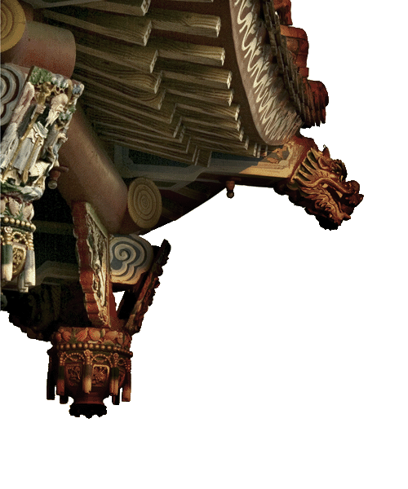
请输入标题
Life if only such as first see, what autumn wind sad paintingan. ILife if only such as first see, what autumn wind sad painting fan. It. ife if only such as first see, what autumn wind sad painting fan. It.
t.
请输入标题
Life if only such as first see, what autumn wind sad paintingan. ILife if only such as first see, what autumn wind sad painting fan. It. ife if only such as first see, what autumn wind sad painting fan. It.
t.
请输入标题
Life if only such as first see, what autumn wind sad paintingan. ILife if only such as first see, what autumn wind sad painting fan. It. ife if only such as first see, what autumn wind sad painting fan. It.
t.

Slide 12
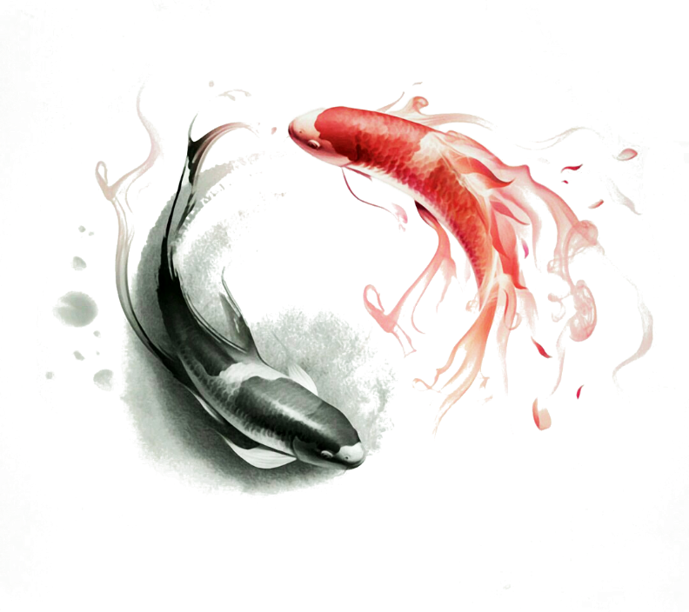
PART 03
请输入标题
Life if only such as first see, what autumn wind sad painting fan. It is easy to change, but it is easy to change.

Slide 13

请输入标题
Life if only such as first see, what autumn wind sad paintingan. ILife if only such as first see, what autumn wind sad painting fan. It. ife if only such as first see, what autumn wind sad painting fan. It.
t.
请输入标题
Life if only such as first see, what autumn wind sad paintingan. ILife if only such as first see, what autumn wind sad painting fan. It. ife if only such as first see, what autumn wind sad painting fan. It.
t.

Slide 14

请输入标题
Life if only such as first see, what autumn wind sad paintingan. ILife if only such as first see, what autumn wind sad painting fan. It. ife if only such as first see, what autumn wind sad painting fan. It.
t.
请输入标题
Life if only such as first see, what autumn wind sad paintingan. ILife if only such as first see, what autumn wind sad painting fan. It. ife if only such as first see, what autumn wind sad painting fan. It.
t.
请输入标题
Life if only such as first see, what autumn wind sad paintingan. ILife if only such as first see, what autumn wind sad painting fan. It. ife if only such as first see, what autumn wind sad painting fan. It.
t.

Slide 15
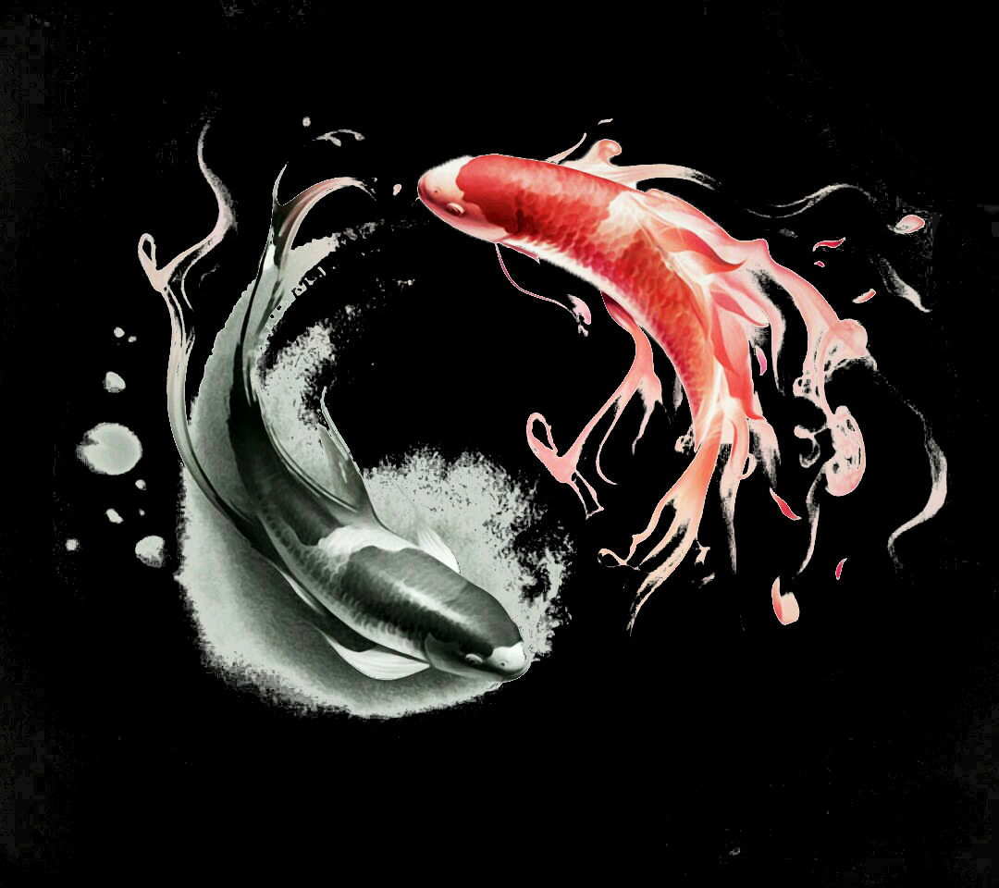
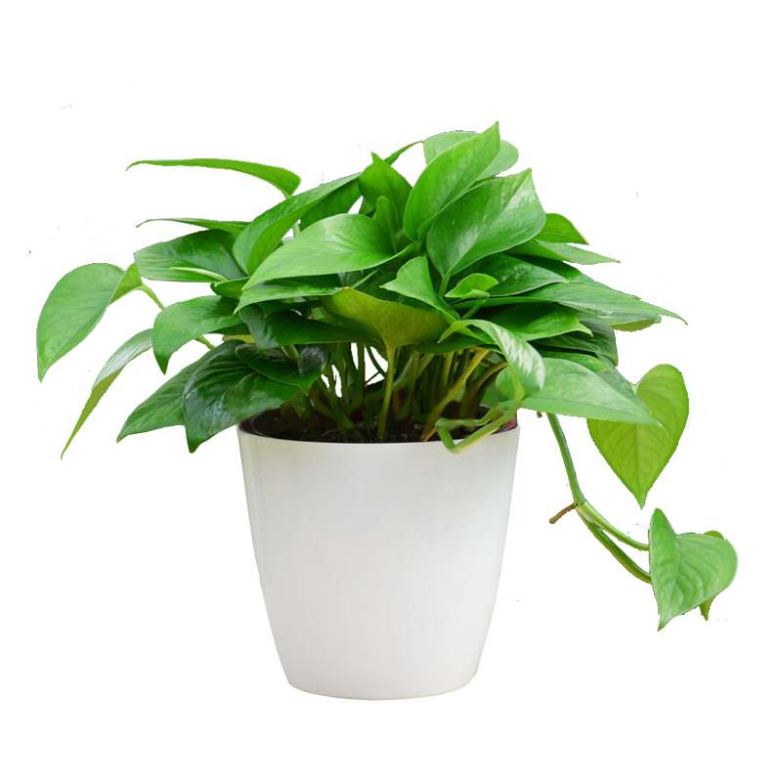
请输入标题
Life if only such as first see, what autumn wind sad paintingan. ILife if only such as first see, what autumn wind sad painting fan. It. ife if only such as first see, what autumn wind sad painting fan. It.
t.
请输入标题
Life if only such as first see, what autumn wind sad paintingan. ILife if only such as first see, what autumn wind sad painting fan. It. ife if only such as first see, what autumn wind sad painting fan. It.
t.

Slide 16

PART 04
请输入标题
Life if only such as first see, what autumn wind sad painting fan. It is easy to change, but it is easy to change.

Slide 17

请输入标题
Life if only such as first see, what autumn wind sad paintingan. ILife if only such as first see, what autumn wind sad painting fan. It. ife if only such as first see, what autumn wind sad painting fan. It.
t.
请输入标题
Life if only such as first see, what autumn wind sad paintingan. ILife if only such as first see, what autumn wind sad painting fan. It. ife if only such as first see, what autumn wind sad painting fan. It.
t.
请输入标题
Life if only such as first see, what autumn wind sad paintingan. ILife if only such as first see, what autumn wind sad painting fan. It. ife if only such as first see, what autumn wind sad painting fan. It.
t.

Slide 18
请输入标题
请输入标题
Life if only such as first see, what autumn wind sad paintingan. ILife if only such as first see, what autumn wind sad painting fan. It. ife if only such as first see, what autumn wind sad painting fan. It.
t.
Life if only such as first see, what autumn wind sad paintingan. ILife if only such as first see, what autumn wind sad painting fan. It. ife if only such as first see, what autumn wind sad painting fan. It.
t.

Slide 19

请输入标题
Life if only such as first see, what autumn wind sad paintingan. ILife if only such as first see, what autumn wind sad painting fan. It. ife if only such as first see, what autumn wind sad painting fan. It.
t.
请输入标题
Life if only such as first see, what autumn wind sad paintingan. ILife if only such as first see, what autumn wind sad painting fan. It. ife if only such as first see, what autumn wind sad painting fan. It.
t.
请输入标题
Life if only such as first see, what autumn wind sad paintingan. ILife if only such as first see, what autumn wind sad painting fan. It. ife if only such as first see, what autumn wind sad painting fan. It.
t.

Slide 20
感谢相遇，感谢观看
Give me a brief overview of the company and your vision for the future，Give me a brief overview of the company and your vision for the future
2020.10.08

