Slide 1



Big Data
移动互联网ppt模板
创新 科技 战略 双赢

Slide 2


大数据
云技术
创新思维
新模式

Slide 3
互联网大数据
创新思维
大数据领域
目录
互联网计算

Slide 4

互联网大数据

Slide 5


领导寄语
华为是全球领先的信息与通信技术(ICT)解决方案供应商，专注于ICT领域，坚持稳健经营、持续创新、开放合作，在电信运营商、企业、终端和云计算等领域构筑了端到端的解决方案优势，为运营商客户、企业客户和消费者提供有竞争力的ICT解决方案、产品和服务，。业务遍及全球170多个国家和地区，服务全世界三分之一以上的人口。
CEO
微软兼执行官
CONTENTS

Slide 6
理念创新
创新技术
互联网大数据
时代创新
安全系数
Raifore 学习算法
创新点
Innovation

Slide 7




核心研发人员
代用名 Name
代用名 Name
The activities of a company with buying and selling a product or service.
The activities of a company with buying and selling a product or service.
代用名 Name
代用名 Name
The activities of a company with buying and selling a product or service.
The activities of a company with buying and selling a product or service.

Slide 8

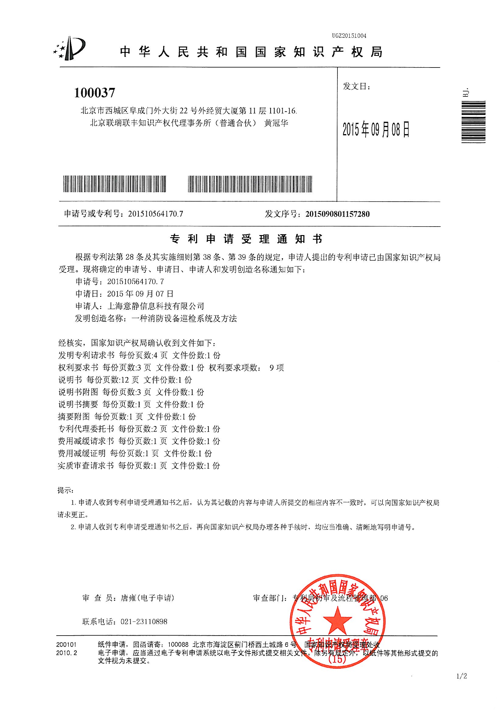
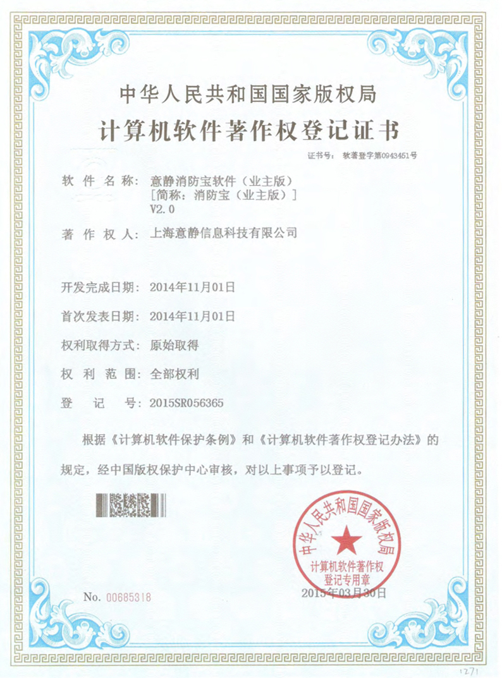
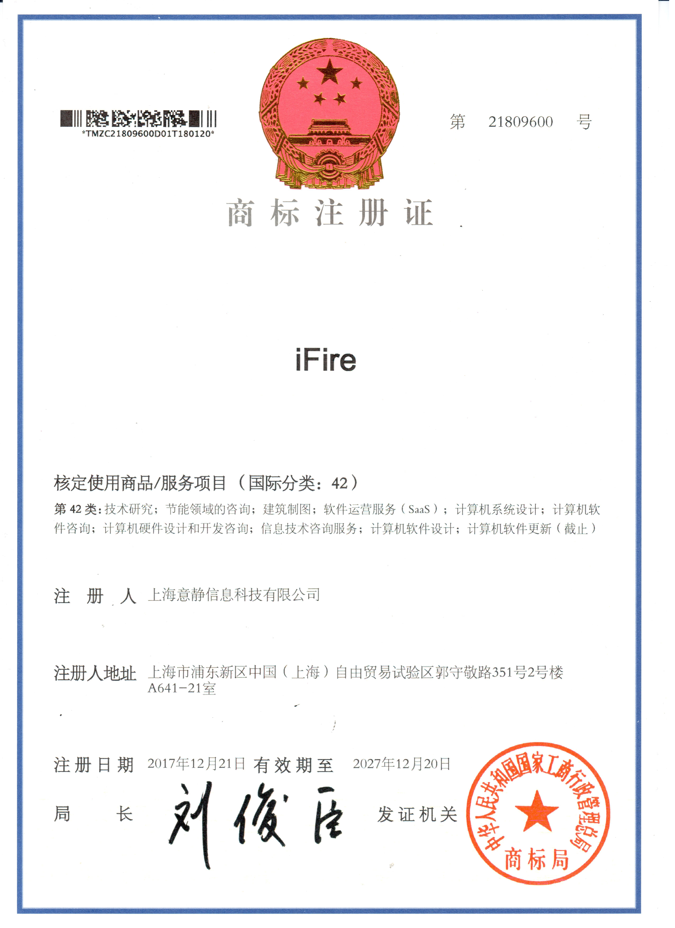
专业技术
软件著作权
注册商标
5
23
5

Slide 9


人员服务体系
JANE DOE
JANE DOE
JANE DOE
JANE DOE
JOHN DOE
JOHN DOE
JOHN DOE
JOHN DOE
JANE DOE
JANE DOE
JOHN DOE

Slide 10

大数据计算关系
填 写 标 题
填 写 标 题
The activities of a company with buying and selling a product or service.
The activities of a company with buying and selling a product or service.
填 写 标 题
填 写 标 题
The activities of a company with buying and selling a product or service.
The activities of a company with buying and selling a product or service.

Slide 11
云网计算机分解
产品技术
优化
需求
零售
智能科技
便捷
便捷
客户端
创新技术
领导者
领导者
云网

Slide 12

专业技术
专业技术
填写标题
填写标题
填写标题
The activities of a company associated with buying and selling a product or service. It
The activities of a company associated with buying and selling a product or service. It
The activities of a company associated with buying and selling a product or service

Slide 13
大数据了解用户
A
填 写 标 题
The activities of a company with buying and selling a product or
互联网
B
填 写 标 题
The activities of a company with buying and selling a product or
c
填 写 标 题
The activities of a company with buying and selling a product or

Slide 14
云计算发展背景和概念
分布
计算
并行计算
效用计算
Distributed Computing
Parallel Computing
Utility Computing
网络存储
负载均衡
热备冗余
虚拟化
Network Storage
Virtualization
Load Balance
High Available

Slide 15
数据计算统计
微博营销
The activities of a company with buying and selling a product or service. The activities of a company with buying and selling a product or service.
微信营销
The activities of a company with buying and selling a product or service. The activities of a company with buying and selling a product or service.
百度推广
The activities of a company with buying and selling a product or service. The activities of a company with buying and selling a product or service.
论坛推广
The activities of a company with buying and selling a product or service. The activities of a company with buying and selling a product or service.

Slide 16
数据存取机构
填 写 标 题
填 写 标 题
The activities of a company with buying and selling a product or service.
The activities of a company with buying and selling a product or service.
A
关键词
B
关键词
C
关键词
D
填 写 标 题
The activities of a company with buying and selling a product or service.

Slide 17

创新思维

Slide 18

产品创新
Gartner
填写标题
产品给客户及其商业模式创造同等价值的产品用户提供“大便捷”方便使用，提现产品的优略型商业价值客户端

Slide 19

到底有多大？
1PB相当于50%的全美学术研究图书馆藏书信息内容
5EB相当于至今全世界人类所讲过的话语
1ZB如同全世界海滩上的沙子数量总和
1YB相当于7000位人类体内的微细胞总和

Slide 20



大数据准确提取
研发产品
客户维护
The activities of a company with buying and selling a product or s. activities The activities of a company with buying and selling a product or
The activities of a company with buying and selling a product or s. activities The activities of a company with buying and selling
产品优势
推广计划
The activities of a company with buying and selling a product or s. activities The activities of a company with buying and selling a
The activities of a company with buying and selling a product or s. activities The activities of a

Slide 21
云计算机集合
首要任务
项目运作
The activities of a company with buying and selling a product or service. The activities
The activities of a company with buying and selling a product or service. The activities
A
B
效益预测
进度推进
The activities of a company with buying and selling a product or service. The activities
F
C
The activities of a company with buying and selling a product or service. The activities
效益预测
启动资金
E
D
The activities of a company with buying and selling a product or service. The activities
The activities of a company with buying and selling a product or service. The activities

Slide 22
填写关键词标题
大数据
存储计算
填写关键词标题
市场数据
填写关键词标题
填写关键词标题
关键字设问？
关键字设问？
关键字设问？
填写关键词标题
填写关键词标题
填写关键词标题

Slide 23
云计算是一种按使用量付费的模式，提供网络访问， 进入可配置的计算资源共享池这些资源能够被快速提供，只需投入很少的管理工作
云计算
网络
计算
分布式计算的一种，由一群松散耦合的计算机组成的一个超级虚拟计算机，常用来执行一些大型任务
效用
计算
IT资源的一种打包和计费方式，比如按照计算、存储分别计量费用，像传统的电力等公共设施一样
自主
计算
具有自我管理功能的计算机系统

Slide 24
云计算机资源
78%
88%
58%
98%
ABOUT . 01
ABOUT . 01
ABOUT . 01
ABOUT . 01
The generated is therefore always free repetition
injected
The generated is therefore always free repetition
injected
The generated is therefore always free repetition
injected
The generated is therefore always free repetition
injected

Slide 25
分布式数据挖掘
35%
填 写 标 题
The activities of a company with buying and selling a product or
35%
35%
填 写 标 题
填 写 标 题
The activities of a company with buying and selling a product or
The activities of a company with buying and selling a product or

Slide 26

数据泄露安全
填 写 标 题
The activities of a company with buying and selling a product or service.
填 写 标 题
The activities of a company with buying and selling a product or service.

Slide 27
大数据应用领域
医疗
医疗行业
市场推广
The activities of a company with buying and selling a product or
金融
金融学
领域
The activities of a company with buying and selling a product or
电子科技
传媒体
客户
统计
资源提取
The activities of a company with buying and selling a product or

Slide 28
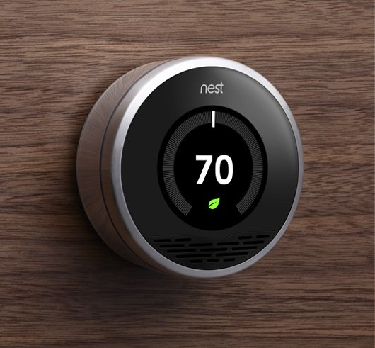

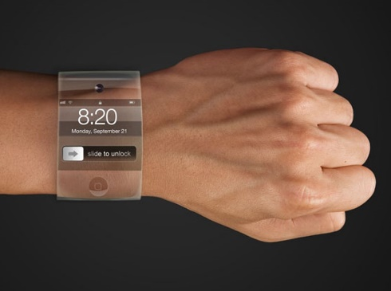

分布式数据挖掘
填 写 标 题
填 写 标 题
The activities of a company with buying and selling a product orThe activities of a company with buying
The activities of a company with buying and selling a product orThe activities of a company with buying

Slide 29


数据分析
填写段落标题
The activities of a company with buying and selling a product or service. The activities
357,782,473

Slide 30

填 写 标 题
填 写 标 题
The activities of a company with buying and selling a product or service.
标题
A
B
The activities of a company with buying and selling a product or service.
C
D
填 写 标 题
填 写 标 题
The activities of a company with buying and selling a product or service.
The activities of a company with buying and selling a product or service.

Slide 31

大数据领域

Slide 32
产品技术
移动零售
客户端
数据
数据
产品
产品
产品
产品
产品
产品
产品

Slide 33
分布式数据挖掘
中 文 标 题
中 文 标 题
中 文 标 题
The activities of a company with buying and selling a product or service. The activities
The activities of a company with buying and selling a product or service. The activities
The activities of a company with buying and selling a product or service. The activities

Slide 34

互联网数据时代
The activities of a company associated with buying and selling a product or service. The activities of a company associated with buying and selling a product or service. t activities of a company associated with buying and selling a product or service. It
A
JAYSHOW
NOTIFICATION
B
MARKETING
BATTERY

Slide 35




产品定义
Gartner
标题内容
产品给客户及其商业模式创造同等价值的产品用户提供“大便捷”方便使用，提现产品的优略型商业价值客户端

Slide 36


数据完善产品
A#
B#
产品名称
The activities of a company with buying and selling a product or service. The activities
产品名称
The activities of a company with buying and selling a product or service. The activities

Slide 37

互联网计算

Slide 38
大数据领域
满足客户需求
提供医疗研发
The activities of a company with buying and selling a product or service. The activities
The activities of a company with buying and selling a product or service. The activities
大数据优点
PROJECT
改变人类生活
优化机器性能
The activities of a company with buying and selling a product or service. The activities
The activities of a company with buying and selling a product or service. The activities

Slide 39
大数据领域
数据精确
金融交易
The activities of a company with buying and selling a product or
The activities of a company with buying and selling a product or
安全性能
创新科技
The activities of a company with buying and selling a product or
The activities of a company with buying and selling a product or

Slide 40
产品展示
ME
The generated is therefore always free from repetition,

Slide 41
分布式数据挖掘
2011
2012
2013
2014
2015
2016

Slide 42
The activities of a company associated with buying and selling a product or service. It includes advertising, The activities
The activities of a company associated with buying and selling a product or service. It includes advertising, The activities
标 题
标 题
标 题
标 题
The activities of a company associated with buying and selling a product or service. It includes advertising, The activities
The activities of a company associated with buying and selling a product or service. It includes advertising, The activities

Slide 43
THANKS
创新 科技 战略 双赢

