Slide 1

读书成果汇报ppt模板
powerpoint business template

Slide 2
CONTENTS
小z
Logo here
1
2
3
Welcome
Our Company
Our Work
Break
Unique design
Unique design
Unique design
10 minutes
4
5
6
7
Statistics
Portfolio
Projects
Contact
Unique design
Unique design
Unique design
Unique design

Slide 3
OUR COMPANY
Don't aim for success if you want it; just do what you love and believe in, and it will come naturally.

Slide 4







Our Company
小z
Logo here
An Awesome Company
By faith I mean a vision of good one cherishes and the enthusiasm that pushes one to seek its fulfillment regardless of obstacles. By faith I mean a vision of good one cherishes and the enthusiasm that pushes one to seek its fulfillment regardless of obstacles.
01

Slide 5
Our Services
小z
Logo here
An Awesome Company
By faith I mean a vision of good one cherishes and the enthusiasm that pushes one to seek its fulfillment regardless of obstacles. By faith I mean a vision of good one cherishes and the enthusiasm that pushes one to seek its fulfillment regardless of obstacles.
Service 01
Service 02
Service 03
By faith I mean a vision of good one cherishes and the enthusiasm that pushes one to seek its fulfillment regardless of
By faith I mean a vision of good one cherishes and the enthusiasm that pushes one to seek its fulfillment regardless of
By faith I mean a vision of good one cherishes and the enthusiasm that pushes one to seek its fulfillment regardless of
02

Slide 6



Our Services
小z
Logo here
Our Company
By faith I mean a vision of good one cherishes and the enthusiasm that pushes one to seek its fulfillment regardless of obstacles. By faith I mean a vision of good one cherishes and the enthusiasm that pushes one to seek its fulfillment regardless of obstacles.
By faith I mean a vision of good one cherishes and the enthusiasm that pushes one to seek its fulfillment regardless of obstacles. By faith I mean a
Service 01
Service 02
Service 03
I mean a vision of good
I mean a vision of good
I mean a vision of good
03

Slide 7
PARAGRAPH
Don't aim for success if you want it; just do what you love and believe in, and it will come naturally.

Slide 8

Paragraph Slide
小z
Logo here
Don't aim for success if you want it; just do what you love and believe in, and it will come naturally.
But all sunshine without shade, all pleasure without pain, is not life at all. Take the lot of the happiest - it is a tangled yarn. Bereavements and blessings, one following another, make us sad and blessed by turns. Even death itself makes life more loving.
But all sunshine without shade, all pleasure without pain, is not life at all. Take the lot of the happiest - it is a tangled yarn. Bereavements and blessings, one following another, make us sad and blessed by turns. Even death itself makes life more loving. But all sunshine without shade, all pleasure without pain, is not life at all. But all sunshine without shade, all pleasure without pain, is not life at all. But all sunshine without shade, all pleasure without pain, is not life at all.
04

Slide 9

Paragraph Slide
小z
Logo here
First chapter
By faith I mean a vision of good one cherishes and the enthusiasm that pushes one to seek its fulfillment regardless of obstacles. By faith I mean a vision of good one cherishes and the enthusiasm that pushes one to seek its fulfillment regardless of obstacles. By faith I mean a vision of good one cherishes and the enthusiasm that pushes one to seek
Second chapter
By faith I mean a vision of good one cherishes and the enthusiasm that pushes one to seek its fulfillment regardless of obstacles. By faith I mean a vision of good one cherishes and the enthusiasm that pushes one to seek its fulfillment regardless of obstacles. By faith I mean a vision of good one cherishes and the enthusiasm that pushes one to seek its fulfillment
05

Slide 10
OUR WORK
Don't aim for success if you want it; just do what you love and believe in, and it will come naturally.
PPT模板下载：www.1ppt.com/moban/ 行业PPT模板：www.1ppt.com/hangye/
节日PPT模板：www.1ppt.com/jieri/ PPT素材下载：www.1ppt.com/sucai/
PPT背景图片：www.1ppt.com/beijing/ PPT图表下载：www.1ppt.com/tubiao/
优秀PPT下载：www.1ppt.com/xiazai/ PPT教程： www.1ppt.com/powerpoint/
Word教程： www.1ppt.com/word/ Excel教程：www.1ppt.com/excel/
资料下载：www.1ppt.com/ziliao/ PPT课件下载：www.1ppt.com/kejian/
范文下载：www.1ppt.com/fanwen/ 试卷下载：www.1ppt.com/shiti/
教案下载：www.1ppt.com/jiaoan/
字体下载：www.1ppt.com/ziti/

Slide 11



Portfolio
小z
Logo here
Design, develop, and create….
06

Slide 12





Portfolio
小z
Logo here
Energy,
Communication, clarity and restraint…
A perfect blend of creativities
07

Slide 13
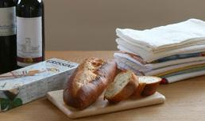
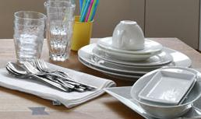
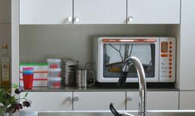
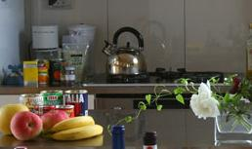
Portfolio
小z
Logo here
INTERIOR
DESIGN
INTERIOR
DESIGN
By faith I mean a vision of good one cherishes and the chain of By faith I mean a vision of
By faith I mean a vision of good one cherishes and the chain of By faith I mean a vision of
INTERIOR
DESIGN
INTERIOR
DESIGN
By faith I mean a vision of good one cherishes and the chain of By faith I mean a vision of
By faith I mean a vision of good one cherishes and the chain of By faith I mean a vision of
08

Slide 14
STATISTICS
Don't aim for success if you want it; just do what you love and believe in, and it will come naturally.

Slide 15
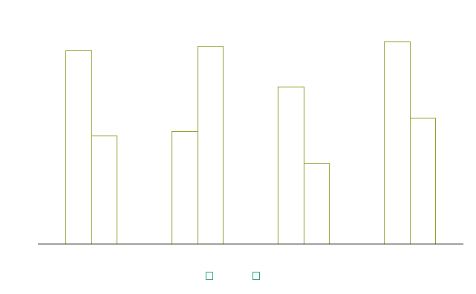
Chart & Data
小z
Logo here
The summary of company report 2014
By faith I mean a vision of good one cherishes and the enthusiasm that pushes one to seek its fulfillment regardless of obstacles. By faith I mean a vision of good one cherishes and the enthusiasm that pushes one to seek its fulfillment regardless of obstacles.
Don't aim for success if you want it; just do what you love and believe in, and it will come naturally.
87%
May
34%
Fed
09

Slide 16
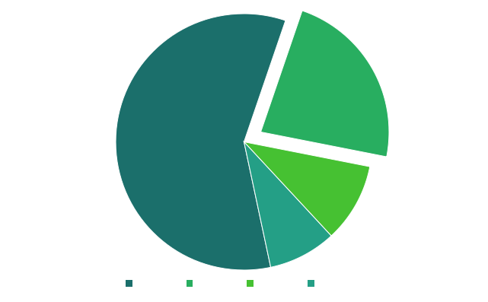
Chart & Data
小z
Logo here
The summary of company report 2014
By faith I mean a vision of good one cherishes and the enthusiasm that pushes one to seek its fulfillment regardless of obstacles. By faith I mean a vision of good one cherishes and the enthusiasm that pushes one to seek its fulfillment regardless of obstacles.
23%
Don't aim for success if you want it; just do what you love and believe in, and it will come naturally.
10

Slide 17

Chart & Data
小z
Logo here
Number Of Sales
87%
May
34%
Fed
26%
Jun
11

Slide 18
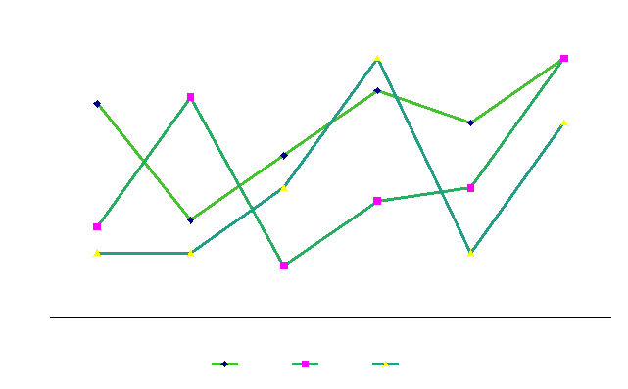
Chart & Data
小z
Logo here
100%
Satisfaction Guarantee
But all sunshine without shade, all pleasure without
100%
Satisfaction Guarantee
But all sunshine without shade, all pleasure without
100%
Satisfaction Guarantee
But all sunshine without shade, all pleasure without
12

Slide 19
Chart & Data
小z
Logo here
Leadership
Quality
Cooperation
12-34%
34-67%
12-34%
Nowadays a growing number of people
Some spend the majority of the time online chatting
cheap, comfortable, and most importantly, very safe.
lack of physical exercise
face-to-face communication with others.
Nowadays a growing number of people
Some spend the majority of the time online chatting
cheap, comfortable, and most importantly, very safe.
lack of physical exercise
face-to-face communication with others.
Nowadays a growing number of people
Some spend the majority of the time online chatting
cheap, comfortable, and most importantly, very safe.
lack of physical exercise
face-to-face communication with others.
13

Slide 20
PRODUCTS
Don't aim for success if you want it; just do what you love and believe in, and it will come naturally.

Slide 21


Products
小z
Logo here
Don't aim for success if you want it; just do what you love and believe in, and it will come naturally.
But all sunshine without shade, all pleasure without pain, is not life at all. Take the lot of the happiest - it is a tangled yarn. Bereavements and blessings, one following another, make us sad and blessed by turns. Even death itself makes life more loving. one following another, make us sad and blessed by turns. Even death itself makes life more loving.
14

Slide 22


Products
小z
Logo here
Don't aim for success if you want it; just do what you love and believe in, and it will come naturally.
But all sunshine without shade, all pleasure without pain, is not life at all. Take the lot of the happiest - it is a tangled yarn. Bereavements and blessings, one following another, make us sad and blessed by turns. Even death itself makes
15

Slide 23


Products
小z
Logo here
Our Product
By faith I mean a vision of good one cherishes and the enthusiasm that pushes one to seek its fulfillment regardless of obstacles. By faith I mean a vision of good one cherishes and the enthusiasm that pushes one to seek its fulfillment regardless of obstacles.
By faith I mean a vision of good one cherishes and the enthusiasm that pushes one to seek its fulfillment regardless of obstacles. By faith I mean a By faith I mean a vision of good one cherishes and the enthusiasm that pushes one to seek its
16

Slide 24
THANKS
Make you different

