Slide 1
NOVA

Slide 2



ABOUT US
Entrepreneurial activities differ substantially depending on the type of organization and creativity involved. Entrepreneurship ranges in scale from solo, part-time projects to large-scale undertakings

Slide 3

Our Welcome
Message
Entrepreneurial activities differ substantially depending on the type of organization and creativity involved. Entrepreneurship ranges in scale from solo, part-time projects to large-scale undertakings

Slide 4
OUR VALUES
Entrepreneurial activities differ substantially depending on the type of organization and creativity involved. Entrepreneurship ranges in scale from
COMMUNICATION
EXCELLENCE
RESEARCH
Entrepreneurial activities differ substantially depending on the type of organization and creativity involved.
Entrepreneurial activities differ substantially depending on the type of organization and creativity involved.
Entrepreneurial activities differ substantially depending on the type of organization and creativity involved.

Slide 5

Success is not final; failure is not fatal: It is the courage to continue that counts."
There are two types of people who will tell you that you cannot make a difference in this world: those who are afraid to try and those who are afraid you will succeed."
WINSTON S. CHURCHILL
CEO & FOUNDER
RAY GOFORTH
GENERAL MANAGER

Slide 6



MEET OUR TEAM
Entrepreneurial activities differ substantially depending on the type of organization and creativity involved. Entrepreneurship ranges in scale from
JOHN DOE
CEO & FOUNDER
JOHN DOE
CEO & FOUNDER
JOHN DOE
CEO & FOUNDER
Entrepreneurial activities differ substantially depending on the type of organization and
Entrepreneurial activities differ substantially depending on the type of organization and
Entrepreneurial activities differ substantially depending on the type of organization and

Slide 7
THE REAL PROCESS
Entrepreneurial activities differ substantially depending on the type of organization and creativity involved. Entrepreneurship ranges in scale from
AUDIO
VIDEO
WEBSITE
Entrepreneurial activities differ substantially depending on the type of organization and creativity involved..
Entrepreneurial activities differ substantially depending on the type of organization and creativity involved.
Entrepreneurial activities differ substantially depending on the type of organization and creativity involved..
Entrepreneurial activities differ substantially depending on the type of organization and creativity involved.
Entrepreneurial activities differ substantially depending on the type of organization and creativity involved..
Entrepreneurial activities differ substantially depending on the type of organization and creativity involved.

Slide 8
The steps to deliver
A Creative Project
IDEA
SETTINGS
COMMUNICATION
DELIVERY
Entrepreneurial activities differ substantially depending on the type of organization and creativity involved. Entrepreneurship ranges in scale from solo, part-time projects to large-scale undertakings that create many jobs. Many high value. Entrepreneurship ranges in scale from solo,,
Entrepreneurial activities differ substantially depending on the type of organization and creativity involved. Entrepreneurship ranges in scale from solo, part-time projects to large-scale undertakings that create many jobs. Many high value

Slide 9


iPhone 6 MOCKUP
Entrepreneurial activities differ substantially depending on the type of organization and creativity involved. Entrepreneurship ranges in scale from
FEATURE
NAME
Entrepreneurial activities differ substantially depending
Entrepreneurial activities differ substantially depending
TITLE
ELEMENT
Entrepreneurial activities differ substantially depending
Entrepreneurial activities differ substantially depending
Notes:
To change the image behind the Mock up.
Select the layer - > Right Click -> Send to Back -> Delete the image -> Drag & Drop your Own Picture -> Send to Back (again)

Slide 10



iPhone 6 Project
Notes:
To change the image behind the Mock up.
Select the layer - > Right Click -> Send to Back -> Delete the image -> Drag & Drop your Own Picture -> Send to Back (again)

Slide 11



IPAD MOCKUP
WITH FEATURES
Entrepreneurial activities differ substantially depending on the type of organization and creativity involved. Entrepreneurship ranges in scale
TITLE
TEXT
Entrepreneurial activities differ substantially depending on the type of organization and creativity involved.
Entrepreneurial activities differ substantially depending on the type of organization and creativity involved.
SOMETHING
WORDS
Entrepreneurial activities differ substantially depending on the type of organization and creativity involved.
Entrepreneurial activities differ substantially depending on the type of organization and creativity involved.
Notes:
To change the image behind the Mock up.
Select the layer - > Right Click -> Send to Back -> Delete the image -> Drag & Drop your Own Picture -> Send to Back (again)

Slide 12
IPAD MOCKUP
WITH FEATURES
Entrepreneurial activities differ substantially depending on the type of organization and creativity involved. Entrepreneurship ranges in scale
TITLE
TEXT
Entrepreneurial activities differ substantially depending on the type of organization and creativity involved.
Entrepreneurial activities differ substantially depending on the type of organization and creativity involved.
SOMETHING
WORDS
Entrepreneurial activities differ substantially depending on the type of organization and creativity involved.
Entrepreneurial activities differ substantially depending on the type of organization and creativity involved.
Notes:
To change the image behind the Mock up.
Select the layer - > Right Click -> Send to Back -> Delete the image -> Drag & Drop your Own Picture -> Send to Back (again)

Slide 13


MACBOOK AIR MOCKUP
Entrepreneurial activities differ substantially depending on the type of organization and creativity involved. Entrepreneurship ranges in scale
FEATURE
NAME
Entrepreneurial activities differ substantially depending on the
Entrepreneurial activities differ substantially depending on the
FUNCTION
ELEMENT
Entrepreneurial activities differ substantially depending on the
Entrepreneurial activities differ substantially depending on the
Notes:
To change the image behind the Mock up.
Select the layer - > Right Click -> Send to Back -> Delete the image -> Drag & Drop your Own Picture -> Send to Back (again)

Slide 14


MACBOOK MOCKUP
Entrepreneurial activities differ substantially depending on the type of organization and creativity involved. Entrepreneurship ranges in scale from
FEATURE
FEATURE
Entrepreneurial activities differ substantially
Entrepreneurial activities differ substantially
FEATURE
FEATURE
Entrepreneurial activities differ substantially
Entrepreneurial activities differ substantially

Slide 15

MACBOOK PRO MOCKUP
Entrepreneurial activities differ substantially depending on the type of organization and creativity involved. Entrepreneurship ranges in scale from
TITLE
TEXT
Entrepreneurial activities differ substantially depending on the type of organization and creativity involved.
Entrepreneurial activities differ substantially depending on the type of organization and creativity involved.
SOMETHING
WORDS
Entrepreneurial activities differ substantially depending on the type of organization and creativity involved.
Entrepreneurial activities differ substantially depending on the type of organization and creativity involved.

Slide 16

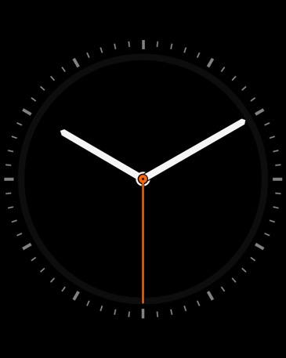
APPLE WATCH MOCKUP
Entrepreneurial activities differ substantially depending on the type of organization and creativity involved. Entrepreneurship ranges in scale from
FEATURE
NAME
NAME
Entrepreneurial activities differ substantially depending on the
Entrepreneurial activities differ substantially depending on the
Entrepreneurial activities differ substantially depending on the

Slide 17



OUR LATEST WORKS
Entrepreneurial activities differ substantially depending on the type of organization and creativity involved.
TITLE
Entrepreneurial activities differ substantially depending on the type of organization and creativity involved.
SOMETHING
Entrepreneurial activities differ substantially depending on the type of organization and creativity involved.
TEXT
Entrepreneurial activities differ substantially depending on the type of organization and creativity involved.

Slide 18



OUR LATEST WORKS
Entrepreneurial activities differ substantially depending on the type of organization and creativity involved.
TITLE
Entrepreneurial activities differ substantially depending on the type of organization and creativity involved.
SOMETHING
Entrepreneurial activities differ substantially depending on the type of organization and creativity involved.
TEXT
Entrepreneurial activities differ substantially depending on the type of organization and creativity involved.

Slide 19

IMAGE + TEXT
LEFT AND RIGHT
WRITE HERE SOMETHING
Entrepreneurial activities differ substantially depending on the type of organization and creativity involved.. Entrepreneurial activities differ substantially depending on the type of organization and
AWESOME WORDS
Entrepreneurial activities differ substantially depending on the type of organization and creativity involved.. Entrepreneurial activities differ substantially depending on the type of organization and
01
WRITE A TITLE
Entrepreneurial activities differ substantially depending on the type of organization and
02
WRITE A TITLE
Entrepreneurial activities differ substantially depending on the type of organization and

Slide 20

IMAGE + TEXT
RIGHT AND LEFT
WRITE HERE SOMETHING
Entrepreneurial activities differ substantially depending on the type of organization and creativity involved.. Entrepreneurial activities differ substantially depending on the type of organization and
AWESOME WORDS
Entrepreneurial activities differ substantially depending on the type of organization and creativity involved.. Entrepreneurial activities differ substantially depending on the type of organization and
01
WRITE A TITLE
Entrepreneurial activities differ substantially depending on the type of organization and
02
WRITE A TITLE
Entrepreneurial activities differ substantially depending on the type of organization and

Slide 21






Meet our Clients around
The World
Entrepreneurial activities differ substantially depending on the type of organization

Slide 22



Meet our Clients
Around the World
Entrepreneurial activities differ substantially depending on the type of organization and creativity involved. Entrepreneurship ranges in scale
TITLE
TEXT
Entrepreneurial activities differ substantially depending on the type of organization and creativity involved.
Entrepreneurial activities differ substantially depending on the type of organization and creativity involved.
SOMETHING
WORDS
Entrepreneurial activities differ substantially depending on the type of organization and creativity involved.
Entrepreneurial activities differ substantially depending on the type of organization and creativity involved.

Slide 23

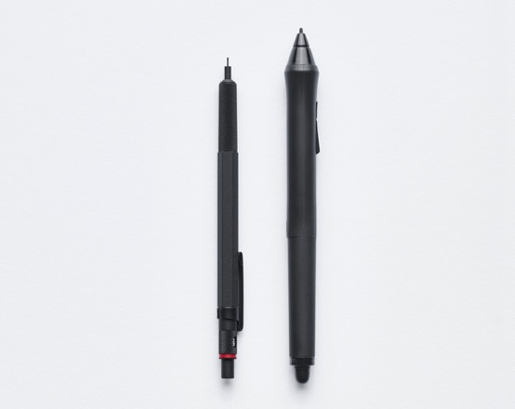


OUR LATEST PROJECTS
Entrepreneurial activities differ substantially depending on the type of organization and creativity involved. Entrepreneurship ranges in scale from
SOMETHING
Entrepreneurial activities differ substantially depending on the type of organization and creativity involved.. Entrepreneurial activities differ substantially depending on the type of organization and creativity
SOMETHING
Entrepreneurial activities differ substantially depending on the type of organization and creativity involved.. Entrepreneurial activities differ substantially depending on the type of organization and creativity
SOMETHING
WORDS
Entrepreneurial activities differ substantially depending on the type of organization and creativity involved.
Entrepreneurial activities differ substantially depending on the type of organization and creativity involved.

Slide 24










OUR LATEST PROJECTS
Entrepreneurial activities differ substantially depending on the type of organization and creativity involved. Entrepreneurship ranges in scale from
WRITE HERE SOMETHING
WRITE HERE SOMETHING
Entrepreneurial activities differ substantially depending on the type of organization and creativity involved.. Entrepreneurial activities differ
Entrepreneurial activities differ substantially depending on the type of organization and creativity involved.. Entrepreneurial activities differ
WRITE HERE
SOMETHING
WRITE HERE
SOMETHING
WRITE HERE
SOMETHING
WRITE HERE
SOMETHING

Slide 25

FOUR IMAGES LAYOUT
Entrepreneurial activities differ substantially depending on the type of organization and creativity involved.
WRITE YOUR
TITLE HERE
WRITE YOUR
TITLE HERE
WRITE YOUR TITLE HERE
Entrepreneurial activities differ substantially depending on the type of organization and creativity involved.. Entrepreneurial activities differ substantially depending on the type of organization and

Slide 26



FOUR PICTURES
ON THE TOP
Entrepreneurial activities differ substantially depending on the type of organization and creativity involved. Entrepreneurship ranges in scale from solo, part-time projects to large-scale undertakings

Slide 27


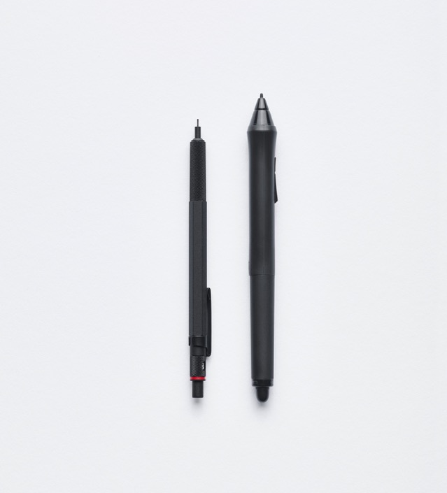

FOUR PICTURES
ON THE LEFT
SIDE
Entrepreneurial activities differ substantially depending on the type of organization and creativity involved. Entrepreneurship ranges in

Slide 28




FOUR PICTURES
ON THE
SIDE
Entrepreneurial activities differ substantially depending on the type of organization and creativity involved. Entrepreneurship ranges in

Slide 29




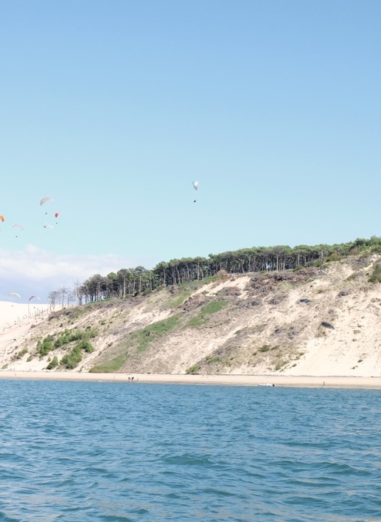

SIX
PICTURES
ON THE
SIDE
Entrepreneurial activities differ substantially depending on the type of.

Slide 30






SIX
PICTURES
ON THE
SIDE
Entrepreneurial activities differ substantially depending on the type of.

Slide 31
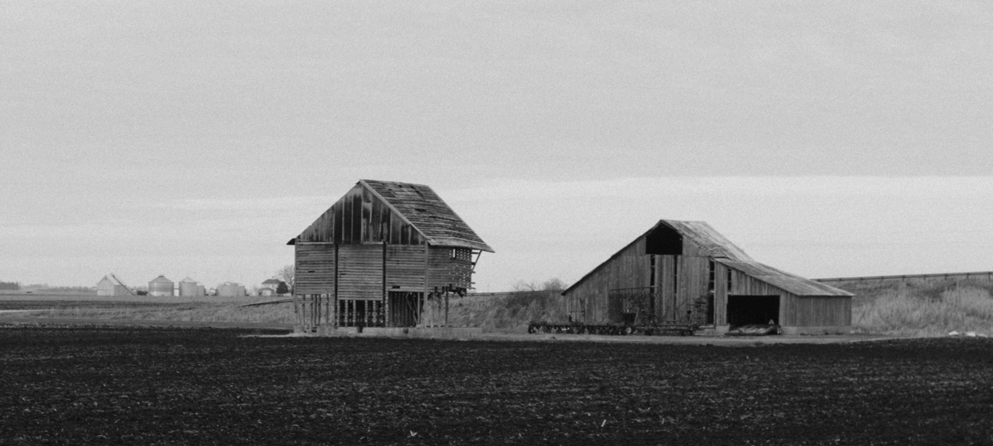
YOUR TITLE HERE
Entrepreneurial activities differ substantially depending on the type of organization and creativity involved. Entrepreneurship ranges in scale from
SHORT
MEDIUM
Entrepreneurial activities differ substantially depending on the type of organization and creativity involved.
Entrepreneurial activities differ substantially depending on the type of organization and creativity involved.
LONG TERM
TARGET Z
Entrepreneurial activities differ substantially depending on the type of organization and creativity involved.
Entrepreneurial activities differ substantially depending on the type of organization and creativity involved.

Slide 32

YOUR TITLE HERE
Entrepreneurial activities differ substantially depending on the type of organization and creativity involved. Entrepreneurship ranges in scale from
SHORT
MEDIUM
Entrepreneurial activities differ substantially depending on the type of organization and creativity involved.
Entrepreneurial activities differ substantially depending on the type of organization and creativity involved.
LONG TERM
TARGET Z
Entrepreneurial activities differ substantially depending on the type of organization and creativity involved.
Entrepreneurial activities differ substantially depending on the type of organization and creativity involved.

Slide 33

WE ARE VERY
CREATIVE PEOPLE
Success is not final; failure is not fatal: It is the courage to continue that counts."
WINSTON S. CHURCHILL
CEO & FOUNDER

Slide 34
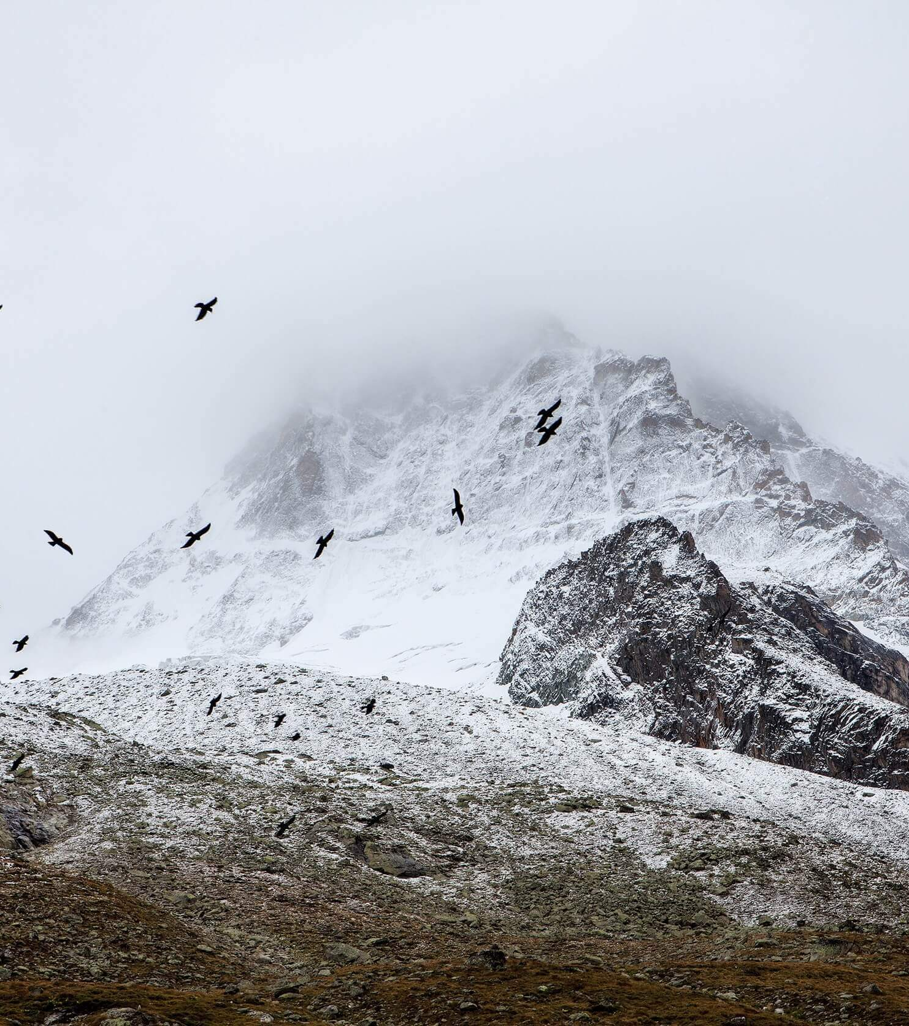
WE ARE VERY
CREATIVE PEOPLE
Success is not final; failure is not fatal: It is the courage to continue that counts."
WINSTON S. CHURCHILL
CEO & FOUNDER

Slide 35

AUDIO
Entrepreneurial activities differ substantially depending on the type of organization and creativity involved..
Entrepreneurial activities differ substantially depending on the type of organization and creativity involved.

Slide 36

AUDIO
Entrepreneurial activities differ substantially depending on the type of organization and creativity involved..
Entrepreneurial activities differ substantially depending on the type of organization and creativity involved.

Slide 37
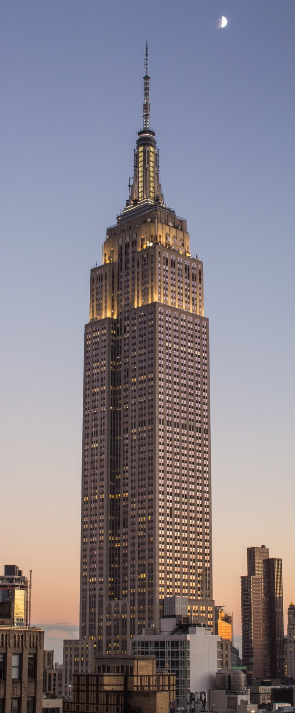
Works in Progress
Entrepreneurial activities differ substantially depending on the type of organization and creativity involved. Entrepreneurship ranges in scale from solo, part-time projects to large-scale undertakings that create many jobs. Many high value. Entrepreneurship ranges in scale from solo,,
FEATURE
NAME
Entrepreneurial activities differ substantially depending on the
Entrepreneurial activities differ substantially depending on the
FUNCTION
ELEMENT
Entrepreneurial activities differ substantially depending on the
Entrepreneurial activities differ substantially depending on the
Notes:
To change the image behind the Mock up.
Select the layer - > Right Click -> Send to Back -> Delete the image -> Drag & Drop your Own Picture -> Send to Back (again)

Slide 38

Works in Progress
Entrepreneurial activities differ substantially depending on the type of organization and creativity involved. Entrepreneurship ranges in scale from solo, part-time projects to large-scale undertakings that create many jobs. Many high value. Entrepreneurship ranges in scale from solo,,
FEATURE
NAME
Entrepreneurial activities differ substantially depending on the
Entrepreneurial activities differ substantially depending on the
FUNCTION
ELEMENT
Entrepreneurial activities differ substantially depending on the
Entrepreneurial activities differ substantially depending on the
Notes:
To change the image behind the Mock up.
Select the layer - > Right Click -> Send to Back -> Delete the image -> Drag & Drop your Own Picture -> Send to Back (again)

Slide 39

PICTURE ON SLIDE
RIGHT POSITION
Entrepreneurial activities differ substantially depending on the type of organization and creativity involved. Entrepreneurship ranges in scale from solo, part-time projects to large-scale undertakings that create many jobs. Many high value. Entrepreneurship ranges in scale from solo,,
FEATURE
NAME
Entrepreneurial activities differ substantially depending on the
Entrepreneurial activities differ substantially depending on the
Entrepreneurial activities differ substantially depending on the type of organization and creativity involved. Entrepreneurship ranges in scale
Notes:
To change the image behind the Mock up.
Select the layer - > Right Click -> Send to Back -> Delete the image -> Drag & Drop your Own Picture -> Send to Back (again)

Slide 40

PICTURE ON SLIDE
RIGHT POSITION
Entrepreneurial activities differ substantially depending on the type of organization and creativity involved. Entrepreneurship ranges in scale from solo, part-time projects to large-scale undertakings that create many jobs. Many high value. Entrepreneurship ranges in scale from solo,,
FEATURE
NAME
Entrepreneurial activities differ substantially depending on the
Entrepreneurial activities differ substantially depending on the
Entrepreneurial activities differ substantially depending on the type of organization and creativity involved. Entrepreneurship ranges in scale
Notes:
To change the image behind the Mock up.
Select the layer - > Right Click -> Send to Back -> Delete the image -> Drag & Drop your Own Picture -> Send to Back (again)

Slide 41

PICTURE AND
FOUR TEXTS
Entrepreneurial activities differ substantially depending on the type of organization and creativity involved. Entrepreneurship ranges in scale
TITLE
TEXT
Entrepreneurial activities differ substantially depending on the type of organization and creativity involved.
Entrepreneurial activities differ substantially depending on the type of organization and creativity involved.
SOMETHING
WORDS
Entrepreneurial activities differ substantially depending on the type of organization and creativity involved.
Entrepreneurial activities differ substantially depending on the type of organization and creativity involved.

Slide 42

PICTURE AND
FOUR TEXTS
Entrepreneurial activities differ substantially depending on the type of organization and creativity involved. Entrepreneurship ranges in scale
TITLE
TEXT
Entrepreneurial activities differ substantially depending on the type of organization and creativity involved.
Entrepreneurial activities differ substantially depending on the type of organization and creativity involved.
SOMETHING
WORDS
Entrepreneurial activities differ substantially depending on the type of organization and creativity involved.
Entrepreneurial activities differ substantially depending on the type of organization and creativity involved.

Slide 43

AUDIO
Entrepreneurial activities differ substantially depending on the type of organization and creativity involved..
Entrepreneurial activities differ substantially depending on the type of organization and creativity involved.

Slide 44

AUDIO
Entrepreneurial activities differ substantially depending on the type of organization and creativity involved..
Entrepreneurial activities differ substantially depending on the type of organization and creativity involved.

Slide 45



OTHER PROJECTS
Entrepreneurial activities differ substantially depending on the type of organization and creativity involved. Entrepreneurship ranges in scale from
ALUSTRALIA
NEW YORK
FRANCE
Entrepreneurial activities differ
Entrepreneurial activities differ
Entrepreneurial activities differ

Slide 46

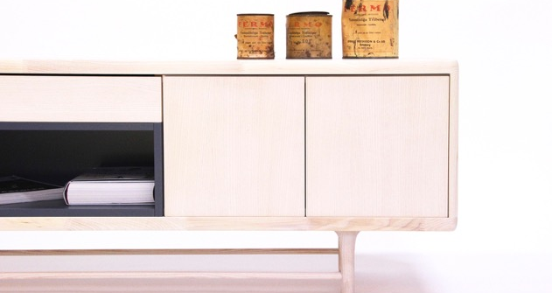




SPAIN
SAN FRANCISCO
HOUSTON
Entrepreneurial activities differ
Entrepreneurial activities differ
Entrepreneurial activities differ
FRANCE
BRAZIL
ARGENTINA
Entrepreneurial activities differ
Entrepreneurial activities differ
Entrepreneurial activities differ

Slide 47




TEXT
WORDS
Entrepreneurial activities differ substantially depending on the
Entrepreneurial activities differ substantially depending on the
SOMETHING
AWESOME
Entrepreneurial activities differ substantially depending on the
Entrepreneurial activities differ substantially depending on the

Slide 48


YOUR TITLE
Entrepreneurial activities differ substantially depending on the type of organization and creativity involved. Entrepreneurship ranges in scale from solo, part-time projects to large-scale undertakings that create many jobs. Many high value
YOUR TITLE
Entrepreneurial activities differ substantially depending on the type of organization and creativity involved. Entrepreneurship ranges in scale from solo, part-time projects to large-scale undertakings that create many jobs. Many high value

Slide 49


YOUR TITLE
YOUR TITLE
Entrepreneurial activities differ substantially depending on the type of organization and creativity involved. Entrepreneurship ranges in scale from solo, part-time projects to large-scale undertakings that create many jobs. Many high value
Entrepreneurial activities differ substantially depending on the type of organization and creativity involved. Entrepreneurship ranges in scale from solo, part-time projects to large-scale undertakings that create many jobs. Many high value

Slide 50


YOUR TITLE
YOUR TITLE
Entrepreneurial activities differ substantially depending on the type of organization and creativity involved. Entrepreneurship ranges in scale from solo, part-time projects to large-scale undertakings that create many jobs. Many high value
Entrepreneurial activities differ substantially depending on the type of organization and creativity involved. Entrepreneurship ranges in scale from solo, part-time projects to large-scale undertakings that create many jobs. Many high value

Slide 51
YOUR TITLE HERE
Entrepreneurial activities differ substantially depending on the type of organization and creativity involved. Entrepreneurship ranges in scale from
SHORT
MEDIUM
LONG TERM
Entrepreneurial activities differ substantially depending on the type of organization and creativity involved.
Entrepreneurial activities differ substantially depending on the type of organization and creativity involved.
Entrepreneurial activities differ substantially depending on the type of organization and creativity involved.
LONG TERM
SHORT
MEDIUM
Entrepreneurial activities differ substantially depending on the type of organization and creativity involved.
Entrepreneurial activities differ substantially depending on the type of organization and creativity involved.
Entrepreneurial activities differ substantially depending on the type of organization and creativity involved.

Slide 52

WE DO CREATIVE STUFF
Entrepreneurial activities differ substantially depending on the type of organization and creativity involved. Entrepreneurship ranges in scale from solo, part-time projects to large-scale undertakings

Slide 53

WHAT OUR CLIENTS ARE SAYING
Entrepreneurial activities differ substantially depending on the type of organization
Entrepreneurial activities differ substantially depending on the type of organization and creativity involved. Entrepreneurship ranges in scale from solo, part-time projects to large-scale.
MARK JOBS
CEO & FOUNDER

Slide 54
Success is not final; failure is not fatal: It is the courage to continue that counts."
WINSTON S. CHURCHILL

Slide 55
Success is not final; failure is not fatal: It is the courage to continue that counts."
WINSTON S. CHURCHILL

Slide 56

WRITE HERE
ANOTHER TITLE

Slide 57

WRITE
HERE
ANOTHER
TITLE

Slide 58

WRITE
HERE
ANOTHER TITLE

Slide 59

WRITE
HERE
ANOTHER
TITLE

Slide 60

WRITE
HERE
ANOTHER
TITLE

Slide 61

WRITE
HERE
ANOTHER
TITLE

Slide 62
WRITE
HERE
ANOTHER
TITLE

Slide 63
WRITE
HERE
ANOTHER
TITLE

Slide 64

WRITE
HERE
ANOTHER
TITLE

Slide 65

WRITE
HERE
ANOTHER
TITLE
SLIDEDIZER

Slide 66
OUR COMPANY IN NUMBERS
Entrepreneurial activities differ substantially depending on the type of organization and creativity involved. Entrepreneurship ranges in scale from
100+
7
19+
5
Projects Delivered in
The paste year
Awards won
In Creative Category
New people added
To our Company
New Branches
In the latest years
FEATURE
TITLE
WORD
TEXT

Slide 67
CLUSTERED COLUMN
Entrepreneurial activities differ substantially depending on the type of organization and creativity involved. Entrepreneurship ranges in scale from
FEATURE
NAME
Entrepreneurial activities differ substantially depending on the
Entrepreneurial activities differ substantially depending on the
FUNCTION
ELEMENT
Entrepreneurial activities differ substantially depending on the
Entrepreneurial activities differ substantially depending on the

Slide 68
LINE INFOGRAPHIC CHART
Entrepreneurial activities differ substantially depending on the type of organization and creativity involved. Entrepreneurship ranges in scale from
FEATURE
NAME
Entrepreneurial activities differ substantially depending on the
Entrepreneurial activities differ substantially depending on the
FUNCTION
ELEMENT
Entrepreneurial activities differ substantially depending on the
Entrepreneurial activities differ substantially depending on the

Slide 69
PIE INFOGRAPHIC CHART
Entrepreneurial activities differ substantially depending on the type of organization and creativity involved. Entrepreneurship ranges in scale from
FEATURE
NAME
57%
Entrepreneurial activities differ substantially depending on the
Entrepreneurial activities differ substantially depending on the
FUNCTION
ELEMENT
Entrepreneurial activities differ substantially depending on the
Entrepreneurial activities differ substantially depending on the

Slide 70
AREA INFOGRAPHIC CHART
Entrepreneurial activities differ substantially depending on the type of organization and creativity involved. Entrepreneurship ranges in scale from
SOMETHING
Entrepreneurial activities differ substantially depending on the type of organization and creativity involved.. Entrepreneurial activities differ substantially depending on the type of organization and creativity involved..
SOMETHING
Entrepreneurial activities differ substantially depending on the type of organization and creativity involved.. Entrepreneurial activities differ substantially depending on the type of organization and creativity involved..

Slide 71
USA VECTOR MAP
Entrepreneurial activities differ substantially depending on the type of organization
POPULATION ANALYSIS
15%
Entrepreneurial activities differ substantially depending on the type of organization and creativity involved.
Entrepreneurial activities differ substantially depending on the type of organization and creativity involved. Entrepreneurship ranges in scale from solo. Entrepreneurial activities differ substantially depending on the type of organization and
FIRST TITLE Entrepreneurial activities differ substantially depending on the.
SECOND TITLE Entrepreneurial activities differ substantially depending on the.

Slide 72
EAST COAST USA VECTOR
Entrepreneurial activities differ substantially depending on the type of organization
POPULATION ANALYSIS
15%
Entrepreneurial activities differ substantially depending on the type of organization and creativity involved.
Entrepreneurial activities differ substantially depending on the type of organization and creativity involved. Entrepreneurship ranges in scale from solo. Entrepreneurial activities differ substantially depending on the type of organization and
FIRST TITLE Entrepreneurial activities differ substantially depending on the.
SECOND TITLE Entrepreneurial activities differ substantially depending on the.

Slide 73
WORLDWIDE VECTOR MAP
Entrepreneurial activities differ substantially depending on the type of organization
15%
Company members share a common purpose and unite in order to focus their various talents and organize their
FIRST TITLE Entrepreneurial activities differ substantially depending on the.
SECOND TITLE Entrepreneurial activities differ substantially depending on the.

Slide 74
GERMANY VECTOR MAP
Entrepreneurial activities differ substantially depending on the type of organization
POPULATION ANALYSIS
15%
Entrepreneurial activities differ substantially depending on the type of organization and creativity involved.
Entrepreneurial activities differ substantially depending on the type of organization and creativity involved. Entrepreneurship ranges in scale from solo. Entrepreneurial activities differ substantially depending on the type of organization and
FIRST TITLE Entrepreneurial activities differ substantially depending on the.
SECOND TITLE Entrepreneurial activities differ substantially depending on the.

Slide 75
CANADA VECTOR MAP
Entrepreneurial activities differ substantially depending on the type of organization
POPULATION ANALYSIS
15%
Entrepreneurial activities differ substantially depending on the type of organization and creativity involved.
Entrepreneurial activities differ substantially depending on the type of organization and creativity involved. Entrepreneurship ranges in scale from solo. Entrepreneurial activities differ substantially depending on the type of organization and
FIRST TITLE Entrepreneurial activities differ substantially depending on the.
SECOND TITLE Entrepreneurial activities differ substantially depending on the.

Slide 76
FRANCE VECTOR MAP
Entrepreneurial activities differ substantially depending on the type of organization
POPULATION ANALYSIS
15%
Entrepreneurial activities differ substantially depending on the type of organization and creativity involved.
Entrepreneurial activities differ substantially depending on the type of organization and creativity involved. Entrepreneurship ranges in scale from solo. Entrepreneurial activities differ substantially depending on the type of organization and
FIRST TITLE Entrepreneurial activities differ substantially depending on the.
SECOND TITLE Entrepreneurial activities differ substantially depending on the.

Slide 77
AUSTRALIA VECTOR MAP
Entrepreneurial activities differ substantially depending on the type of organization
POPULATION ANALYSIS
15%
Entrepreneurial activities differ substantially depending on the type of organization and creativity involved.
Entrepreneurial activities differ substantially depending on the type of organization and creativity involved. Entrepreneurship ranges in scale from solo. Entrepreneurial activities differ substantially depending on the type of organization and
FIRST TITLE Entrepreneurial activities differ substantially depending on the.
SECOND TITLE Entrepreneurial activities differ substantially depending on the.

Slide 78
MEXICO VECTOR MAP
Entrepreneurial activities differ substantially depending on the type of organization
POPULATION ANALYSIS
15%
Entrepreneurial activities differ substantially depending on the type of organization and creativity involved.
Entrepreneurial activities differ substantially depending on the type of organization and creativity involved. Entrepreneurship ranges in scale from solo. Entrepreneurial activities differ substantially depending on the type of organization and
FIRST TITLE Entrepreneurial activities differ substantially depending on the.
SECOND TITLE Entrepreneurial activities differ substantially depending on the.

Slide 79
VENEZUELA VECTOR MAP
Entrepreneurial activities differ substantially depending on the type of organization
POPULATION ANALYSIS
15%
Entrepreneurial activities differ substantially depending on the type of organization and creativity involved.
Entrepreneurial activities differ substantially depending on the type of organization and creativity involved. Entrepreneurship ranges in scale from solo. Entrepreneurial activities differ substantially depending on the type of organization and
FIRST TITLE Entrepreneurial activities differ substantially depending on the.
SECOND TITLE Entrepreneurial activities differ substantially depending on the.

Slide 80
UK VECTOR MAP
Entrepreneurial activities differ substantially depending on the type of organization
POPULATION ANALYSIS
15%
Entrepreneurial activities differ substantially depending on the type of organization and creativity involved.
Entrepreneurial activities differ substantially depending on the type of organization and creativity involved. Entrepreneurship ranges in scale from solo. Entrepreneurial activities differ substantially depending on the type of organization and
FIRST TITLE Entrepreneurial activities differ substantially depending on the.
SECOND TITLE Entrepreneurial activities differ substantially depending on the.

Slide 81
INDIA VECTOR MAP
Entrepreneurial activities differ substantially depending on the type of organization
POPULATION ANALYSIS
15%
Entrepreneurial activities differ substantially depending on the type of organization and creativity involved.
Entrepreneurial activities differ substantially depending on the type of organization and creativity involved. Entrepreneurship ranges in scale from solo. Entrepreneurial activities differ substantially depending on the type of organization and
FIRST TITLE Entrepreneurial activities differ substantially depending on the.
SECOND TITLE Entrepreneurial activities differ substantially depending on the.

Slide 82
BRAZIL VECTOR MAP
Entrepreneurial activities differ substantially depending on the type of organization
POPULATION ANALYSIS
15%
Entrepreneurial activities differ substantially depending on the type of organization and creativity involved.
Entrepreneurial activities differ substantially depending on the type of organization and creativity involved. Entrepreneurship ranges in scale from solo. Entrepreneurial activities differ substantially depending on the type of organization and
FIRST TITLE Entrepreneurial activities differ substantially depending on the.
SECOND TITLE Entrepreneurial activities differ substantially depending on the.

Slide 83
SPAIN VECTOR MAP
Entrepreneurial activities differ substantially depending on the type of organization
POPULATION ANALYSIS
15%
Entrepreneurial activities differ substantially depending on the type of organization and creativity involved.
Entrepreneurial activities differ substantially depending on the type of organization and creativity involved. Entrepreneurship ranges in scale from solo. Entrepreneurial activities differ substantially depending on the type of organization and
FIRST TITLE Entrepreneurial activities differ substantially depending on the.
SECOND TITLE Entrepreneurial activities differ substantially depending on the.

Slide 84
CHINA VECTOR MAP
Entrepreneurial activities differ substantially depending on the type of organization
POPULATION ANALYSIS
15%
Entrepreneurial activities differ substantially depending on the type of organization and creativity involved.
Entrepreneurial activities differ substantially depending on the type of organization and creativity involved. Entrepreneurship ranges in scale from solo. Entrepreneurial activities differ substantially depending on the type of organization and
FIRST TITLE Entrepreneurial activities differ substantially depending on the.
SECOND TITLE Entrepreneurial activities differ substantially depending on the.

Slide 85
ITALY VECTOR MAP
Entrepreneurial activities differ substantially depending on the type of organization
POPULATION ANALYSIS
15%
Entrepreneurial activities differ substantially depending on the type of organization and creativity involved.
Entrepreneurial activities differ substantially depending on the type of organization and creativity involved. Entrepreneurship ranges in scale from solo. Entrepreneurial activities differ substantially depending on the type of organization and
FIRST TITLE Entrepreneurial activities differ substantially depending on the.
SECOND TITLE Entrepreneurial activities differ substantially depending on the.

Slide 86
MALAYSIA VECTOR MAP
Entrepreneurial activities differ substantially depending on the type of organization
POPULATION ANALYSIS
15%
Entrepreneurial activities differ substantially depending on the type of organization and creativity involved.
Entrepreneurial activities differ substantially depending on the type of organization and creativity involved. Entrepreneurship ranges in scale from solo. Entrepreneurial activities differ substantially depending on the type of organization and
FIRST TITLE Entrepreneurial activities differ substantially depending on the.
SECOND TITLE Entrepreneurial activities differ substantially depending on the.

Slide 87
THAILAND VECTOR MAP
Entrepreneurial activities differ substantially depending on the type of organization
POPULATION ANALYSIS
15%
Entrepreneurial activities differ substantially depending on the type of organization and creativity involved.
Entrepreneurial activities differ substantially depending on the type of organization and creativity involved. Entrepreneurship ranges in scale from solo. Entrepreneurial activities differ substantially depending on the type of organization and
FIRST TITLE Entrepreneurial activities differ substantially depending on the.
SECOND TITLE Entrepreneurial activities differ substantially depending on the.

Slide 88
SOUTH EAST VECTOR MAP
Entrepreneurial activities differ substantially depending on the type of organization
POPULATION ANALYSIS
15%
Entrepreneurial activities differ substantially depending on the type of organization and creativity involved.
Entrepreneurial activities differ substantially depending on the type of organization and creativity involved. Entrepreneurship ranges in scale from solo. Entrepreneurial activities differ substantially depending on the type of organization and
FIRST TITLE Entrepreneurial activities differ substantially depending on the.
SECOND TITLE Entrepreneurial activities differ substantially depending on the.

Slide 89
INDONESIA VECTOR MAP
Entrepreneurial activities differ substantially depending on the type of organization
15%
Company members share a common purpose and unite in order to focus their various talents and organize their
FIRST TITLE Entrepreneurial activities differ substantially depending on the.
SECOND TITLE Entrepreneurial activities differ substantially depending on the.

Slide 90
RUSSIA VECTOR MAP
Entrepreneurial activities differ substantially depending on the type of organization
POPULATION ANALYSIS
15%
Entrepreneurial activities differ substantially depending on the type of organization and creativity involved.
Entrepreneurial activities differ substantially depending on the type of organization and creativity involved. Entrepreneurship ranges in scale from solo. Entrepreneurial activities differ substantially depending on the type of organization and
FIRST TITLE Entrepreneurial activities differ substantially depending on the.
SECOND TITLE Entrepreneurial activities differ substantially depending on the.

Slide 91
AFRICA VECTOR MAP
Entrepreneurial activities differ substantially depending on the type of organization
POPULATION ANALYSIS
15%
Entrepreneurial activities differ substantially depending on the type of organization and creativity involved.
Entrepreneurial activities differ substantially depending on the type of organization and creativity involved. Entrepreneurship ranges in scale from solo. Entrepreneurial activities differ substantially depending on the type of organization and
FIRST TITLE Entrepreneurial activities differ substantially depending on the.
SECOND TITLE Entrepreneurial activities differ substantially depending on the.

Slide 92
RUSSIA VECTOR MAP
Entrepreneurial activities differ substantially depending on the type of organization
POPULATION ANALYSIS
15%
Entrepreneurial activities differ substantially depending on the type of organization and creativity involved.
Entrepreneurial activities differ substantially depending on the type of organization and creativity involved. Entrepreneurship ranges in scale from solo. Entrepreneurial activities differ substantially depending on the type of organization and
FIRST TITLE Entrepreneurial activities differ substantially depending on the.
SECOND TITLE Entrepreneurial activities differ substantially depending on the.

Slide 93
CUBA VECTOR MAP
Entrepreneurial activities differ substantially depending on the type of organization
15%
Company members share a common purpose and unite in order to focus their various talents and organize their
FIRST TITLE Entrepreneurial activities differ substantially depending on the.
SECOND TITLE Entrepreneurial activities differ substantially depending on the.

Slide 94
NORTH AMERICA VECTOR MAP
Entrepreneurial activities differ substantially depending on the type of organization
POPULATION ANALYSIS
15%
Entrepreneurial activities differ substantially depending on the type of organization and creativity involved.
Entrepreneurial activities differ substantially depending on the type of organization and creativity involved. Entrepreneurship ranges in scale from solo. Entrepreneurial activities differ substantially depending on the type of organization and
FIRST TITLE Entrepreneurial activities differ substantially depending on the.
SECOND TITLE Entrepreneurial activities differ substantially depending on the.

Slide 95
EUROPE VECTOR MAP
Entrepreneurial activities differ substantially depending on the type of organization
POPULATION ANALYSIS
15%
Entrepreneurial activities differ substantially depending on the type of organization and creativity involved.
Entrepreneurial activities differ substantially depending on the type of organization and creativity involved. Entrepreneurship ranges in scale from solo. Entrepreneurial activities differ substantially depending on the type of organization and
FIRST TITLE Entrepreneurial activities differ substantially depending on the.
SECOND TITLE Entrepreneurial activities differ substantially depending on the.

Slide 96
JAPAN VECTOR MAP
Entrepreneurial activities differ substantially depending on the type of organization
POPULATION ANALYSIS
15%
Entrepreneurial activities differ substantially depending on the type of organization and creativity involved.
Entrepreneurial activities differ substantially depending on the type of organization and creativity involved. Entrepreneurship ranges in scale from solo. Entrepreneurial activities differ substantially depending on the type of organization and
FIRST TITLE Entrepreneurial activities differ substantially depending on the.
SECOND TITLE Entrepreneurial activities differ substantially depending on the.

Slide 97
THREE REGION VECTOR MAP
Entrepreneurial activities differ substantially depending on the type of organization
FIRST TITLE Entrepreneurial activities differ substantially depending on the.
SECOND TITLE Entrepreneurial activities differ substantially depending on the.
THIRD TITLE Entrepreneurial activities differ substantially depending on the.

Slide 98

YOUR TITLE
YOUR TITLE HERE
Entrepreneurial activities differ substantially depending on the type of organization and creativity involved. Entrepreneurship ranges in scale
ANOTHER QUOTE
Entrepreneurial activities differ substantially depending on the type of organization and creativity involved. Entrepreneurship ranges in scale
SOMETHING AWESOME
Entrepreneurial activities differ substantially depending on the type of organization and creativity involved. Entrepreneurship ranges in scale
AN IMPRESSIVE TEXT
Entrepreneurial activities differ substantially depending on the type of organization and creativity involved. Entrepreneurship ranges in scale

Slide 99

YOUR TITLE
YOUR TITLE HERE
Entrepreneurial activities differ substantially depending on the type of organization and creativity involved. Entrepreneurship ranges in scale
ANOTHER QUOTE
Entrepreneurial activities differ substantially depending on the type of organization and creativity involved. Entrepreneurship ranges in scale
SOMETHING AWESOME
Entrepreneurial activities differ substantially depending on the type of organization and creativity involved. Entrepreneurship ranges in scale
AN IMPRESSIVE TEXT
Entrepreneurial activities differ substantially depending on the type of organization and creativity involved. Entrepreneurship ranges in scale

Slide 100
FULL WITH TEXT SAMPLE
A company is an association or collection of individuals, whether natural persons, legal persons, or a mixture of both. Company members share a common purpose and unite in order to focus their various talents and organize their collectively available skills or resources to achieve specific, declared goals. A company or association of persons can be created at law as legal person so that the company in itself can accept Limited liability for civil responsibility and taxation incurred as members perform (or fail) to discharge their duty within the publicly declared "birth certificate" or published policy.
Because companies are legal persons, they also may associate and register themselves as companies – often known as a corporate group. When the company closes it may need a "death certificate" to avoid further legal obligations. A company or association of persons can be created at law as legal person so that the company in itself can accept Limited liability for civil responsibility and taxation incurred as members perform (or fail) to discharge their duty within the publicly declared "birth certificate" or published policy. A company or association of persons can be created at law as legal person so that the company in itself can accept Limited liability for civil responsibility and taxation incurred as members perform (or fail) to discharge their duty within the publicly declared "birth certificate”

Slide 101
TWO COLUMNS TEXT SAMPLE
A company is an association or collection of individuals, whether natural persons, legal persons, or a mixture of both. Company members share a common purpose and unite in order to focus their various talents and organize their collectively available skills or resources to achieve specific, declared goals. A company or association of persons can be created at law as legal person so that the company in itself can accept Limited liability for civil responsibility and taxation incurred as members perform (or fail) to discharge their duty within the publicly declared "birth certificate" or published policy. Because companies are legal persons, they also may associate and register themselves as companies – often known as a corporate group.
When the company closes it may need a "death certificate" to avoid further legal obligations. A company or association of persons can be created at law as legal person so that the company in itself can accept Limited liability for civil responsibility and taxation incurred as members perform (or fail) to discharge their duty within the publicly declared "birth certificate" or published policy. A company or association of persons can be created at law as legal person so that the company in itself can accept Limited liability for civil responsibility and taxation incurred as members perform (or fail) to discharge their duty within the publicly declared "birth certificate”

Slide 102
THREE COLUMNS TEXT SAMPLE
A company is an association or collection of individuals, whether natural persons, legal persons, or a mixture of both. Company members share a common purpose and unite in order to focus their various talents and organize their collectively available skills or resources to achieve specific, declared goals. A company or association of persons can be created at law as legal person so that the company in itself can accept Limited liability for civil responsibility and taxation
A company is an association or collection of individuals, whether natural persons, legal persons, or a mixture of both. Company members share a common purpose and unite in order to focus their various talents and organize their collectively available skills or resources to achieve specific, declared goals. A company or association of persons can be created at law as legal person so that the company in itself can accept. incurred as members perform (or fail) to discharge their duty within the publicly declared
A company is an association or collection of individuals, whether natural persons, legal persons, or a mixture of both. Company members share a common purpose and unite in order to focus their various talents and organize their collectively available skills or resources to achieve specific, declared goals

Slide 103

Contact Us
Entrepreneurial activities differ substantially depending on the type of organization and creativity involved.
1760 Woodlands Rd. Houston, TX 77090
United States of America
PHONE
EMAIL
WEBSITE
Entrepreneurial activities differ substantially depending on the
Entrepreneurial activities differ substantially depending on the
Entrepreneurial activities differ substantially depending on the
Notes:
更多精品素材：http://shop248912786.taobao.com/index.htm （下拉可隐藏）

Slide 104
General

Slide 105
Electronics
Miscellaneous

Slide 106
E-Commerce
Web

Slide 107
Arrows
Location
Weather

Slide 108
Notes:
更多精品素材：http://shop248912786.taobao.com/index.htm （下拉可隐藏）

