Slide 1

外贸季度销售计划ppt模板
It’s the first time for the last me and all the above
当我回望我所有的过去，我都发现自己活在一望无际的迷惘与挣扎中，试图朝着不同的方向奔跑，回头望去，那些荒芜的道路和流离的脚印，都是我的青春。
Thinker

Slide 2




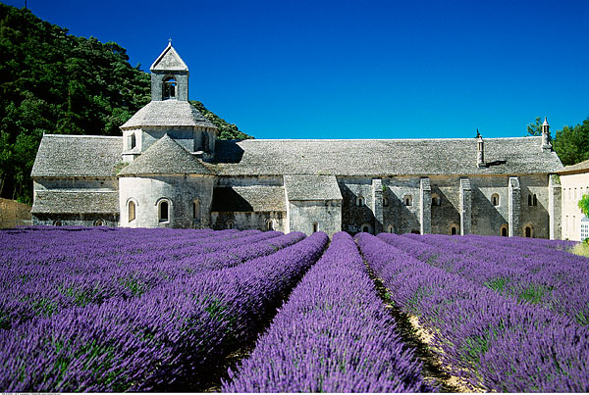


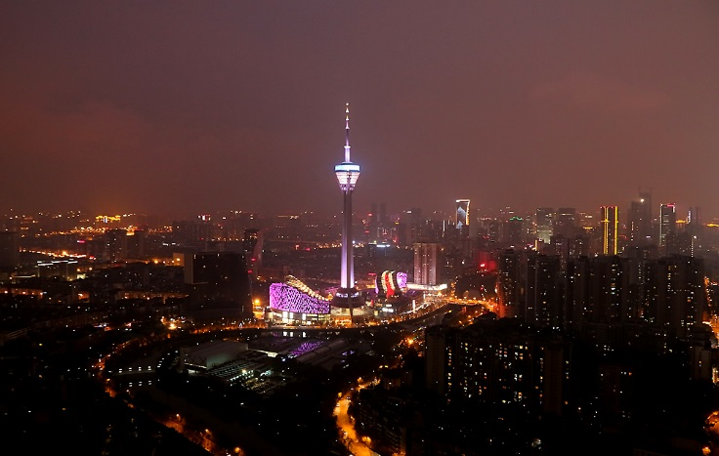


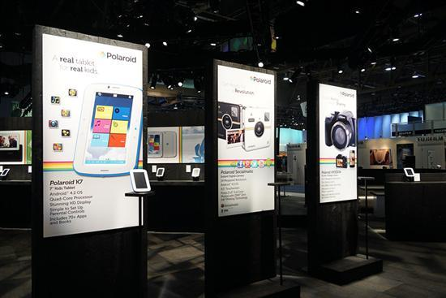
Add Your Tittle Here
Please click here to add your tittle here and write something to describe your theme with the introduction

Slide 3



Add Your Tittle Here
Please click here to add your tittle here and write something to describe your theme with the introduction
Your Tittle
Your Tittle
Your Tittle
Please add your tittle and introduction
Please add your tittle and introduction
Please add your tittle and introduction

Slide 4




Your Tittle
Youth is not a time of life; it is a state of mind; it is not a matter of rosy cheeks, red lips and supple knees; it is a matter of the will, a quality of the imagination, a vigor of the emotions.

Slide 5



Your Tittle Here
Youth is not a time of life; it is a state of mind; it is not a matter of rosy cheeks, red lips and supple knees; it is a matter of the will, a quality of the imagination, a vigor of the emotions.
Your Tittle
Your Tittle
Your Tittle

Slide 6

Your Tittle Here
1
Youth is not a time of life,it is a state of mind
2
Youth is not a time of life; it is a state of mind
3
Youth is not a time of life; it is a state of mind
4
Youth is not a time of life; it is a state of mind

Slide 7
Your Tittle Here
Youth is not a time of life; it is a state of mind; it is not a matter of rosy cheeks, red lips and supple knees; it is a matter of the will, a quality of the imagination, a vigor of the emotions.
Tittle
Tittle
Tittle
Tittle
Tittle
Tittle
Tittle
Content
content
content
Content
content
content
content
Content
content
content
content
Content
content
content
Content
content
Content
content
content
Content
content

Slide 8






Your Tittle Here
Your Tittle Here
Your Tittle Here
Youth is not a time of life; it is a state of mind; it is not a matter of rosy cheeks, red lips and supple knees; it is a matter of the will, a quality of the imagination, a vigor of the emotions.
Youth is not a time of life; it is a state of mind; it is not a matter of rosy cheeks, red lips and supple knees; it is a matter of the will, a quality of the imagination, a vigor of the emotions.
Your Tittle Here
Your Tittle Here
Youth is not a time of life; it is a state of mind; it is not a matter of rosy cheeks, red lips and supple knees; it is a matter of the will, a quality of the imagination, a vigor of the emotions.
Tittle
Youth is not a time of life; it is a state of mind; it is not a matter of rosy cheeks, red lips and supple knees; it is a matter of the will, a quality of the imagination, a vigor of the emotions.
Your Tittle Here
Your Tittle Here
Youth is not a time of life; it is a state of mind; it is not a matter of rosy cheeks, red lips and supple knees; it is a matter of the will, a quality of the imagination, a vigor of the emotions.
Youth is not a time of life; it is a state of mind; it is not a matter of rosy cheeks, red lips and supple knees; it is a matter of the will, a quality of the imagination, a vigor of the emotions.

Slide 9
Your Tittle Here
Youth is not a time of life; it is a state of mind; it is not a matter of rosy cheeks, red lips and supple knees; it is a matter of the will, a quality of the imagination, a vigor of the emotions.
管理效率低
推广渠道单一
营销模式缺乏
互联网转型难

Slide 10


Your Tittle Here
1
Add Your Tittle Here
1
Add Your Tittle Here
1
Add Your Tittle Here
1
Add Your Tittle Here

Slide 11


Add Your Tittle Here
Youth is not a time of life; it is a state of mind; it is not a matter of rosy cheeks, red lips and supple knees; it is a matter of the will, a quality of the imagination, a vigor of the emotions.
Add Your Tittle Here
Add Your Tittle Here
Youth is not a time of life; it is a state of mind; it is not a matter of rosy cheeks, red lips and supple knees; it is a matter of the will, a quality of the imagination, a vigor of the emotions.
Youth is not a time of life; it is a state of mind; it is not a matter of rosy cheeks, red lips and supple knees; it is a matter of the will, a quality of the imagination, a vigor of the emotions.

Slide 12


Add Your Tittle Here
Youth is not a time of life; it is a state of mind; it is not a matter of rosy cheeks, red lips and supple knees; it is a matter of the will, a quality of the imagination, a vigor of the emotions.

