Slide 1
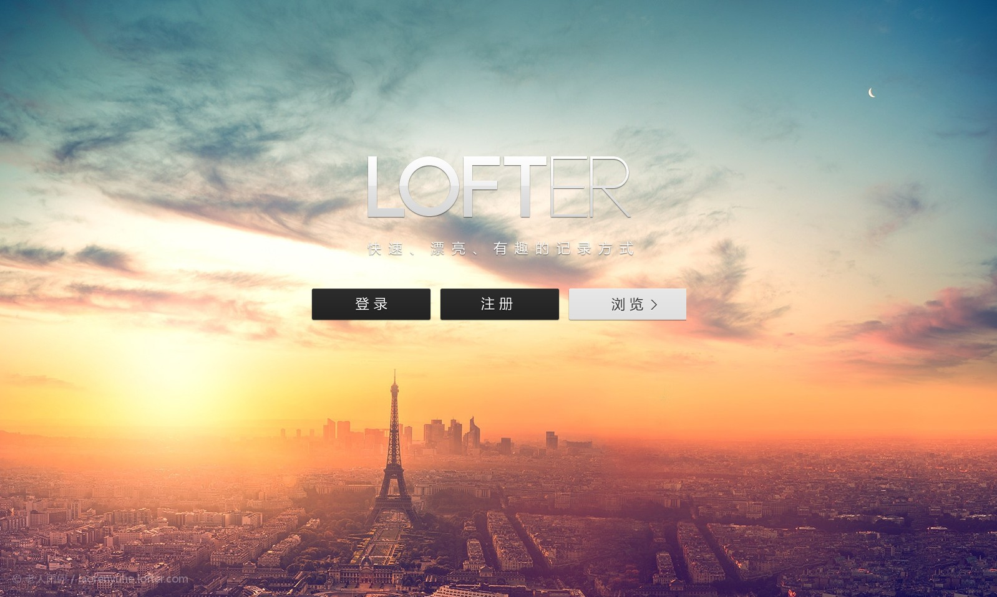
2018
The Eiffel Tower
@
Never use your eyes to cry for the wrong person who hurt you.
Strong belief can transcend the calculation

Slide 2

No.2
输入您的标题

Slide 3

content
目录
①
②
③
④
⑤
The Eiffel Tower
The Eiffel Tower
The Eiffel Tower
The Eiffel Tower
The Eiffel Tower

Slide 4
Eiffel Tower
Eiffel Tower
Eiffel Tower
The Eiffel Tower The Eiffel Tower
The Eiffel Tower The Eiffel Tower
The Eiffel Tower The Eiffel Tower
2
4
6
1
3
5
Eiffel Tower
Eiffel Tower
Eiffel Tower
The Eiffel Tower The Eiffel Tower
The Eiffel Tower The Eiffel Tower
The Eiffel Tower The Eiffel Tower

Slide 5
The Eiffel Tower
We are all in the gutter, but some of us are looking at the stars.
Eiffel Tower
Type something here
Type something here Type something here Type something here Type something here Type something here Type something here Type something here Type something here Type something here

Slide 6
The Eiffel Tower
We are all in the gutter, but some of us are looking at the stars.
Never use your eyes to cry for the wrong person who hurt you.
Never use your eyes to cry for the wrong person who hurt you.
Never use your eyes to cry for the wrong person who hurt you.

Slide 7
The Eiffel Tower
We are all in the gutter, but some of us are looking at the stars.
Eiffel Tower
We are all in the gutter, but some of us are looking at the stars. We are all in the gutter, but some of us are looking at the stars.
We are all in the gutter, but some of us are looking at the stars.
74%

Slide 8
The Eiffel Tower
We are all in the gutter, but some of us are looking at the stars.
Eiffel Tower
Eiffel Tower
Eiffel Tower
Eiffel Tower
We are all in the gutter, but some of us are looking at the stars. We are all in the gutter, but some of us are looking at the stars.
We are all in the gutter, but some of us are looking at the stars. We are all in the gutter, but some of us are looking at the stars.
We are all in the gutter, but some of us are looking at the stars. We are all in the gutter, but some of us are looking at the stars.
We are all in the gutter, but some of us are looking at the stars. We are all in the gutter, but some of us are looking at the stars.

Slide 9
The Eiffel Tower
We are all in the gutter, but some of us are looking at the stars.
Eiffel Tower
Eiffel Tower
Eiffel Tower
Eiffel Tower
We are all in the gutter, but some of us are looking at the stars. We are all in the gutter, but some of us are looking at the stars.
We are all in the gutter, but some of us are looking at the stars. We are all in the gutter, but some of us are looking at the stars.
We are all in the gutter, but some of us are looking at the stars. We are all in the gutter, but some of us are looking at the stars.
We are all in the gutter, but some of us are looking at the stars. We are all in the gutter, but some of us are looking at the stars.

Slide 10
The Eiffel Tower
We are all in the gutter, but some of us are looking at the stars.
Eiffel Tower
Eiffel Tower
We are all in the gutter, but some of us are looking at the stars.
We are all in the gutter, but some of us are looking at the stars.
Eiffel Tower
Eiffel Tower
We are all in the gutter, but some of us are looking at the stars.
We are all in the gutter, but some of us are looking at the stars.

Slide 11
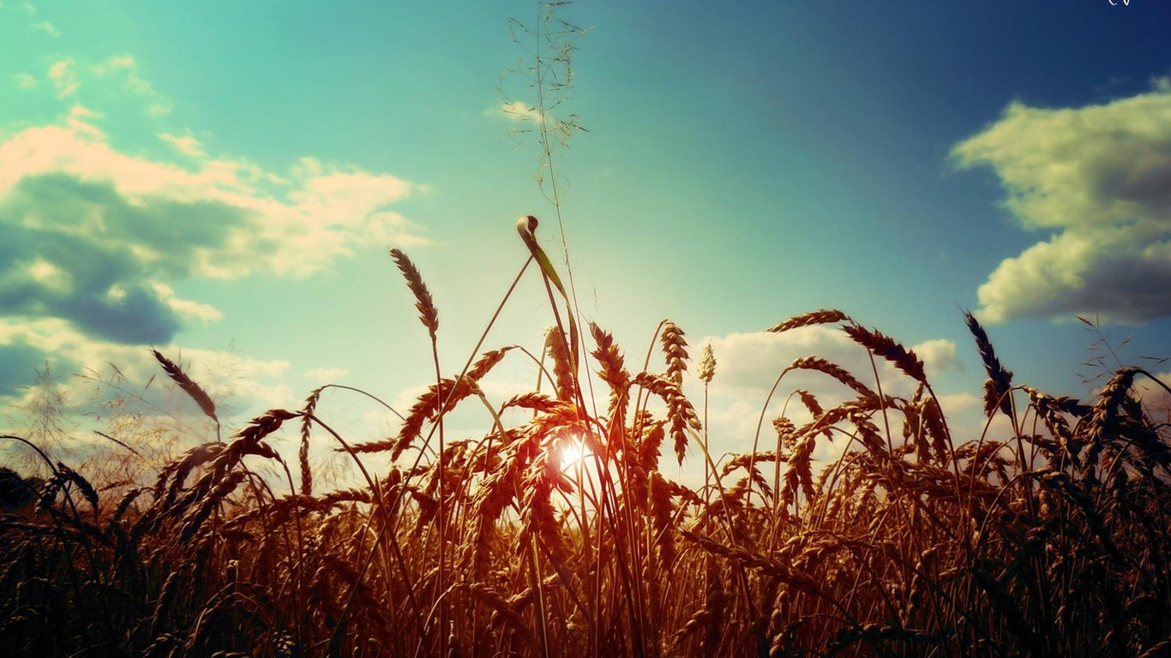
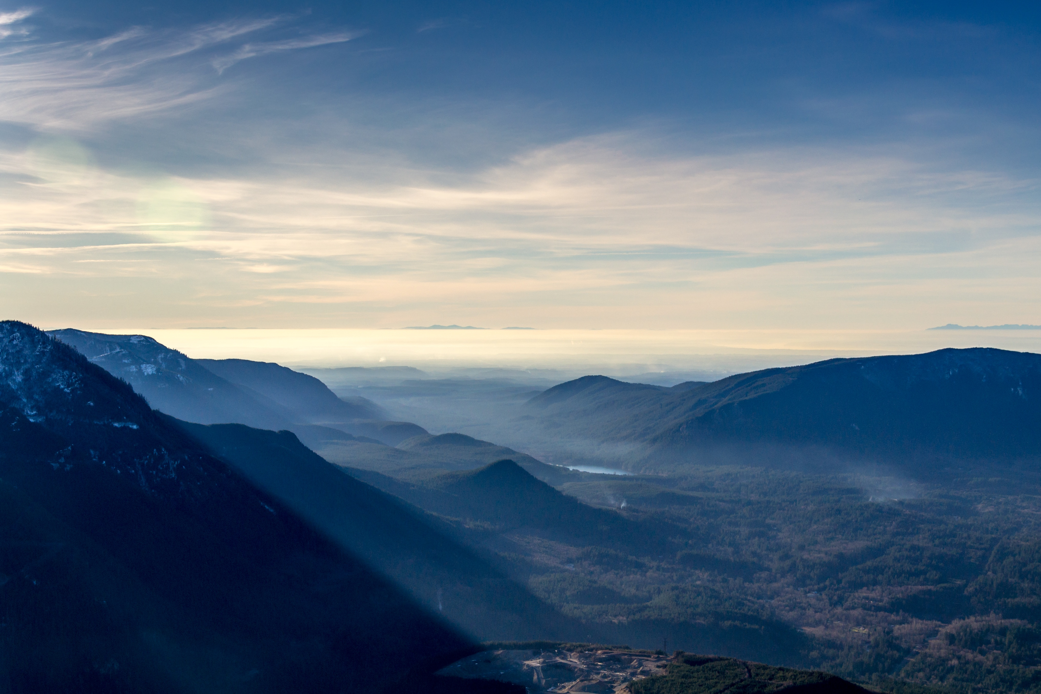
The Eiffel Tower
We are all in the gutter, some of us are looking at the stars.
Eiffel Tower
We are all in the gutter, but some of us are looking at the stars. We are all in the gutter, but some of us are looking at the stars We are all in the gutter, but some of us are looking at the stars.

Slide 12
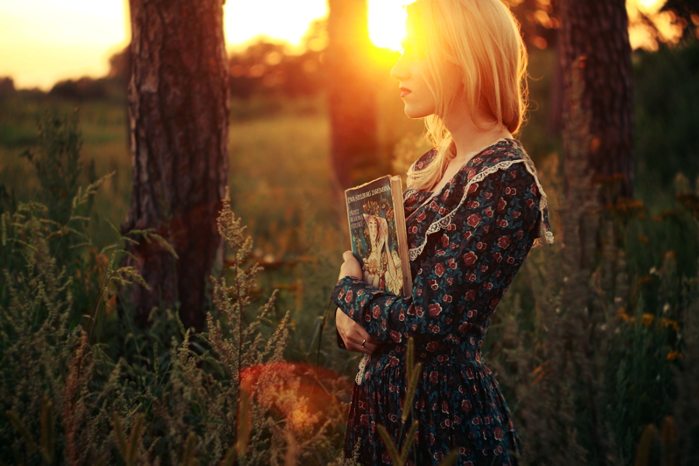
The Eiffel Tower
We are all in the gutter, but some of us are looking at the stars.
The Eiffel Tower
The Eiffel Tower in sun
The Eiffel Tower in sun
The Eiffel Tower in sun
The Eiffel Tower in sun
The Eiffel Tower in sun
The Eiffel Tower in sun
The Eiffel Tower in sun
The Eiffel Tower in sun

Slide 13
The Eiffel Tower
We are all in the gutter, but some of us are looking at the stars.
Eiffel Tower
We are all in the gutter, but some of us are looking at the stars.
Eiffel Tower
Eiffel Tower
We are all in the gutter, but some of us are looking at the stars.
We are all in the gutter, but some of us are looking at the stars.
Eiffel Tower
We are all in the gutter, but some of us are looking at the stars.

Slide 14
The Eiffel Tower
We are all in the gutter, but some of us are looking at the stars.
EIFFEL
EIFFEL
EIFFEL
EIFFEL
The Eiffel Tower
The Eiffel Tower
The Eiffel Tower
The Eiffel Tower
The Eiffel Tower
The Eiffel Tower
The Eiffel Tower
The Eiffel Tower
The Eiffel Tower
The Eiffel Tower
The Eiffel Tower
The Eiffel Tower
The Eiffel Tower
The Eiffel Tower
The Eiffel Tower
The Eiffel Tower
The Eiffel Tower
The Eiffel Tower
The Eiffel Tower
The Eiffel Tower

Slide 15
THANKS

