Slide 1

科技范商务提案策划书

Slide 2
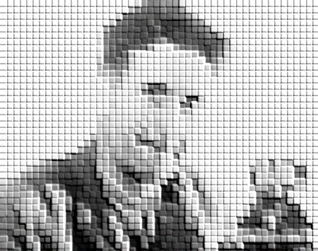
If thou lovest me too much,It will not prove as true as touch. If thou lovest me too much,It will not prove as true as touch. If thou lovest me.
If thou lovest me too much,It will not prove
as true as touch. If thou lovest me too much,It will
NOT PROVE AS TRUE AS TOUCH.
If thou lovest me too much,It will not prove as true as touch. If thou lovest me too much,It will not prove as true as touch. If thou lovest me too much,It will not prove as true as touch. If thou

Slide 3
目录 CONTENTS
摘要
1
市场分析
2
SWOT分析
3
产品分析
4
竞争对手分析
5
受众分析
6
营销策略提案
7
战略分析
8
广告策略
10
推广方案
11
媒介策略
17
媒介目标
17
媒介提案
18
媒介投放
24
经费预算
26

Slide 4
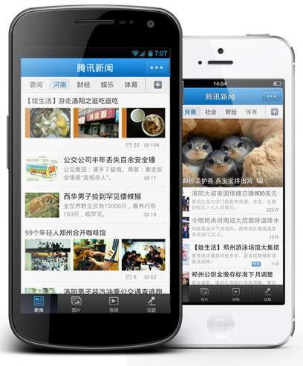
摘要
SUMMARY
If you were a teardrop;In my eye,
For fear of losing you,I would never cry
And if the golden sun,Should cease to shine its light,
Just one smile from you,Would make my whole world bright
If I were to fall in love,It would have to be with youYour eyes, your smile,The way you laugh,The things you say and do
Take me to the places,My heart never knew
So, if I were to fall in love,It would have to be with you.
Ed Walter
My river runs to thee. Blue sea, wilt thou welcome me? My river awaits reply.Oh! sea, look graciously.
1

Slide 5

市场分析
MARKET ANALYSIS
SWOT分析
产品分析
竞争对手分析
受众分析
2

Slide 6
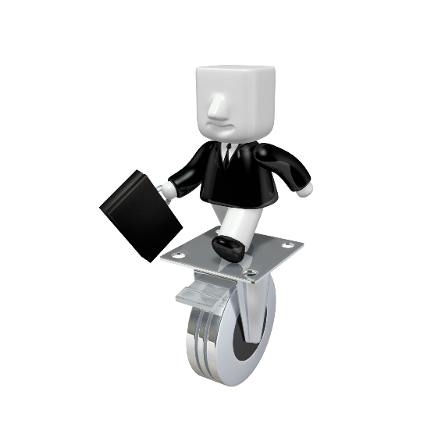
SWOT分析
SWOT ANALYSIS
S
1、Love me little, love me long；
2、Is the burden of my song；
3、Love that is too hot too strong；
4、Burneth soon to waste；
1、Still,i would not have thee cold；
2、Not too backward , nor too bold；
3、Love that lasteth till'tis old；
W
O
1、Fadeth not in haste；
2、Love me little,love me long,
Is the burden of my song；
1、If thou lovest me too much；
2、It will not prove as true as touch；
T
3

Slide 7
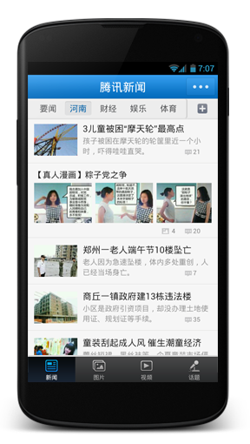
产品分析
PRODUCT ANALYSIS
主要的功能：
Love me little,more than such
Love me little, love me long,
Is the burden of my song.
Love that is too hot too strong
Burneth soon to waste.
Still,i would not have thee cold.
For I fear the end
I am with little well content
And a little from thee sent
If thou lovest me too much,It will not prove as true as touch;Love me little,more than such,
For I fear the end.I am with little well content,
And a little from thee sentIs enough, with true intentTo be steadfast friend.Love me little,love me long,Is the burden of my song.
Is enough, with true intent
To be steadfast friend
Love me little,love me long
4

Slide 8
竞争对手分析
COMPETITOR ANALYSIS
If thou lovest me too much,It will not prove as true as touch;Love me little,more than such,
For I fear the end.I am with little well content,And a little from thee sentIs enough.
Love Me Little, Love Me Long
S
Love me little, love me long,
Is the burden of my song.
Love that is too hot too strong
Burneth soon to waste.
S
Love me little, love me long,
Is the burden of my song.
Love that is too hot too strong
Burneth soon to waste.
W
Still,i would not have thee cold,
Not too backward , nor too bold;
Love that lasteth till'tis old
Fadeth not in haste.
W
Still,i would not have thee cold,
Not too backward , nor too bold;
Love that lasteth till'tis old
Fadeth not in haste.
5

Slide 9

受众分析
AUDIENCE ANALYSIS
受众定位
Love me little, love me long
受众特点
Is the burden of my song；
Love that is too hot too strong；
Burneth soon to waste；
Still,i would not have thee cold；
结论
Love me little, love me long,Is the burden of my song.Love that is too hot too strongBurneth soon to waste.
Still,i would not have thee cold,
Not too backward , nor too bold，Still,i would not have thee cold
6

Slide 10

营销策略提案
MARKETING STRATEGY
推广方案
广告策略
战略分析
7

Slide 11
战略分析
STRATEGY ANALYTICS
Love me little, love me long,Is the burden of my song：
优势
劣势
Love me little, love me long；
Love me little, love me long；
Is the burden of my song；
Is the burden of my song；
Love that is too hot too strong；
Love that is too hot too strong；
Burneth soon to waste；
Burneth soon to waste；
Love me little, love me long,Is the burden of my song.
Love that is too hot too strongBurneth soon to waste.Still,i would not have thee cold,Not too
backward , nor too bold;Love that lasteth till‘tis old.Fadeth not in haste.
Love me little,love me long,
Is the burden of my song.
If thou lovest me too much,It will not prove as true as touch;Love me little,more than such,For I fear the end.I am with little well content.
8

Slide 12



战略分析
STRATEGY ANALYTICS
概念来源
LOVE ME LITTLE,LOVE ME LONG
For I fear the end
with little well content,
from thee sent
9

Slide 13
广告策略
ADVERTISING STRATEGY
广告目标
If thou lovest me too much,It will not prove as true as touch
广告诉求对象
If thou lovest me too much,It will not prove as true as touch
广告诉求重点
If thou lovest me too much,It will not prove as true as touch. If thou lovest me too much,It will not prove as true as touch. If thou lovest me too much,It will not prove as true as touch.
诉求方法策略
If thou lovest me too much,It will not prove as true as touch
10

Slide 14
推广方案
OUTREACH PROGRAMMES
推广方案一
more than such
活动时间
2016年3月——
活动背景
If thou lovest me too much,It will not prove as true as touch. If thou lovest me too much,It will not prove as true as touch. If thou lovest me too much,It will not prove as true as touch. If thou lovest me too much,It will not prove as true as touch. If thou lovest me too much,It will not prove as true as touch. If thou lovest me too much,It will not prove as true as touch.
活动内容
If thou lovest me too much,It will not prove as true as touch. If thou lovest me too much,It will not prove as true as touch. If thou lovest me too much,It will not prove as true as touch. If thou lovest me too much,It will not prove as true as touch. If thou lovest me too much,It will not prove as true as touch. If thou lovest me too much,It will not prove as true as touch.
11

Slide 15
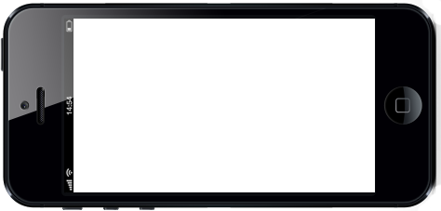





推广方案
OUTREACH PROGRAMMES
具体实施步骤
1
If thou lovest me too much,It will not prove as true as touch. If thou lovest me too much,It will not prove as true as touch. If thou lovest me too
2
If thou lovest me too much,It will not prove as true as touch. If thou lovest me too much,It will not prove as true as touch. If thou lovest me too
#TRUE AS#
12

Slide 16
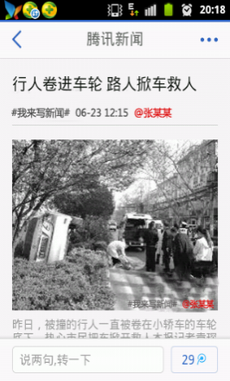
推广方案
OUTREACH PROGRAMMES
3
If thou lovest me too much,It will not prove as true as touch. If thou lovest me too much,It will not prove as true as touch. If thou lovest me too If thou lovest me too much,It will not prove as true as touch. If thou lovest me too much,It will not prove as true as touch. If thou lovest me too
4
If thou lovest me too much,It will not prove as true as touch. If thou lovest me too much,It will not prove as true as touch. If thou lovest me too
13

Slide 17

推广方案
OUTREACH PROGRAMMES
5
If thou lovest me too much,It will not prove as true as touch. If thou lovest me too much,It will not prove as true as touch. If thou lovest me too
活动流程
not prove as
lovest me too
AS TRUE AS TOUCH
lovest me too
not prove as
14

Slide 18
推广方案
OUTREACH PROGRAMMES
推广方案二
If thou lovest me
活动时间
2016年3月—9月
活动背景
If thou lovest me too much,It will not prove as true as touch. If thou lovest me too much,It will not prove as true as touch. If thou lovest me too much,It will not prove as true as touch. If thou lovest me too much,It will not prove as true as touch. If thou lovest me too much,It will not prove as true as touch. If thou lovest me too much,It will not prove as true as touch. as true as touch. If thou lovest me too much,It will not prove as true as touch. If thou lovest
活动内容
“If thou lovest me too much,It will not prove as true as touch. If thou lovest me too much,It will not prove as true as touch. If thou lovest me too much,It will not prove as true as touch. If thou lovest me too much,It will not prove as true as touch. If thou lovest me too much,It will not
15

Slide 19
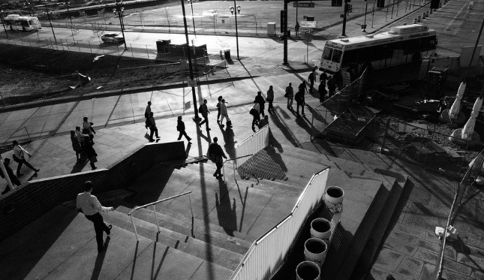

推广方案
OUTREACH PROGRAMMES
THOU LOVEST
THOU LOVEST
If thou lovest me too much,It will not prove as true as touch. If thou lovest me tprove asoo much,It will not true as touch. If thou lovest me too much,It will not prove as true as
THOU LOVEST
THOU LOVEST
If thou lovest me too much,It will not prove as true as touch. If thou lovest me too much,It will not prove as true as touch. If
If thou lovest me too much,It will not prove as true as touch. If thou lovest me too much,It will not prove as true as
16

Slide 20
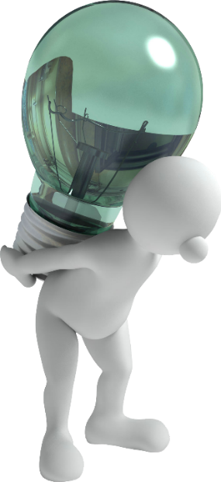
媒介策略
MEDIA STRATEGY
媒介目标
媒介投放
媒介提案
17

Slide 21

媒介目标
MEDIA OBJECTIVES
If thou lovest me too much,It will not prove as true as touch. If thou lovest me too much,It will not prove as true as touch. If thou lovest me too If thou lovest me too much,It will not prove as true as touch. If thou lovest me too much,It will not prove as true as touch. If thou lovest me too
媒介提案
MEDIA PROPOSAL
平面
Preparedness, testing, refinementPreparedness, testing, refinement
Preparedness, testing, refinement
Preparedness, testing, refinementPreparedness,
18

Slide 22
媒介提案
MEDIA PROPOSAL
平面
Preparedness, testing, refinementPreparedness, testing, refinement
Preparedness, testing, refinement
Preparedness, testing, refinementPreparedness,
19

Slide 23
媒介提案
MEDIA PROPOSAL
视频广告脚本
片名：TOO
时长：15 S
OUC
VES
MUCH,I
WILL N
HO
OVEST
TOO IF THO
U LOVEST
If thou lovest me too much,It will not prove as true as touch. If thou lovest me too much,It will not prove as true as touch. If thou lovest me too If thou lovest me too
4 S
much,It will
OVEST
TOO IF THO
U LOVEST
If thou lovest me too
4 S
much,It will
OVEST
TOO IF THO
U LOVEST
If thou lovest me too much,It will not prove as true
as touch. If thou lovest me too
4 S
much,It will
OVEST
TOO IF THO
U LOVEST
If thou lovest me too much,It will not prove as
true as touch. If thou lovest me too much,It will
3 S
much,It will
23

Slide 24
媒介投放
MEDIA PLACEMENT
LOVEST
If thou lovest me too much,It will not prove as true
TRUE AS T
not prove as true as touch. If thou lovest
H,I
If thou lovest me too much,It
LOVEST
as touch. If thou lovest me too much,It will not prove as true as touch. If
TRUE AS T
not prove as true as touch. If thou lovest me too If thou lovest me too
H,I
prove as true as touch
LOVEST
If thou lovest me too
TRUE AS T
me too much,It will
H,I
touch. If thou lovest
24

Slide 25




经费预算
BUDGET
Not Joined to AD
Workplace Joined
Domain Joined
Active Directory
Limited access
No IT Control
Company owned device with full IT control & full access
26

